Slide 1
13th Capacity Building Sub-Committee
Capacity Building Development
- Customized Capacity Building Programmes -
East Asia Hydrographic Commission(EAHC)
27-29 May 2015
Mexico City, Mexico
Notes:
Thank you Chair.
I am Moon Bo SHIM from KHOA of Republic of Korea.
It is my pleasure to have a presentation about the EAHC developments of CB Program on behalf of the TRDC which stand for the Training, Research and Development Centre of EAHC.

Slide 2
Contents
Introduction
Formation of the Training, R&D Centre (TRDC)
Concept of TFT and Basic course
Training for Trainer (Cartography)
Training for Trainer (Hydrography)
TRDC Website and e-Learning
Notes:
I will introduce about motives, challenges and current status of the EAHC CB Program and its developments.
First, I will introduce about the Formation of the Training, Research and Development Centre (TRDC) of EAHC.
Next, I will present about the Concept of TFT and Basic course of the TRDC.
And, I will show you 3 cases of the Training for Trainer programme about Cartography which were executed.
Also I will introduce about the Training for Trainer program about Hydrography.
Lastly, you will have information about the TRDC Website and e-Learning program development of EAHC.

Slide 3
Introduction – The Challenges
Each HO provides internal training programmes
Participate in IHO sponsored capacity building training programmes
However, the success of these programmes have been limited .
The limited human resources :
Challenges faced in the sustainability of hydrographic work and projects when officers:
Move/promoted to different positions, retire or resign.
Difficult to release staff for long periods of training, especially overseas.
Notes:
Each hydrographic office provides its staff with their own staff training programmes or has them participate in capacity building (CB) seminars arranged by the IHO. However, the outcomes of these programmes have not been as successful as expected.
Due to the limited human resources at the hydrographic offices in the East Asian region, the East Asia Hydrographic Commission (EAHC) has been experiencing
difficulties in the continuation of hydrographic projects when personnel in charge are transferred to a different position, leave or retire.

Slide 4
Introduction - The Challenges
IHO CB programmes are delivered in English
Countries with limited English proficiency have expressed difficulties in fully grasping course contents.
Usually one officer per country attends.
Find challenges when applying what they have learnt to their work and spreading their knowledge to other staff
The EAHC Steering committee recognized the need for coordinated and standardised training in the region.
The Training, Research and Development Centre (TRDC) was established in Feb 2013 to provide CB programmes to meet changes in technology.
Notes:
In particular, as many IHO CB programmes are delivered in English, participants from non-English speaking countries in the East Asian region have expressed difficulties in fully grasping course contents. As a result, they find it challenging applying what they have learnt to their actual work.
Therefore, in order to create cooperative programmes and to improve capacity building, TRDC was established to meet the present and changing needs of the region.

Slide 5
Formation of the TRDC
Main Objectives of the TRDC
To plan, develop and implement the training and R&D programmes
Extend to non EAHC MS
The composition of the TRDC Board of Director (BOD)
Chair(Jamie, Singapore) and Vice-Chair(Yong, S. Korea)
One representative from EAHC MS
Meet at least once a year (4th TRDC BOD in Philippines at Sep.2015)
Reports to the SC for approval of programmes
TRDC based in KHOA (Busan, ROK)
TRDC Logo and website
http://trdc.eahc.asia
Notes:
The Main Objectives of the TRDC are to plan, develop and implement the training and R&D programmes, and extend it to non EAHC Member States.
The TRDC has a Board of Directors (BOD) which have a Chair, Mr. Jamie Chen from Singapore and a Vice-Chair, Mr. Yong BACK from Republic of Korea. This BOD also have one representative from each MS of EAHC.
BOD will meet at least once a year. There was the 4th TRDC BOD meeting in Philippines at September, 2015. BOD will report to the Steering Committee of EAHC for approval of programmes to be developed and implemented.
The TRDC based in KHOA (Busan, ROK) and this is the logo of the TRDC. It’s website is “trdc.eahc.asia”

Slide 6
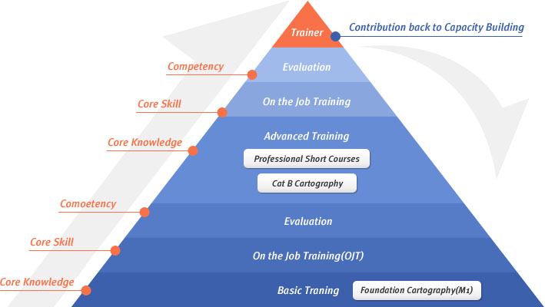
Concept of TFT and Basic course
EAHC TRDC adopted the “Self-Propelling Capacity Building” model.
Allows development of customized training programmes
Training for Trainers (TFT)
Basic courses for Cartography and Hydrography
Self propelling
CB Model
Notes:
Taking the EAHC CB situation and problems into consideration,
TRDC to develop a customized training programme model called “Training for Trainers (TFT)” to establish a programme equivalent to the basic course.
On the screen, this is a pyramid model for self propelling.
There are basic, intermediate, advanced level. When the trainee learn all level or have experience, then the trainee will become master trainer, who will contribute back to capacity building.

Slide 7
Concepts of TFT and Basic course
What is TFT…
Designed to identify and develop master trainers (from each HO) in the areas of hydrography and cartography
These master trainers undergo teaching courses to be more effective teachers
The master trainers then plan and conduct training courses in their own country delivered in their mother tongue
Progressively, this allows the pool of hydrographic experts to grow sustainably
Teaching skills
common material
MS1
MS2
Feedback
TFT
(Basic course)
Deliver the Basic course
in home country
MS3
Notes:
The TFT is designed to develop trainers in the area of hydrography more
fectively so that trainees of hydrographic offices in the East Asian region can take IHO’s training programmes in their own country delivered in their mother tongue and grow as hydrographic experts.

Slide 8
Concepts of TFT and Basic course
What is Basic course…
Basic training course in Cartography and Hydrography.
Based on a common course syllabus.
Aims to harmonize standards in the EAHC
A 3-week basic job training course- theory and practices
Obtain fundamental job skills and be quickly deployed at the job site with supervision.
Trainees to be assessment by the Trainers
Future plans to set up an EAHC Assessment Board
Basic course can be a key to addressing the lack of human resources in hydrographic field in the East Asian region.
Notes:
The basic course is a basic job training programme.
The course period is shorter than that of other IHO CB courses such as CAT A
and CAT B.
Participants can obtain fundamental job skills and be immediately placed at the job site upon successful completion of the course.
EAHC recommends a 3-week basic job training programme for the course.
Basic course can be a key to addressing the lack of human resources in
hydrographic field in the East Asian region.

Slide 9
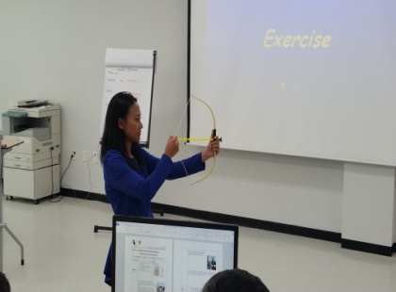
Concepts of TFT and Basic course
TFT can be applied to all types of training programmes.
- Master trainers are expected to hold extensive knowledge and experience in their
respective expertise.
Required to have an excellent delivery of course contents, suitable teaching
methodology, practice execution skills and teaching material development skills etc.
Notes:
The TFT can be applied to all types of training programmes. Participants of the
TFT programme are expected to hold extensive knowledge and experience in the relevant area. They are also required to have an excellent delivery of course
contents and a high level of trainee performance assessment skills, suitable
teaching methodology, practice execution skills, and teaching material
development skills.

Slide 10
Training for Trainer_ Cartography
1st TFT Carto. Workshop took place from 18th -29th Nov. 2013 at KHOA
18 trainees from 8 EAHC MSs
Training skills and develop the EAHC common basic Cartographic course.
Conducted by UKHO
Evaluation
All delegates successfully completed the course and are capable of developing and delivering the basic course that suits their own HOs requirements
Notes:
As a part of the IHO CB work programme under the EAHC in 2013, development and delivery of a basic Training for Trainers (TFT) took place from 18th – 29th November.
All delegates successfully completed the course and are capable of further developing and delivering the Foundation Course that suits their own requirements of each Hydrographic Office.
There were recommendations. One of them is to request to conduct a refresher course in approximately one year’s time.

Slide 11
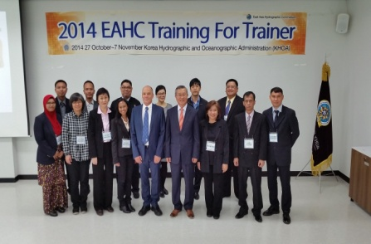
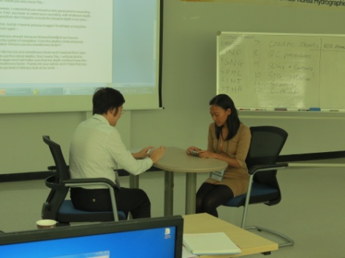
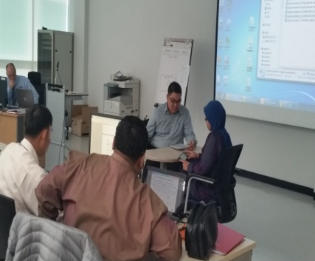
Training for Trainer_ Cartography
2nd TFT took place from 27th -7th Nov. 2014 at KHOA
13 trainees from 7 EAHC MSs
2014 TFT is to complement and improve the first basic course, reflecting additional requirements concerning teaching experience of each country’s instructor, curriculums of the course, and teaching materials after the completion of the 1st TFT
Workshop conducted by UKHO
Notes:
In 2014, the 2nd TFT Programme was proposed to complement and improve
EAHC Foundation Course, reflecting additional requirements concerning
teaching experience of each country’s instructor, curriculums of the course, and teaching materials after the completion of the first TFT.
It was also proposed to support initial stages of TFT Programme such as
instructors, teaching materials, curriculum implementation consulting so that
Foundation Course will be established in Member States of EAHC.
This workshop was conducted by UKHO.

Slide 12
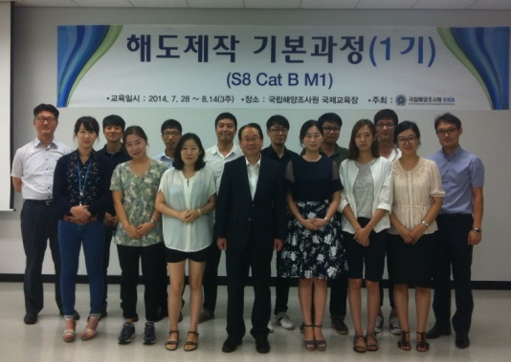
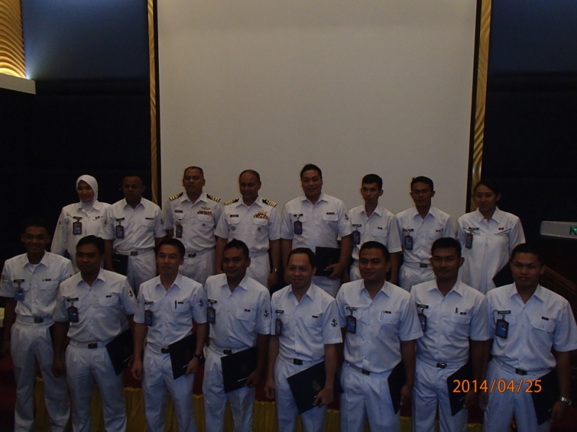
Conduct of Basic Cartographic Course
In 2014
Master Trainers Conduct Basic course in their own country
- Indonesia :10 person, - Malaysia : 15 person
- ROK : 13 person. - Singapore : 2 person
Plan of Basic course in their own country in 2015
- Indonesia, ROK, Malaysia, Philippines, Singapore, China
Notes:
In 2014, Master Trainers who have conducted Basic course in their own country were totally 40 person.
More than 5 MSs of EAHC have a Plan of Basic course in their own country in 2015.

Slide 13
TFT in Basic Hydro Survey
Basic Hydro survey course was discussed in 2011 EAHC meeting is composed of two subjects
Hydrographic survey
Survey data post processing
EAHC discussed and plans to implement TFT hydro course in 2015.
Review syllabus of Basic hydrographic course
Develop common basic material
Training skills etc.
Notes:
Two subjects of the Basic Hydrographic Survey Course which was discussed in the EAHC meeting in 2011 were the Hydrographic survey and the Post Processing course using Surveyed data.
EAHC discussed and planed to implement TFT hydrographic course in 2015.
Now, TRDC will review the syllabus of Basic hydrographic course. And it will develop common basic material and Training skills etc.

Slide 14
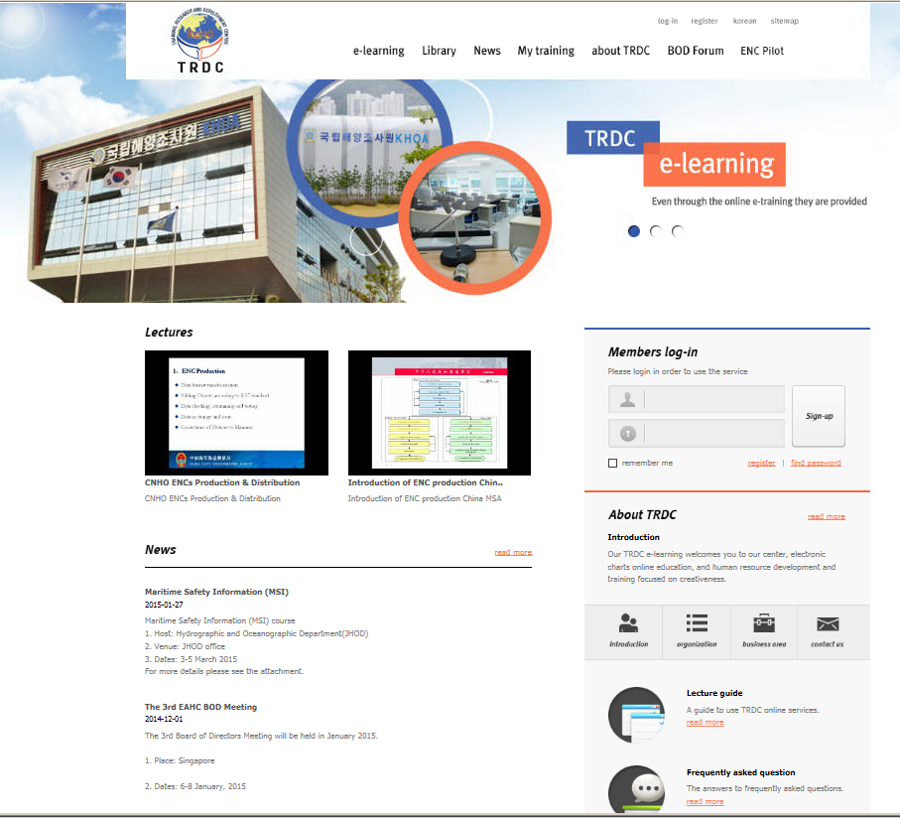
TRDC website
Purpose of the website
Functions of website : Training videos, trainees training roadmap, e-learning….
http://trdc.eahc.asia
Notes:
We have established TRDC in KHOA located in Busan of Korea, and been conducting EAHC CB courses and related supporting tasks.
In this year, we opened TRDC homepage to provide an effective support and management for the CB programmes.
The homepage contains e-Learning, Training support tools, and pages for a management of student and BOD forum. You can check more detailed information on the website of the “trdc.each.asia”.

Slide 15
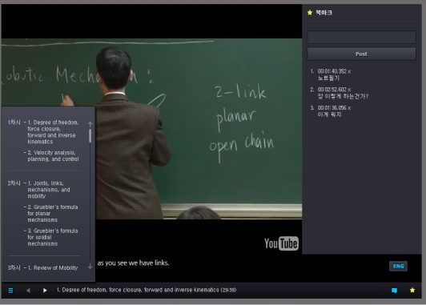
e-Learning
e-Learning contents design and the research for management plan to extend opportunities to provide effective and economical training courses in the hydrographic field (2013 ~ 2014)
Functions and components of e-learning system for establishing e-Learning system
e-Learning development procedure model
Contents design strategies to deliver knowledge and to provide opportunities of practice
Operational strategies for e-learning and methods for continuous maintenance
Research for future plans include Learning community formation, e-Learning establishment based on emotion, Flipped Learning combining on line and off line, and Blended Learning
Notes:
The design of the E-learning contents and the research for management plan have been carried out for two years since 2013 to extend opportunities to provide effective and economical training courses in the hydrographic field,
Main contents of the e-Learning system are
- Functions and components, Procedure model, Contents design strategies, Operational strategies, Researches for the directions of future plan,
including Learning community formation, e-Learning establishment based on Emotional Quotient, Flipped Learning combining on line and off line, and Blended Learning.
We have a plan to produce e-Learning contents and start operational test in this year.

Slide 16
Conclusion
Lessons learnt
The implementation of the CB model is at its early stage.
Well received and participated by EAHC Member States.
TFT and basic courses in Cartography have proven to be successful.
Need to extend to Hydrography
The EAHC CB programme to include new members Vietnam and Brunei Darusallam
Notes:
As a conclusion, the implementation of the CB model of EAHC is at its early stage.
However, it was well received and participated by EAHC Member States.
The TFT and basic courses in Cartography have proven to be successful.
Now, we need to extend the CB course of Cartography to Hydrography.
Lastly, the EAHC CB programme should include Vietnam and Brunei Darusallam as new member states of EAHC and IHO.

Slide 17
Thank you
Notes:
Thank you for your listening, and thank you Mr. Chair.

