Slide 1
Example of overlapping Quality of Bathymetric Data objects
An area with two overlapping quality of bathymetric data objects due to the presence of a swept area object
Multiple Depth Areas Objects
Swept Area object
Depth range maximum value = 5m
Depth of water 0m to > 10m
Quality of Bathymetric Data (Wire-drag to 5 metres)
Category of temporal variation = 4 (unlikely to change)
Features detected: Significant features detected = True
Full seafloor coverage = False
Survey date range: Date end = 20120731
Technique of sounding measurement = 6 (swept by wire-drag)
Depth range minimum value = empty
Depth range maximum value = 5m
Surface of the water
Quality of Bathymetric Data (single bream full water column)
Category of temporal variation = 4 (unlikely to change)
Features detected: Significant features detected = False
Full seafloor coverage = False
Survey date range: Date end = 19850704
Technique of sounding measurement = 1 (found by echo-sounder)
Depth range minimum value = empty
Depth range maximum value = empty
Quality of Bathymetric Data (single beam full water column)
Category of temporal variation = 4 (unlikely to change)
Features detected: Significant features detected = False
Full seafloor coverage = False
Survey date range: Date end = 19850704
Technique of sounding measurement = 1 (found by echo-sounder)
Depth range minimum value = empty
Depth range maximum value = empty
Quality of Bathymetric Data (single beam full water column)
Category of temporal variation = 4 (unlikely to change)
Features detected: Significant features detected = False
Full seafloor coverage = False
Survey date range: Date end = 19850704
Technique of sounding measurement = 1 (found by echo-sounder)
Depth range minimum value = 5m
Depth range maximum value = empty
When the attribute depth range minimum value is empty the Quality of Bathymetric Data object is representing data quality from the top of the water column down to the value of depth range maximum value. If the value of depth range maximum value is empty then the quality of bathymetric data object is representing the data quality of the water column down to the sea floor.
Sea floor
Notes:
Multiple depth areas

Slide 2
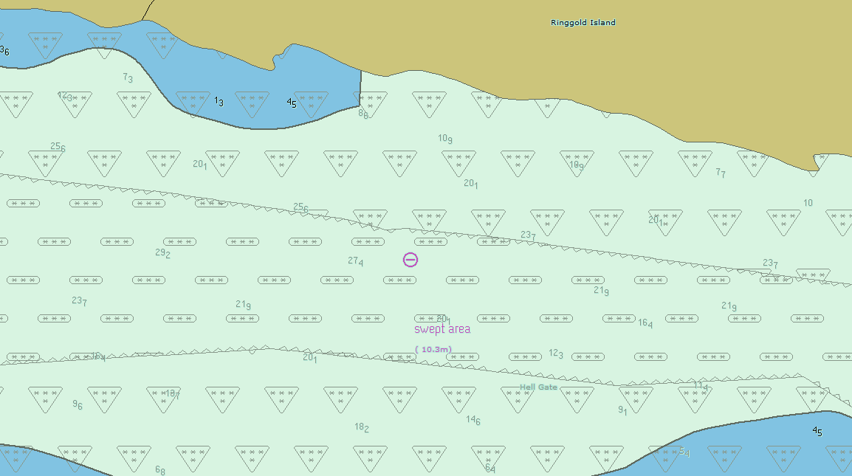
Area with swept area with Bathy below

Slide 3
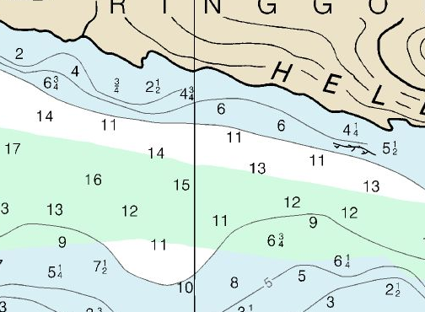
Same area on RNC

