Slide 1
IHO Check Dataset Thomas Mellor, CMarTech, FIMarEST IHO ENCWG Chair
Notes:
Good Morning ladies and Gentlemen,
I am the Vice chair of the IHO Digital Imaging and Portrayal work group and a member of the IEC 61174 drafting committee
Today my presentation is going to focus on the new ECDIS standards that I have been working on over the last few years, where we are in the process and what we can expect when they come into force.

Slide 2
IHO Check Dataset PL3.4

Slide 3
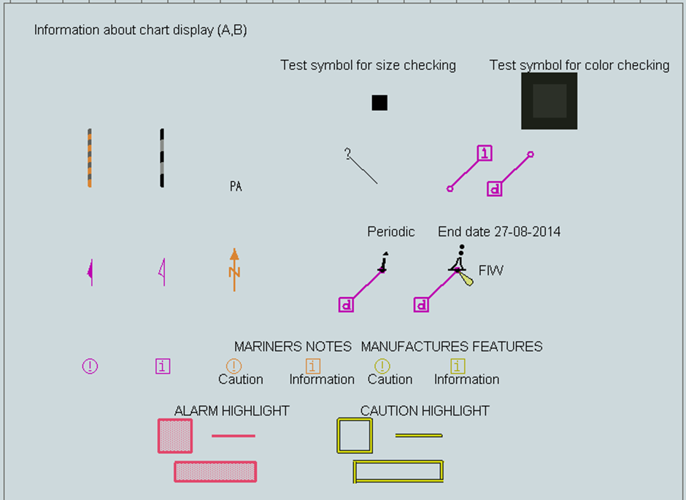
IHO Check PL 4.0 ECDIS Chart1

Slide 4
ECDIS legend
ECDIS Chart 1

