Slide 1
OGC Marine Domain Working Group (MDWG) Update
IHO HSSC Meeting
Rostock, Germany
Jonathan Pritchard IIC Technologies, Co-Chair
16th May 2018

Slide 2
Update – MDWG2
MDWG full day meeting held 2nd Feb 2018 – Niteroi, Brazil
In conjunction with IHO Marine Spatial Data Infrastructure working group (MSDIWG)
Content of meeting:
Input to IHO MSDIWG. Review of key relevant OGC activities
DGGS
Testbed 14
Interesting Things…
Update on existing initiatives within MDWG
Concept Development Study on MSDI
New activities and strategies
GEBCO 2030
S-121 Pilot Study

Slide 3
Interesting things 1 – GEBCO 2030
Bathymetry has never had such focus!!
GEBCO ambition of the world’s seafloor at 100m resolution (minimum) by 2030
Regional data centers
Data flows from hydrographic
offices, scientific institutes
Data being collected on a
range of platforms
Satellite derived bathymetry
Crowd sourced bathymetry
Ocean Discovery Xprize

Slide 4
Interoperability will be key
Formats for bathymetry
Point Clouds, Grids, VR Grids
S-102, BAG, GEOTIFF, HDF, CSAR etc.
Standardized metadata profiles: Quality, Uncertainty, Datums
Federated databases - Web services connecting database content to public portal
A multi-year opportunity to rollout the latest enabling technology. Could cover DGGS, Point Cloud, Big Data/ML and many other OGC areas.
The OGC Marine DWG should be a key stakeholder
Reaching out to the GEBCO steering committee suggesting the involvement of the OGC Marine DWG and IHO MSDIWG

Slide 5
Interesting Things 2 – OGC PipelineML & S-100
Presentation from Industry partner Petrobras
Standardisation of subsea pipeline data interchange
For wells, pipelines, platforms, moorings, etc…
“OOGI specification”
Offshore Oil and Gas
Involves IOGP / Geomatics
Integrates IHO S-100 / ISO / OGC

Slide 6
Interesting Things 2 – Cables, Pipelines

Slide 7
Why is this good?
Great opportunity to bring together IHO standards (IHO S-100) to model content and OGC innovation and standards for distribution and web services.
Uses industry subject matter experts
Can engineer in links to land based standards and showcase interoperability
Mirrors approach in Maritime Limits and Boundaries S-121 OGC pilot project

Slide 8
Interesting things 3 Maritime Boundaries and Limits
Fundamental data for spatial data infrastructure, fundamental for many applications
Different models exist between marine and land for representation of areas, zones, parcels, etc…
Maritime limits and boundaries are modelled under an IHO working group – standard IHO S-121
OGC pilot project has been proposed to explore the integration of the data model with OGC standards for encoding and distribution via web services.
Pilot project will also explore the LADM/MLB “hooks” in the emerging standard.
Great example of IHO modelled content in OGC standards

Slide 9
The Environment is Changing
ISO19152 – Support interoperability with Land Administration standard
Diversifying uses for data
“digitalisation”
MSDI
Marine Cadastre
Marine Protected Areas
Marine Spatial Planning (MSP)
UN sustainable Development Goals SDG 14
UN-GGIM
INSPIRE
Maritime Limits and boundaries is a fundamental dataset in the context of MSDI, its application to Marine Spatial Planning and the progress towards the UN’s sustainable Development Goals.
Hydrographic data has far wider uses and potential.
SDG14 Target 14.C.1
Number of countries making progress in ratifying, accepting and implementing through legal, policy and institutional frameworks, ocean-related instruments that implement international law, as reflected in the United Nation Convention on the Law of the Sea, for the conservation and sustainable use of the oceans and their resources

Slide 10
Engaging a wider community
Generic feature objects to allow a tailored approach by member states
ISO19152 interoperability within S-121 standard through simple “hooks”
Engagement of OGC through Pilot project to :
Creation of web services layer for data
Reference implementations within COTS and open source software and their interoperability
“Exchange” use cases, refinement of “deposit” use case.
Testing the model, promoting its potential.
Outreach to other organisations and meetings to encourage takeup and involvement.

Slide 11
The S-121 model Structure
Two levels which following ISO TC211 principle separating
“carrier from content”.
Administration, management and maintenance of MLB features
Data Model
Distribution and accessibility
Exchange formats
Notes:
Separate the carrier from the content. Where the carrier is the exchange format and the content been the administered information is quite only logical. For example, before producing a financial report, incomes and expenditures are to be gathered and logically organized. Thus before exchanging MLBs, a State administer, manage and maintain the MLBs in some form of data model.
The S-121 data model is by all means not meant to be prescriptive, but instead it aims to be as open as possible. The data model, is really what hold the most information about the MLBs, whereas exchange formats may be only representing a subset of the information found in the data model, a subset extracted and formatted in such a way to fit specific purposes or use cases.

Slide 12
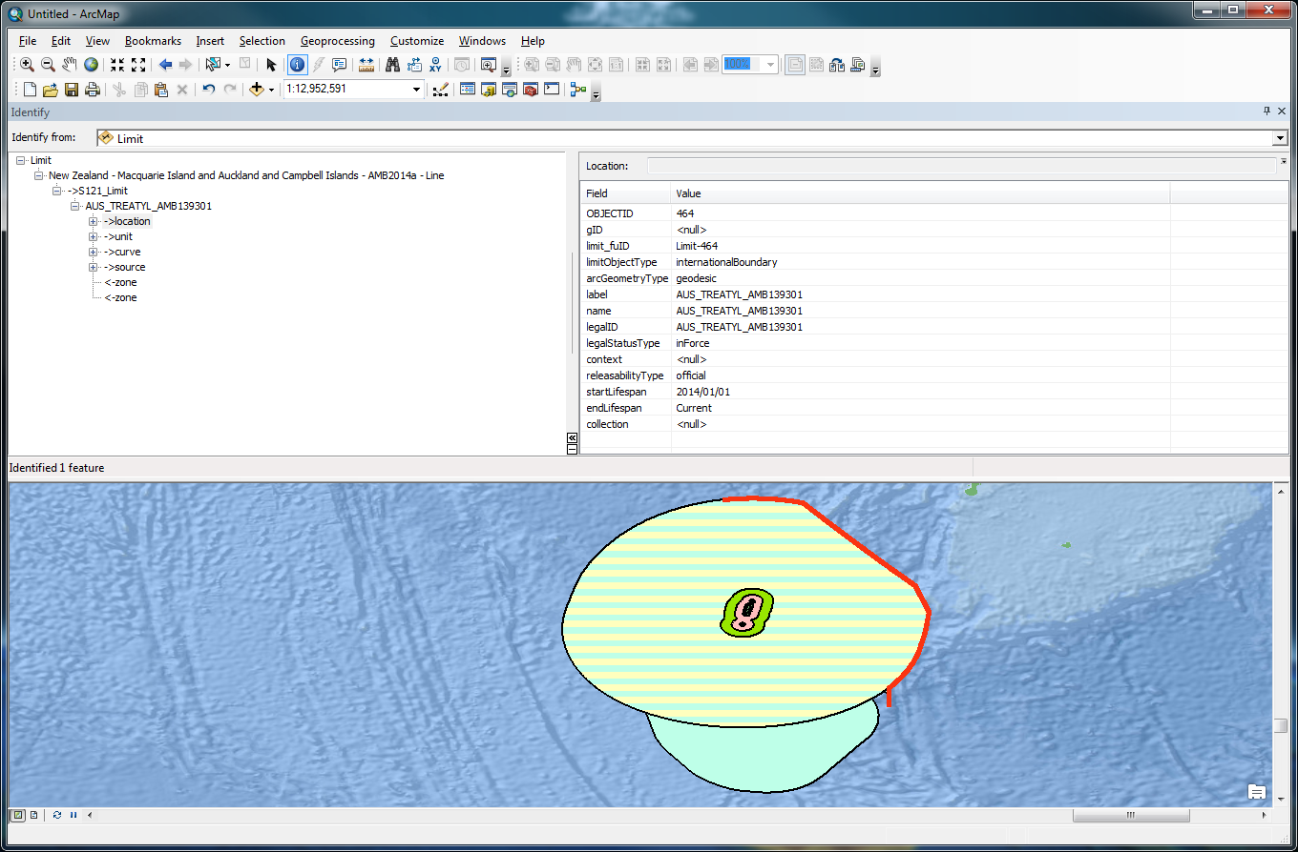
Notes:
Example Treaty Limit
Red is treaty

Slide 13
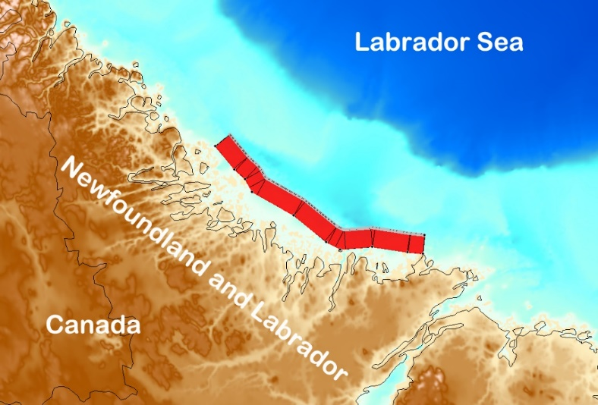
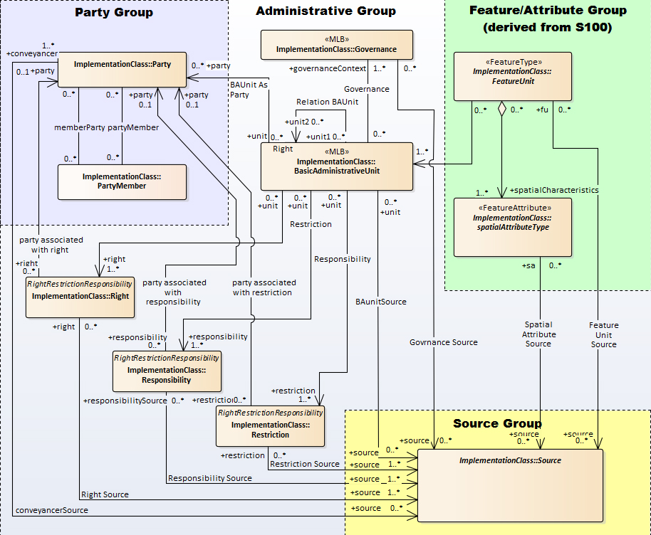
Canadian example data:
A territorial sea area with its straight baseline
Labrador coast territorial sea and baseline:
Ten straight baseline points off the coast of Labrador (points)
Segments of straight baseline joining these points (curves)
Outer limit of the Territorial Sea built from the baseline (curves)
Territorial sea area bounded by the outer limit and the baseline (surface/area)
S-121 ☺

Slide 14
Pilot project goals
Exchange format conformance tests
GIS reference implementations, including open source
Universal Exchange format
Input to legal dissemination format
Administrative Overlays
Portrayal via web services, including LADM elements
Modelling of state specific objects

Slide 15
OGC meetings
December 4th to 8th, North Palmerston NZ, Hosted by Manaaki, Whenua, Land Care research
March 19th to 23rd, 2018 , Orleans, France
June 4th to 8th, 2018, Fort Collins, Co, USA
September , 2018, Stuttgart, Germany

Slide 16
Other Activities:
All things “UN-GGIM”
Updates of OGC framework and standards documents for upcoming UN-GGIM meetings
Review of UN-GGIM Europe outputs, “feature names” and “Administrative Units”
Input to LADM conference Washington DC
UN-GGIM Marine Geospatial Information Working Group (MGIWG)
Projects
CDS for MSDI
Pilot projects: we want to do more!
IHO/OGC relationship – how can we make it work for mutual benefit. Sharing Best Practice

Slide 17
Working Group on Marine Geospatial Information (MGIWG)
7th session of Committee of Experts on Global Geospatial Information Management (August 2017)
Proposal by US, IHO to “provide a forum for dialogue and coordination between Member States, the United Nations system, the International Hydrographic Organization, and other international organisations and experts with a view to encourage enhanced global cooperation to substantively address issues related to the availability and application of marine geospatial information”
Proposed MGIWG will:
Play a leading role at the policy level
Encourage the use of internationally agreed-upon geospatial information frameworks, schemas, systems and established standards
Support the Committee of Experts in the development of norms, principles, guides and standards.
TORs proposed
Side event organised to discuss importance of marine geospatial information and its relevance to SDG, particularly SDG14

Slide 18
Our Plan…
Continue to support standards development and innovation in the marine environment in key areas:
Bathymetry
MSDI
Forge links with other DWGs/SWGs in areas of marine interest: DGGS, Point Cloud, Web services, WFS 3.0, Big Data, Linked Data
Support development of standards in marine where required. Feedback on how standards need development from industry, government and academia
Act as a liaison point for other marine organisations
IHO / MSDI, UN-GGIM, ISO, GEBCO
Actively develop the community of marine standards
Develop relationship with marine science, IOC to reduce disparity in standards use globally
Work with IHO to get tighter integration and interoperability between our domains
Develop relationship with GEBCO 2030
Have GREAT future Technical Committee meetings – combine workplan items with great presentations.

