Slide 1
INTERTANKO
IHO HSSC 10
Short update
Johan Gahnström

Slide 2
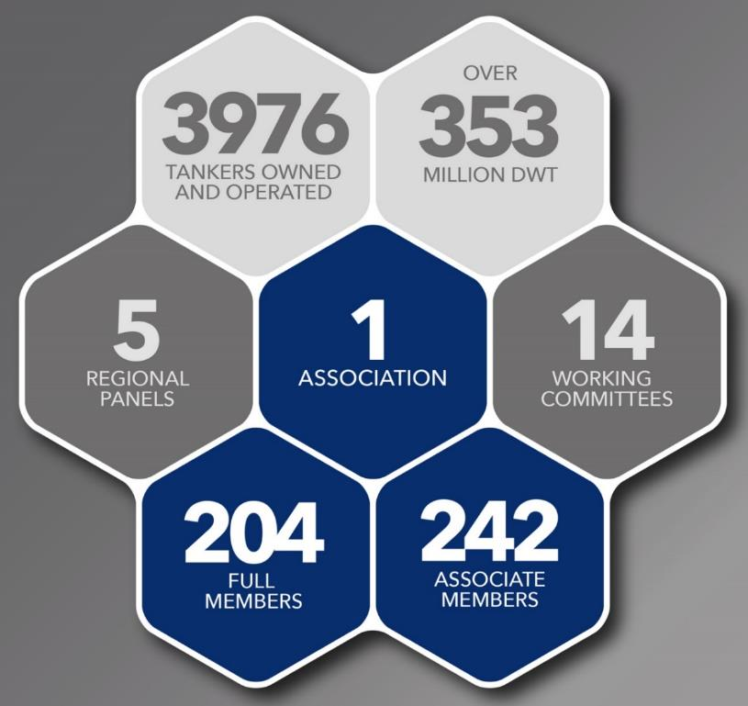
INTERTANKO 2018
Members
Lead continuous improvement of tanker industry’s performance
Strive to achieve the goals of:
ZERO fatalities
ZERO pollution
ZERO detentions
Deliver highest quality services to meet stakeholders’ expectations
Promote availability and use of personnel with best marine skills and competencies

Slide 3
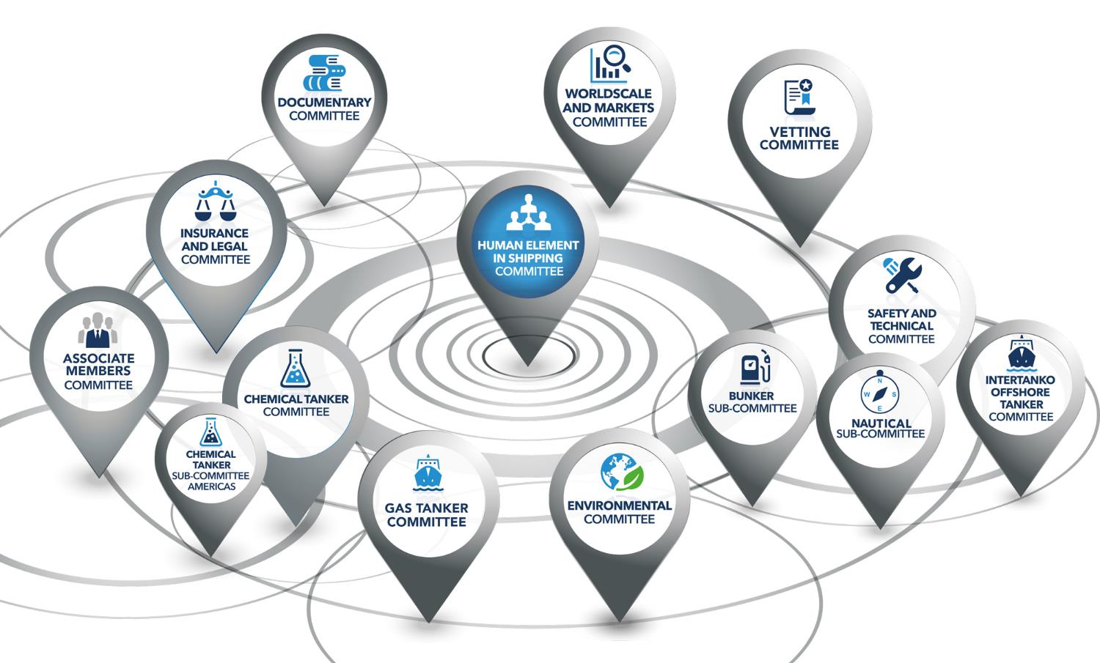
Members working for Members

Slide 4
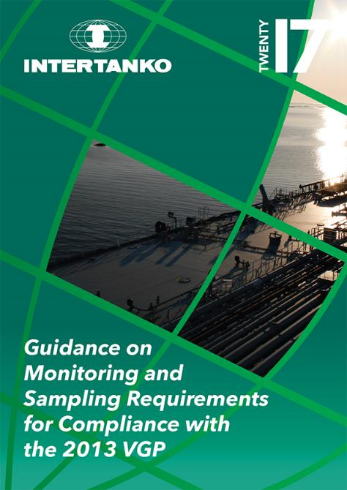
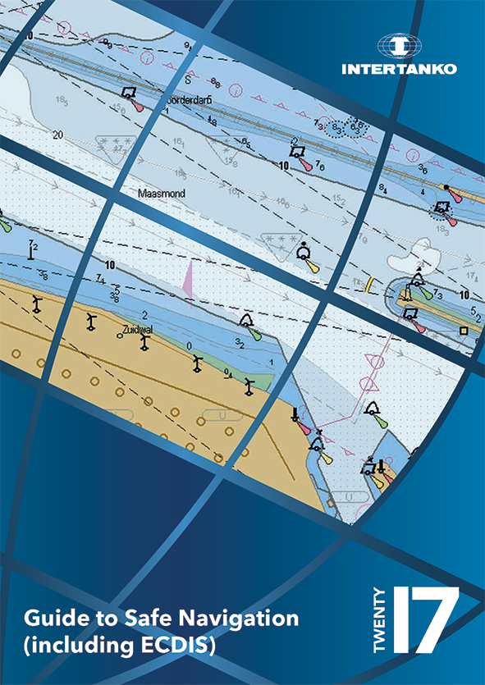
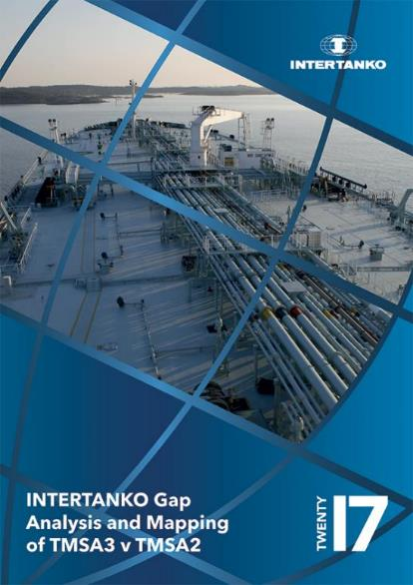
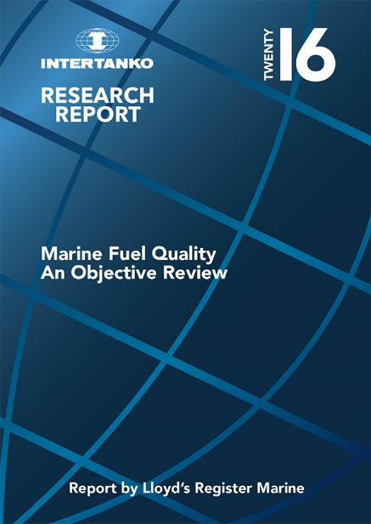
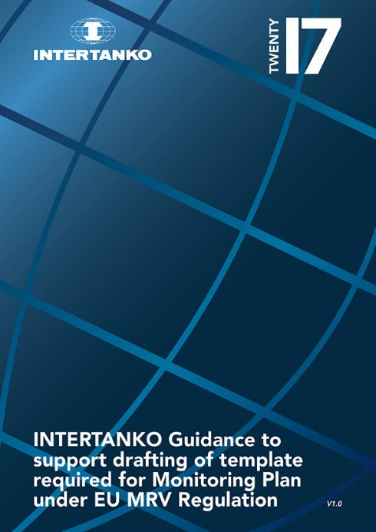
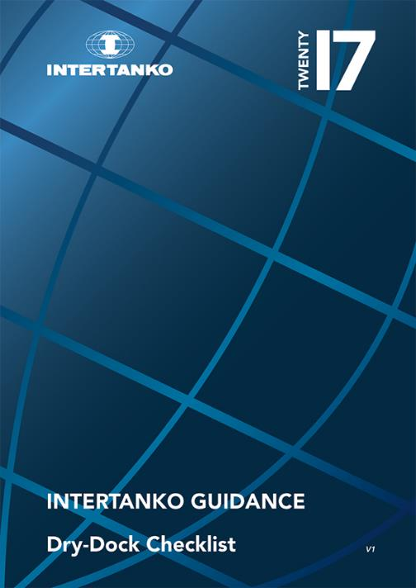
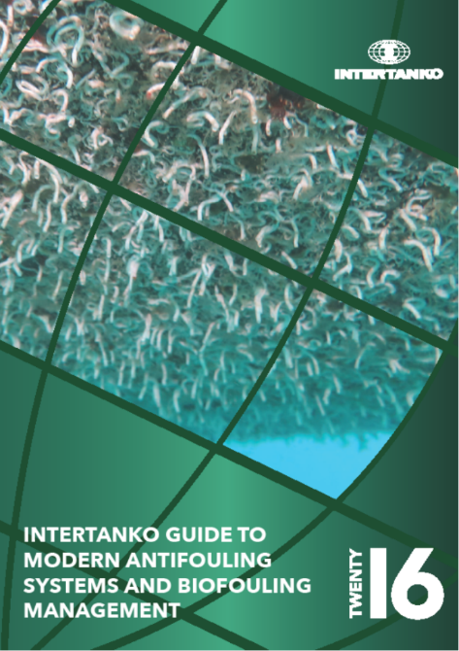
Guidance and Research

Slide 5
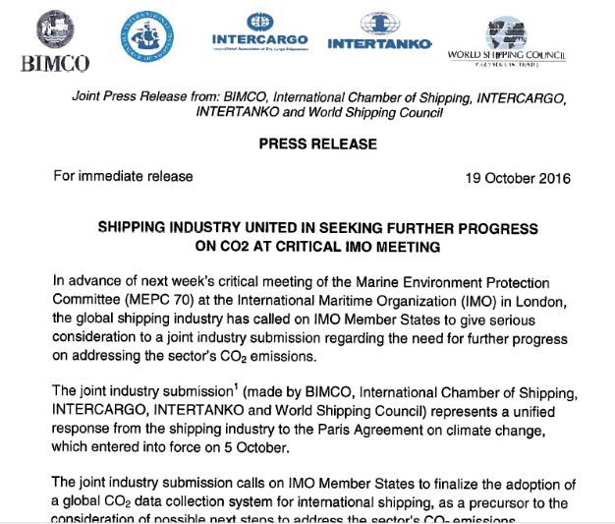
Tripartite Meetings with Class & Yards, Seoul, Rep. Korea Tanker Safety Initiative with OCIMF & others Round Table of Shipping Associations coordination Greenhouse Gas Emissions Marpol Annex VI Ballast Water Management Piracy Fair Treatment & Criminalisation Reception Facilities Places of Refuge Corruption (& PSC)
Cooperation with Industry partners

Slide 6
Update of INTERTANKO work

Slide 7
Navigation Audits
There is increased focus on navigation audits
OCIMF / TMSA say that you should have comprehensive navigational audit not exceeding two years for all ships
ECDIS use is of high priority for OCIMF and INTERTANKO.

Slide 8
Standardized bridge design
Producing a checklist for new buildings
Focus on IMO regulations and guidelines guiding towards a unified approach on implementing these.
Will add an INTERTANKO recommended/nice to have column for those who want to go above and beyond statutory requirements.

Slide 9
ECDIS and Navigation guidelines
Zone of Confidence (ZOC) - ZOC and Passage Planning
Under Keel Clearance (UKC)
Position Verification in ECDIS/Chart radars
Depth Contours In ENCs in Relation to Safety Contour and Safety Depth Function
Temporary And Preliminary Notices to mariners
Air Draft guideline
Will start with an update now. Current version can be downloaded for free from INTERTANKO website.

Slide 10
Cyber Security
Kick off meeting for third edition of the joint industry guidelines in May (sometimes wrongly referred to as the BIMCO guidelines…)
IACS have a working group on establishing shipbuilding standards for newbuilt ships
High on INTERTANKO agenda

Slide 11
Some thoughts and questions

Slide 12
T & P notices
INTERTANKO notes the IHO progress on recognizing that T&P notices in general do not have a role in ENC production and that the weekly updates should include T&P notices.
INTERTANKO also recognizes that the new Presentation library allows for timed entries in ENC updates.
However, INTERTANKO do, despite the fact that this has been recognised by IHO-HSSC, there is still not a finalised solution and UKHO is still issuing AIO because there is a need to do so.
A speedy implementation by HO’s is high on the members wish list.
As is a list of participating HO’s

Slide 13
Depth contours
We are very greatful to the work done by ENCWG on higer density depth contours
We look forward to a widespread implementation of this to all HO’s
An alternate route for S-57/ECDIS would be to populate with higher density bathymetry and allow for automatic Depth Contours generation based on safety depth
(no-go areas are drawn today manually!)

Slide 14
Quality of underlying ENC data
Example (many many more exist):
A vessel arrives at a port in Spain. In the updated chart the channel depth is 10.6 meters
The port via agent says the channel actually has 13 meters depth
Ship ask the port to support evidence that the depth is what they say. This is not produced.
Ship refuses to enter the port.
Ship and master on HOLD by charter (cannot trade for this charterer)
How should a ship act when there is a difference between a port and an official ENC when no proof is provided by the port? Note that the commercial pressure is huge…
How does HO’s collaborate with ports? Is it push or pull?

Slide 15
Upgrade to the newest IHO presentation library
What we learned:
For future larger upgrades, two dates:
One for manufacturers to have the software upgrades available for ALL equipment
One for when the ships to have it installed on-board
With the paper from China to IMO MSC saying that upgraded ECDIS systems require a new Type approval. Upgrades to ECDIS software to be kept at long intervals
A learning and preferably interactive teaching tool for end users is needed. This upgrade changed how the tool for safe navigation behave. How would it be done for the airline industry?

Slide 16
S-Mode
Interlay between layers such as radar and ECDIS but also future S-100 layers. S-98 does it to some extent. But what says that other layers/PS cant be displayed beyond S-98. How do we do then?
Who is in control of ECDIS and layers/PS ensuring that an ECDIS always acts as a safety of navigation tool?
A user should be able to perform the same type of task in a similar way regardless if it’s a radar, ECDIS or a combination. (example VRM and EBL)

Slide 17
S-100 questions and reflections
INTERTANKO is in general positive to the development of a standard that addresses E-Navigation. BUT...
Should S-100 be a carriage requirement or be voluntary?
The ECDIS is a tool for safe navigation replacing paper charts. Where should all information go?
Who has the overall control of interactions between PS. S-98 only identifies some layers/PS…
If a carrige requirement: How will changes to a PS be done/pushed out, this can change how the ECDIS operates (data is depicted) but does not require an upgrade of the software...
Where do end users go when we identify a need for PS?
S-1xx for a radar image?
S-1xx for a ship layout and a terminal layout including mooring points and loading arms (cargo equipment), fenders etc. (compatibility studies)
S-1xx Currents at various water depths (example Rotterdam)
?? Elevation and buildings on the shore side (3D?)
S-2xx Depiction on actual layout of AtoN (2D/3D)
If S-100 will be a carriage requirement, the upgrade must be timed and coordinated with the release of S-mode. Both must be mature.

Slide 18
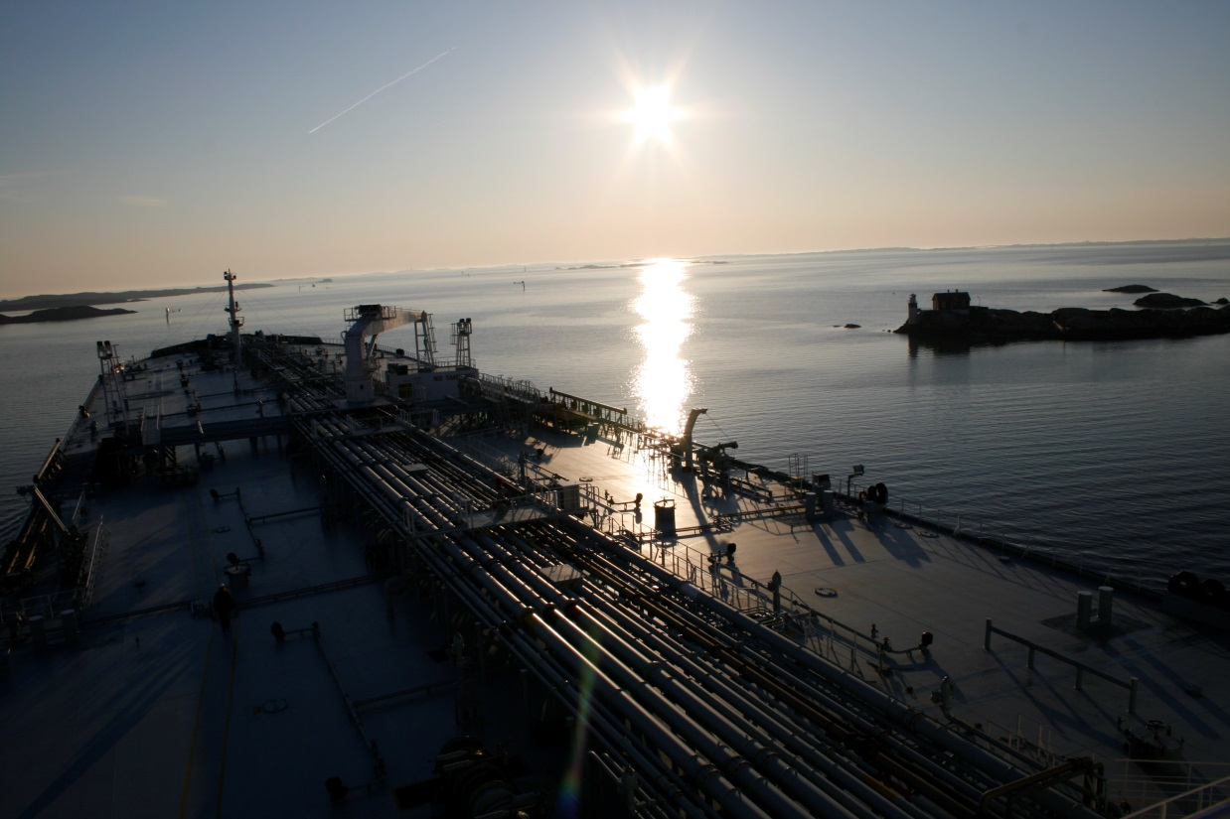
Thank you Capt. Johan Gahnström johan.gahnstrom@intertanko.com +44 (788) 400 20 68 For participation in evaluation of standards etc. Use: marine@intertanko.com johan@competensea.com CompetenSea www.competensea.com
Port of Gotheburg, Sweden: Photo: Johan Gahnström
More information?
INTERTANKO web page: www.intertanko.com

