Slide 1
INToGIS PROJECT II KHOA / IHO Sec. Presented by KHOA (Yong BAEK)
Hydrographic Services and Standards Committee

Slide 2
Back ground(1/2)
Purpose of the INToGIS Project
Support International Chart Scheme of S-11
Provide systematic management procedures and functionality
Share the digital data among the IHO MSs and other parties with common data format such as EXL, SHP and GML(S-100 based)
Main outcomes of Project 1(2014~2015)
S-11 Part B INT chart DB modelling
S-11 Part B GIS Database
Tool for Management rules according to the S-11
INT chart Web-service for the Management system and Cat…

Slide 3
Back ground(2/2)
Requirements
Base map for Polar regions (Artic & Antarctic)
ENC scheme management procedures (S-11)
Additional layers for 500 world ports and AIS traffic information ..
Connection between IHO ENC catalogue and INToGIS systems
Improve the chart display functions
User Feedbacks from HO, regional coordinator …
And other improvements

Slide 4
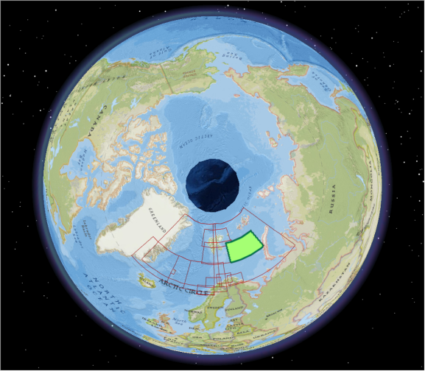
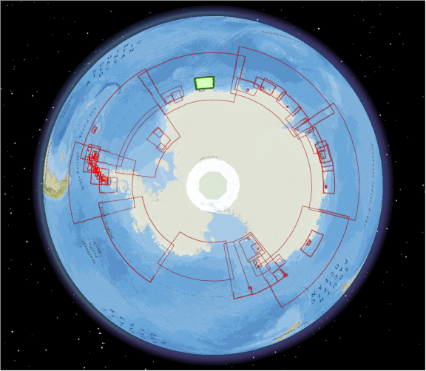
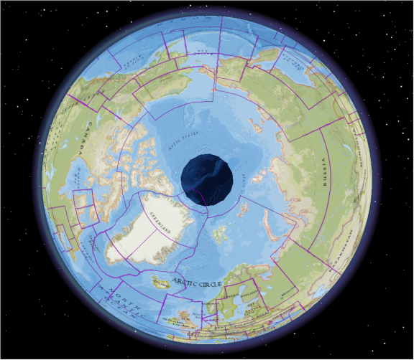
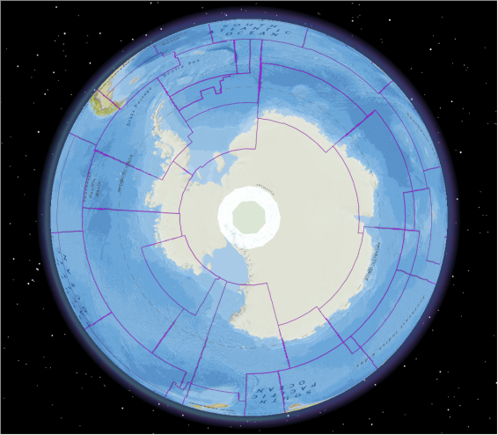
Improvement(1/8)
1. Base map of Polar region
Both INT Chart and ENC Scheme
Apply to the management procedures
INT Chart Arctic
INT Chart Antarctic
ENC Scheme Arctic
ENC Scheme Antarctic

Slide 5
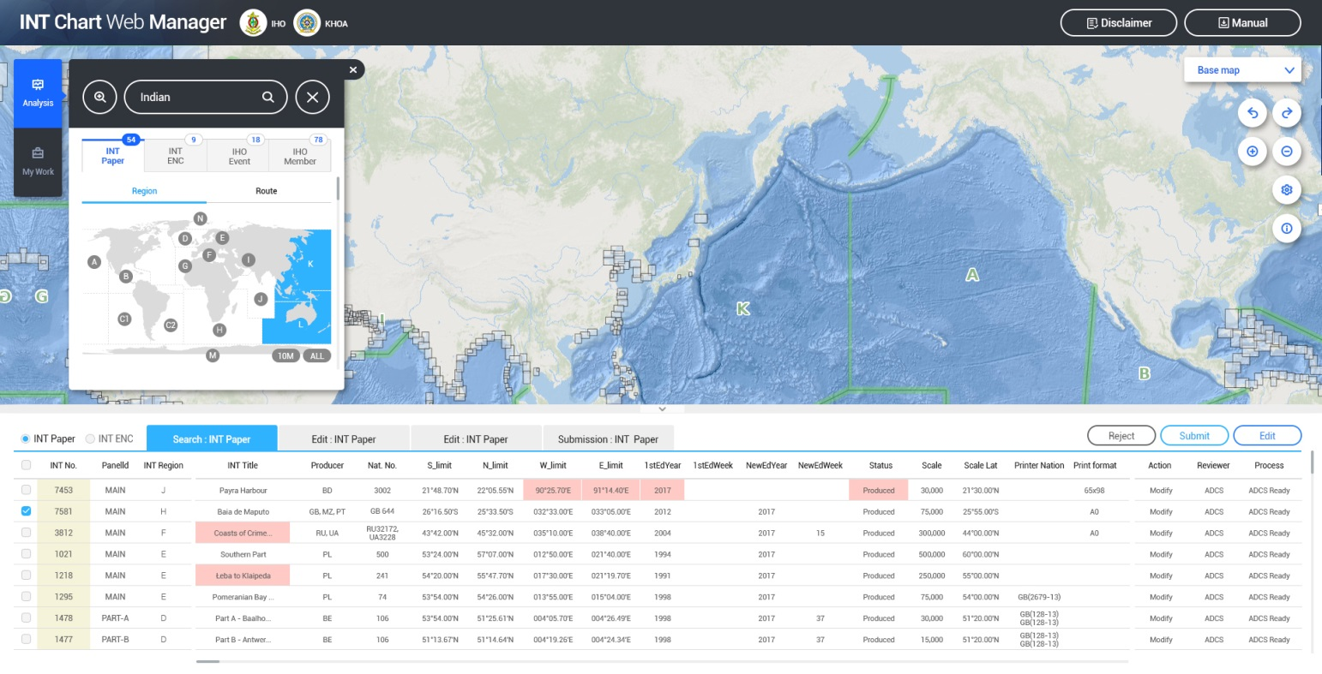
Improvement(2/8)
2. ENC scheme Management procedure
Management workflow
(HO→ICCWG→IHO sec.→DB)
Search options / Various Base Maps / Database for ENCs

Slide 6
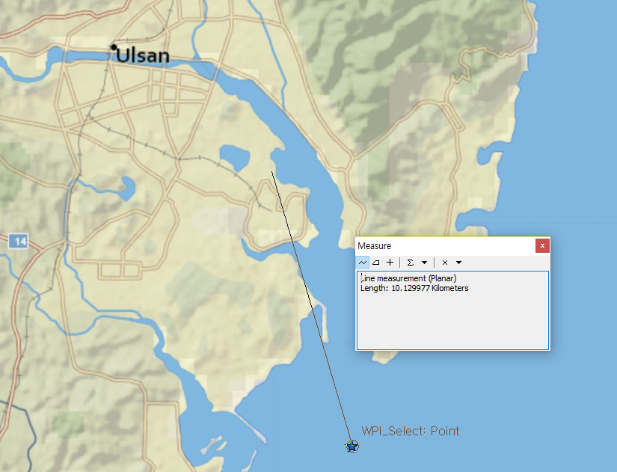
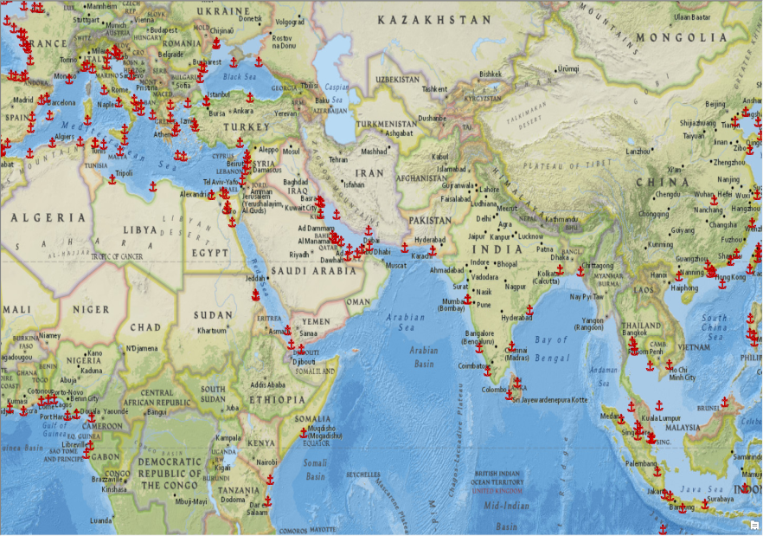
Improvement(3/8)
Low accuracy of position
3. World Port layer
Size Code | Count | Harbor Size
L | 159 | Large
M | 362 | Medium
S | 992 | Small
V | 2166 | Very Small
Source from NGA

Slide 7
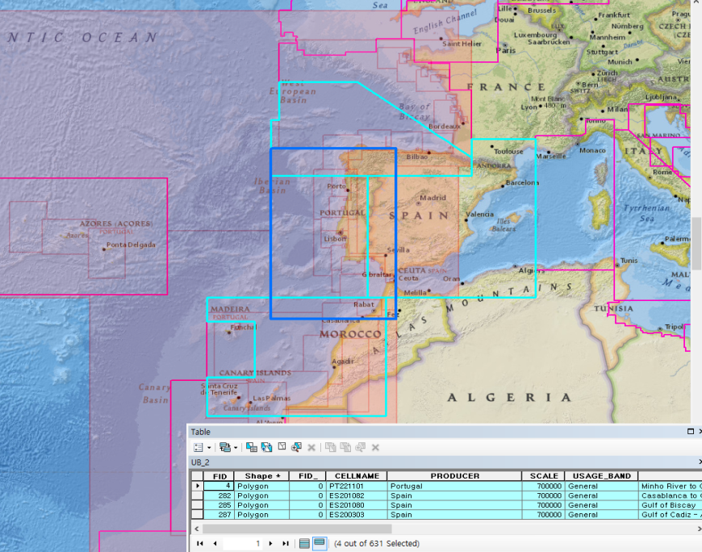
Improvement(4/8)
4. ENC scheme : Gap finder
Comparison between INT Chart and ENC
Support analysis of ENC coverage to Ports and Passage line
For instance
INT Chart : G region
Selected INT chart
(Scale : 1,000,000)
ENC: UB2
Comparison of the INT chart and ENC
For ENC UB2(Scale:700,000)

Slide 8
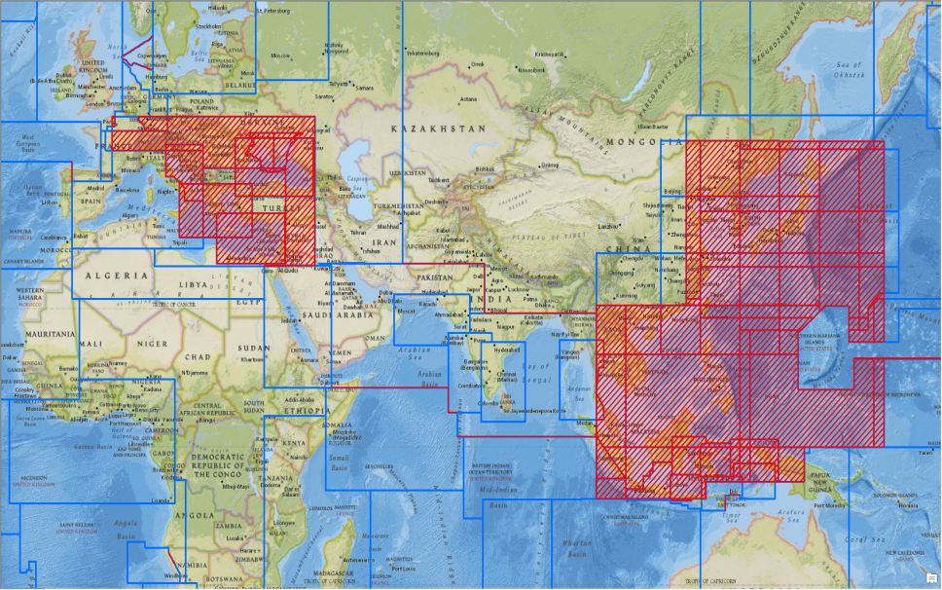
Improvement(5/8)
5. ENC scheme : Overlapping checker
Check the overlap of ENCs with various options
Automatic check the ENC coverage for NEW and modified ENC
- Buffer zone : 5m
For instance
ENC UB 1
Overlapping area

Slide 9
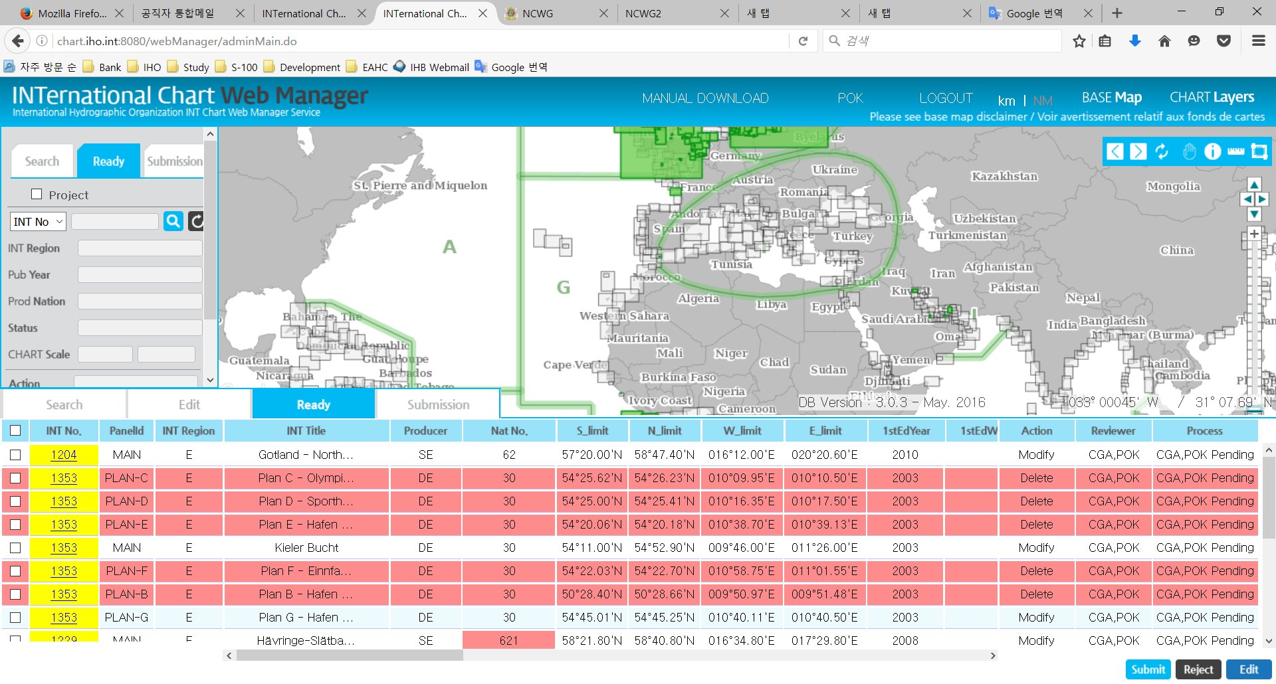
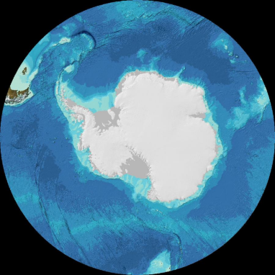
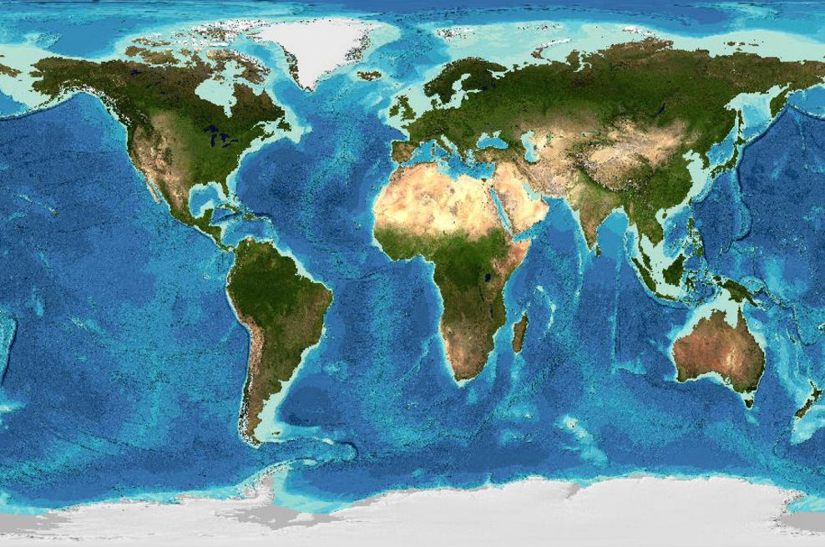
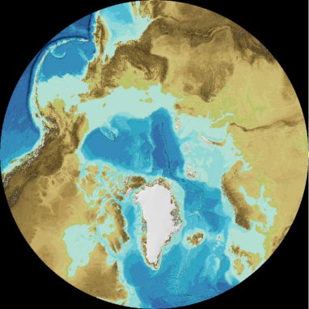
Improvement(6/8)
6. Other improvements
a. GEBCO Base Map
a) GEBCO base map

Slide 10
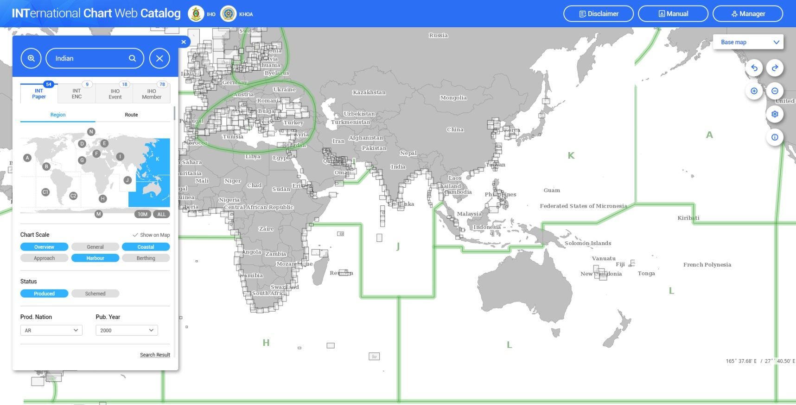
Improvement(7/8)
7. Other improvements
b. Renewal INTOGIS interface

Slide 11
Improvement(8/8)
8. Other improvements
c. Additional layers
AIS traffic history layer
IHO meeting & event layer
IHO member states layer
Undersea Feature Names layer
d. Functions
Email notification
Update the manuals and …

Slide 12
Plans
Design and develop DB (Oct.2017)
Develop the new interface and functions (Nov.2017)
Create additional layers (Nov.2017)
Test operation (Nov.2017 ~ Jan.2018)
Run the New INToGIS system (early 2018 ~, t.b.d )

Slide 13
Action requested of HSSC
Note the report.
Request to provide recommendations and feedbacks if any.

