Slide 1
6th Meeting of the Inter Regional Coordination Committee
HCA Report
IRCC6-07A

Slide 2
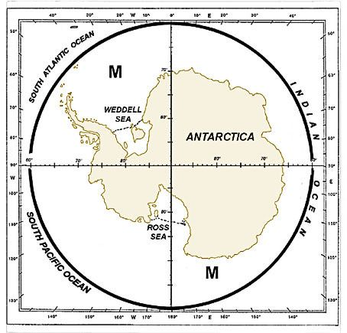
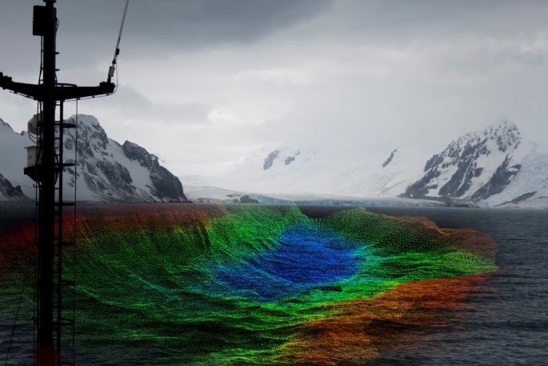
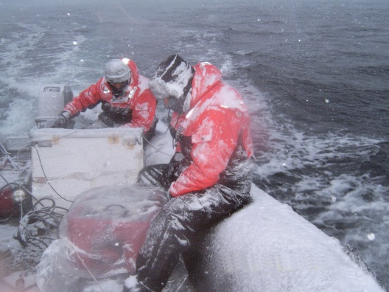
Hydrographic Commission on Antarctica
Argentina, Australia, Brazil, Chile, China, [Columbia], Ecuador, France, Germany, Greece, India, Italy, Japan, Korea (Rep. of), New Zealand, Norway, Peru, Russian Federation, South Africa, Spain, United Kingdom, United States, Uruguay and Venezuela

Slide 3
HCA 13, Cadiz, Spain, November 2013
15/23 Member States
Colombia
GEBCO / IBCSO, MSDIWG
COMNAP, IAATO, IALA
Expert contributors:
Fugro Pelagos, Kongsberg Maritime, Caris
Next meeting: Ecuador ??? early 2015

Slide 4
Principal Topics
ways to increase surveying activity in Antarctic waters
continuing the campaign to raise awareness at the Antarctic Treaty Consultative Meeting (ATCM)
progress INT chart and ENC scheming and production in the HCA Region

Slide 5
Outcomes
Progress on crowd-sourcing (passage sounding initiatives -
IHO [HCA] guidelines for the collection and rendering of hydrographic data by Ships of Opportunity operating in the Antarctic Region
HCA declaration on encouraging public/private cooperation in minimising expenses for contract surveying

Slide 6
Raising awareness at Antarctic Treaty Consultative Meeting (ATCM)
New consolidated ATCM Resolution on Strengthening Cooperation in Hydrographic Surveying and Charting of Antarctic Waters
clear acknowledgment from ATCM regarding importance of improving hydrography and charting
acknowledgment that coordination, collaboration and sharing of resources is key to improving the situation

Slide 7
EIHC5
Red Book - 15 July
9 Proposals
3 Reports and Recommendations
3 Programme summaries and recommendations
2015 WP and budget

Slide 8
Status of INT and ENC Charting
INT Charts
71 of 111 published
ENCs
87 of 104 published
However,
>95% of Antarctic waters are unsurveyed !

Slide 9
IHO Work Programme
Member State Participation
Increasing dependence on voluntary industry participation and contract support
Scheduling of meetings
Resource-based planning depends on WG and Committee input

Slide 10
Action Requested
Consider the contents of this report
Note the report
Take any actions as considered appropriate

