Slide 1
Land and Marine Spatial Information
-
An Interesting Relationship
Ellen Vos
IHO MSDIWG Vice Chair
Em.vos@mindef.nl

Slide 2


Slide 3
A love story:
Marina
and
Gio

Slide 4
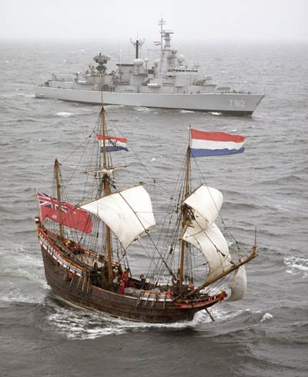
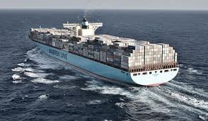
Notes:
Eventuele voettekst
En deze…

Slide 5
INTERNATIONAL HYDROGRAPHIC CONFERENCE
INTERNATIONAL HYDROGRAPHIC BUREAU
WGs as required
Finance Committee
(FC)
Hydrographic Services and Standards Committee
(HSSC)
Inter-Regional Coordination Committee
(IRCC)
MSDIWG
Regional Hydrographic Commissions
Capacity Building
Sub-Committee
Technical Working Programme
Regional Coordination
INSPIRE
other WGs as required
other WGs as required
Notes:
Overall Structure of International Hydrographic Organization.

Slide 6
European dimension of IHO
EU Members | NHC | BSHC | NSHC | MBSHC | EAtHC | ARHC
Austria
Belgium |  |  | XXX
Bulgaria
Cyprus |  |  |  | XXX
Czech Republic
Denmark | XXX | XXX | XXX |  |  | XXX
Estonia |  | XXX
Finland | XXX | XXX |  |  |  | X
France |  |  | XXX | XXX | XXX
Germany |  | XXX | XXX
Greece |  |  |  | XXX
Hungary
Ireland |  |  | XXX
Italy |  |  |  | XXX
Latvia |  | XXX
Lithuania |  | XX
Luxembourg
Malta |  |  |  | XX
Netherlands |  |  | XXX
Poland |  | XXX
Portugal |  |  |  |  | XXX
Romania |  |  |  | XXX
Slovakia
Slovenia |  |  |  | XXX
Spain |  |  |  | XXX | XXX
Sweden | XXX | XXX | XXX
United Kingdom |  |  | XXX | XX | X
Other EEA members
Iceland |  |  | XXX |  |  | X
Liechtenstein
Norway | XXX |  | XXX |  |  | XXX
XXX: Full member
XX: Associate member
X: Observer

Slide 7
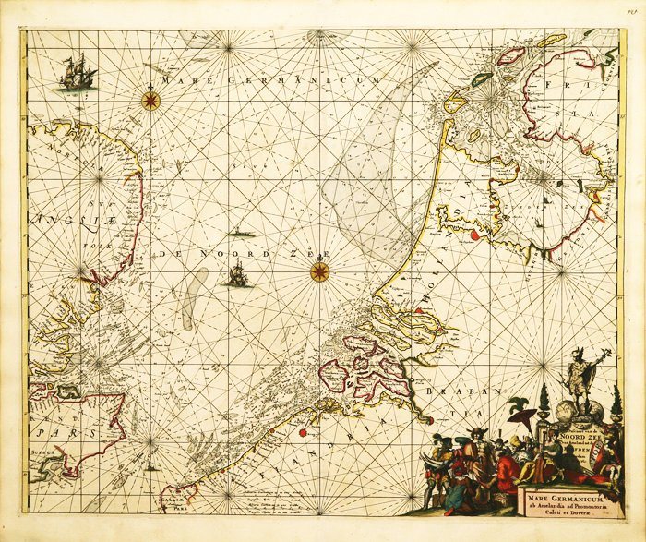
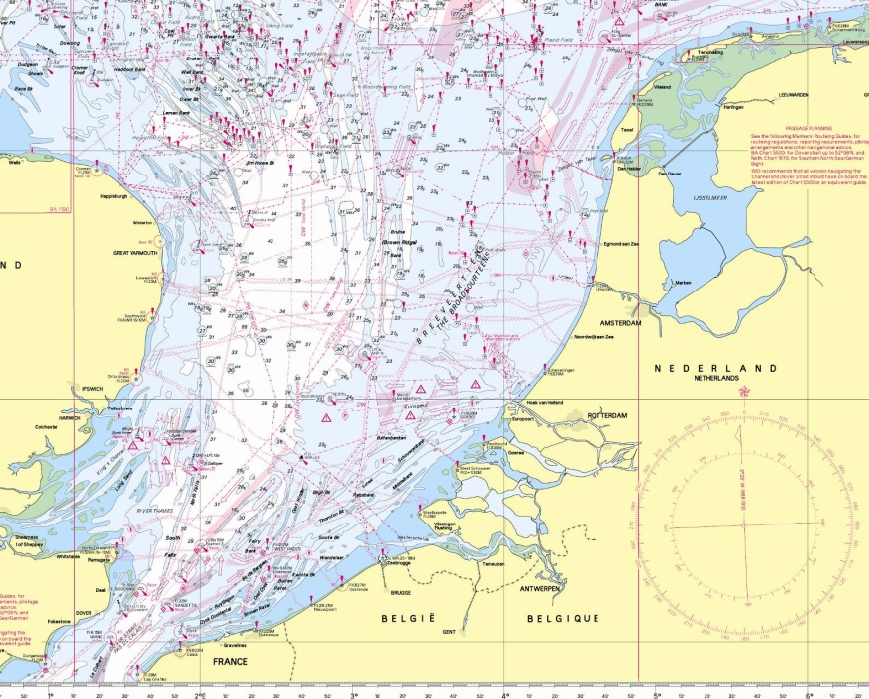
7
Notes:
Onderdeel, afdeling
1/20/2015
Eventuele voettekst
7
Laten we nog even kijken naar een van onze kaarten. Hoe zou die eruit gezien hebben als we die nooit hadden ge-update?

Slide 8
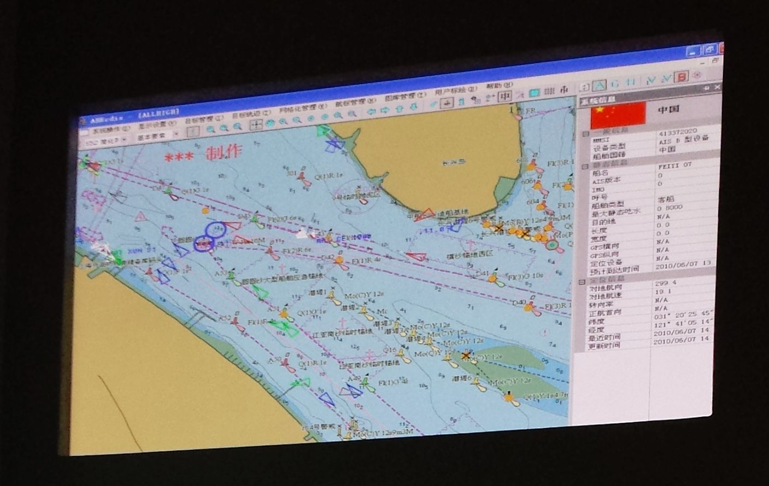

Slide 9
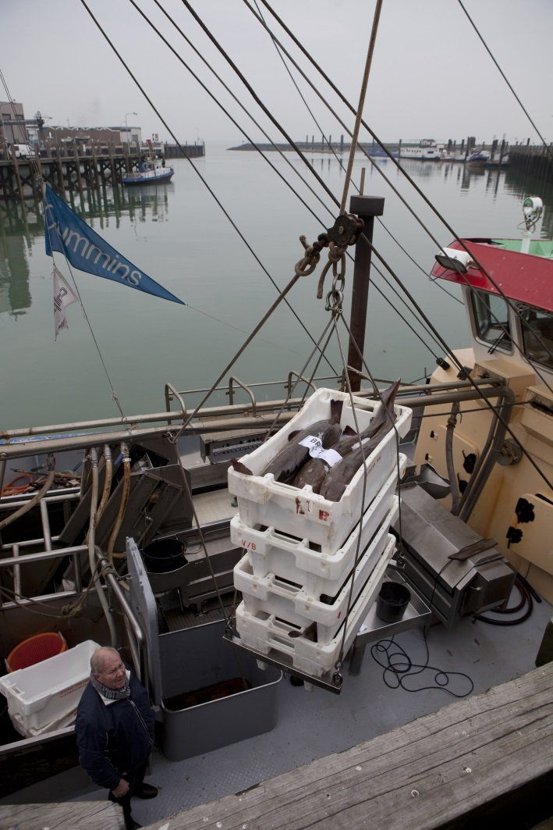

Slide 10
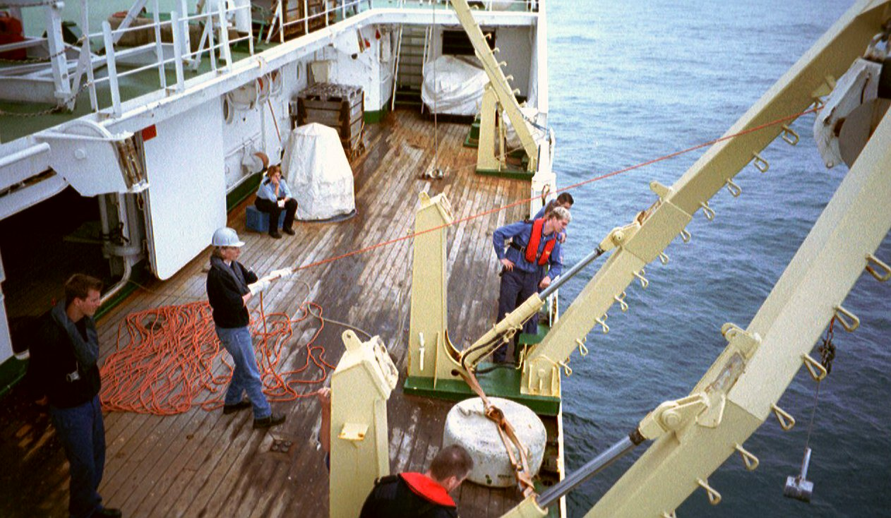

Slide 11
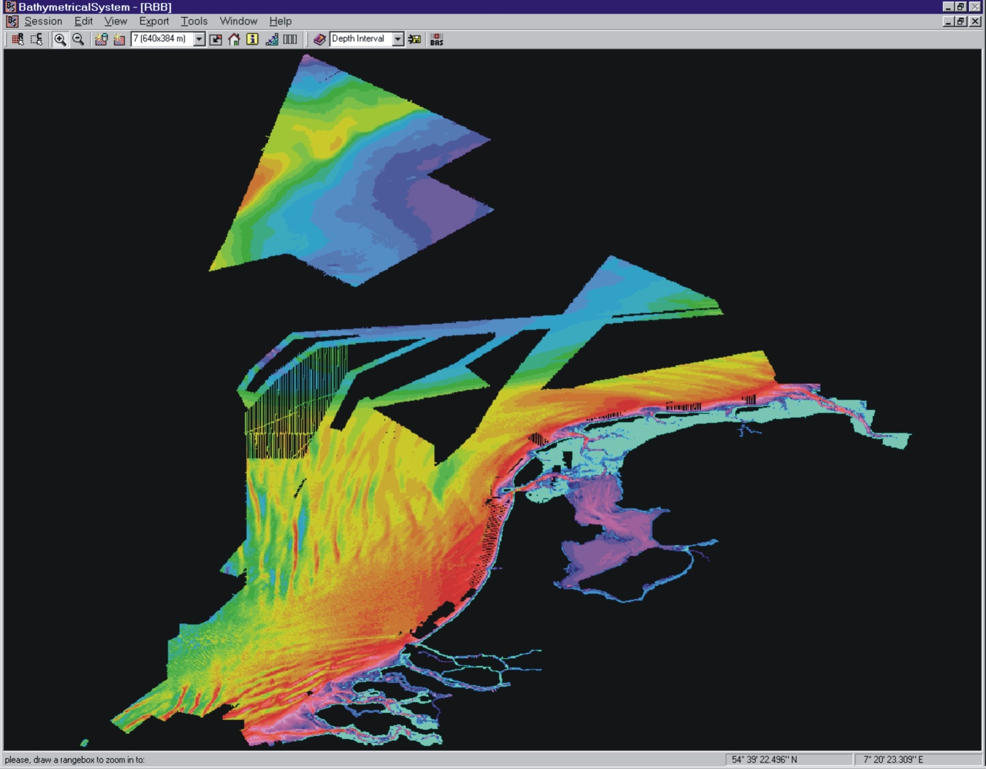

Slide 12
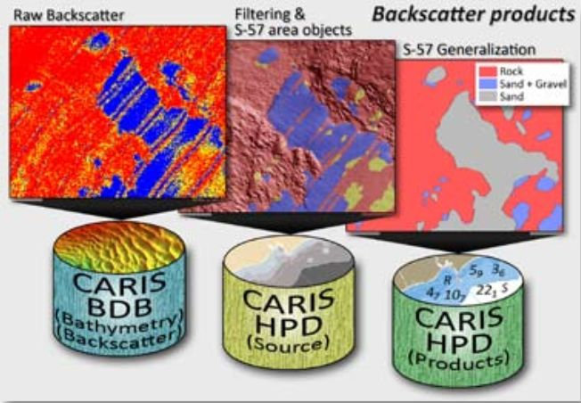
Notes:
Hydrographic processing

Slide 13
Issues related to land, coastal and marine environment : UN - GGIM

Slide 14
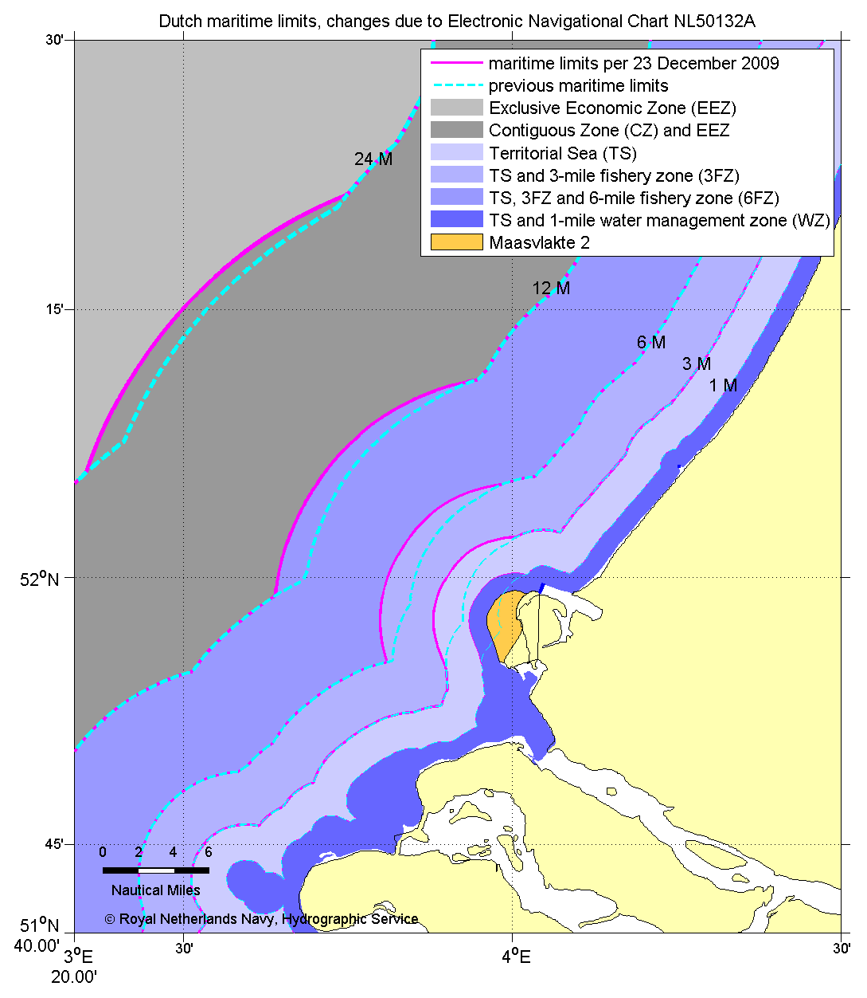

Slide 15
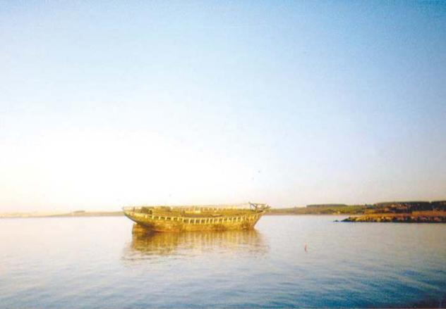

Slide 16
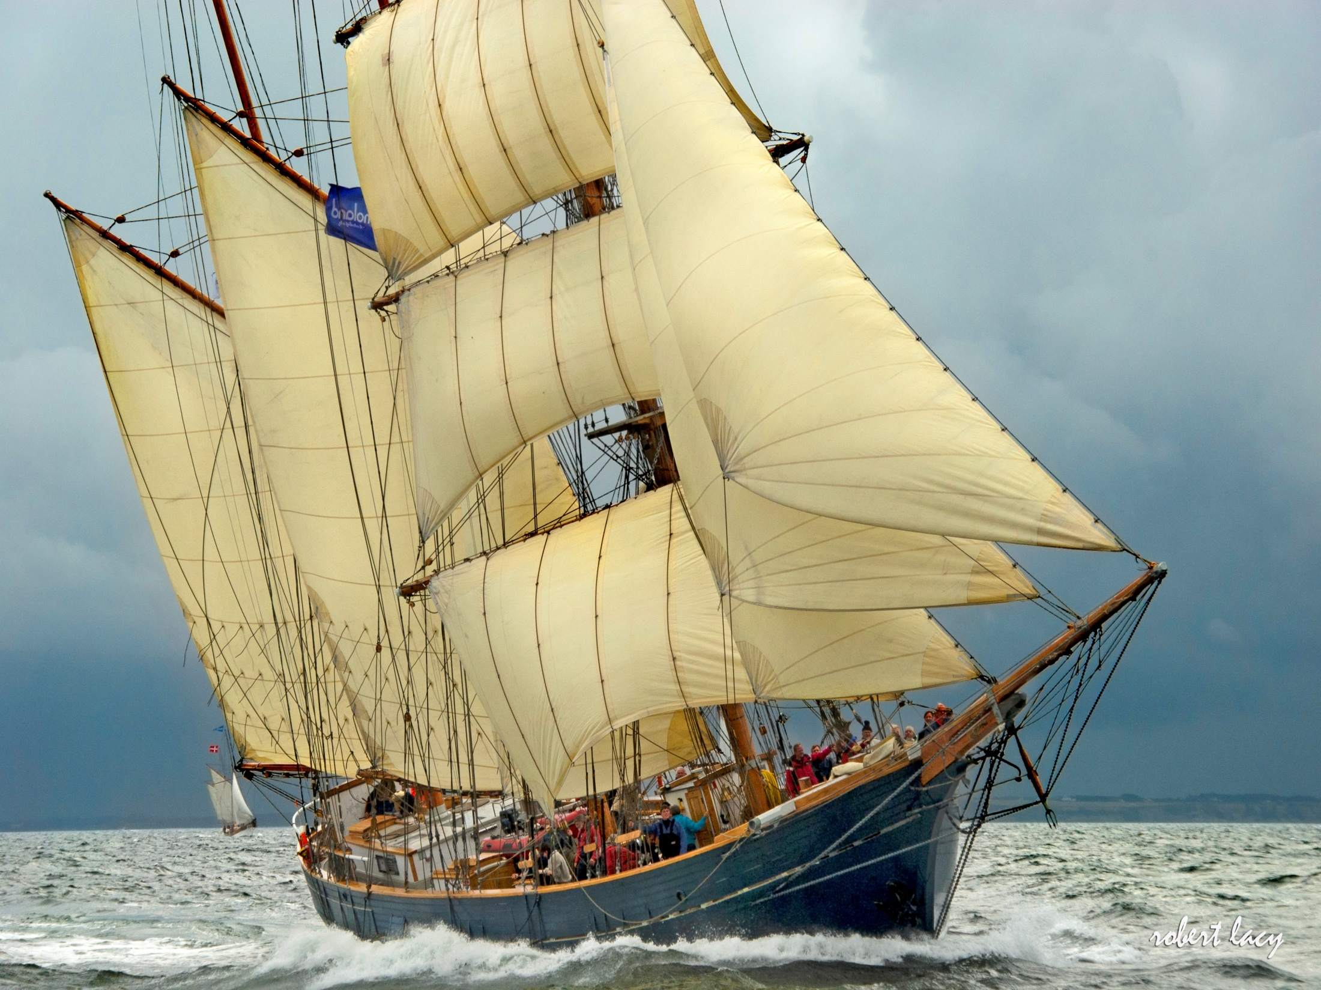

Slide 17
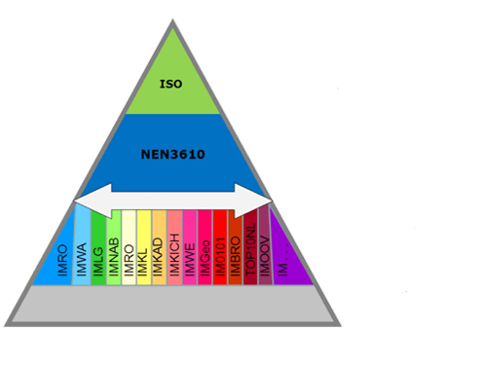
S-57
NLHO
Notes:
Also Rijkswaterstaat en Harbour Authorities (IENC + Port ENC)

Slide 18
S-100
NLHO

Slide 19
+ geodetic harmonisation (ETRS89)
NLHO

Slide 20
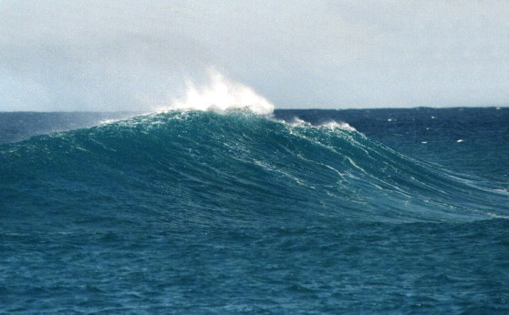
LAT ???

Slide 21
OGC Oil industry
ISO
ESRI Copernicus
Caris
Fugro …
Academia

Slide 22
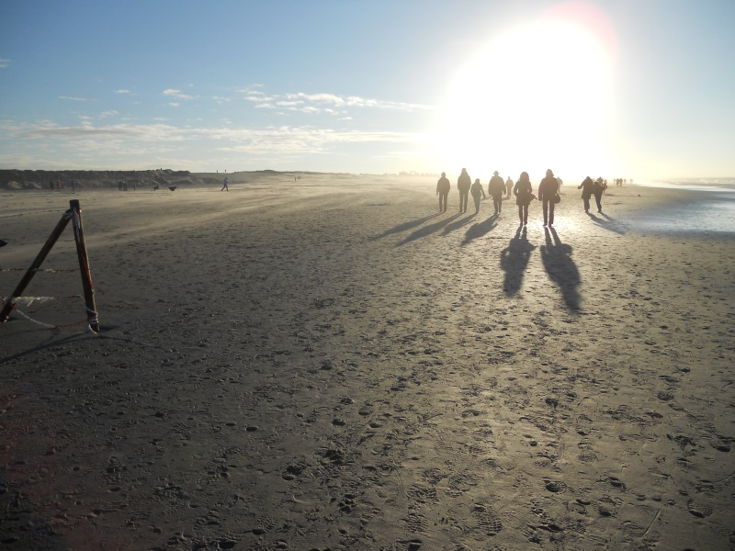
To be continued…

