Slide 1

DATA EVOLUTION
(and the EVIDENCE)...
Knowledge Doubling Curve
Buckminster Fuller created the “Knowledge Doubling Curve”
He noticed that until 1900 human knowledge doubled approximately every century.
By the end of World War II knowledge was doubling every 25 years.
Today things are not as simple as different types of knowledge have different rates of growth. For example, nanotechnology knowledge is doubling every two years and clinical knowledge every 18 months.
But on average human knowledge is doubling every 13 months.
IBM states that the build out of the “internet of things” will lead to the doubling of knowledge every 12 hours!

Slide 2
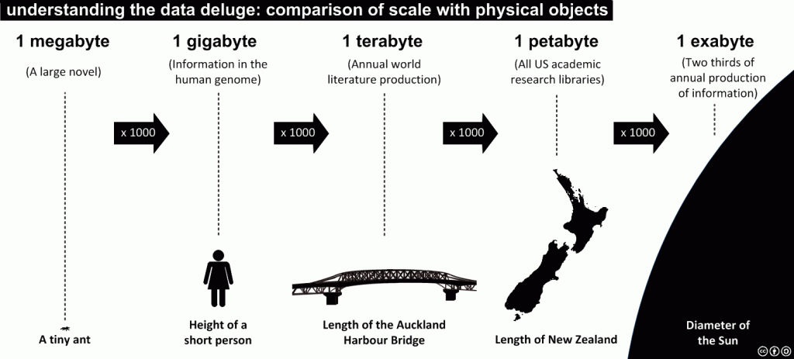
The Data Deluge!
Linear to Exponential Growth of Human Knowledge

Slide 3

Beyond the data dump!
flickr © fdecomite

Slide 4
The Role of Data Management Plans
Growing Government-wide emphasis on “community” access to data supports a substantive push towards more open sharing of data
National Science Foundation (NSF) in USA requires data management plans as a pre-cursor to it providing Federal funds
This is consistent with NSF's mission and US policymakers in making sure that any data obtained with federal funds be made accessible to the general public as OPEN DATA
NSF is subject to the US Federal Open Government Directive to make government more transparent and more participatory
This addresses the trends and needs in the modern era of data-driven science and solutions

Slide 5
MSDI Components and Hydrography
Policy & Governance
(People)
Technical Standards
(Standards)
Information Systems
(ICT)
Geographic Content
(Data)
Greatest challenge resides here! We do not have the hearts and minds of all HO’s
We have ISO,OGC and IHO standards
We have the technologies
We are collecting more and data

Slide 6
Challenges facing the HO community
Cultural and Organisational inertia
Many HO’s still find it difficult (or refuse) to release data except for SOLAS purposes but why?
  No mandate from Government
  Decision Makers do not understand the need to release
  No re-use licensing capability
  Cannot accept or gain benefit from any revenue derived
  Security concerns (an excuse not a reason)?
  Lack of understanding
The current situation is not sustainable!

Slide 7
The Way Forward for MSDIWG?
Education
  Capacity Building
  Training
  Mentoring
  Coaching
Change Management
  People
  Organisational
  Cultural
  Technical

Slide 8
MSDIWG Task C: Develop content for an MSDI training course
Sub Task C1: Identify the need for education and training among the Member States and report to WG Chair
  Activity C1.1: Develop and deliver training and education events as required
  Activity C1.2: Investigate the possibilities to arrange an IHO INSPIRE Workshop with EC-JRC and / or DG Environment
Sub Task C2: Establish a MSDI training syllabus for use across IHO Community

Slide 9
  C1.1: Develop and deliver training and education events as required
What kind of events are needed?
What is our message?
Who is our audience?
Where is this training required?
Why should we do this?
When (or how often) should we do this?
How might this be delivered?
  Face to face?
  e-learning?

Slide 10
C2: Establish a MSDI training syllabus for use across IHO Community
Aimed at Directors, Managers and Practitioners?
Different focus for different audiences?
What would be in such syllabi?
How would this be delivered?
  On-Line resources/e-Learning?
  Face to face workshops?
Who would deliver the training?
Role of RHC’s and CBSC

Slide 11
Existing Resources
IHO Publication C-17: Spatial Data Infrastructures “The Marine Dimension” Ed:1.1 - Feb 2011*
  Appendix 2: 1-day SDI Awareness Training Course template
    OceanWise / IHO Capacity Building Courses “Data Management, Database Design & MSDI” since 2010:
  5-day Practitioner Course syllabus
  2-day Management Course syllabus
  1-day Senior Management Briefing – Fundamentals of MSDI
  ½ day Marine Data Management Awareness Briefing
    2 and 5-day courses certified by RHC’s
    End of course assessment
    Delivered to EAHC, NIOHC, SAIHC, MACHC, SWAtHC, RSAHC
Case Studies (e.g. Germany, Norway)
* To be revised? MSDIWG Task E

Slide 13

Publication C-17
“The IHO will support Member States in the identification, development and implementation of an appropriate role in national Spatial Data Infrastructure (SDI) and MSDI initiatives.
This will be achieved through the development and maintenance of a Special Publication that will provide a definitive procedural guide to establishing the role of the national hydrographic authority in MSDI.”
EIHC Resolution K4.7 (2009)
Notes:
But is the role of HO’s wrt MSDI any better established?

Slide 14
Task E - Maintain And Extend Publication C-17
Ref: IHO Task 2.9.2.
Current version 5 years old!
Time for Revision, Extension or Replacement?
If so what needs to be added and/or changed?
  Policy and Governance?
  Standards?
  ICT?
  Data?
  Other?

Slide 15
Some Thoughts (1)
S-100 Hydrographic Data Model
S-1xx Product Specifications
Future Applications
Real Time Data Feeds
Data Sharing & Re-Use
Non- Navigational Use Cases
Open & Linked Data
Web Services (e.g. WMS,WMTS, WFS, CSW)
Publishing
Land-Sea Interoperable Data
Case Studies

Slide 16
Some Thoughts (2)
What business is the HO community in now?
What will the HO community look like in 2025?
Additional information as part of the navigational suite of products?
Multi-suppliers of source or application data?
Core Reference Data defined
Next Generation ECDIS?
Impact of Ports development and Maritime Information Infrastructure
Seamless Linked Data

Slide 17
Thank you
Any Questions?

