Slide 1
Essential Standards for Developing Spatial Data Infrastructures
IHO
MSDI-WG-7
Trevor Taylor, Open Geospatial Consortium
January 26-28, 2016
Tokyo, Japan

Slide 2
The Open Geospatial Consortium
Not-for-profit, international voluntary consensus standards organization; leading development of geospatial standards
Established 1994
515+ members worldwide
40+ standards
Many profiles, schema and best practices
Thousands of product implementations
Broad user community
implementation worldwide
Alliances and collaborative activities with many other organizations

Slide 3
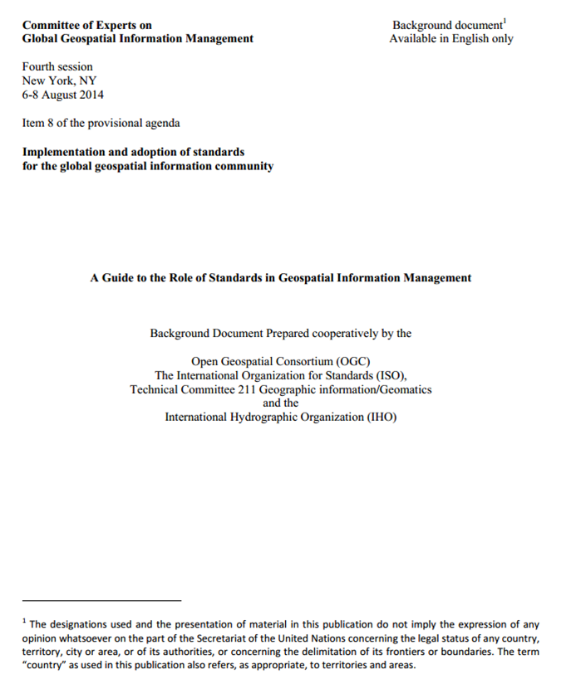
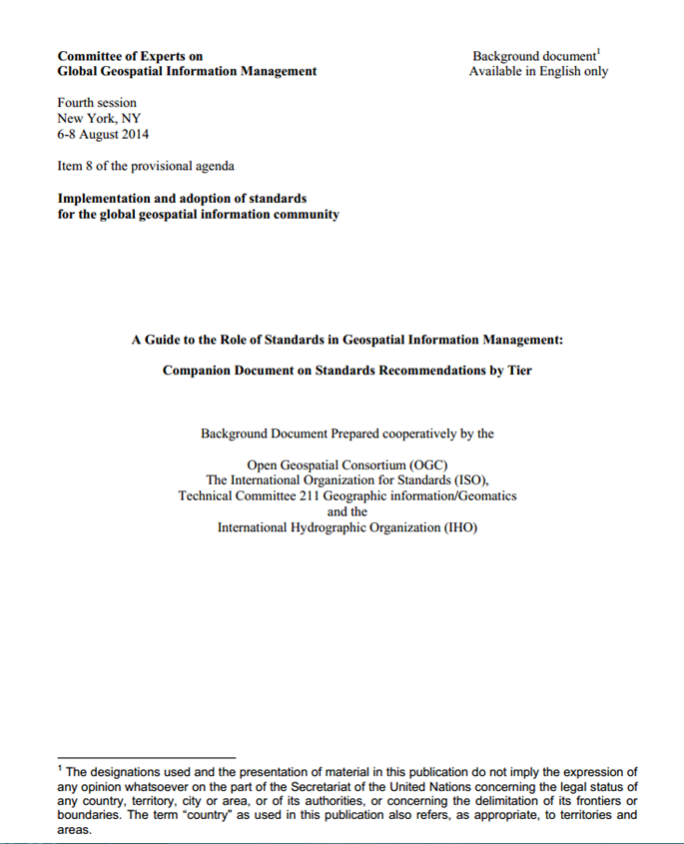
UN-GGIM Standards Guide - Background
2013 UNGGIM Secretariat request OGC, ISO & IHO to create a non-technical guide explaining the role and importance of open geospatial standards.
The Result:
  The Guide to the Role of Standards in Geospatial Information Management
  A Companion Document on Standards by Tier
The guide provides a model for the phased implementation of geospatial standards, considering the different levels of experience and expertise of the players involved.
Notes:
The UN-GGIM Secretariat requested OGC, ISO, and IHO (IHO) create a guide that explains the importance of open standards supporting the development of Spatial Data Infrastructure.
Structured around a set of three “tiers”, covering single enterprises up to complex multiple information communities and beyond.

Slide 4
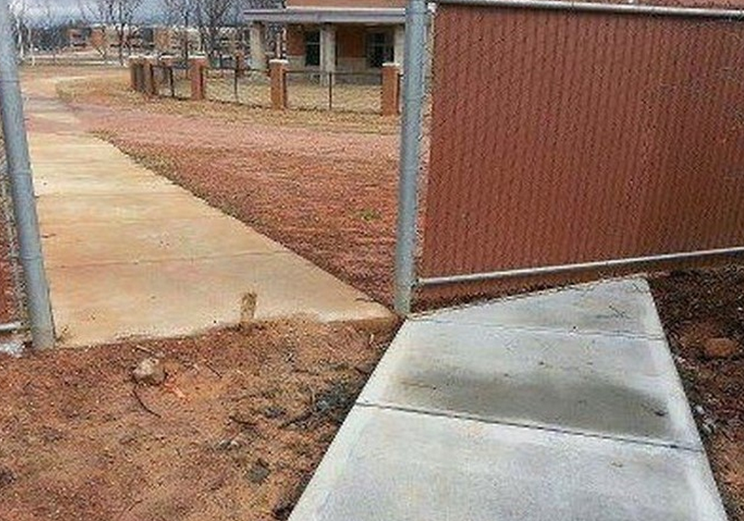
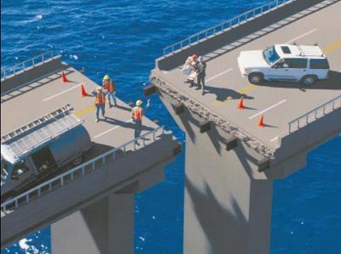
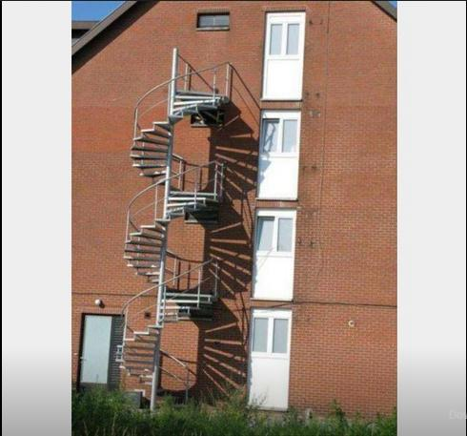
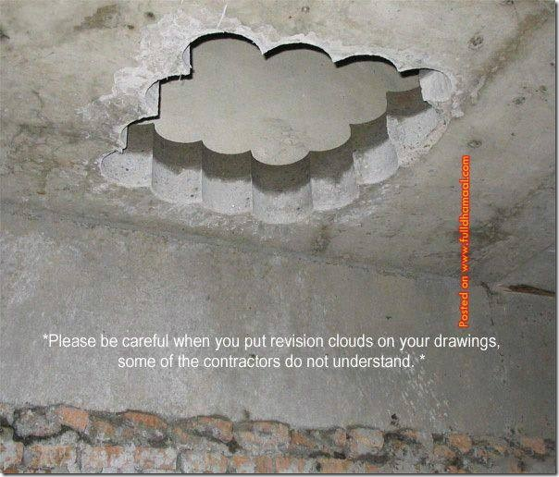
The Goal: Sustainable Interoperability!
"Open data , open standards and technologies that implement standards are all critical to the goals of GEO to "unleash the power of EO" for the greater benefit of society. A clear understanding about the relationship of these three elements. and how to implement on both the policy and technical level is critical to sharing information across boundaries and creating transparency.
Barbara Ryan, Geo Secretariat Director, May , 2014

Slide 5
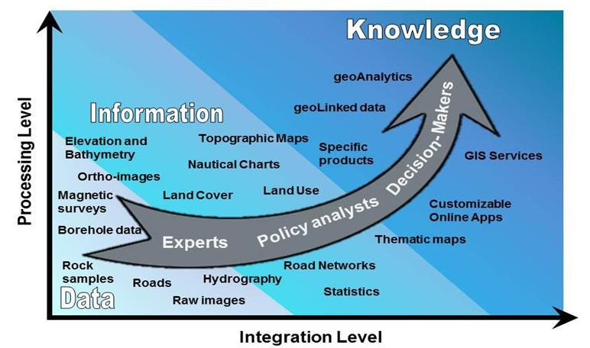
Background
Adoption of standards is driven by the desire of organizations to share, integrate and use geospatial information
Standards are a continuum enabling the achievement of increasing levels of interoperability as more standards are adopted to keep pace with evolving requirements, technologies and tools.
Adoption is a journey and organizations are likely to be starting this journey at different points

Slide 6
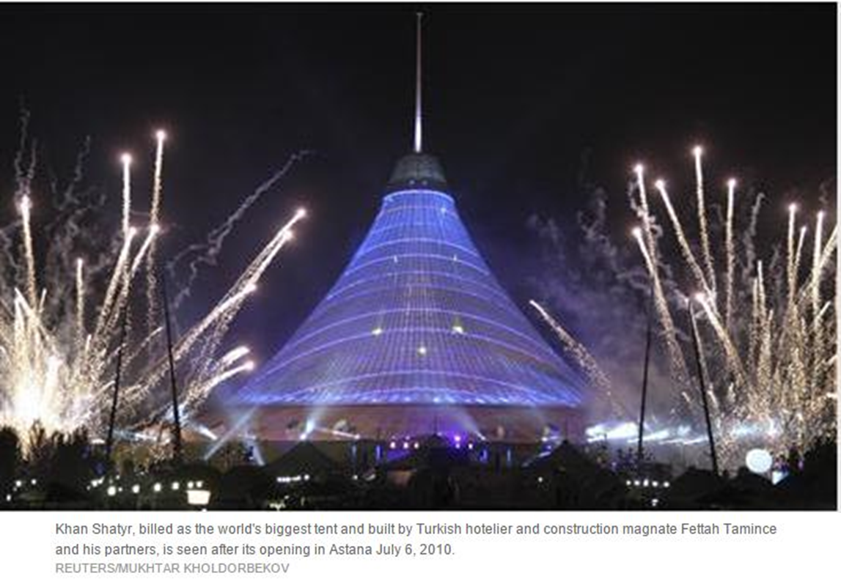
A Note about “Open”
“Open” is Ubiquitous – and sometimes confusing
Open standards , open data, open and proprietary technologies are all critical parts of successfully sharing geospatial information
Technical, Policy and Legal Implications
It’s a Big Tent – Room for all!

Slide 7
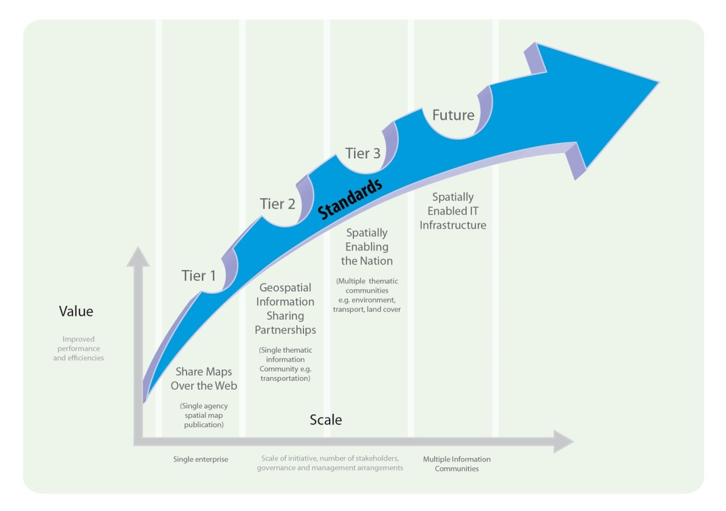
Model – a Continuum
Notes:
Tier 1 - Share maps over the Web
Tier 2 - Geospatial Information sharing partnerships - share, integrate and use geospatial data from different providers
Tier 3 - Spatially enabling the nation - large scale efforts to develop a ‘full-blown’ SDI that provides access to multiple themes of information, applications for using the shared information, and access via a variety of environments (mobile, desktop, etc.)
The future - Towards spatially enabling the Web of data - delivering geospatial information into the Web of data, and bridging between SDI and a broader ecosystem of information systems

Slide 8
Tier 1: Share maps over the web
Discover and view interactive maps
Organizations describe, organize, collect and manage geospatial information.
View and query geospatial information using a variety of devices such as a desktop, tablet, or other mobile devices.

Slide 9
Typical scenarios for Tier 1
Simple, low cost way to share geospatial information
Information may be stored in more than one system using different technology and organizations do not have to standardize on a single technology platform
information is stored in more than one format and the organization(s) does not need to incur data conversion costs
Data remains with the owner of the data , increasing the likelihood of update
Publish maps for government and citizen access;
An organization is unable to distribute the data but is willing share images of the data
Policy and governance related to geospatial information management and operations may be informal

Slide 10
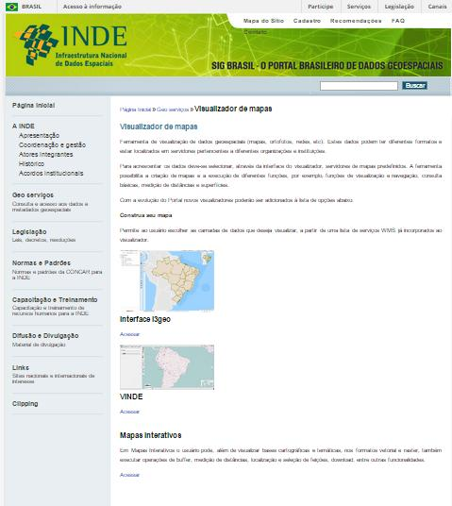
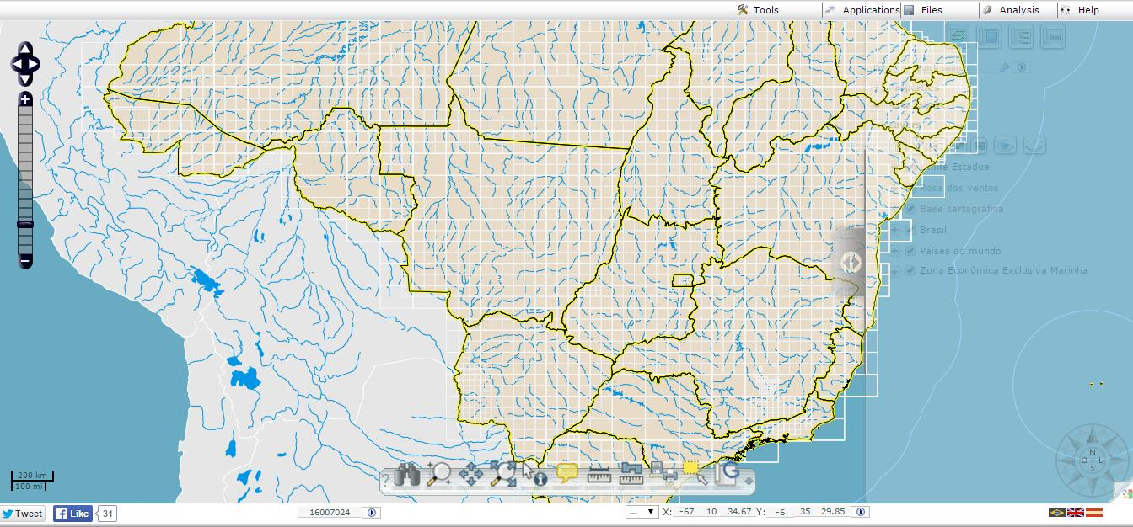
Example: INDE
http://www.inde.gov.br/geo-servicos/visualizador-de-mapas

Slide 11
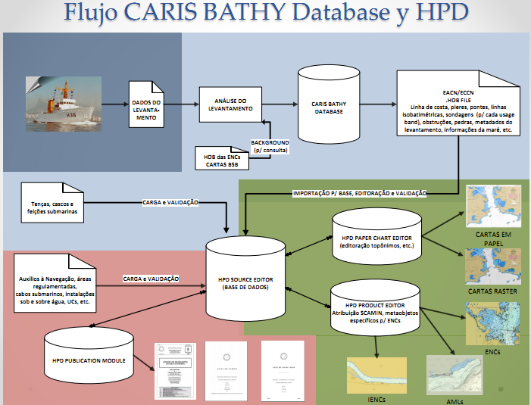
Example: Brazilian Navy MSDI
Notes:
This diagram was presented at the Hydrographic Production Database (HPD) workshop by the representatives of the Brazilian Navy in Lima, Peru last September.
The diagram shows the workflow implemented at the Brazilian Navy for the management all their hydrographic information in a seamless database solution using Oracle as relational database management system and open industry standard data formats and specifications for marine spatial data to ensure interoperability within the organization and with other stakeholders.
The use of those databases (HPD and Bathy DataBASE) is shared for 4 departments at the Brazilian Navy Directorate of Hydrography and Navigation (DHN) that are shown with different colors in the diagram:
Dark grey: Survey division.
The survey division is in charge of carrying out the different hydrographic surveys like multibeam, singlebeam and side scan, process the information and provide survey data to the division in charge of the Bathy DataBASE system.
Light grey: Bathy DataBASE Division
This division receives survey data from the survey division and they are tasked with validation of the data and populate the data base with the survey data along with metadata. The are also in charge to produce the bathymetric products in S-57 format containing depth contours, soundings, obstructions, underwater rocks, etc.
Green: Cartographic Division (chart production with HPD).
The cartography department integrated the information from the BDB database in the HPD database and from the same source database they produce the paper nautical charts, raster chars, S-57 Electronic Navigational Charts (ENCs), Inland Electronic Navigational Charts (IENCs) and Additional Military Layers (AML).
Pink: Notices to Mariners division
The NtMs division also uses the source information from the HPD database to produce notices to mariners and list of lights.
The Brazilian Navy also provides part of the spatial information in the HPD and BDB databases to the National SDI and other national mapping agencies using OGC standards.

Slide 12
Tier 1 – Standards List
Visualisation & Portrayal
  OGC/ISO 19128 Web Map Service (WMS)
  OGC Web Map Tile Service (WMTS) 1.0
  OGC Styled Layer Descriptor 1.1 (SLD)
  OGC Web Map Context 1.1 (WMC)
  OGC KML 2.2
Catalogue & Discovery
  ISO 19115, Geographic information – Metadata
  OGC Catalogue Services Specification 2.0.2 (CSW)
  ISO Metadata Application Profile
  OGC (ISO19115 Metadata) Extension Package of CS-W ebRIM4 Profile 1.0
Notes:
So, turning to each tier,
The principal objective in Tier 1 is to enable an organization or an institution, its stakeholders and its users to view and query interactive maps on the web. Closely associated with this requirement is the ability to discover and share geospatial information.
Here is a list of the recommended standards that should be considered to meet this objective.
The most basic function in an SDI is to easily and effectively access and display geospatial information that may be stored in one or more databases and may rely on different vendor solutions and storage formats. In our list, the Web Map Service standard and KML are the most widely implemented. Using just WMS, an organization can generate web based applications that provide access to spatial information holdings, regardless of the formats used or GIS technology deployed. Many organizations have implemented WMS as a first step towards providing seamless access to geospatial information. It provides quick, short term success and a return on investment. As an SDI matures, most organizations will then enhance their SDI capability with a discovery and metadata browsing capability.
The other standards shown here support more powerful access, browse, search and display capabilities.
Of course, robust data management practices are an important foundation, even for tier 1 objectives. For this reason, you should review the ISO foundational standards listed at the end of the document that are specifically intended to support effective data management practices.

Slide 13
Tier 2: Geospatial Information Sharing Partnerships
A “community” builds, shares, and uses datasets that provide a common view of important issues (e.g. navigation, flood control, road maintenance, disaster management)
Data providers do not need to adopt the same technology solutions provided that they conform to agreed upon data models.
View, distribute, and share geospatial information

Slide 14
Typical scenarios Tier 2
Accessible over the web for use online or for download and offline use;
Improve efficiency of an information community with identified common information needs (e.g. organizations in neighboring jurisdictions that wish to share consistent thematic data such as nautical charting, roads or forest cover and data models to support easy geospatial information exchange between cooperating organizations and jurisdictions
Users from different organizations are able to query, exchange and interact with similar geospatial datasets in a consistent way (e.g. road networks) forming an aggregated view;
Provide information (by way of metadata) about the context in which geospatial data has been collected and used. This provenance and data quality information is critical in allowing users to determine fitness for use of geospatial information within a given application
More formal geospatial policies and practices have been adopted, agreed upon data models have been established, and information sharing agreements have been established between cooperating organizations.

Slide 15
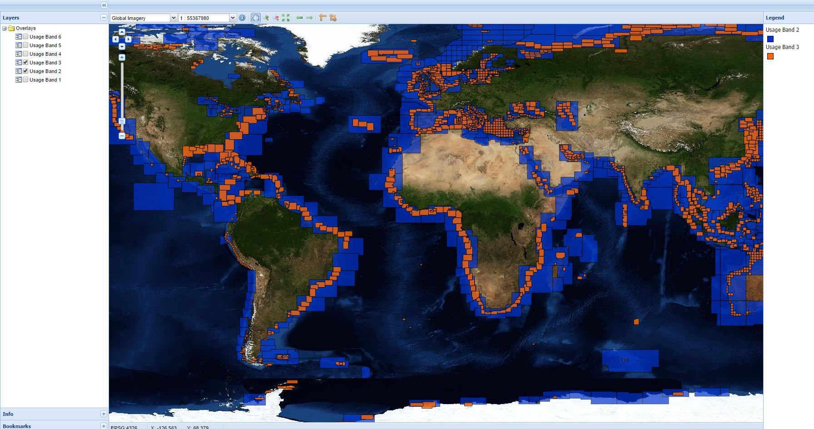
Example: IHO Worldwide Electronic Navigational Chart Database
http://www.iho-wms.net/encat/

Slide 16
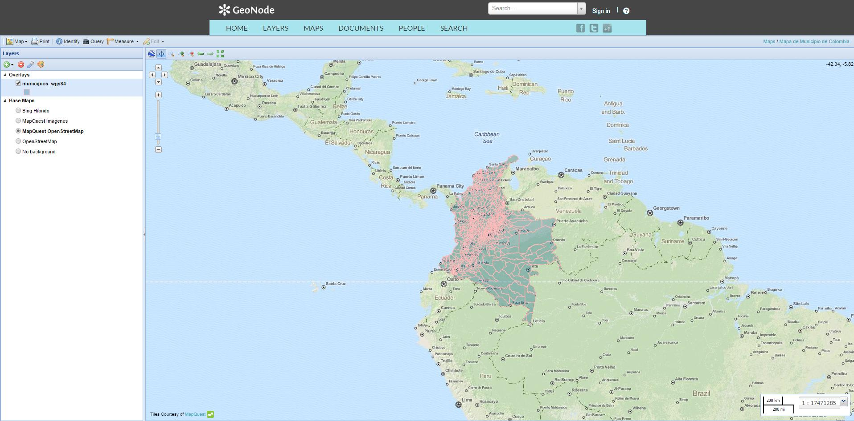
Example: GeoNode
geonode.org

Slide 17
Tier 2 – Standards List
Distributed Maintenance & Use (Technology)
  OGC/ISO 19136 Geography Markup Language (GML)
  OGC/ISO 19142 Web Feature Service 2.0
  OGC/ISO 19143 Filter Encoding 2.0
  OGC Web Coverage Service (WCS) 2.0
Domain Model standards (Content)
  OGC CityGML
  ISO 19144, Geographic information -- Classification systems
  ISO 19152, Geographic information -- Land Administration Domain Model (LADM)
  GeoSciML – Geological structure and bore holes
  OGC WaterML 2.0 - Sharing in-situ sensor water observations
  S-57/S-100 - IHO Transfer Standard for Digital Hydrographic Data
Notes:
The objectives of tier 2 are all about being able to share, integrate and use geospatial data from different providers.
Tier 2 builds on the infrastructure, policies, technologies, and standards implemented in Tier 1.
At this tier level, the SDI infrastructure has matured to the point that the services are well used and stable but the community is requesting more and more functionality. More partners wish to participate in your SDI infrastructure. As such, increased capability as well as additional reliance on standards is now required. As more partners (both public and private) wish to join the SDI community, the infrastructure must evolve to accommodate a wider range of international technology standards and information modelling standards.
There are two key types of geospatial standards that apply here: technology standards and information (or content) standards.
The concept of information or content model standards is introduced in Section 2 of the Guide. The need for such models is to enable multiple stakeholders across many jurisdictions to describe data in the same way for a specific domain, examples are weather, geology, or land use. Having agreed models significantly enhances interoperability and the ability to share geospatial information at any time and as required.
An important aspect of the Tier 2 data modelling standards is their reliance on a number of abstract standards or models that describe geographic information elements in terms of geometry (such as points and lines), coordinate reference systems, data quality, time, and so on. These standards are included in the list of foundational standards that we’ve included at the end of the our document.
Domain data modelling assumes a particular importance in tier 2 (and in tier 3) by enabling the reuse of concepts, semantics and data schemas between related systems. Domain modelling involves the practice of creating definitions of concepts which can then be reused between multiple systems. This enables greater interoperability of models and provides for platform independence.
The objective of tier 3 is to enable multiple organizations to share foundation or framework geospatial information and services with each other and the broader community thereby improving knowledge and understanding, and contributing to evidence-based decision making, situational awareness, and improved outcomes.

Slide 18
Tier 3:Spatially Enabling the Nation/Region
Multiple organizations share foundational geospatial information and services
Contributes to evidence-based decision making, situational awareness, and improved societal outcomes
Multiplies the value of their geospatial information
Groups share across and between application domains

Slide 19
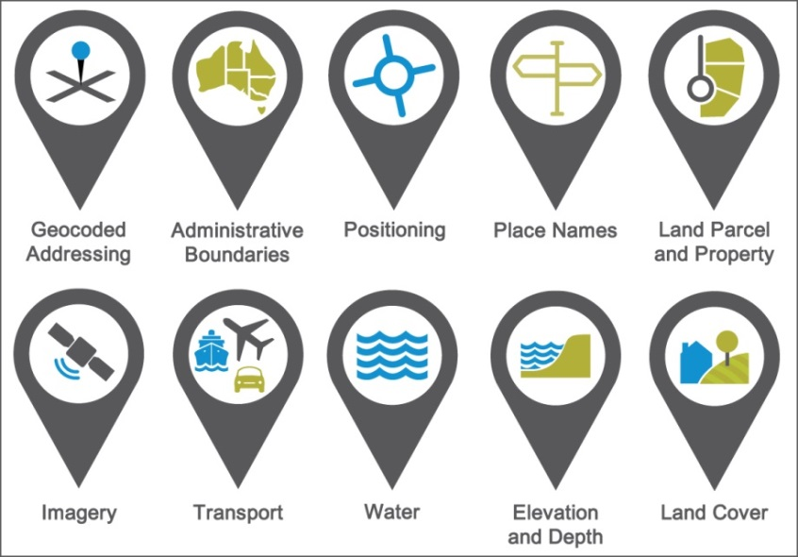
Foundational Data
“Foundation” or “framework” spatial data enable geospatial data from different providers to be easily integrated across multiple applications domains,
Known accuracy and currency
Example: Foundation geospatial information layers (Source, ANZLIC)

Slide 20
Typical scenarios for Tier 3
A nation begins the implementation of a National SDI to deliver foundational or framework geospatial data for the nation.
May be an effort that starts from scratch or builds on domain specific activities characterized in Tier 2;
Geoprocessing over the web;
Delivery to multiple platforms including desktop and mobile;
Real time data from a variety of sensors is incorporated;
Account for data sovereignty.
A robust framework of policies has been established for organizations operating from the local to national level.
Well defined geospatial data themes, content models, policies and service level agreements between organizations and governments for operations and cooperative maintenance of data themes are in place.

Slide 21
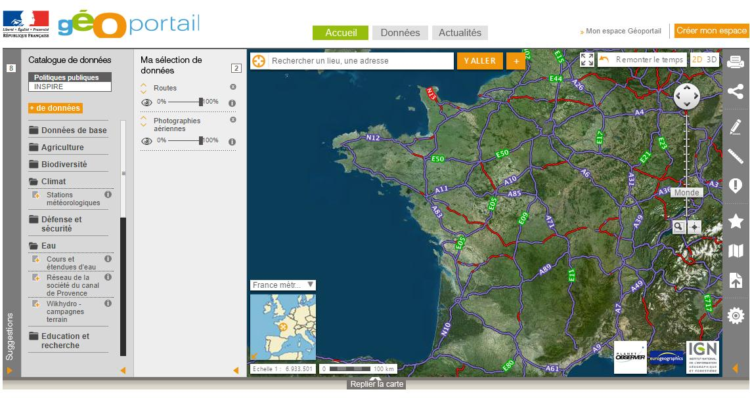
Example: France Geoportal
http://www.geoportail.gouv.fr/accueil

Slide 22
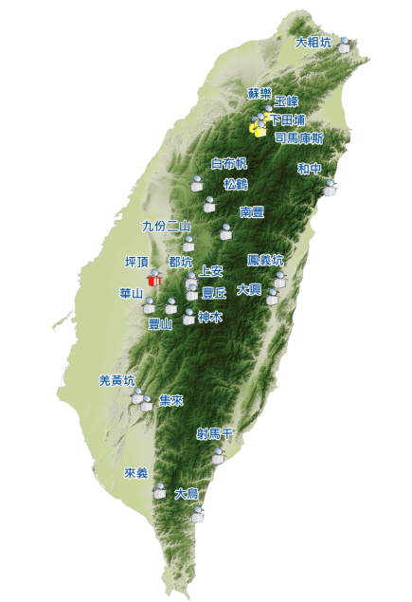



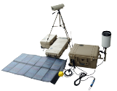








Example: Debris Flow Monitoring
Portable Units
R&D
2010
Mobile Stations
http://www.gis.tw/
2003
Establishment
2002
Debris Flow
On-Site ×24
Mobile×3
Portable Units×14
Sediment
Landslide

Slide 23
Tier 3 – Standards List
Geospatial Processing
  OGC Web Processing Service (WPS)
Mobile Devices
  OGC Open GeoSMS
  OGC GeoPackage
Real Time
  OGC/ISO Observations & Measurements Schema (O&M) / ISO 19156
  OGC Observations and Measurements XML (OMXML)
  OGC Sensor Model Language (SensorML)
  OGC Sensor Observations Service (SOS)
  OGC Sensor Planning Service (SPS)
Geosemantics
  ISO 19150 Geographic information – Ontology
Notes:
In tier 3, the SDI is mature enough to support the deployment of more and more applications to enhance value, provide increased citizen benefit, increase collaboration between organizations, and much more, including volunteered and real time sensor feeds and the mature deployment of mobile applications.
There are a number of applicable standards recommended in our document.

Slide 24
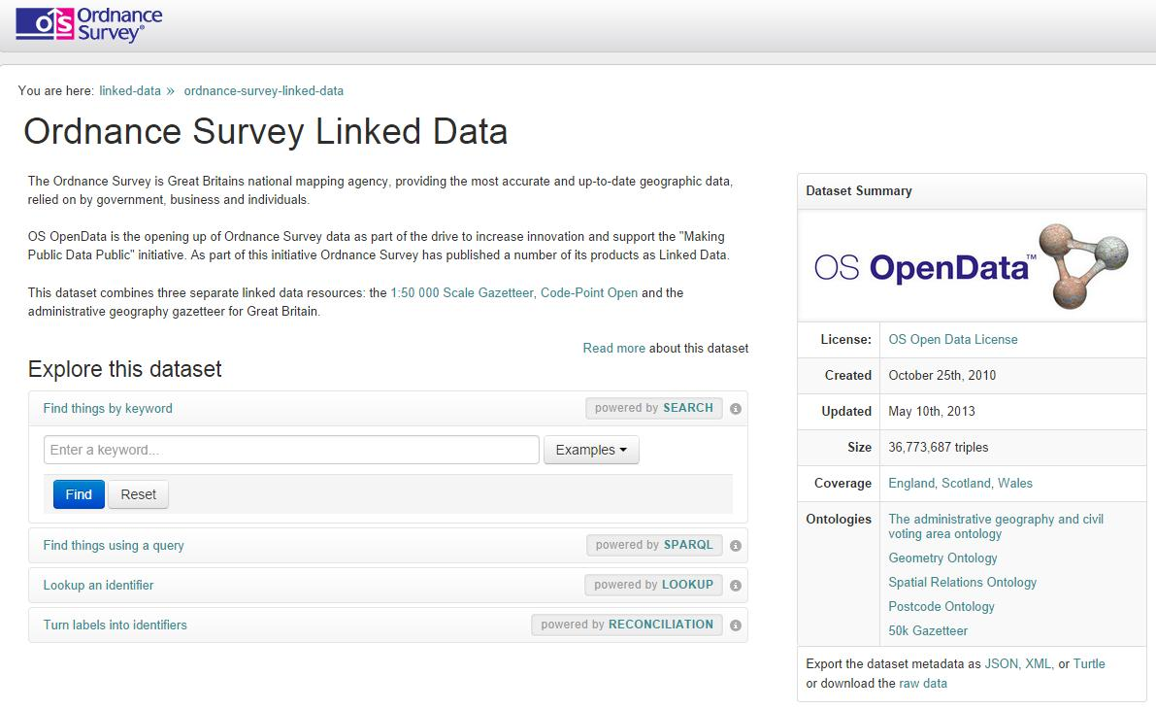
Example: Linked Data
A way to interconnect related data resident on the web, and deliver it in a more effective manner
"Web of data" has recently started being populated with geospatial data.
Ordnance Survey (OS) is the first national mapping agency that has made various kinds of geospatial data from Great Britain available as open linked data.
.
http://data.ordnancesurvey.co.uk/datasets/os-linked-data

Slide 25
To make this work:
Organizations must agree & commit to use standards in their SDI
Make clear statements in policy
Use procurement language that requires vendors to offer standards-based solutions

Slide 26
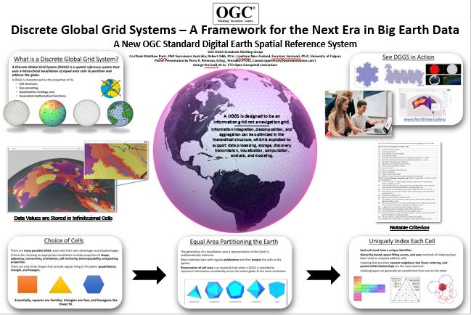
Discrete Global Grid System

Slide 27
Conclusion
Standardization is the reason for the success of the Internet, the World Wide Web, e-commerce, and the emerging wireless revolution
Advances in technology change organizational structures, workflows and business models
The pace of change requires new thinking about national SDI roles and investments, and a commitment to interoperability based on open standards is essential in dealing with this transition
“Interoperability seems to be about the integration of information. What it’s really
about is the coordination of organizational behavior.”
David Schell, Founder, OGC
Notes:
Stakeholder organizations must agree and commit to the use of standards in their SDI infrastructure.
Make clear statements regarding the commitment to using standards and document in policy.
To maximize the value of investments, organizations should use procurement language that requires vendors to offer standards-based solutions.
Standardization is the reason for the success of the Internet, the World Wide Web, e-commerce, and the emerging wireless revolution.
Advances in technology change organizational structures, workflows and business models.
The pace of change requires new thinking about national SDI roles and investments, and a commitment to interoperability based on open standards is essential in dealing with this transition.
The capability/maturity model is intended to be flexible as new innovations reach the market.

Slide 28
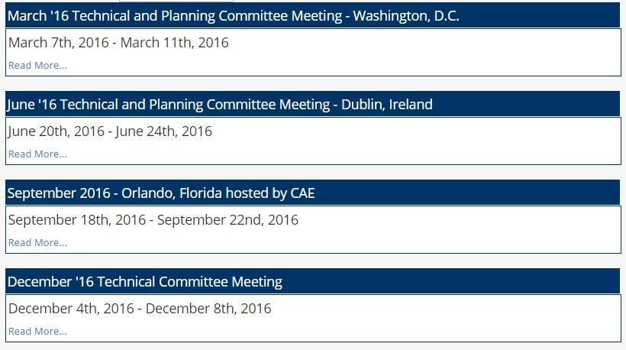
Thank You!
2016 OGC Meetings
World Bank
University College, Dublin
CAE
Taichung, Taiwan, GIS-FCU
Apply to join OGC and contribute to the Local, National and Global collaboration process!

Slide 29
Links
Documents:
Standards Guide
Companion Document
UN-GGIM Collaborators:
International Hydrographic Organisation
International Standards Organisation TC-211
Open Geospatial Consortium

