Slide 1
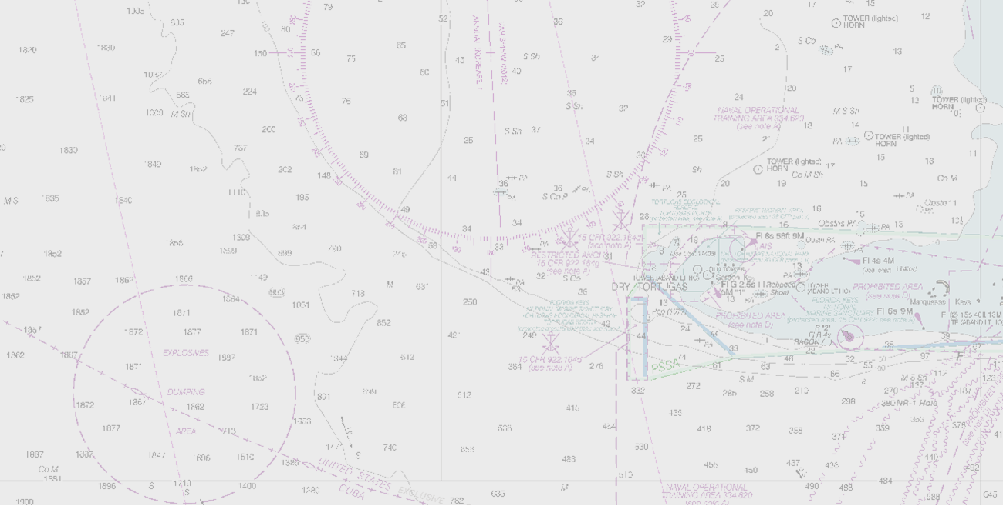
MARINE SPATIAL DATA INFRASTRUCTURES
MSDIWG8 - VANCOUVER, 2017
DIRECTORATE OF HYDROGRAPHY AND NAVIGATION (DHN)
Lt. Julierme G PINHEIRO
julierme.pinheiro@marinha.mil.br

Slide 2
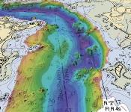
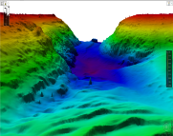
INDEX
DHN DATA POLICY AND GOVERNANCE
DHN MSDI ARCHITECTURE
DHN-MSDI PRESENT STATE
FUTURE PERSPECTIVE

Slide 3
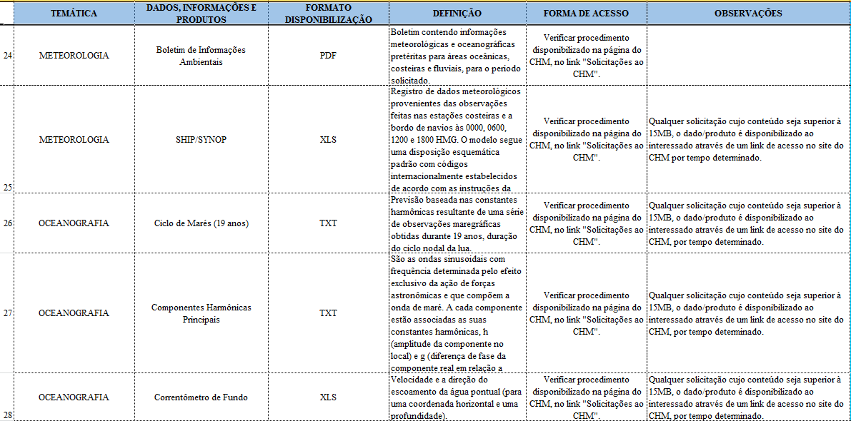
DHN DATA POLICY AND GOVERNANCE
Establishment of Environmental Data Exchange based on:
Federal Laws
Internal Regulations
In Development

Slide 4
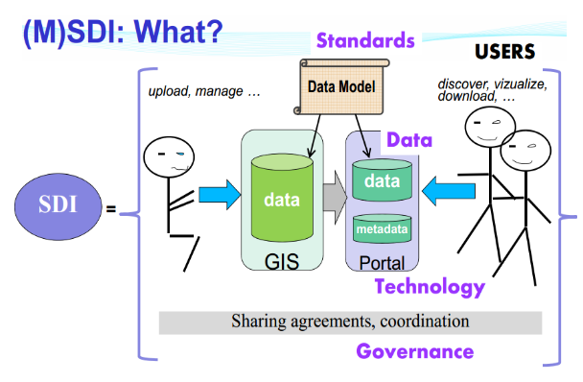
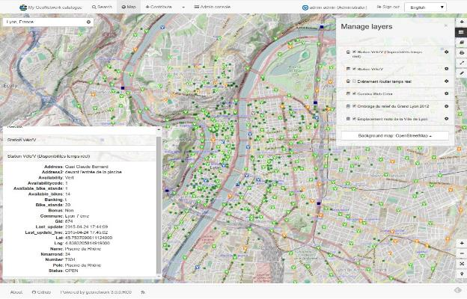
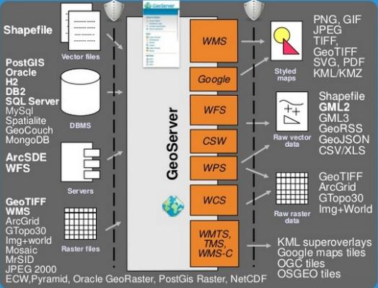
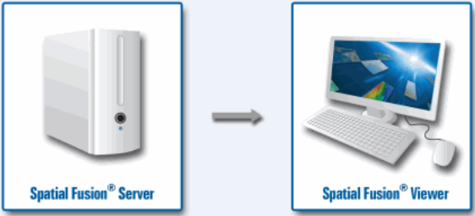
DHN MSDI ARCHITECTURE
Standards and Interoperability Framework:
OGC standards for spatial data and metadata
IHO S-57/S-100 standards
NSDI Vector Model – INDE/EDGV
Armed Forces SDI Vector Model – IDE-DEFESA/EDGV
Adapted from Stephanie Vrac, 2016

Slide 5
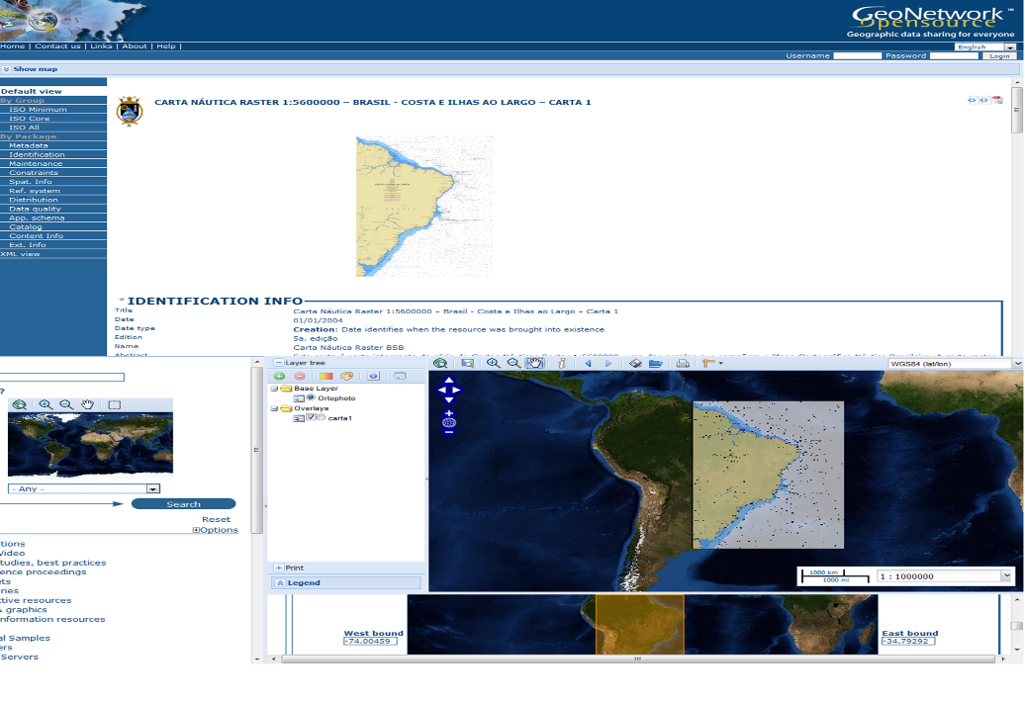
DHN-MSDI PRESENT STATE
Intranet Technologies Implementation
Geonetwork – Metadata Catalog

Slide 6
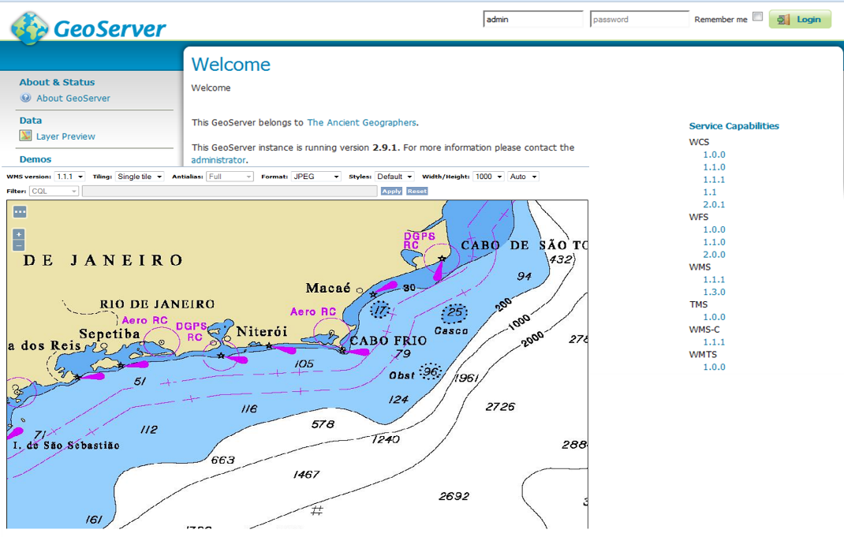
DHN-MSDI PRESENT STATE
Intranet Technologies Implementation
Geoserver – Geoservices Catalog

Slide 7
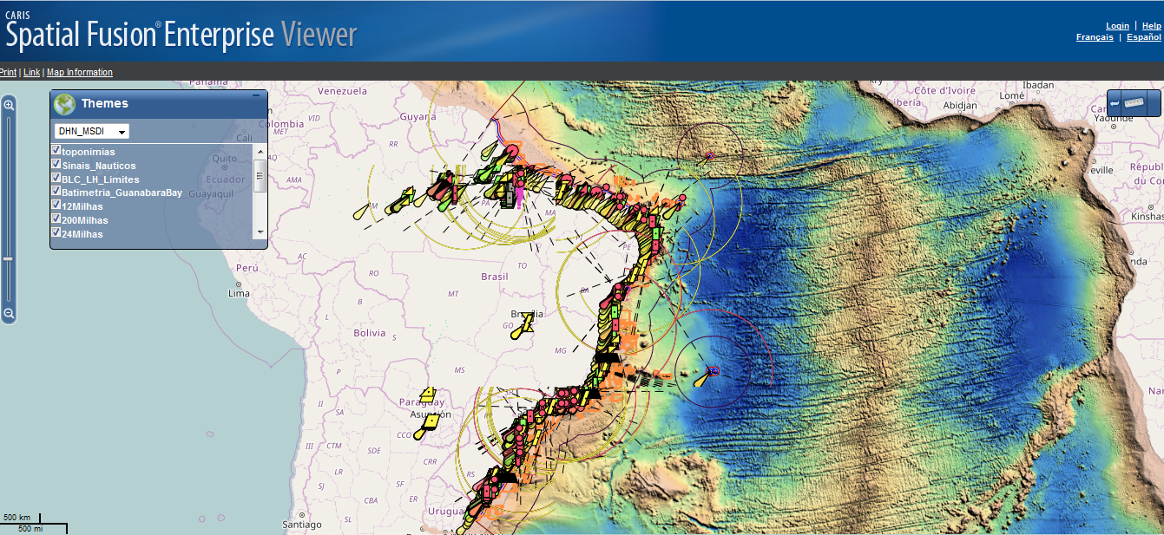
DHN-MSDI PRESENT STATE
Intranet Technology Implementation
Map Viewer – SFV

Slide 8
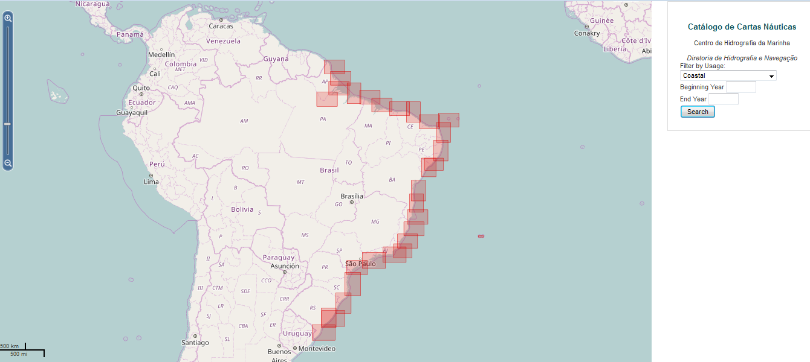
DHN-MSDI PRESENT STATE
Intranet Technologies Implementation
Nautical Charts Catalog

Slide 9
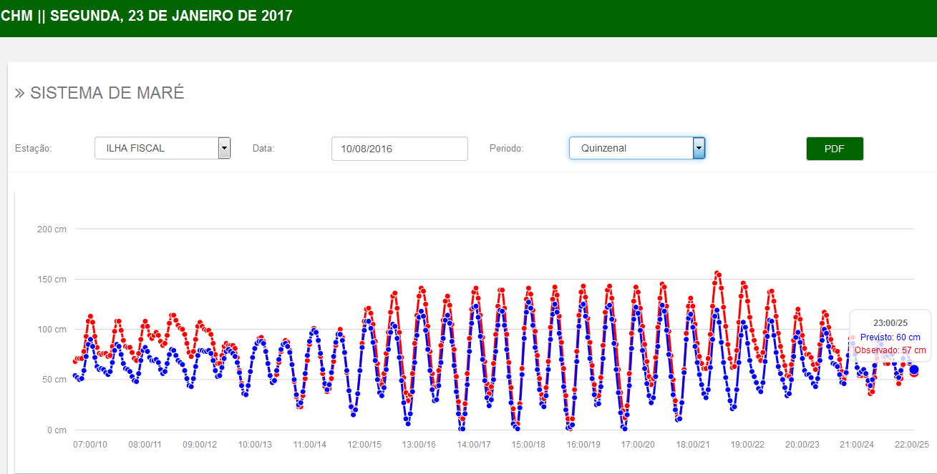
DHN-MSDI PRESENT STATE
Intranet Technologies Implementation
Tide Data Acquision
Tide Data Radio Transmission
Tide Data Exchange Web Framework

Slide 10
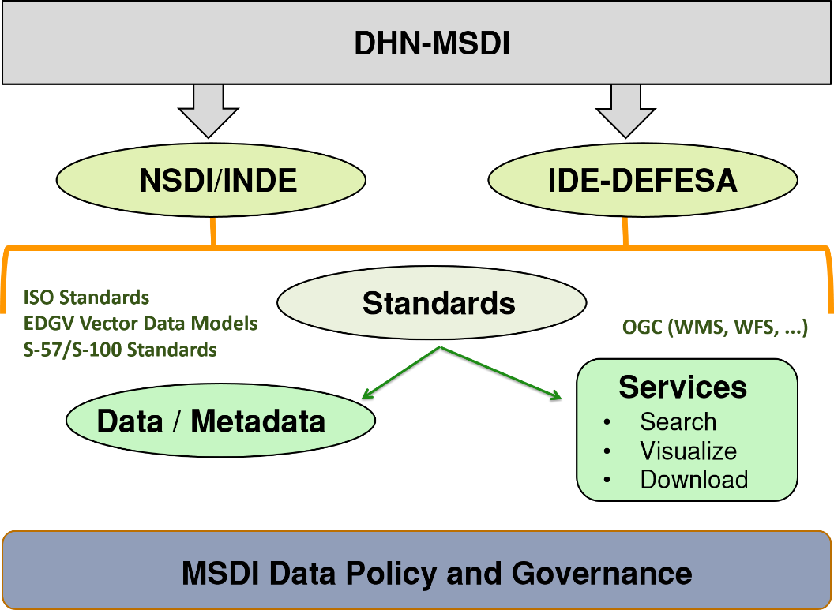
FUTURE PERSPECTIVE

Slide 11
Thank you very much

