Slide 1
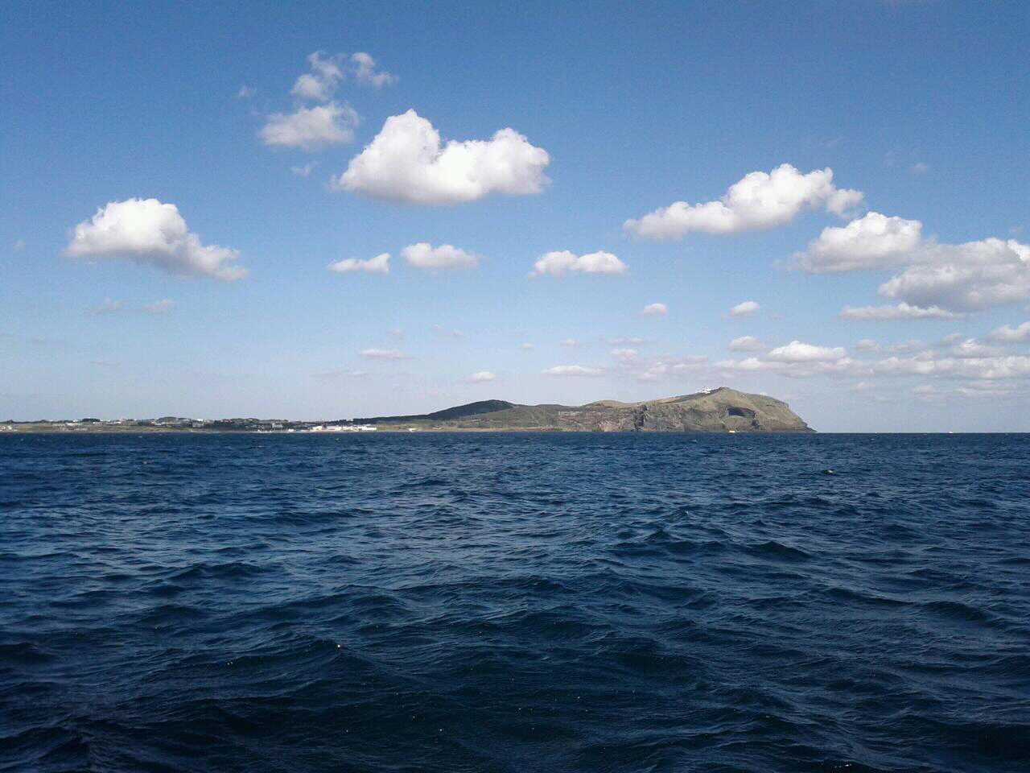


MSDIWG8
National Report – Republic of Korea
Marine Spatial
Information Team
31 Jan 2017

Slide 2
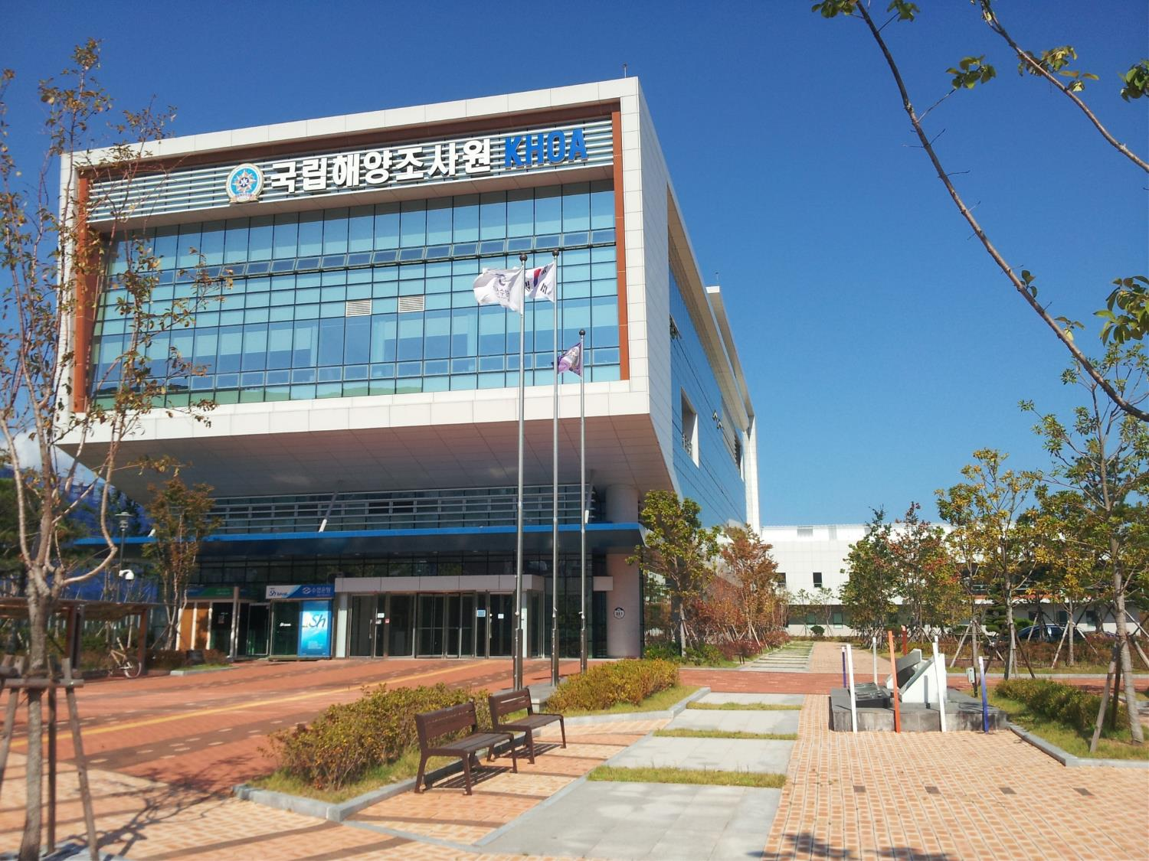

Slide 3

1
Production & Management of MSD
2
Changes occurred from MSDI
Table of Contents
3
Provision of MSD Service
4
Ways Forward

Slide 4
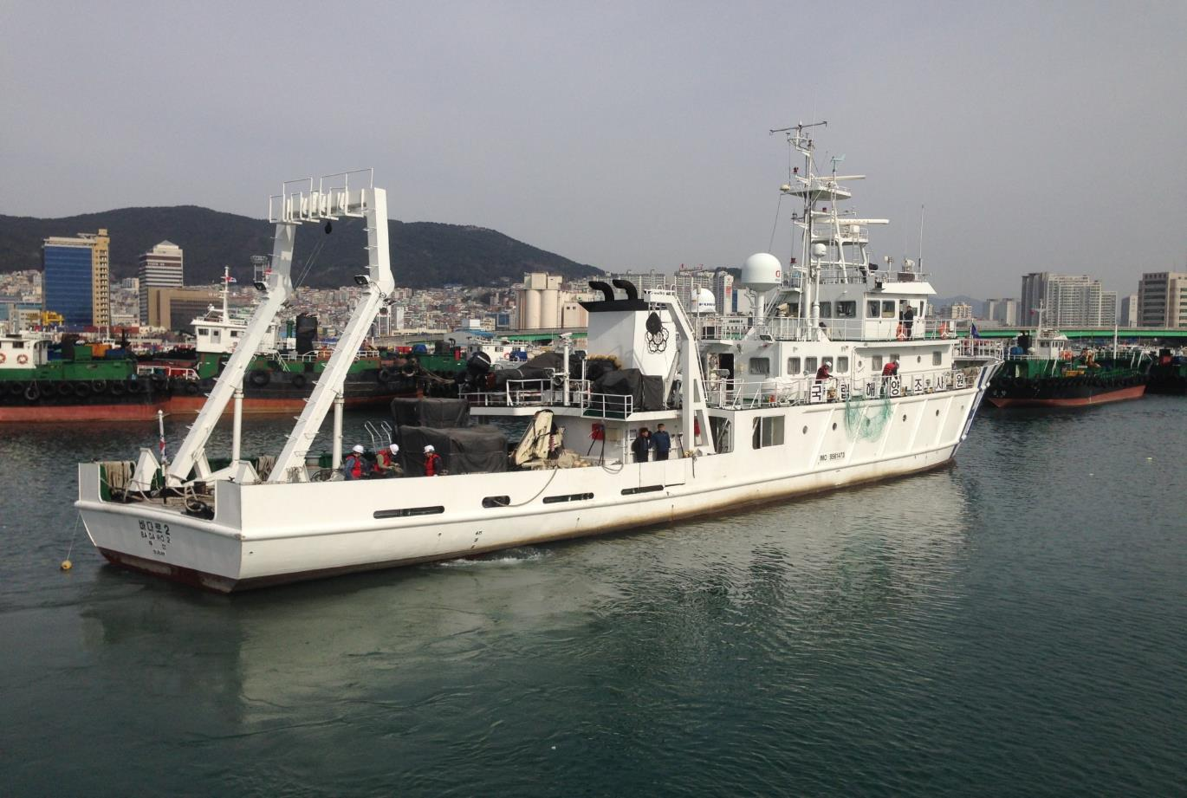
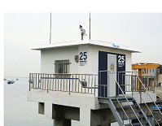
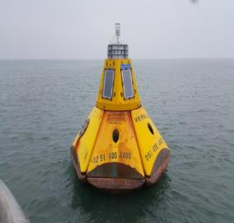
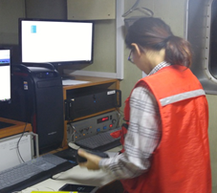
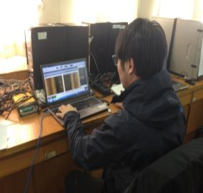
1. Production & Management of MSD
Observation, Survey Data Product

Slide 5
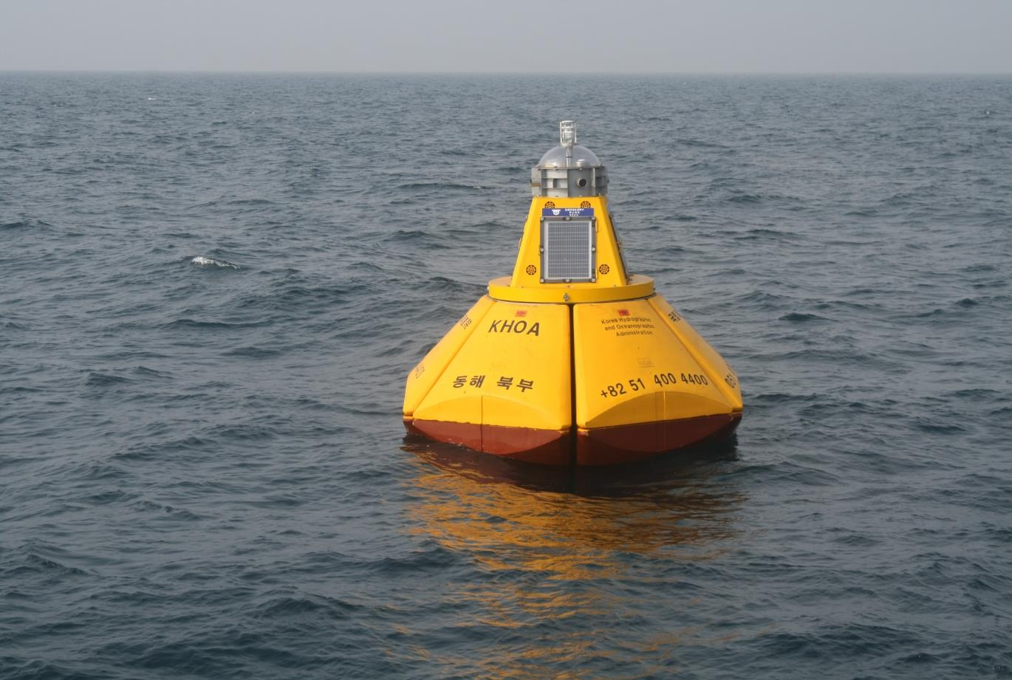
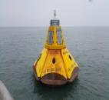

1. Production & Management of MSD
Korea Ocean Observing Networks
125 Points of Observatories, Buoys and Research Stations
Real Time Data: Tide, Current, Wave, Salinity, Water Temperature, Atmosphere, Wind… etc.
Basic & Coastal Survey
Total 343,000 ㎢ (1,157,000 ㎞ ) of Survey Data
Soundings, Coastlines, Magnetic… etc.

Slide 6
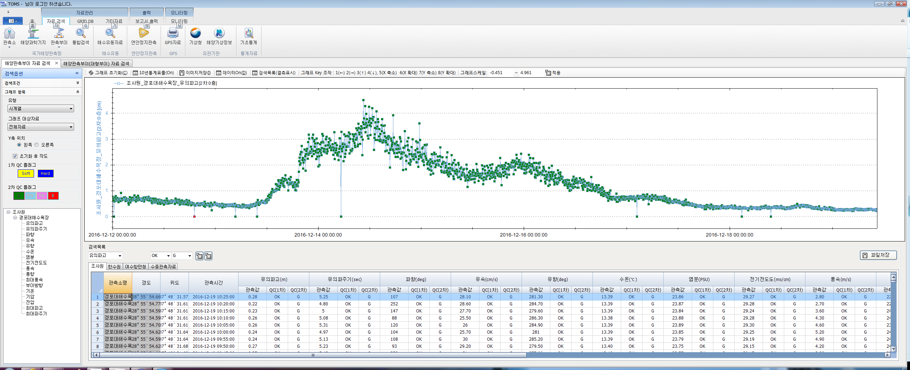

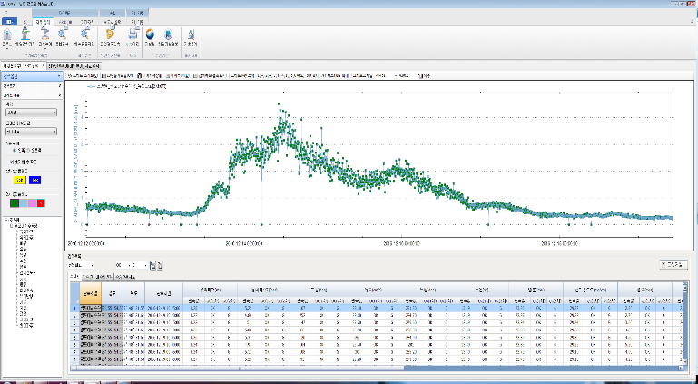
1. Production & Management of MSD
1. TOMS & TOPS
Ocean Data Management Systems
TOMS: Total Ocean data Management System
TOPS: Total Ocean data Processing System
Ocean DB

Slide 7
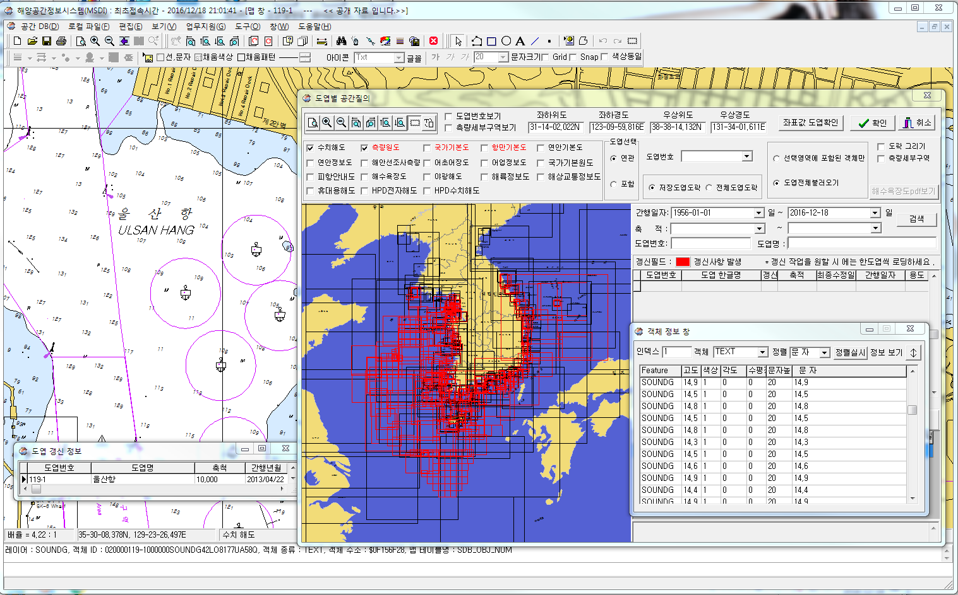

1. Production & Management of MSD
2. TOIS
Hydrographic Data Management System
TOIS: Total Ocean Information System
TOIS DB

Slide 8












2. Changes occurred with MSDI
  Value of Data
  Change of Data
  Fusion
  Industry
  Market
Big
Data
  Share
  Policy
  (Marine Spatial Planning)
Digital
Data
  Internet Service
  Public
Chart
Data
  Mariners
  Change of Use

Slide 9

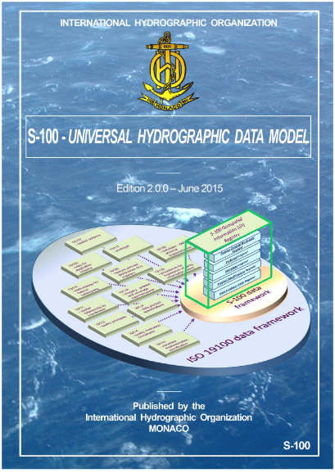
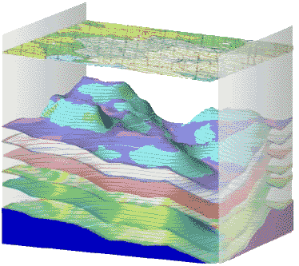
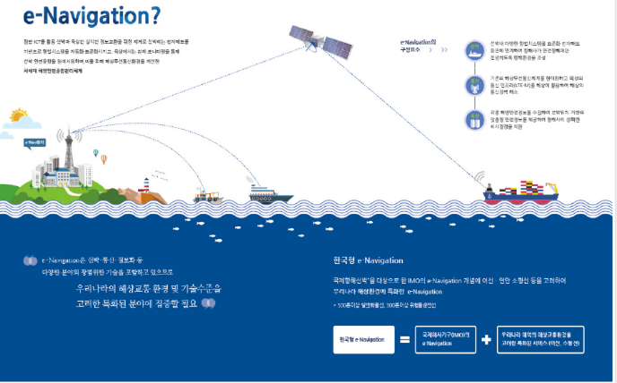

2. Changes occurred with MSDI

Slide 10

3. Provision of MSD Service
MSDI
DB
Service
Distribution
Government
Industry
Public
More Easier and Convenient Access to
and Use of Marine Data
MSP
Market Creation
Product
Service
Benefits
Better Decisions
Economic Growth
Wider Using

Slide 11











3. Provision of MSD Service
MSDI Center
1
2
MSP
Database Platform
Service Platform
Connect additional data
  Sharing Oceans
  Intranet service
Fisheries
Maritime
Safety
Info on oceans and fisheries statutory area
  Opening up Oceans
Big Data
Fairway, fishing ground, area, bridge, buoy
  Internet service
Oceans and fisheries stats
Fisheries, maritime, port
Designated as the MSP platform for the
Ministry of Oceans and Fisheries
e-Navigation
Ocean observation & prediction info
3
Market Platform
Water temp, tidal current, tide
Basic Marine Spatial Data
Portal
Education
Satnav
Bathymetry, depth, coastline
Design
Tourism &
Leisure
Virtual Experience
Industrialization

Slide 12
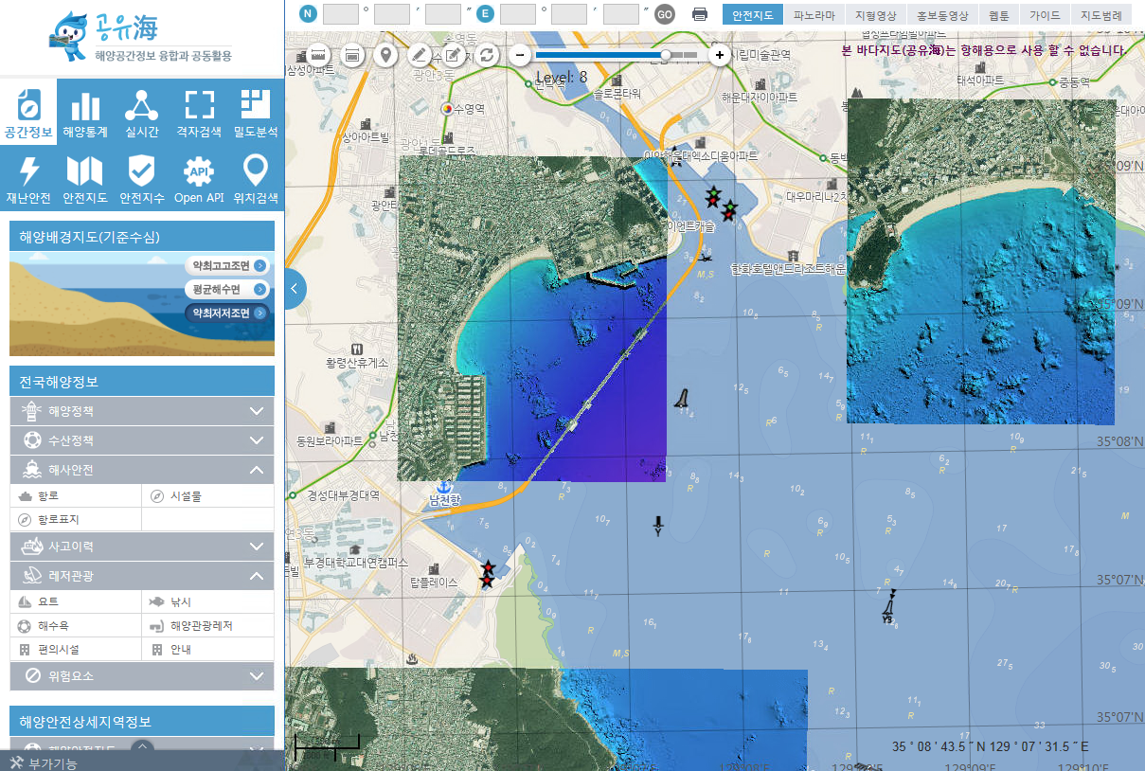
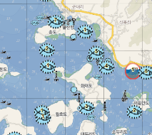
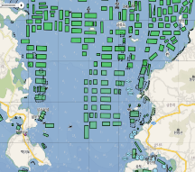
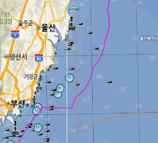
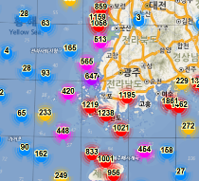
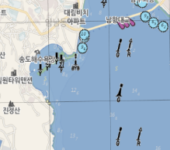
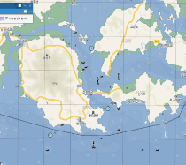
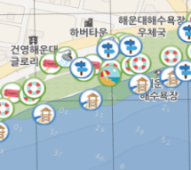
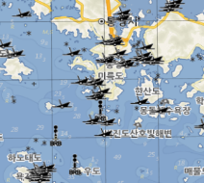
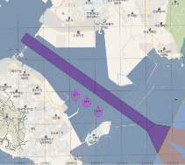
3. Provision of MSD Service
Marine Spatial Data Service
Fish Haven
Marine Farm
Jurisdictional Sea Area
Marine Environment
Protection Area
Accident History
Aids to Navigation
Marine Leisure Facilities
Wreck
Fairway & Port

Slide 13
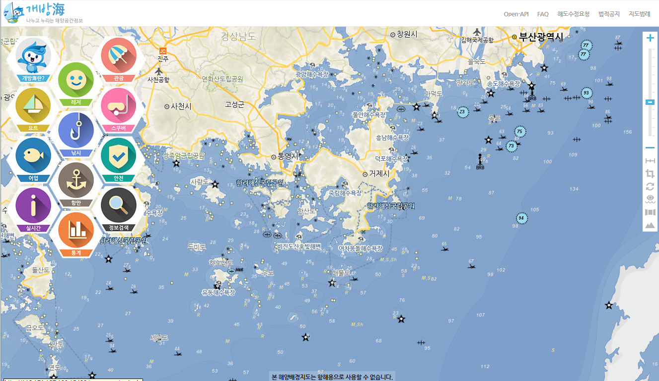
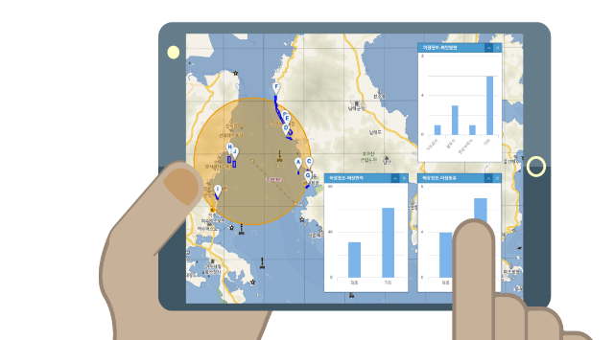
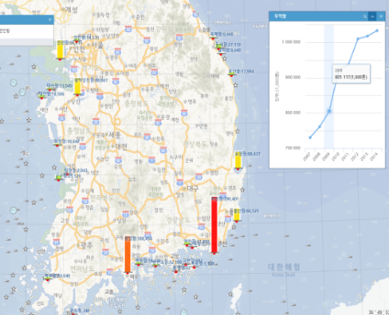
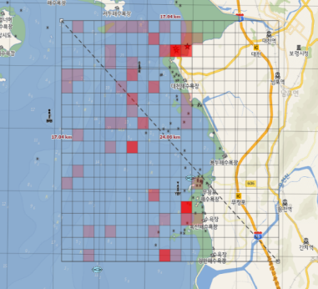
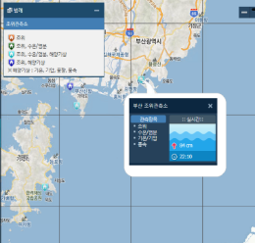
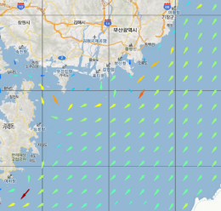
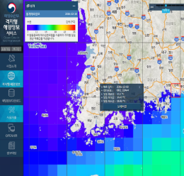
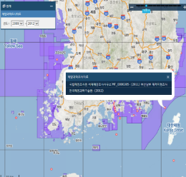
3. Provision of MSD Service
침수, 재난정보
Stats by grid
National Oceanic stats
Density analysis
Tide
Data
Current
Data
Forecast Data
Science Data

Slide 14
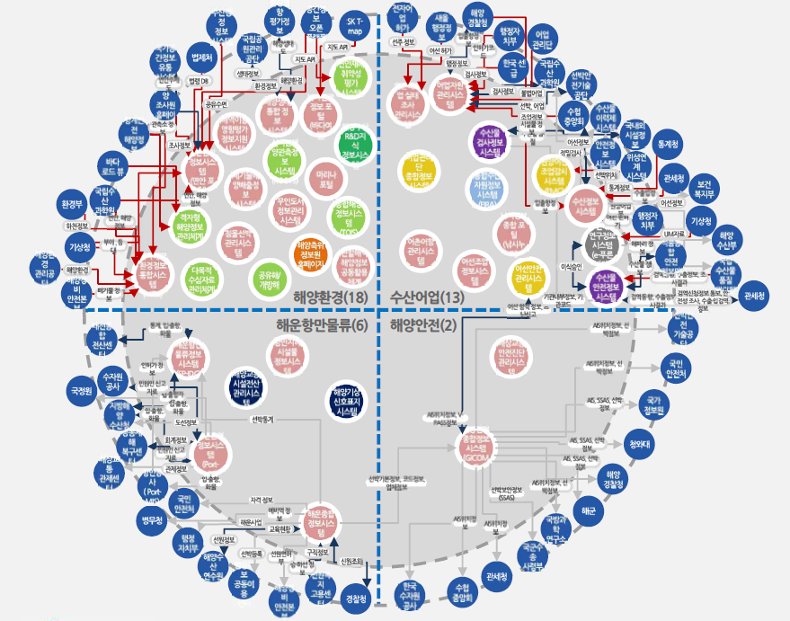
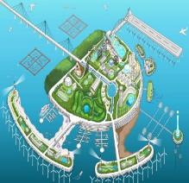

3. Provision of MSD Service
MSP Organizations in Korea
Ministry of Oceans and Fisheries
MSP (Governance, Planning, Integration)
Korea Hydrographic and Oceanographic Agency
MSDI (Oceans & Fisheries Database Framework)
Integration of Marine Spatial Data

Slide 15
3. Provision of MSD Service
Environment
Fisheries
Safety
Port Logistics

Slide 16
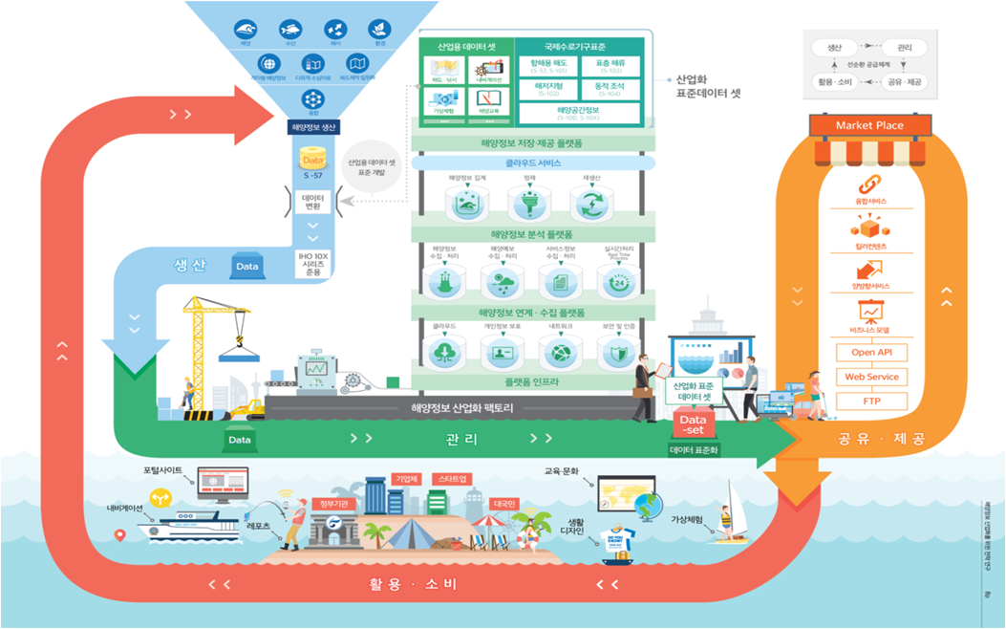


3. Provision of MSD Service
Growing Marine Data Industry
Expand use of marine spatial data:
Chart production → Ocean data industries
KHOA is making a law and data system
for MSDI and marine data industrialization

Slide 17
3. Provision of MSD Service
Market Place
Factory

Slide 18
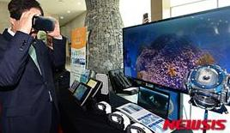
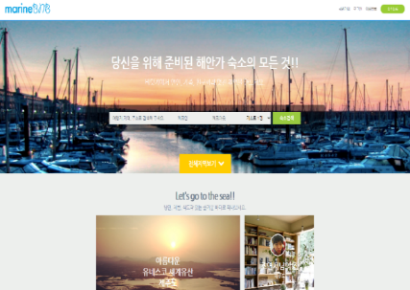
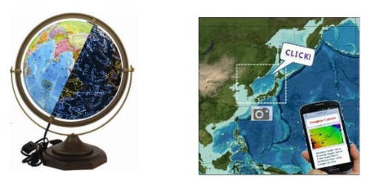
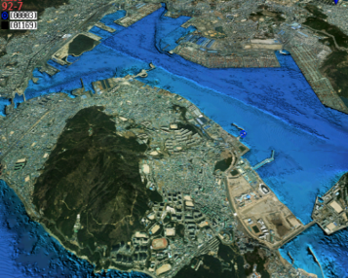
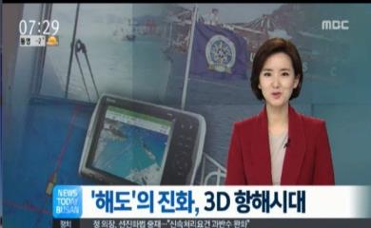
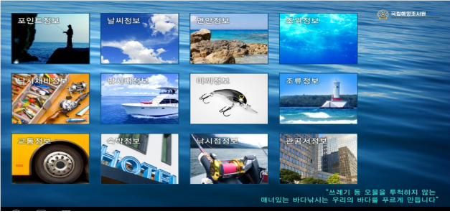
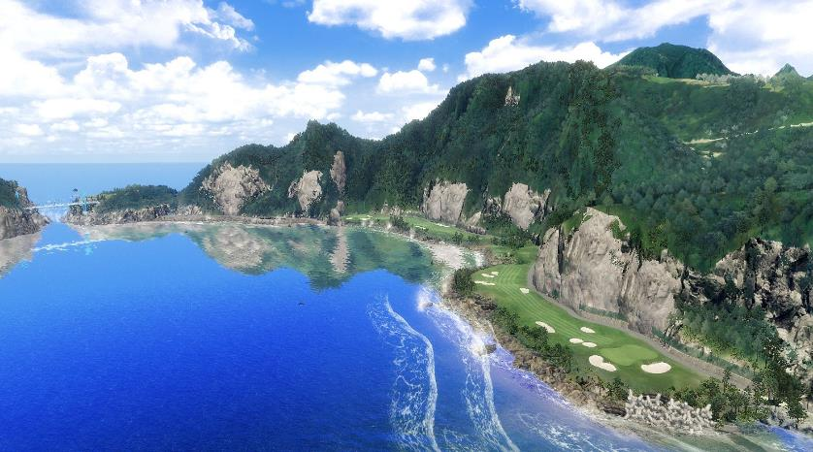
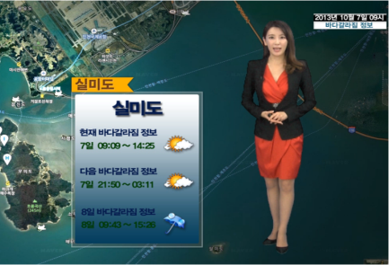
3. Provision of MSD Service

Slide 19
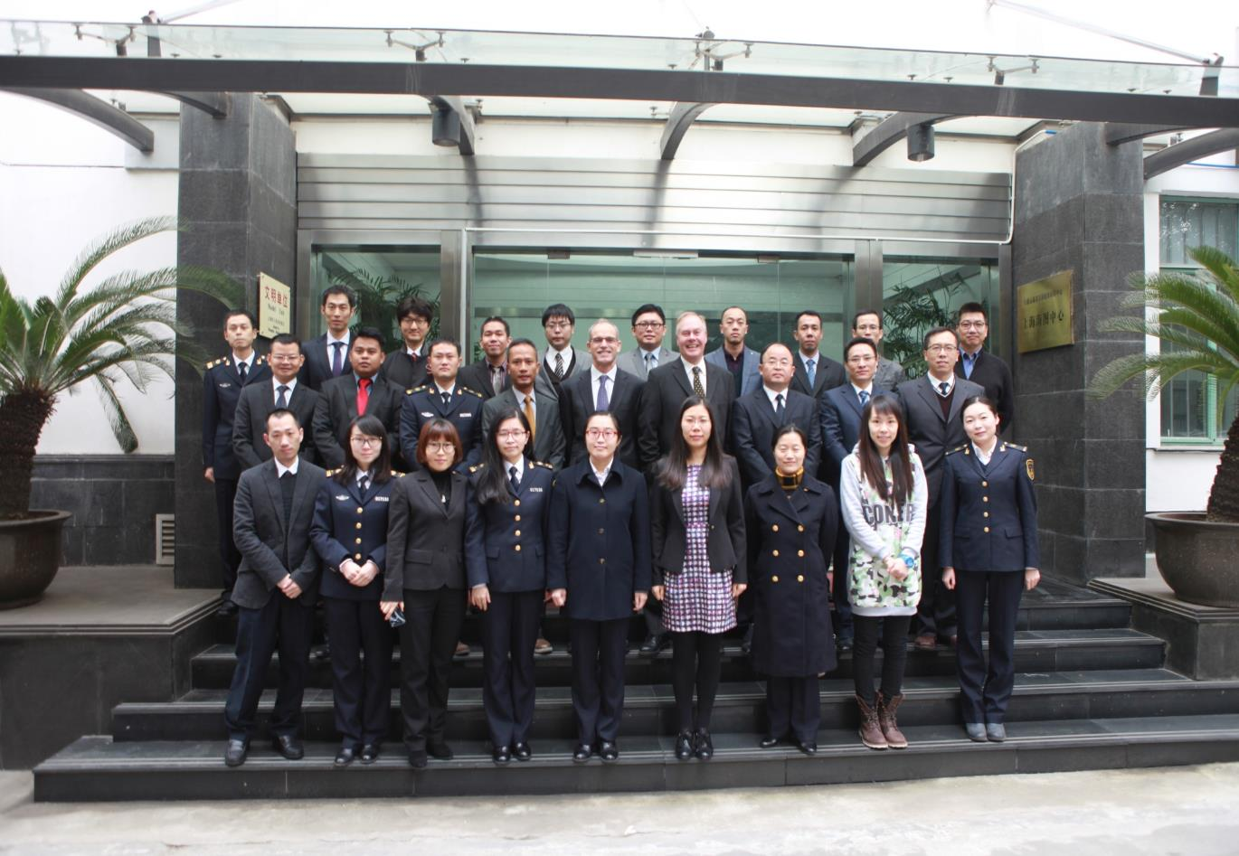
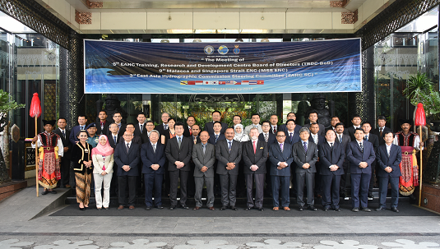
4. Ways Forward
3rd EAHC Steering Committee Mtg.
East Asia Hydrographic Commission MSDIWG
Harmonization of regional data, some of which is already shown on nautical charts
The same information could be used to form the basic database to kick start the MSDIWG
which will benefit other users.
Decision No. 3: ROK will lead the EAHC MSDIWG.

Slide 20
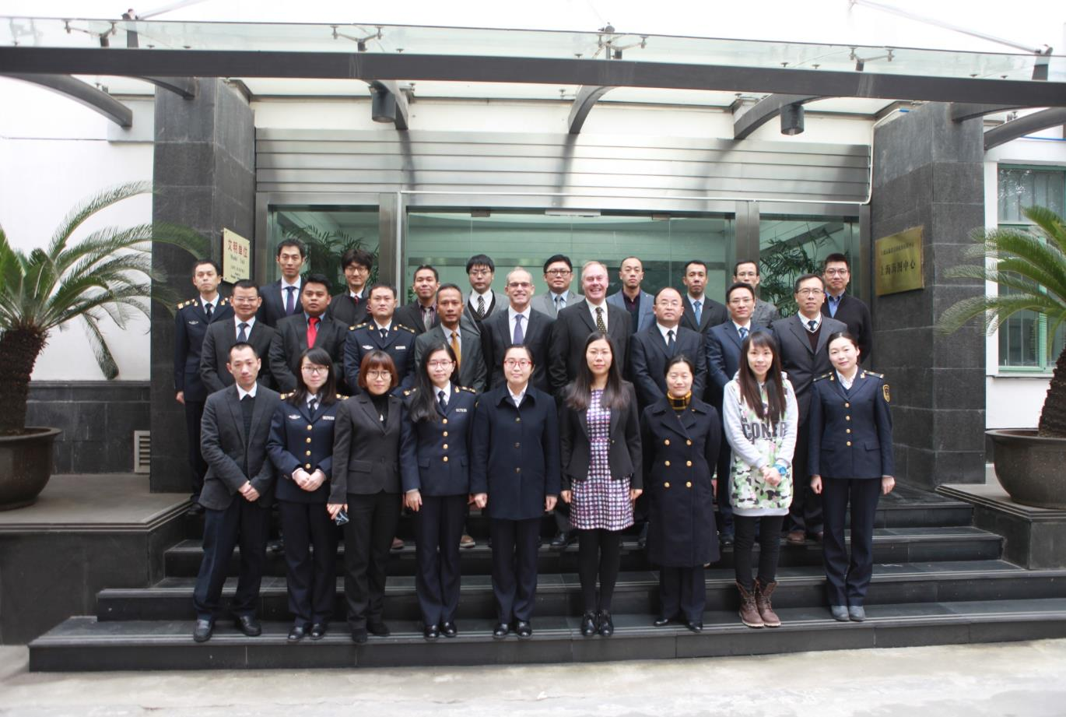
4. Ways Forward
WG Membership: 7 Member States
(Korea, Japan, Philippines, Indonesia, Thailand, China, Brunei)
Draft Terms of Reference of EAHC MSDIWG
Support MSDI activities of EAHC Member States
Monitor and share work on national MSDI
Promote the use of IHO standards
Monitor regional MSDI Center activities
Identify any EAHC capacity building requirements on MSDI
Use meetings or workshops if required.
Submit a report to the EAHC Steering Committee

Slide 21
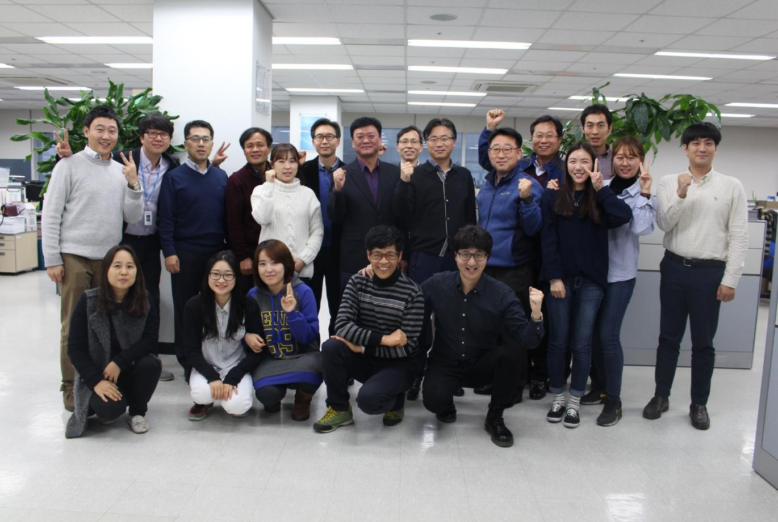




Q&A
Marine Spatial Information Team
(in Nautical Chart Division, KHOA)
Mr. Kim
Mr. Lee
Tony
oceanjh@korea.kr
Mr. Shin

