Slide 1
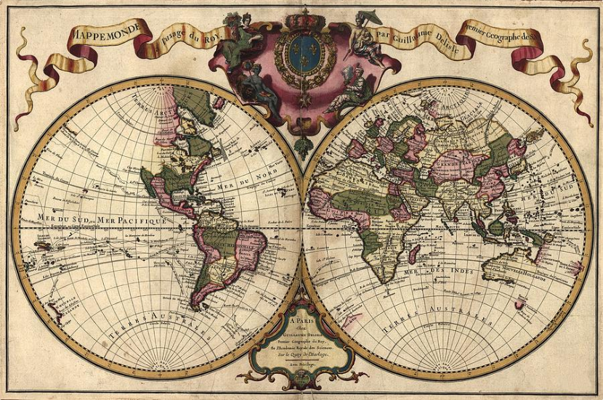
Future of the Paper Chart
Updated 26 Oct 2018
IHO Nautical Cartography Working Group
The Hague ~ 6-9 November 2018

Slide 2
“Future of the Paper Chart” Schedule
Assign Authors
Authors Submit Text
Edit First Draft
Quick NCWG Review
Final Edit
Submit to HSSC
6 Nov 2018
31 Dec 2018
1 - 31 Jan 2019
1 - 22 Feb 2019
23 Feb - 17 Mar 2019
18 Mar 2019
Approve Survey Questions
FOPC Team
members
C. Harmon
& M. Hovi
All NCWG members
C. Harmon
& M. Hovi
Present at HSSC-11
6-9 Nov 2018
Create Survey Form
FOPC Team
members
6-9 May 2019
31 Dec 2018
Mikko Hovi
Survey Team
When and how should the survey be conducted?

Slide 3
Background – Current Status
Author | Status | § | Section Title | Survey
Harmon | Assigned |  | Executive Summary
Harmon | Draft Completed | 1 | Introduction
Harmon | Draft Completed | 1.1 | Purpose
Harmon | Draft Completed | 1.2 | Background
Harmon | Draft Completed | 1.3 | Scope
 | In Work | 1.4 | Related Documents
 |  | 2 | Current Environment
Harmon | Draft Completed | 2.1 | Traditional Role of Paper Charts
 |  | 2.2 | International and National Regulations
Harmon | Draft Completed | a. | IMO ECDIS Mandate and use of Paper Charts on SOLAS Vessels
 |  | b. | Paper chart carriage requirements for other regulated vessels | YES
Rodwell | Draft Completed | c. | United Nations Convention on the Law of the Sea (UNCLOS)

Slide 4
Current and Changing User Requirements – Chart Production Issues
Author | Status | § | Section Title | Survey
 |  | 2.3 | User Requirements
Alvaro | Draft Completed | a. | “Fit for Purpose” paper charts for use as a back-up | YES
 |  | b. | Small Scale Planning Charts
 |  | c. | Remarks and recommendations from other stakeholders | YES
 |  | d. | Impacts on non-navigational users of paper nautical charts
 |  | 2.4 | Production Issues
 |  | a. | Systems/databases used for both raster and vector chart production
 |  | b. | Portrayal of raster products with S-57 attributed data
Milli | Draft Completed | c. | Print on Demand | YES

Slide 5
Current and Future Chart Production and Usage
Author | Status | § | Section Title | Survey
 |  | 2.5 | Paper Chart Sales and Product Usage
 |  | a. | Declining demand for paper charts | YES
Palma | Draft Completed | b. | Increasing demand for ENCs | YES
 |  | c. | Diminishing need for RNCs for ECDIS
 |  | d. | Recreational Boaters’ Contribution to Paper Chart Sales | YES
 |  | e. | Recreational Boaters’ use of Digital Charts
 |  | 3 | Future Environment
 |  | 3.1 | Product Coverage
 |  | a. | International (INT) Charts | YES
 |  | b. | Rescheming paper chart coverage. | YES
Harmon | Assigned | c. | ENC-only coverage | YES
Harmon | Assigned | d. | RNC-only coverage | YES

Slide 6
Alternatives to Traditional Paper Charts
Author | Status | § | Section Title | Survey
 |  | 3.2 | Alternative Methods of Paper Chart Provision
Sheatsley | Draft Completed | a. | Printing paper charts from ENCs
Sheatsley Harmon | Draft Completed | b. | Product on Demand / Chart of Demand
Sheatsley | Draft Completed | c. | Enhancing the portrayal of S-57 ENCs
 |  | 3.3 | e-Navigation
 |  | 4 | Changes a Future without Paper Charts Would Require | YES
 |  | 4.1 | Regulatory and Standards Changes
Rodwell | Draft Completed | a. | IMO and other International Regulations
Rodwell | Draft Completed | b. | National Regulations << Combined with 4.a., § c-g re-lettered b-f >> | YES
Rodwell | Draft Completed | b. | Chart Producing Agency Production Process
Rodwell | Draft Completed | c. | Chart Sales Revenue
 |  | d. | User Requirements
 |  | e. | IHO Standards and Specifications
 |  | f. | IHO Working Groups

Slide 7
Does NCWG have recommendations to make to all of these stakeholders?
Author | Status | § | Section Title
 |  | 5 | Recommendations for:
NCWG |  | 5.1 | IHO
NCWG |  | 5.2 | National hydrographic offices, IHO Member States
NCWG |  | 5.3 | ECDIS, ECS, and other “chart plotter” manufacturers
NCWG |  | 5.4 | Other stakeholders organizations, such as IMO, UNCLOS
NCWG |  | 5.5 | Mariners
NCWG |  | 5.6 | Recreational boaters
NCWG |  | 5.7 | Other stakeholders, such as GIS and other non-navigational users
 |  | 6 | Actions to be considered by:
NCWG |  | 6.1 | NCWG
NCWG |  | 6.2 | HSSC

