Slide 1
Nautical Cartography Working Group
NCWG-5, Stockholm, Sweden, 5-8 November 2019
Results of the Future of the Paper Nautical Chart
Survey of IHO Member States
Colby Harmon - US (NOAA)
Future of the Paper Nautical Chart Sub-working Group Lead

Slide 2
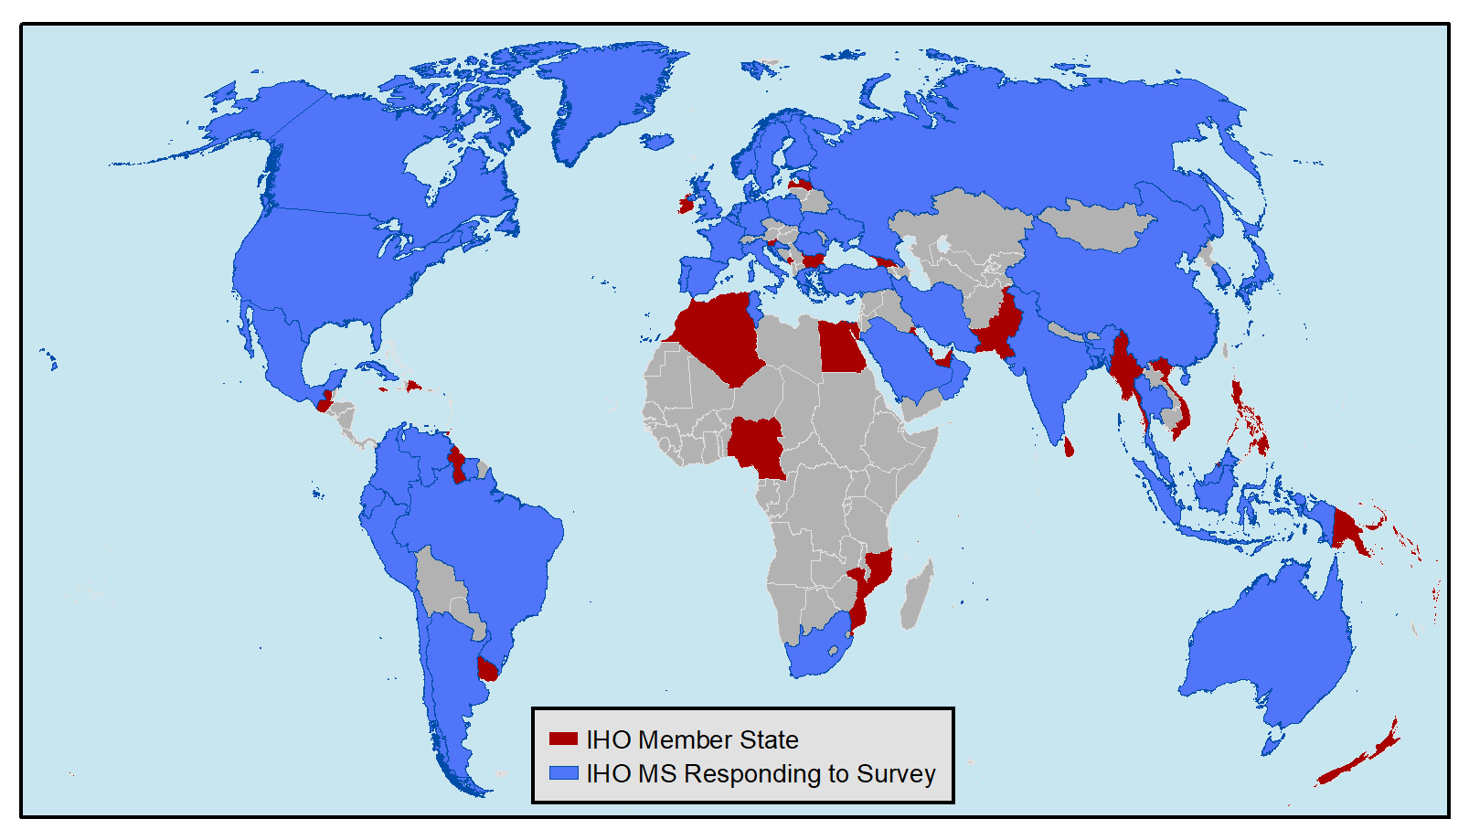
IHO Member States responding to the Survey

Slide 3
52 IHO Member States responded to Survey
Argentina Australia Bahrain Bangladesh Belgium Brazil Canada Chile China^{[1]} Colombia Croatia Cuba Cyprus | Ecuador Estonia Denmark^{[1]} Finland France Germany Greece Iceland India Indonesia Iran Italy Japan | Korea (Rep of) Malaysia Malta Mauritius Mexico Netherlands Norway Oman Peru Poland Portugal Romania Russian Federation | Saudi Arabia^{[2]} Singapore South Africa Spain Suriname Sweden Thailand Tunisia Turkey Ukraine United Kingdom United States Venezuela
[1] Survey responses from China and Denmark were received too late to incorporate into report to NCWG-5.
[2] Saudi Arabia responded to IHO Circular Letter 29/2019, but abstained from submitting a survey questionnaire.

Slide 4
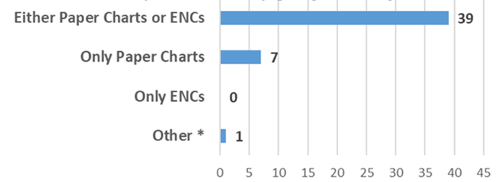
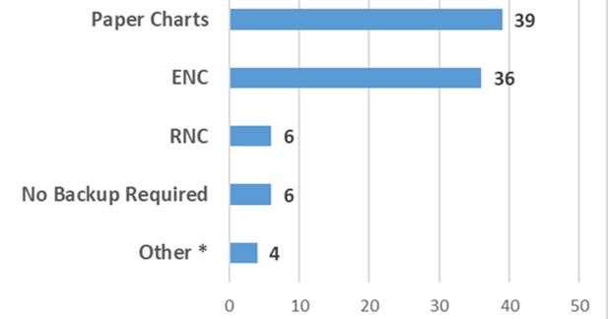
Carriage requirements for domestic voyages
Primary - Required
* One member state responded "ENCs and Paper Charts."
Backup – Allowed
* Four member states responded “Other” and referred to ECDIS or ECS usage.

Slide 5
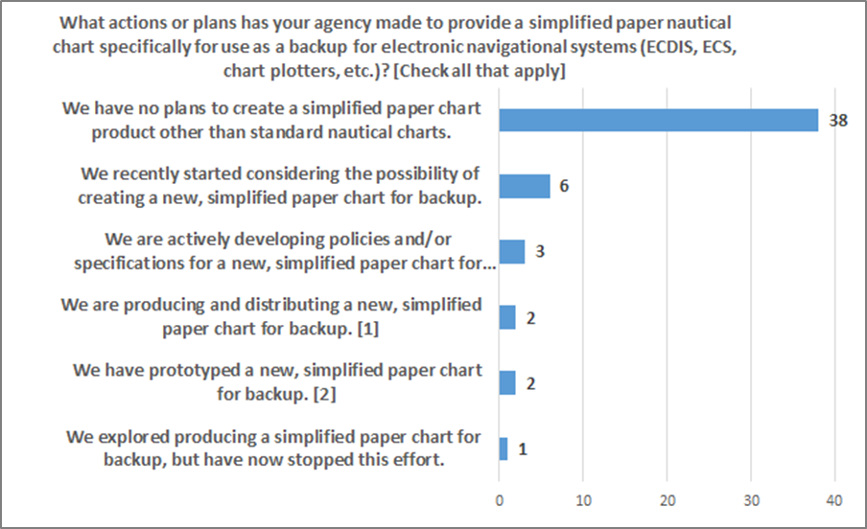
Plans for developing simplified backup
No – 39
Yes – 13

Slide 6
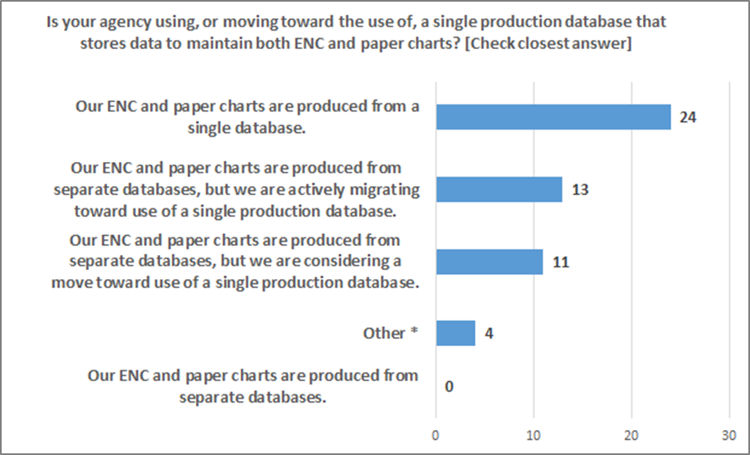
Single production database
Have or are moving toward a single database

Slide 7
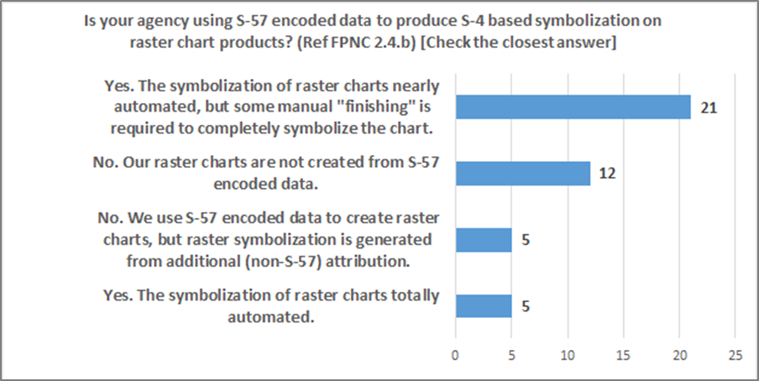
S-42 symbolized Raster charts from S-57 data
No – 17
Yes – 26

Slide 8
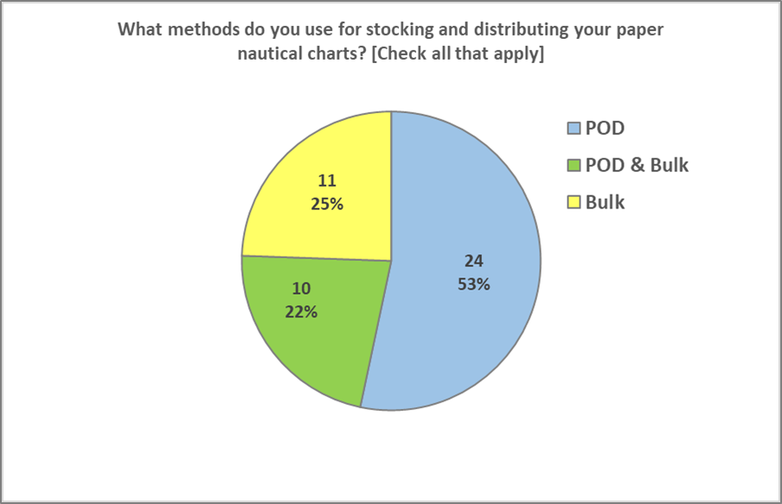
Paper chart Distribution method by agency

Slide 9
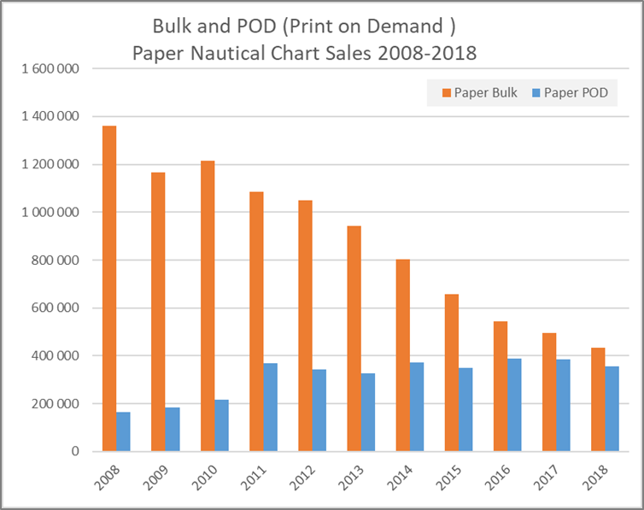
Paper chart distribution method trend by sales

Slide 10
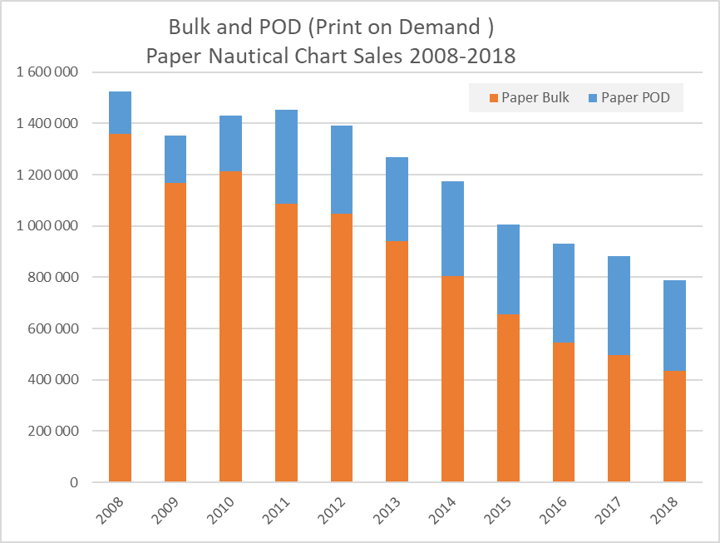
Overall Paper chart sales trend

Slide 11
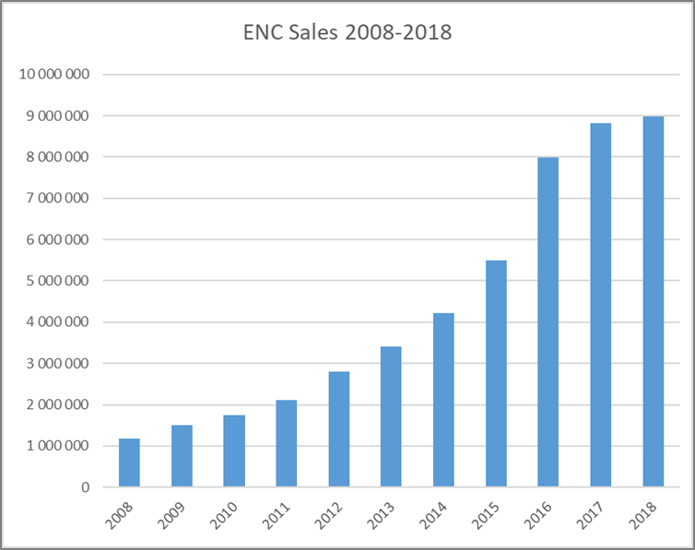
ENC Sales trend – increased almost 7X since 2008

Slide 12
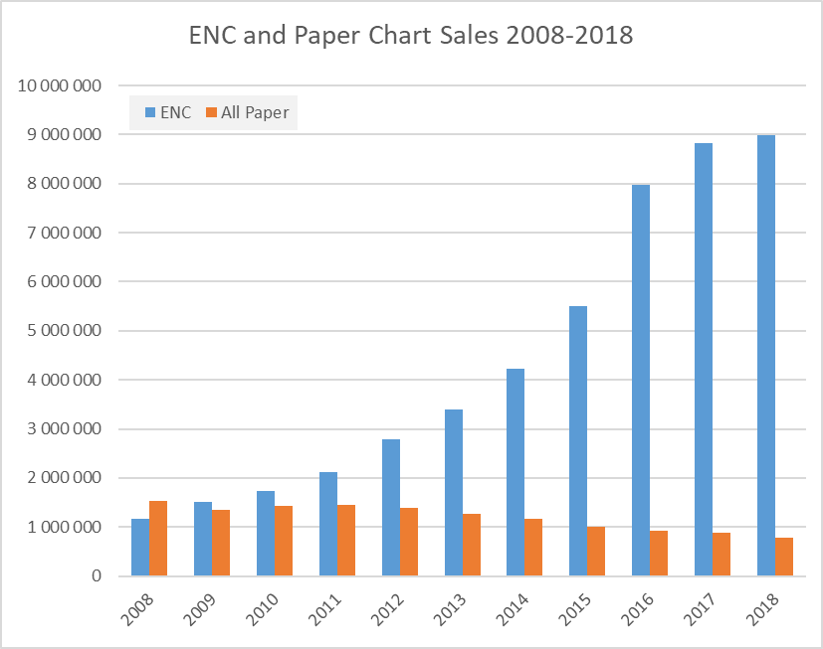
ENC and Paper chart sales compared

Slide 13
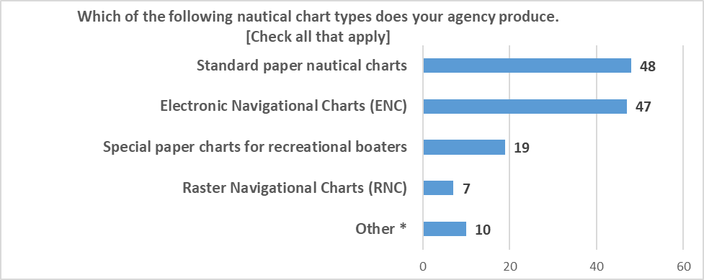
Types of Nautical charts being Produced

Slide 14
21 Countries maintaining 55K km of inland enc
Inland ENC Harmonization Group reports in their IENC Production Overview
55 629 km of IENC coverage has been produced by the countries listed below.
Australia Belgium Brazil Bulgaria China Croatia Czech Republic | France Germany Hungary Luxembourg Netherlands Poland Romania | Russian Federation Serbia Slovakia Switzerland Ukraine United States

Slide 15
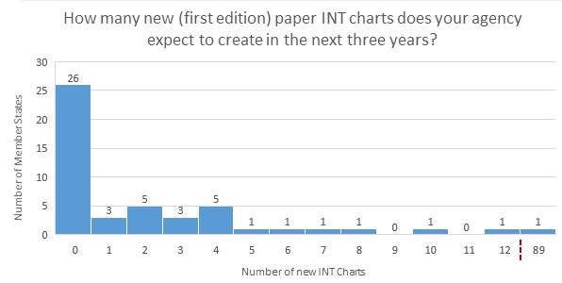
Planned int chart production

Slide 16
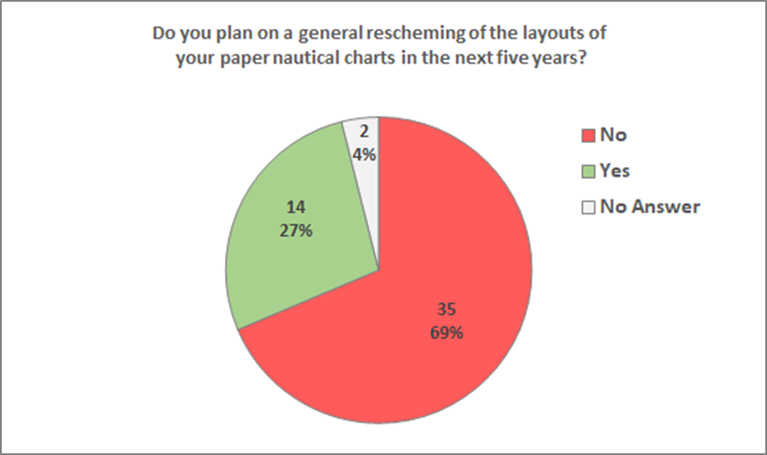
Plans to rescheme paper/raster charts

Slide 17
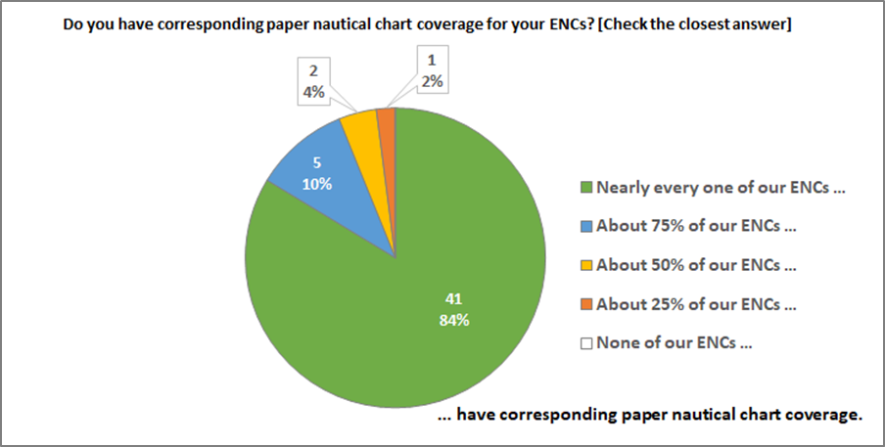
Corresponding paper chart coverage

Slide 18
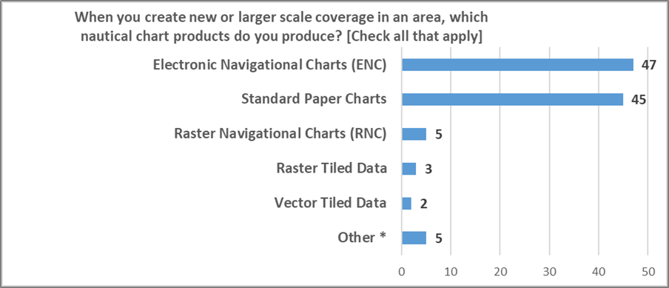
Products created for new coverage

Slide 19
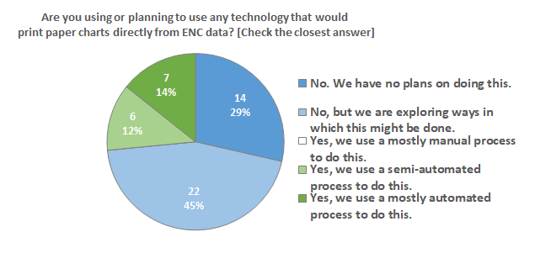
Paper charts from enc data
29% – No
71% – Yes, in some manner or considering doing so

Slide 20
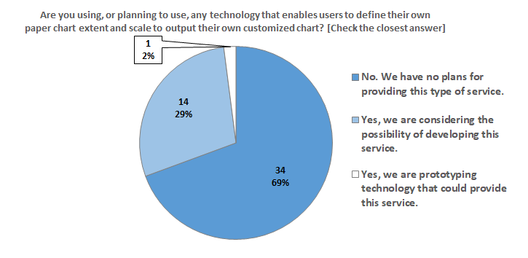
Customized charts
69% – No
31% – Considering the option or already doing so.

Slide 21
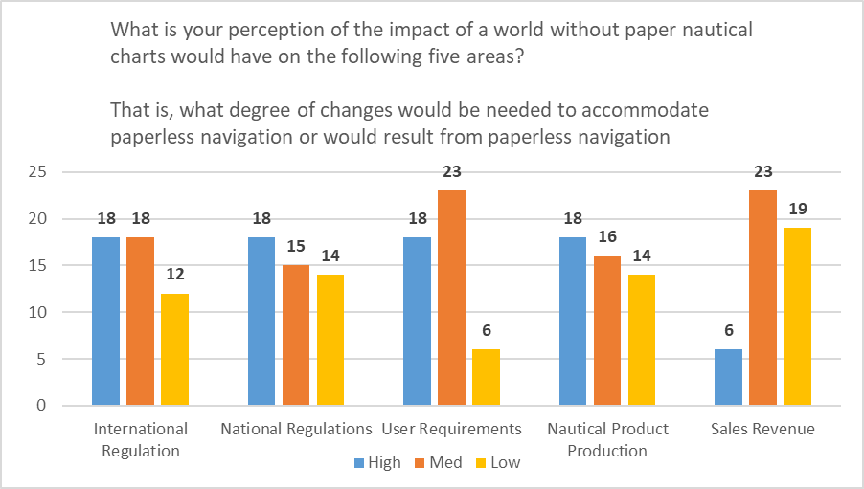
Perception of impacts of a paperless world

