Slide 1
Report of the representative of the MACHC on the implementation of ENC Schemes
John Nyberg
United States
WORLDWIDE ENC DATABASE WORKING GROUP (WENDWG)

Slide 2
Status of the ENC Scheme UB1 MACHC Region
12 ENCs

Slide 3
Status of the ENC Scheme UB2 MACHC Region
34 ENCs

Slide 4
Status of the ENC Scheme UB3 MACHC Region
106 ENCs

Slide 5
Status of the ENC Scheme UB4 MACHC Region
239 ENCs

Slide 6
Status of the ENC Scheme UB5 MACHC Region
406 ENCs

Slide 7
Status of the ENC Scheme UB6 MACHC Region
45 ENCs

Slide 8
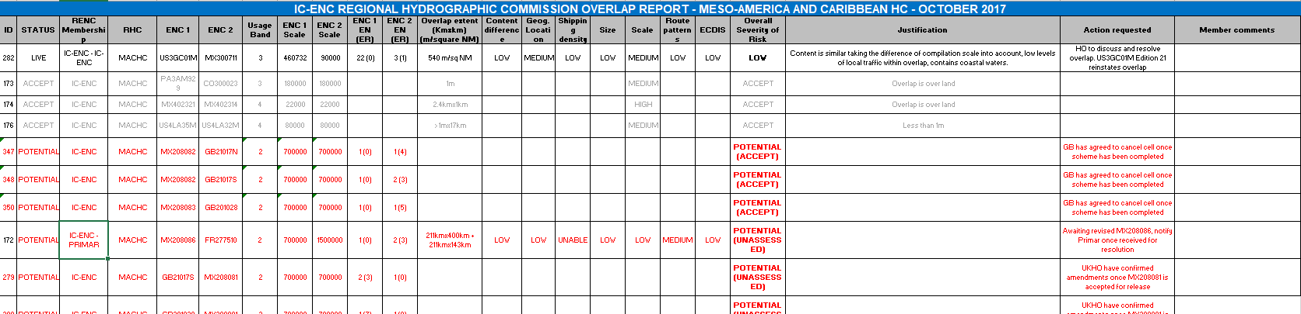
Existence of overlapping ENCs that may have a possible impact on safe navigation
4 low risk overlaps
HO’s working to resolve
Multiple potential overlaps with new
Mexican cells (risk unassessed)

Slide 9
Coverage issues, gaps and risk assessment analysis
Cruise ship analysis identified 43 ports lacking large scale coverage
  14 of these 43 ports have ENC coverage planned
Orinoco River coverage being built

Slide 10
Problems or outstanding issues, Recommendations
Recommend members to consider creating large scale coverage of ports identified in cruise ship analysis
Encourage members to continue to work to resolve overlaps in ENC coverage

Slide 11
Actions requested of WENDWG/IRCC
WENDWG is invited to note the report from MACHC

