Slide 1
Report of the representative of the MACHC on the implementation of ENC Schemes
John Nyberg United States
WORLDWIDE ENC DATABASE WORKING GROUP (WENDWG)

Slide 2
New Leadership - MACHC Charting Committee
Bernice Mahabier (Chair)
Suriname
Ricardo Freire (vice Chair)
Brazil

Slide 3
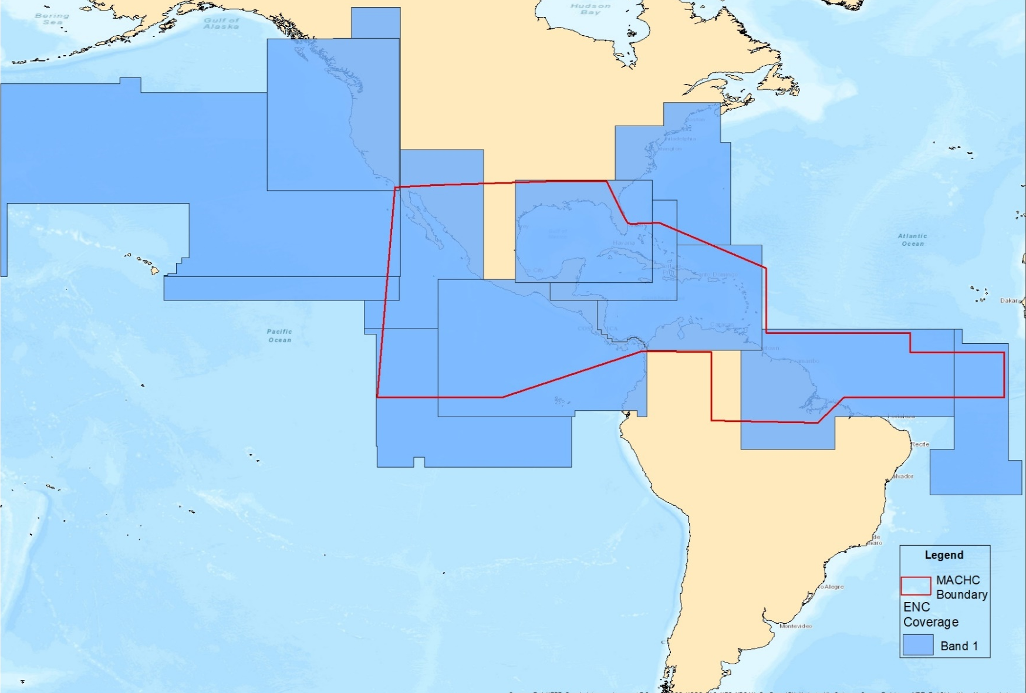
Status of the ENC Scheme UB1 MACHC Region
12 ENCs

Slide 4
Status of the ENC Scheme UB2 MACHC Region
35 ENCs

Slide 5
Status of the ENC Scheme UB3 MACHC Region
109 ENCs

Slide 6
Status of the ENC Scheme UB4 MACHC Region
286 ENCs

Slide 7
Status of the ENC Scheme UB5 MACHC Region
424 ENCs

Slide 8
Status of the ENC Scheme UB6 MACHC Region
53 ENCs

Slide 9
Existence of overlapping ENCs that may have a possible impact on safe navigation
One small overlap between two Venezuela cells

Slide 10
Coverage issues, gaps and risk assessment analysis
Gaps Analysis
Cruise ship analysis identified 43 ports lacking large scale coverage
14 of these 43 ports have Large Scale ENC coverage

Slide 11
Problems or outstanding issues, Recommendations
Recommend members to consider creating large scale coverage of ports identified in cruise ship analysis
Encourage members to continue to work to resolve overlaps in ENC coverage
Recommendation to create an ENC Scheme for the MACHC region was discussed at annual meeting in December.

Slide 12
Actions requested of WENDWG/IRCC
WENDWG is invited to note the report from MACHC

