Slide 1
WORLDWIDE ENC DATABASE WORKING GROUP (WENDWG)
SAIHC REGION H
Report of the representative of the SAIHC on the implementation of ENC schemes
Notes:
Introduction of SAIHC Region H presentation.

Slide 2
SOUTHERN AFRICAN AND ISLANDS HYDROGRAPHIC COMMISSION
Membership:
France, Mauritius, Mozambique, Norway, Republic of South Africa, Seychelles, and United Kingdom.
Associate Members:
Angola, Comores, India, Kenya, Madagascar, Malawi, Namibia, Portugal and Tanzania.

Slide 3
Status of the ENC Scheme in Region H
Overview
SAIHC ENC COVERAGE
Usage Band 1
28 ENCs
Notes:
Comment as per slide.

Slide 4
Status of the ENC Scheme in Region H
General
SAIHC ENC COVERAGE
Usage Band 2
23 ENCs
Notes:
Comment as per slide.

Slide 5
Status of the ENC Scheme in Region H
Coastal
SAIHC ENC COVERAGE
Usage Band 3
55 ENCs
Notes:
Comment as per slide.

Slide 6
Status of the ENC Scheme in Region H
Approaches
SAIHC ENC COVERAGE
Usage Band 4
70 ENCs
Notes:
Comment as per slide.

Slide 7
Status of the ENC Scheme in Region H
Harbour
SAIHC ENC COVERAGE
Usage Band 5
66 ENCs
Notes:
Comment as per slide.

Slide 8
Status of the ENC Scheme in Region H
Berthing
SAIHC ENC COVERAGE
Usage Band 6
66 ENCs
Notes:
Comment as per slide.

Slide 9
Existence of overlapping ENCs that may have a possible impact on safe navigation
SUMMARY OF OVERLAP REPORTS AS AT DECEMBER 2018
STATUS | RENC Membership | RHC | ENC 1 | ENC 2 | Usage Band | Overall Severity of Risk
LIVE | IC-ENC - PRIMAR | SAIHC | GB500722 | IN52551A IN52552W | 5 | MEDIUM
LIVE | IC-ENC - PRIMAR | SAIHC | GB502758 | IN52510B IN52511A | 5 | Under assessment
LIVE | IC-ENC - PRIMAR | SAIHC | GB54232A | IN52520A | 5 | Under assessment
LIVE | IC-ENC | SAIHC/HCA | RU1A2K00 | AU160060 | 1 | LOW
LIVE | IC-ENC | SAIHC | ZA200020 | ZA200030 | 2 | LOW
RESOLVED | IC-ENC | SAIHC | ZA1N0010 | GB104203 | 1 | RESOLVED
RESOLVED | IC-ENC | SAIHC | ZA100030 | GB104701 | 1 | RESOLVED
ACCEPTED | IC-ENC | SAIHC | ZA300120 | GB302930 | 3 | ACCEPTED
ENC overlaps (2018):
UB 5 = 3
UB 3 = 1
UB 2 = 1
UB 1 = 3
Overlaps are medium to low risk
Resolved: 2
Live: 5
Accepted: 1
Notes:
Summary of current status of overlaps in the SAIHC region. Breakdown of each overlap portrayed in the next few slides.

Slide 10
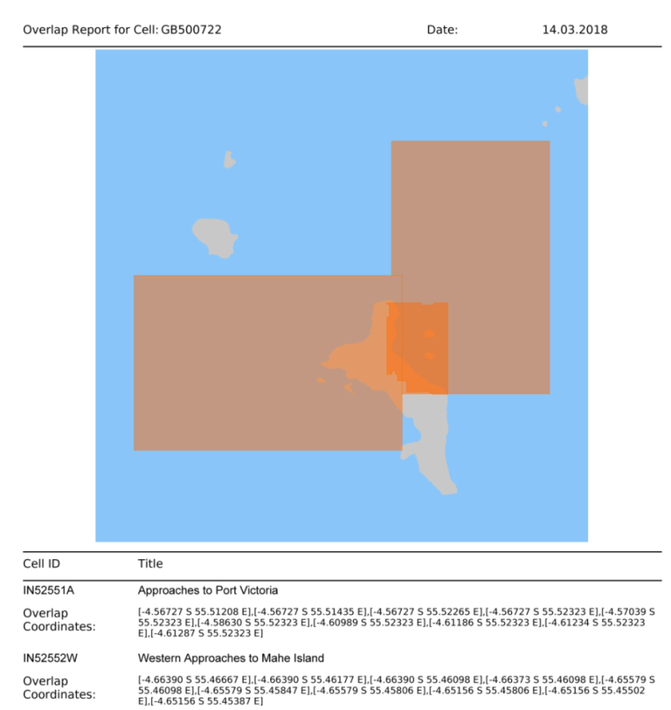
Existence of overlapping ENCs that may have a possible impact on safe navigation
STATUS | RENC Membership | RHC | ENC 1 | ENC 2 | Usage Band | Overall Severity of Risk
LIVE | IC-ENC - PRIMAR | SAIHC | GB500722 | IN52551A IN52552W | 5 | MEDIUM
Seychelles
Notes:
Significant overlap exists between IN and GB. Clipping has been agreed upon between the nations and is a works in progress.

Slide 11
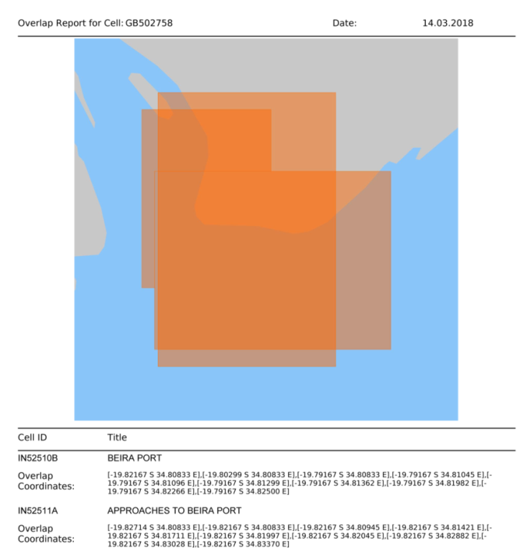
Existence of overlapping ENCs that may have a possible impact on safe navigation
STATUS | RENC Membership | RHC | ENC 1 | ENC 2 | Usage Band | Overall Severity of Risk
LIVE | IC-ENC - PRIMAR | SAIHC | GB502758 | IN52510B IN52511A | 5 | Under assessment
Mozambique
Notes:
Significant overlap exists between IN and GB. IN has agreed to withdraw ENCs in overlap.

Slide 12
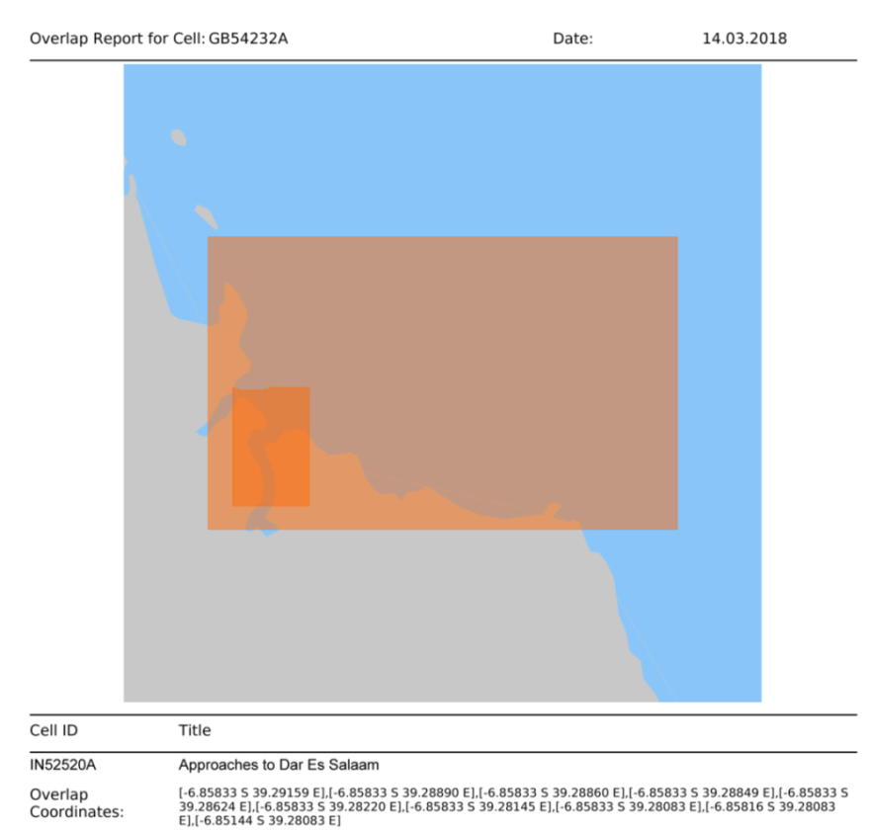
Existence of overlapping ENCs that may have a possible impact on safe navigation
STATUS | RENC Membership | RHC | ENC 1 | ENC 2 | Usage Band | Overall Severity of Risk
LIVE | IC-ENC - PRIMAR | SAIHC | GB54232A | IN52520A | 5 | Under assessment
Tanzania
Notes:
Significant overlap exists between IN and GB. Clipping has been agreed upon between the nations and is a works in progress.

Slide 13
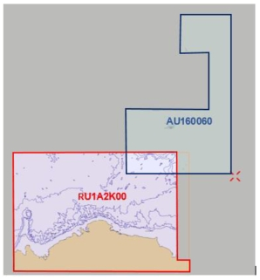
Existence of overlapping ENCs that may have a possible impact on safe navigation
STATUS | RENC Membership | RHC | ENC 1 | ENC 2 | Usage Band | Overall Severity of Risk
LIVE | IC-ENC | SAIHC/HCA | RU1A2K00 | AU160060 | 1 | LOW
Notes:
Overlap in UB1 between Russia and Australia remains unresolved.

Slide 14
Existence of overlapping ENCs that may have a possible impact on safe navigation
STATUS | RENC Membership | RHC | ENC 1 | ENC 2 | Usage Band | Overall Severity of Risk
LIVE | IC-ENC | SAIHC | ZA200020 | ZA200030 | 2 | LOW
Notes:
South Africa in the process of producing NE of these cells and the overlap will be resolved within the one-year ‘clock’.

Slide 15
Existence of overlapping ENCs that may have a possible impact on safe navigation
STATUS | RENC Membership | RHC | ENC 1 | ENC 2 | Usage Band | Overall Severity of Risk
RESOLVED | IC-ENC | SAIHC | ZA1N0010 | GB104203 | 1 | RESOLVED
Notes:
Comment as per table. Overlap resolved.

Slide 16
Existence of overlapping ENCs that may have a possible impact on safe navigation
STATUS | RENC Membership | RHC | ENC 1 | ENC 2 | Usage Band | Overall Severity of Risk
RESOLVED | IC-ENC | SAIHC | ZA100030 | GB104701 | 1 | RESOLVED
Notes:
Comment as per table. Overlap resolved.

Slide 17
Existence of overlapping ENCs that may have a possible impact on safe navigation
STATUS | RENC Membership | RHC | ENC 1 | ENC 2 | Usage Band | Overall Severity of Risk
ACCEPTED | IC-ENC | SAIHC | ZA300120 | GB302930 | 3 | ACCEPTED
Notes:
Overlap between ZA300120 and GB302930 has been assessed and classified as acceptable as it is on land.

Slide 18
Coverage issues, gaps and risk assessment analysis
Development of the SAIHC ENC scheme
The ENC scheme from Mozambique to the northern limit of SAIHC Region H is
undergoing assessment and risk analysis (Mozambique, Tanzania and Kenya).
Notes:
Action item no 4 arising from the SAIHC 7th ICCWG minutes of the meeting.
Noting actions from IRCC concerning the creation of ENC Schemes, to define an ENC scheme initially from Mozambique to the northern limit of SAIHC.
There is a requirement to develop a larger scale usage band ENC schema which is currently the main area of focus and a works in progress undergoing assessment and risk analysis by the UKHO. There are areas of paper chart coverage where an ENC does not exist.
Overlaps still exist in Region H which have not been resolved within the one-year “clock” and range from medium to low risk.

Slide 19
Problems or outstanding issues, Recommendations
Representation at WENDWG by SAIHC representative has not been possible due to internal challenges and budget constraints.
SAIHC continues its full support for the development of the ENC scheme (INT paper chart schema equivalent) and encourages members to submit their ENC Schemes if not already done.
Notes:
Comment as per slide.

Slide 20
Actions requested of WENDWG
WENDWG is invited to note the report from SAIHC.
Notes:
Comment as per slide.

