Slide 1
USCHC WEND Report

Slide 2
3 Low Risk Overlaps

Slide 3
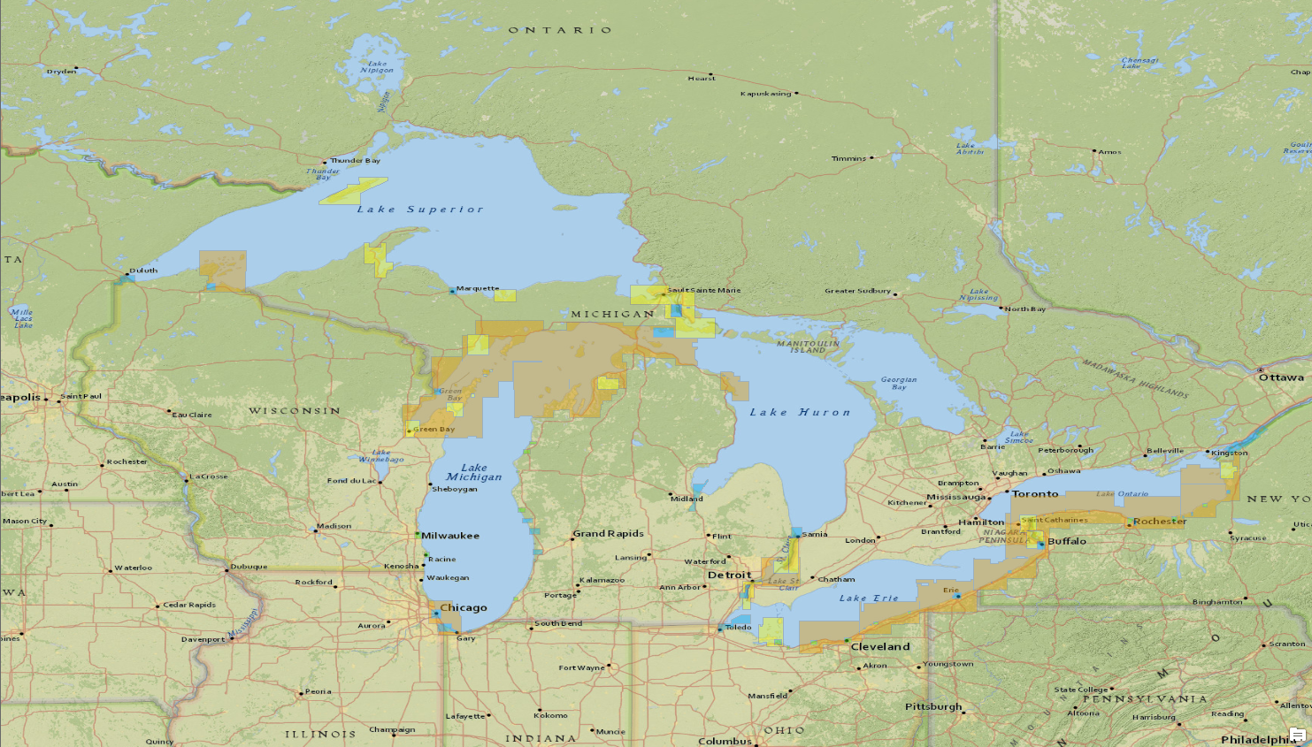
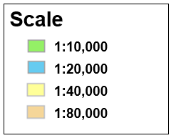
Current Electronic Chart Suite

Slide 4
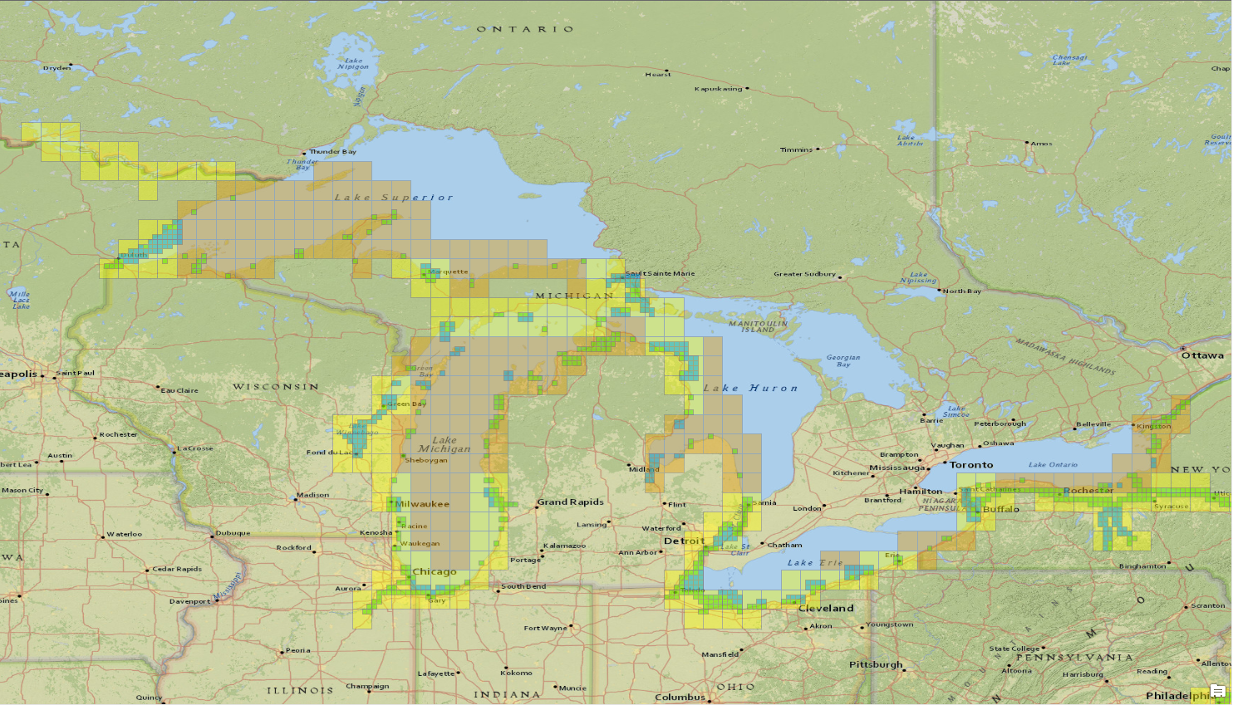
Re-scheme Plan

Slide 5
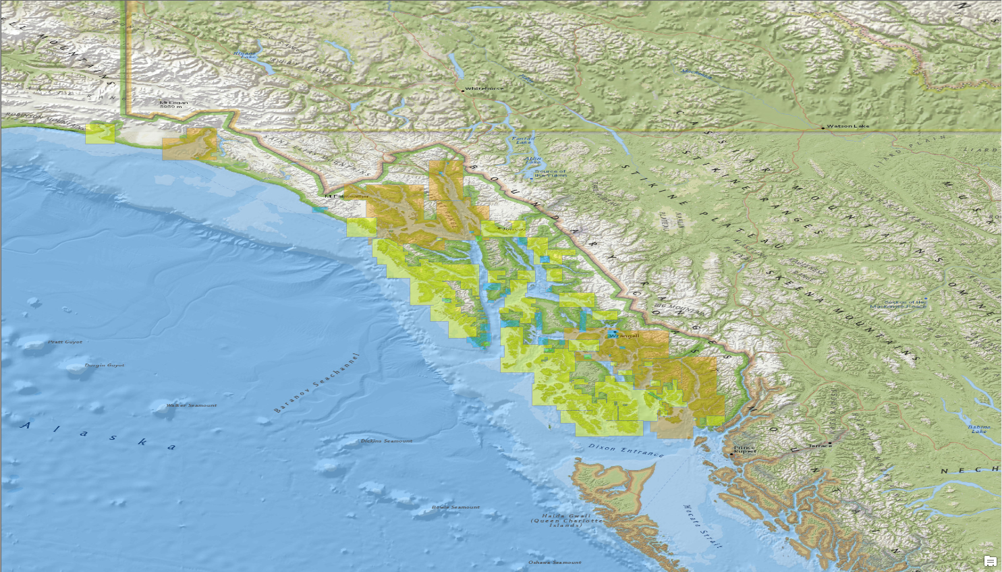
Current Electronic Chart Suite

Slide 6
Re-scheme Plan

Slide 7
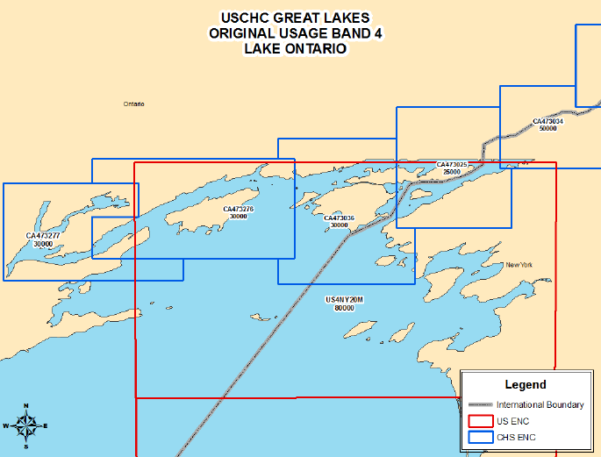
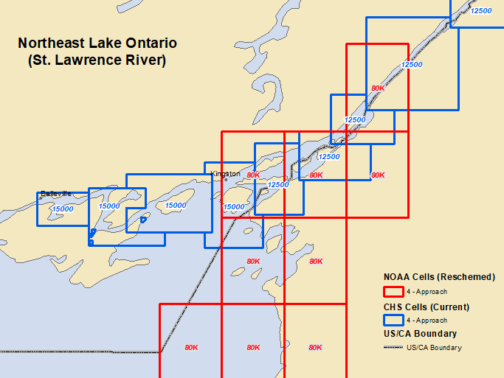
Band 4 Overlap
25K
25K
25K
25K
25K
30K
30K
30K
25K

Slide 8
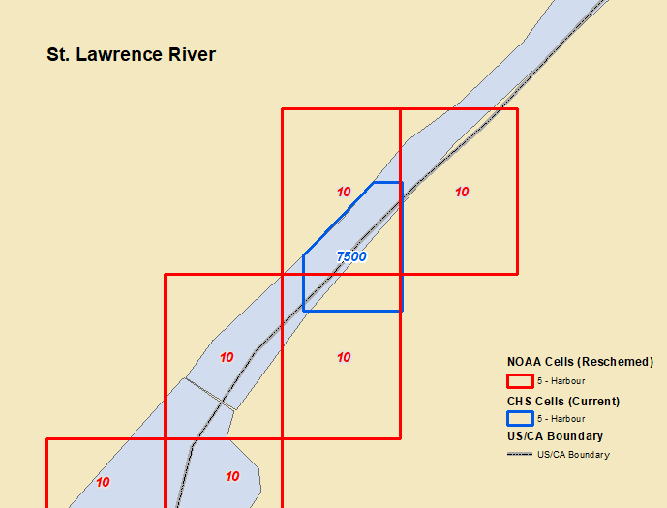
Band 5 Overlap
15K

Slide 9
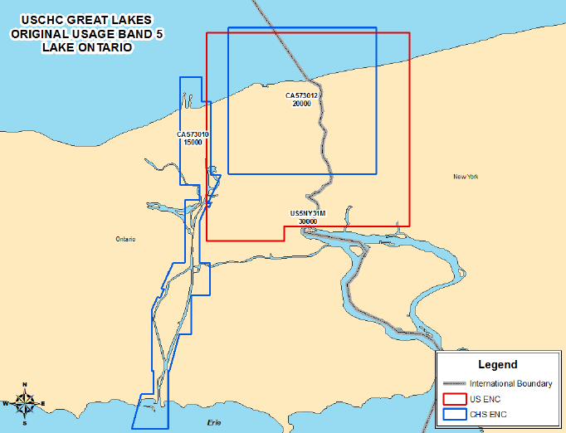
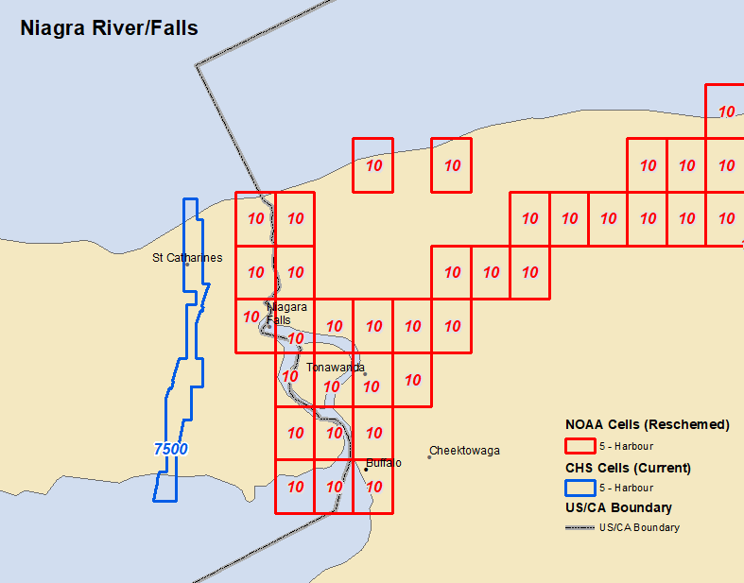
Band 5 Overlap
Niagara River/Falls
15K

Slide 10
Chart Advisory Committee (CAC) Meeting – 2/21/2019
Use of M_COVR S-57 Object
US/Canada Transboundaries
US proposed use of M_COVR encoding to preserve shape of gridded cells that overlap the US/Canadian Boundary
Revisited previous overlap agreements along the Atlantic Coast, Pacific Coast, and the Great Lakes
Provided comparison study on how the rescheming of US (NOAA) electronic charts will affect the current agreements
CATCOV = 2
(no coverage available)
CANADA
US
CATCOV = 1
(coverage available)

Slide 11
Chart Advisory Committee (CAC) Meeting – 2/21/2019
The Next Generation Electronic Navigation Chart (ENC)
CHS has grid model determined with a nationwide origin at 0° / 0°
The grid will be grouped into three (3) usage bands:
Band 6 – Berthing
Band 4 – Approach
Band 2 – General
Scales will be determined by RADAR range
CHS is considering aggregation of grid tiles in some areas to decrease number of products while preserving a gridded system
CHS is investigating the impact on naming conventions

Slide 12
Chart Advisory Committee (CAC) Meeting – 2/21/2019
Paper Chart 2.0
CHS recommends the S-4 Standard to be frozen at Edition 4.8
CHS requests the Nautical Cartography Working Group (NCWG) to develop and test automated paper chart creation from ENC databases

Slide 13
THANK YOU

