Slide 1
IHO Council – October 2017 Review of IHO Strategic Plan
Submitted by the United Kingdom of Great Britain and Northern Ireland

Slide 2
Purpose of this presentation:
Not to propose specific content for the Strategic Plan, but
- to stimulate discussion about current deficiencies
- propose that the Strategic plan should:
Reflect significant marine/maritime changes since 2009
Give direction on new priorities
Define time-bound outcomes (for 6 year period)
Enable more rigorous performance reporting
We need to consider what a Strategic Plan should be

Slide 3
Need for a strong Strategic Plan
Important for Council to be focused on IHO Strategy
to give context for discussions
to focus activity
to limit distraction by other interests
to direct content of work programmes
to be the target against which success is measured
Important for HSSC & IRCC to understand IHO Strategy
to direct activity
to give context for proposals relating to work programme

Slide 4
Need for a strong Strategic Plan
Important for IHO Member States to see the IHO Strategy
to understand what the IHO is aiming to achieve
to justify of the use of IHO funds
to justify the commitment of MS staff to IHO activities
to have confidence in the Council
Important for future IHO Member States to see the IHO Strategy
to understand what they are joining
to attract their commitment
Important for the wider stakeholder community:
to have confidence in what the IHO stands for
to support the activities of the IHO

Slide 5
What’s changed since 2009?
ENC coverage
ECDIS use
S-100
E-navigation
Technological advances
Environmental concerns
MSDI
Maritime trade
Blue growth
Economy

Slide 6
What’s changed since 2009?
ENC coverage
ECDIS use
S-100
E-navigation
Technological advances
Environmental concerns
MSDI
Maritime trade
Blue growth
Economy
Amended IHO Convention
Greater resource constraints

Slide 7
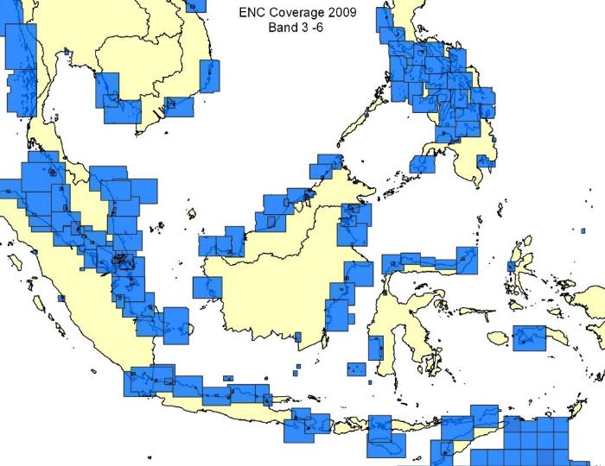
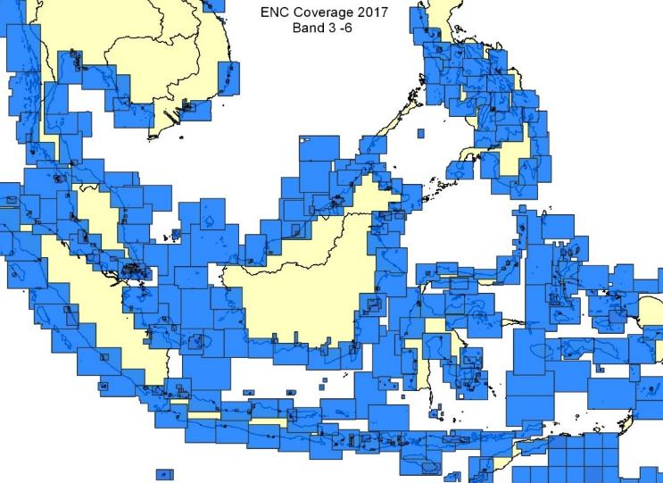
ENC Coverage
2009 – ENC Band 3-6
2017 – ENC Band 3-6

Slide 8
ENC Coverage
2008 ENC global coverage
Small scale 94%
Medium scale 68%
Large scale 65%
2017 ENC global coverage
Small scale 100%
Medium scale 93%
Large scale 98%
2009 – ENC Band 3-6
2017 – ENC Band 3-6
So what?
Focus on ENC coverage is no longer the main issue.
Focus should now be on quality of data.
How to improve ENC quality? More large scale? S-101?

Slide 9
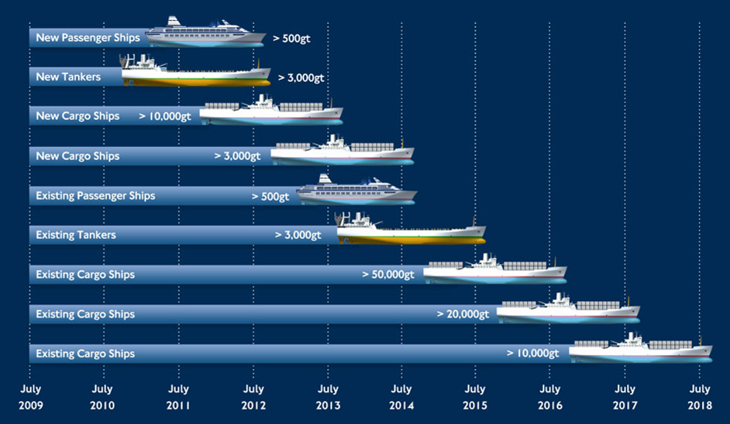
ECDIS Adoption
ECDIS carriage timetable

Slide 10
ECDIS Adoption
2009 No mandatory carriage
2012 Mandatory carriage started
2017 ECDIS adopted by over half of internationally trading fleet.
So what?
ECDIS and ENC use is now more significant that paper charts.
Still need to improve user experience of ECDIS.
What opportunities for IHO direction does this provide?

Slide 11
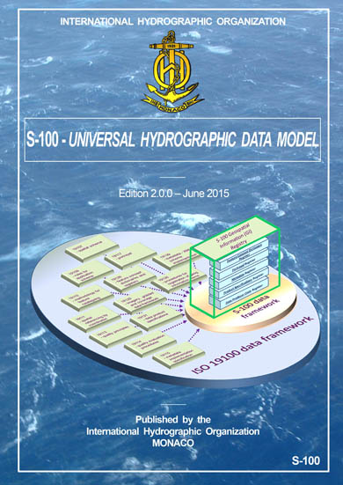
S-100

Slide 12
S-100
2009 S-100 under development
2010 S-100 edition 1.0.0
2017 S-100 edition 3.0.0
2017 S-101 edition 1.0.0 expected
So what?
S-100 is now a significant part of the IHO’s work.
S-101 implementation plan.
Need focus on interoperability of S-10x product standards.

Slide 13
E-navigation
2009-12
2012-15
2012-15
2015-18

Slide 14
E-navigation
2009-12 EfficienSea project
2010-15 MonaLisa projects
2012-15 ACCSEAS project
2015-18 EfficienSea2.0
2014 e-nav SIP approved.
e-navigation language includes MSPs, CMDS and HGDM
So what?
S-100 is now a significant part of the IHO’s work.
S-101 implementation plan contributes to e-navigation.
Need focus on interoperability of S-10x product standards.

Slide 15
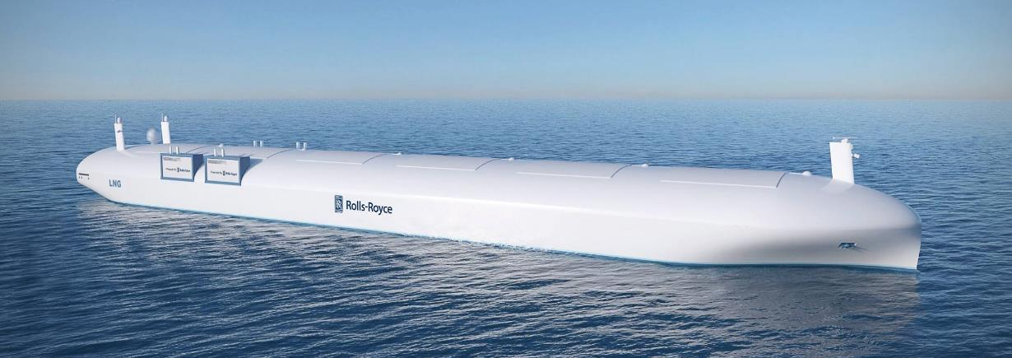
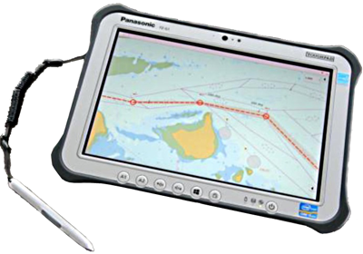
Technological advances

Slide 16
Technological advances
2009
Poor maritime internet
No iPad until 2010
No 4G connectivity until 2010
2017
Maritime bandwidth much improved
Handheld device usage common
Autonomous vessel development
Cyber security issues
So what?
Different data requirements
Data more portable
Regulation issues not yet addressed
Notes:
)

Slide 17
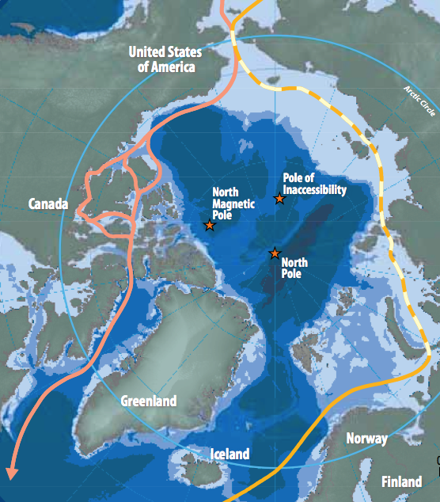
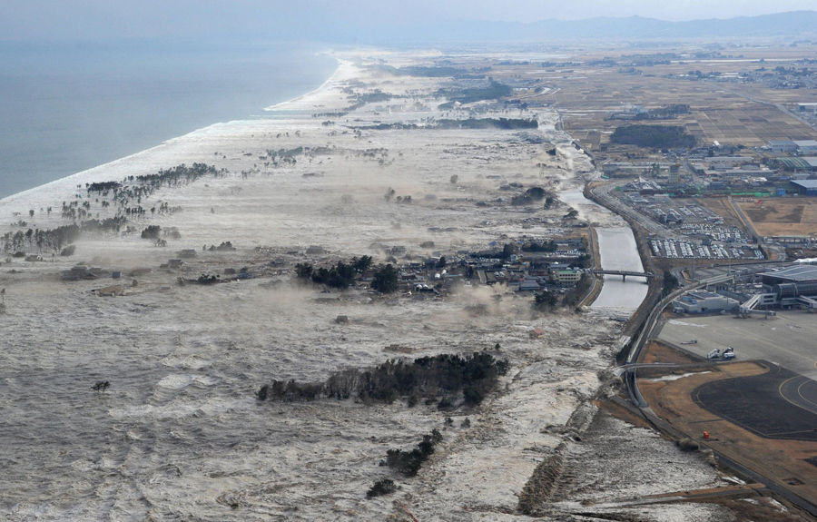
Environmental Issues

Slide 18
Environmental Issues
Since 2009
2012 Rio Earth Summit
2015 Paris Climate Change Conference
2017
Ocean warming and acidification
Marine pollution; NOx; SOx;
Sea level rise
Arctic shipping routes
So what?
2009 IHO WHD: “The significant contribution that hydrography makes to the protection of the marine environment”
Greater focus on disaster preparedness and response

Slide 19
MSDI Marine
Spatial
Data
Infrastructure
UN-GGIM
Global
Geospatial
Information
Management

Slide 20
MSDI
2009
MSDIWG formed in 2008
C-17 first published in 2010
2017
OGC Marine Domain WG formed
C-17 edition 2.0.0
So what?
2014 WHD: “Hydrography - much more than just nautical charts”
Should IHO have an MSDI strategic goal?
MSDIWG is aiming to develop a 2030 vision
UN-GGIM
Global
Geospatial
Information
Management

Slide 21
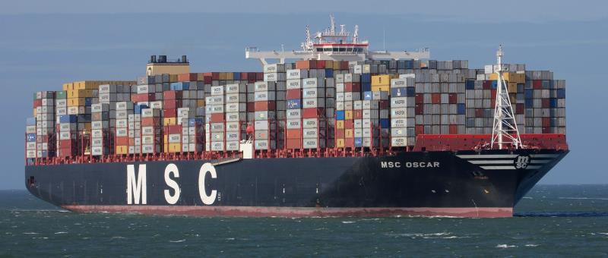
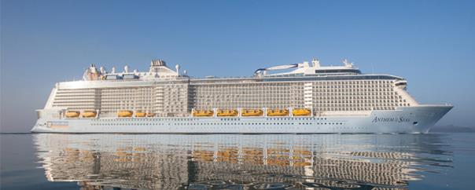
Maritime Trade

Slide 22
Maritime Trade
2009 - largest containership 15,500 TEU
2009 - largest cruise ship 3959 passengers
2015 - largest containership 19,224 TEU (24% increase)
2015 - largest cruise ship 6360 passengers (60% increase)
So what?
Larger ships have greater demands for high quality, up to date hydrographic information.
Dynamic information of greater advantage to high value vessels/cargo.

Slide 23
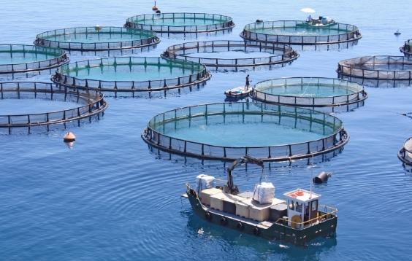
Blue Economic Growth Pressures on the marine environment
2006 2020

Slide 24
Blue Economic Growth Pressures on the marine environment
2006
Global offshore wind 0.9 GW
2013 - Global offshore wind generation 7.1 GW
2020 prediction 39.9 GW
So what?
Increasing pressure of sea space
2013 WHD theme: “Hydrography - underpinning the Blue Economy”
How do we need to react in 2017?
2006 2020

Slide 25
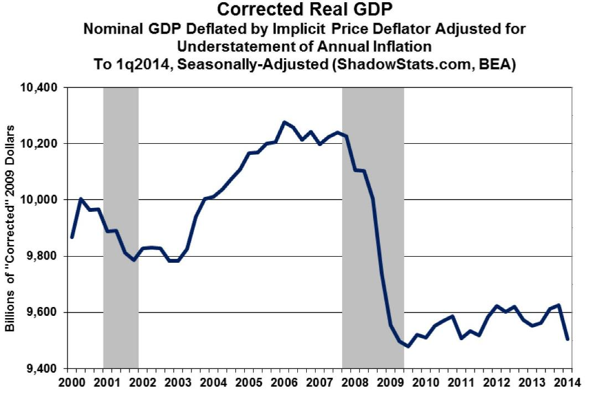
Global Financial Crash/Shipping Crisis

Slide 26
Global Financial Crash/Shipping Crisis
2006 - Global average GDP 5.5%
2009 - World growth -2.1%
2017 -
Global average GDP 3.4%
So what?
Most governments have less money than pre-2008
Most HO have less resource to commit to IHO work
More important than ever before to prioritise what can be done with the resource available.

Slide 27
Since Assembly:
IHO voluntary commitments at the UN Ocean Conference (June 2017)
To provide fundamental mapping of the seas and oceans (referring to GEBCO 2030)
To provide capacity building to support sustainability and economic development (link to UN Sustainable Development Goal 14)
Opportunity to record strategic intent and targets within a revised Strategic Plan

Slide 28
Current Strategic Plan & Work Programmes
The current Strategic Plan acknowledges the Work Programmes:
Corporate Affairs
HSSC
IRCC
but sets no targets, or priorities.
The work programmes are managed independently, rather than jointly focused on higher strategic priorities.
Current links from the Work Programme to the Strategic Plan are used to justify the tasks, rather than to direct priorities.

Slide 29
Features of a Strategic Plan
A target to aim for (i.e. what to achieve by what time)
Prioritised activities to increase chances of success
Appropriate performance measures to monitor progress

Slide 30
Strategy > Outcomes > Success
Strategic priorities give focus
Defined strategic outcomes with target dates will hold us to account
Strategic focus will drive the content of the Work Programme
Resource planning is then justified by strategic priorities

Slide 31
Strategy > Outcomes > Success
Strategic priorities give focus
Defined strategic outcomes with target dates will hold us to account
Strategic focus will drive the content of the Work Programme
Resource planning is then justified by strategic priorities
Defining success will be key

