Slide 1
Development and future provision of S-100 based Products
Agenda Item 4.3
Reference Document C2-4.3

Slide 2
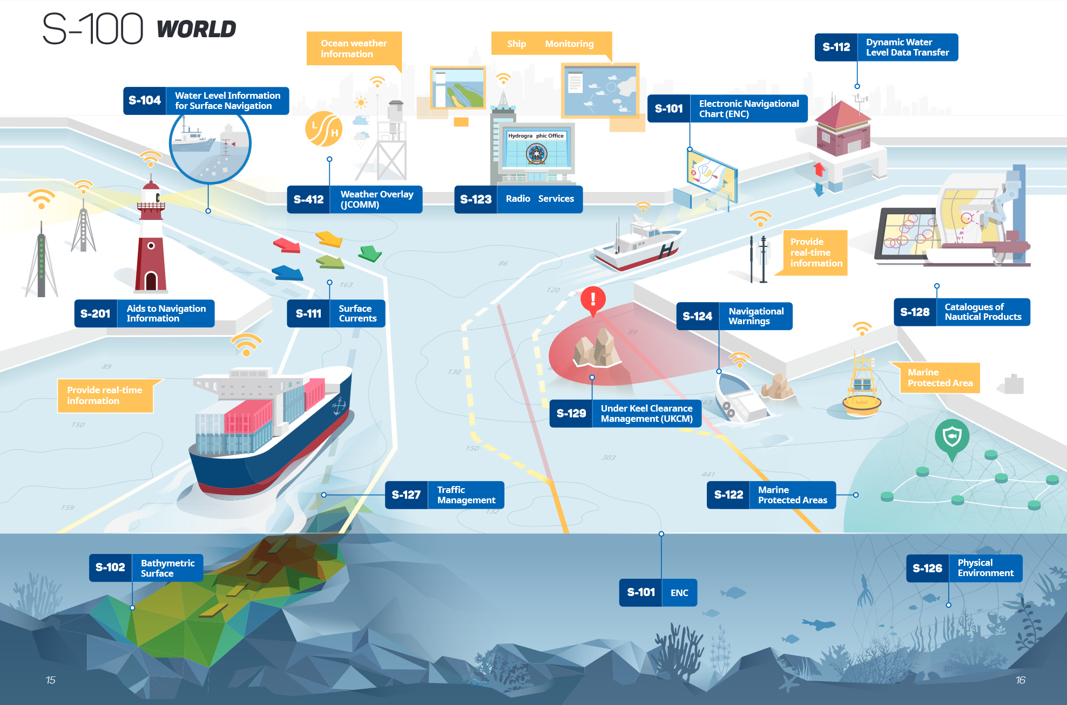
The IHO S-100 Standards Aquarium

Slide 3
S-100 – forms the basis (1)
S-100 is the most important application of ISO 19100 series of Geographic Standards on a global scale. It opens a new world in the provision of geoinformation:
New components not developed in isolation.
Standards are never “frozen”,
Plug-and-Play updating of data, symbology and software enhancements.

Slide 4
S-100 – forms the basis (2)
S-100 provides the data model for IMO future Maritime Service Portfolio.
S-100 is used by IALA as the principal basis for the digitization of Navigational Aids data flow.
S-100 will be instrumental for future exchange of Marine Safety Information under WWNWS.
S-100 is gaining increased recognition of associated domains under IOC.

Slide 5
S-100 – technical infrastructure matures
S-100 Registry is under intense maintenance.
S-100 feature catalogue builder is developing further.
S-100 portrayal catalogue builder is developing as well.
S-100 several IHO working groups and project teams contribute to the S-100 Product Interoperability Specification.

Slide 6
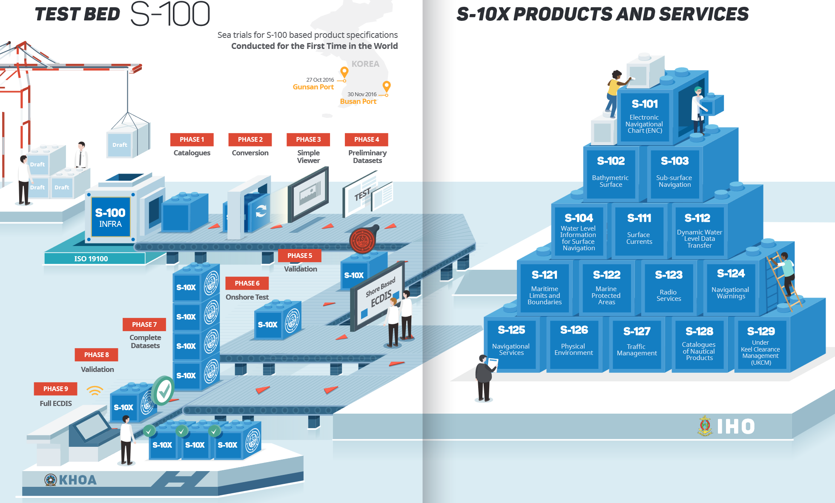
The IHO S-100 Standards Factory has started to work

Slide 7
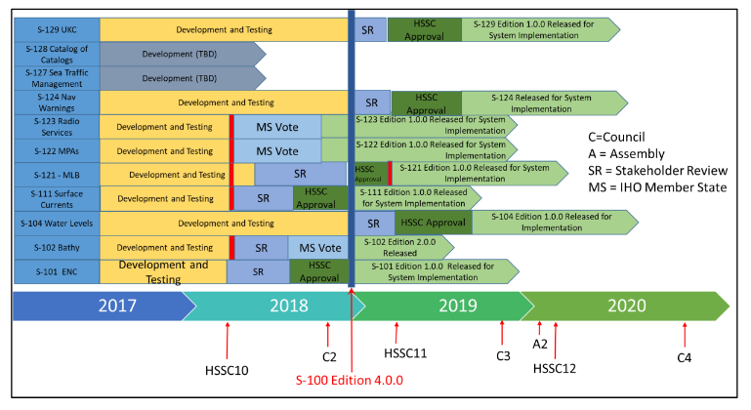
Several S-100 based products are at the start
Bathymetric Surface (S-102)
Water level information for surface navigation (S-104)
Surface Currents (S-111)
Maritime Limits and Boundaries (S-121)
Marine Protected Areas (S-122)
Marine Radio Services (S-123)
Navigational Warnings (S-124)
Under Keel Clearance (S-129)
… and the IHO flag ship product:
First Edition of
S-101 next generation ENC
planned to be out for testing end of 2018.

Slide 8
Data Product Standardization is one side of the coin only …
Regular dataset production, validation/qualification and dissemination should be agreed and synchronously implemented on international level.
Collaboration with industry is needed to make end user devices fit for purpose.
Legal recognition of new data products within the framework of IMO is required.
To make this happen, a lot of details have to be considered with the best intention of an international harmonized approach:
Exactly that is it what the IHO is for!

Slide 9
What to do? Proposed activities … (1)
IRCC to instruct the WENDWG to consider the applicability of the WEND Principles to S-101 ENCs and the first generation of S-100 based products and to report back at C-3;
HSSC - in liaison with IHO MS who are RENC Members - to host a workshop on S-100 based data production, validation and distribution concepts in 2019 (back-to-back with C-3?);

Slide 10
What to do? Proposed activities … (2)
Chairs of Council, HSSC, IRCC and SecGen to draft a roadmap for the regular production and dissemination of S-100 based hydrographic products and for further discussion at A-2 for the 2021-2023 IHO Work Programme;
SecGen to inform IMO about the recent developments within the S-100 framework with particular emphasis on the uptake of S-101 and S-100 based data products to provide additional nautical information. Propose the approval of these products as meeting the mandatory SOLAS carriage requirements for nautical charts and other nautical publications.

Slide 11
The Council is invited to
discuss and agree on a roadmap for the regular production and dissemination of S-100 based hydrographic products;
instruct HSSC Chair and IRCC Chair to put resulting action on the affected Working Groups, namely S-100WG, ENCWG, NIPWG and WENDWG;
instruct the Secretary-General to inform IMO about the recent developments within the S-100 framework with particular emphasis on the progress of S-101 and S-100 based data products to provide additional nautical information; and
take any other actions that may be appropriate.

