Slide 1
3rd Meeting of the IHO Council
Report and Proposals from HSSC
C3-04.1A

Slide 2
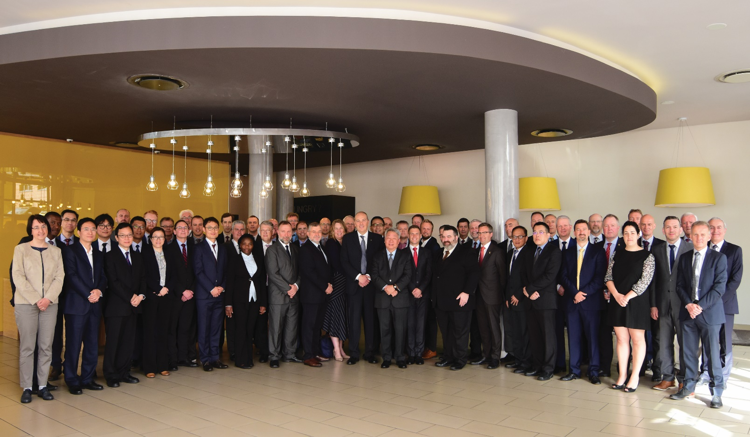
Introduction
HSSC work is guided by the IHO Work Programme 2 “Hydrographic Services and Standards” and by the Council key priorities
Meetings since C-2:
HSSC-11 Cape Town,
South Africa
(6-(10 May 2019)
Next Meeting:
HSSC-12 Bristol,
UK (11-15 May 2020)

Slide 3
HSSC-11 Key Priorities
Demonstration showcase of S-100 based products
Technical level
Strategic Level
Final remarks of the Resolution 2/2007 as amended
Future of Paper charts
Revised Strategic Plan
S-100 Implementation Strategy
Development of the S-1xx Product Specifications and operationalization of S-1xx framework
Priorities of IHO 2019 Work Plan 2
Interoperability S-101 and S1XX

Slide 4
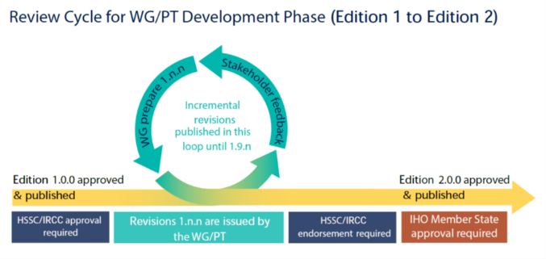
Analysis/Discussion – Resolution 2/2007
In accordance with C2/11&12 and endorsement by HSSC & IRCC, submitted for approval by MS (CL 32/2019)
The approved Resolution 2/2007 (cfr. CL 46/2019) as amended is structured as follows:
Main doc: updated review cycle for WGs/PTs for the development of PSs and standards
Appendix 1 and 2: lists of IHO standards that must be maintained in conformance with the IHO Resolution 2/2007 as amended
Appendix 3: guidance for conducting stakeholders impact study

Slide 5
IHO future strategic plan (2021- 2026)
To direct the IHO`s Work Programme and foster the IHO vision, mission, and objects
Evolving the hydrographic support for safety and efficiency of maritime navigation, undergoing profound transformation
Increasing the use of hydrographic data for the benefit of society
Participating actively in international initiatives related to the knowledge and the sustainable use of the Ocean
1° Goal
2° Goal
3° Goal

Slide 6
IHO Strategic Plan
STANDARDIZATION
QUALITY
DISSEMINATION
INTEROPERABILITY
HSSC relevant elements of the Future IHO Strategic Plan considered
HSSC Chair provided comments on ST and SPI to SPRWG Chair info IRCC Chair (HSSC CL 2/2019 dated 31 March 2019)
Notes:
HSSC relevant elements of the Future IHO Strategic Plan were considered by HSSC WGs.
In particular ST and SPI related to SG1 and SG 2 were analysed.
The following aspects were considered:
Effectiveness of SPI (measurability): general concerns arose about the effectiveness of SPIs and in particular their measurability. A correlated implementation strategy is necessary to achieve the Strategic Targets
Necessity of a connection with the implementation strategy that is under development
In the picture the key words that are the life motive of the
STANDARIZATION →Develop standards, best practices (eg. cyber security, data quality assessment)
DISSEMINATION → Deliver Standards, Product Specificatios, implementation strategy support
QUALITY → Adopt/Promote new tools and methods to increase coverege, contistency amd quality of surveys
INTEROPERABILITY →Adopt and apply UN guiding principles for geospatial information management ensuring interoperability of Hydrographic data with their marine related data

Slide 7
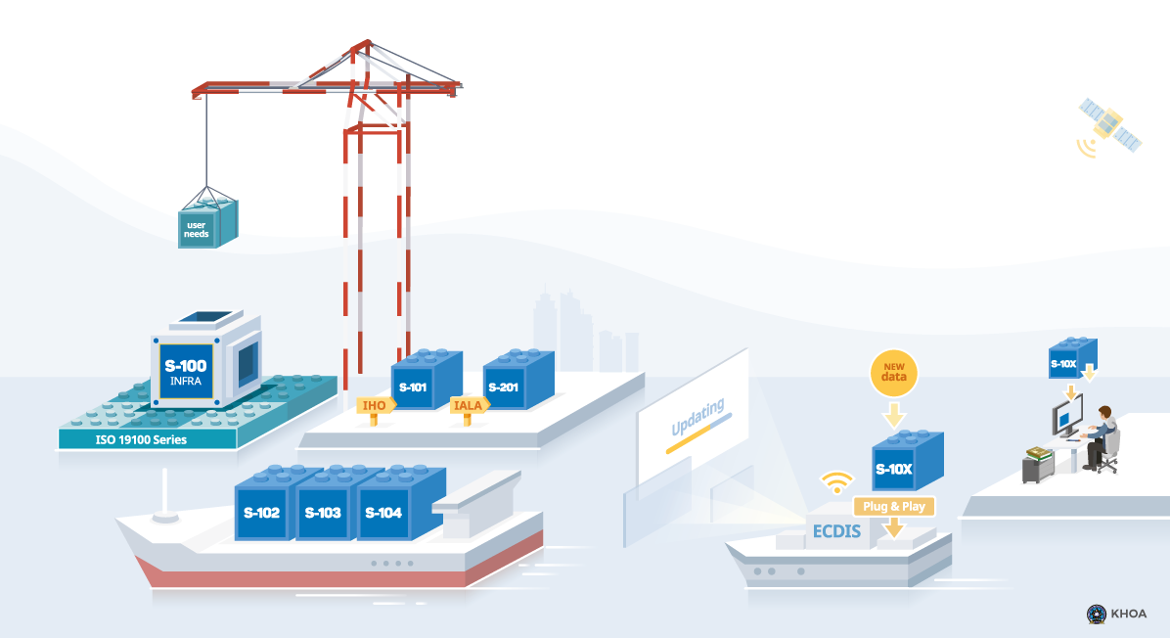
S-100 ImplemeNtation DECADE
C-2 tasked IHO SG, COUNCIL, HSSC and IRCC (action C2/31)
WGs Chairs have been asked to provide their contribution

Slide 8
Showcase of S-100 based products
C-2 tasked the HSSC (see action C2/29)
HSSC-11 discussed showcase structure
S-100 WG Chair coordination
5 presentation:
Canada – A Data Centric Approach
Norway (PRIMAR) – S-100 Development
United States (NOAA) – S-111 Surface Currents Operationalization
United States (NGA) – S-100 Test Bed Development
Republic of Korea – S100 Web Viewer and Sea Trial

Slide 9
Develop and deliver standards for hydrographic data and specifications of hydrographic products
New S-100 TIMELINE (Ed. October 2019)

Slide 10
C=Council
A = Assembly
SR = Stakeholder Review
MS = IHO Member State
S-129 UKC
Development and Testing
SR
HSSC Approval
S-129 Edition 1.0.0 Released
S-128 Catalog of Catalogs
Development (TBD)
S-127 Sea Traffic Management
Development (TBD)
S-124 Nav Warnings
Development and Testing
IRCC Approval
S-124 Edition 1.0.0Released
S-123 Radio Services
HSSC Approval
S-123 Edition 1.0.0 Released
S-122 MPAs
HSSC Approval
S-122 Edition 1.0.0 Released
S-121 - MLB
SR
HSSC Approval
S-121 Edition 1.0.0 Released
S-111 Surface Currents
HSSC Approval
S-111 Edition 1.0.0 Released
S-104 Water Levels
Development and Testing
HSSC Approval
S-104 Edition 1.0.0 Released
S-102 Bathy
Development and Testing
SR
HSSC Approval
MS Vote
S-102 Edition 2.0.0 Released
S-101 ENC
HSSC Approval
S-101 Edition 1.0.0 Released
S-101 Edition 1.X.X
2018
2020
2021
2019
A2
C2
HSSC11
C3
C4
HSSC10
HSSC12
September 2019
S-100 Edition 4.0.0
S-100 Edition 5.0.0
Notes:
As WGs and PTs are working, S-100 timeline have changed a little bit in respect to the HSSC report posted on the council website - especially with respect to S-104.
Originally, they would submit to HSSC12 (but since they are not meeting until after HSSC12 ), so don't think that it will be ready in time.
The first slide fixes S-104 - the second slide goes a bit further and adds 2021 (removes 2017).

Slide 11
MAKING THE S-100 a reality
MSs approved S-100 Ed. 4.0.0
MSs approved S-122 Ed. 1.0.0 – Marine Protected Areas
MSs approved S-123 Ed. 1.0.0 – Marine Radio Services
HSSC approved S-101 Ed. 1.0.0 – ENC
HSSC approved S-111 Ed. 1.0.0 – Surface Currents
HSSC endorsed S-102 Ed. 2.0.0 – Bathymetric Surface (CL 35/2019)
HSSC approved Ed. 1.0.0 of S-97 – Guidance for PS developers
HSSC approved Ed.1.0.0 of S-127 – Marine Traffic Management
HSSC approved Edition 1.0.0 of S-129 – Under Keel Clearance Management Information
S-100 Ed. 5.0.0 shifted to 2021
S-98 to be submitted for endorsement in 2020/2021

Slide 12
Priorities of IHO 2019 Work Plan 2
Develop an S-100 interoperability specification
Ed. 1.0.0. of S-98 final approval is part of S-100 Implementation Strategy
Ed. 1.0.0 of S-98 to be submitted for endorsement in 2020/2021
HSSC-11 agreed to organize a S-100 Test Strategy Meeting (TSM) in liaison with IEC
Develop S-121 Product Spec for Maritime Limits and Boundaries
HSSC endorsed the S-121PT to pursue the development of Ed. 1.0.0
HSSC encouraged the IHO Member States to participate in the S-100 WG review process of S-121
From the S-121PT meeting held in August 2019:
MSs comments discussed, consolidated and incorporated
S-121 Ed.1.0.0 to be release in October for test and evaluation

Slide 13
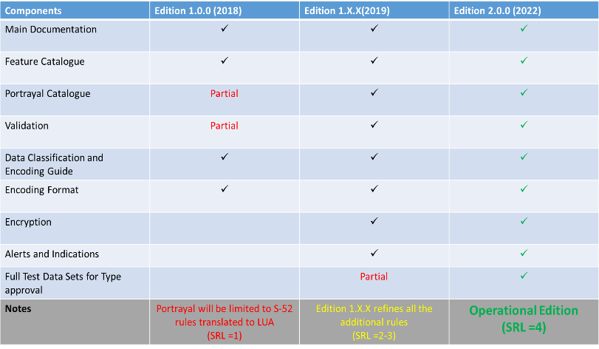
Priorities of IHO 2019 Work Plan 2
Develop all the components to make S-101 a reality
Ed. 1.1.0 of S-101 to be expected in December 2020
Ed. 2.0.0 to be expected in December 2022
S-101 components for Encryption, Alerts and Indications to be fully developed

Slide 14
Priorities of IHO 2019 Work Plan 2
Consolidation and clarification of standards in relation to ECDIS/ENC:
HSSC tasked ENCWG to develop a draft proposal for mitigation measures for cyber security and to make an impact assessment
HOs to review the current ENC production process and make changes where necessary to encode meaningful values of CATZOC

Slide 15
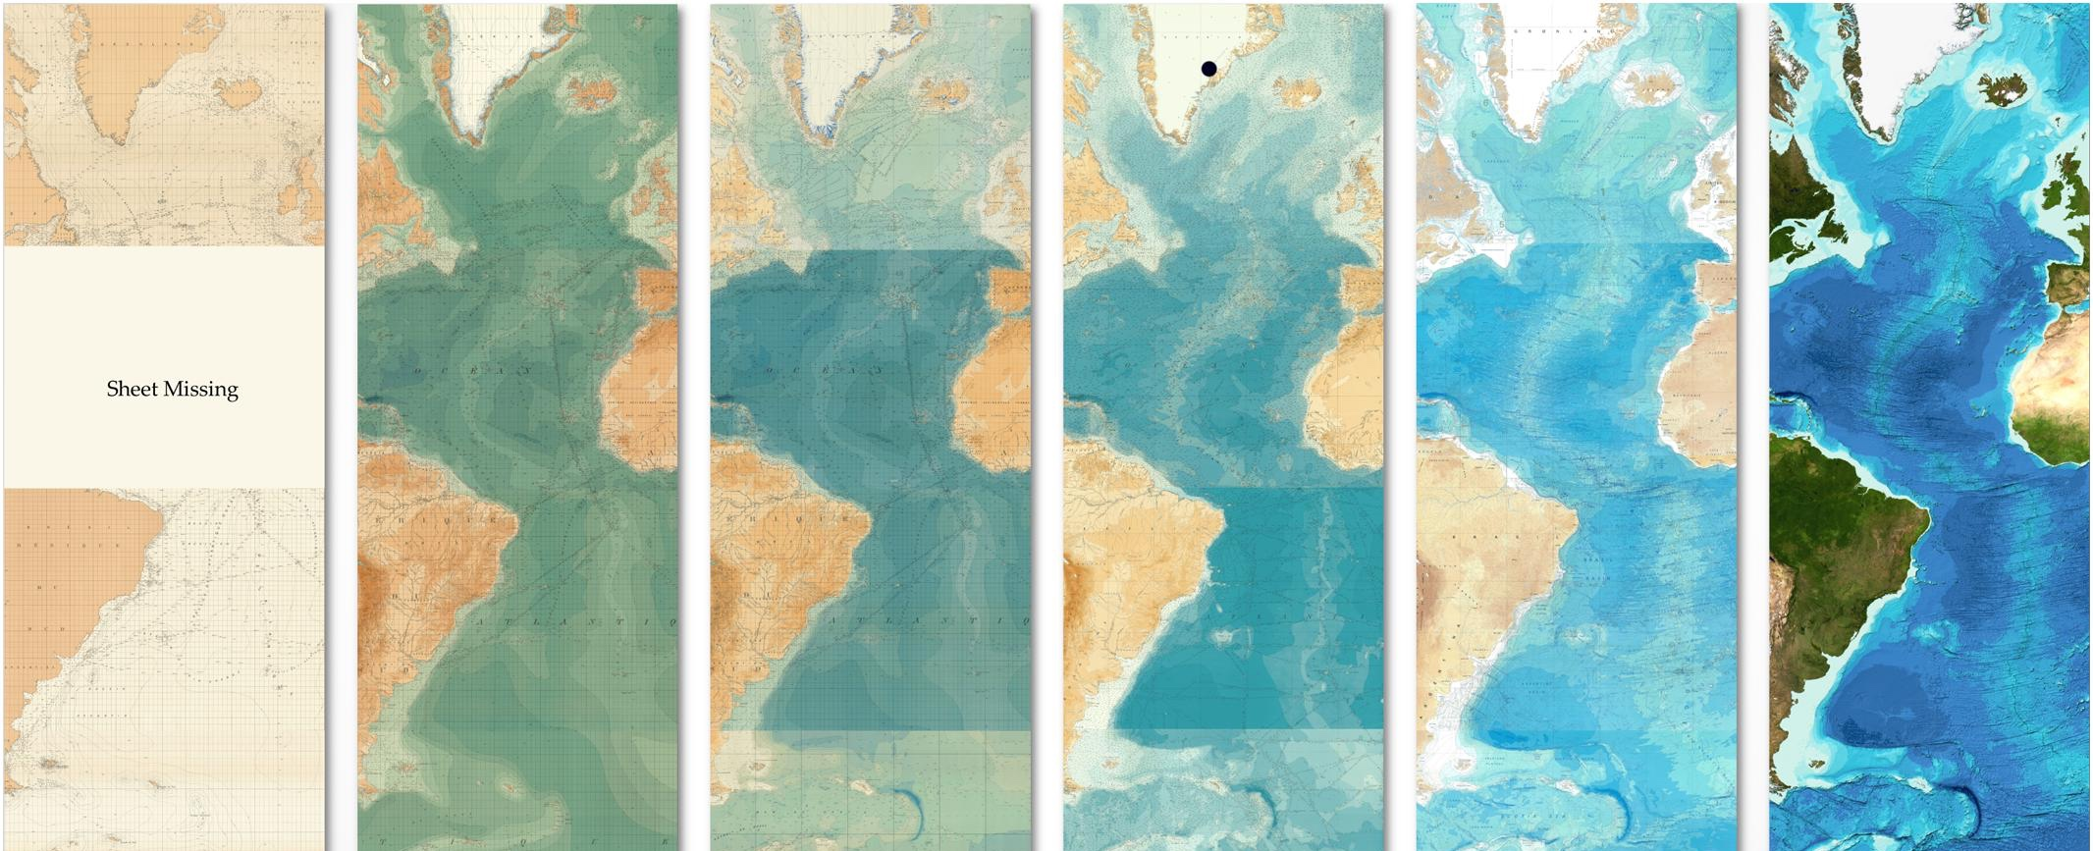
Priorities of IHO 2019 Work Plan 2
Future of Paper Charts
Sales and use of paper nautical charts is declining
NCWG drafted a document about PC’s Future
Preliminary comments received from HOs
Questionnaire to MSs (CL 29/2019)
Survey outcome to be discussed at NCWG5 (5-8 Nov)
Final Report at HSSC 12
Notes:
Common needs:
Reallocate the resources currently dedicated to traditional paper
Ultimate goal is to fully automate the creation of paper products from fully populated ENC vector databases

Slide 16
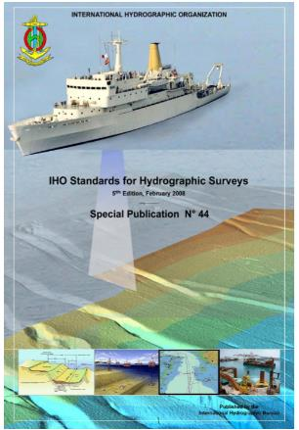
Priorities of IHO 2019 Work Plan 2
Prepare Ed. 6.0.0 of S-44:
May/June 2019 - HSPT: draft of the 6th Edition (v1.7.0) for review and comments by MSs and stakeholders
HSSC Letter 3/2019 dated16/7/19: seek for comments on version 1.7.0
March 2020: S-44 6th Edition (v2.0.0) delivered to HSSC for endorsement
End 2020: Approval of the S-44 6th Edition
Contest for designing the cover page of Edition 6 of S-44 to be advertised among MSs

Slide 17
Priorities of IHO 2019 Work Plan 2
Consider data quality aspects in harmonized way for all S-100 based PSs
Transversal role between Committees
Review of S-100 based products
General support for decision making
Response to the request of automation for the production of charts from ENCs
Contribution to S-100 Test Strategy Meeting
Visualization methodology of Quality of Bathymetric Data
HSSC amended DQWG ToRs → DQWG to support IRCC WGs and sub-committees on request (MSDI, CSBWG, S-124 PT)

Slide 18
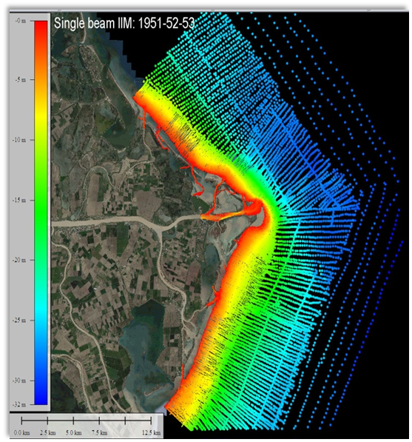
Priorities of IHO 2019 Work Plan 2
Consider data quality aspects in harmonized way for all S-100 based PSs
Visualization methodology of Quality of Bathymetric Data
Method to depict the quality of the bathymetry and isolated features hazardous to the safety of navigation (wrecks, rocks, obstructions)
Also supportive for decision making and autonomous shipping
Raised awareness of this methodology at IRCC

Slide 19
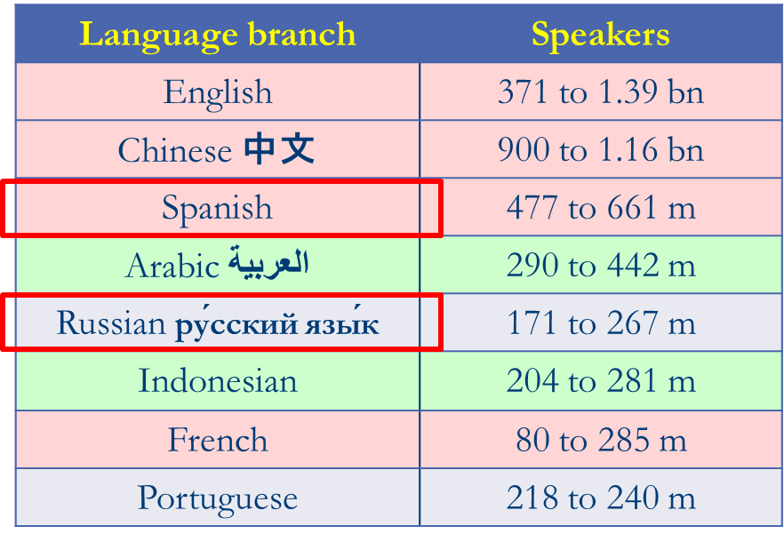
Hydrographic Dictionary (HD)
HSSC11 noted the work done in the development of S-32 IHO HD
Achievements:
The HD and the IHO GI Registry will share the same management system, use the same metadata and will be enriched and maintained by using the same procedure
Language improvements (New HDs)
SPAIN joined HDWG in September 2019
HDWG template to be used by WGs when submitting new terms
RHCs to support the HD (Ambassador Role)
MS are invited to develop their National variants

Slide 20
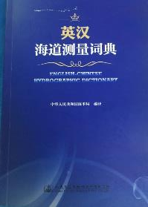
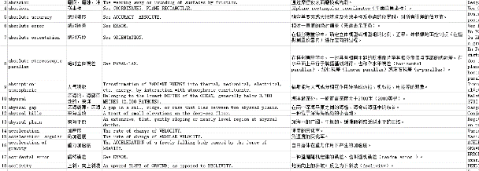
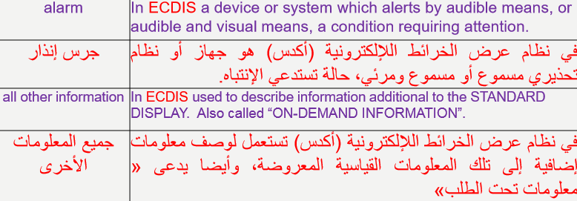
Hydrographic Dictionary (HD)
Chinese HD is now available on the IHO website
Arabic HD in progress

Slide 21
Action requested of the council
The Council is invited to:
Note the Report
Approve HSSC Work at strategical and technical level

