Slide 1
3rd Meeting of the IHO Council
IHO ANNUAL WORK PROGRAMME AND BUDGET
Agenda Item 5.2
Proposed IHO Work Programme 2020
starts with a review of the IHO Work Programme 2019 achievements

Slide 2
Review of IHO Annual work programme 2019
The IHO Work Programme for 2019 is based on the second year of the three-year work Programme approved by the first session of the IHO Assembly. It covers all three Work Programme elements and cumulates all tasks as an instrument of control for the operations of the Secretariat:
Corporate Affairs (WP1)
Hydrographic Services and Standards (WP 2)
Interregional Coordination and Support (WP 3)
The achievements under the work programme items “Hydrographic Services and Standards” and “Interregional Coordination and Support” were discussed under Agenda Items 4.1 and 4.2 by means of the respective reports of HSSC and IRCC chairs.
Work Programme item “Corporate affairs” covers the provision of the services of the Secretariat of the IHO and, through the Secretariat, the management and fostering of relations with other international organizations.
C-2 set priorities for WP 1 to be reported here.

Slide 3
WP 1 priorities for 2019
Facilitate the technical and operational arrangements of the S-100 environment.
Development of S-100 roadmap.
Promote the joint approach of DCDB, GEBCO and SeaBed2030 in collaboration with IOC.
Strategic agreement about the designated roles of IHO, IOC, GEBCO GC and Seabed2030 Sponsors.
Installation of the Seabed2030 Director.
Intensify engagement within the framework of the UN Nations to foster the use of marine geoinformation on the basis of the IHO Standardization framework and regional/national contributions of the IHO Member states
Joint presentation with ISO and OGC at UN-GGIM.
Contribution of a special chapter about geoinformation standards to the Integrated Geoinformation Framework IGIF of UN GGIM.

Slide 4
WP 1 priorities for 2019
Enhance the visibility of the IHO trough digital centricity of communication including incorporation of the Secretariat´s GIS-services.
Overhaul of IHO website.
Installation of social media.
Evolution to INToGIS II.
Continue preparations of the upcoming Centenary celebrations of IHO.
Conduct and preparation of several events (to be reported separately).

Slide 5
And much more than the set priorities …
Reinforcement of the links with Parties to the Antarctic Treaty through ATCM (a new ATCM Resolution, thanks to strong support provided by MS delegates that were present or briefed at the Seminar).
Involvement in the 1st Global Planning Meeting of the UN Decade of Ocean Science for Sustainable Development.
Strategic discussions with ISA in Jamaica for accession of their seabed data for GEBCO purposes.
Promotion of Crowd Sourced Bathymetry on all levels including ABLOS.
Recruitment of a new Editor-in-Chief for International Hydrographic Review.
Welcome of four new IHO Member States, namely
Guyana, Solomon Islands, Ghana and Samoa – cumulates to 93 IHO MS.

Slide 6
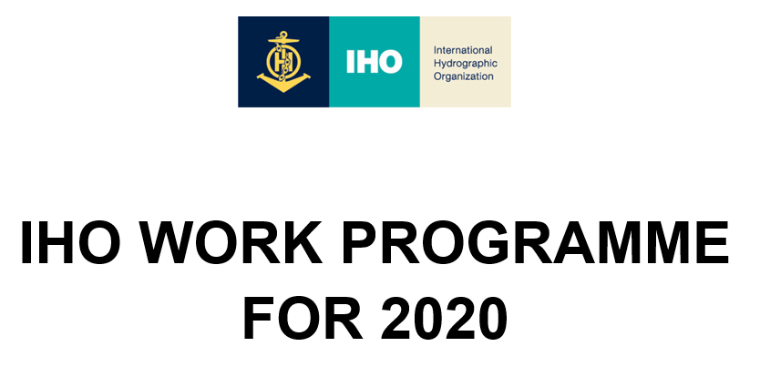
Proposed IHO Work Programme for 2020
The proposed Work Programme for 2020 is based on the third year of the three-year work Programme approved by A1. As for the previous years it covers all three Work Programme elements:
Corporate Affairs
Hydrographic Services and Standards
Interregional Coordination and Support
The document in table form of altogether 46 pages lists tasks related to the strategic directions of the strategic work plan in force and associates personal and material resources including authorities to desired activities and deliverables.
It is expected that the priorities will be defined as a result of the revision of the Strategic Plan (Agenda Item 2.1 refers).

Slide 7
Proposed Theme for World Hydrographic Day 2020
Hydrography - enabling autonomous technologies

Slide 8
Actions to be considered by Council
C-3 is invited to:
take note of the activities addressing the priorities put on WP 1 in 2019,
approve the Work Programme for 2020,
endorse the concept to apply the renewed Strategic Plan priorities to the Work Programme for 2020,
take note of the proposed theme for World Hydrographic Day 2020.

