Slide 1
3rd Meeting of the IHO Council
Preparation of the
2nd Session of the IHO Assembly C.3-07.1A

Slide 2
OUTLINE
Timetable / Countdown
Draft Programme
Reports to A-2 (by SG, Council, FC and RHCs)
List of Deliverables of C-3 to A-2
Finance Committee meeting (20 April 2019)
Other Admin / Logistic matters

Slide 3
TIMETABLE
Preparation of the Assembly (RoP of the Assembly)
Date | Assembly Calendar
Time 0 (T 0) (21 April 2020) | Opening of the Assembly
T0 – 2 months (21 Feb 2020) | Circulation of reports and other documents
T0 – 4 months (21 Dec 2019) | Submission of proposals to the Secretariat
T0 – 6 months (21 Oct 2019) | Circulation of provisional Agenda

Slide 4
Countdowns FOR Council and Assembly by 2020
Jul. 2020
Report/Prop. to C-4
Oct. 2019
Nov. 2019
Aug. 2020
Oct. 2020
C-3
Report/Prop. to A-2
Red Book C-4
C-4
20 Oct. 2019
15 Dec. 2019
20 Feb. 2020
21 Apr. 2020
Prov Agenda A-2
Proposals to A-2
Rev Prov Agenda&Red Book A-2
A-2

Slide 5
PLANNED ACLs and
DRAFT PROGRAMME

Slide 6
Reports to A-2 (by SG, Council, FC and RHCs)
- Chair of the Council : Report on the work of the Organization since the preceding ordinary session of the Assembly and all items the inclusion of which has been requested by the Council;
- Secretary-General: Report on the activities of the Secretariat and three-year budget, as well as matters pertaining to the accounts and financial arrangements of the Organization;
- Chair of the Finance Committee: Report of the FC Meeting regarding the review the financial statements, budget estimates and reports on administrative matters prepared by the Secretary-General and to present its observations and recommendations thereon to the Assembly.

Slide 7
Reports to A-2 (by SG, Council, FC and RHCs)
- Chairs of the Regional Hydrographic Commissions : Report to the IHO Assembly on RHC activities, the findings of the assessments on nautical information, navigational warnings, hydrographic surveying, nautical charting, hydrographic capacity and requirements within their region and future plans and the agreed key targets that support RHC tasks detailed in the IHO Work Programme.

Slide 8
Finance Committee meeting
The Finance Committee will hold its next regular meeting on Monday 20 April 2020 from 14:00 to 17:30 at the IHO Secretariat, as part of the 2nd session of the Assembly.
Member States wishing to attend the meeting of the Finance Committee are requested to register their delegates through the IHO registration system not later than 1 March 2020.
The Chair and Vice-Chair shall be elected for a period of three years and hold office until the end of the next ordinary session of the Assembly (A-3).

Slide 9
Finance Committee meeting
-The Secretary-General shall ask Member States, four months before (20 December 2019) the Finance Committee meeting, to provide the details of the heads of delegations and names of alternative delegates and the Candidates for the Chair and Vice-Chair of the Finance Committee.
-Member States are requested to submit their proposals that they wish to be discussed by the Finance Committee, no later than 20 January 2020.

Slide 10
Agenda of the Finance Committee
Opening of the meeting
Adoption of the agenda
Election of the Chair and Vice-Chair
Any item the inclusion of which has been requested by the FC
Financial statements for 2017-2018
Implementation of the budget for 2019
Proposed budget for 2021-2023
Report to the Assembly
Any other business
Closure of the meeting

Slide 11
List of Deliverables of C-3 to A-2
Proposal to A-2, Revision of the IHO Strategic Plan
Proposal to A-2, Revision of the IHO Resolution 2/2007 (HSSC)
Proposal to A-2 Revision of the IHO Resolution 1/2005 (IRCC)
Proposal to A-2, Revision of the IHO Resolution 2/1997 (IRCC)
Proposal to A-2, S-100 Implementation Strategy (SG)
Proposal to A-2, Election of Chair and Vice-Chair of the Council (SG)

Slide 12
List of Deliverables of C-3 to A-2
Proposal to A-2, Amendments to General Regulations (medical fitness of candidates for election (SG)
Proposal to A-2, Reconsideration of the definition of hydrographic interests (SG)
Proposal to A-2, Interpretation of the ROP 8(i) of the Council and the Art. VI(g)(vii) of the IHO Convention (SG) ( no discrepancies between the Convention and the Rules of Procedure of the Council)
Proposal to A-2, 3-year Programme and Budget (SG)

Slide 13
Other Administrative / Logistic matters
Venue of the Assembly (Auditorium Rainer III)
Registration and Security Arrangements
Opening Ceremony
Exhibitions
Side Meetings
Ship Visits
Receptions

Slide 14
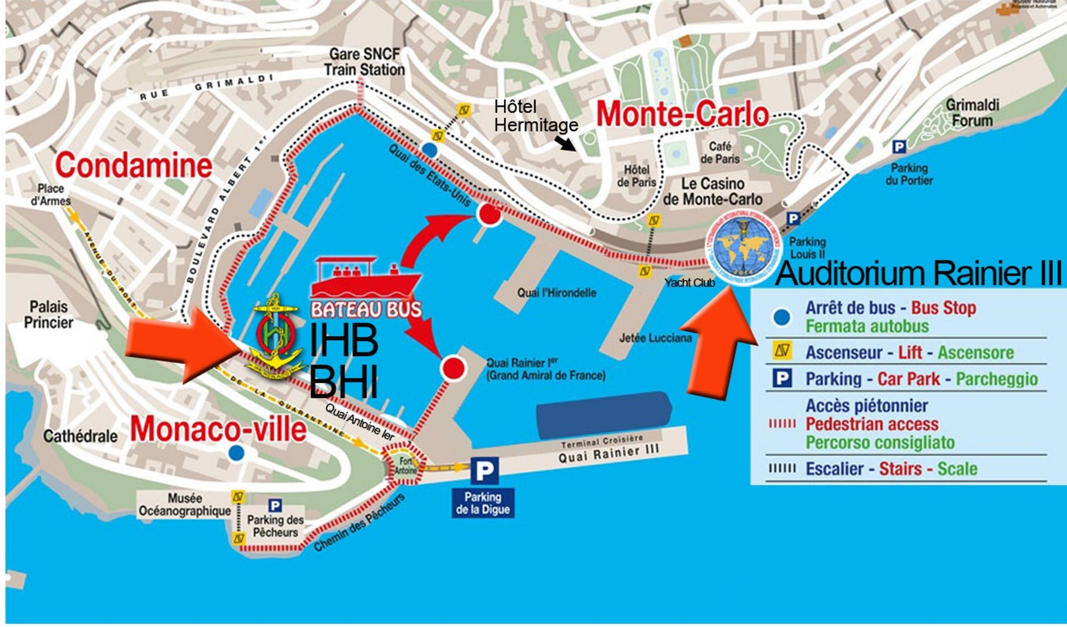
LOCATION OF THE ASSEMBLY VENUE (Auditorium)

Slide 15
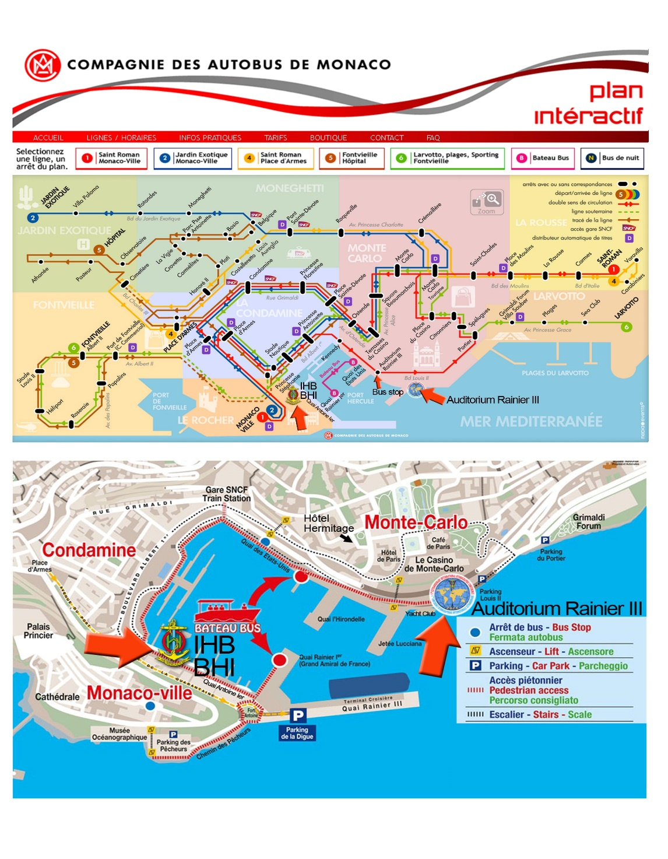
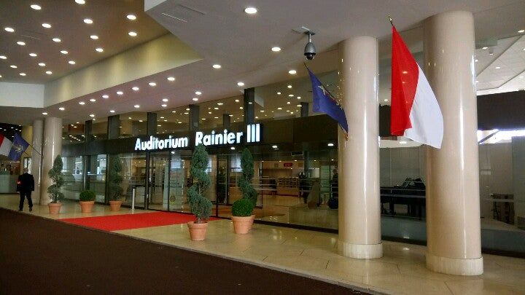
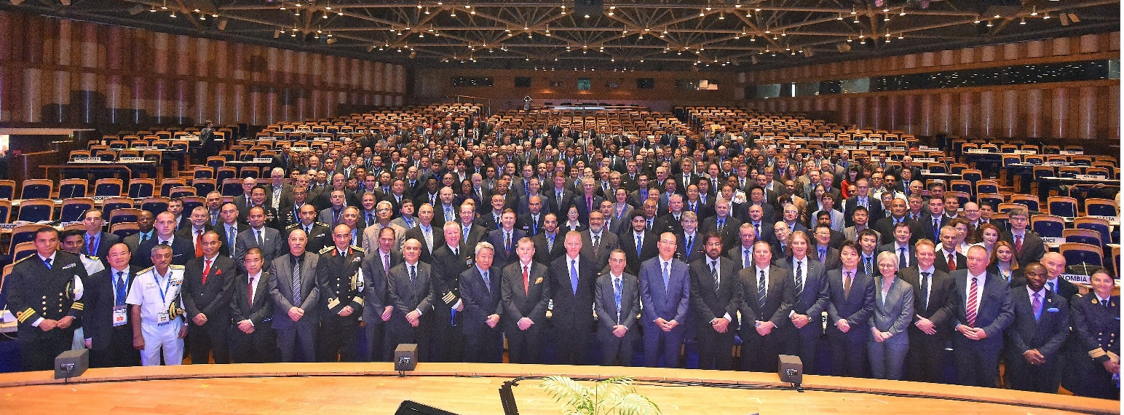
THE ASSEMBLY VENUE (Auditorium)

Slide 16
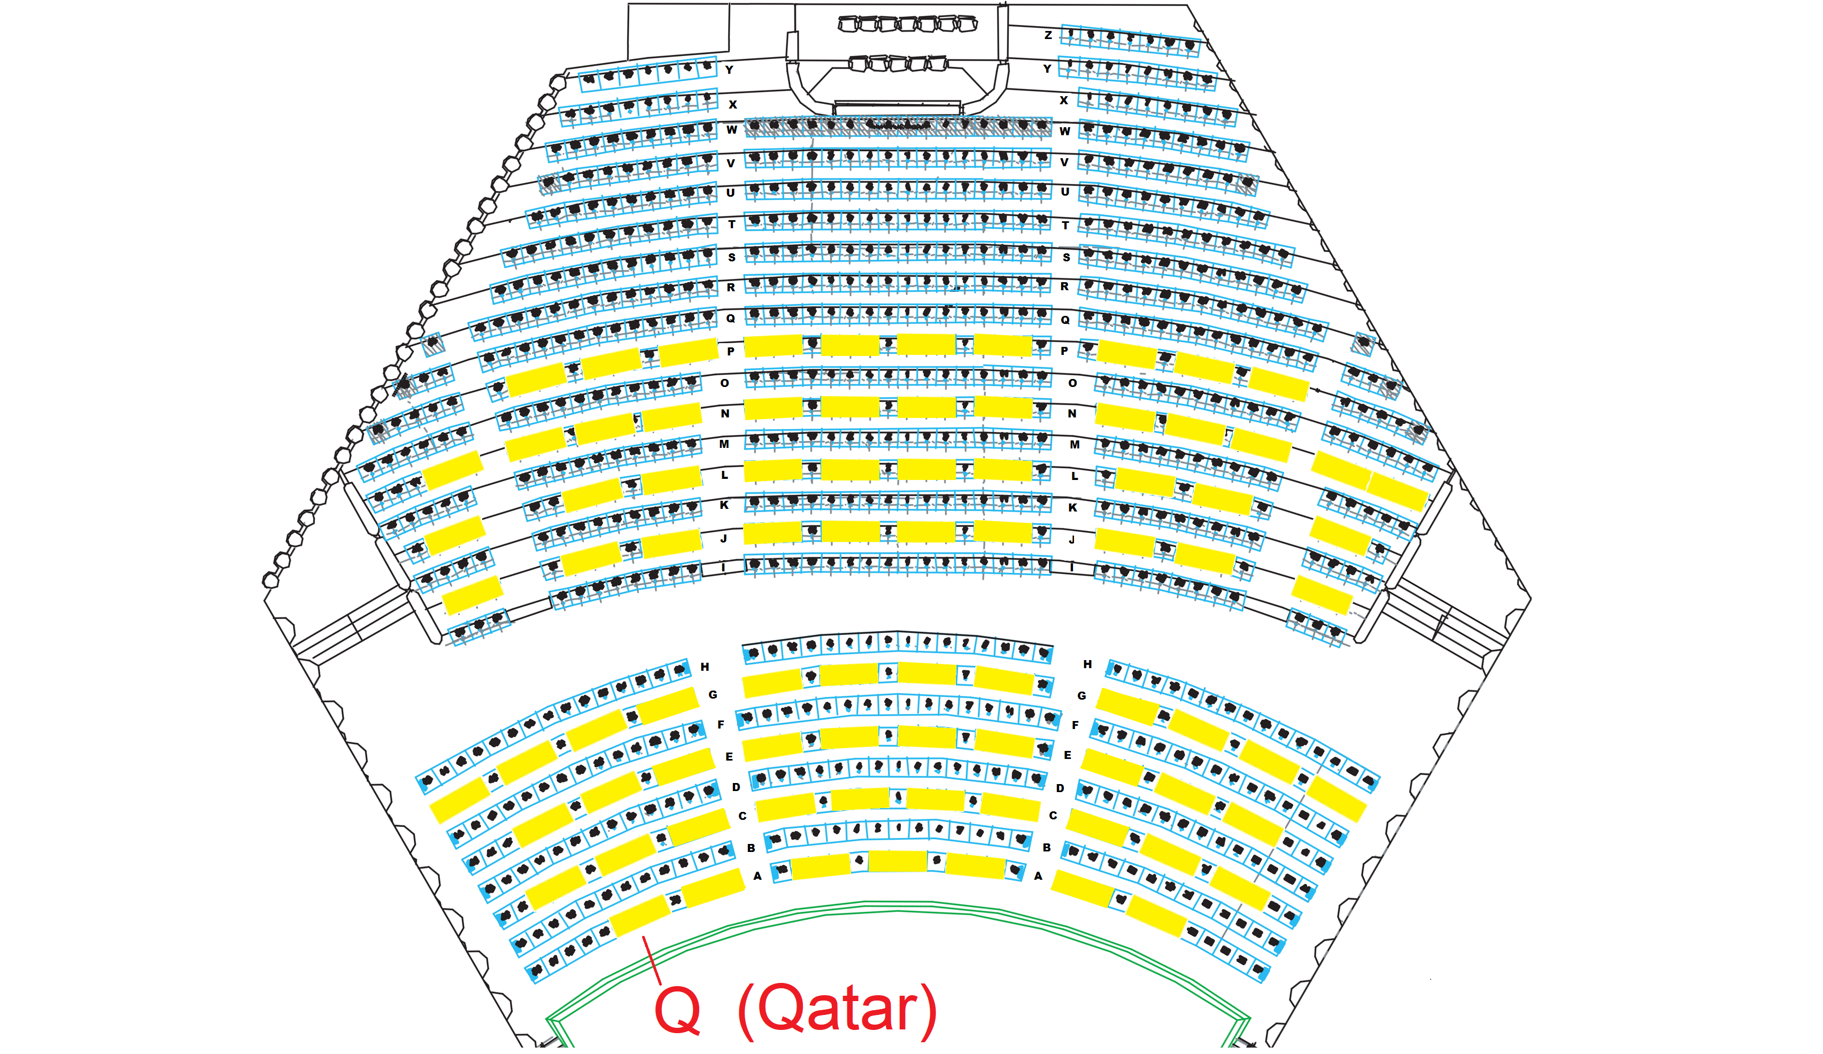
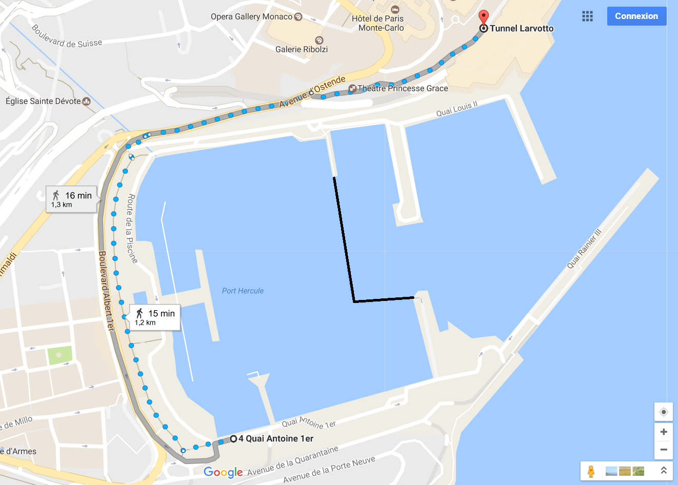
Venue of the Assembly
Auditorium Rainier III
Address: Boulevard Louis II, Monaco
Location

Slide 17
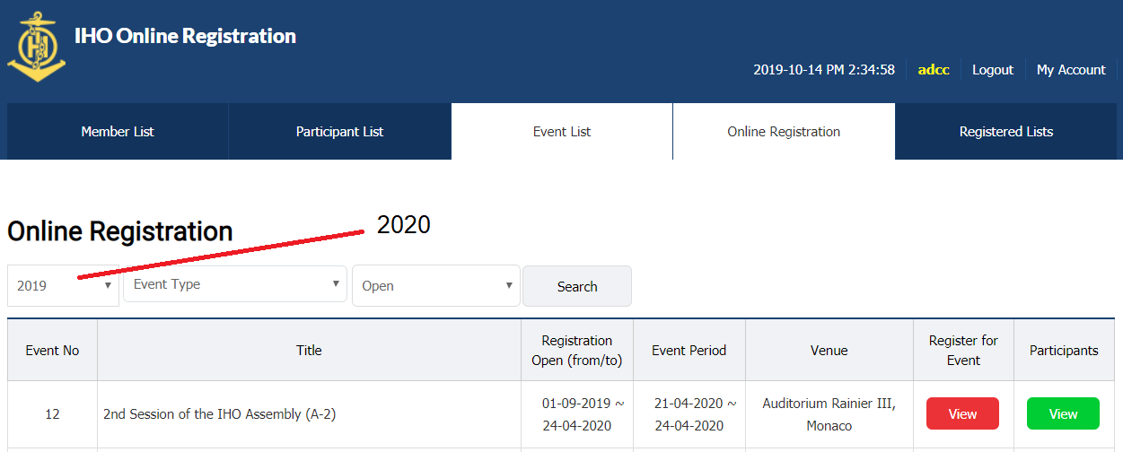
Registration and Security Arrangements
Registration via the IHO Online Registration System:
www.iho.int → IHO Assembly → Online Registration
Two steps:
1. Create account (not necessary for those registered for C-3)
2. Register for A-2

Slide 18
Registration and Security Arrangements
Security arrangements:
Security will work from 20 to 25 April 2019
Two security officers during the Assembly (21 to 24)
One security officer for the assembly and disassembly
Delays may happen in busy hours

Slide 19
Opening Ceremony
The Opening Ceremony for A-2 will take place on Tuesday morning, 21 April 2020 (10.00-12.00)
Speakers:
Chair of the Assembly
Secretary-General
Keynote speaker: HE Peter Thompson, Special Envoy for Ocean Matters to UN-Secretary General
HSH Prince Albert II
New Member States that have joined the IHO since A-1 will be invited to present their flag on this occasion

Slide 20
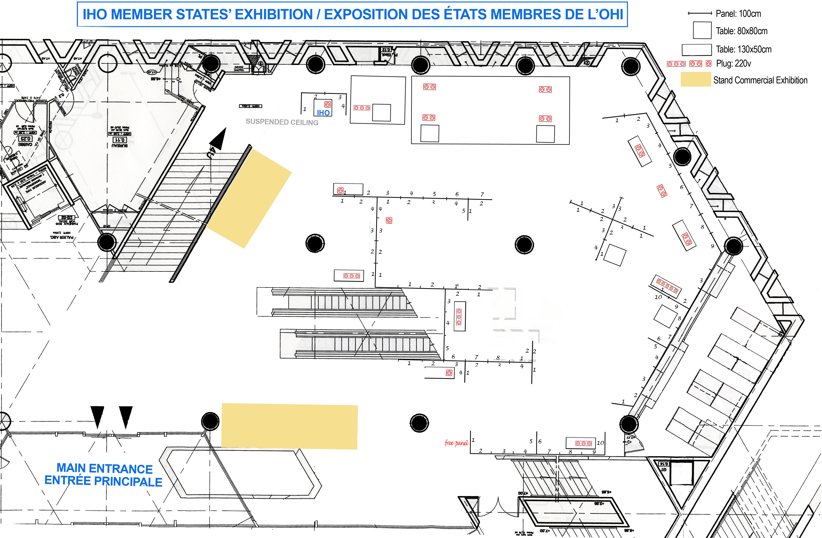
Member states Exhibition
The past, present and future of hydrographic services
Member States Exhibition will take place in the ground floor of the Auditorium Rainier III
Exhibition will take place from 21 to 24 April 2020
ACL 10 provides additional information
It is still possible to participate in the Exhibition

Slide 21
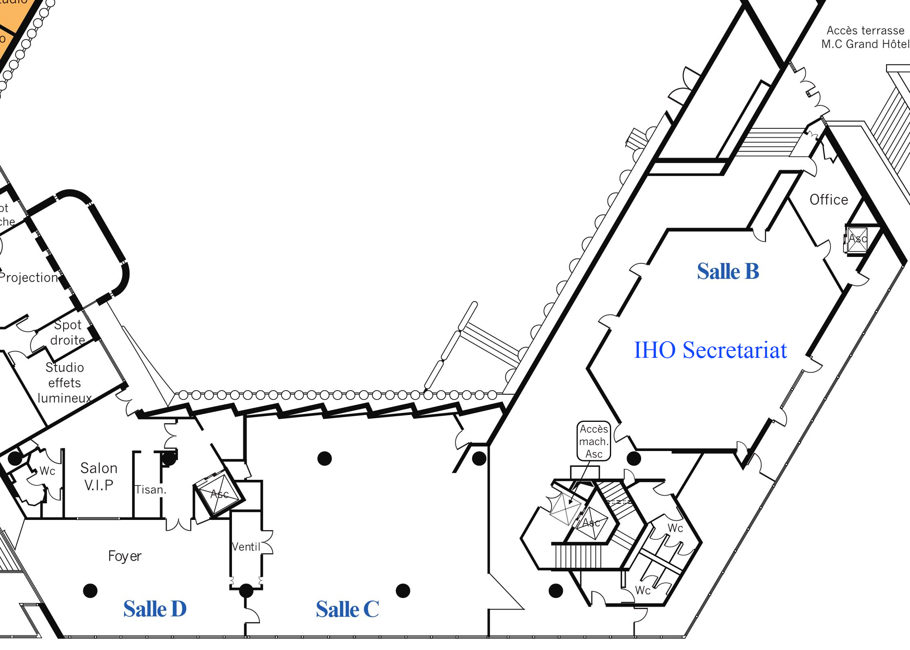
Side Meetings
Side meetings may be organized during A-2.
In the Auditorium there will be two rooms:
Salle C: 20 people
Salle D: 12 people
Third floor of the Auditorium
Contact with Director Abri Kampfer

Slide 22
Ship Visits
Three Member States confirmed ship visit during A-2:
Brazil (Tall Ship)
Italy (Frigate)
United States (Survey Ship)
One Member State is considering to send a ship: Spain
Member States are invited to notify the IHO Secretariat no later than 01 November 2019
Diplomatic request to Monaco Government is required
Reference: ACL 5

Slide 23
RECEPTIONS
Monday, 20 April: Heads of Delegation Reception (IHO Sec.)
Tuesday, 21 April: Industry Exhibitors’ Reception (Auditorium)
Wednesday, 22 April: Monaco Government Reception (TBD)
Thursday, 23 April: TBD
Friday, 24 April: IHO Reception
Other receptions will be coordinated by the IHO Secretariat, if any.

Slide 24
Action requested of the council
The Council is invited to:
note the Report
take any other action considered appropriate

