Slide 1
3rd Meeting of the IHO Council
IHO Innovation and Technology Lab
7.2

Slide 2
Proposal: iHO Innovation and Technology Lab
A collective IHO approach towards:
Keeping pace and remain relevant with the rapid evolving technologies that will impact on the hydrographic community;
Identifying products and services that will be developed and how can we provide the support their development;
Contributing to other global initiatives related to seas and oceans, such as the United Nations Sustainable Development Goal 14: “Conserve and sustainably use the oceans and sea and marine resources for sustainable development”

Slide 3
Objectives: iHO Innovation and Technology Lab
Facilitate the conduct of research or investigative projects in the laboratory and/or test bedding in the field submitted by IHO Member State(s), IHO organs, or other stakeholders.
Enable knowledge creation for the evaluation and specification of global standard-setting at the request of eg. IHO member State(s); and
Foster a multidisciplinary and collaborative environment for researchers and investigators to interact, learn and promote new solutions and technologies, including collaboration with other international organisations under the guidance of a Governing Board (see para 9).

Slide 4
Governance: iHO Innovation and Technology Lab
IHO Secretary General or his Appointee.
The members would include IHO appointees from member States.

Slide 5
IHO Lab Management Team: iHO Innovation and Technology Lab
Roles of IHO Lab Management Team
– Administrative support from Singapore
Assess and make recommendations on proposals submitted for funding support;
Monitor IHO Lab’s project activities, progress and outputs; and
Manage the technical reviews of IHO Lab’s projects and new proposals.

Slide 6
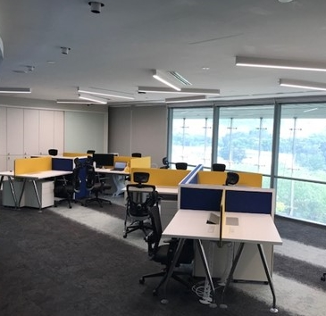
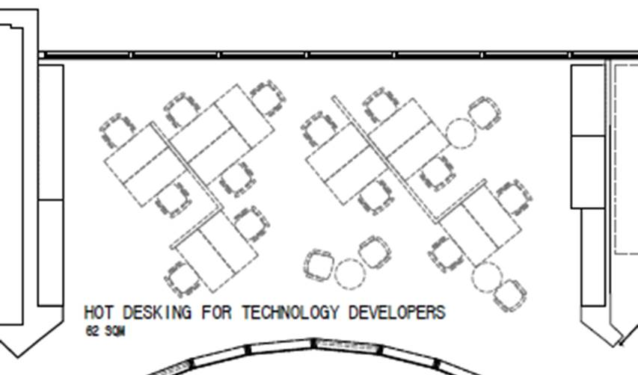
Singapore in kind contribution: iHO Innovation and Technology Lab
Work Space + Manpower Costs
Total estimated costs to be borne by Singapore US$163,000 annually

Slide 7
iHO Innovation and Technology Lab
The Council is invited to:
Discuss and consider the proposal to set up an “IHO Innovation and Technology Laboratory”;
Discuss Singapore’s proposal to host this Laboratory at no cost implication to the IHO, including administrative support; and
Take any other actions that may be appropriate.

