Slide 1
9th Meeting of the Arctic Regional Hydrographic Commission National Report by
United States of America

Slide 2
U.S. Hydrographic Leadership
NOAA
Director, Office of Coast Survey
Rear Admiral Shep Smith
Deputy Director, Office of Coast Survey
Katie Ries
NGA
Senior GEOINT Authority-Maritime
John Lowell
Director, Maritime Office
Capt Richard Kennedy
Navy
Commander Naval Meteorological and Oceanography Command (CNMOC) Oceanographer of the Navy, Hydrographer of the Navy, and Navigator of the Navy
Rear Admiral John Okon
Deputy Hydrographer of the Navy
Matthew Borbash (as of January 2019)
Notes:
Note:
Rear Admiral John Okon has replaced Admiral Tim Gallaudet this past year. Admiral Gallaudet is now the Acting Under Secretary of Commerce for Oceans and Atmosphere within NOAA.

Slide 3
Notables since ARHC-8
NOAA ENC rescheming underway in the Arctic
Status of ENC overlaps
2 Survey’s and ASV testing
“Projection of Maritime Activity in the U.S. Arctic, 2020–2030”
Release of VDATUM-SE Alaska and spatial varying uncertainty

Slide 4
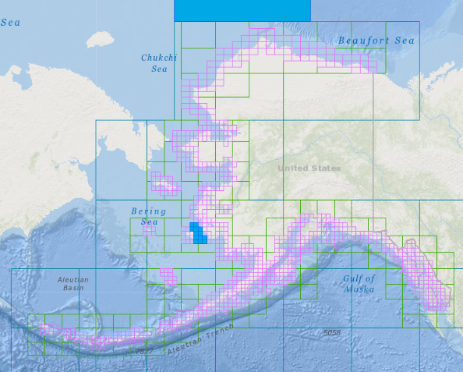
Rescheming U.S. ENCs (NOAA)
Current scheme of 1266 ENCs
Final rescheming will produce suite of over 9,000 ENCs
Planned ENC Scheme for Usage Bands 1-4.
ENCs already created are shown in blue.
For real-time status updates: https://noaa.maps.arcgis.com/apps/webappviewer/index.html?id=ab6ad790ac3f411f8ef96cb26d0c4868
Notes:
NOAA has started to rescheme its suite of 1266 ENCs into a regular gridded set of rectangular cells. The current ENC scheme is based on the extents of the paper nautical charts from which ENCs were originally digitized. Rescheming will replace this puzzle-piece layout with a rectangular grid of ENCs, often providing larger scale, more detailed coverage than the existing paper charts. The final product suite is expected to exceed 9,000 ENCs. The current status of the creation of the new gridded ENC product layout is available online at:
https://noaa.maps.arcgis.com/apps/webappviewer/index.html?id=ab6ad790ac3f411f8ef96cb26d0c4868

Slide 5
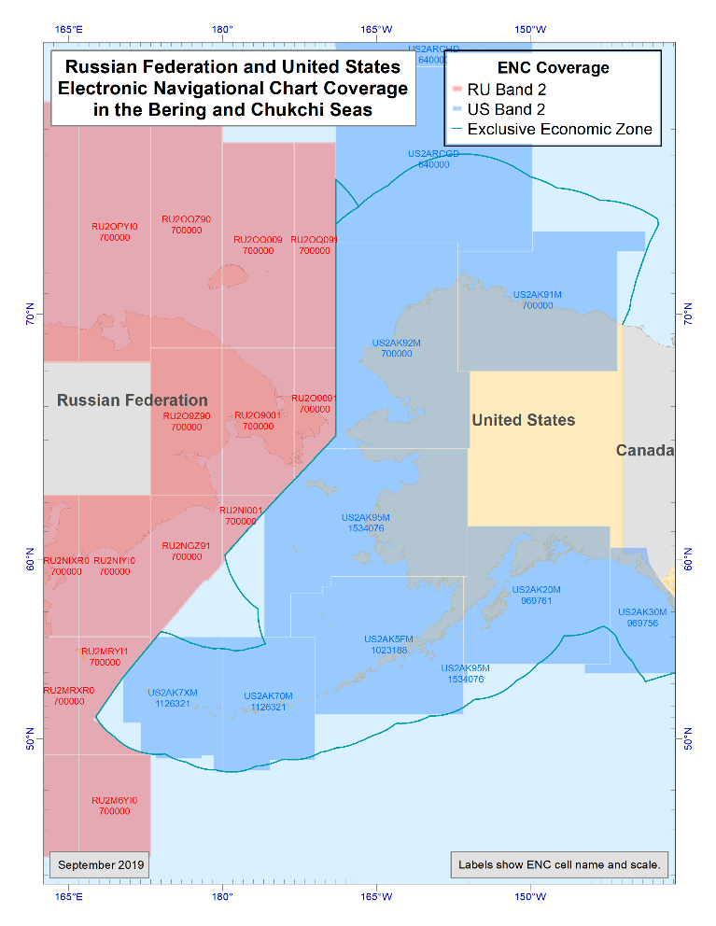
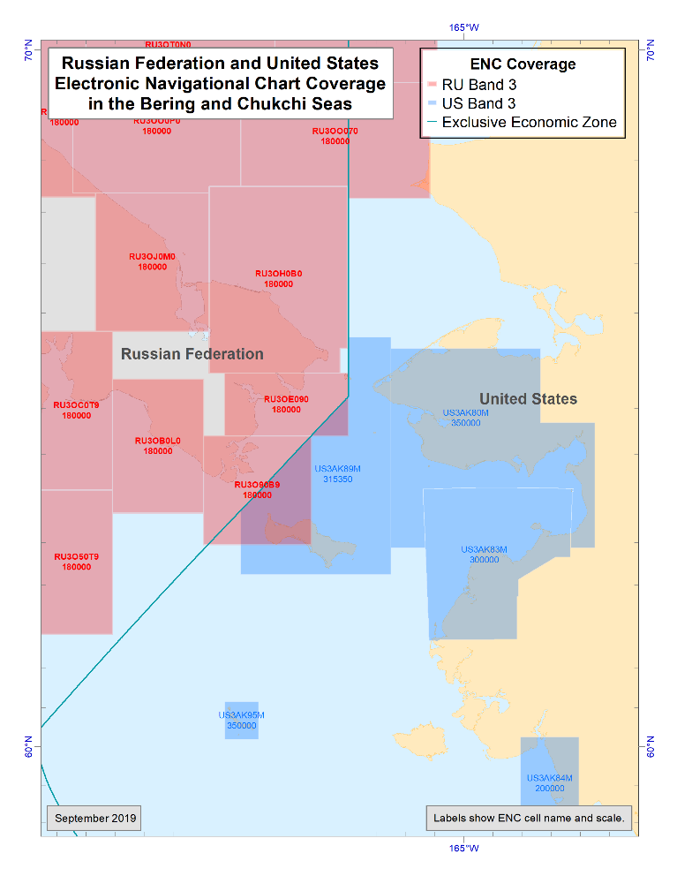
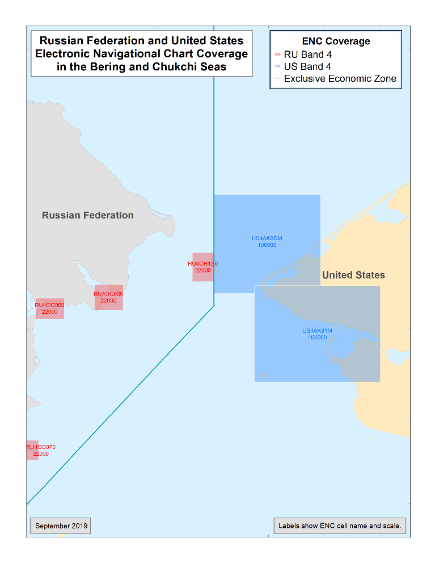
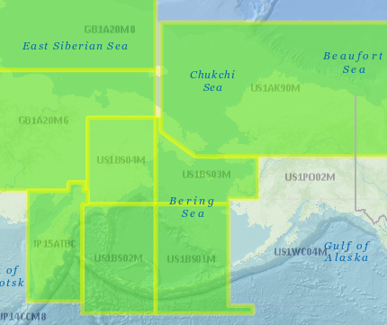
RU-US ENC Overlaps
Reschemed US ENCs will continue to be clipped to the US EEZ
The gaps on the US side will be filled with planned ENCs in coming decade
For discussion
Should we compile a regional chart plan?
Full coverage at Bands 1-3?
Band 2
Band 3
Band 4
Band 1

Slide 6
Arctic Surveys since ARHC-8
Vicinity of Cape Newenham, Alaska (58.755184N,162.680935W)
May 22-August 8, 2019
Planned days at sea: 57
approx. 315 square nautical miles
Kuskokwim Bay, AK & Vicinity (TerraSond Ltd.)
(59.745N, 160.000W)
June 01, 2019- February 28, 2020
Planned days at sea: 56
Approx. 5,762 square nautical miles
More on ASV testing results in the OTWG Report

Slide 7
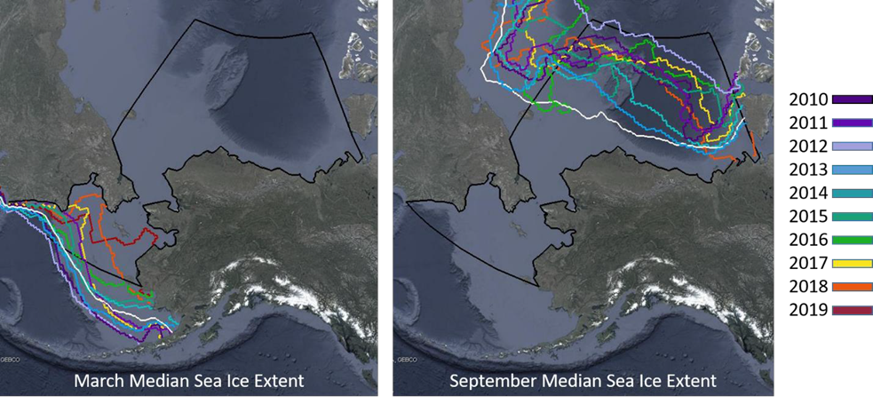
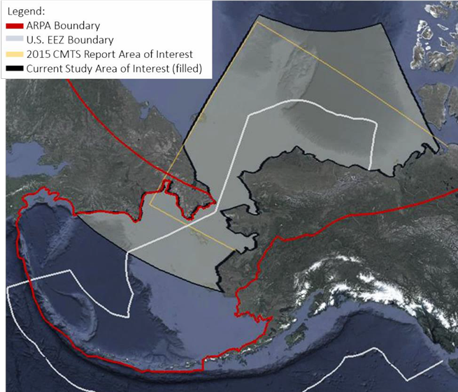
“Projection of Maritime Activity in the U.S. Arctic, 2020–2030”
Committee on the Marine Transportation System
90 page draft open for comment July 2019
The final version of this report expected to be released in October 1

Slide 8
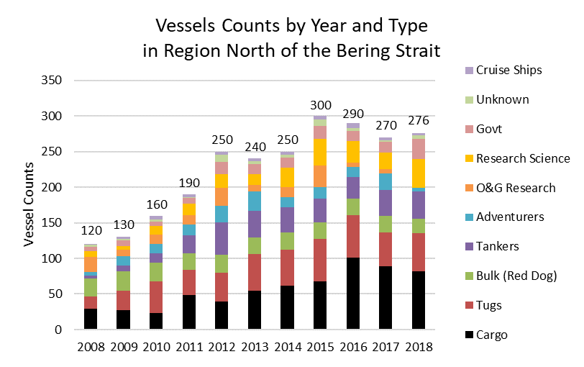
Where are we now?
We continue to see increases in vessel numbers and a shift away from regional operations
Despite Shell’s withdrawal, we have not seen the activities north of the Bering Strait return to pre-2010 baseline (image left)
The number of flag states operating in study area of interest has increased, indicating a shift in ‘who’ is there.
There’s also been an increase in number of fishing-related vessels south of the Bering Strait
Data provided by U.S. Coast Guard, District 17

Slide 9
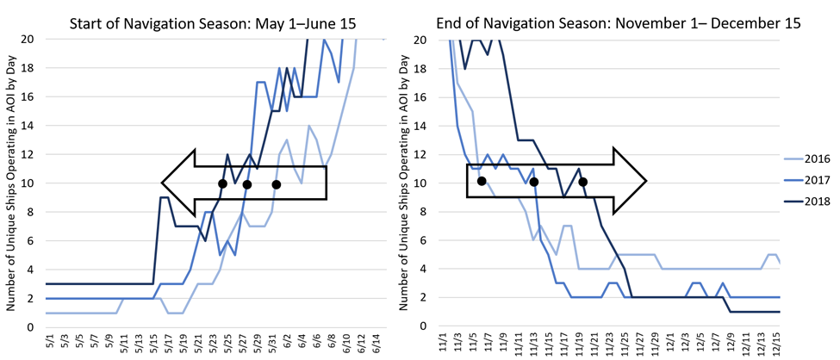
Where are we now?
The region’s highly seasonable navigation season is growing longer each year
The navigation season grew from 159 days in 2016, to 171 in 2017, and 180 in 2018;
An average of 10-day increase each year.
Further supported by independent data from the Marine Exchange of Alaska

Slide 10
Building the Scenarios
The Reduced Activity Scenario assumes that the high risks of operating in the region are not able to be mitigated over the next decade, and this uncertainty limits the volume of growth in the region.
The Optimized Growth Scenario assumes that much of the risk for operating in the region will be mitigated over the next decade. This scenario incorporates the upper end of growth rates.
The Most Plausible Scenario assumes that some of the risks for operating in the region will be mitigated. This scenario incorporates the most reasonable estimates of traffic growth and vessel counts into a single scenario.
The Accelerated, but Unlikely Scenario assumes that the risks of operating in the region are completely mitigated and incorporates all sources of growth for the region, including components which may be unlikely according to best available data.
This scenario is meant to act as a ceiling for the projections in this study

Slide 11
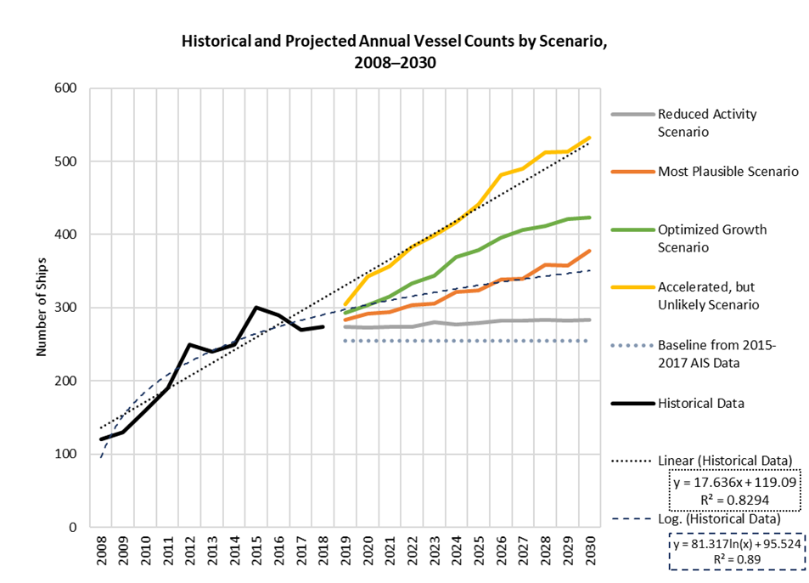
Projections compared with historic data for the region

Slide 12
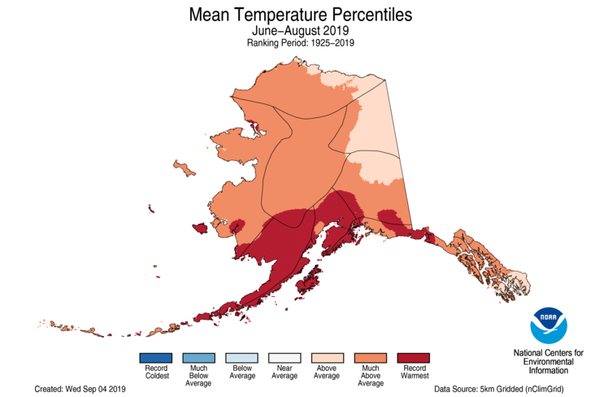
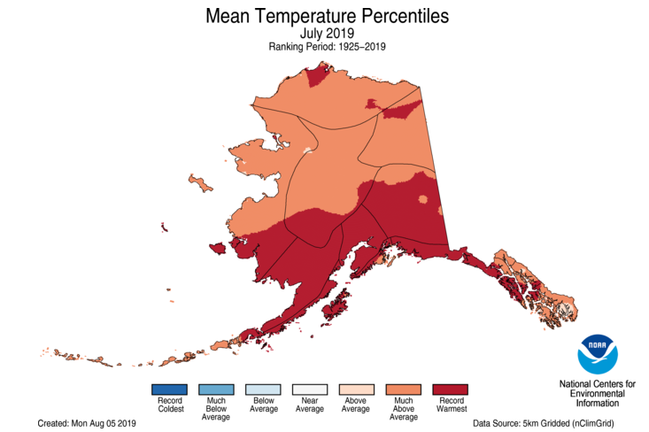
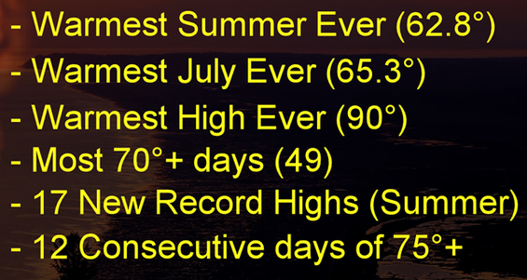
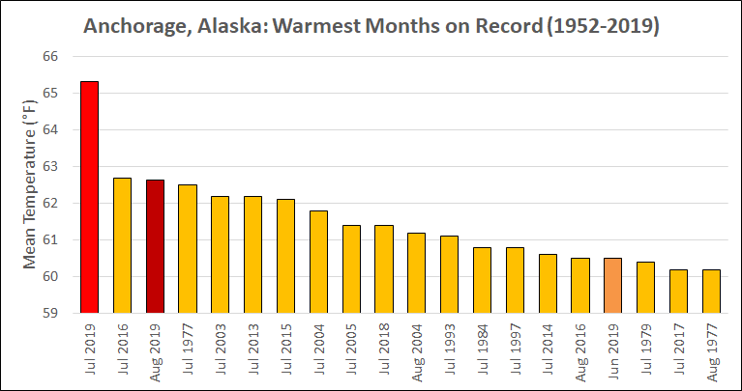
Alaska Temperatures
Hottest Jun-Aug on record in parts of Alaska
2nd Hottest Overall
Hottest July on record Overall
Hottest June, July, and August on
record at Anchorage
Anchorage Records
All-Time Highs set at Anchorage, Kenai, Palmer, King Salmon, Kodiak
Notes:
This was the 2nd hottest summer on record overall in Alaska, but the hottest over the Southwest and South Central portions of the state. July was the hottest of any month in Alaska. Many records were broken by a significant margin in southern areas.
On July 4, all-time high temperature records were set in Kenai, Palmer, King Salmon, and Anchorage International Airport. The airport reached 90°F for the first time, breaking the previous all-time record by 5°F.

Slide 13
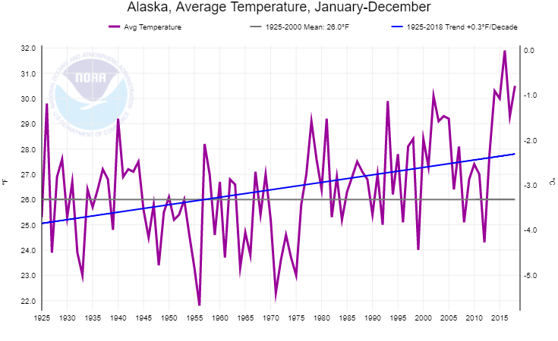
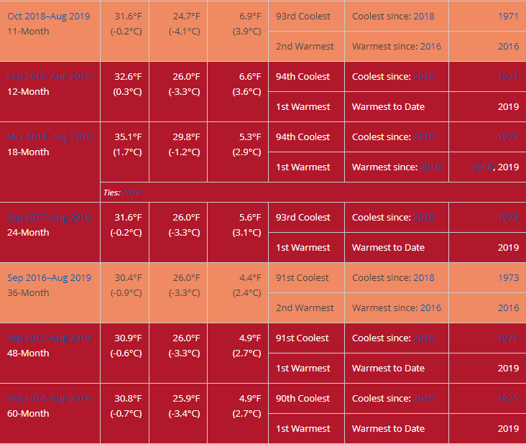
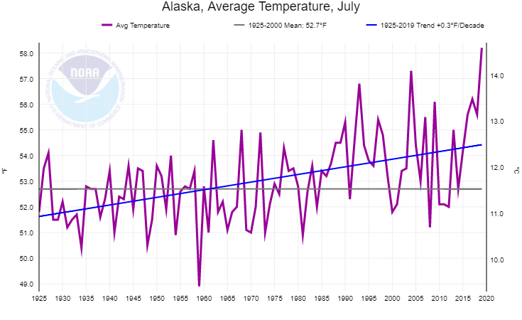
Alaska Temperatures
Alaska Long Term Annual Temp Trend
Last 5+ years have been exceptionally warm
Alaska Long Term July Temp Trend
Notes:
This summer’s warmth is a continuation of exceptionally warm weather since June of 2013 and is part of a long term warming trend.

Slide 14
VDATUM
Vertical Transformation Models
Tidal and chart datums to Orthometric and Geodetic datums
Enables ellipsoid-referenced surveying
Ties land datums to hydrographic datums
Ongoing development
Extend to Western/northern Alaska
Updated existing models with spatial-varying uncertainty

Slide 15
Southeast Alaska (Released 2019)

Slide 16
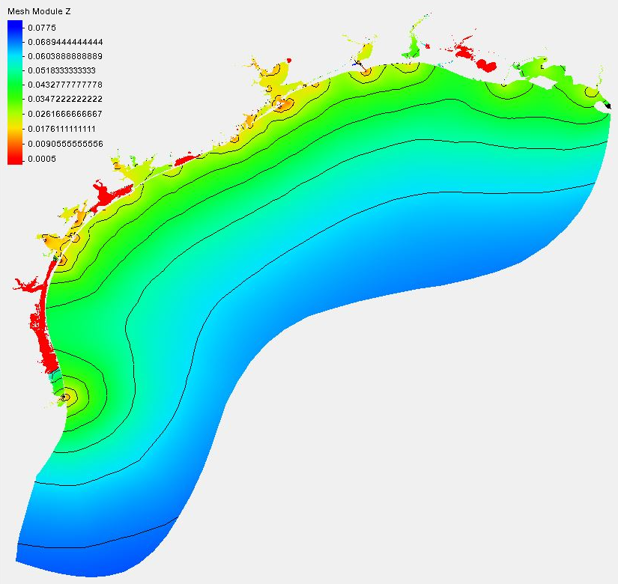
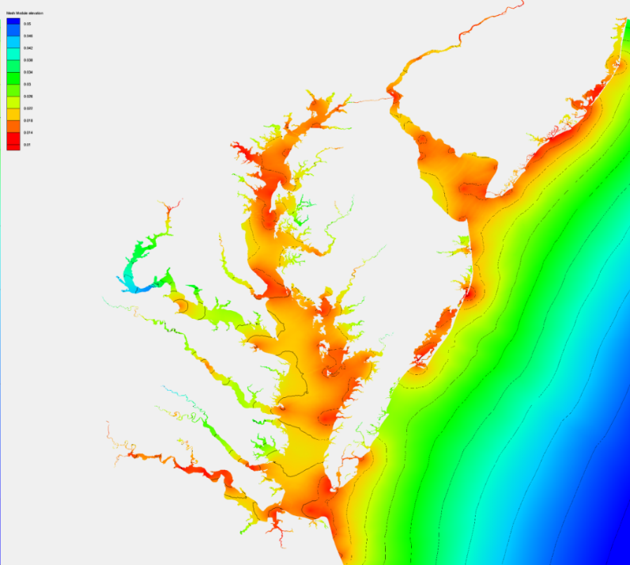
Spatially Varying Uncertainty
(Phase 2: Transition to Operations)
Statistical data assimilation is used to blend model results and data, also providing the associated uncertainty.
Uncertainty in one standard derivation (m)

