Slide 1
ARHC Ambition Plan towards Effective Cooperation with Arctic SDI
Addressing personnel, resources, and level of support needed to continue effective collaboration towards an overall Spatial Data Infrastructure (SDI) for the Arctic Region.
9th Arctic Regional Hydrographic Commission Meeting
17-19 SEP 2019

Slide 2
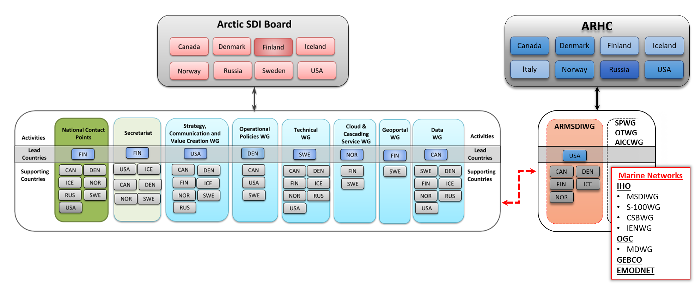
Proposed Arctic SDI & ARHC ARMSDIWG Cooperation Structure
WG-MGI

Slide 3
Analysis
Arctic SDI
ARHC
The Arctic SDI is led by an executive-level board (i.e. Arctic SDI Board representing each National Mapping Agency) with subsidiary secretariat, national contact points, and working groups.
Arctic SDI is an organization wholly devoted to SDI development/activities in the region.
ARMSDIWG is the key coordinating body for MSDI in the Arctic, as a subsidiary working group to the ARHC.
The ARHC is led by the duly authorized representatives of hydrographic offices comprising membership of the commission.
ARHC is an organization with several working group devoted to separate work plans.

Slide 4
Decision Point
ARMSDIWG sees a potential increased allocation of personnel and technical resources from ARHC as mutually beneficial impact to both ARHC and Arctic SDI in creating a robust SDI for the Arctic.
Heading in to 2020, with the majority or ARMSDIWG Consolidated Work Plan 2017-2020 items in an “Ongoing” status, ARMDSIWG seeks to understand an ambition plan from ARHC with regards to collaborating with Arctic SDI and promoting the development of MSDI in the overall Arctic SDI.

Slide 5
Possible Topics to Guide Discussion
Should a formal ARHC strategic direction be created regarding SDI (and aligned with Arctic SDI strategic documents)?
Should ARHC and Arctic SDI Board more formally adopt a Joint Statement of Intent?
Does ARHC collectively have, and is willing to allocate the personnel resources to support greater engagement and participation in other working groups of Arctic SDI?
Do virtual options (e.g., web meetings, electronic voting, etc.) need to be more utilized to expedite approvals between ARMSDIWG and ARHC, on a more-than-annual basis, for updating of marine documents and resources posted to Arctic SDI website and geoportal under the “ARHC” moniker?

Slide 6
Possible Topics to Guide Discussion
Areas in need of support:
Technical Expertise
Cloud & Cascading Service Expertise
Standards Expertise
Geoportal Expertise
Data Expertise
Catalogue Service Development
Prototyping and Testing
Web Development

Slide 7
Invited Actions of ARHC
The ARHC members are invited to:
Take note of the ARMSDIWG Consolidated Work Plan 2017-2020 provided under separate cover.
Take note of the Possible Topics to Guide Discussion (below).
Discuss an ambition plan for ARHC/ARMSDIWG, its collaboration with Arctic SDI, and facilitating the MSDI as a component of the overall SDI for the Arctic Region.
Discuss level of contribution (people and resources), if mutual agreement exists, to provide greater support within ARHC towards MSDI development to the overall SDI for the Arctic Region.
Take action as seen appropriate.

