Slide 1
Status
AICCWG

Slide 2
Since ARHC-5
AICCWG fully manned
Slow progress of INT Charts
INT coordinator workshop Monaco
Awaiting plans from each country for INT charts the next 5 years.

Slide 3
INT charts Defined in S-4
”Suitable for the navigational require-ments of international shipping”
Each country charts its own waters!!
In conformity with an international agreed scheme.
Carries INT number
Conforms to S-4 Chart spec.

Slide 4
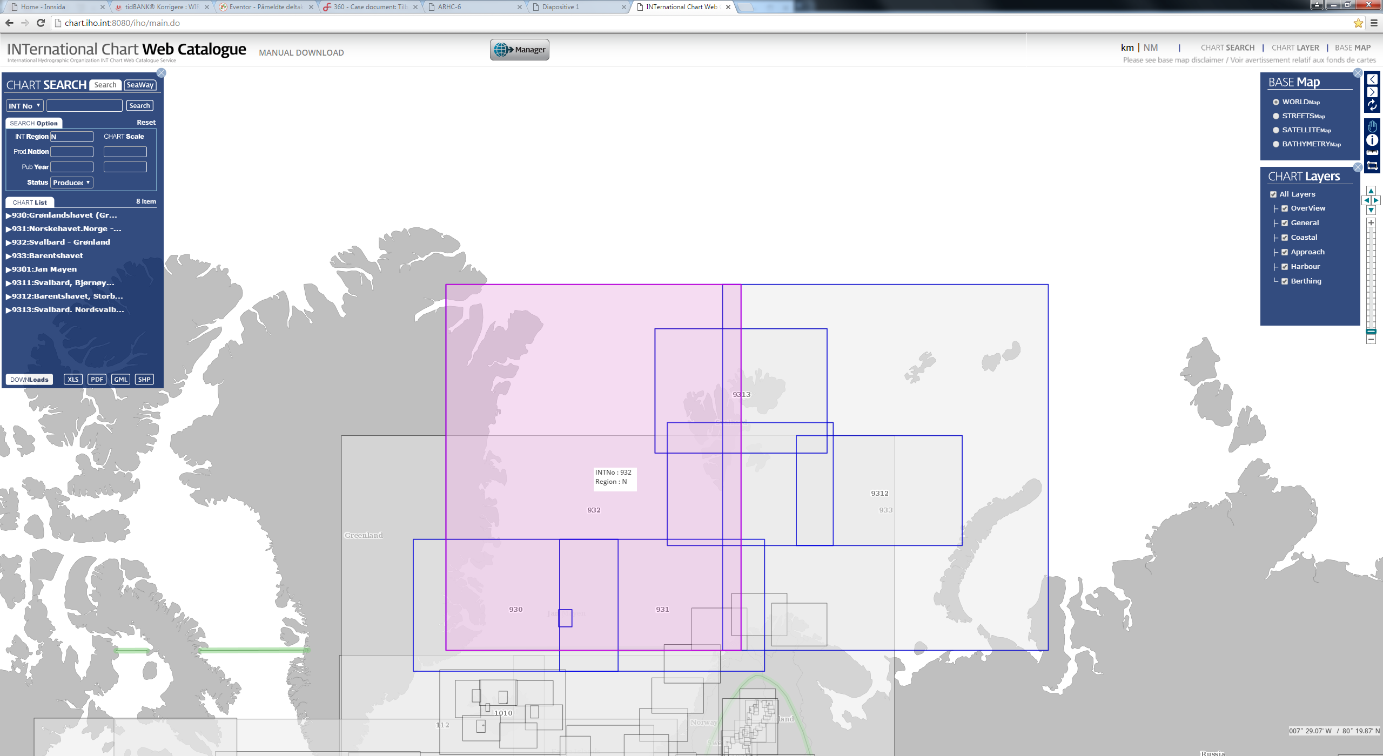
INTernational Chart Web Catalogue
Successful launch of the new web based Catalogue
Easy to use and very intuitive
INT coordinator Region N attendance at IHB workshop in Monaco

Slide 5
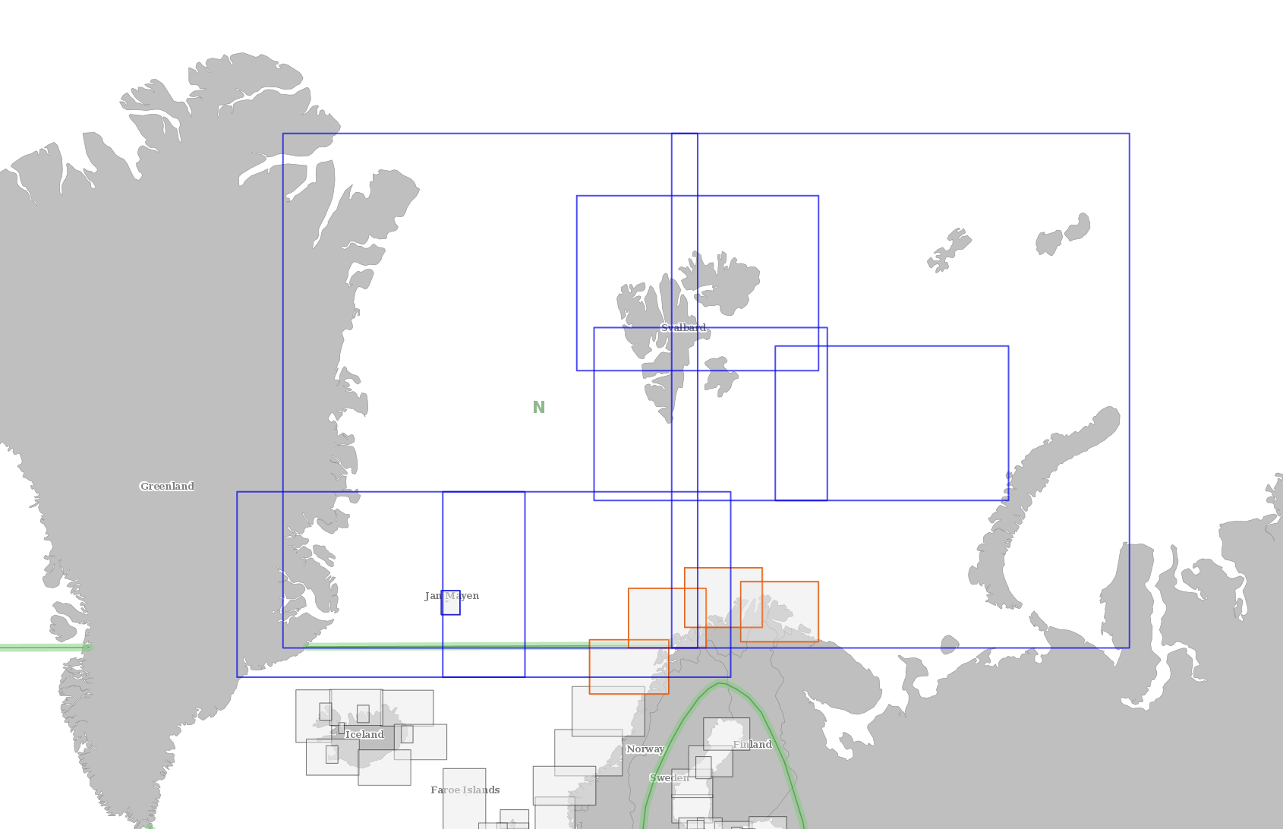
Current INT-Charts
930, 931, 932, 933, 9301, 9311, 9312, 9313.
Planned:
9314, 9315, 9316, 9317.
932
933
9313
9311
9312
930
931
9316
9315
9317
9314
9301

Slide 6
Action required
Note the report
Await plans from each ARHC MS for INT charts next 5 years.

