Slide 1
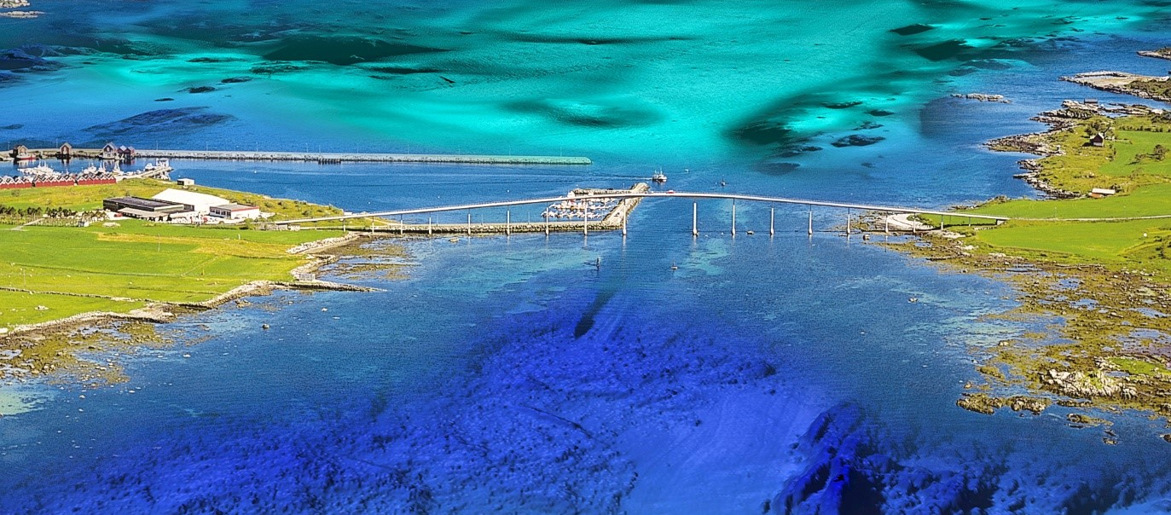
National report Norway
ARHC6

Slide 2
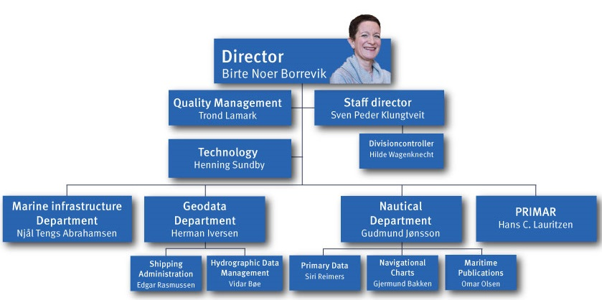
New organization
New director

Slide 3
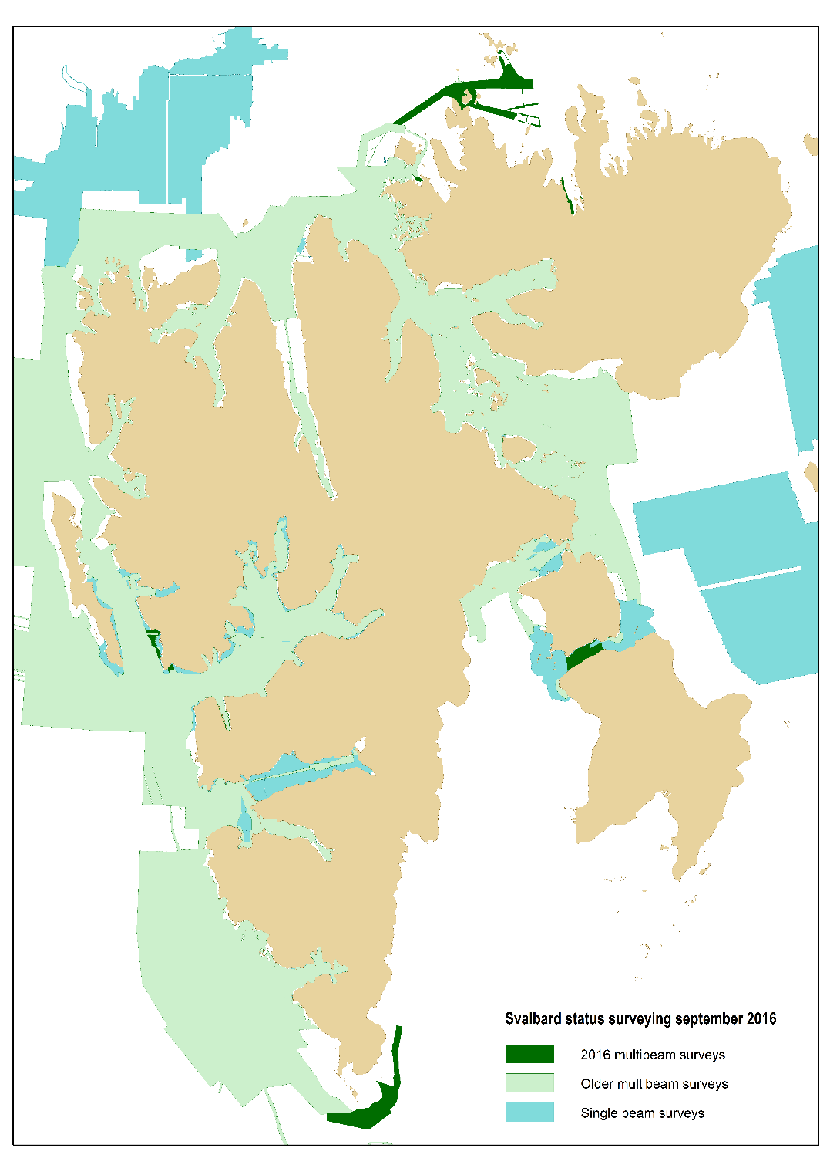
Arctic survey activities
Svalbard 2016
1750 km2
Corridor survey in the North

Slide 4
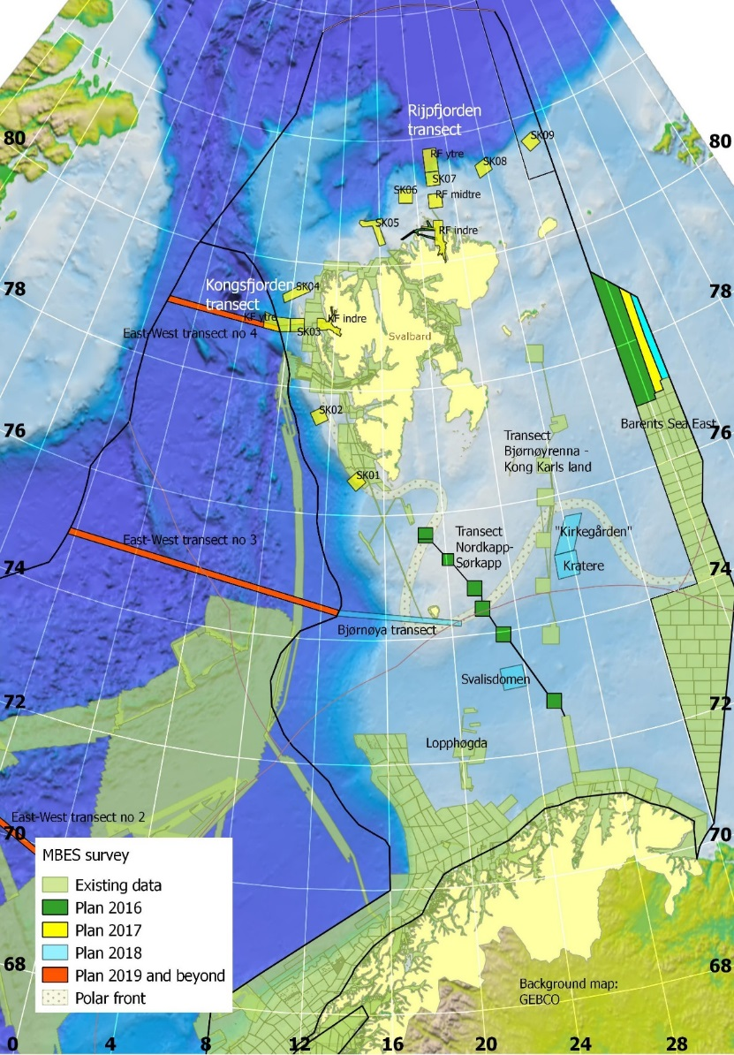
Arctic survey activities
Mareano 2016
13.500 km2
Climatic transects North-South (polar front)
Preparing safe corridors for 2017 survey plan

Slide 5
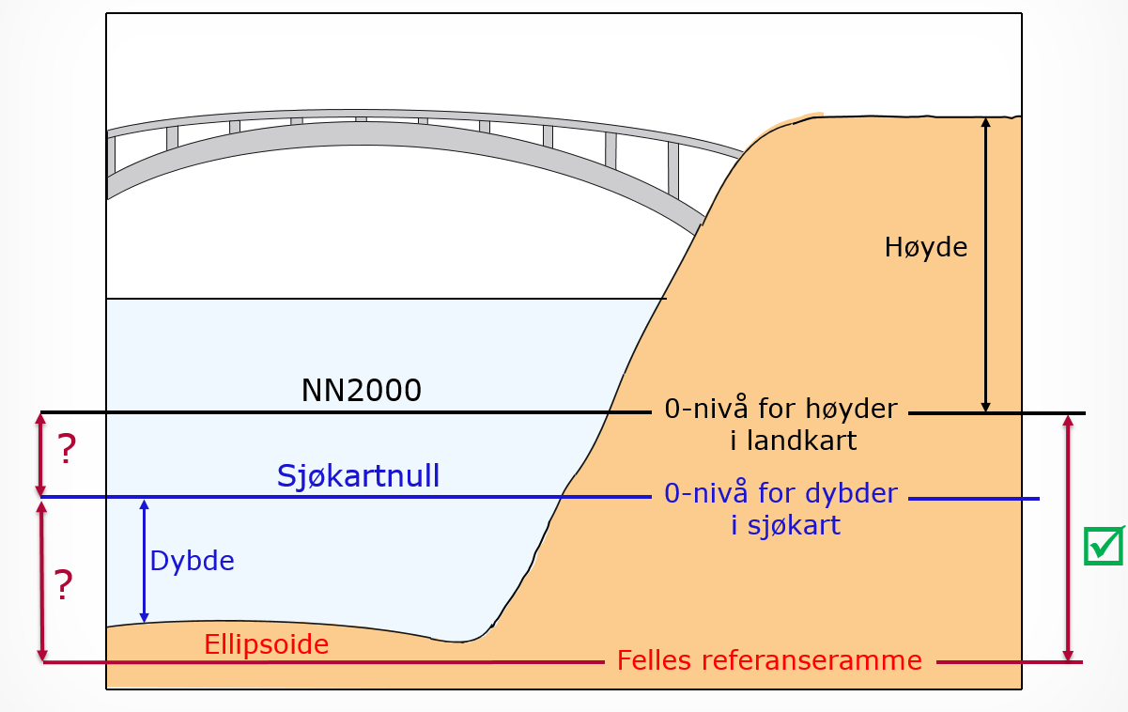
Oseanographic activities
Joint vertical reference frame project

Slide 6
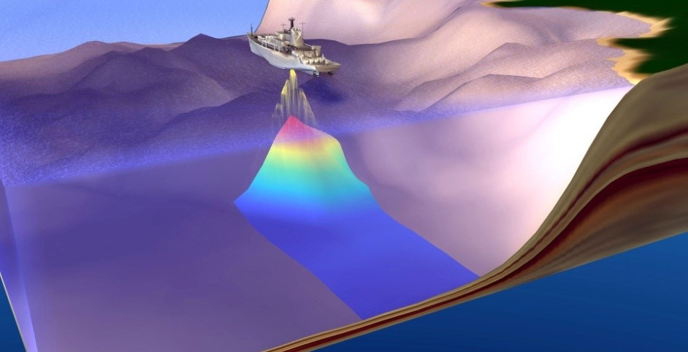
Socio-economic study

Slide 7

Socio-economic study

Slide 8
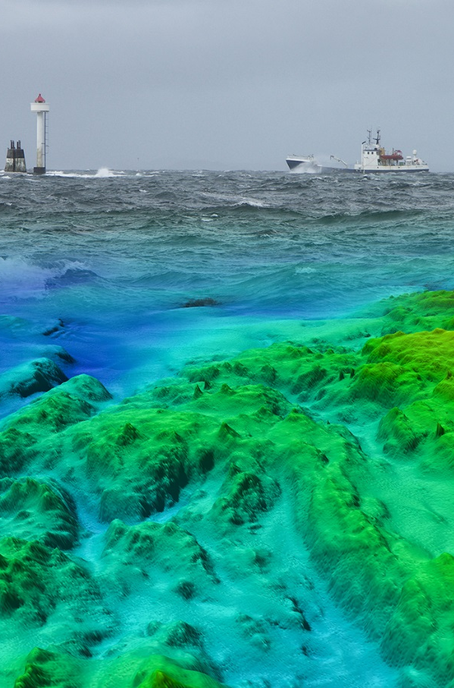
National bathymetric data manager
Prevent unnecessary surveys
Ensure re-use of bath. data for various purposes
Improve quality of metadata
Easier access to a national database
Increased use of hydrographic data
Increased relevance of HO for society

Slide 9
National Spatial Data Infrastructure
Data content
Prioritize content and requirements
Dataflow and common solutions
Organization & cooperation
Policy & framework
Policy development
Legal framework
Standards and interfaces
Technology
& tools
Establish, manage and distribute geospatial data
Incorporate new technology
Business models
Metadata & QA
Meeting arenas & partnerships
Joint innovation & programs
Research & development
Communication
Promote new initiatives
E-government
User needs
Socio-economic value

Slide 10
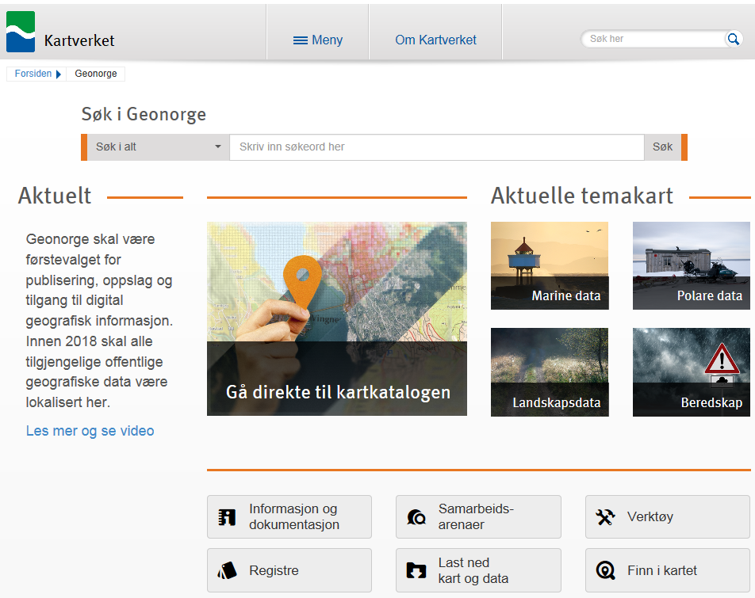
Geonorge
Search in Geonorge
Entire Geonorge
Type in search phrase
Search
Latest
Thematic maps
Geonorge is the key place to find, view and download Norwegian spatial data.
By the end of 2018 all public Norwegian spatial data will be located within Geonorge.
Read more and watch video
Marine data
Arctic data
Spatial Data Catalogue
Disaster managment
Landscape
Information & Documentation
Partnerships
Tools
Registries
Download
Map Viewer

Slide 11
MSP - Marine Spatial Management Tool
Governmental initiative based on the needs
for a more coherent and uniform geographic
information content, suitable for underpinning
tasks attached to marine spatial planning and
marine management
More effective updates of management plans
Better overview over political decisions and
actions related to marine management
Contribute to more transparancy, openness
and increased involvment from the stake-
holders

Slide 12
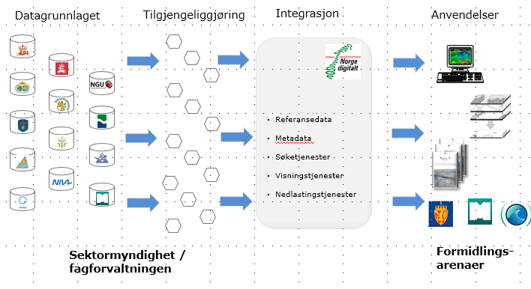

MSP - Marine Spatial Management Tool
Deliveries:
Common network based map tools
Served through BarentsWatch portal
Standardized map services
Standardized and harmonized data content
Catalogue service through Geonorge (NSDI)
Configured to serve MSP processes
Transparent access for public users
Registers & catalogue services
Thematic Data
Map services
Applications
References
Metadata
Discovery
Sectorial authorities
Dissemination

Slide 13
MSP - Marine Spatial Management Tool
A cross-sectoral cooperation, representing MSP participants, data owners, and SDI service providers
Ministry of Climate and Environment
BarentsWatch
Norwegian Environment Agency
Norwegian Mapping Authority
Directorate of Fisheries
Institute of Marine Research
Norwegian Coastal Administration
Norwegian Maritime Authority
Norwegian Petroleum Directorate
Petroleum Safety Authority
Norwegian Radiation Protection Authority
National Institute of Nutrition and Seafood Research
Norwegian Polar Institute
Norwegian Mapping Authority

Slide 14


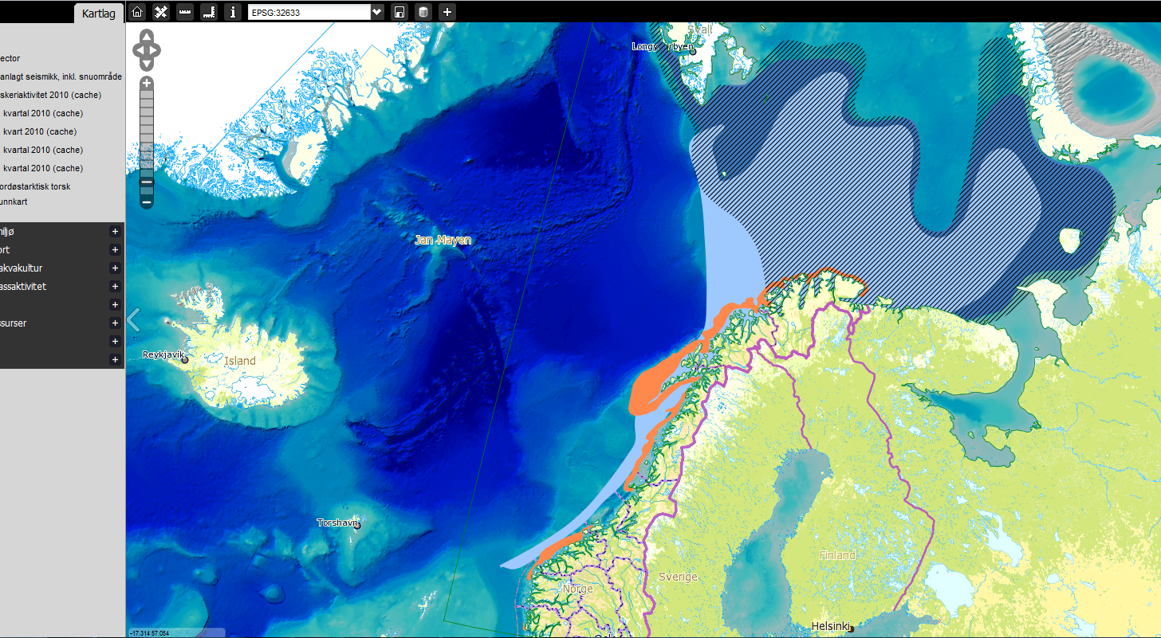
NorthEast Atlantic Cod (breeding grounds)
+ Base map

Slide 15

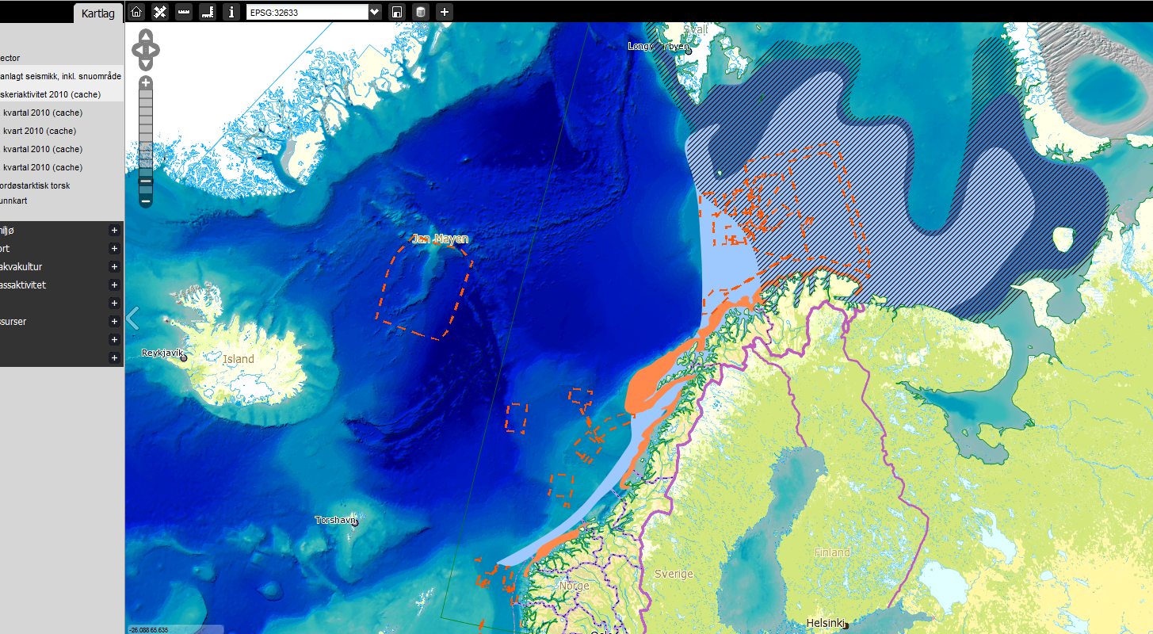
NorthEast Atlantic Cod (breeding grounds)
+ Planned Seismic Activity + Base map

Slide 16

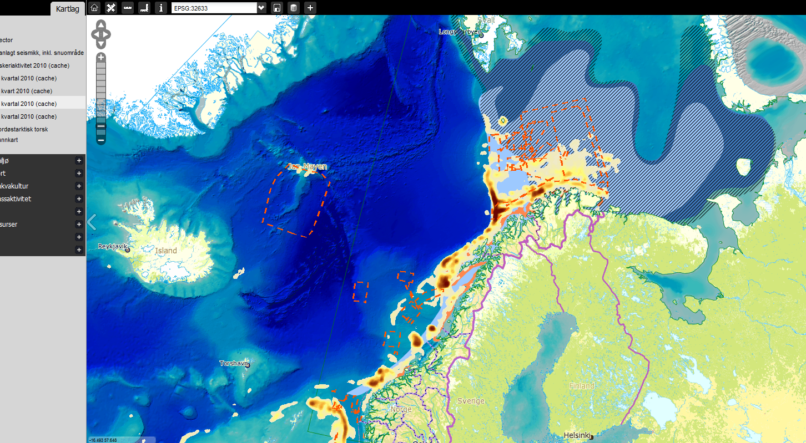
NorthEast Atlantic Cod (breeding grounds)
+ Planned Seismic Activity + Commercial Fishing (Q1)
+ Base map

Slide 17
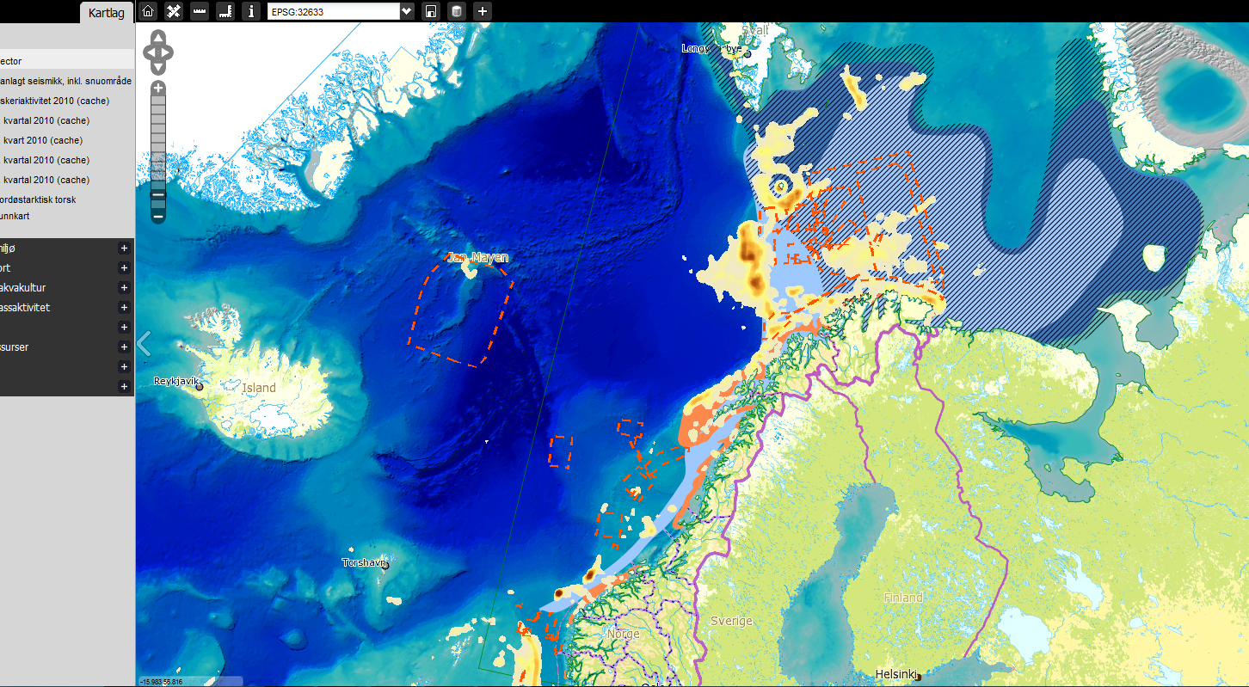
NorthEast Atlantic Cod (breeding grounds)
+ Planned Seismic Activity + Commercial Fishing (Q4)
+ Base map

