Slide 1
The Hydrographic Dictionary
and
Chinese Version
Notes:
I'd like to introduce the hydrographic dictionary and Chinese version on behalf of the Chair of IHO Hydrographic Dictionary Working Group.

Slide 2
Summary
1.
Basic principles
1.1
The HD new policy
1.2
HD Layout
1.3
GI Registry and HD structure
2.
HD updating procedure
2.1
Principles
2.2
Updating Forms
2.3
Approval procedure
3.
National Hydrographic Dictionaries
3.1
World most spoken languages
3.2
The Chinese Hydrographic Dictionary
3.3
Status of HD Implementation
4.
Work programme
4.1
The HDWG work programme and calendar
Notes:
The presentation consists of four parts: Basic principles, HD updating procedure, National Hydrographic Dictionaries, Work programme.

Slide 3
1.
Basic Principles
1.1
The HD new policy
Unique IHO reference number (ID) and HDWG format
Selection of terms by IHO Working Groups
Submission to the IHO GI Registry Manager with Change Forms
Approval of upgrade mechanism by HSSC
Optional translations in an unlimited number of languages under National HOs’ responsibility.
All national dictionaries accessible on the IHO website
Notes:
The HD new policies include:
The HD will provide to all users a unique definition of hydrographic terms with a unique identifier and will be database format.
All proposals can be submitted to the Registry Manager with change forms for content and completeness checks.
The terms will be evaluated and selected by DCB which consists of representatives of IHO Working Groups.
The updating mechanism for accepting, reviewing and submitting revisions and new terms will be submitted to HSSC for approval.
All national dictionaries could be accessible on the IHO website.

Slide 4
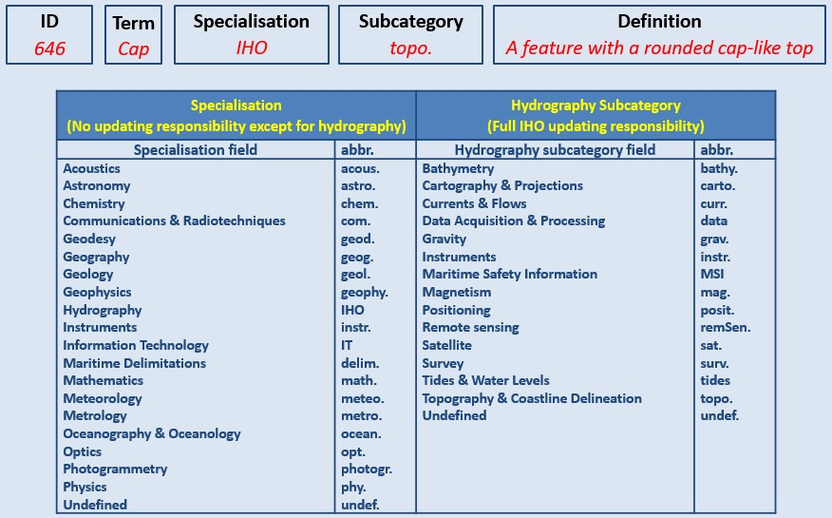
1.2
HD Layout
Notes:
The possible future HD layout include ID,Term,Specialisation,Subcategory and Definition.
The division of terms would be divided between other scientific terms and IHO terms. The list of specialisations and Hydrography have the proposed sub-category as an additional attribute.
Other scientific terms would be taken directly from the appropriate origin and not maintained by the HDWG.

Slide 5
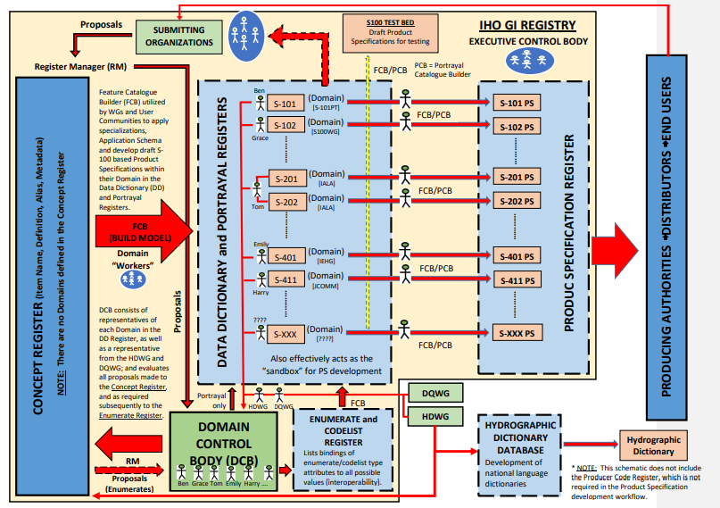
1.3
GI Registry and HD structure
Notes:
the HD and GI Registry management are going to be identical.
The job of HDWG will be to select amongst the terms those who are pertinent to the Hydrographic Dictionary. Conversely, the S-100 GI Registry Manager will select the terms pertinent to the S-100 Registry.

Slide 6
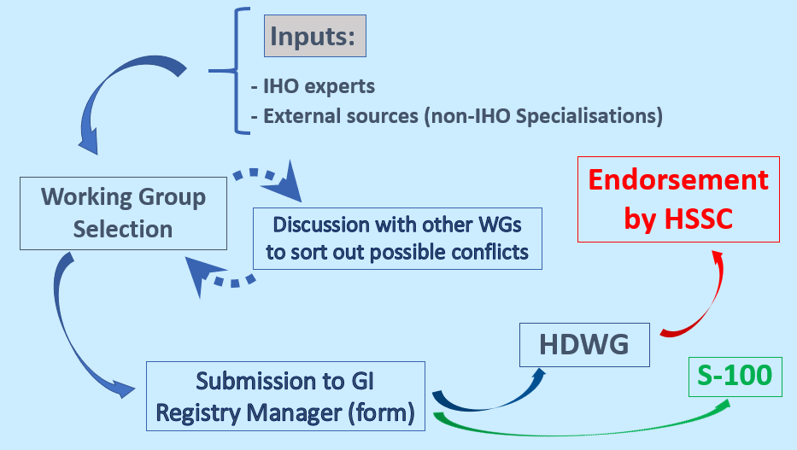
2.
HD updating procedure
2.1
Principles
Notes:
This is the HD updating procedure：
Submitting Organization submits a proposal to the Register via the IHO GI Registry interface。
Proposal is assessed by the Register Manager for completeness and possible duplication with items already registered. If suitable, the proposal is forwarded to the Concept Register Domain Control Body.
Before inclusion in the Feature Data Dictionary, all changes and amendments must be approved by DCB which consists of representatives of IHO Working Groups.
If approved, the proposal is forwarded to the Register Manager for incorporation in the Register.
Then，HDWG assesses whether the changes should be included in the HD.

Slide 7
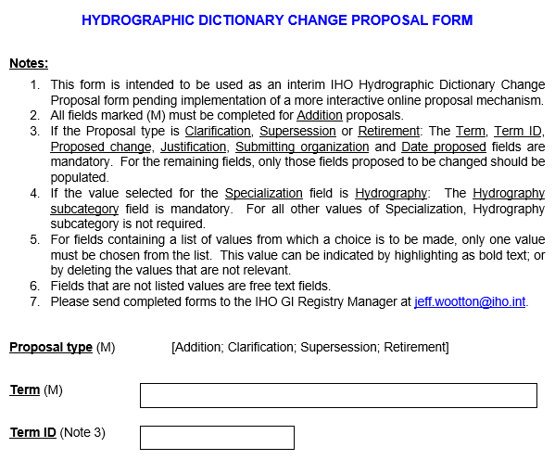
2.2
Updating Forms
Straightforward forms are to be filled for each new term or change
These forms will ultimately be replaced by an online mechanism
Forms to be sent to: jeff.wootton@iho.int
Notes:
This form is intended to be used as an interim IHO HD change proposal from .
Straightforward forms are to be filled for each new term or change. These forms will ultimately be replaced by an online mechanism.
Forms to be sent to Jeff Wootton，the IHO Technical Standards Support Officer: jeff.wootton@iho.int

Slide 8
2.3
Approval procedure
Until now, new terms had to be approved by HSSC, then translated into French and Spanish.
In future, the IHO reference will be language neutral. Each country shall be responsible of its own translation (Arabic, Chinese, English, English US, French, Indonesian, Spanish, Argentine Spanish, etc.).
New terms will be selected by the IHO Working Groups, based on their technical relevance (non-IHO Specialisation or Hydrography Subcategories).
The HD new principles and change mechanism will be submitted to HSSC for approval, but no longer the new terms.
Notes:
Until now, new terms had to be approved by HSSC, then translated into French and Spanish.
In future, the IHO reference will be language neutral. Each country shall be responsible of its own translation (Arabic, Chinese, English, English US, French, Indonesian, Spanish, Argentine Spanish, etc.).
New terms will be selected by the IHO Working Groups, based on their technical relevance (non-IHO Specialisation or Hydrography Subcategories).
The HD new principles and change mechanism will be submitted to HSSC for approval, but no longer the new terms.

Slide 9
3.
National Hydrographic Dictionaries
3.1
World most spoken languages
Language branch | Speakers
English | 371 to 1.39 bn
Chinese 中文 | 900 to 1.16 bn
Spanish | 477 to 661 m
Arabic العربية | 290 to 442 m
Russian ру́сский язы́к | 171 to 267 m
Indonesian | 204 to 281 m
French | 80 to 285 m
Portuguese | 218 to 240 m
Member States are invited to develop their national variants that will be made available on the IHO Website
Note:
these unofficial figures can vary considerably according to native/non-native considerations and to the projection in time
⇨
Notes:
This table lists some world most spoken languages，As we all know English is a language spoken all round the world. Chinese is the most spoken language in the world.
Member States are invited to develop their national variants that will be made available on the IHO Website

Slide 10
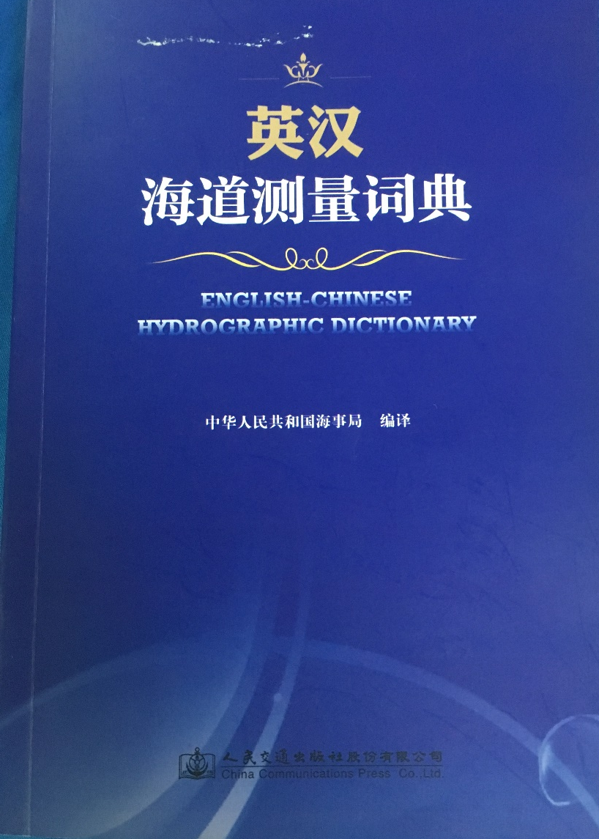
3.2
The Chinese Hydrographic Dictionary
China translated and published IHO English-Chinese Hydrographic Dictionary in December 2015
In the Dictionary, China has already translated 5315 terms from the IHO official Excel file.
Notes:
China MSA translated and published IHO English-Chinese Hydrographic Dictionary in December 2015, in order to standardize the use of hydrographic terms.
In the Dictionary, China has already translated 5315 terms from the IHO official Excel file.

Slide 11
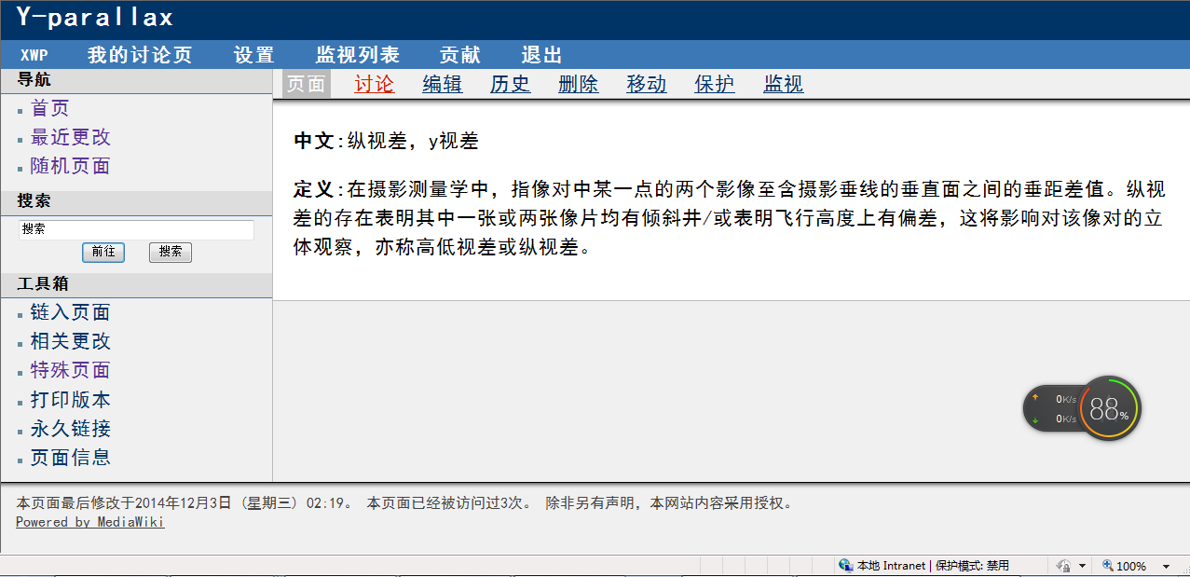
3.2
The Chinese Hydrographic Dictionary
China also generated the Chinese version in a Wiki format.
Notes:
China also generated the Chinese version in a Wiki format.

Slide 12
3.2
The Chinese Hydrographic Dictionary
As noted at the last HDWG2 meeting in Monaco, integration of these terms into the IHO database should be very easy.
The Chinese HD should be available on the IHO Website in May 2019.
In the future，the Chinese HD would be updated under normal maintenance.
Notes:
As noted at the last HDWG2 meeting in Monaco, integration of these terms into the IHO database should be very easy.
In addition to the traditional English / French /Spanish dictionaries, the Chinese HD should be available on the IHO Website in time for the 11th HSSC (6 – 9 May 2019).
In the future，the Chinese HD would be updated under normal maintenance.

Slide 13
3.3
Status of Other HD Implementation
Indonesia has decided to develop its National HD version
In NIOHC and RSAHC, Oman is in the process of developing its national HD, available to all Arabic users
Notes:
Indonesia has further decided to develop its National HD version
In NIOHC and RSAHC, Oman is in the process of developing its national HD, available to all Arabic users

Slide 14
4.
HDWG Work Programme
HDWG Work Programme
4.1
Work Item | Start | End | Obs
Review of terms currently included in S-32 | 2018 | 2020 | 4 batches a-d, e-l, m-r, s-z HDWG and IHO Secretariat (Capt Aste, PN)
Implement structure and database application to support the on-line dictionary | 2017 | 2018 | Tony Pharaoh (IHO Secretariat)
Add the HSPT New Terms | 2018 | 2018 | HDWG and HSPT internal arrangement
Add the TALOS New Terms | 2018 | 2018 | HDWG and TALOS internal arrangement
Start translating Arabic Terms | 2018 | TBD | Sultanate of Oman
Publish Chinese HD dictionary | 2018 | 2018 | IHO Secretariat, Lyu Yuxiao and HDWG Chair
Submit new terms and HD update mechanism to HSSC | 2019 |  | HSSC 11
Notes:
This is the HDWG work programme. The work items include Review of terms currently included in S-32,to implement structure and database application to support the on-line dictionary,to add the HSPT New Terms and the TALOS New Terms, to Start translating Arabic Terms, to add the Chinese version to the database along with the English, Spanish and French versions, and to submit new terms and HD update mechanism to HSSC

Slide 15
HDWG calendar
Date | Event / Venue | HDWG concerned Members
18-20 Feb 2019 | 8th RSAHC / Islamabad | Oman
20-22 Feb 2019 | EAHC 6th Steering Committee /Bali, Indonesia | China - Indonesia
25-28 March 2019 | 19th NIOHC / Muscat | Oman
19-22 Mar 2019 | 42nd USCHC / Biloxi, USA | Canada
11-12 Apr 2019 | 13th SWAtHC / Buenos Aires | Argentina
6-9 May 2019 | HSSC 11 / Cape Town | HDWG Chair
11-13 Jun 2019 | 21st MBSHC / Cadiz | Italy, Argentina?
10-12 Sep 2019 | 24th BSHC / ? | Italy
? March 2020 | 34th NSHC / Reykjavik | Italy
? 2020 | 14th SEPRHC / Chile | Argentina
26 Nov-01 Dec 2018 | 19th MACHC / Colombia | Argentina
28 Sep-02 Oct 2020 | 16th EAtHC / Lisbon | Argentina
Notes:
This is the HDWG calendar.

Slide 16
The Hydrographic Dictionary
and
Chinese Version
Thank you!

