Slide 1
HCA-GIS and relevant progress reports
IHO Hydrographic Commission on Antarctica (HCA)

Slide 2
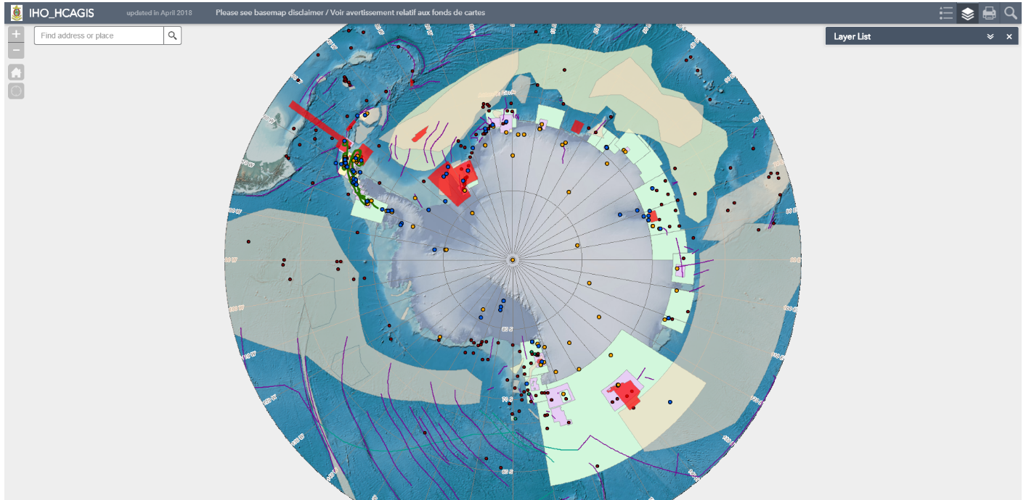
HCA GIS
<https://www.iho.int/gis/antarctic.gis.html>

Slide 3
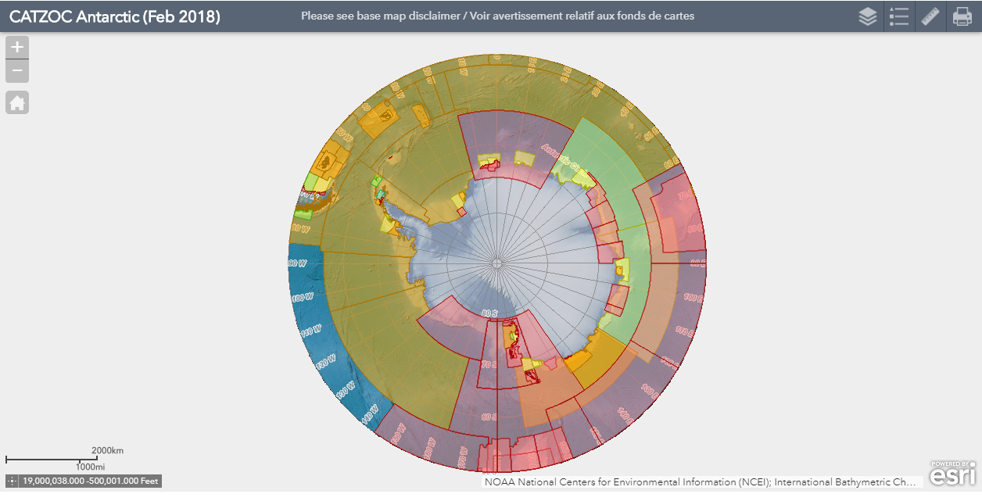
HCA GIS CATZOC Information
Internal use for IHO Secretariat

Slide 4
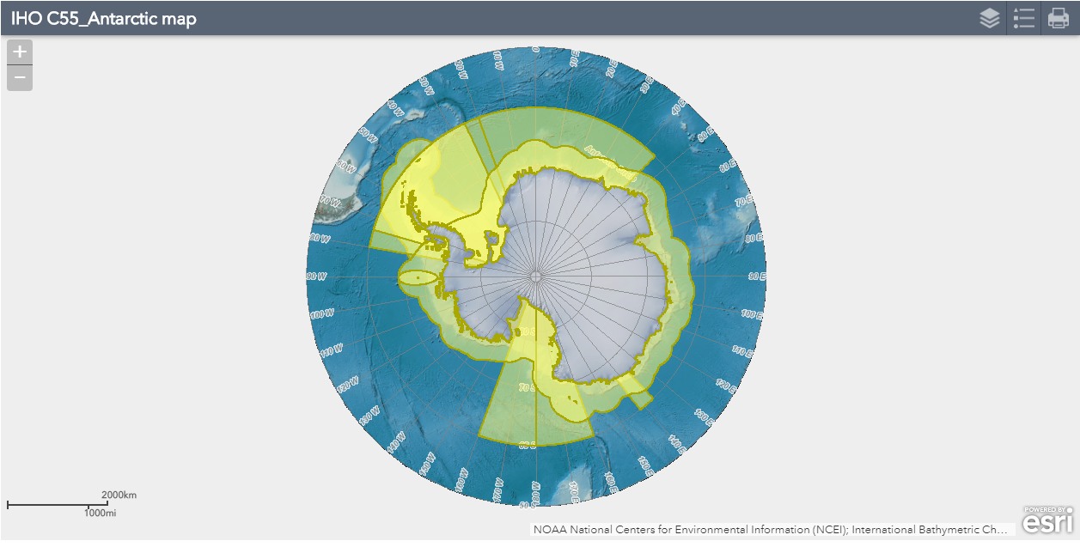
HCA GIS C-55 Information
Internal use for IHO Secretariat
N.B: the visualization is only for technical consideration and does not reflect any official position of IHO.

Slide 5
Survey Information added into HCA GIS
March 2017 | Brazil | South Shetland Islands operated in 2015
April 2017 | Chile | Foster Port to Fuelles de Neptuno Passage operated in 1989, Ravn Rock operated in 2005
May 2017 | Colombia | Mikkelssen Bay operated in 2017, Cierva Cove Bay operated in 2017
(Pending) January 2018 | Chile | Bismark Strait etc. 24 areas operated in 2010-2015 (including polygons with spikes)
(Pending) June 2018 | France | 12 surveys from 1992 to 2013 (metadata is to be considered)

Slide 6
Progress report from the HCA14 (14/07)
HCA 14/07: "IAATO to consider the possibility of providing metadata of vessels traffic patterns to the IHO for inclusion as a layer into the IHO HCA GIS.“
Reminder sent to IAATO (Ms Lisa Kelley). Provision of data still under consideration (May 2018)

Slide 7
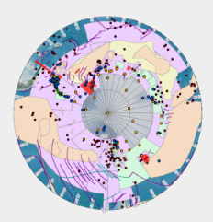
Progress report about HCA14/12
HCA 14/12: “HCA Sec. to consider how to provide an example of a data discovery portal by implementing the offer made by Colombia to display relevant wms, wfs data on the IHO Antarctica GIS, and to liaise with France and Korea (Rep. of) for the same purpose.“
IHO Secretariat has considered a way to mash up relevant information among GIS services. At the moment, the Quantarctica users can display the HCA-GIS data into their own GIS environment. On the other hand, importing other data flows (WMS, WFS) into HCA-GIS still needs to be considered (see outcome of HCA-letter 2/2017 on the use of HCA-GIS). This is due to limitation of ArcGIS Online.
HCA-GIS
?

Slide 8
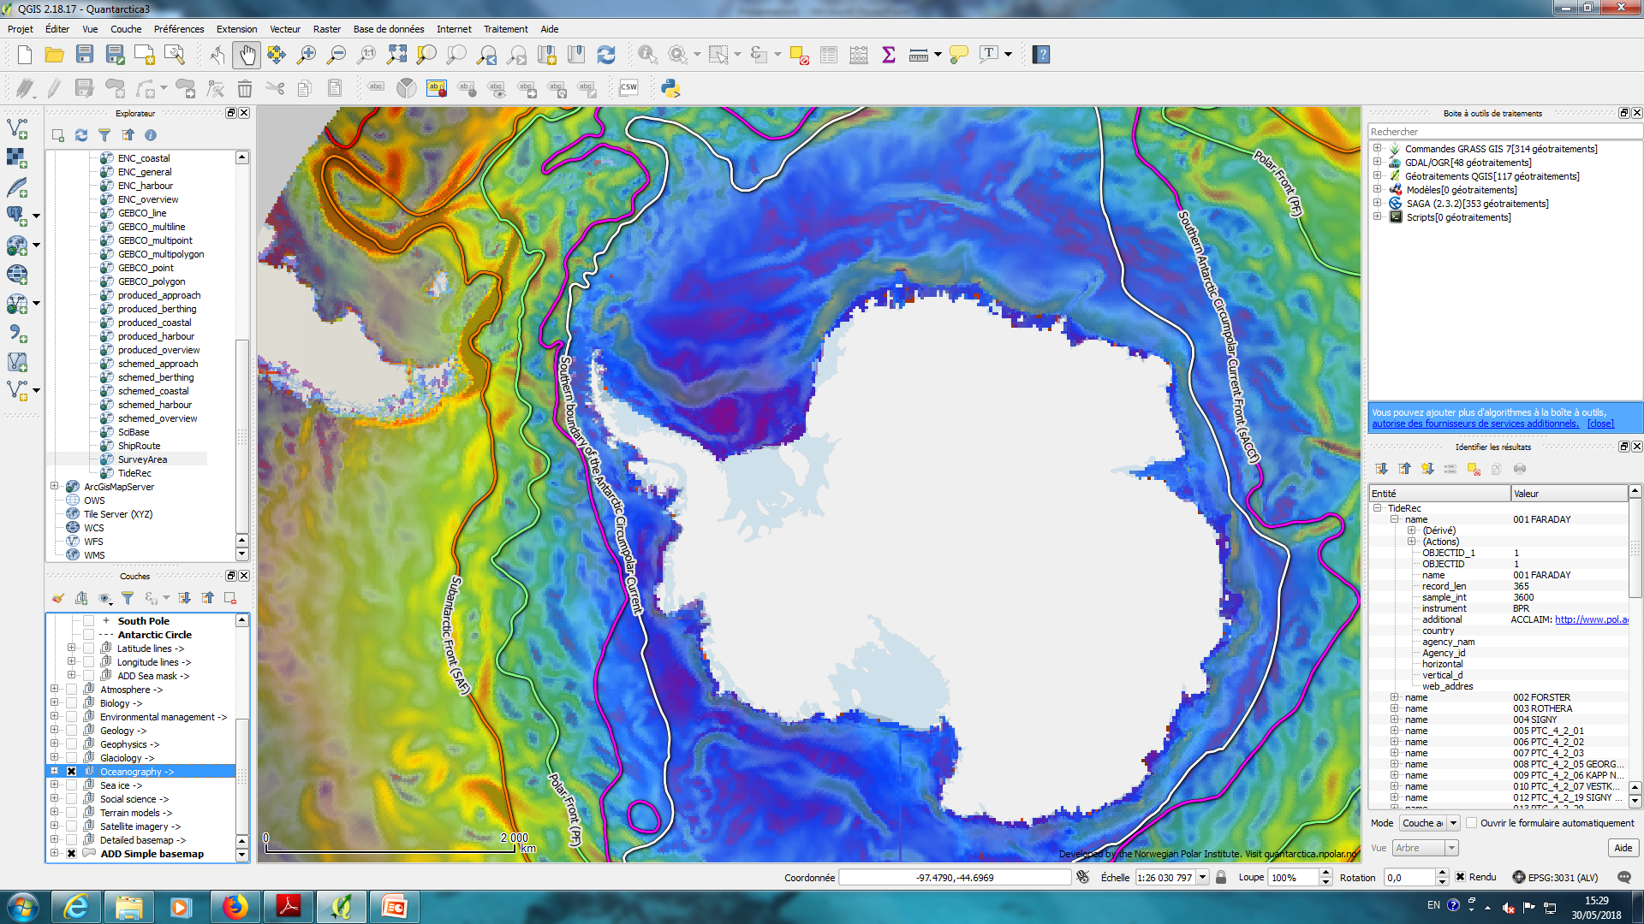
Progress report about HCA14/12
An experiment of GIS mash-up visualization with Quantarctica.
Stand-alone GIS full service package: http://quantarctica.npolar.no/

Slide 9
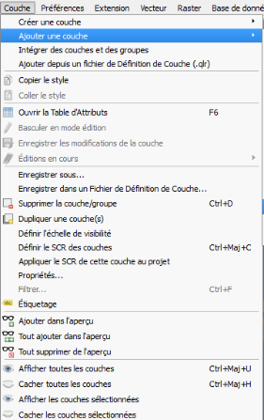
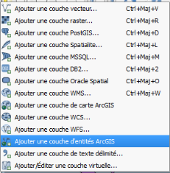
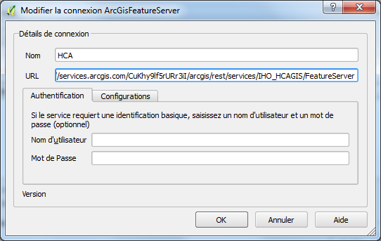
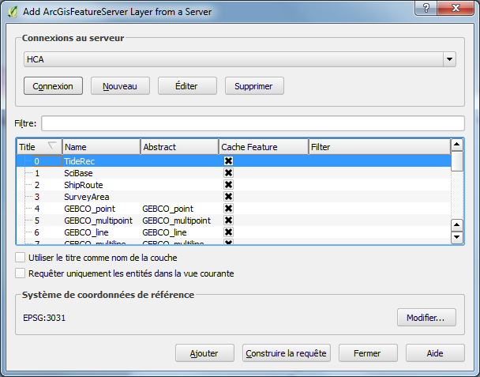
Progress report about HCA14/12
It is necessary for users to refer the URL of HCA-GIS as
<https://services.arcgis.com/CuKhy9lf5rURr3iI/arcgis/rest/services/IHO_HCAGIS/FeatureServer>

Slide 10
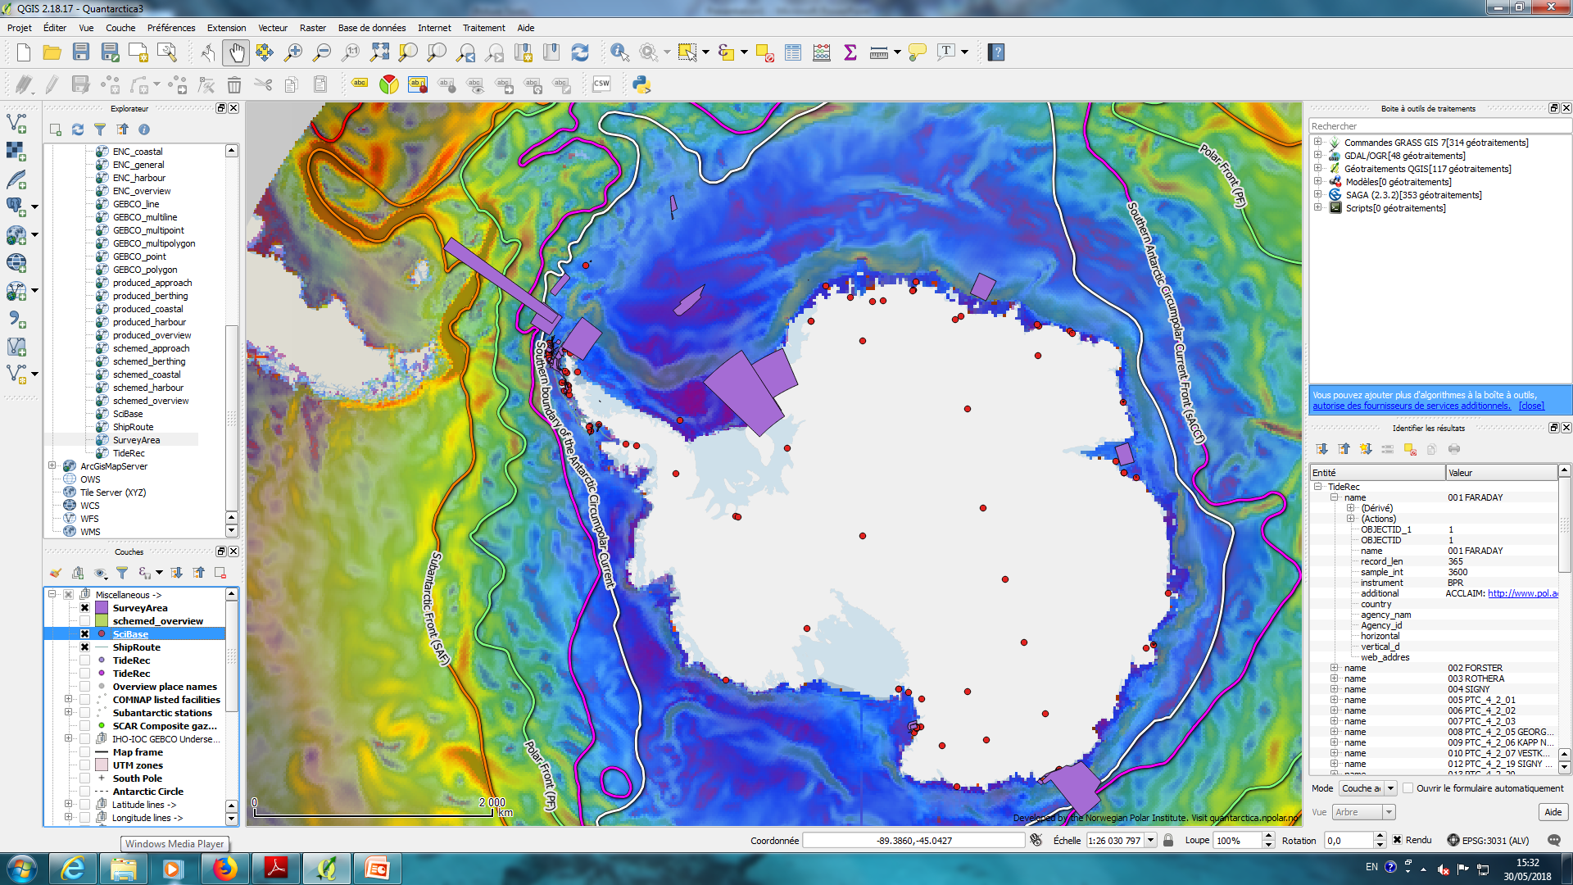
Progress report about HCA14/12
The data from HCA-GIS is now shown in Quantarctica.

Slide 11
Related to HCA14/12 (WMS, WFS data)
HCA-GIS is based on ArcGIS Online of which the standard projection is WebMercator. It is also possible to display in Polar projection on ArcGIS Online but it is not a true projection. It seems that ArcGIS Online cannot handle more than two projections at the same time (WebMercator + Polar). Which is the main limitation of ArcGIS online to display features for Polar regions. Since there aren´t many users for polar region related information improvement is not likely.
Some SHOM’s WMS, WFS are available for Antarctica:
http://services.data.shom.fr/INSPIRE/wms/r or http://services.data.shom.fr/INSPIRE/wfs
Toponymy
World sedimentology map
Tidal types
Archives (old fair sheets or charts)

Slide 12
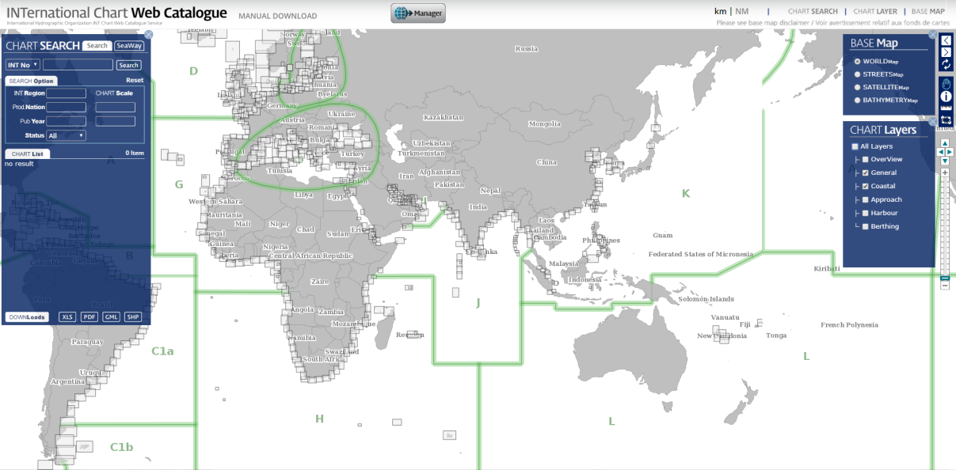
Related to HCA14/12 (INTernational Chart Web Catalogue)
Web GIS for INT charts: http://chart.iho.int:8080/iho/main.do
HCA-GIS
?
As mentioned, full service GISes can connect to and draw the HCA-GIS data into their GIS. The full service INT-GIS probably supports this dataflow from HCA-GIS. (Still to be investigated.) The opposite direction from INT-GIS to HCA-GIS does not seem to work because of principal technical limitations of ArcGIS Online.

Slide 13
Progress report about HCA14/15
HCA 14/15: “HCA Members and Observers to evaluate the existing data layers available in the IHO HCA GIS database and to propose: additional layers (and the sources), any duplicate layers that could be linked from other databases rather than maintained by IHO, and any other comments“
No particular comments | Argentina, Chile, Norway, New Zealand, South Africa, Spain and US
Suggestions | Brazil | Color tones (possible), UI (partly possible), and Data Download function (possible)
(comments from Secretariat ) | France | New layer such as geographical name, historical archives (projections issues to be solved), tidal records to be distinguished whether permanent or not (possible)
 | Italy | More metadata needed for Tidal records and Scientific Stations (possible)
 | Japan | HCAGIS method can be more widespread for other RHC (possible).
 | ROK | Update needed for Scientific Stations and GEBCO features (possible), basemap resolution (not possible)
 | UK | Mercator projection when zoomed in (not possible), MSRs to be updated (done), new layers for Nav-aids etc (possible).

Slide 14
Actions to be considered by HCA
→ HCA15/xx: HCA Members to decide on the way forward for HCA GIS:
- option 1: leave it « as it is »,
maintenance of existing layers on case-by-case basis on HCA Members request
Publicise the (limited) provision of HCA GIS layers for adoption by full service GIS with a focus on Polar regions and indicate their existence under www.iho.int

Slide 15
Actions to be considered by HCA
→ HCA15/xx: HCA Members to decide on the way forward for HCA GIS:
- option 2: Complete decommissioning of HCA GIS,
incorporation of native IHO content such as ENC and INT chart coverage into INTtoGIS II (capable for true polar projection),
instead of the provision of a native IHO system, make reference to specialized full service systems such as
Quantartica,
national geospatial portals,
GEBCO Gazetteer for feature names,
IHO DCDB for surveys and bathymetry (to GEBCO Seabed 2030),
to IBCSO
As part of this option, IHO Secretariat to register as Quantarctica user
Option 2 is IHO Chair’s recommended option:
cost-effective, no duplication,
reliability and long term sustainability,
interoperability with the scientific community,
better recognition and visibility than a stand-alone HCA GIS viewer only, providing poor and mostly out-of-date information

Slide 16
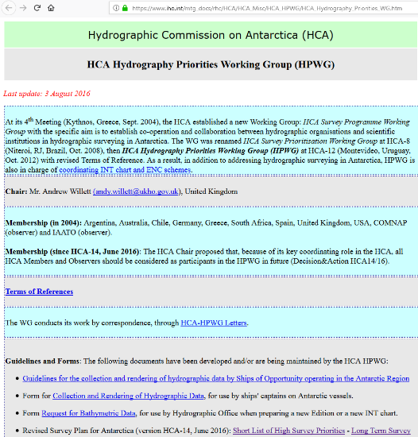
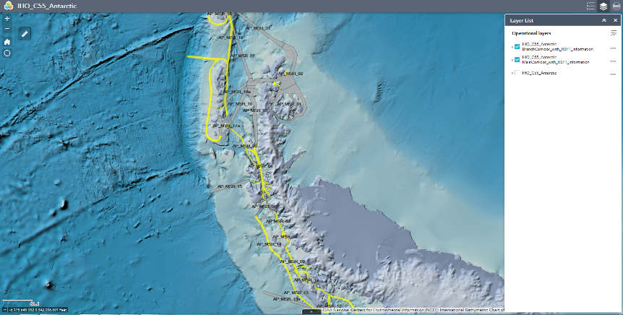
Progress report about HCA14/24
HCA 14/24; "IHB to consider the possibility of supplementing C-55 with survey and charting statistics in relation to agreed MSR, and find a way of posting the relevant information within the IHO GIS environment.“
UKHO provided the GIS file of MSR area. IHO Secretariat has integrated the data with HPWG shortlist and long plan and compared with the C-55 data.
Yellow: shortlisted area

Slide 17
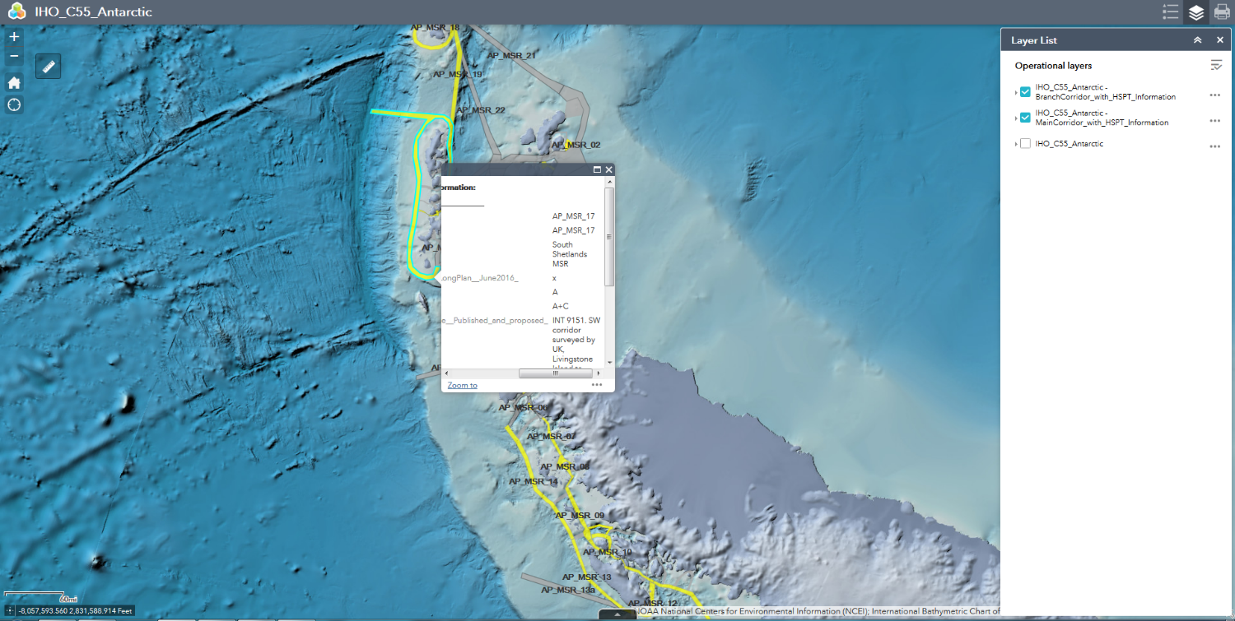
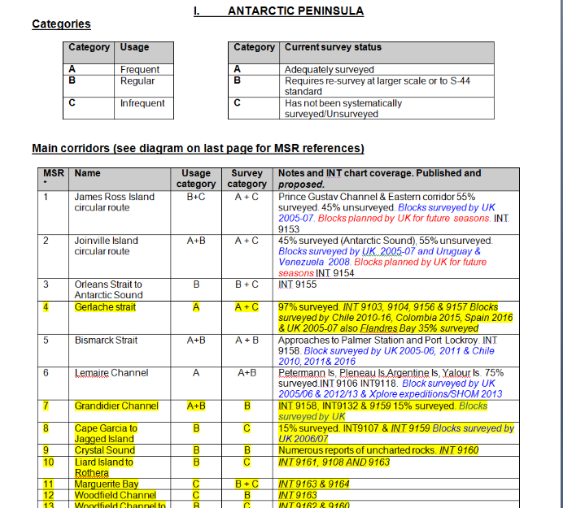
Progress report about HCA14/24
Metadata is reflected.

Slide 18
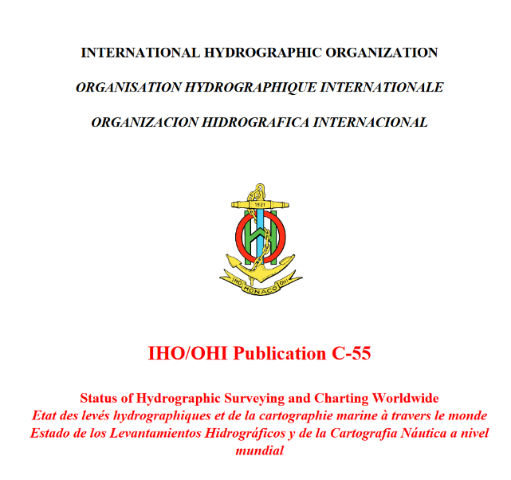
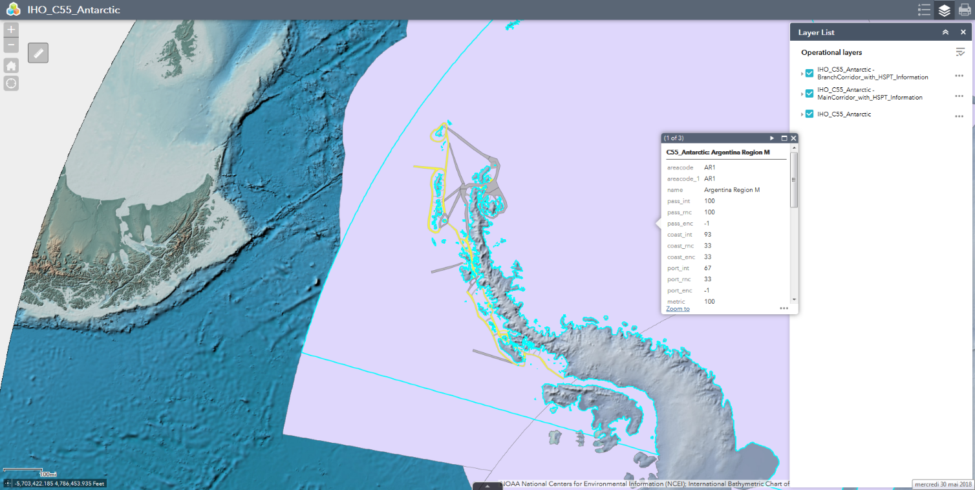
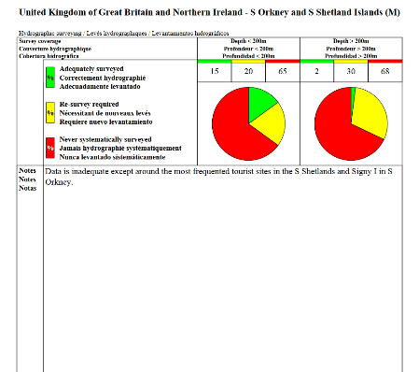
Progress report about HCA14/24
https://www.iho.int/iho_pubs/CB/C-55/c55.pdf
The MSR area is located in the area where UK and Argentina provided the C-55 data to IHO. N.B: the visualization is only for technical consideration and does not reflect any official position of IHO.

Slide 19
Progress report about HCA14/24
HCA 14/24: "IHB to consider the possibility of supplementing C-55 with survey and charting statistics in relation to agreed MSR, and find a way of posting the relevant information within the IHO GIS envrionment.“
The current C-55 segmentation does not have enough resolution for the Peninsula for further analysis of survey priority concerning the MSR area.

Slide 20
Actions to be considered by HCA
→ HCA15/xx: HCA Members to decide on the way forward for C-55 Antarctica Peninsula
- option 1: leave it « as it is »
- option 2: breakdown into MSR segments the « C-55 responsibilty » of which, being allocated to HCA « Peninsula » Members, common metric to be agreed by HCA « Peninsula » Members, annual updates to be provided.
Option 1 is IHO Chair’s recommended option: as the practice implementation of option 2 looks quite unrealistic and provides poor added value. CATZOC values (real values) can provide detailed information if required for the Peninsula….which means however that HCA ENC Producers in this area should « harmonize » their production for consistency purposes → ENC data exchange to be set up in overlapping areas

