Slide 1
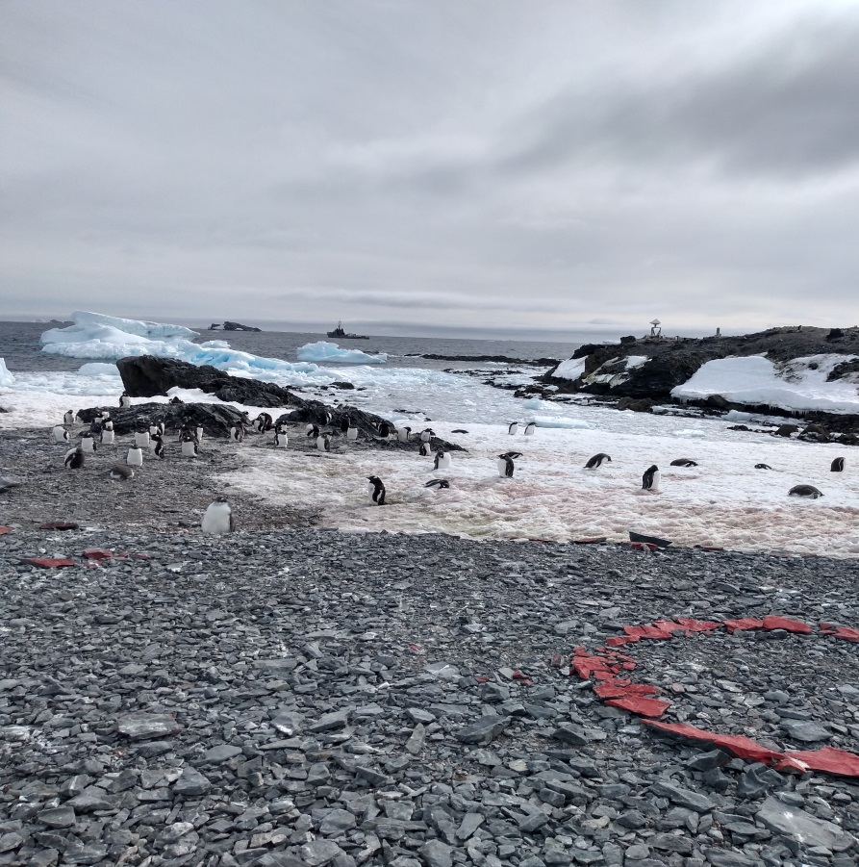
National Report by CHILE
IHO Hydrographic Commission on Antarctica (HCA)

Slide 2
Survey and charting progress in Antarctica (2018 - 2019)
TABLE OF CONTENTS
New charts produced (INT, national, ENC)
Areas surveyed
Risk assessment studies
Impact of Polar Code on your activities

Slide 3
Survey and charting progress in Antarctica (2018 – 2019)
New charts produced (INT, national, ENC): None

Slide 4
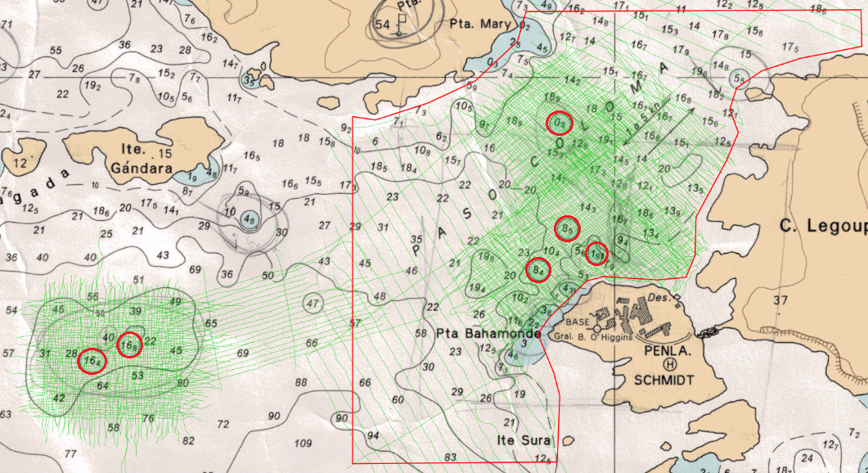
Survey and charting progress in Antarctica (2018-2019)
Areas surveyed
Between January 25th and March 05th, SHOA carried out hydrographic surveys at Rada Covadonga – Paso Coloma. The survey was planned to obtain the data for the National Paper Chart 14511 (INT-9102) “Rada Covadonga y Accesos”, scale 1:10.000.
The hydrographic survey was performed by the Chilean ship ATF “Lautaro”.

Slide 5
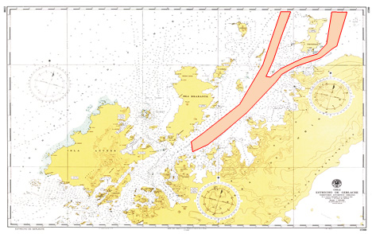
Survey and charting progress in Antarctica (2018-2019)
Areas surveyed
In November 2019, SHOA will carry out hydrographic surveys at the Gerlache Straight, being the second one to the area to adquiere data for the National Paper Charts 15300 (INT-9157) “Gerlache Straight”, scale 1:200.000.
The hydrographic survey will be performed using a multibeam echosounder.
CHART 15300 (INT 9157)

Slide 6
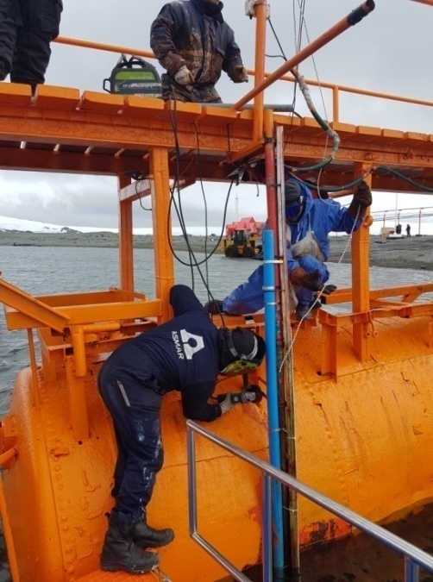
Survey and charting progress in Antarctica (2018-2019)
Areas surveyed
OCEANOGRAPHIC ACTIVITIES:
Permanent Activities:
- Tide gauge maintenance in Puerto Soberanía, Bahía Chile.
- Tide gauge maintenance in Rada Covadonga.
Base Prat, Puerto Soberanía.

Slide 7
Survey and charting progress in Antarctica (2018-2019)
Areas surveyed
OCEANOGRAPHIC ACTIVITIES:
Activities during Antarctic Campaign 2018-2019:
- Tide gauge installation in Rada Covadonga.
The Tide Gauge was installed only for the survey period, being removed after it finished.

Slide 8
Survey and charting progress in Antarctica (2018-2019)
Risk assessment studies: None
Impact of Polar Code on your activities: None

Slide 9
Status of Relations with Other Organizations
Scientific and polar institutes
Cruise vessels
Hydrographic data received from other organizations
Hydrographic data provided to other primary charting authorities and/or GEBCO

Slide 10
Status of Relations with Other Organizations
Scientific and polar institutes
The National Committee of Antarctic Geographic Names:
This year first meeting of the National Committee of Antarctic Geographic Names, was hold on May 27^{th.}

Slide 11
Status of Relations with Other Organizations
Hydrographic data received from other organizations:
None

Slide 12
Status of Relations with Other Organizations
Hydrographic data provided to other primary charting authorities and/or GEBCO: None

Slide 13
Planned Activities for 2019-20
New charts
New surveys

Slide 14
Planned Activities for 2019-20
New charts
-2019 SHOA is currently updating (INT 9104) Nautical Paper Chart 15350 “Islote Useful
a Isla Wednesday” (scale 1:50.000).
-2019 SHOA will publish the new National Nautical Paper Chart 14213 “Ensenadas Mackellar y Martel” (scale 1:15.000).

Slide 15
Any other matters of relevance to HCA
MARITIME SAFETY INFORMATION (MSI)
Chile has an infrastructure in accordance with the assigned area of responsibility NAVAREA XV. This area considers the Antarctic area of the Chilean responsibility. Transmissions are made through NAVTEX and SafetyNet INMARSAT “C” according to pre-established schedule. Additionally, the Meteorological Service of the Navy broadcasts through NAVTEX and SafetyNet the navigational warnings about ice edges and drifting icebergs.
The Chilean Maritime Authority, through “Puerto Fildes” (port authority), issues Antarctic weather forecast for Zone IX and “Presidente Eduardo Frei Montalva” Antarctic Meteorological Center, issues weather forecast for the Drake Passage and Bellingshausen Maritime Region.

Slide 16
Chilean National Report HCA-16
Valparaíso, CHILE June 2019

