Slide 1
National Report by UNITED KINGDOM
IHO Hydrographic Commission on Antarctica (HCA)

Slide 2
Survey and charting progress in Antarctica since HCA-15
New charts produced (INT, national, ENC)
UK have published 2 INT charts and the corresponding ENCs since HCA15
Areas surveyed
UK have surveyed the following areas since HCA15:
Peltier Channel, Melchior Islands and Signy
Risk assessment studies
Nothing to report
Impact of Polar Code on your activities
Nothing to report

Slide 3
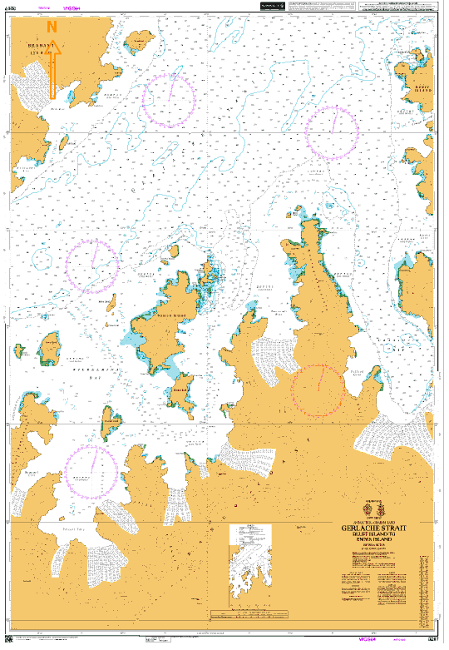
New INT Charts published in Antarctica since HCA-15
INT9166 (BA3207)
GERLACHE STRAIT
BLUFF ISLAND TO EMMA ISLAND
PUBLISHED 14TH MARCH 2019

Slide 4
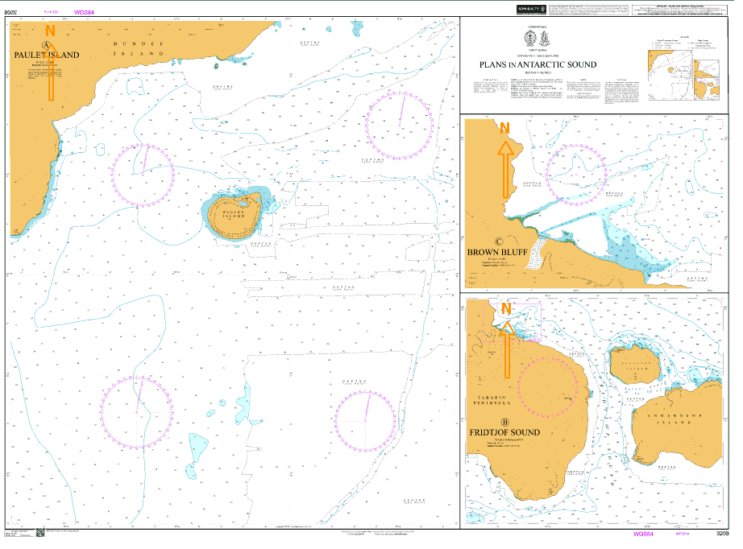
New INT Charts published in Antarctica since HCA-15
INT9114 (BA3208)
PLANS IN ANTARCTIC SOUND
PAULET ISLAND (GB403208)
BROWN BLUFF (GB53208C)
FRIDTJOF SOUND (GB43208B)
PUBLISHED 2ND MAY 2019

Slide 5
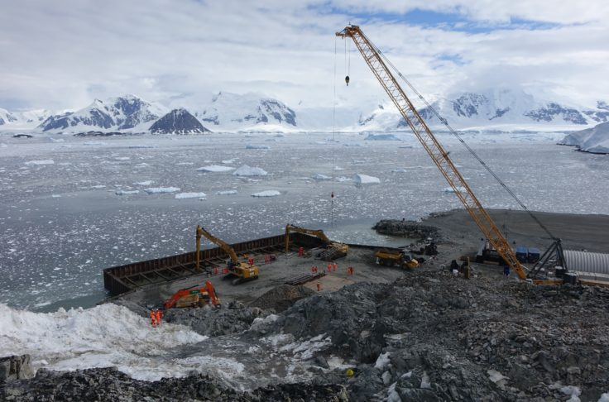
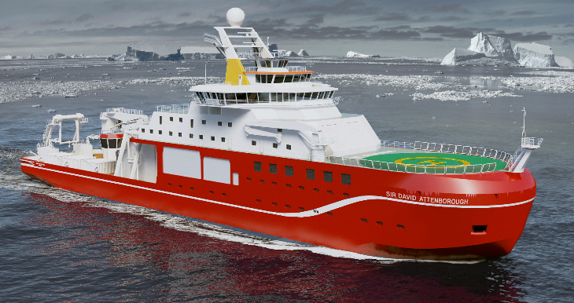
Status of Relations with Other Organizations
Scientific and Polar Institutes
Regular liaison maintained with British Antarctic Survey (BAS), exchanging data and coordinating scientific and surveying requirements. New BAS Polar research vessel to be completed in 2019 and survey of the new wharf at Rothera Station.

Slide 6
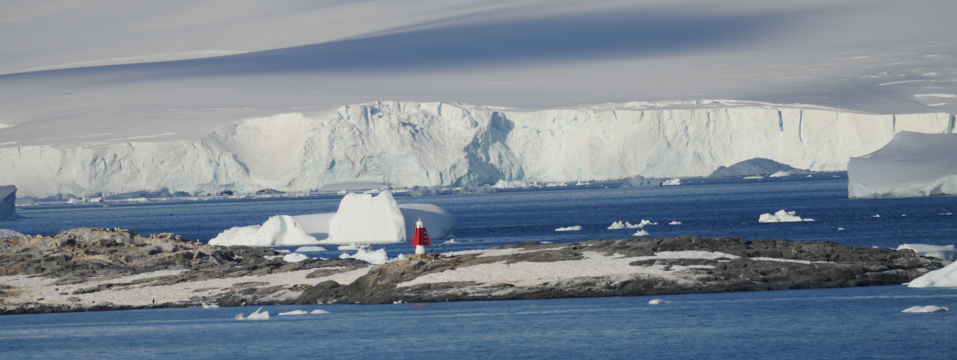
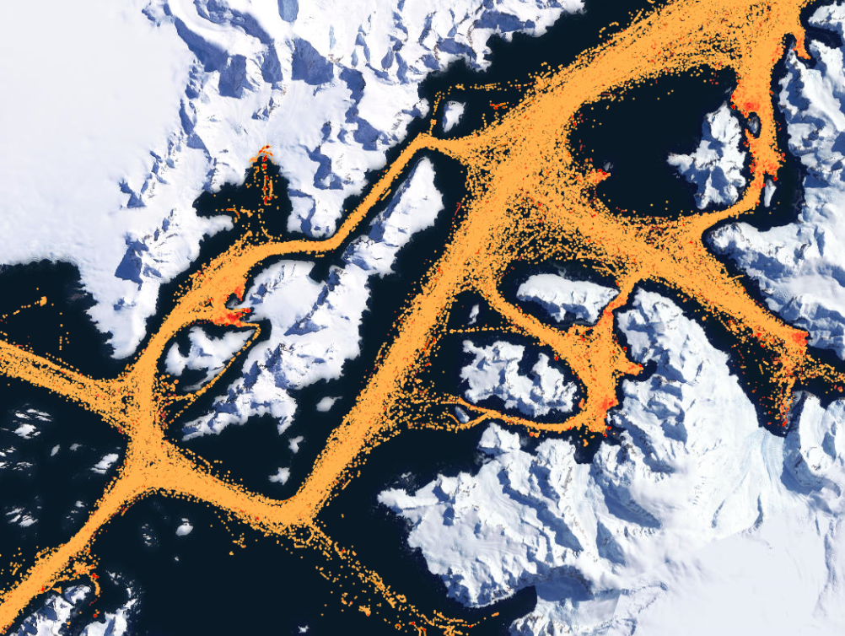
Status of Relations with Other Organizations
Cruise vessels
Regular contact maintained with IAATO, providing data to vessels and receiving access to AIS vessel movements to monitor navigational “hotspots”. This contributes to the understanding of vessel destinations, charting coverage and surveying requirements. IAATO keen to task their vessels to provide confirmation of the existence of navigational aids in the Antarctic Peninsula.

Slide 7
Status of Relations with Other Organizations
Hydrographic data received from other organizations
Multibeam and Singlebeam data received from British Antarctic Survey (BAS)
Hydrographic data provided to other primary charting authorities and/or GEBCO
Data provided to Brazil

Slide 8
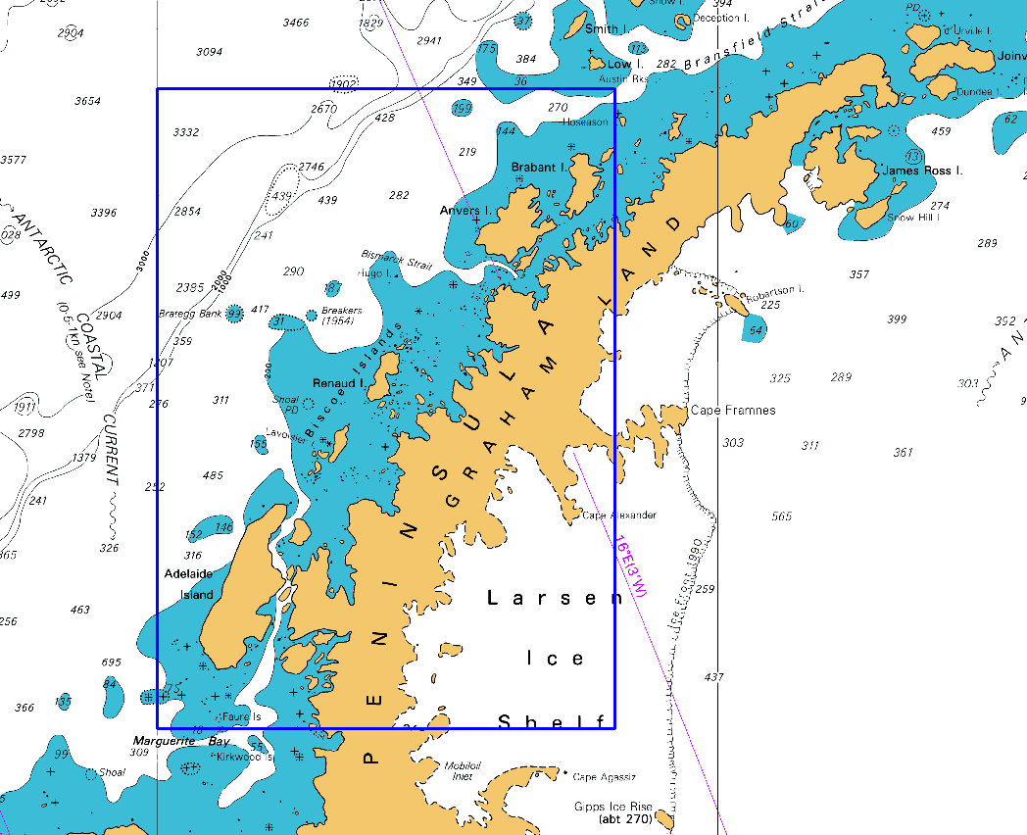
Planned Activities for 2019-2020
New charts and ENCs
UK have 2 INT charts in preparation and 2 further charts planned for 2019/20. All to be published with corresponding ENCs
INT9171 (BA3572)
BRABANT ISLAND TO ADELAIDE ISLAND

Slide 9
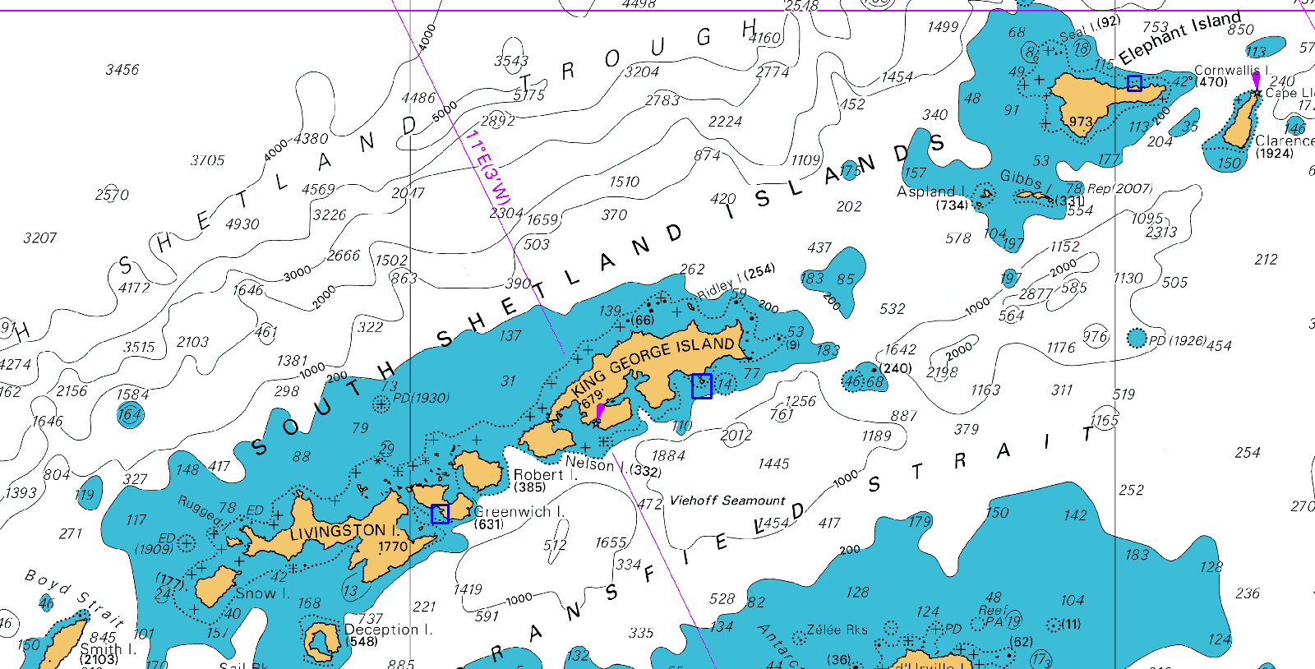
Planned Activities for 2019-2020
New charts and ENCs
INT9112 (BA3210)
PLANS IN THE SOUTH SHETLANDS
POINT WILD
PENGUIN ISLAND
YANKEE HARBOUR

Slide 10
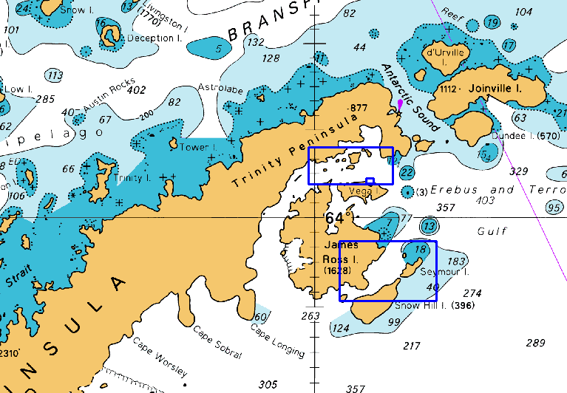
Planned Activities for 2019-2020
New charts and ENCs
INT9130 (BA3209)
PLANS IN THE TRINITY PENINSULA
CRYSTAL HILL TO DEVIL ISLAND &
PLAN OF DEVIL ISLAND
APPROACHES TO SNOW HILL ISLAND

Slide 11
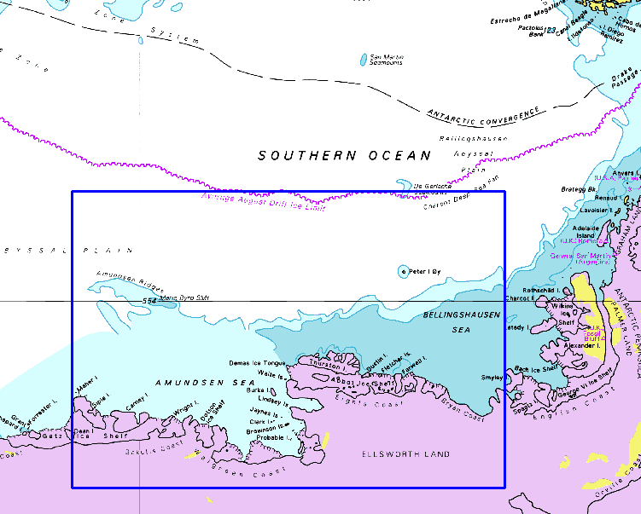
Planned Activities for 2019-2020
New charts and ENCs
INT908 (BA3579)
BRYAN COAST TO MARTIN PENINSULA

Slide 12
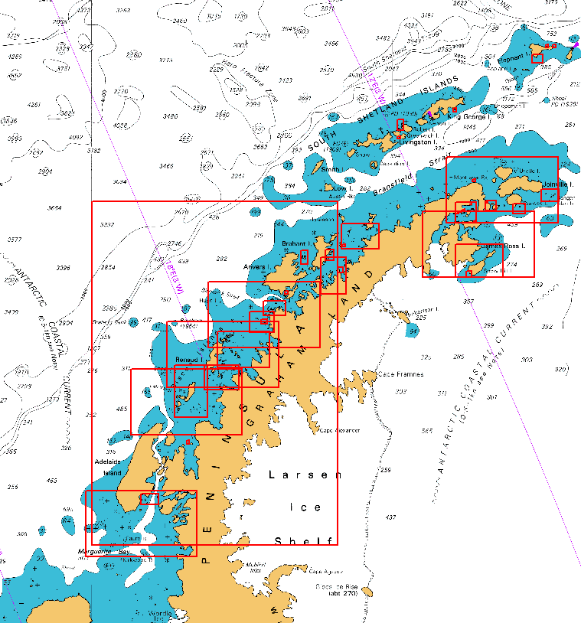
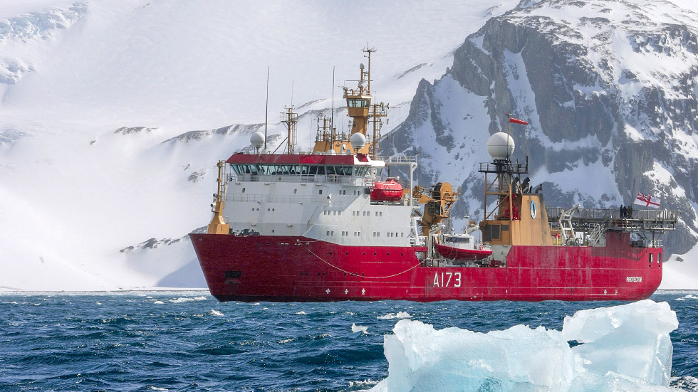
Planned Activities for 2019-2020
New surveys
HMS PROTECTOR will continue to survey within UK INT charts prioritising Maritime Routes and Corridors

Slide 13
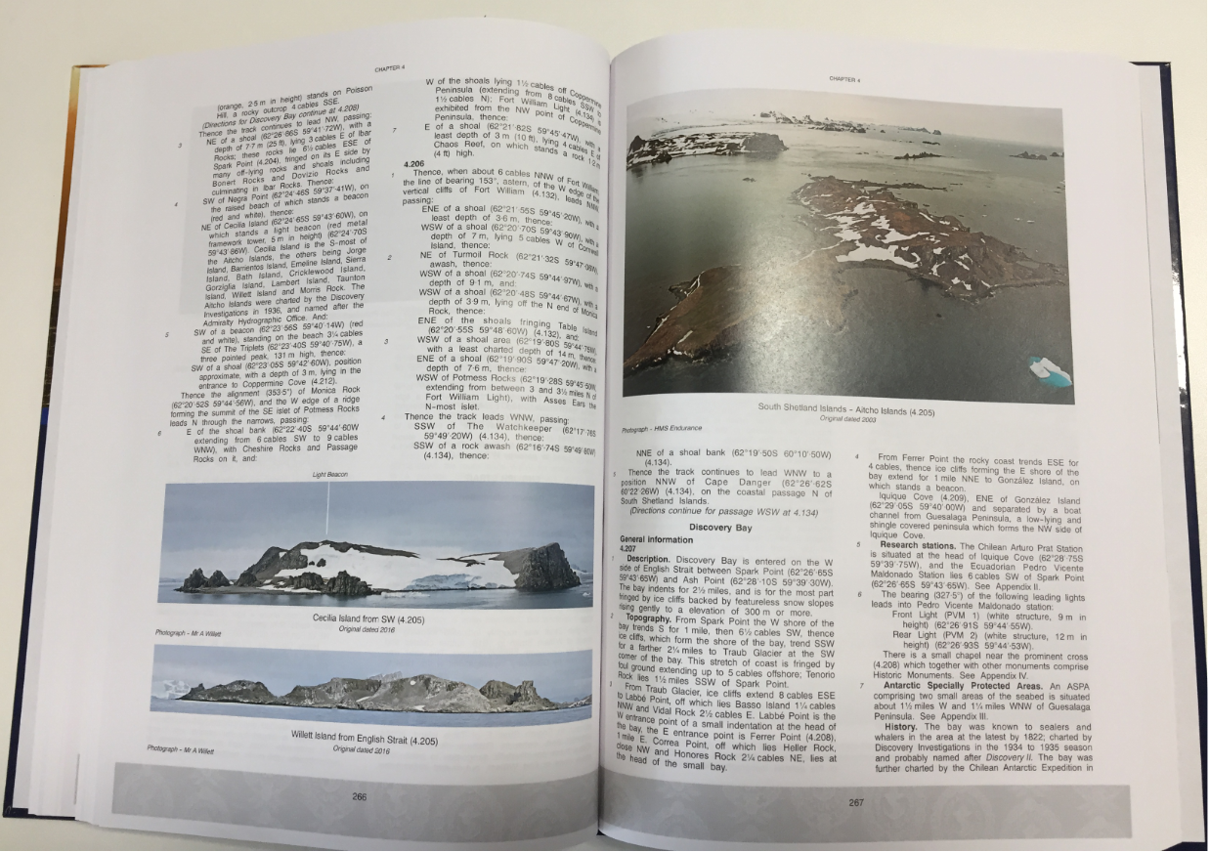
Any other matters of relevance to HCA
UK ADMIRALTY SAILING DIRECTIONS
ANTARCTIC PILOT NP9
NINTH EDITION
PUBLISHED 13TH JUNE 2019

