Slide 1
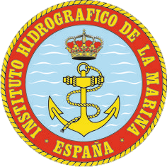
National Report by
Spain
IHO Hydrographic Commission on Antarctica (HCA)

Slide 2
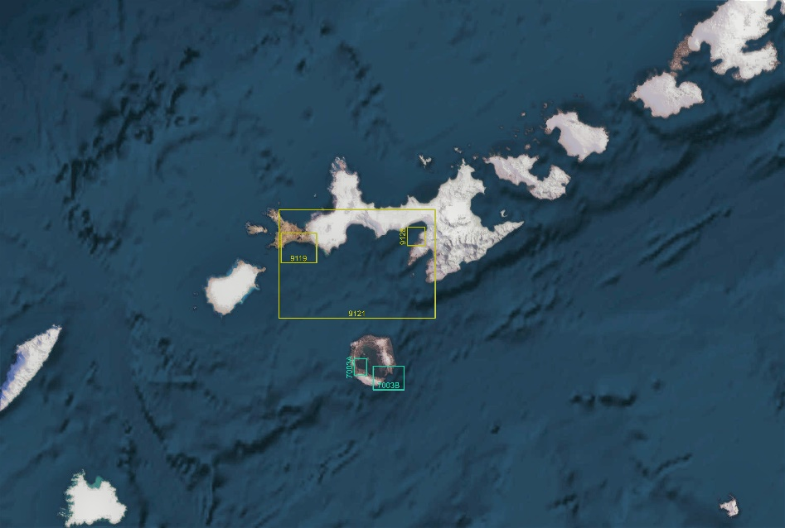
Survey and charting progress in Antarctica since HCA-13 (I)
new charts produced
INT:
INT 9119 (Byers Peninsula) (2nd Edition)
INT 9128 (Livingston Island. Juan Carlos I Base)
INT 9121 (From Bond point to Brunow Bay)
national:
ES 7003 (Bahía Fumarolas y Fuelles Neptuno, Isla Decepción)
ENC:
ES507001 (Livingston Island. Juan Carlos I Base)
ES507002 (Byers Peninsula)

Slide 3
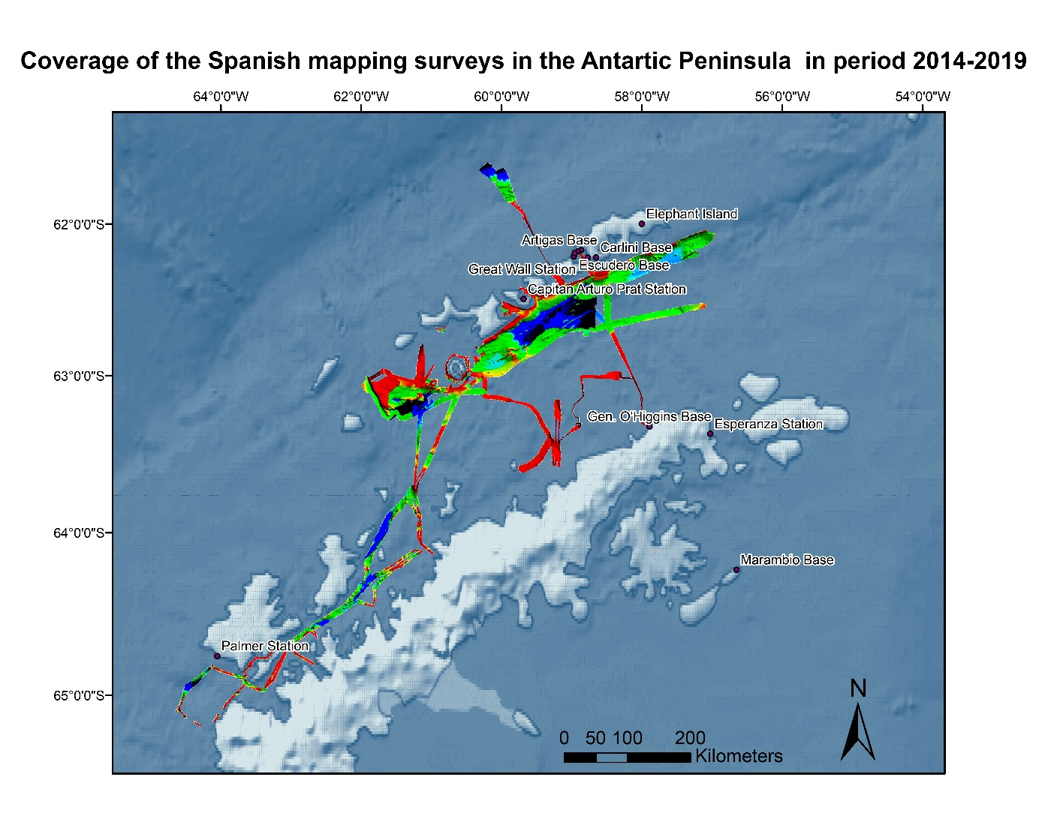
Survey and charting progress in Antarctica since HCA-13 (II)
areas surveyed

Slide 4
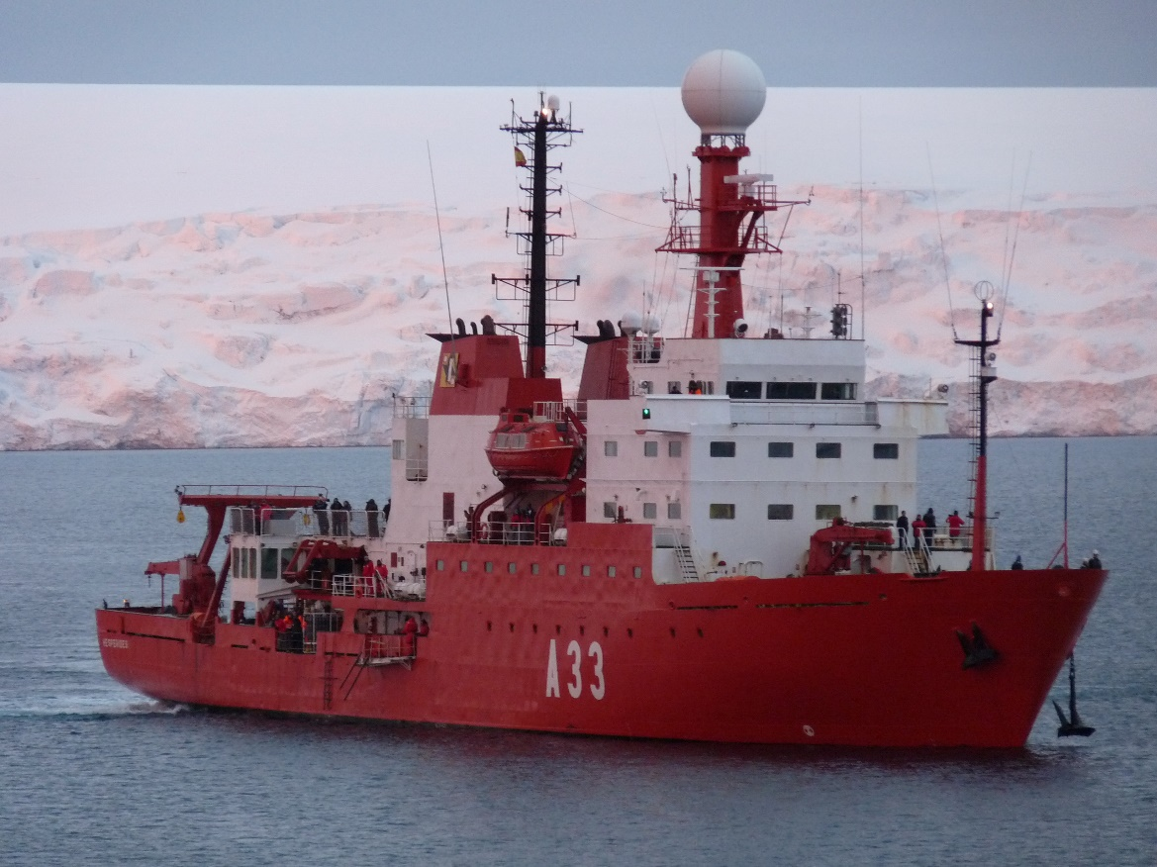
Status of Relations with Other Organizations
scientific and polar institutes
Spanish Polar Committee
cruise vessels
BIO Hesperides

Slide 5
Planned Activities for 2020-21
new charts
INT 9136 and INT 9137
ENC: ES40700A (ENC version of INT 9121)
national: 700B (Isla Decepción)
new surveys

Slide 6
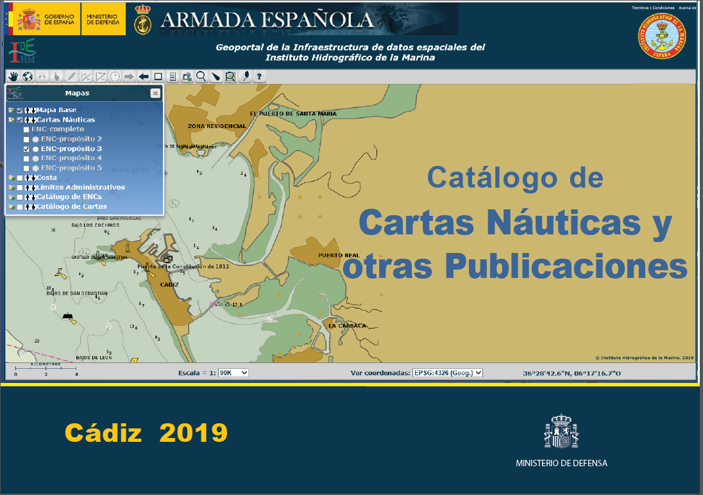
Any other matters of relevance to HCA
The 2019 edition of “Catalogue of Nautical Charts and other Publications”, which includes the Spanish chart scheme in Antarctica, was published in the beginning of last year

Slide 7
Any other matters of relevance to HCA
Tide Gauge Network:
The University of Cádiz (UCA) has been monitoring tides both in Livingston Island and in Decepción Island for the last three years by leaving one bottom pressure sensor in each island for the winter. At the end of the summer campaign these sensors are recovered for their recorded data to be retrieved, and then deployed again. Currently there are two sensors recording tides in the two islands. IHM is collaborating with UCA in data management on these gauges.

Slide 8
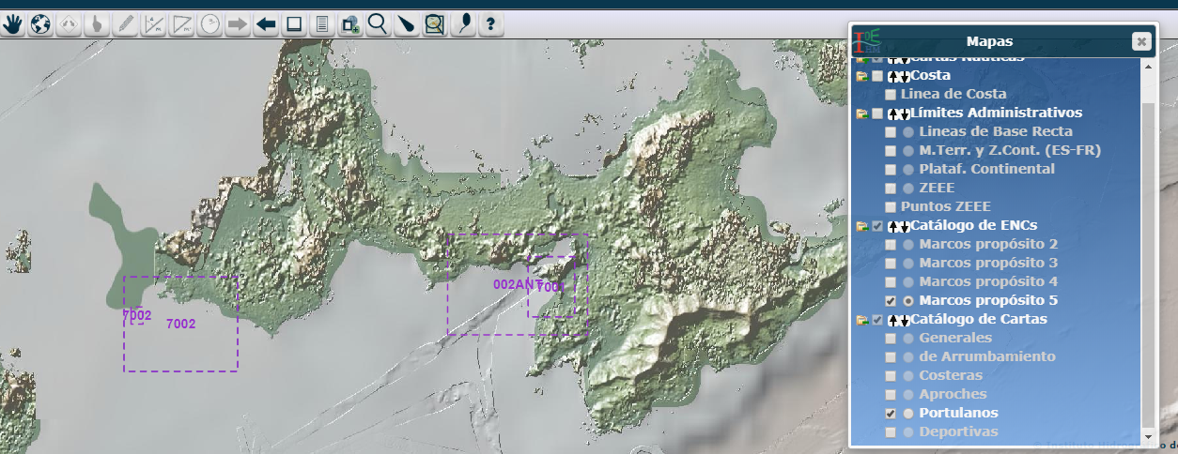
Any other matters of relevance to HCA
IDE-IHM :
The IHM has developed its own SDI with the following services:
Nautical Chart WMS Services.
Nautical Chart WMS Services.
CSW Service of Metadata Catalog (Spanish IHM Nautical Chart).
WMS/WFS for straight territorial sea baseline.
WMS/WFS for Maritime boundaries.
WMS/WFS for IHM nautical chart catalogue scheme.
WMS/WFS for military maritime practice areas.

