Slide 1
Update on HCA-GIS and Quantarctica: The Path to Antarctica Research Community
IHO Hydrographic Commission on Antarctica (HCA)
HCA-16, Prague, Czech Republic (3 -5 July 2019)

Slide 2
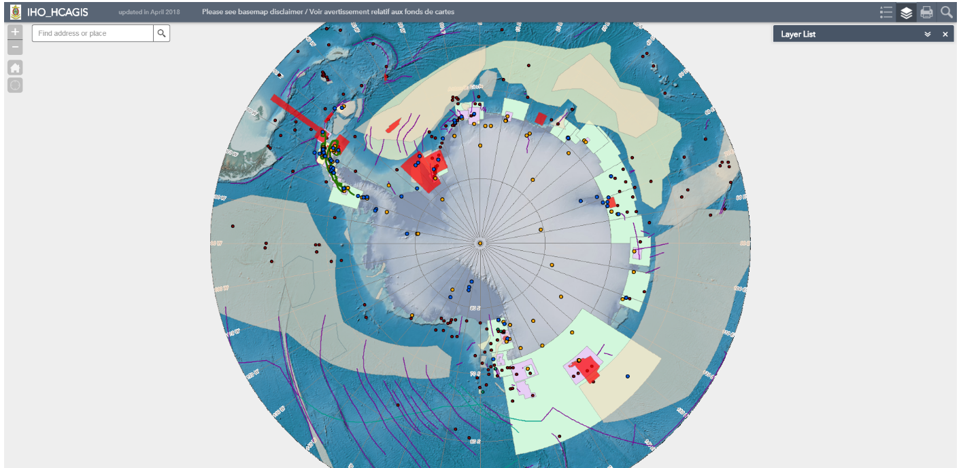
HCA GIS
<https://www.iho.int/gis/antarctic.gis.html>

Slide 3
Decision on HCA-15
HCA15/32:
Noting the current status of the HCA GIS, the developments in progress (INToGIS II, national MSDI Polar portals, Quantarctica…), and the outcomes of the survey made by HCA Letter 02/2017, HCA tasked the HCA Secretariat to prepare the decommissioning of the HCA GIS and a transition plan for the future (Doc. HCA15- 07.5A_Rev1 refers).

Slide 4
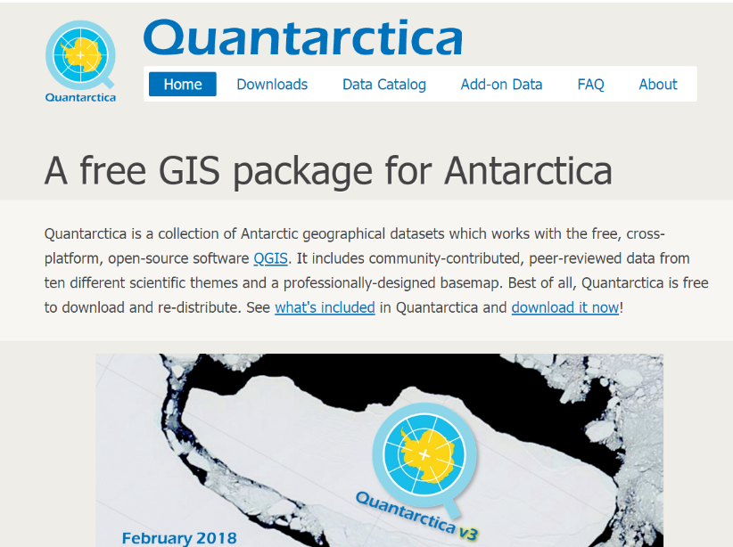
Progress reports from the HCA15
IHO Secretariat has kept a discussion with Norwegian Polar Institute which operates one of the most popular GIS service “Quantarctica” in the region.
Free, stand-alone software based on QGIS (open-source GIS) including various data such as
Oceanography
Atmospheric sciences
Geology
Biology
remote-sensing data
http://quantarctica.npolar.no/
For brief introduction (on Youtube)
https://youtu.be/_HV_VbxKKDM

Slide 5
Progress reports from the HCA15
Quantarctica Friendly Dataset:
Any researcher/ institution ready to open scientific GIS data in the Polar region can contribute to the Quantarctica as “Friendly Dataset” if it is:
ESRI Shapefile with Antarctic Polar Stereographic
It is possible to call HCA GIS dataset as “Quantarctica Friendly Dataset” and the connection between IHO website and Quantarctica website will be explained later.

Slide 6
Progress reports from the HCA15
Issue
Discussion with Norwegian Polar Institute | Done | It was kindly consented that the HCA GIS dataset is now “Quantarctica Friendly Dataset” which allows users to use the data on their Quantarctica.
Preparation of HTML documents and the guidebook for Quantarctica user | Done | The guidebook mentions about technical issues on GIS as well as the meaning of hydrographic activities.
Technical preparation (GIS feature service and a download website) | Done | It will allow Quantarctica users to overlap/download the HCA GIS dataset. An image will be shown later.
A new function on HCA GIS to connect with Quantarctica | Done | A transitional function which will be shown later.
Update of information | Done | INT and ENC chart scheme and production area updated in April 2019.

Slide 7
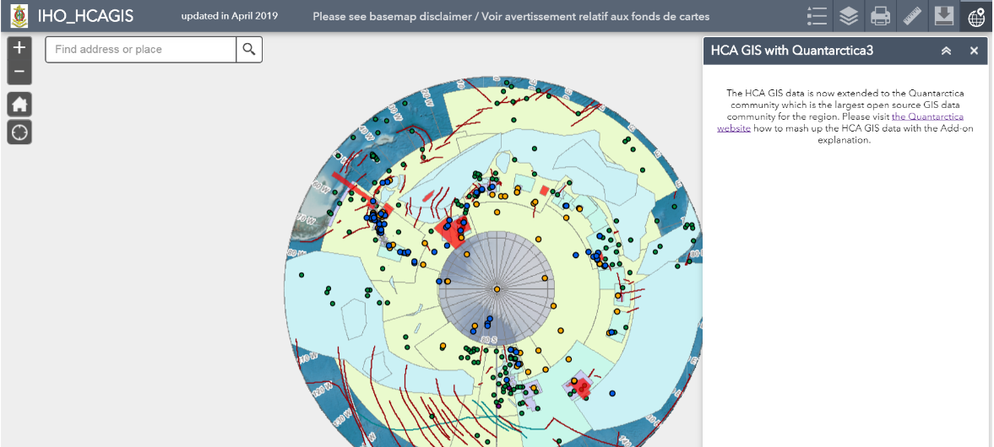
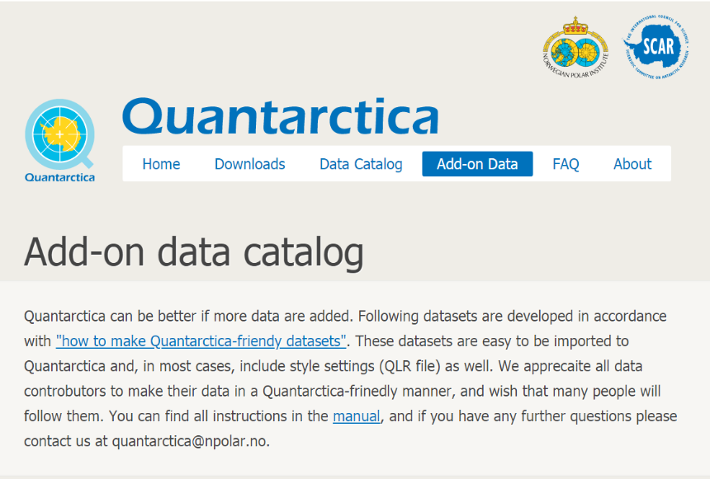
Connection with Quantarctica (new function)
To the HCA GIS data page within the Quantarctica website,

Slide 8
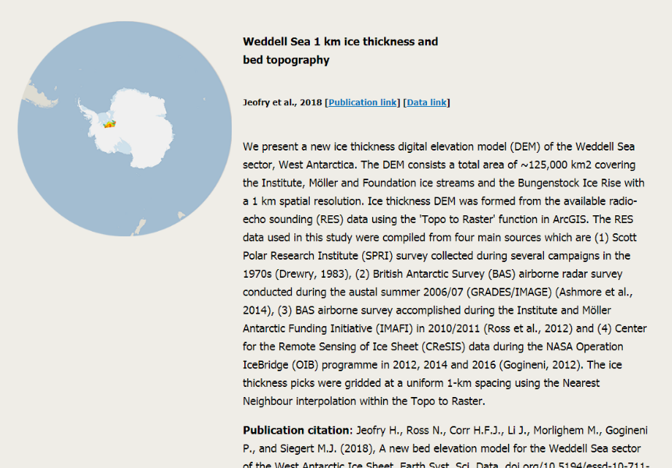
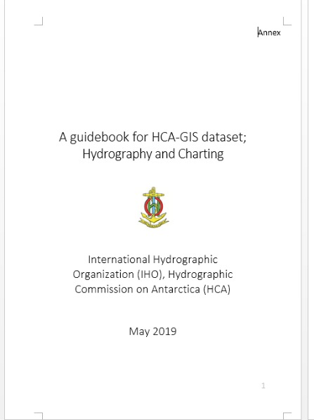
Connection with Quantarctica (new function)
The HCA GIS dataset will be introduced in the Quantarctica website with a technical guidebook for users.
IHO HCA GIS dataset
Technical guidebook

Slide 9
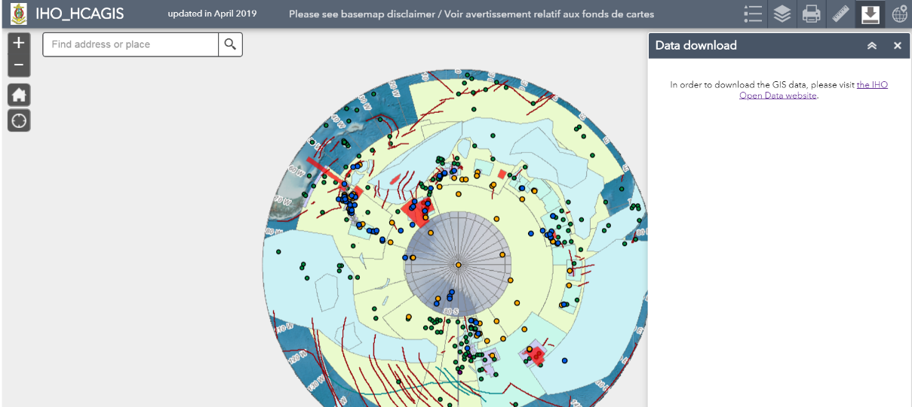
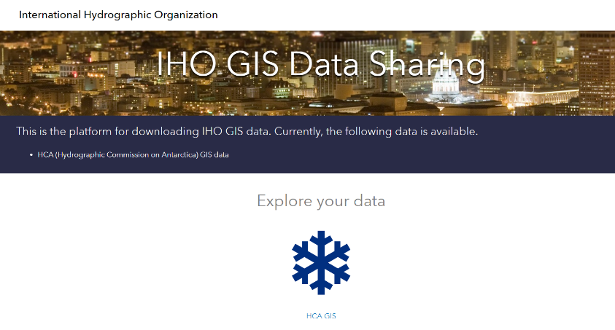
Download of HCA GIS data (new function)
To data download page:
https://data-iho.opendata.arcgis.com/

Slide 10
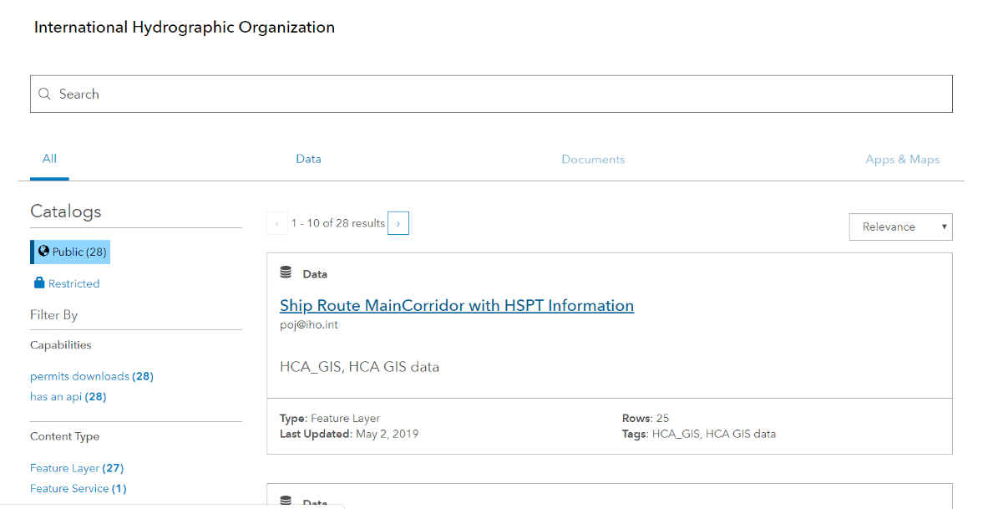
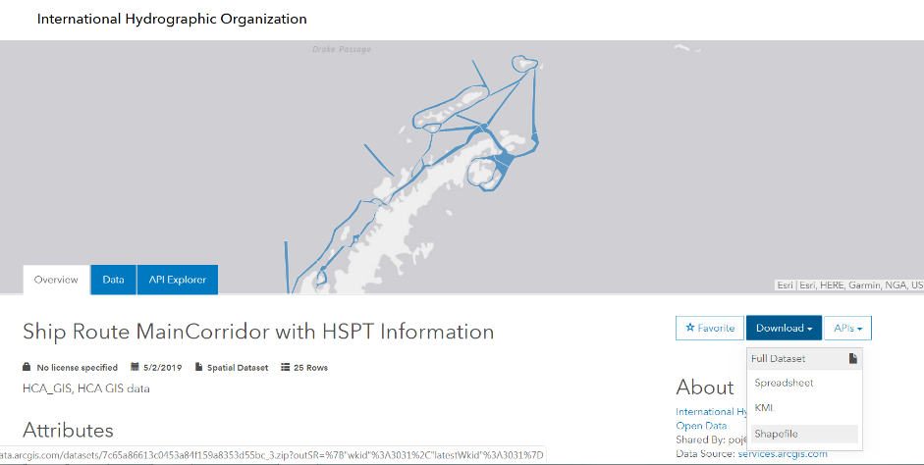
Download of HCA GIS data (new function)
KML, shapefile and spreadsheet can be chosen to download.

Slide 11
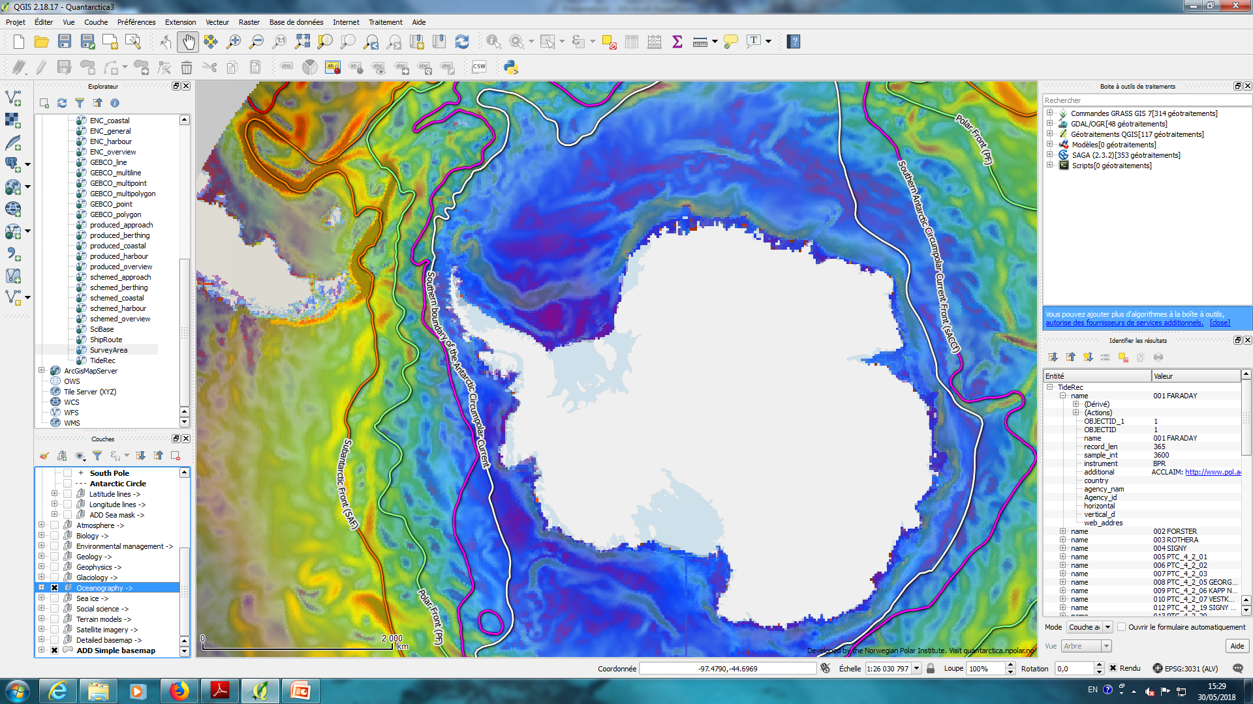
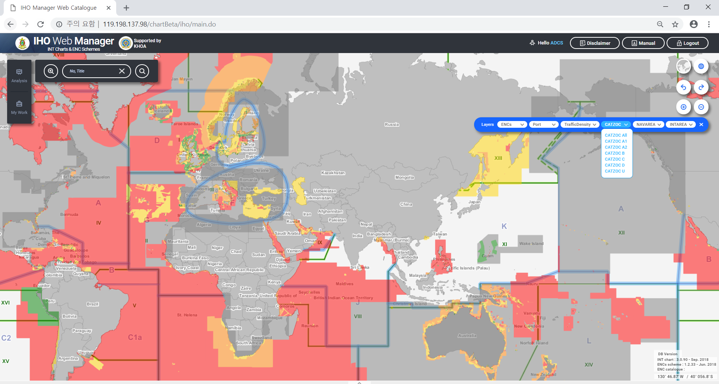
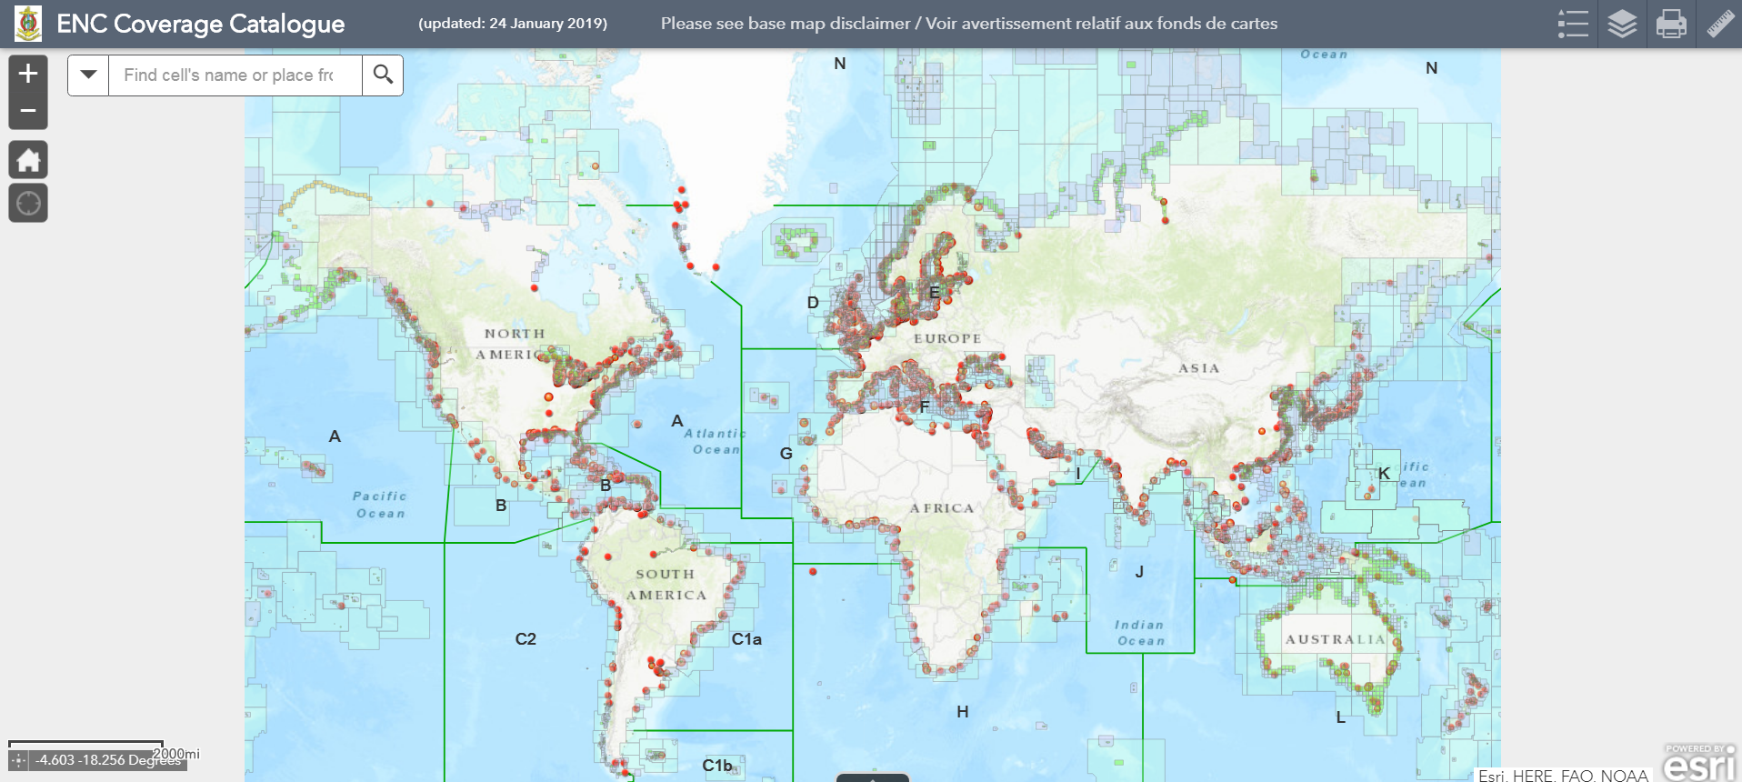
Data FLOW IN FUTURE
Ship route
Data input tool (in preparation)
IHO GIS DB
Automation tool (in preparation)
Data provider
Survey area
Tidal record
HCA GIS data
ENC coverage
Quantarctica
by Norwegian Polar Institute
Undersea feature names
Connectivity will be improved.
INToGIS II by KHOA
ENC availability by IHO Sec.
For wider audience
(polar researchers, industry, etc.)

Slide 12
ACTIONS TO BE CONSIDERED
HCA Members to note the on-going transition plan
HCA Members are encouraged to start using Quantarctica as the primary entrance gate to get access to HCA GIS data
HCA Members to provide inputs/comments, if any, on the draft Edition 1.0 of the HCA Guidebook for Quantarctica Users (15 Sept 2019)
HCA Members to note that during the transition phase, HCA GIS service will remain active
HCA Members to note the on-going development of a data providers interface to update HCA GIS data and to use it when implemented (formstack in development)
HCA Members to consider at HCA-17 (in 2021), whether they prefer simply to use Quantarctica in replacement, and/or to keep a direct access to HCA GIS Services on the IHO GIS webpage (alternative)

