Slide 1
Input report from HSSC10 and HSSC11 to MBSHC Rostock, Germany (14-17 May 2018) Cape Town, South Africa (6-9 May 2019)
IHO HYDROGRAPHIC SERVICES AND STANDARDS COMMITTEE
MBSHC-21, Cádiz, Spain, 11-13 June 2019
R.Admiral Luigi Sinapi – HSSC Chair

Slide 2
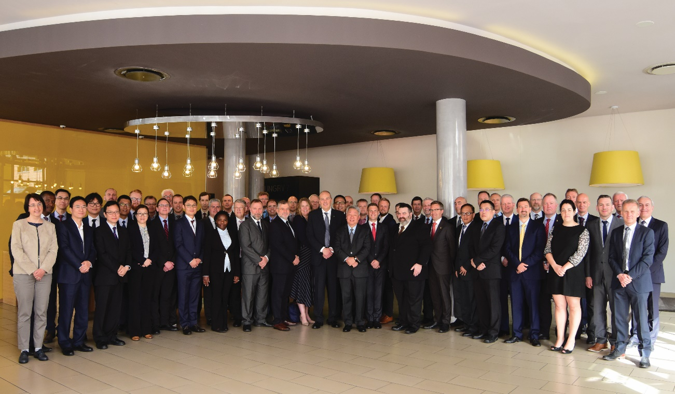
Introduction
HSSC work is guided by the IHO Work Programme 2 “Hydrographic Services and Standards” and by the Council key priorities
Meetings since MBSHC-20:
Rostock, Germany (13-17 May 2018)
Cape Town, South Africa (6-10 May 2019)
Next Meeting:
HSSC-12 Bristol, UK (11-15 May 2020)
MBSHC-21, Cádiz, Spain, 11-13 June 2019

Slide 3
HSSC-11 Key Priorities
Operational/strategic level
Resolution 2/2007 as amended
Revised Strategic Plan
S-100 Implementation Strategy
Future of Paper charts
Technical level
Demonstration showcase of S-100 based products
Development of the S-1xx Product Specifications and operationalization of S-1xx framework
Priorities of IHO 2019 Work Plan 2
Hydrographic Dictionary S-32
MBSHC-21, Cádiz, Spain, 11-13 June 2019
Notes:
Main challenges

Slide 4
Analysis/Discussion – Resolution 2/2007
HSSC endorsed IHO Resolution 2/2007 as amended
Resolution 2/2007 applicable also to IRCC publications
IRCC to endorse - at IRCC11 - the Resolution 2/2007 as amended
IHO Secretariat will send out a CL to the MSs seeking for the approval
MBSHC-21, Cádiz, Spain, 11-13 June 2019

Slide 5
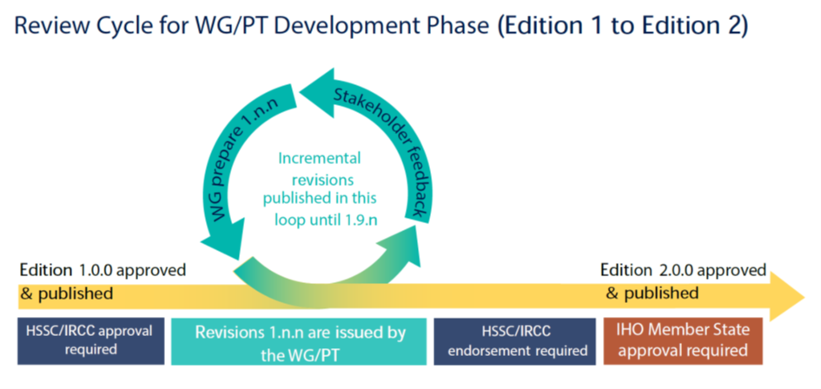
Analysis/Discussion – Resolution 2/2007
The Resolution 2/2007 as amended is structured as follows:
Main doc: updated review cycle for WGs/PTs for the development of PSs and standards
Appendix 1 and 2: lists of IHO standards that must be maintained in conformance with the IHO Resolution 2/2007 as amended
Appendix 3: guidance for conducting stakeholders impact study
MBSHC-21, Cádiz, Spain, 11-13 June 2019

Slide 6
Analysis/Discussion – IHO Strategic Plan
SPRWG provided a “Draft IHO Strategic Plan” (17th March 2019) where are defined:
Strategic Goals
Strategic Targets (ST)
Strategic Performance Indicators (SPI)
HSSC relevant elements of the Future IHO Strategic Plan to be considered
HSSC Chair provided comments on ST and SPI to SPRWG Chair and IRCC Chair (HSSC CL 2/2019 dated 31 May 2019)
MBSHC-21, Cádiz, Spain, 11-13 June 2019

Slide 7
Analysis/Discussion – IHO Strategic Plan
1. Safety and Efficiency of the "transforming navigation"
1.1. Deliver Standards for data formats, Product Specificatios, including accompanying transition and implementation support
1.1.1 XX% of the Member States have operationalized some S-1XX based products by XXXX (year)
1.1.2 “Complete and implement a refurbished standardisation of paper charts to enable advanced support for “print on demand” based on content of S-101 electronic nautical charts” or “Improved paper chart production based on ENCs S-101 data implemented and standardized"
1.2 Develop standards and best practices in the areas of data assurance, including cyber security and data quality assessment
1.2.1 % of certified cyber secure data products and services delivered by XXXX (year)
Strategic Goal 1
Strategic Targets (ST)
Strategic Performance Indicator (SPI)
1.1.3 Autonomous shipping requirement supported by S-1xx
1.2.3 XX % of CATZOC X (or QoBD level better than X) assessed by XXXX (year)
2. Developing hydrographical geospatial data use for the benefit of sociey
2.2 Adopt or promote new tools and methods to accelerate and increase coverage, consistency, quality of surveys in poorly surveyed areas, e.g. crowd-source bathymetry; satellite-derived bathymetry
2.2.2 New Edition of S-44 promulgated for all kind of applications and navigation by 2021, revised every 2 years, and fully implemented by all HOs by 2026
2.2..1 Quality indicators for all sorts of hydrographic data available and applied
2.3 Adopt and apply UN guiding principles for geospatial information management ensuring interoperability of Hydrographic data with ither marine related data
Strategic Goal 2
Strategic Targets (ST)
Strategic Performance Indicator (SPI)
2.3.1 % of S-1xx data sets in the regional and global MSDI
MBSHC-21, Cádiz, Spain, 11-13 June 2019

Slide 8
Analysis/Discussion –Implemetation Strategy – HSSC contribution
Implementation levels definition | Transition phases, milestones, timeline | HSSC Chair, S-100 WG
 | Technical Readiness Levels | S-100 WG
Provision of standards | PS structure | S-100 WG
 | Interoperability aspects (S-98 development) and responsibility | S-100 WG, NIPWG
 | Harmonization and responsibility | DQWG, S-100 WG, NIPWG
 | Data management issue | ENC WG
Synchronization of standards and products | Design / Provision of synchronised products | NIPWG, S-100 WG
 | Industry level of readiness | NIPWG, S-100WG,
Operationalization of the data | Guidance for data producers / WENS? | IRCC (WEND WG)
 | Data protection | ENC WG
 | Service distribution (cloud service) | S-100WG, IRCC (RENCs + HOs)
Note: IRCC contribution
MBSHC-21, Cádiz, Spain, 11-13 June 2019

Slide 9
Analysis/Discussion – Future of Paper Charts
Sales and use of paper nautical charts is declining
NCWG drafted a document about PC’s Future
Preliminary comments received from HOs
CL to be issued seaking for MS contribution
Document to be approved in 2020
Common needs:
Reallocate the resources currently dedicated to traditional paper
Ultimate goal is to fully automate the creation of paper products from fully populated ENC vector databases
MBSHC-21, Cádiz, Spain, 11-13 June 2019

Slide 10
Analysis/Discussion – Future of Paper Charts
PROPOSALS | CAN+UK | GER | AU | FR | US | NCWG
Full automating process from ENC to paper charts | X | X | X | X | X | X
Radical revision/Freezing of S4 | X | X (ENCWG) |  | X (No NCWG) |  | Only Revision
Limit investment on paper charts | X |  |  |  | X | X
Freezing of INT1 |  | X
IMO involvement |  |  | X |  | X | X
Task an HSSC WG to develop a WP to the “Future of paper charts” |  |  |  | X (NCWG) | X (ENCWG or NCWG) | X
MBSHC-21, Cádiz, Spain, 11-13 June 2019

Slide 11
Analysis/Discussion –Showcase of S-100 based products
C-2 tasked the HSSC (see action C2/29) :
“Consider the possibility to organize a demonstration showcase of S-100 based products and test beds as an embedded session at C-3 in October 2019”
HSSC-11 discussed showcase structure
MSs/WGs volunteered to provide expertise, test data and examples
S-100 WG Chair coordination
MBSHC-21, Cádiz, Spain, 11-13 June 2019

Slide 12
Analysis/Discussion – Showcase of S-100 based products
Showcase characteristics:
“Educational narrative”
Help the HOs to support and follow S-1xx framework concept development towards its operational phase
Highlighting front-of-bridge/back-of-bridge requirements
(topic to be reported to C-3 for IHO Secretariat involvement with IMO)
General need to work in connection with IRCC, especially concerning the dissemination of S-1xx PS and the role of RENCs
HSSC intention to reach a larger audience at the Assembly
(topic to be addressed to C-3)
MBSHC-21, Cádiz, Spain, 11-13 June 2019

Slide 13
Analysis/Discussion –Showcase of S-100 based products
 | Duration | Topic | Speaker
1 | 15/20’ | Point of situation of the new PSs and S-100 implementation strategy | HSSC Chair/IHO Secretariat (HSSC Report to C-3)
2 | 15’ | S-101 with examples of conversion from S-57 | S100WG/S101PT representative
3 | 15’ each PS | Examples of PSs at semi-operative stage (S-102, S-111, etc) | PTs/HOs
4 | 15’ each | Examples from the HOs/RENCs S-100 Service distribution | HOs, RENCs
Duration 2 hrs
MBSHC-21, Cádiz, Spain, 11-13 June 2019

Slide 14
Analysis/Discussion – HSSC Actions of interest
MSs approved S-122 Ed. 1.0.0 – Marine Protected Areas
MSs approved S-123 Ed. 1.0.0 – Marine Radio Services
HSSC approved S-101 Ed. 1.0.0 – ENC
HSSC approved S-111 Ed. 1.0.0 – Surface Currents
HSSC endorsed S-102 Ed. 2.0.0 – Bathymetric Surface
HSSC approved Ed. 1.0.0 of S-97 – Guidance for PS developers
HSSC approved Ed.1.0.0 of S-127 – Marine Traffic Management
HSSC approved Edition 1.0.0 of S-129 – Under Keel Clearance Management Information
S-100 Ed. 5.0.0 shifted to 2021
S-98 to be submitted for endorsement in 2020/2021
MBSHC-21, Cádiz, Spain, 11-13 June 2019

Slide 15
Analysis/Discussion – HSSC Actions of interest
HSSC to seek the agreement of IRCC and RHCs for a survey for the production of the following data sets (NIPWG coordination):
S-122 - Marine Protected Area
S-123 - Marine Radio Services
IRCC to evaluate to extend WENDWG scope to S-101 ENCs and other S-100 based products
Proposal of “Cloud distribution” of S-100 based products (Canada):
To be investigated by IRCC and RENCs
MBSHC-21, Cádiz, Spain, 11-13 June 2019

Slide 16
Analysis/Discussion – Priorities of IHO 2019 Work Plan 2
Develop an S-100 interoperability specification
Ed. 1.0.0. of S-98 final approval is part of S-100 Implementation Strategy
Ed. 1.0.0 of S-98 to be submitted for endorsement in 2020/2021
HSSC-11 agreed to organize a S-100 Test Strategy Meeting (TSM) in liaison with IEC
Develop S-121 Product Spec for Maritime Limits and Boundaries
HSSC encouraged the S-121PT to pursue the development of Ed. 1.0.0
HSSC encouraged the IHO Member States to participate in the S-100 WG review process of S-121
MBSHC-21, Cádiz, Spain, 11-13 June 2019

Slide 17
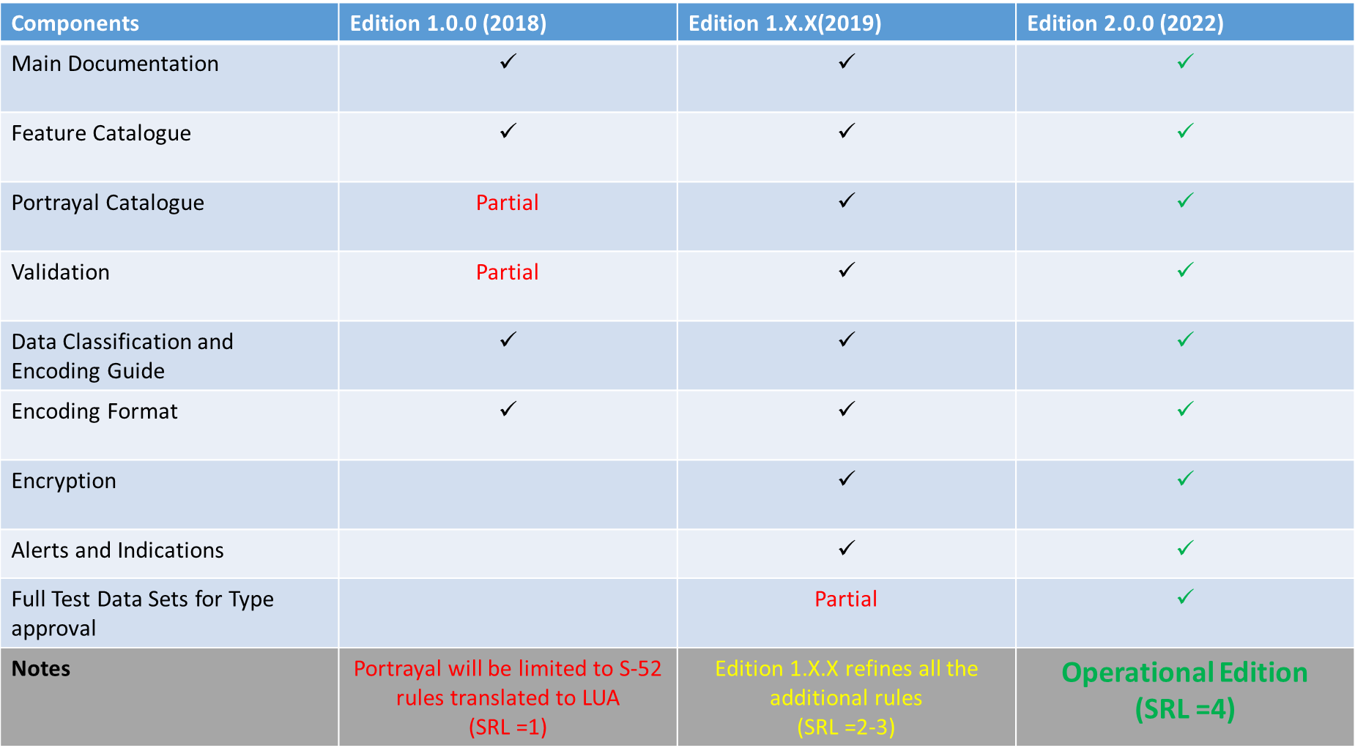
Analysis/Discussion – Priorities of IHO 2019 Work Plan 2
Develop all the components needed to make S-101 a reality:
Ed. 1.1.0 of S-101 to be expected in December 2020
Ed. 2.0.0 to be expected in December 2022
S-101 components for Encryption, Alerts and Indications to be fully developed
MBSHC-21, Cádiz, Spain, 11-13 June 2019

Slide 18
Analysis/Discussion – Priorities of IHO 2019 Work Plan 2
Consolidation and clarification of standards in relation to ECDIS/ENC:
ENCWG liaised with CIRM and IEC for updating S-63 for improved security for investigations and risk assessment
HSSC tasked ENCWG to develop a draft proposal for mitigation measures for cyber security and to make an impact assessment
HOs to review the current ENC production process and make changes where necessary to encode meaningful values of CATZOC
MBSHC-21, Cádiz, Spain, 11-13 June 2019

Slide 19
Analysis/Discussion – Priorities of IHO 2019 Work Plan 2
Prepare Ed. 6.0.0 of S-44:
May/June 2019 - HSPT: draft of the 6th Edition (v1.7.0) for review and comments by MSs and stakeholders
March 2020: S-44 6th Edition (v2.0.0) delivered to HSSC for endorsement
End 2020: Approval of the S-44 6th Edition
Contest for designing the cover page of Edition 6 of S-44 to be advertised among MSs
MBSHC-21, Cádiz, Spain, 11-13 June 2019
Notes:
HSPT is finalizing the drafting process of Edition 6.0.0 of S-44.
HSPT Chair reported that the PT will finalise the work on draft v1.5 in order to propose a draft v1.7 to HSSC Chair (June 2019).
HSSC agreed on the recommendation made by HSPT that the final draft version 1.x.x of the 6th Edition of S-44 should be circulated to all stakeholders, prior to submission for endorsement to HSSC-12. HSPT will submit final proposed version 2.0.0 of 6th Edition of S-44 to HSSC for endorsement.

Slide 20
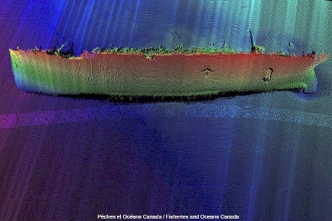
Analysis/Discussion – Priorities of IHO 2019 Work Plan 2
Consider data quality aspects in harmonized way for all S-100 based PSs:
Visualization methodology of Quality of Bathymetric Data
Method to depict the quality of the bathymetry and isolated features hazardous to the safety of navigation (wrecks, rocks, obstructions)
Also supportive for decision making and autonomous shipping
MBSHC be aware of importance of QoBD
Navigable depth (95% confidence)
D < 17.1
C = 17.1
draft
A2, B = 18.7
A1 = 19.4
safe depth
20m contr
0.7m
1.4m
3.0m
>3.0m
A1
A2
B
C
D
CATZOC value
Charted depth = 20.1 m
MBSHC-21, Cádiz, Spain, 11-13 June 2019

Slide 21
Analysis/Discussion – Priorities of IHO 2019 Work Plan 2
HSSC supported “conditional visualization methodology” concept to be further developed
HSSC encourage DQWG to involve other WGs and stakeholders
Raise MBSHC awareness about:
Existence of the methodology of visualization of the QoBD
Correct compilation of S-101 QoBD
Correct CATZOC attribution
HSSC amended DQWG ToRs → DQWG to support IRCC WGs and sub-commitees on request (MSDI, CSBWG, S-124 PT)
MBSHC-21, Cádiz, Spain, 11-13 June 2019

Slide 22
Analysis/Discussion – Priorities of IHO 2019 Work Plan 2
An Initial Guidance on definition and harmonization of “Maritime Services in context of e-navigation” was produced:
WWNWS-SC → No. 5 - Maritime Safety Information Service (MSI);
NCWG, ENCWG → No. 11 - Nautical Chart Service;
NIPWG → No. 12 - Nautical Publications Service;
TWCWG →No. 15 - Real-time hydrographic and environmental information Service.
Need to maintain the Guidance up-to-dated under the IMO indications
IRCC/WWNWS-SC is invited to contribute
MBSHC-21, Cádiz, Spain, 11-13 June 2019

Slide 23
Analysis/Discussion – Hydrographic Dictionary (HD)
HSSC11 noted the work done in the development of S-32 IHO HD
Achievements:
The HD and the IHO GI Registry will share the same management system, use the same metadata and will be enriched and maintained by using the same procedure
Language improvements (New HDs)
HDWG template to be used by WGs when submitting new terms
MBSHC-21, Cádiz, Spain, 11-13 June 2019
Notes:
Although technically separated, the HD and the IHO GI Registry will share the same management system, use the same metadata and will be enriched and maintained by using the same procedure

Slide 24
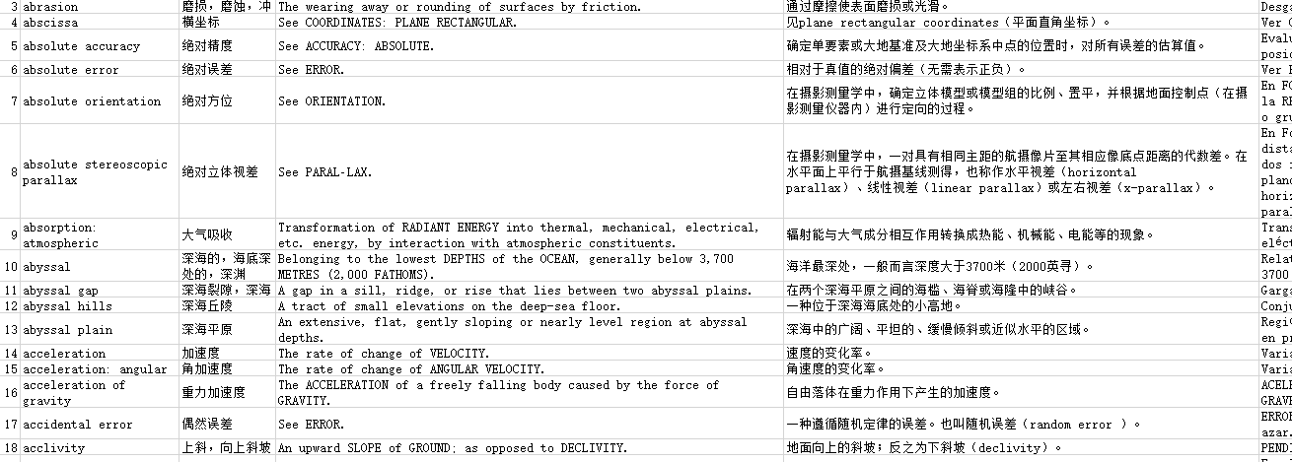
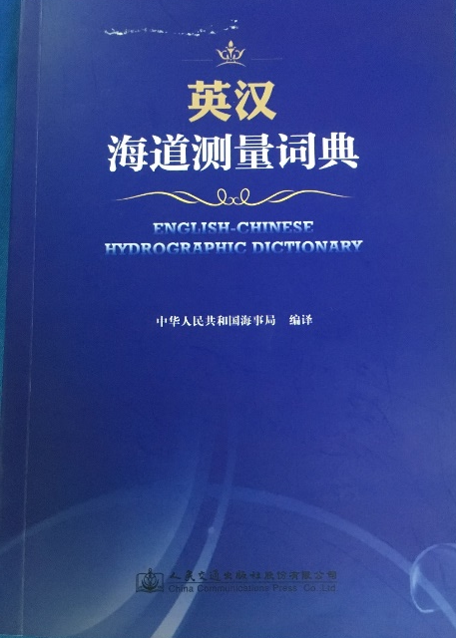
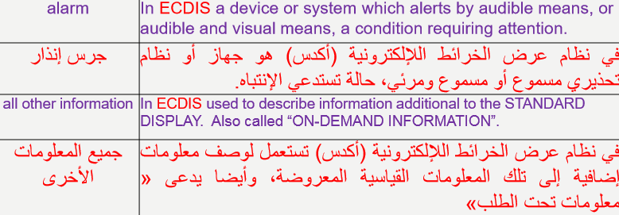
Analysis/Discussion – Hydrographic Dictionary (HD)
Chinese HD is now available on the IHO website
Arabic HD in progress
MBSHC-21, Cádiz, Spain, 11-13 June 2019

Slide 25
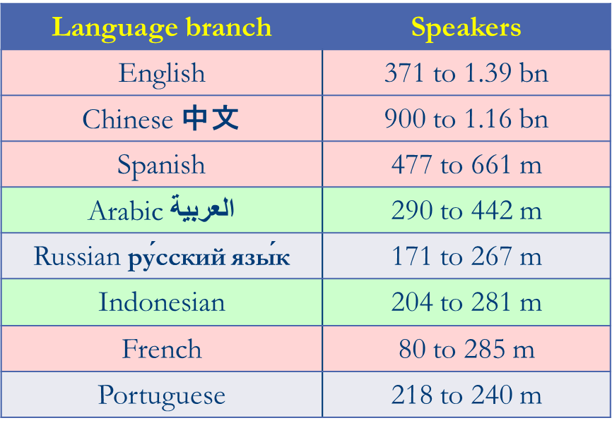
Analysis/Discussion – Hydrographic Dictionary (HD)
MS are invited to develop their National variants that will be made available on the IHO Website
HD members have been invited to act as HDWG (and GI Registry) ambassadors in RHCs
→MBSHC to support the HD
HDWG Spanish and Russian representatives needed
MBSHC-21, Cádiz, Spain, 11-13 June 2019
Notes:
Although technically separated, the HD and the IHO GI Registry will share the same management system, use the same metadata and will be enriched and maintained by using the same procedure

Slide 26
Action requested of MBSHC
The MBSHC is invited to:
Note the report
Contribute to S-122 and S-123 datasets
Encourage MSs to participate in PSs development (eg. S-121)
Encourage the encoding of meaningful values of CATZOC
Note the existence of the “conditional visualization methodology” of QoBD
Encourage MSs to support HDs development
Take any other action deemed necessary
MBSHC-21, Cádiz, Spain, 11-13 June 2019

