Slide 1
PRIMAR MBSHC 21 Hans Chr. Lauritzen, Director PRIMAR

Slide 2
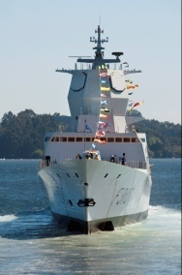
PRIMAR RENC value chain
Albania Croatia
Estonia
Finland
France
Georgia
Iran
Latvia
Lithuania
Montenegro
Mozambique
Norway
Poland
Sweden
Russia
Ukraine Vietnam
> 60 different official ENC providers
PRIMAR
RENC MEMBERS
Commercial
users
PRIMAR
ENC
Database
> 16 000
ENCs
55 Commercial Distributors
Governmental users
10 Governmental Distributors
9 Navy Suppliers
Canada
China India
Indonesia EAHC
MSS
Japan
Korea
PRD ENC
Singapore
NTOU (Taiwan)
PRIMAR LICENSING PARTNERS
(Others)
Navy
users
>26 000 registered end-users
ALL IC-ENC
RENC
DATA

Slide 3
2018 Financial Issues
Total revenue of ENC sales 18 % increase compared with 2017.
Total cost of PRIMAR operation (commercial/national) $2,46m.
Financial surplus (excess of cost coverage after regular royalty payments) of approximately $690k to be used for S-101 development.

Slide 4
2019 Financial Issues
New financial model introduced from 1.1.2019
100 % royalty payback to PRIMAR member nations.

Slide 5
PRIMAR Current and Future Services
Current Validation Services
Services under development
S-58 upload checks
Validation Report Checker – VRC
S-57 Advisor (Errors DB)
ISO8211 to Text
Overlap Checker
ENC Consistency Checker
ENC Service
(Dual fuel S-57/S-101)
S-102 Service
Proposed Services
Digital Publication Service
IENC Service
Current Distribution Services
ENC Service (S-57)
WMS Service
Research Project
PUT
Improver Inspector
POQ
Navy / Governmental
Unencrypted S-57 Service
S-104
S-111
S-129

Slide 6
PRIMAR S-100 Projects
S-102 data upload, validation and distribution.
S-102 in an operational environment (completed)
Project supported by The Research Council of Norway
S-100 Data as a Service.
Project in cooperation with CARIS and CHS
S-101 data upload, validation and distribution.
S-100 part 15 Data Protection (new S-63).
Research project - IHO S-100 portfolio (S-101, S-102, S-104, S-111, S-129).
Project supported by The Research Council of Norway

Slide 7
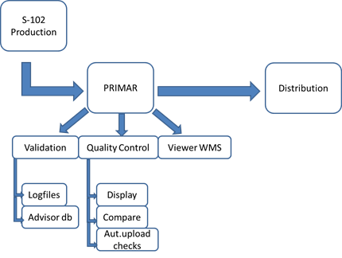
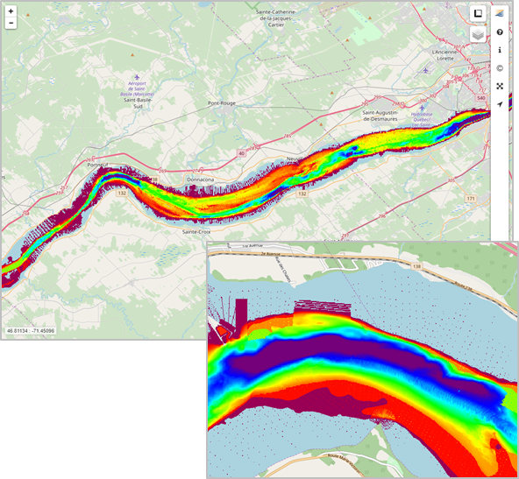
PRIMAR S-102 Project
Expand the PRIMAR service to encompass S-102 data.
S-102 data upload, validation, viewer and distribution.
PRIMAR S-102 viewer

Slide 8
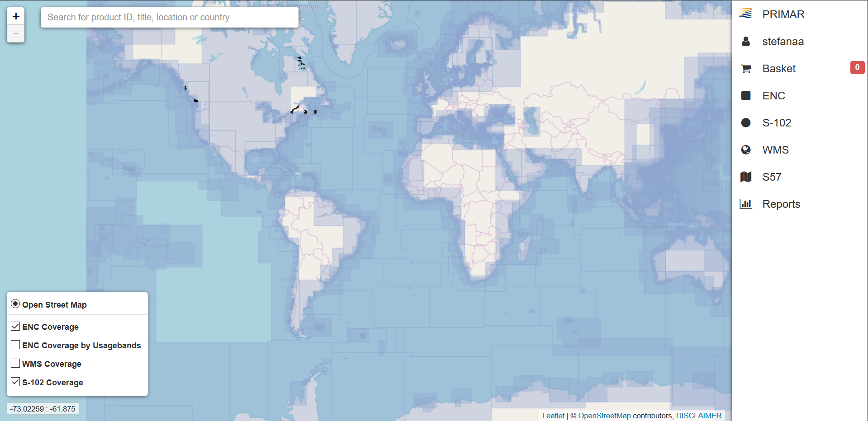
PRIMAR S-102 Project
S-102 data in the PRIMAR Chart Catalogue.

Slide 9
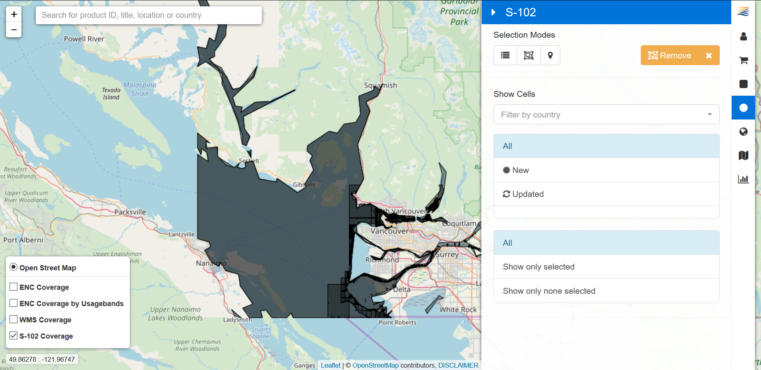
PRIMAR S-102 Project
S-102 data selection in the PRIMAR Chart Catalogue.

Slide 10
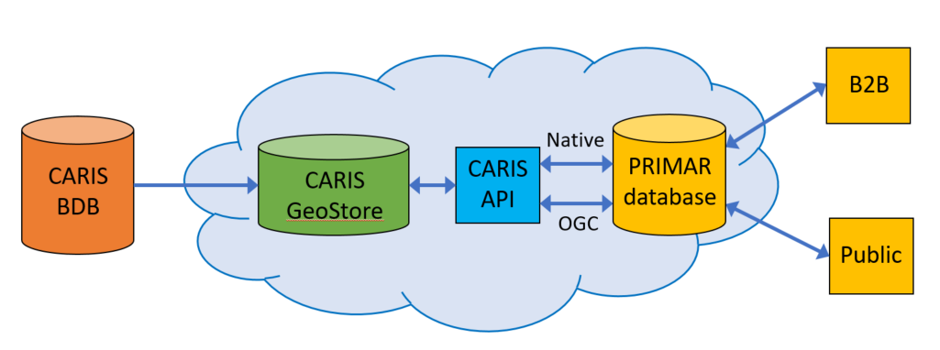
Pilot Project Overview:
S-100 Data as a Service
This pilot will allow CHS, Teledyne CARIS and PRIMAR to demonstrate its ability to provide a service that consumers of bathymetry data can subscribe to.
Data will be available in pre-determined geographic areas of interest.
By bathymetry data we mean coverages, vector features and S-102 products.
CARIS will develop a cloud hosted datastore located outside of the CHS infrastructure.
CARIS will develop a rich API providing 3rd party access to the data store.
3rd party
PRIMAR will expand its existing database and web applications to provide a store front to subscribe to the latest available S-102 bathymetry data and access OGC services.
AWS

Slide 11
Pilot Project Objectives:
S-100 Data as a Service
Garner support from potential stakeholder groups e.g. hydrographic offices, ports, pilots, other government agencies, global mapping initiatives (Seabed 2030).
Expose the hydrographic community to these capabilities to foster support for the potential benefits of S-102 and bathymetry as a service.
Explore potential for use of S-104 and S-111 standard for supplementary services.
Refine the cloud and service technology to work towards a robust and commercially viable service.
Determine the costs involved in offering cloud based storage and services.
Develop innovative business models to ensure customer adoption by providing value added benefits for stakeholders.

Slide 12
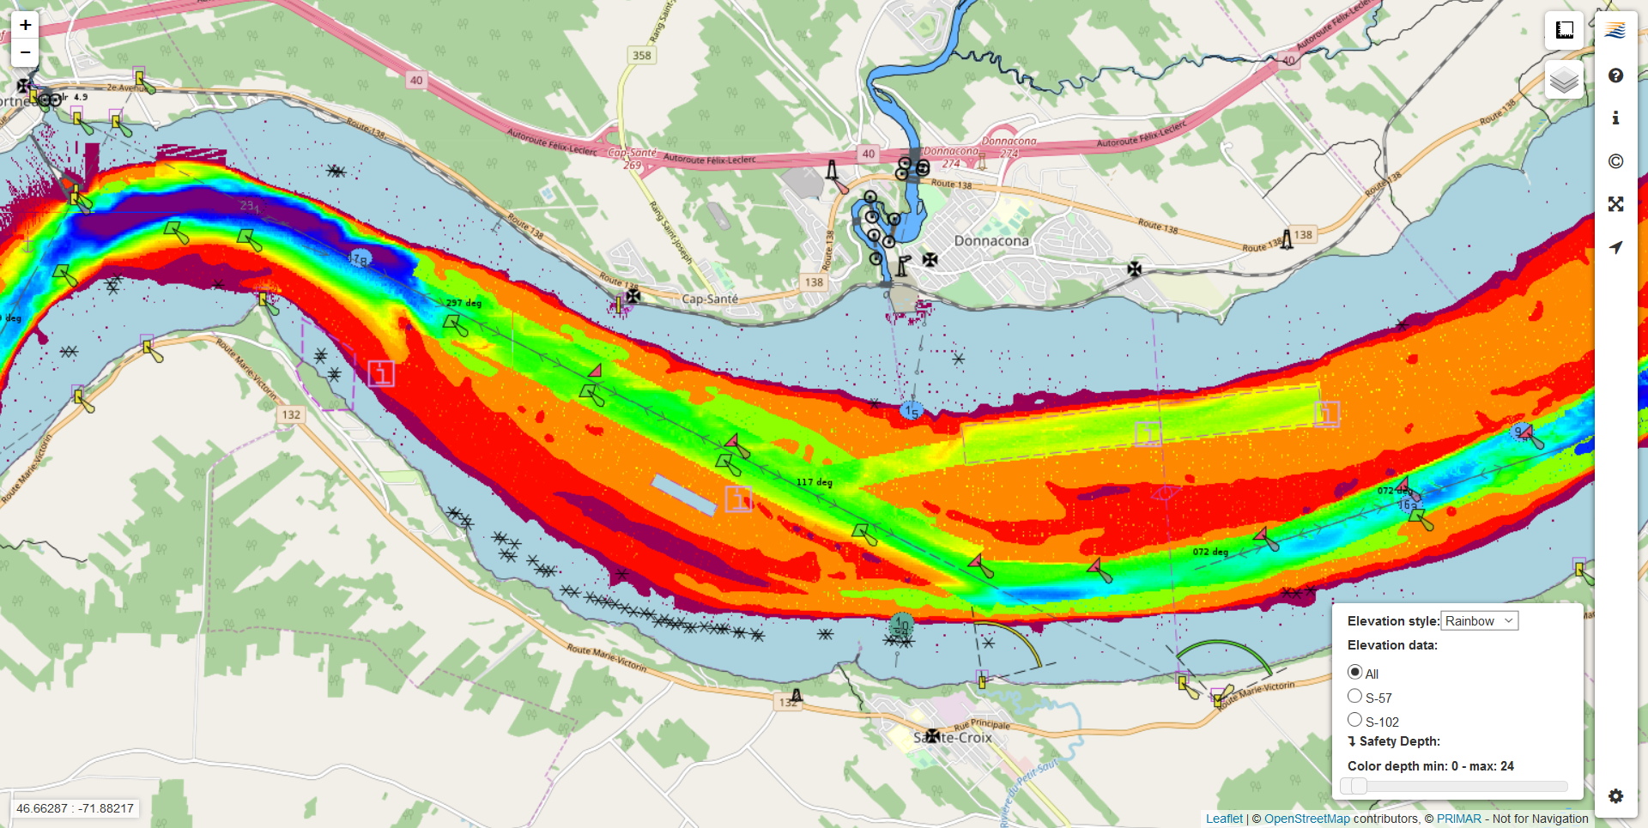
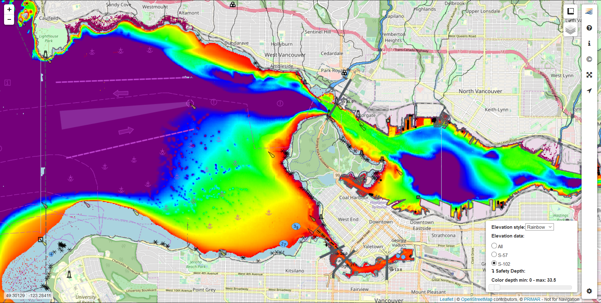
CHS S-102 data in PRIMAR Viewer:
S-100 Data as a Service
St. Lawrence River
Vancouver

Slide 13
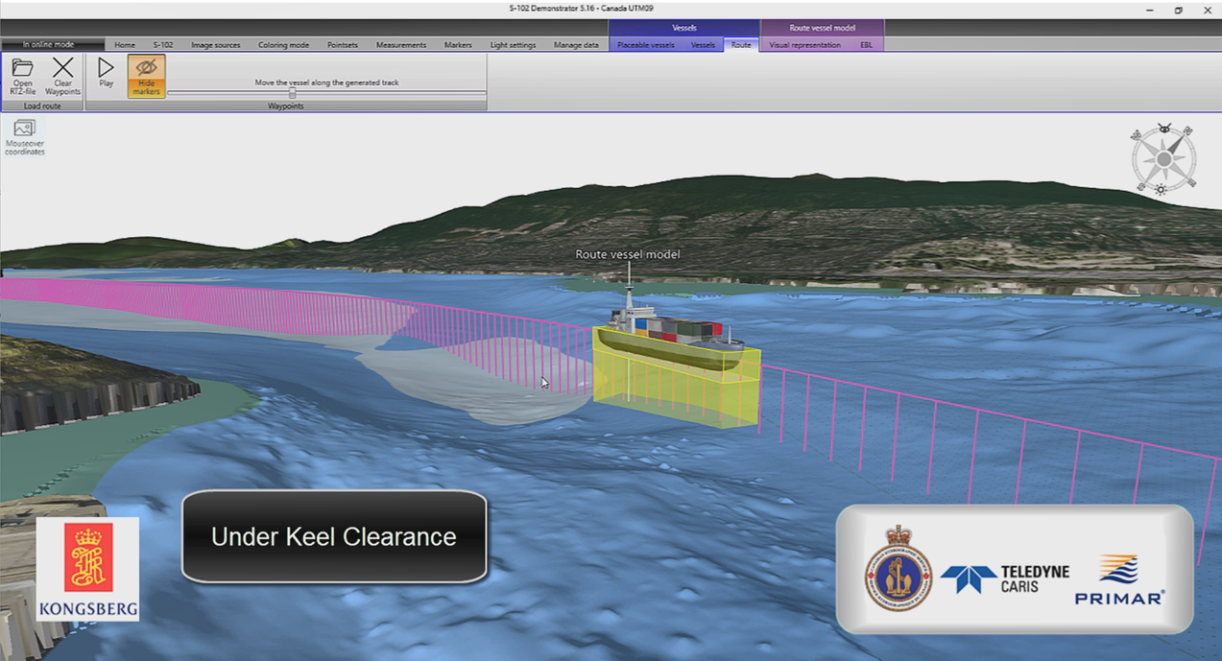
CHS S-102 data in Kongsberg S-102 demo:
S-100 Data as a Service
Vancouver
Vancouver

Slide 14
PRIMAR S-101 Project
Objective: Develop dual-fuel S-57 and S-101 distribution services
Project goals:
Enable PRIMAR to integrate S-101 ENC services with the existing S-57 ENC services to operate a dual-fuel distribution service within a 5-years timeframe (2018-2022)
Functionality for PRIMAR member states to facilitate S-101 ENC quality control and data management
Enable PRIMAR member states to obtain experience and training in S-100/S-101 standards
Provide valuable feedback to the new IHO standards to PRIMAR member states and IHO Working Groups.

Slide 15
S-101 Project Proposal - timeline

Slide 16
Targets for 2019
Provide the world’s most efficient ENC quality control and validation services.
Increased ENC coverage – new members.
Updated strategic plan – PRIMARs place in the future.
Continue the S-100 technology development
Visibility

Slide 17
Thank you for your attention Questions?
www.primar.org

