Slide 1
Agenda item B.1.2
63rd Meeting of the Nordic Hydrographic Commission Meeting
9 – 11 April 2019, Helsinki, Finland
Strategy review, outcome from Nordic workshop

Slide 2
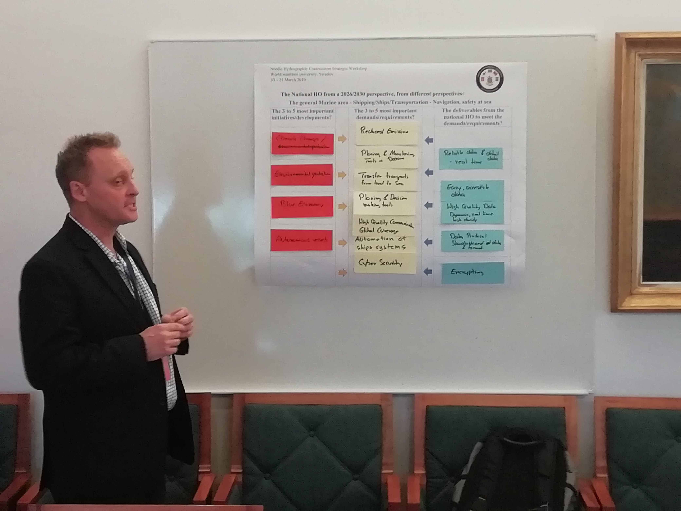
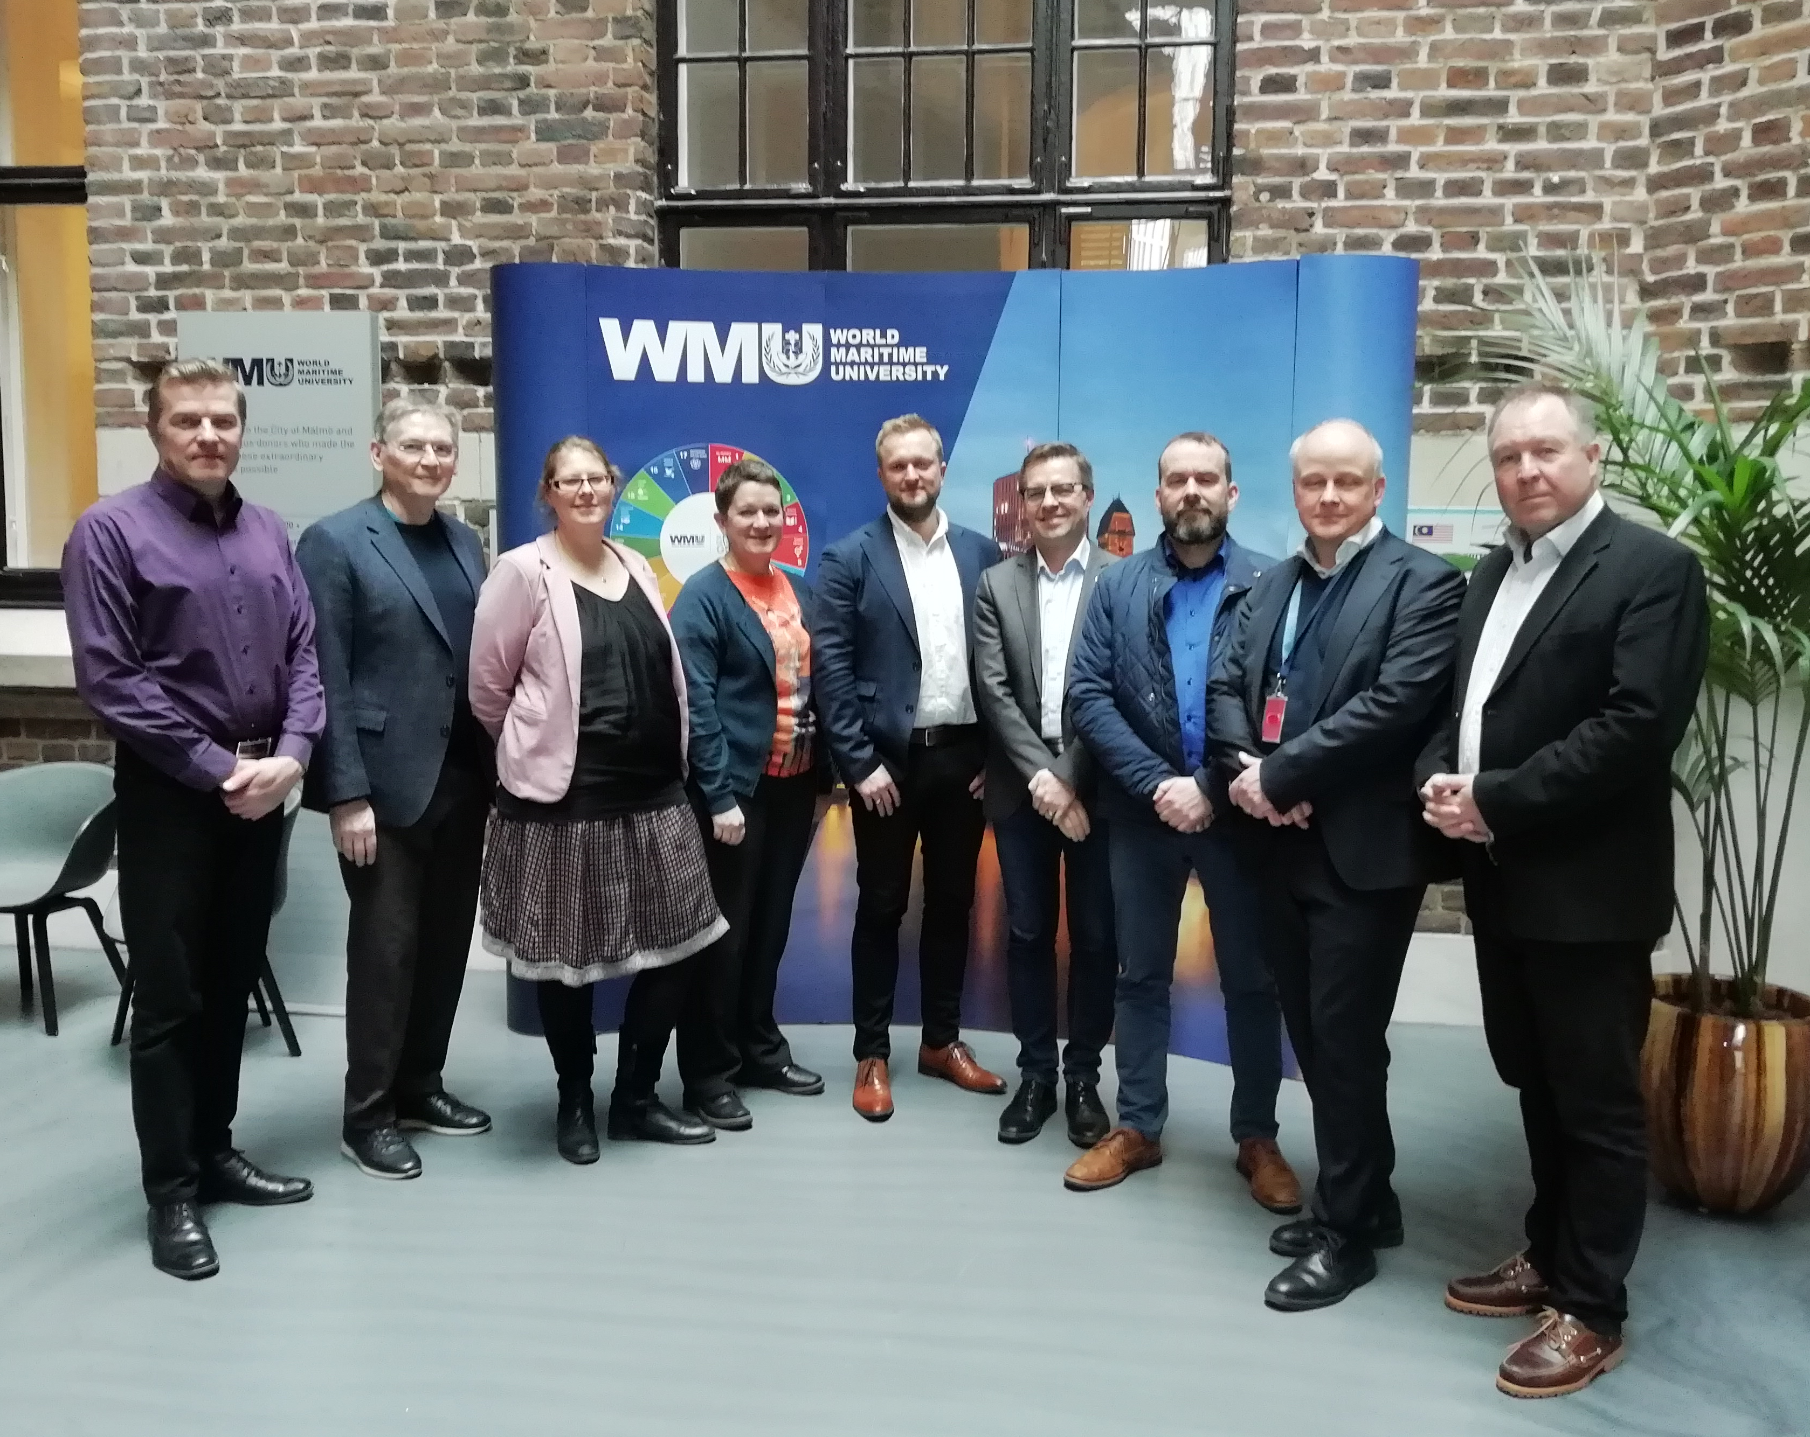
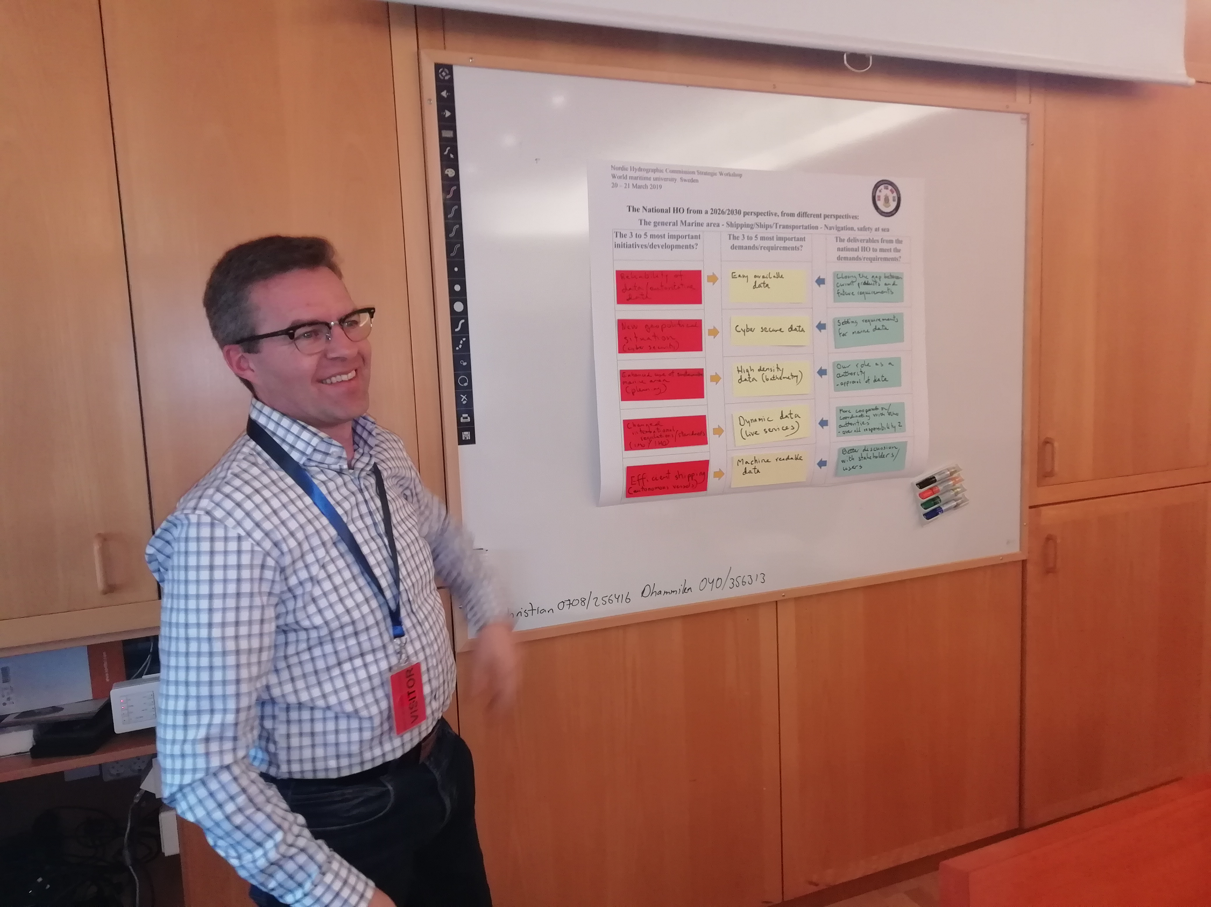
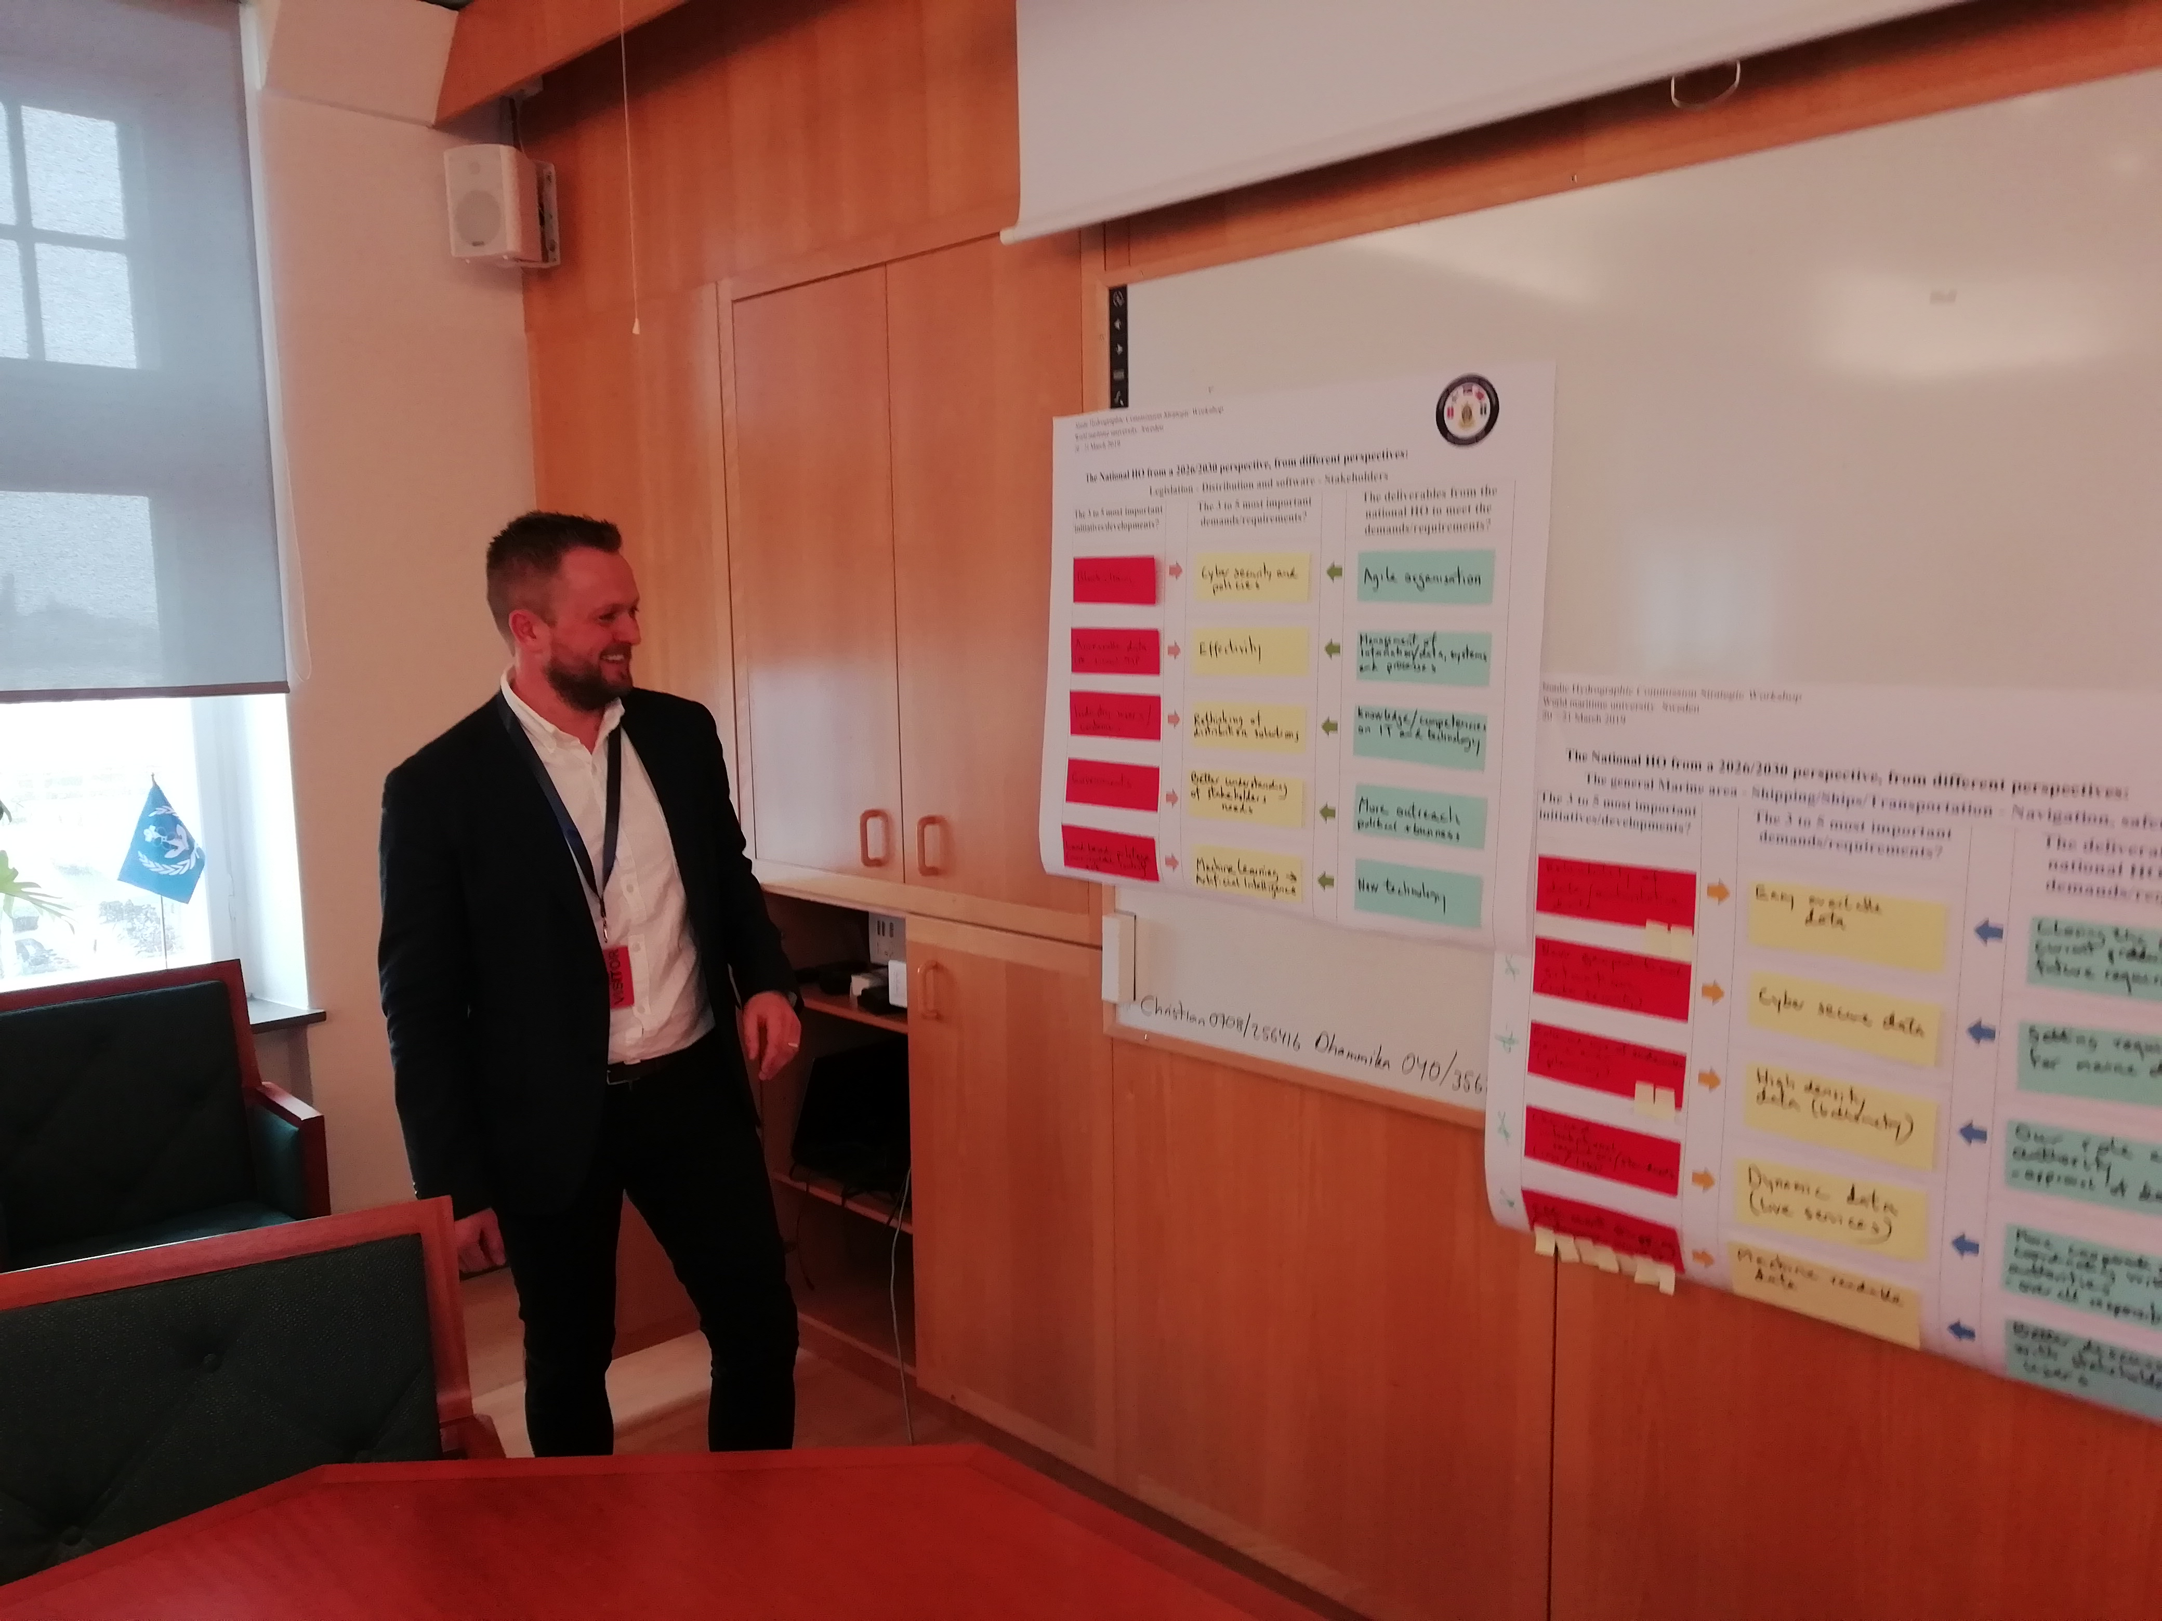
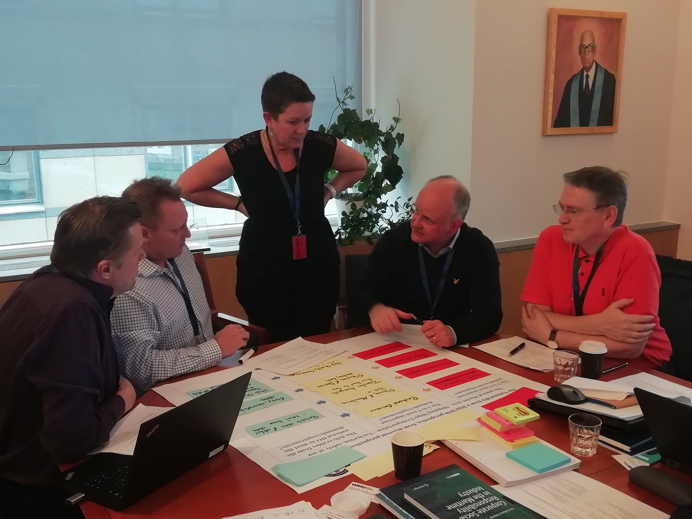
Welcome to NHC - Strategic Workshop at
World Maritime University 20-21 March 2019

Slide 3
Aim.
The aim of the NHC strategic workshop is to establish a strategic framework for the NHC MS in a Nordic perspective within the timeframe 2026/30.
Preparation for the workshop.
Each NHC MS to prepare a presentation and to complete a questionnaire about the present status and expectation for the future before the Workshop.
National presentation at the workshop:
All NHC MS to prepare and give a presentation of their SWOT analysis at the workshop.
Please describe your HOs Vision, Mission and Object, and present these at the Workshop.
Pinpoint the three most important UN Sustainable Development Goals from a national HO perspective.
Describe how you as a HO can support these three important goals and present it at the workshop.

Slide 4

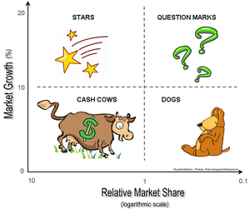
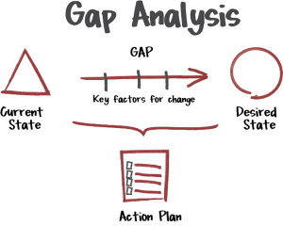
Strategic Analysis
Discussion at NHC63
Vision, Mission
and Object
SWOT analysis
What are the most important challenges from a HO perspective
UN Sustainable
Development Goals
Group Work 1
What are the future role of a Nordic HO?
Group Work 2
Group Work 4
Nordic HO from a
2030 perspective
Group Work 3
Home Work
Looking outside in
Looking inside out
Preparation for NHC63
NHC63

Slide 5
National presentations
All NHC MS to prepare and give a presentation of their SWOT analysis at the workshop.
The Nordic SWOT general trends.

Slide 6
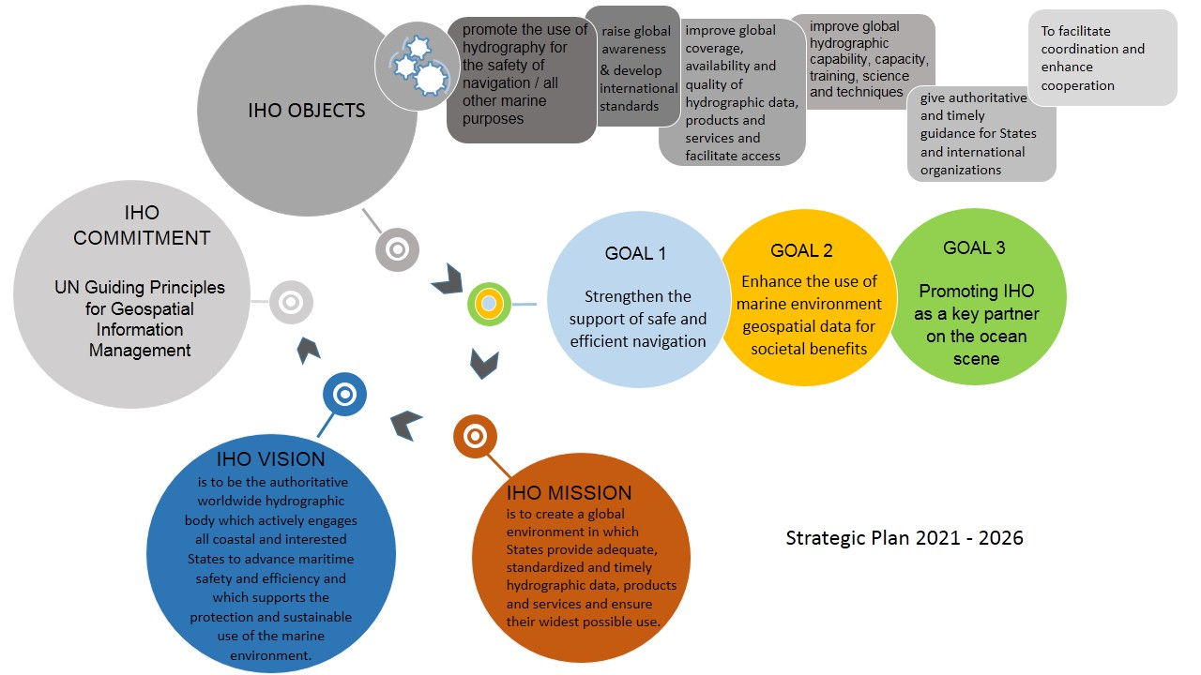
Strategic Plan Review Working Group (SPRWG)
International Hydrographic Organization (IHO) Strategic Plan version x.x
For 2020-2026
(For consideration by the 2nd IHO Assembly)

Slide 7
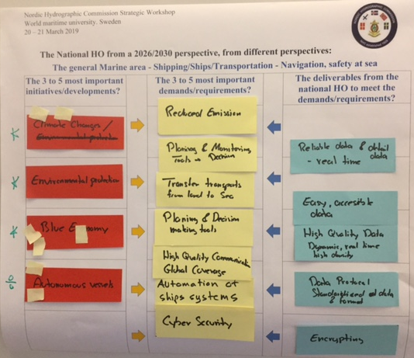
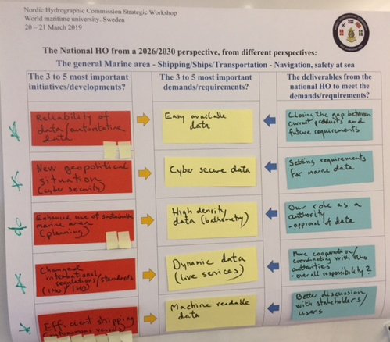
Group Work 2.
The Nordic HO from a 2026/2030 perspective. Looking outside and in, from three perspectives. Part 1.

Slide 8
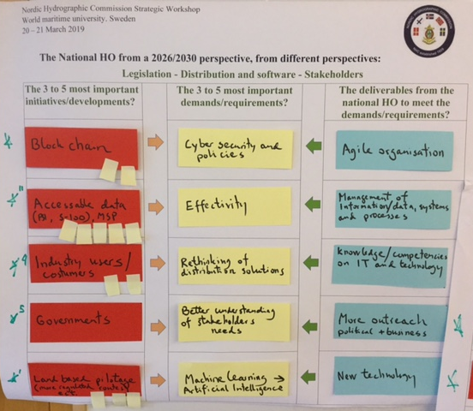
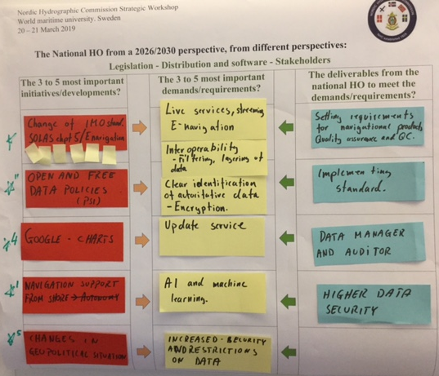
Group Work 3.
The Nordic HO from a 2026/2030 perspective. Looking outside and in, from three perspectives. Part 2.

Slide 9
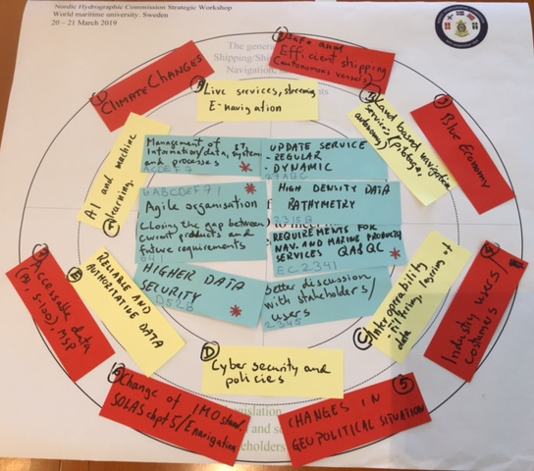
Group Work 4.
Discussion on how the requirements agreed in group work 1 to 3 will influence on the Nordic HOs and how to prioritise these requirements

Slide 10
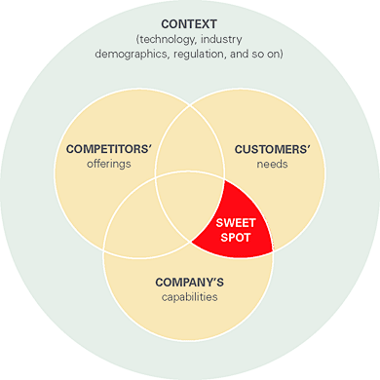
Discussion at NHC63
What are the most important challenges and possibilities from a HO perspective
Vision, Mission
and Object
SWOT analysis =>
The Nordic SWOT
What are the future role of a Nordic HO?

Slide 12
Group Work 4.
Discussion on how the requirements agreed in group work 1 to 3 will influence on the Nordic HOs and how to prioritise these requirements

Slide 14
What are the most important challenges and possibilities from a HO perspective?
What are the future role of a Nordic HO?

