Slide 1
National Report of Denmark 63rd Meeting of the Nordic Hydrographic Commission Meeting 9 – 11 April 2019, Helsinki, Finland

Slide 2
Items
Surveys – new ships
New ship route system in the Skagerrak and Kattegat
Greenlandic Chart Production
New Production System
MSDI business Case
Free data analysis

Slide 3
Surveys

Slide 4
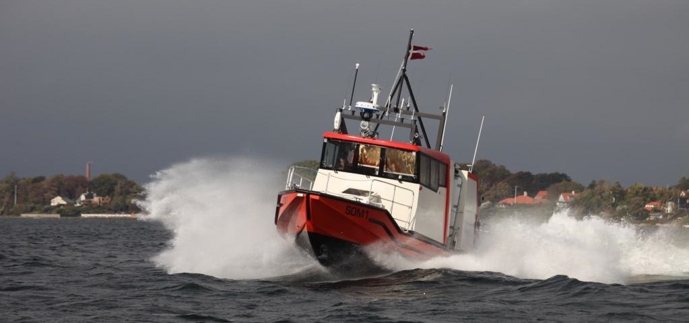
https://www.youtube.com/watch?v=1hK0N3JMdMY#action=share

Slide 5
New ship route system in the Skagerrak and Kattegat

Slide 6
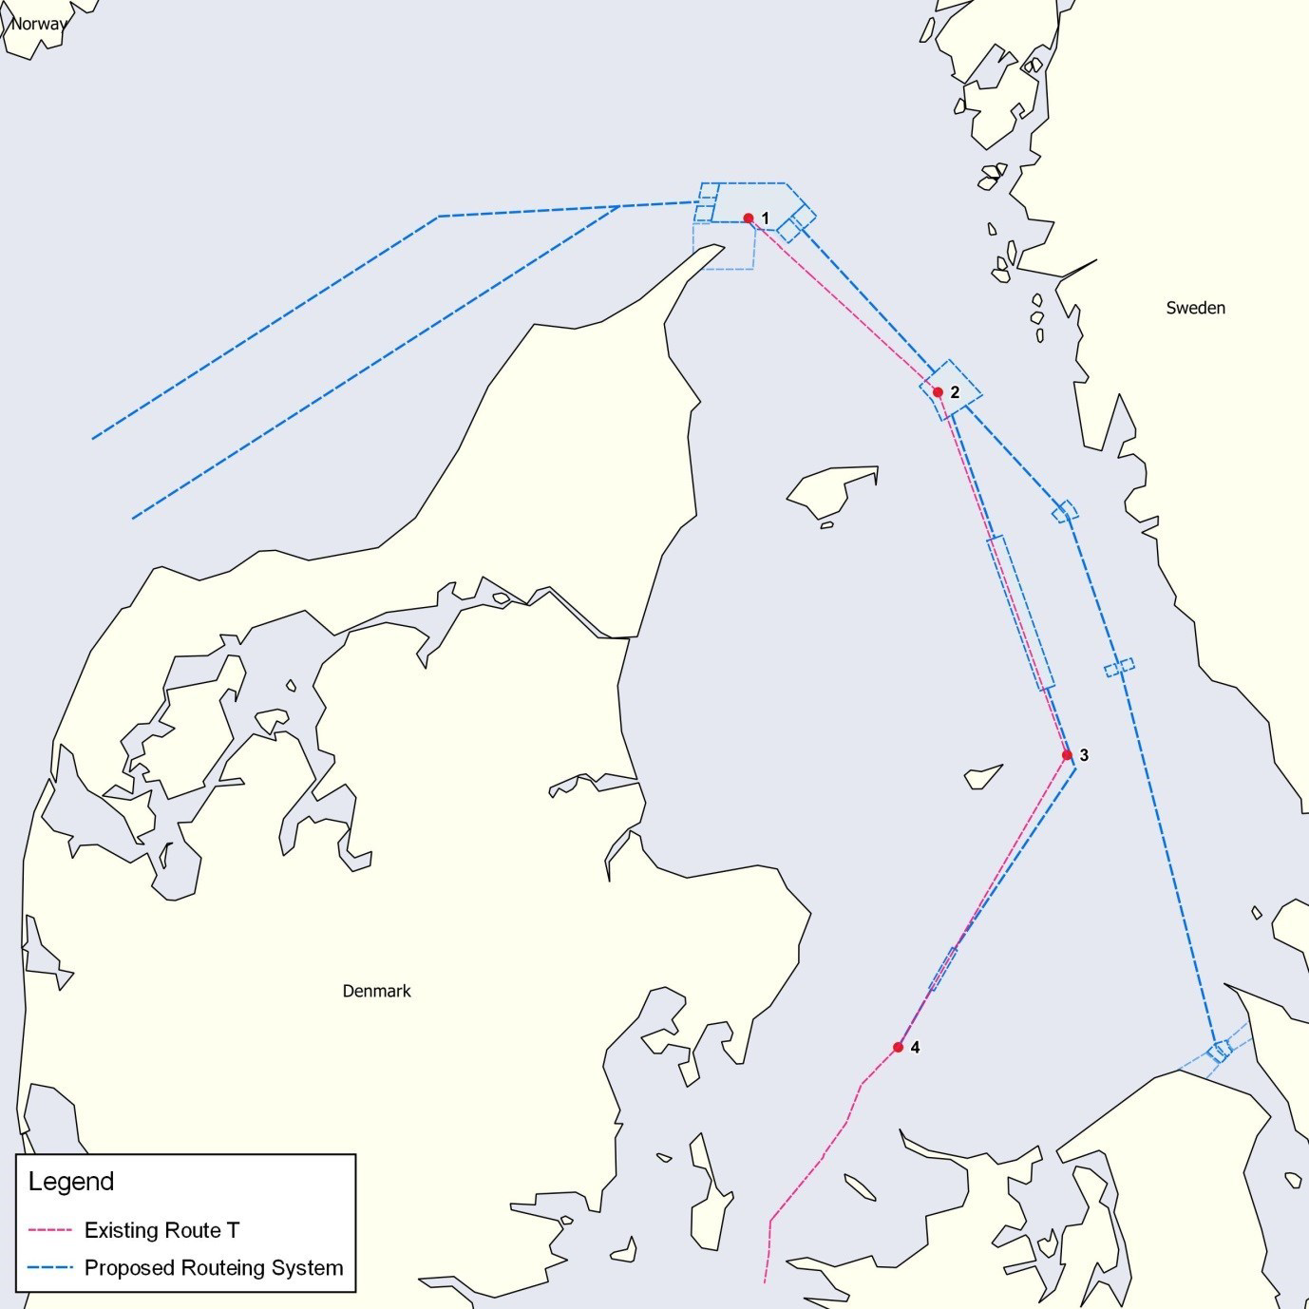
Existing Route T and the proposed routing system
Under today’s conditions of navigation in Skagerrak and Kattegat ship traffic face unnecessary challenges without any assisting routing systems.
Denmark and Sweden have developed new routing measures
This will lead ship traffic via new routes that will guide and separate two-way ship traffic better than today and thus make navigation considerably more predictable and safe.
Reference:
IMO NCSR 5/3/3
IMO NCSR 5/3/4
IMO NCSR 5/3/5
Notes:
Traffic Separation Scheme (TSS) "Skagen West" and TSS "Skagen East" with the associated precautionary area are established to organize traffic flow in the area north of Skagen.
The two recommended routes, route A and route B, off the west coast of Denmark are introduced to allow the traffic to navigate safely to and from the traffic separation schemes north of Skagen.
The recommended routes enable the traffic to sail in areas with advocate water depth and give wide berth to the coastline which consists of areas with limited depth and uncertain soundings.
Recommended route S is introduced for traffic between Skagen and the Sound. It follows the existing traffic flow off the Swedish coast as it exists today, but traffic is expected to increase with the introduction of route S.
At the current date the traffic situation in Kattegat – particularly in route T – is congested and close to areas with limited water depth.
The introduction of route S will spread the traffic over a larger area, allow more sea room for ships sailing in the area and is expected to improve the safety of navigation as it reduces the risk of collisions and grounding.
Traffic separation scheme (TSS) "Fladen", TSS "Lilla Middelgrund" and TSS "Entrance to the Sound" are established in order to separate opposing streams of traffic, to reduce the danger of collision or groundings and to organize safe traffic in environmentally sensitive areas in and around the new recommended route S.
The recommended route S holds a minimum water depth of 12.5 metres. With the introduction of route S, ships with a draught of 10 metres or less sailing between Skagen and the Sound are recommended to use the recommended route S.
Today the nationally implemented route T is used by almost all ships sailing to and from the Great Belt and the Sound. The Kattegat consists of several environmentally sensitive areas and areas of shallow waters. In order to avoid accidents and incidents, there is a need to further spread the traffic in the Kattegat and to separate deep-draught ships from ships with a smaller draught.
A deep-water route (DW) "Kattegat North", with a minimum depth of 19 metres, is established in the northern part of the recommended route T.
A deep-water route (DW) "Kattegat South", with a minimum depth of 19 metres, is established in the southern part of the recommended route T.
Recommended route T will be established connecting the proposed TSS "Skagen East", the deep-water routes "Kattegat North" and "Kattegat South" and joining the nationally implemented Route T north of the TSS "at Hatter Barn".

Slide 7
Recommended route B has been surveyed in 2018.
Recommended Route A will be surveyed in 2019.
Hydrographic information will be updated in existing and new paper and electronic charts covering Skagerrak upon completion of the surveys.
The implementation date of the routeing measures will be 1 July 2020.
Notes:
This date allows sufficient time to complete hydrographical surveys, production of new charts, and to inform ship traffic thoroughly in due time.
There is a need for new and updated paper charts and ENCs in the concerned area, and to synchronize depth information, such as specific depth contours between Danish and Swedish waters.
The hydrographical authorities in Denmark and Sweden are allocating resources for this matter.

Slide 8
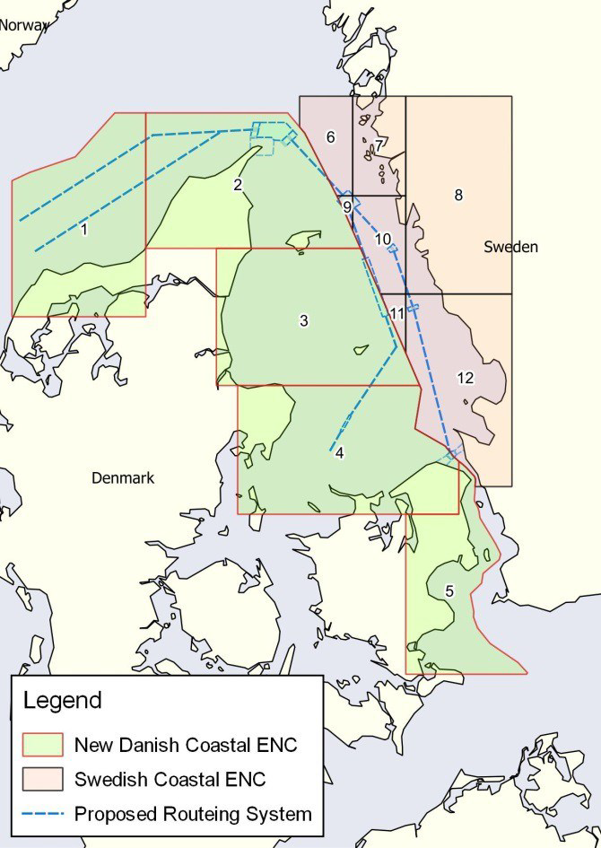
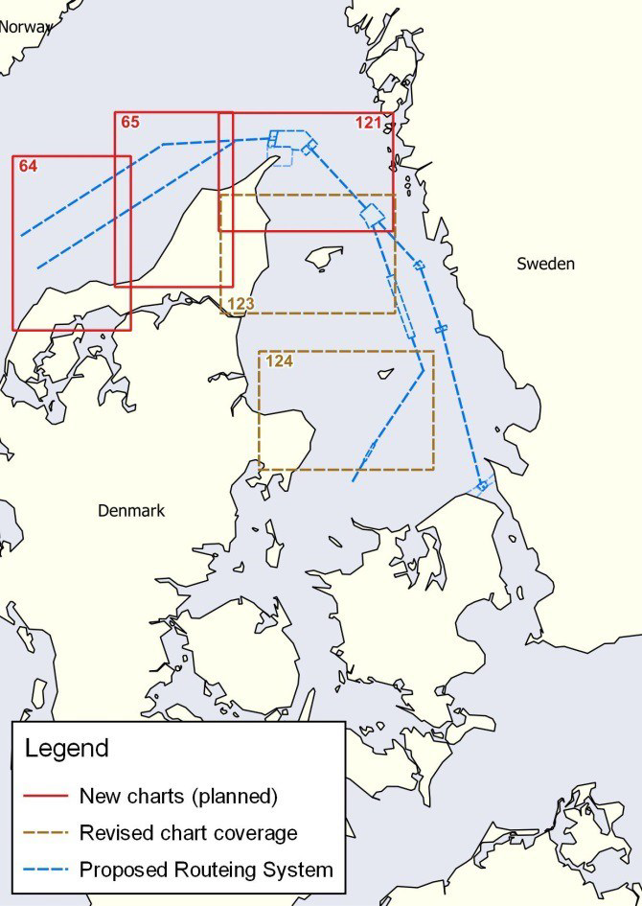
DGA are making new ENC’s in Coastal Band (DK3) with 30 and 50 m depth curves.
DGA are making 3 new charts in 1:100.000 and adjustment of chart 123 and 124 also in 1:100.000.
Notes:
Venstre illustration - harmonisering af svenske og danske elektroniske søkort (ENC) I Kattegat
Den svenske del af Kattegat er for nuværende dækket af celler i navigation bands General (SE2), Coastal (SE3) og Approach (SE4).
Den danske del af Kattegat er for nuværende dækket af celler i navigation bands General (DK2) og Approach (SE4).
I den danske del af Kattegat mangler således dækning i navigation band Coastal (DK3).
Søfarende oplever ved brug af danske og svenske ENC I ECDIS, at danske og svenske dybdedata ikke præsenteres ensartet og harmonisk på tværs af søgrænsen.
En del af denne udfordring er, at der på danske side præsenteres 20 m og 40 m dybdekurver, mens der på svensk side præsenteres 30 m og 50 m dybdekurver.
For at afhjælpe den situation er det danske søkortkontor I gang med at fremstille celler i navigation band Coastal (DK3). Det sker i et løbende samrbejde med det svenske søkortkontor.
30 m og 50 m dybdekurver implementeres i samme ombæring i danske ENC.
Højre illustration – fremstilling af nye danske papirsøkort og justering af eksisterende papirsøkort
Skagerrak og Nordsøen er for nuværende kun dækket af papirsøkort i lille målestok (kort 92 – Skagerrak – 1:360 000 og kort 93 – Nordsøen – 1:375 000).
Særligt de nye trafikseparationer inklusiv ITZ (Inshore traffic Zone = kysttrafikzone, til lokal trafik rundt Grenen) ved Skagen vil ikke kunne præsenteres fyldestgørende i kort 92.
Eksisterende papirsøkort over Læsø og Anholt (kort 123 og kort 124 – begge i 1:75 000) har ikke en dækning, som rækker ud til justerede rute T.
For at afhjælpe den situation er det danske søkortkontor i gang med at fremstille 3 nye papirsøkort (kort 64 – Hanstholm, kort 65 – Hirtshals og kort 121 Skagen – alle i 1.100 000).
Vi er desuden ved at justere dækningen af papirsøkort over Læsø og Anholt (nu 1:100 000).

Slide 9
Greenlandic Chart Production

Slide 10
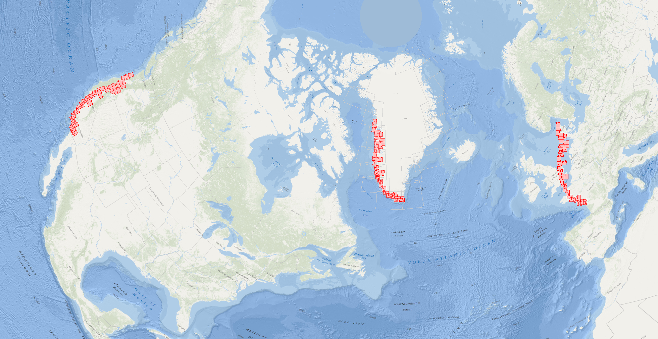
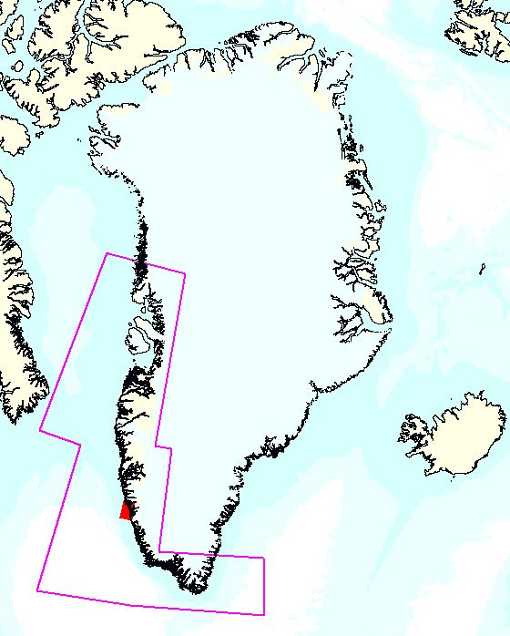
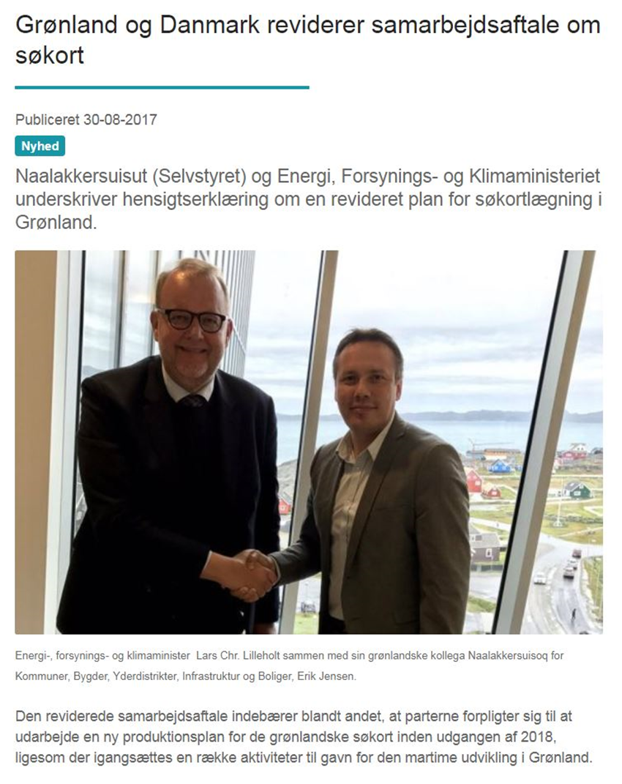
Chart production in Greenland – New agreement with Greenland
Denmark: 105.000 km2
Greenland: > 2.000.000 km2
Notes:
- Political agreement with Greenland from 2009, on the cooperation on spatial data was “renewed/updated” in 2017.
The agreement includes among others rectification and digitization of 73 charts in Southwest Greenland - equals the distance from the northern tip of Denmark to South France.
New production plan to be completed before end of 2018
Remaining areas surrounding Greenland to the East and North will be completed afterwards.

Slide 11
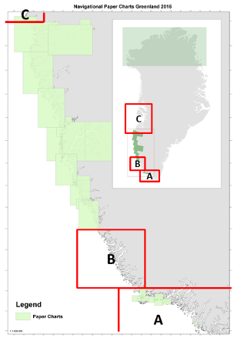
New production plan for Greenland Paper Charts
Year | 2018 | 2019 | 2020 | 2021 | 2022 | 2023 | 2024 | 2025 | 2026
Planned yearly production rate | 2 | 3 | 4 | 6 | 6 | 6 | 6 | 6 | 2
Planned – accumulated | 34 | 37 | 41 | 47 | 53 | 59 | 65 | 71 | 73
Prioritization list according to agreement with Greenland
Possible Mining projects in area A
Areas with unpublished new multibeam data
Charts are produced in clusters according to area – Safety of Navigation & efficiency.
Charts in best scale has first priority.
ENCs & papercharts are produced at the same time.
3 charts planned in 2019
Notes:
Left picture + Tekst under tabel:
Overview of the prioritized areas in Southwest Greenland. Area A had the highest priority due to possible mining projects beeing developed and unpublished new multibeam data. Area A is expected finalized in 2022. Next area will probably be Area C according to recent discussions with the Greenland Government.
Charts are produced in clusters according to area – safety of navigation & efficiency.
Charts in best scale has first priority.
ENCs & papercharts are produced at the same time.
Table – New Production Plan:
34 papercharts out of 73 - ultimo 2018
3 charts planned in 2019
Maximum production capacity reached in 2021
Last charts will be produced in 2026

Slide 12
New Production System

Slide 13
Background for a new production system in GST
Today GST has two separate production lines and use two separate production systems – one file-based and one database-based
GST wishes to have one single, data-centric production system for ENCs and paper charts
Notes:
On this background we have formulated a vision for the production in our hydrographic office

Slide 14
Main goals for a new production system in GST
One production system for ENCs and paper charts for all of GST’s geographic areas
An efficient production system, where redundancy and manual steps are minimized
A production system prepared for a data driven production flow

Slide 15
Scope of the NCPS project
A fully installed, configured and operational Nautical Chart Production Environment comprising:
Development and Education system
Production System – manage incoming data sources, store and clean data, production and updates for ENC and paper chart, workflow management

Slide 16
DGA has choosen Esri ArcGis for Maritime because…
One goal for DGA is to have a data-driven production flow with open and well-defined interfaces between the different parts of the production chain.
Esri and ArcGIS for Maritime live up to our requirements and the vision that GST has for future production:
Open and well-defined interfaces so that the overall production flow can be linked together and optimized over time.
Automation of processes, which in the long term can reduce the risk of errors.
Possibility of a data-driven production. With data-driven production, changes in data automatically bring about end-product changes. Parts of the workflow can still be manual.
DGA has experience with the system already

Slide 17
Milestones
Design and planning phase until June 2019
Implementation phase June – December 2019
Production and Final acceptance of the Delivery phase Jan – April 2020
Project expected to end June 2020

Slide 18
Notes:
Proposed Schedule. Kevin Ingram will be present in Aalborg after the kickoff meeting. Geoinfo will provide a more detailed time schedule for the steering committee to approve.

Slide 19
Notes:
We agreed that there will be an iterative process during the configuration time lines, where Esri and GST are in dialog.

Slide 20
Notes:
This is where we move production over to the new system.

Slide 21
Deliverables
Installation and configuration of the system
Data migration
- Danish waters
- Faroe Island waters
- Greenlandic waters
Training
Configuration of workflows (to be decided in the design phase)

Slide 22
MSDI Business case

Slide 23
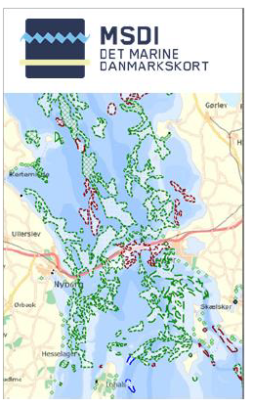
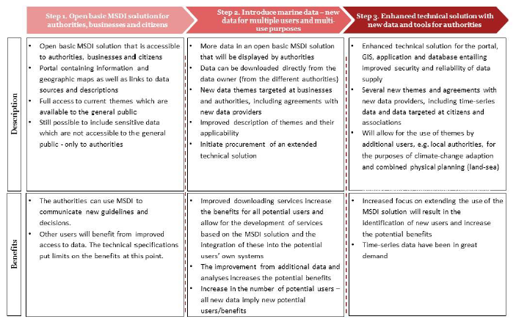
Danish MSDI – Business case
Today the Danish MSDI are only accessible for the 11 marine authorities that participated in development of the MSDI.
Business case: Benefits of and costs associated with the further development of the MSDI
Three-step development plan
Open MSDI solution for all, e.g. authorities, businesses and citizens
Introduce more marine data
Enhanced technical solution with tools and time-series data.

Slide 24
Danish MSDI – Business case
An important step towards realising the Danish Government’s growth plan for ‘The Blue Denmark’
Indicated a strong demand for a further development of the Danish MSDI as a free and open data infrastructure for marine data
Showed an annual net benefit of DKK 2 million (€ 0.27 mio) after implementation of the three-step development plan and a positive net value over an 8 year period. Implementation costs around DKK 7.1 million (€ 0.95 mio).
Several qualitative benefits, e.g.
improving authorities communication of decisions, rules and guidelines
new business opportunities for entrepreneurs
improved data accessibility for research
improvement of recreational apps and maps aimed at citizens.

Slide 25
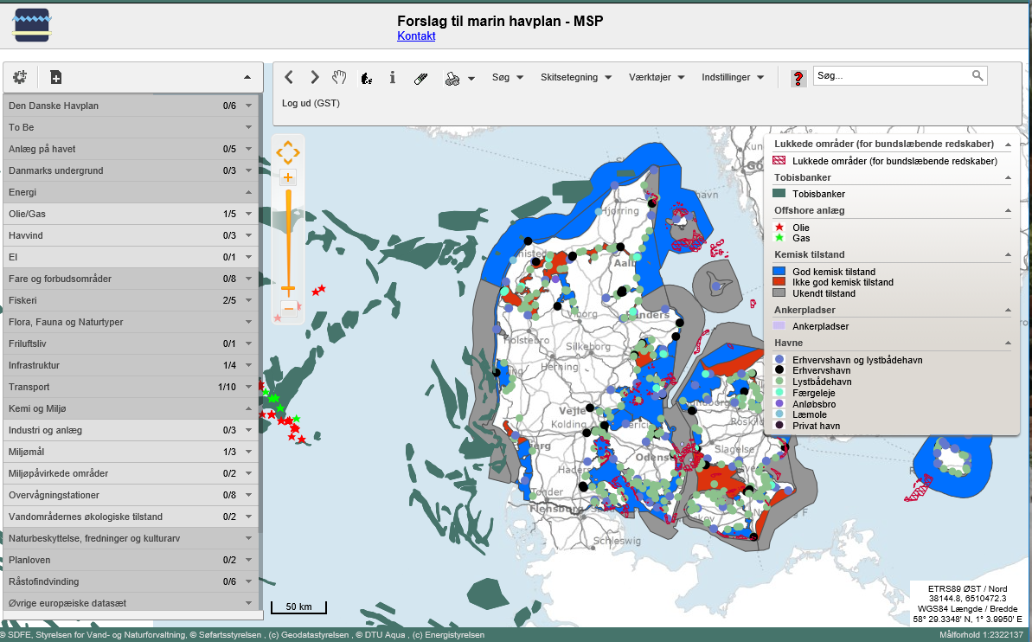
Danish MSDI
Specific profiles
Requests from marine authorities
Separate profiles with selected datasets which are relevant to a specific task
Only access for working group members, whereby confidential GIS-dataset can be shared within the group
Currently two profiles: Marine Spatial Planning and Marine Strategy
Examples of datasets
Sustainable Energy, e.g. Windmills; Oil and Gas
Protected Areas, e.g. Nature Reserve, Restricted Areas, Dumping grounds
Environmental Data, e.g. Water Quality; Hazardous Substances; Flora and Fauna; Sediment

Slide 26
Free data analysis

Slide 27
Great potentials from free hydrographic data
Free hydrographic data is associated with great potentials from both a welfare economic, environmental and financial perspective
Welfare economic benefits
Improved safety at sea – and lower costs to sea rescues and insurance
Improved quality of sailing
Increased sailing tourism
Environmental benefits
Better flood forecasting
Research, e.g. within marine spatial planning
Reduced fuel consumption – due to better route planning and loading
Financial benefits
Increased turnover – both from improved quality of existing products and services and new products
Effectivization, e.g. due to better planning tools

Slide 28
Benefits amounting to 145 million DKK
A business case from Deloitte assess that there is a direct economic potential within three sectors amounting to 145 million DKK over a three year period – primarily driven by the availability of detailed depth data
Commercial sailing
Increased turnover in services based on new and more advanced route planning models
The energy sector
Reduced costs of offshore installations due to better data to be used in the screening and planning phase
Data companies
Increased turnover in companies providing services and products related to navigation and route planning – and reduced costs of input factors

Slide 29
What will be included?
What does it take?
Investment in development of a bathymetric model
New business models (from royalty agreements to public funding)
Change in distribution channels – more efficient distribution to the public
Enhanced surveying and/or data collection – especially for shallow waters
Raster charts (paper charts)
Vector charts (un-encrypted S-57 data)
Bathymetric models (depth data)
Publications
ENC’s not included

