Slide 1
NHS 2017
Departments
Sections
Groups

Slide 2
Restructuring Key objectives
Separate the authority role -
Chart, water level ( tide ), hydrographic data, marine geodata co-ordinator
and the production line.
Create the same interface to internal surveying as external.
Be prepared for the change in legislation lifting restrictions on data < 30m depth.
Utilize available competence to be more robust and to balance production across the production line.
Reduce number of layers in the organization.

Slide 3
Vision
Norwegian sea areas have the world’s most dynamic and usable geographic data
Mission
Visible, competent and recognized body of authority.
Efficient data collection, -management, production and distribution
Object
Separate authority role and production
Balanced production line within existing boundary conditions
Improved data management and automated production through implementation of new technology

Slide 4
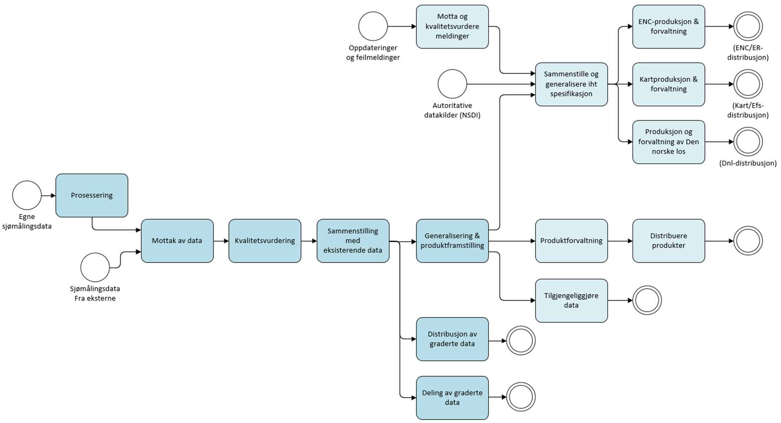
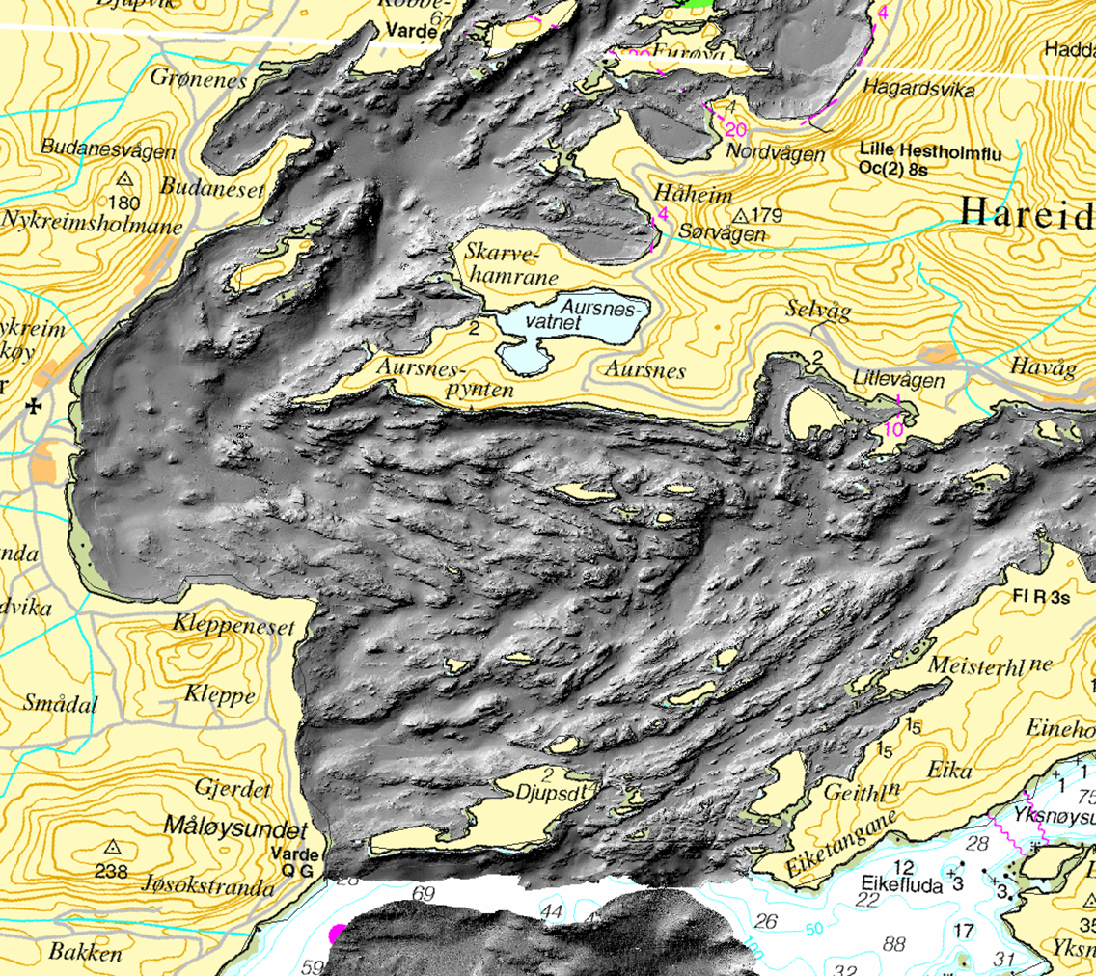
Processes
Establish
Manage
Distribute

Slide 5
NHS 2019

Slide 7
SWOT
Strengths | Weaknesses
Recognized authority body Financed by state budget Regulations Authorized Hydrographic Office Act relating to information regarding specific areas, vital objects and depth conditions Fully integrated production line Nautical expertise Existing data portfolio | Low level of adaptability Low economic flexibility Inefficient production line Long chains of decision from Government Rigid internal management and governance processes
Opportunities | Threats
Increased need for high resolution hydrographic data Focus on sustainable use of the ocean Autonomy Environment Uncharted Arctic areas Increased focus on safety in the leisure fleet New areas for use of our data | Technological development makes us irrelevant Other Government agencies with similar/overlapping skills and products Privatization of public services

Slide 8
UN Sustainability goals
9 Industry, Innovation and Infrastructure
Continually improve nautical information
Operator of PRIMAR
IHO capacity building and support of initiatives from the Norwegian foreign ministry
13 Climate action
Tidal water and sea water level observations
14 Life below water
MAREANO and “ Marine grunnkart “

