Slide 1
HSSC OUTCOMES: Introduction
HSSC work is guided by the IHO Work Programme 2 “Hydrographic Services and
Standards” and by the Council key Priorities
Meetings:
•
•
HSSC 9 - Ottawa, Canada (6-10 November 2017)
HSSC 10 - Rostock-Warnemünde, Germany (14-17 May 2018) – 6 month earlier due
to
the decision to adjust the timing of subsequent meetings
input to the IHO Council
Next Meeting:
in
order
to
provide
timely
•
HSSC 11 - Cape Town,
South
Africa (6-10 May 2019)
International Hydrographic Organization
Organisation Hydrographique Internationale

Slide 2
Analysis/Discussion – ToRs revision
•
HSSC-10 endorsed the proposed amendments to the HSSC Terms of Reference with the
aim that the TORs final version to be submitted to the Council for
by A-2.
the
subsequent
adoption
•
Main amendments to the current HSSC TORs and ROPs reflect:
✓ The presence and the role of the COUNCIL;
✓ The possibility for the HSSC to decide on the need to go
through the Council for
recommendations on
States for approval.
standards and publications before submitting them to Member
International Hydrographic Organization
Organisation Hydrographique Internationale

Slide 3
Analysis/Discussion – Resolution 2/2007
•
HSSC initiated the revision of the IHO Resolution 2/2007 in accordance with Decision
A1/12 (guidance for impact assessment) and Action C1/05 (endorsement/approval
procedure of standards listed in Appendix for instance);
•
Two steps:
1.
Creation of “Guidance on conduction of an Impact Study” and identification of
new Review Cycle for WG/PT development phase of Product Specifications
(endorsed at HSSC10);
a
2.
Development of the endorsement/approval procedure of the relevant standards
taking into account
the
role
of the Council in the approval process (Target HSSC11).
International Hydrographic Organization
Organisation Hydrographique Internationale

Slide 4
Analysis/Discussion
–
Resolution
WG /PT Activity
2/2007
WG/PT submit for
Stakeholder (OEM, industry)
HSSC Approval
Testing, Evaluation and System Implementation
Publish
Edition 1.0.0
Stakeholder
fe
St
fe
…
edback
akeholder
edback
….
Stakeholder
Stakeholder feedback
…….
New
Development
Cycle
feedback
Stakeholder feedback
Prepare new Edition
Publish
Edition 1.n.n
Stakeholder (OEM, Industry, MS & End user)
feedback
Conduct Impact Assessment
Publish
Edition 2.0.0
Provide Impact
Assessment Report
HSSC, then …MS Approval (Res 2/2007)
Process
International Hydrographic Organization
Organisation Hydrographique Internationale

Slide 5
Analysis/Discussion – Key Priorities
•
•
•
•
•
•
Develop
Develop
Develop
an S-100 Interoperability Specification;
S-121 Product Spec for Maritime Limits and Boundaries;
all the components needed to make S-101 a reality;
Consolidation and clarification of standards in relation to ECDIS/ENC;
Prepare Ed. 6.0.0 of S-44;
Consider data quality aspects in an appropriate and harmonized way for all S-100 based product spec;
•
Develop initial guidance
on
definition and harmonization of Maritime Service Portfolios.
International Hydrographic Organization
Organisation Hydrographique Internationale

Slide 6
Analysis/Discussion – Key Priorities
Develop an S-100 Interoperability Specification:
•
•
The development of an S-100 interoperability Specification is in progress (target HSSC11);
HSSC assigned number S-98, approved the title “S-98 Specification for Data Product Interoperability in S-100 Navigation Systems” and tasked S-100WG to consider how to incorporate generic interoperability into future editions of S-100.
Develop S-121 Product Spec for Maritime Limits and Boundaries:
•
•
S-121 Project Team, under S-100WG umbrella, finalized the draft of S-121 Product Spec;
HSSC agreed to the publication timeline of S-121 Edition 1.0.0 under the conditions
depicted by the IHO Secretariat for the new Review Cycle;
•
S-121 Edition 1.0.0 is planned
to
be published in March 2019 (After S100WG4).
International Hydrographic Organization
Organisation Hydrographique Internationale

Slide 7
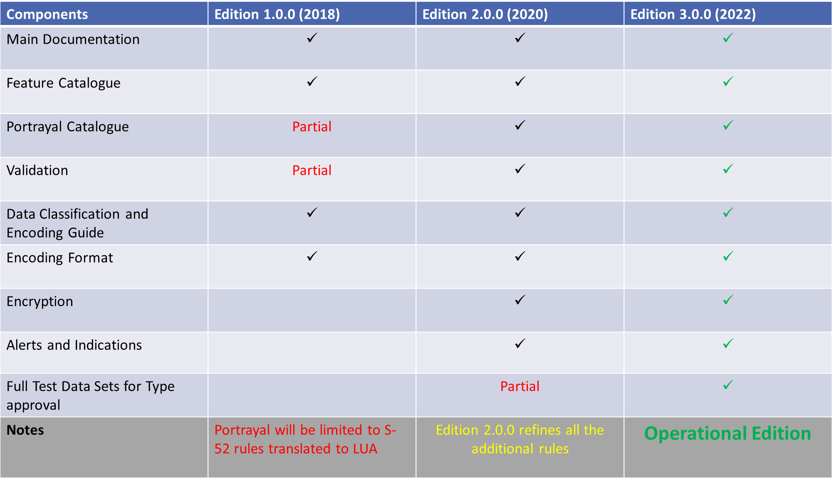
Analysis/Discussion –
Key Priorities
Develop
all
the
components
needed
to
make
S-101
a
reality:
International Hydrographic Organization
Organisation Hydrographique Internationale

Slide 8
Analysis/Discussion – Key Priorities
Consolidation and clarification of standards in relation to ECDIS/ENC:
•
HSSC endorsed Ed. 6.1.0 of S-58 and a CL to IHO Member States seeking their approval
Has been issued;
ENCWG is working to identify the individual components in S-57 (file size, etc.) that prevent ENC Producers from providing high density contour lines;
•
•
HSSC tasked the ENCWG to liaise with the CIRM and IEC for further investigations and
assessment before considering the need for updating S-63 to improve cyber security.
risk
Prepare Ed. 6.0.0 of S-44:
•
A questionnaire has been spread to the members of the International
Community, thanks also to the IFHS;
The replies to the questionnaire identified the need of guidelines;
Hydrographic
•
•
Work in Progress (Target
date
2019).
International Hydrographic Organization
Organisation Hydrographique Internationale

Slide 9
Analysis/Discussion – Key Priorities
Consider data quality aspects in an appropriate and harmonized way for all S-100 based product spec:
•
DQWG has been reinvigorated through the approval of new TORs which consider and
ensure that data quality aspects are addressed in an appropriate and harmonized way for
all S-100 based Product Specifications;
A data quality checklist for product specification developers has been developed and will
be included in the S-100 Product Specification Guidebook (S-97);
HSSC agreed that the level of authority of Data Quality Checklist for Product Specifications
is a recommendation, which can be adapted as necessary by WGs, under the condition
•
•
that it will not create any
potential interoperability issue.
International Hydrographic Organization
Organisation Hydrographique Internationale

Slide 10
Analysis/Discussion
–
Key
Priorities
•
Dilemma between
harmonized encoding of
quality information and the
allowable input into a data
model.
FUTURE
S-57,
encoding is
harmonized
S-101,
encoding is
harmonized
•
HO’s use workarounds
current S-57 model.
Harmonized encoding
in
S-57,
encoding not
harmonized
S-101,
encoding not
harmonized
•
is a
NOW
common effort (HSSC
IRCC).
and
International Hydrographic Organization
Organisation Hydrographique Internationale

Slide 11
Analysis/Discussion – Key Priorities
•
DQWG Reference Documents (www.iho.int -> HSSC -> DQWG -> Reference
Documents):
✓
✓
National Methodologies from survey data to CATZOC values
National Methodologies how to generalize quality information at various
scales (planned)
•
HOs / Regional Hydrographic
guidelines and Best Practices
the DQWG.
Commissions are invited to share their internal
on the population of CATZOC values through
International Hydrographic Organization
Organisation Hydrographique Internationale

Slide 12
Analysis/Discussion – Key Priorities
Develop initial guidance on definition and harmonization of Maritime Service Portfolios:
•
The first HGDM meeting proposed to rename Maritime Service Portfolios
Services;
Following Marine Services have been identified as relevant for the IHO:
into
Marine
•
✓
✓
✓
✓
No.
No. No. No.
5 - Maritime Safety Information Service (MSI),
11
12
15
-
-
-
Nautical Chart Service,
Nautical Publications Service, and
Real-time hydrographic and environmental information Service.
•
HSSC tasked NIPWG to coordinate the provision of the Marine Services definition
under
IHO remit and invited IHO
HGDM meeting.
Member States to consider their attendance to the forthcoming
International Hydrographic Organization
Organisation Hydrographique Internationale

Slide 13
Strategic discussion on future provision of S-100 based
Prod
•
HSSC endorsed the initiation of discussions on the development and future
provision of Products based on S-100;
Such discussion should be brought to the Council’s attention in order to stimulate actions aimed to consolidate a common position that covers all IHO interests (HSSC, IRCC and stakeholders);
•
•
HSSC/IRCC/IHO Secretary General are developing a
paper
on
the subject to be
brought to the Council’s
attention.
International Hydrographic Organization
Organisation Hydrographique Internationale

