Slide 1
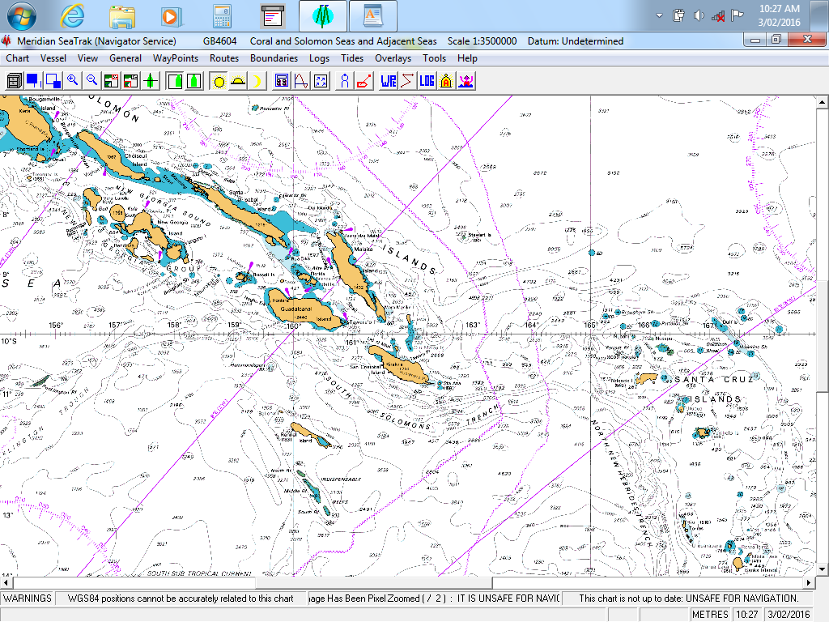
14th South West Pacific
Hydrographic Commission Conference
30 November – 02 December
Noumea, New Caledonia
Solomon Islands Hydrographic Unit
(SIHU)

Slide 2
14th South West Pacific Hydrographic Commission Conference
Topic Contents.
Introduction: Brief history of SIHU
SIHU’s Responsibility, Mission Statement, Vision Statement
Surveying activities – 2015, 2016 & 2017
Maritime Safety Information
Primary Charting Authority (PCA)
IHO Membership
Capacity Building/ Technical support
Other activities
Conclusion…….
30 November – 02 December, 2016
NOUMEA

Slide 3
14th South West Pacific Hydrographic Commission Conference
Introduction: Brief History
SIHU – part of the Solomon Islands Maritime Safety
Administration (SIMSA),
- under the Ministry of Infrastructure Development
(MID),
- established under an Act of Parliament –
April 2009
30 November – 02 December, 2016
NOUMEA

Slide 4

SIHU’s Responsibility…
- To provide Hydrographic Services to the Solomon Islands
Government (SIG), its Stakeholders and the Maritime Community.
SIHU’s Mission…
- To provide and manage an integrated, safe, reliable and sustainable
infrastructure and transport services throughout Solomon Islands.
SIHU’s Vision…
- To be an effective and efficient government agency in improving
the lives of every Solomon Islanders through reliable infrastructures
and safe transportation throughout the Solomon Islands.

Slide 5
14th South West Pacific Hydrographic Commission Conference
HYDROGRAPHIC OFFICE/SERVICE
- Significant progress made over the past four and half years since its establishment in
2012
- SIG continues to support SIHU’s activities, including 2 Hydrographic Surveys a year,
assisting the Aids to Navigation (AtoN) Unit to coordinate positions of all existing
and newly installed Navigational Aids to enhance SAFE NAVIGATION and updating of
MSI in the areas,
Provide Chart Sales Service to the local shipping industry, foreign vessels entering SI
waters,
Hydrographic Surveying & Charting Awareness to tertiary institutions, Government
agencies,
30 November – 02 December, 2016
NOUMEA

Slide 6
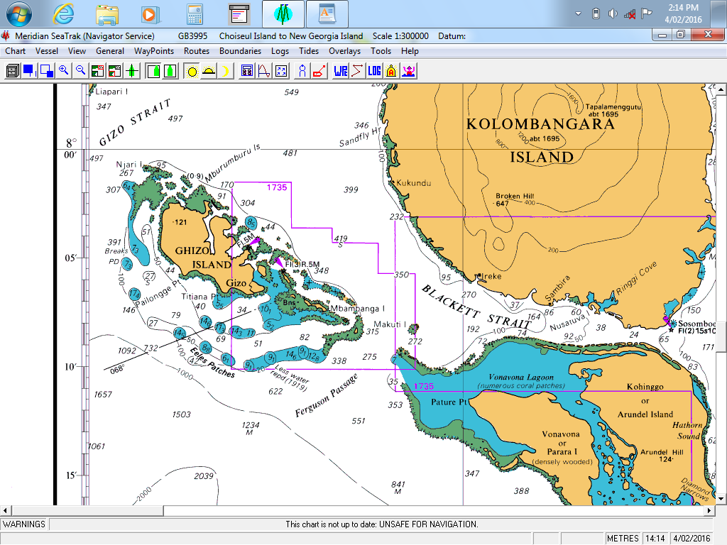
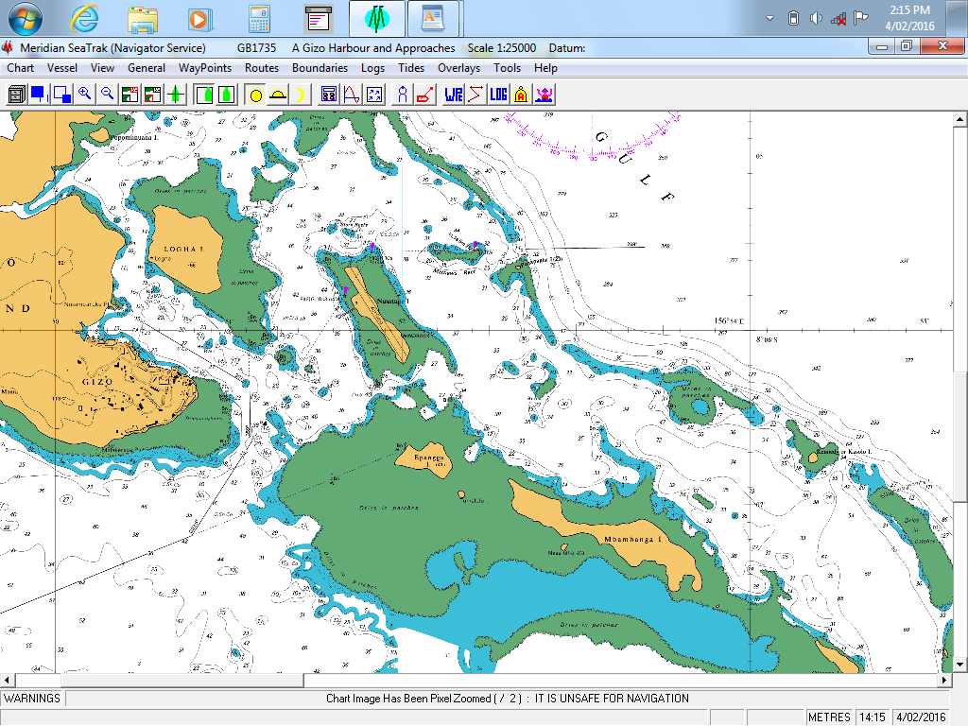
Surveys : Ghizo Hr. & Approaches
2015
2016
Scale 1: 2,500
Purpose: Cruise ship approach
& anchorage,
:Domestic Shipping
Location
30 November – 02 December, 2016
NOUMEA

Slide 7
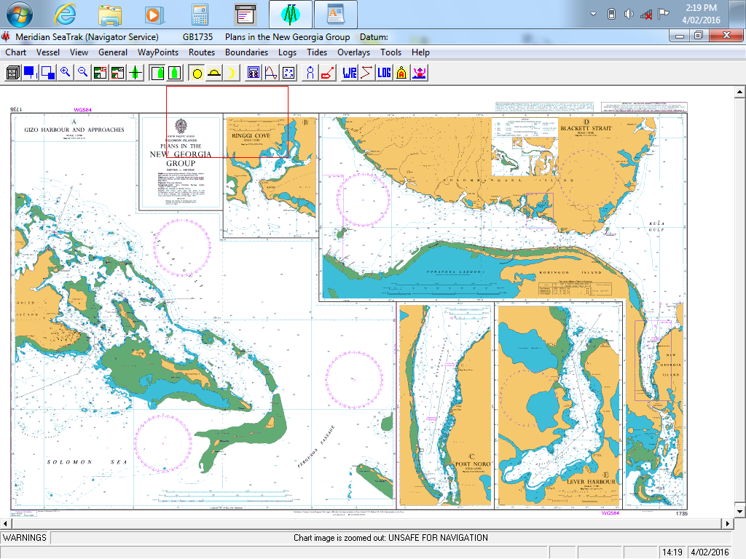
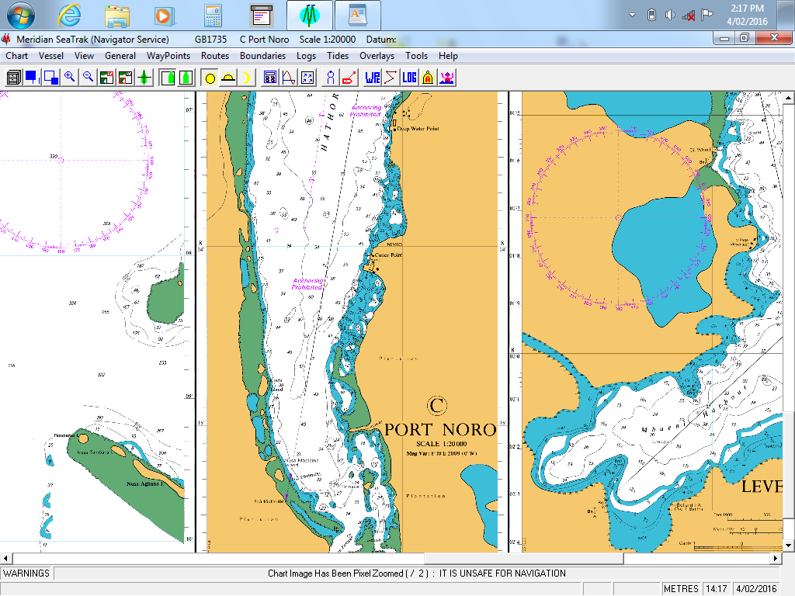
14th South West Pacific Hydrographic Commission Conference
Surveys : Noro Port & Approaches - 2016
Scale 1: 2,500
Purpose: International Wharf
Expansion Project
:International &
Domestic Shipping
Location
30 November – 02 December, 2016
NOUMEA

Slide 8
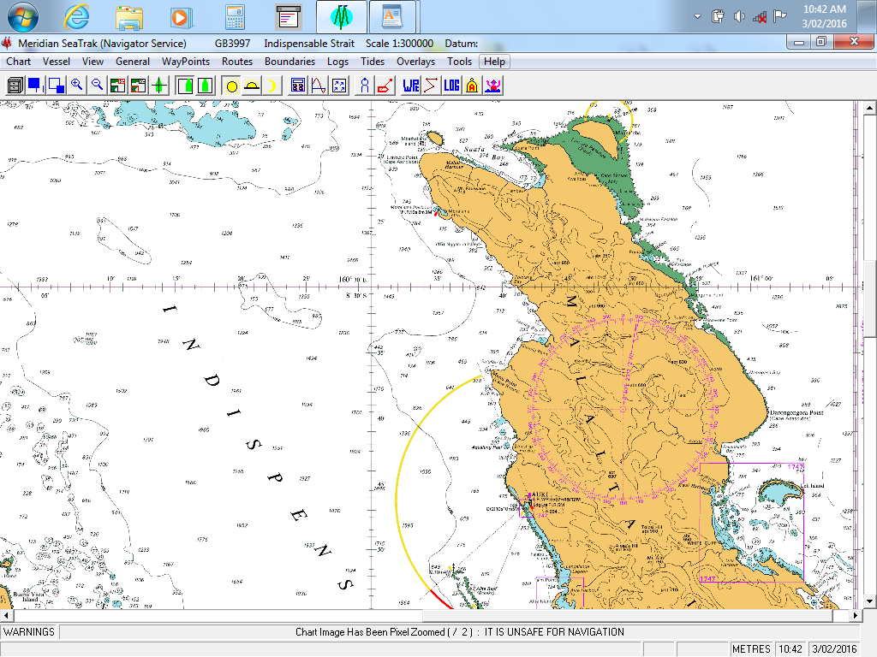
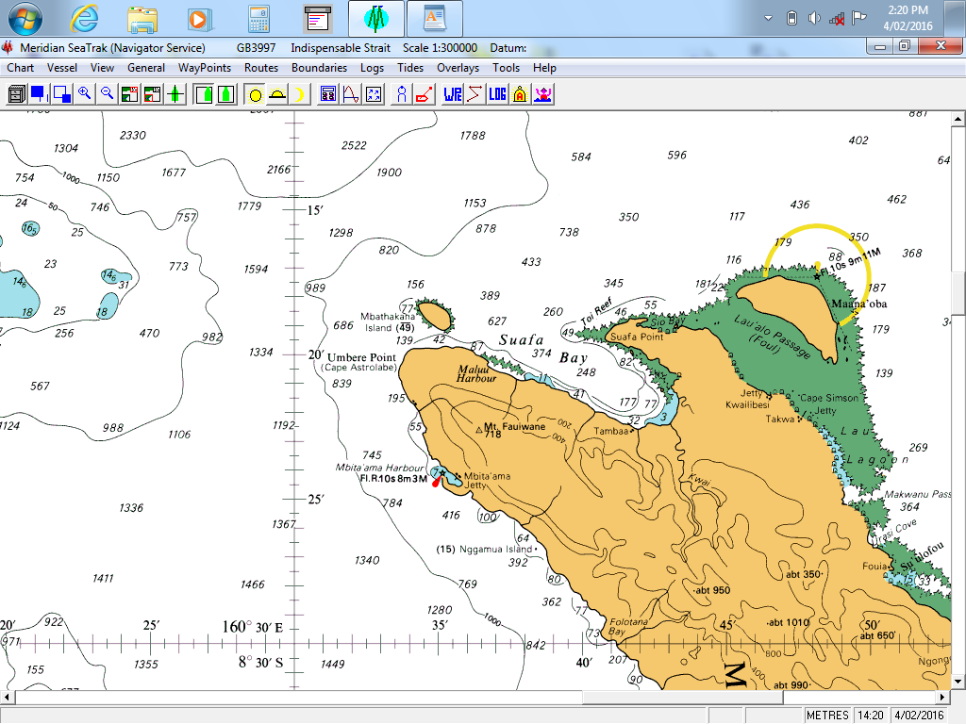
14th South West Pacific Hydrographic Commission Conference
New Surveys : Suava Bay - 2017
Scale 1: 10,000
Purpose: International Wharf
& Fisheries
Development Project
:International &
Domestic Shipping
Location
Extract from BA 3997
30 November – 02 December, 2016
NOUMEA

Slide 9
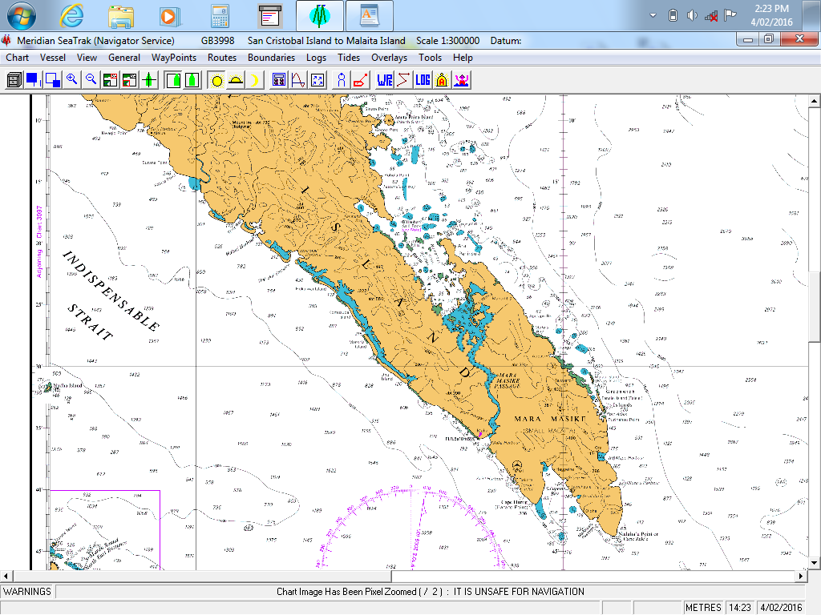
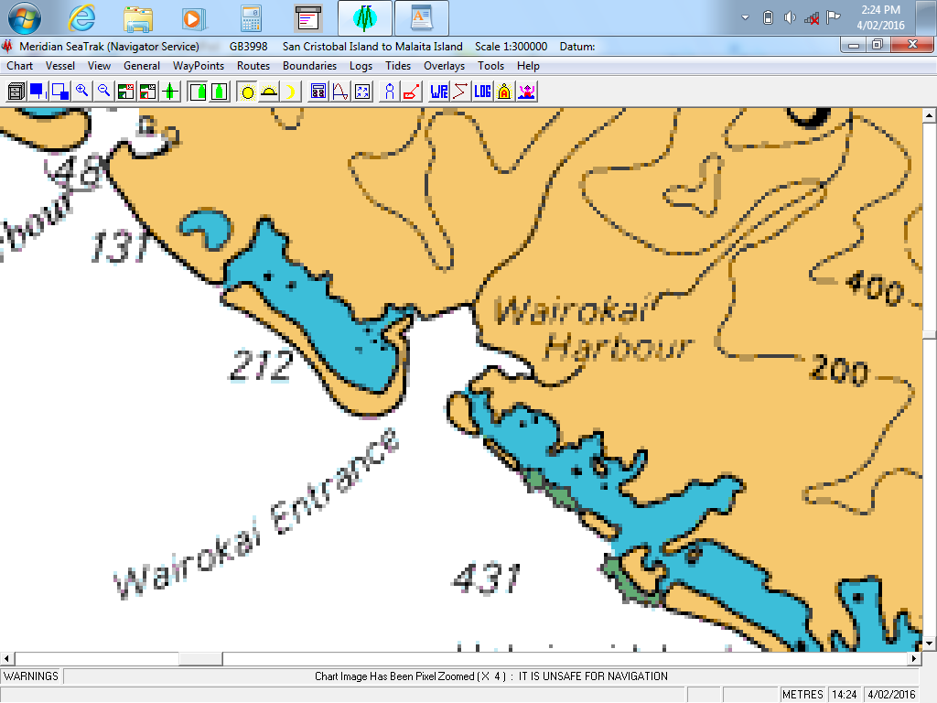
14th South West Pacific Hydrographic Commission Conference
New Survey : Wairokai Harbour - 2017
Scale 1: 10,000
Purpose: International Wharf
& Palm Oil Project
:International &
Domestic Shipping
Location
Extract from BA 3997
30 November – 02 December, 2016
NOUMEA

Slide 10
14th South West Pacific Hydrographic Commission Conference
MARITIME SAFETY INFORMATION (MSI)…
SIHU –
Continues to develop and improve on its MSI data collection capability,
Improve its dissemination process to relevant stakeholders and general
public,
Nautical Cartographer tasked to collect, compile & disseminate MSI to other stakeholders, Aids to Navigation (AtoN) Unit & MRCC
30 November – 02 December, 2016
NOUMEA

Slide 11
14th South West Pacific Hydrographic Commission Conference
PRIMARY CHARTING AUTHORITY (PCA)
UKHO is currently the PCA for Solomon Islands,
On-going negotiations with AHS to take on the PCA responsibility following the Australian Government’s approval,
30 November – 02 December, 2016
NOUMEA

Slide 12
14th South West Pacific Hydrographic Commission Conference
IHO MEMBERSHIP:
Solomon Islands Government has officially submitted its request to be considered by the IHO,
Other IHO Member countries have officially endorsed SI’s application bid to become a full member of IHO,
SIHU recently noted that the existing procedure to apply for membership have been changed (08/11/2016?) and a more effective is now established.
Hopeful that SI will be a FULL MEMBER OF IHO by 2017.
30 November – 02 December, 2016
NOUMEA

Slide 13
14th South West Pacific Hydrographic Commission Conference
CAPACITY BUILDING / TECHNICAL SUPPORT
SIHU – supports the idea of CAPACITY BUILDING TRAININGS as this is the only
way forward for small island states to further improve mainly due to
limitations of adequate resources in their countries.
- Such an initiative will enable personnel within the region to acquire up to
date knowledge and skills in specific important areas/topics to fully
equipped them for future challenges.
- SI was a recipient of the SWPHC Capacity Building Training workshop in
MSI this year in Wellington, New Zealand.
30 November – 02 December, 2016
NOUMEA

Slide 14
14th South West Pacific Hydrographic Commission Conference
CAPACITY BUILDING / TECHNICAL SUPPORT
SIHU wishes to highlight certain areas which we are seeking support if at all maybe possible from elsewhere as follows:
i) Technical support in the developing of the SIHU’s Hydrographic Survey Instructions,
ii) Technical support during a field survey trip especially in using the survey program –
HYPACK MAX Software and familiarization training of few other equipment recently
acquired,
iii) Any support to our Nautical Cartographer purposely to have OJT on the different stages in
Chart Production following his attendance at the IHO CAT B Cartography training in the
UKHO, and
iv) IHO CAT A Hydrography Training for one candidate during 2017/18 period
30 November – 02 December, 2016
NOUMEA

Slide 15
14th South West Pacific Hydrographic Commission Conference
Other Activities…
SIHU continues to provide support and assistance to SIG in matters relating to Maritime Boundaries Delimitation and its Extended Continental Shelf (ECS) dealings,
SIHU’s Nautical Cartographer has recently attended the IHO-Nippon Foundation Alumni Training Workshop 2016, in Bangkok, Thailand from 2 to 4 November 2016,
SIHU’s Principal Hydrographic Officer has been given the opportunity to travel with the SI’s Surveyor General to attend the PGSC Meeting, followed by the GIS/RS User Conference in Suva, Fiji from 24 November to 02 December 2016
30 November – 02 December, 2016
NOUMEA

Slide 16
14th South West Pacific Hydrographic Commission Conference
Conclusion....
SIHU continues to be faced up with challenges in its ongoing developments.
Currently SIMSA is under going organisational review by the ADB towards transformation into an Authority.
It is anticipated SIHU’s aspiration shall be effectively considered and things should be functioning smoothly as expected.
SIHU will continue to maintain our continuous cordial relationship with our Stakeholders locally, regionally and internationally.
30 November – 02 December, 2016
NOUMEA

Slide 17
14th South West Pacific Hydrographic Commission Conference
Thank you all for your attention!!!
30 November – 02 December, 2016
NOUMEA

