Slide 1
14th South West Pacific Hydrographic Commission Conference 30 November – 02 December Noumea, New Caledonia
Update on NZ Aid Programme
Pacific Regional Navigation Initiative
[PRNI]
Trevor Larkin: Project Manager
Stuart Caie: LINZ
David Mundy: SPC (Geoscience)

Slide 2
14th South West Pacific Hydrographic Commission Conference
PRNI Overview
Commenced in 2015
Delivery Partners
LINZ – 2020
SPC (Geoscience Division) – 2018
NZ $5M

Slide 3
14th South West Pacific Hydrographic Commission Conference
NZ PRNI Update
Pacific Island Partners:
NZ PCA Countries | SPC Target Countries
Cook Is Niue Samoa Tokelau Tonga | Kiribati Vanuatu Tuvalu Data Discovery Pacific - Wide

Slide 4
14th South West Pacific Hydrographic Commission Conference
NZ PRNI UPDATE
Goal
Safe, reliable and affordable transport services in the Pacific that connect people to markets and services.
Long / Medium / Short Term outcomes to build institutional capacity, improve compliance obligations, identify risks, conduct mitigation measures.(surveys), and upgrade charts

Slide 5
14th South West Pacific Hydrographic Commission Conference
NZ PRNI UPDATE
Outputs:
Pacific-Wide Data Discovery
Hydrographic Risk Assessments
Capacity Building
Mitigation Measures
Partnerships

Slide 6
14th South West Pacific Hydrographic Commission Conference
NZ PRNI UPDATE
Progress to Date:
Project Team Established
Relationships
Bathymetric Data
Risk Assessments
Bilateral Agreements
Plans for mitigation measures / surveys

Slide 7
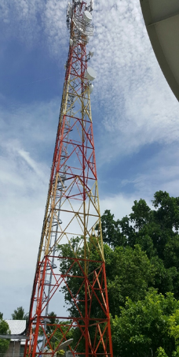
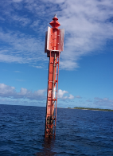
14th South West Pacific Hydrographic Commission Conference
Other NZ Maritime Projects in Pacific
Pacific Maritime Safety Programme
(Phase 2: 2015-18)
Cook Is (Technical Adviser)
Kiribati (Technical Adviser)
Niue
Tokelau
Tonga
Tuvalu (Technical Adviser)
AtoN Infrastructure Projects

Slide 8
14th South West Pacific Hydrographic Commission Conference
Output 1:
Pacific-wide Data Discovery
Output 2:
Hydrographic Risk Assessment
SPC to search database to identify data with potential for use to improve quality of existing charts
SPC to work with PICs to release data to Primary Charting Authorities
LINZ to undertake risk assessments for Niue, Samoa & Tokelau
PRNI
LINZ: Cooks, Niue, Samoa, Tokelau, Tonga
SPC: Other PICs
Output 3:
Capability/Capacity Building
Output 5:
Pacific-wide Partnerships
LINZ to work with NZ 5 PICs on annual plans to increase capability following IHO framework
LINZ to assess NZ 5 PICs requirements for AtoN
SPC focus on other prioritised PICs to build capability and develop annual plans for improved legislation and AtoN
NZ to work with regional partners, development donors, PICs and private sector to develop partnerships for improving navigation safety
Output 4:
Mitigation Measures
LINZ to lead prioritising and project managing mitigation measures including AtoN, hydrographic surveys and chart modernisation

Slide 9
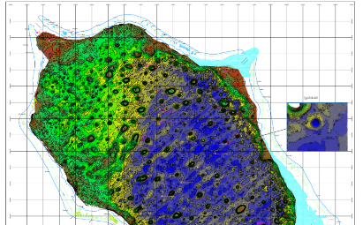
14th South West Pacific Hydrographic Commission Conference
LINZ Update
Output 1 – Data Discovery
Cook Islands
Niue
Samoa
Tonga
Review and assess

Slide 10
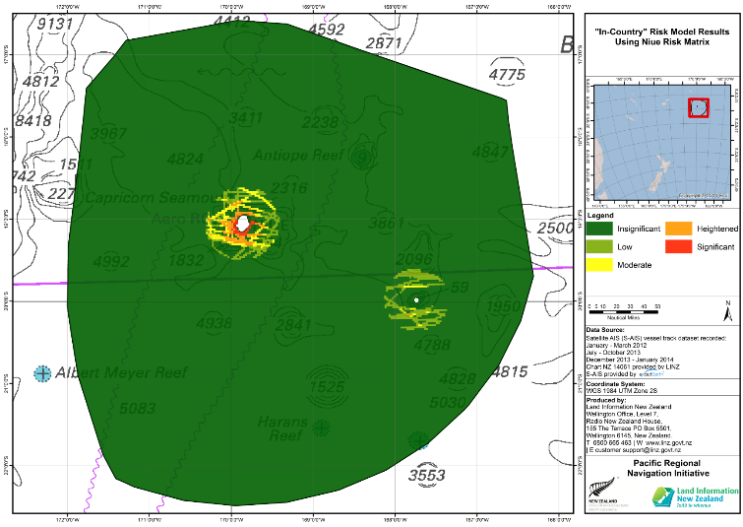
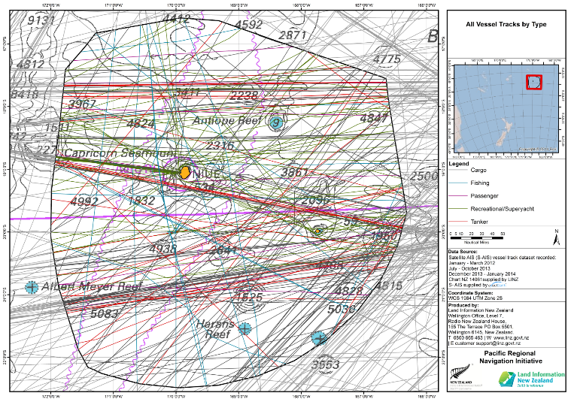
14th South West Pacific Hydrographic Commission Conference
LINZ Update
Output 2 – Risk Assessments

Slide 11
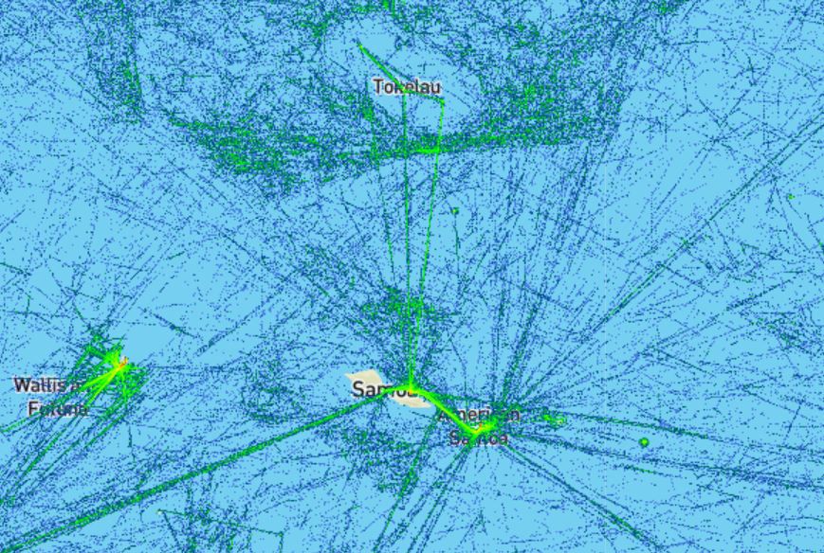
14th South West Pacific Hydrographic Commission Conference
Samoa risk assessment
Data gathering visit February 2017
Report June 2017

Slide 12
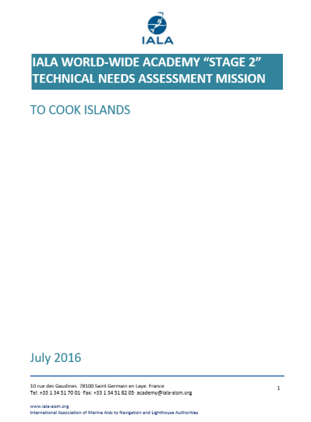
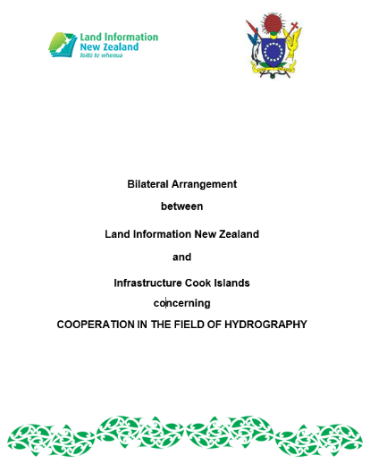
14th South West Pacific Hydrographic Commission Conference
LINZ Update
Output 3 – Capacity Building
Signed October 2016

Slide 13
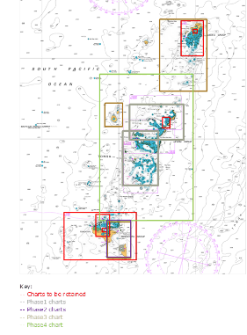
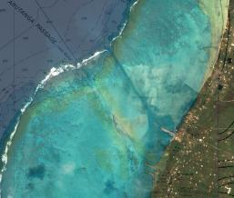
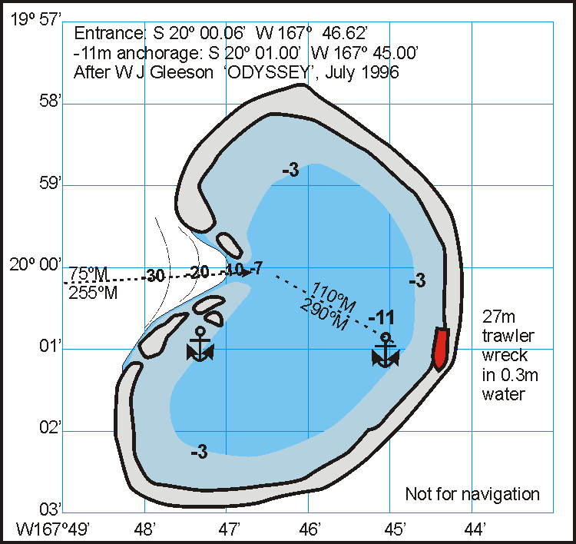
14th South West Pacific Hydrographic Commission Conference
LINZ Update
Output 4 – Mitigation Measures
Cook Islands
Niue
Samoa
Tonga

Slide 14
14th South West Pacific Hydrographic Commission Conference
SPC Update
Recap of SPC Specific Outputs
Targeted countries
Tuvalu, Vanuatu and Kiribati
Aids to Navigation
Create and maintain register of AtoN in Collaboration with LINZ and IALA
Data Discovery
Collate and analyse bathymetry and related data
Release Agreements with PICTs
Mechanism for access and monitoring of data

Slide 15
14th South West Pacific Hydrographic Commission Conference
SPC Update
Capacity Building – Country Visits
Kiribati
November 2015 – Joint PRNI / IHO Technical Implementation Visit
May 2016 – Hydrographic Awareness / Basic Survey Training
Vanuatu
November 2015 – Joint PRNI / IHO Technical Implementation Visit
May 2016 – Joint PRNI / UKHO / KFW – Follow up and TC PAM scoping visit

Slide 16
14th South West Pacific Hydrographic Commission Conference
SPC Update
Capacity Building – Country Visits
Tuvalu
May 2016 – Joint PRNI / PMSP Scoping Visit
November 2016 – Joint PRNI / UKHO IHO Technical Assessment Visit and MSI CB

Slide 17
14th South West Pacific Hydrographic Commission Conference
SPC Update
Tuvalu MSI Example
AtoN network overhauled in 2013 as part as part of the NZ MFAT Ship to Shore Project
Substantial project - 34 AtoN in 7 Islands (9 in Funafuti)
Completion report issued December 2013
......but no charting action was taken.

Slide 18
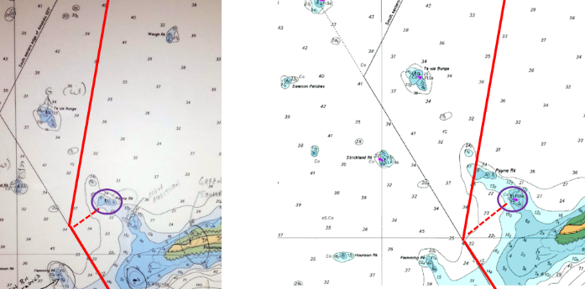
14th South West Pacific Hydrographic Commission Conference
SPC Update
18 months – potential for navigation incident
BA 2983 - May 2016
BA 2983 - June 2016

Slide 19
14th South West Pacific Hydrographic Commission Conference
SPC Update
Data Discovery
Historical data
Bathymetric data held by SPC for PICT’s comprises:
Over 300 discrete datasets potentially useful for nautical charting (Mainly SBES data (>90%) and MBES
Most data captured for non-nautical charting purposes
Assessment for usefulness for charting
High level assessment in progress (70% complete)
Detailed assessment / metadata compilation

Slide 20
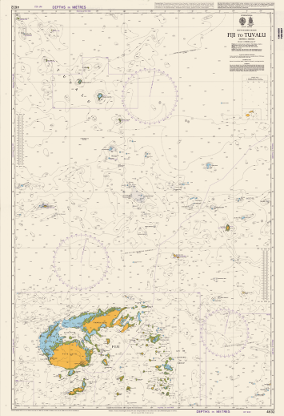
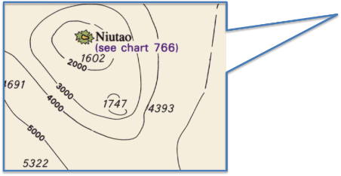
14th South West Pacific Hydrographic Commission Conference

Slide 21
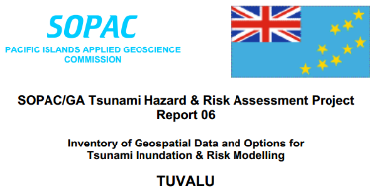
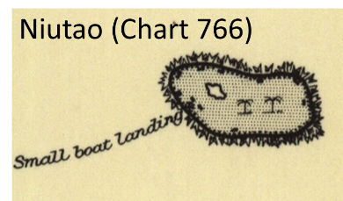
14th South West Pacific Hydrographic Commission Conference

Slide 22
14th South West Pacific Hydrographic Commission Conference
SPC Update
Data Discovery
Data Release Agreements
Agreements with 8 out of 17 PICTS achieved under PRNI
Two agreements pending
Formal proposals to be sent to remaining 7 PICT’s after discussions at SWPHC14 (PCA with SHOM and USA)

Slide 23
14th South West Pacific Hydrographic Commission Conference
SPC Update
Data Discovery
Access and Monitoring Mechanism
Development of PRNI Portal
Provide tools for PCA to assess data via appropriate and relevant metadata
Enable access to data
Provide visibility to PICT’s
Enduring (ie beyond life of PRNI)
Secure – preserves Data Release Arrangements

Slide 24
14th South West Pacific Hydrographic Commission Conference
PRNI – CONCLUSION
Moving into tangible delivery Phase
Relationships and communication key to success.
Notes:
Thanks to Stuart and Dave for their inputs – and I hope you now have a sense of the collaboration that is going on across NZ / SPC / and this group of Pacific Island countries on these matters . And also, that you have a sense our NZ’s willingness to share information and cooperate with others.
Having done the job of explaining what PRNI is about and building the relationships, we are getting close to the more exciting phase of getting moving on some survey work. And hope that by the next meeting of this commission, that we will closer to having a product to talk about.
Thanks for your time and attention. Are there any questions?

Slide 25
14th South West Pacific Hydrographic Commission Conference
PRNI – CONCLUSION
Moving into tangible delivery Phase
Relationships and communication key to success
Plan well ahead…

