Slide 1
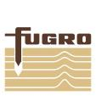
Recent Surveys in Samoa and French Polynesia
Hugh Parker, Fugro

Slide 2
Overview
Background and overview of sensors
Surveys undertaken in the region
French Polynesia
French Polynesian Government, Service de l’Urbanisme (SAU)
Samoa
Samoan Government, Ministry of Natural Resources and Environment (MNRE)

Slide 3
Background and overview of sensors
There are now 2 types of ALB systems in production/operation:
Traditional Bathymetric LiDAR Sensors with High Power / Lower PRF
Examples: Fugro LADS HD (Mk 3 / Mk 2 / Mk 1)
Teledyne Optech CZMIL Nova (deep channel), SHOALS
Leica Hawkeye III (HE II / HE I)
Topo / Bathy Sensors (for shallow Water) with Low Power / Higher PRF
Examples: Leica Chiroptera II
Riegl VQ-820-G
Riegl VQ-880-G
Teledyne CZMIL Nova (shallow channel)
USGS EAARL-B
Reference: Quadros, N., 2013, LiDAR Magazine • Vol. 3 No. 6, “Unlocking the Characteristics of Bathymetric LiDAR Sensors”
Fugro’s “LADS HD” High Powered ALB system
Riegl “VQ-880-G” Low Powered ALB System
Notes:
…
All bathymetric LiDAR sensors have variable depth penetration capabilities depending on laser power and frequency rate. High powered sensors generally achieve depth penetration of 2-3 times the water clarity (Secchi depth) but have a lower operating frequency. Low powered sensors have a higher operating frequency, but generally achieve depth penetration to only between 1.0 – 1.5 times the water clarity. The following sensors are currently in operation:
High Powered: Fugro LADS HD, SHOALS, Teledyne Optech CZMIL, Leica Hawkeye III.
Low powered: Leica Chiroptera II, RIEGL VQ-820-G, RIEGL VQ-880-G
It should be noted that all the LiDAR systems listed can measure both topographic data and bathymetry. The topographic data gathered from a traditional bathymetric LiDAR system tends to be of a lower density compared to that provided by a topo-bathy LiDAR sensor. The topo-bathy LiDAR sensors have a lower laser power, narrower beam, more frequent measurements and a smaller receiver field-of-view (FOV)

Slide 4
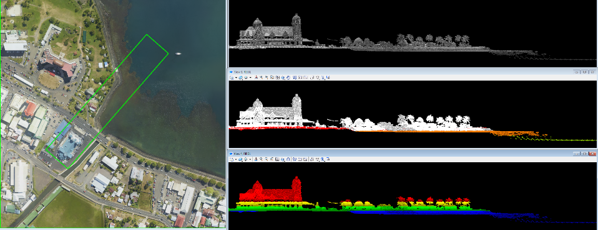
Background and overview of sensors
Topo/Bathy (Shallow Water) ALB Sensors
Pros:
High Frequency/High resolution/small footprint, smaller units for installation
Cons:
Lower power, Limited depth performance, 1 – 1.5 x Secchi Depth
Notes:
The shallow-water systems tend to have less laser power per pulse, a higher measurement frequency (high resolution), smaller laser footprint diameter and a smaller receiver field of view, but can generally only measure water depths within the visible water column.
Point densities for low powered systems can be up to 12 pts per m², depending on frequencies used

Slide 5
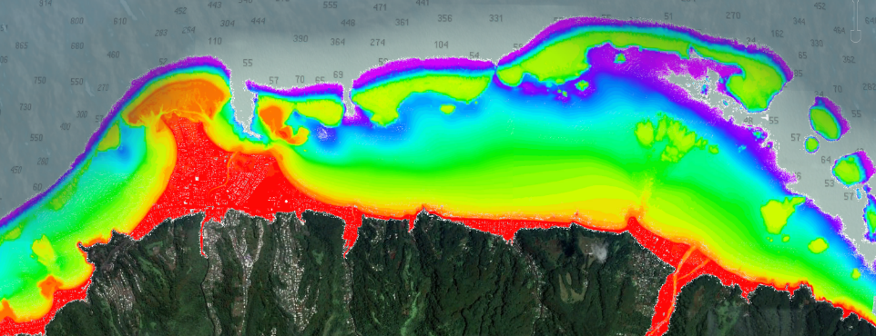
Background and overview of sensors
Traditional Bathymetric LiDAR Sensors
Pros:
High power, Greater depth performance, 2 – 3 x Secchi Depth
Cons:
Low Frequency/lower resolution/larger footprint, Larger units for installation
Notes:
The deep-water more traditional bathymetric Lidar systems use more laser power per pulse, have a lower measurement frequency (low resolution), a larger laser footprint and receiver field-of-view. These deep-water bathymetric Lidar systems vary in depth penetration capability from between 2.0 to 3.0 times the Secchi depth measurement.
High Powered sensors generally has a minimum resolution of 2 m x 2 m resolution and up to 4.0 x 4.0 m or greater…

Slide 6
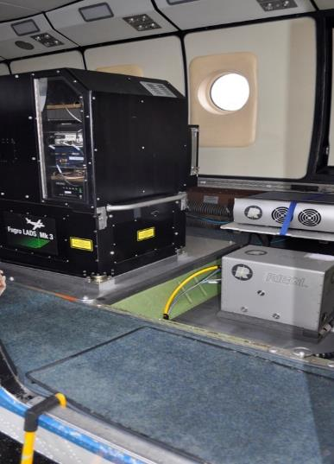
Multi-sensor operations
Common practice is to nowadays undertake ALB surveys using both type of sensors, for example:
LADS HD
7mj Laser Power
Depth performance to 80m in best conditions (3 x Secchi disk)
High Data Quality
Wide Aperture Receiver
Automatic Gain Control - for optimised signal return
Efficient data collection
Operating heights from 1200 – 3000 feet
2x2 to 3.5x3.5 m spot spacing;
Roll and off-track compensation
RIEGL VQ-820-G
High spatial resolution
Up to ~8 points / m²
Depth performance to 10-15m in best conditions (1 x Secchi disk)
LADS HD
RIEGL
Notes:
Multi Sensor operations
It is common practice nowadays to undertake ALB surveys using both a high powered and low powered ALB system simultaneously to measure the coastal zone and shallow water to depths of up to 80m (subject to water clarity). This combination provides clients with high resolution data in the shallow water and on land from the low powered/high frequency sensor, and deep water depth penetration form the high powered/lower frequency sensor. Data can be processed simultaneously and merged together to deliver one final seamless dataset from two sensors. This ALB data can also be merged with topographic LiDAR data, or with sonar data in deeper water.

Slide 7
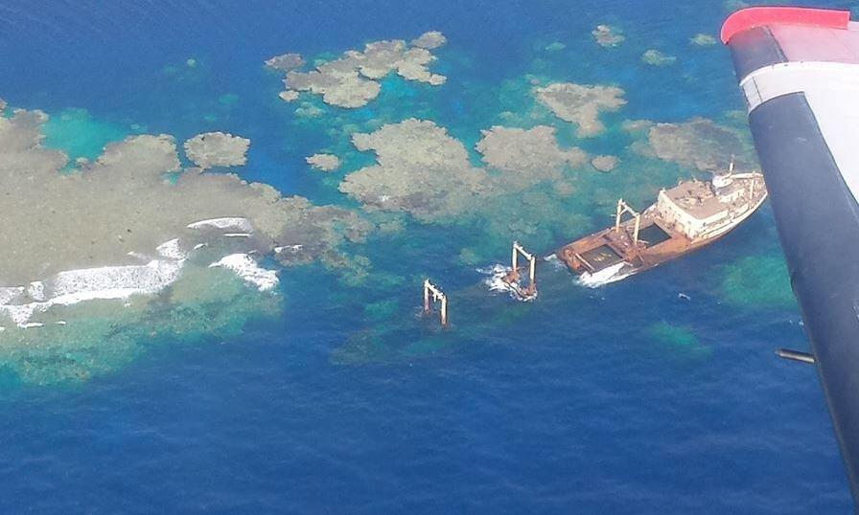
Example of LADS + Riegl data

Slide 8
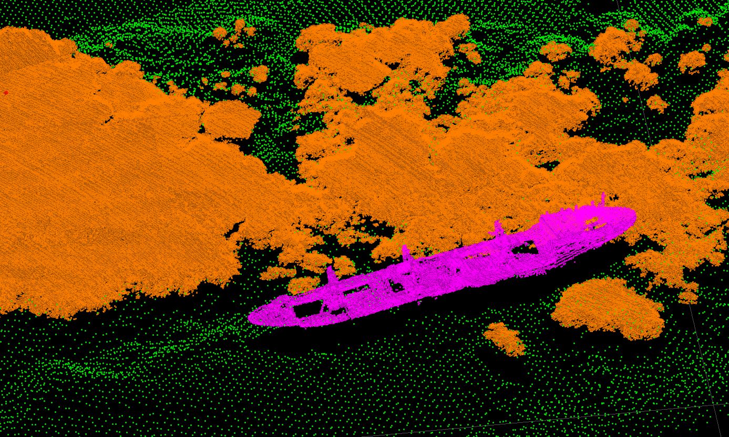
Example of LADS + Riegl data

Slide 9
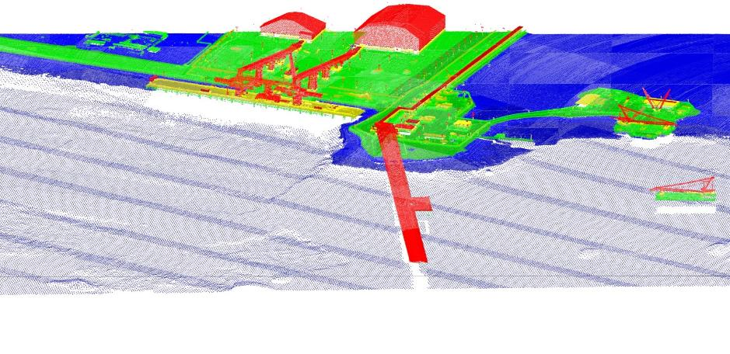
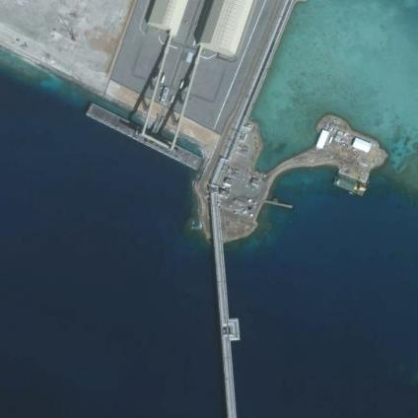
Example of LADS + Riegl data
Notes:
Merged LADS and Riegl data set.
You can see from the imagery that the higher point density Riegl data cuts out along the line of visible seabed, and the lower resolution LADS data continues to measure the seabed further seaward in deeper water
Operating these systems simultaneously also enable the operator to prioritise the data processing efforts that compliments each sensors capabilities. For example, the shallow water data from the high powered sensor can be ignored, and this is somewhat redundant due to the overlapping high resolution data form the low powered sensor. Likewise, the deeper, poorer quality data from the low powered sensor can also be ignored as this is superseded buy the better quality/more accurate data from the High Powered ALB sensor. Through doing this we are able to reduce processing times for faster data delivery.
BUT – this does not mean the redundant data is completely ignored… this data can still be used to cross-check or verify data collected by the other sensor. This can therefore also help reduce the number of reflys that are perhaps needed to verify a suspicious feature that could potentially be a danger to navigation.

Slide 10
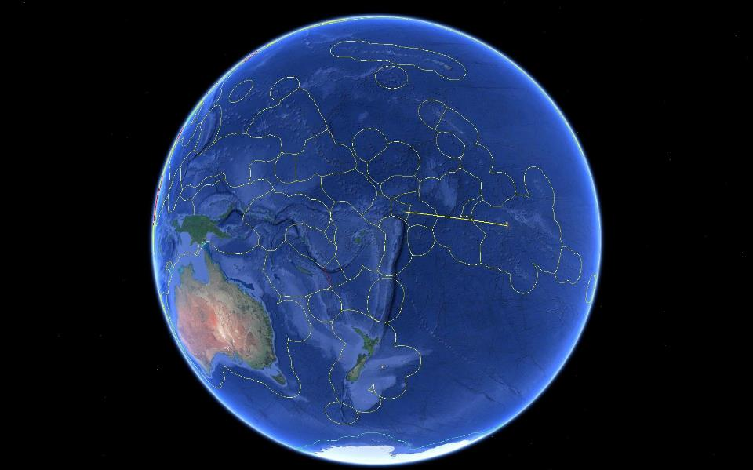
South West Pacific LiDAR Surveys
SAMOA
FRENCH POLYNESIA
2450 kms

Slide 11
French Polynesia Survey - Requirement
The French Polynesian Government Service de l’Urbanisme (SAU) needed to assess the vulnerability of land to climate change at a local level.
With SHOM, developed a project to produce a seamless, precise topographic and bathymetric model utilising ALB technology to survey areas of interest in French Polynesia
Uses:
Hazard & Risk assessment for tsunamis, floods, landslides & earthquakes (creation of Prevention Plans for Natural Hazards)
Improve nautical charting in the region for general shipping and tourism industries
Other: planning for agriculture improvements, infrastructure upgrades, fisheries management …
Additional Stakeholders:
Direction de l’Equipment – Additional area in Tahiti
Moorea Coral Reef - Long Term Ecological Research / US National Science Foundation Long Term Ecological Research Program
Notes:
RIEGL points coloured using the mosaic imagery captured by the on-board camera.

Slide 12
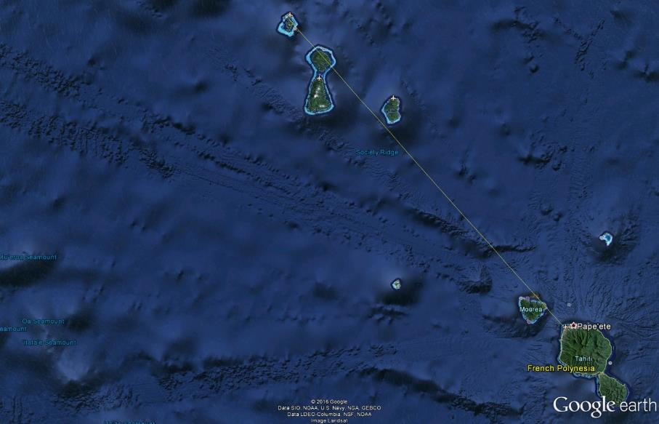
French Polynesia Survey - Areas
The …
Bora Bora
Moorea
Distance from Papeete to Bora Bora is
~ 140nm,
260 km.
Tahiti
Notes:
RIEGL points coloured using the mosaic imagery captured by the on-board camera.

Slide 13
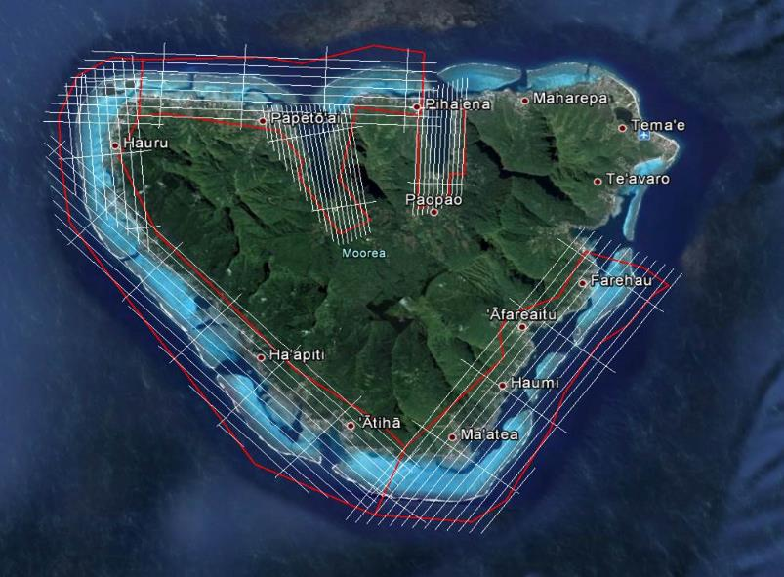
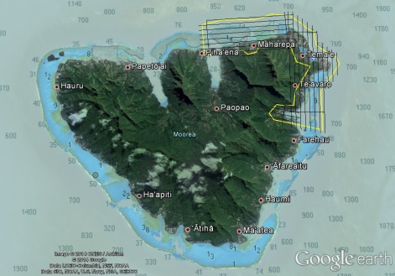
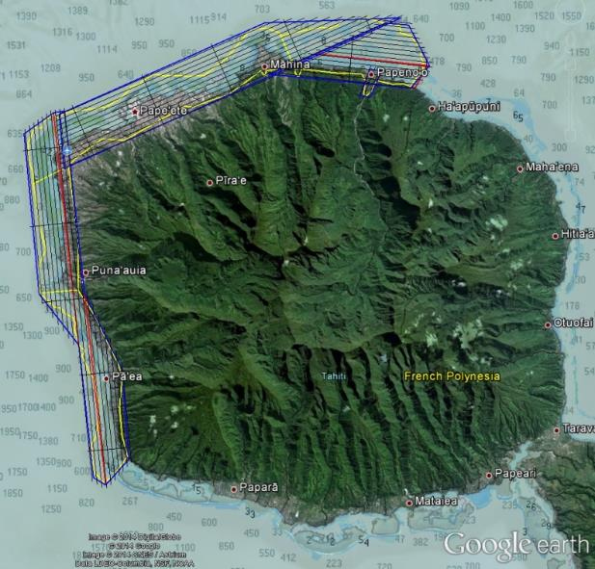
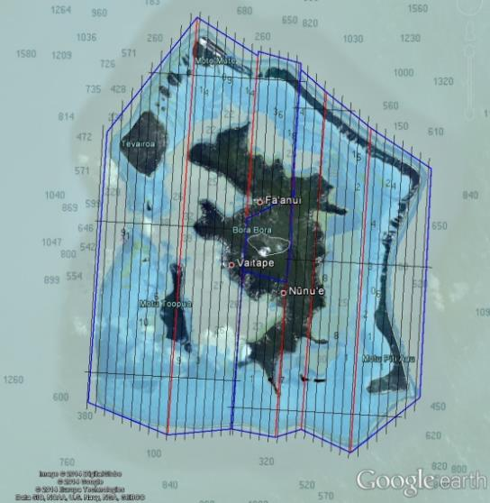
French Polynesia Survey - Areas
Bora Bora
Moorea
Tahiti
Notes:
RIEGL points coloured using the mosaic imagery captured by the on-board camera.

Slide 14
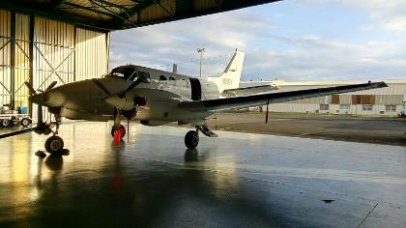
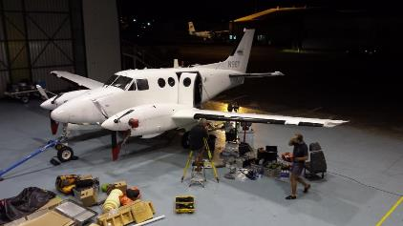
French Polynesia Survey - Operations
27 May - Mobilise equipment & personnel to Papeete
03 June - Aircraft Arrival
Planning and control requirements for SW Pacific
04 – 09 June – remove bladder tank, install equipment, STW & calibrate Riegl & Fugro LADS ALB systems
10 – 26 June – 12 sorties including 7 weather days & 2 days internal mob
29 June – demobilisation (Depart to Samoa)

Slide 15
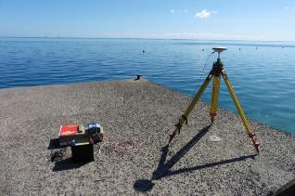
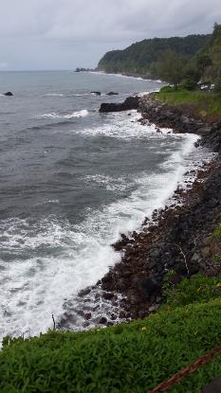
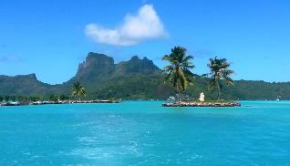
French Polynesia Survey – Activities during the survey
Lead-up to survey:
Antenna / lever-arm survey
Static position check
Setup GNSS base stations
Establish ground control
Check sensor calibrations
Reconnaissance of areas
During Survey:
Cross lines
Depth Benchmarks
Quality assessment
Forward deployments

Slide 16
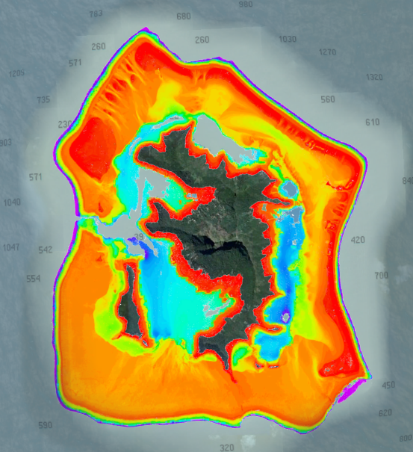
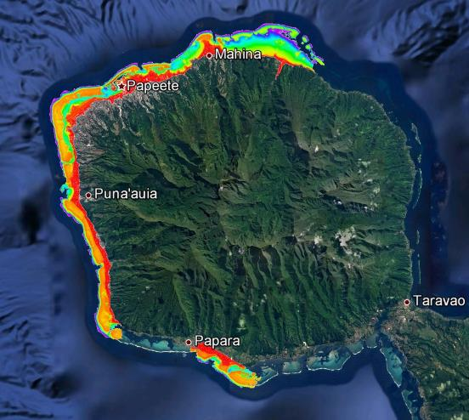
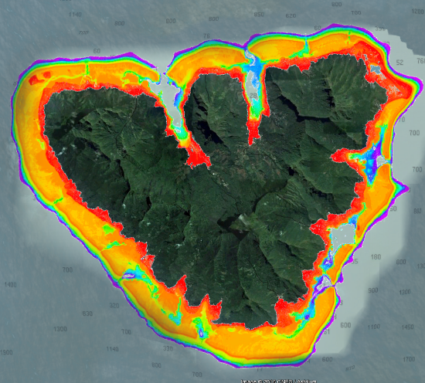
French Polynesia Survey – Results and Coverage
Ridge to outer Reef
Achieved 30m ASL to -60m below consistantly
(Note this achieves the specification of 10m ASL to -40m below)
Max depth achieved was 76.1 metres (North coast of Tahiti)
Fifty benchmark lines flown over 5-20m water depth
236,342 individual soundings.
The results from all benchmark comparisons were:
MDD: -0.05 metres
SDev: ± 0.13 metres (1σ).

Slide 17
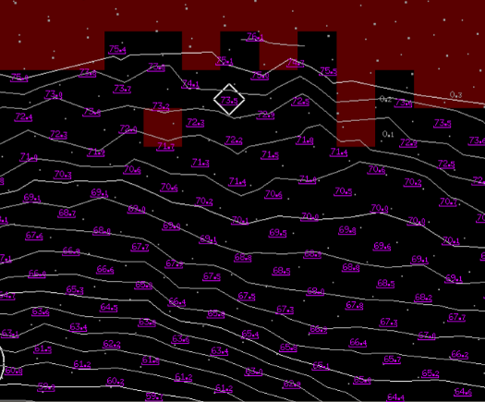
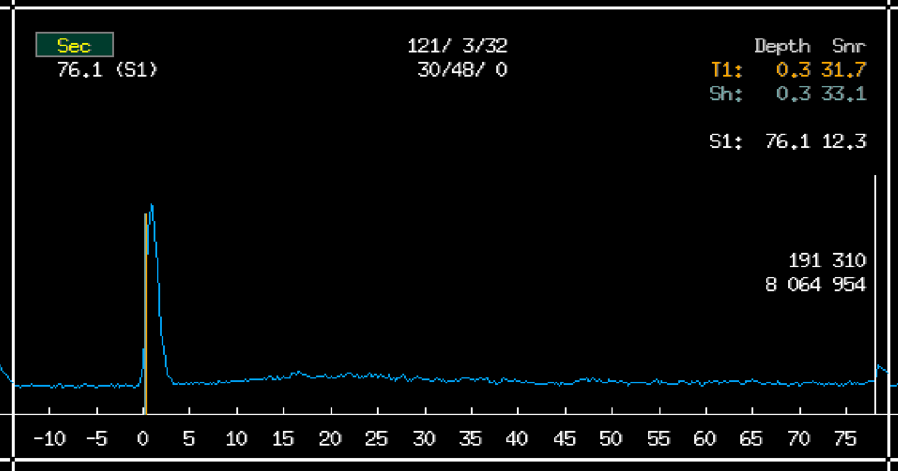
French Polynesia Survey – Results and Coverage (76.1m)

Slide 18
French Polynesia Survey – Results and Coverage
Area | Required SqKm (+10m drying to 40m depth) | Achieved SqKm (+10m drying to 40m depth) | Area percentage covered
Tahiti | 77.20 | 73.16 | 96.81%
Moorea (Whole Island) | 82.54 | 80.33 | 97.32%
Bora Bora | 98.56 | 93.04 | 94.40%

Slide 19
Samoan Survey - Requirement
Funding from: World Bank
Why: climate change resilance - identify risks, understand the exposure and better manage vulnerabilities and impacts on a national scale at high definition and accuracy. This includes hazards such as sea level rise, flooding, tsunamis, landslides, storm surge and cyclones. What did the Samoan Government Seek?
What was required: An up to date, accurate and detailed national wide data, from 30m depth contour to top of mountain (~1900m). Coverage from top of Ridge to Outer Reef
Seamless dataset from the 1900m topo height to -30m depth contour
98% coverage of topographic (2900 sqkm) &
90% of bathymetric areas < 30m WD (~430 sqkm) – IHO Order 1 b specification
What we planned to satisfy the requirement:
LADS sensor: 5m x 5m point spacing
Riegl Bathy Sensor: 4 points per m (along coastline & shallow water to 8m)
Riegl Topo Sensor: 4 points per m (Ridge to waterline coverage)
High Res Imagery: 15cm pixel (ridge to waterline coverage + overlap)
Incidental Mid Res Imagery: ~40cm pixel (reef/coastal coverage)

Slide 20
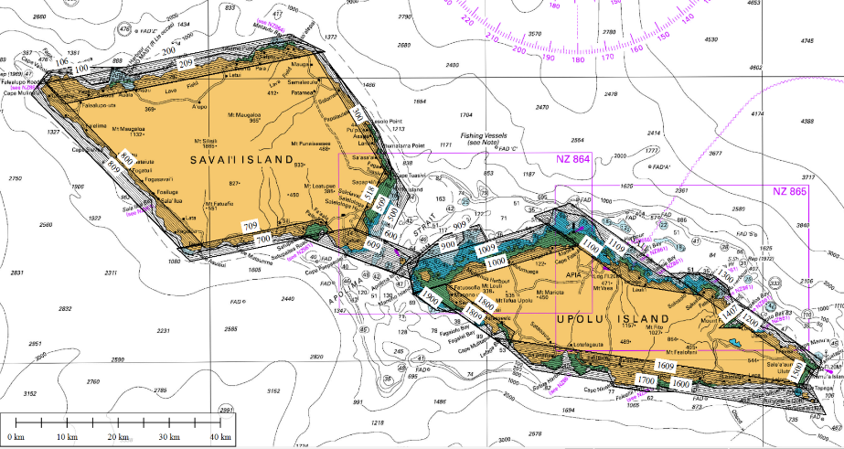
Samoan Survey – Bathymetry (ALB) Areas
ALB data collection plan.:
Number of flight Planned | 15
Total flight time | 55 hrs
Data collection duration | 12 days
Survey area < 30m | ~430 sqkm
Total Survey area (line plan) | ~1100 sqkm

Slide 21
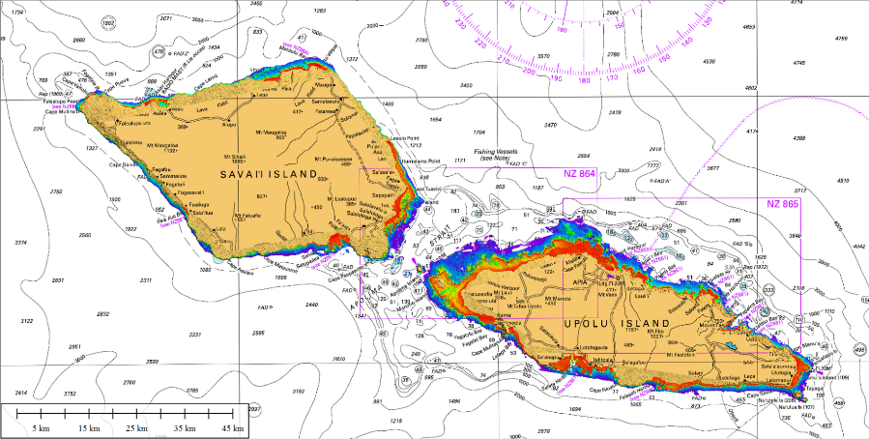
Samoan Survey – ALB Coverage
ALB coverage achieved:
Flights achieved | 15 sorties completed in 25 days
Total 0 to 30m contour area | 438.7 SqKm
0 to 30m contour covered | 424.3 SqKm (97%>>90%)
Area covered beyond 30m depth | 231.7 SqKm
Total ALB coverage | 656.1 SqKm
Deepest bathymetric measurement | 75.2m

Slide 22
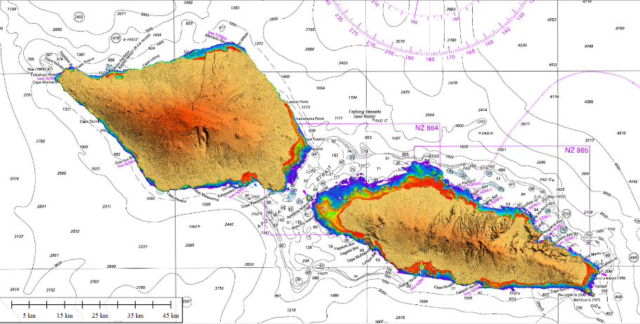
Samoan Survey – Entire Coverage (bathy and topo)

Slide 23
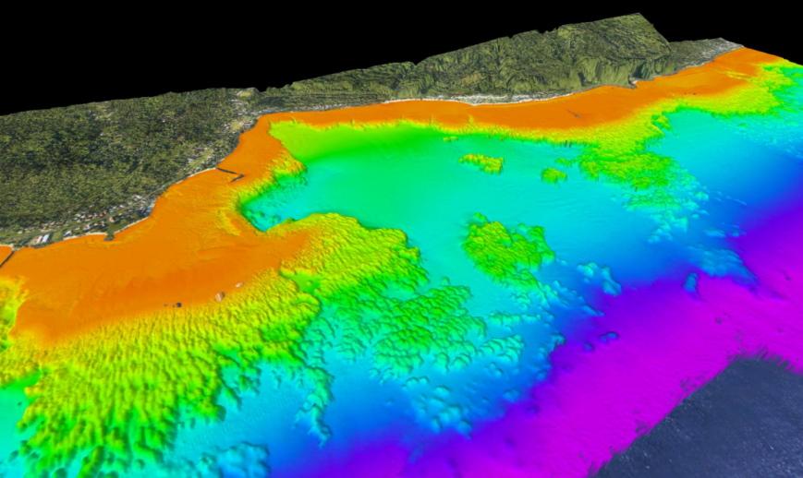
Samoan Survey – Coverage

Slide 24
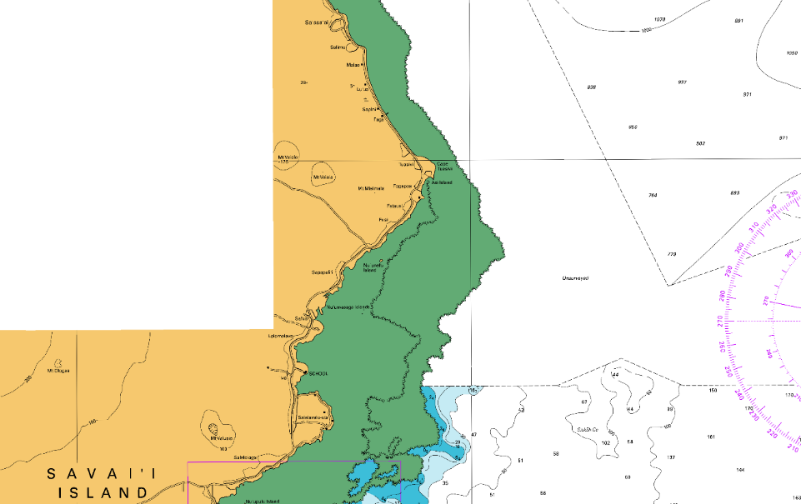
Samoan Survey – Coverage
Chart NZ 864
(Apolima Strait)
NOTE: Unsurveyed area North of Salelologa Harbour, Savai’i Island

Slide 25
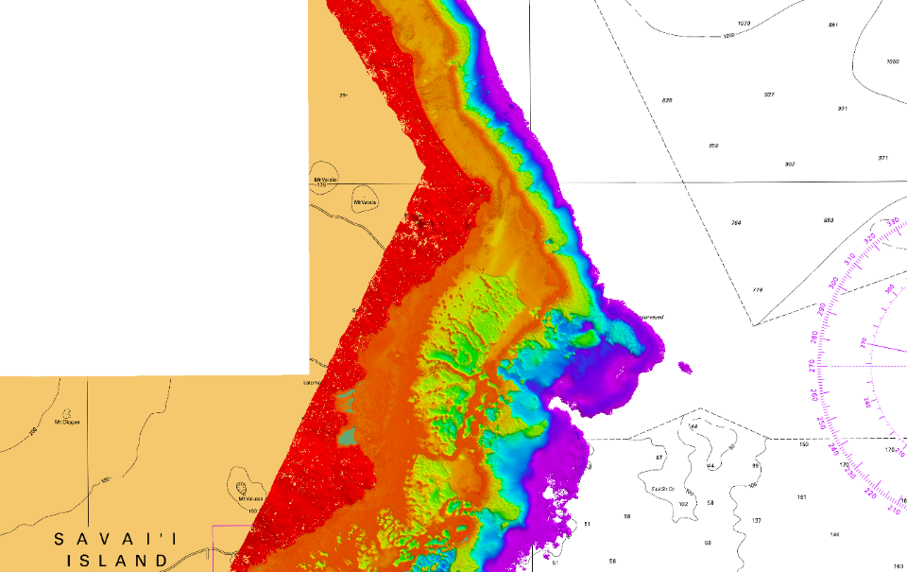
Samoan Survey – Coverage
Chart NZ 864
(Apolima Strait)
NOTE: Unsurveyed area North of Salelologa Harbour, Savai’i Island

Slide 26
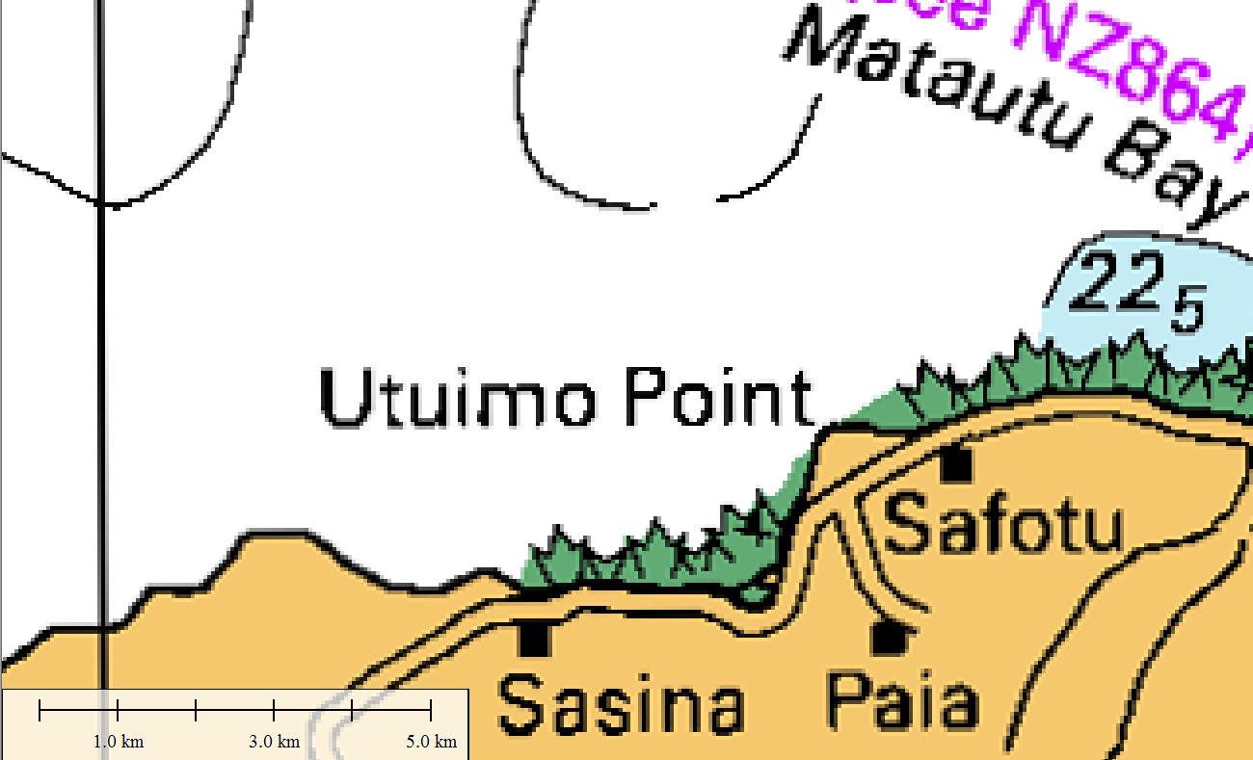
Samoan Survey – Coverage
Chart NZ 86 (Samoa)
Only chart for most of island
NOTE: Utuimo Point

Slide 27
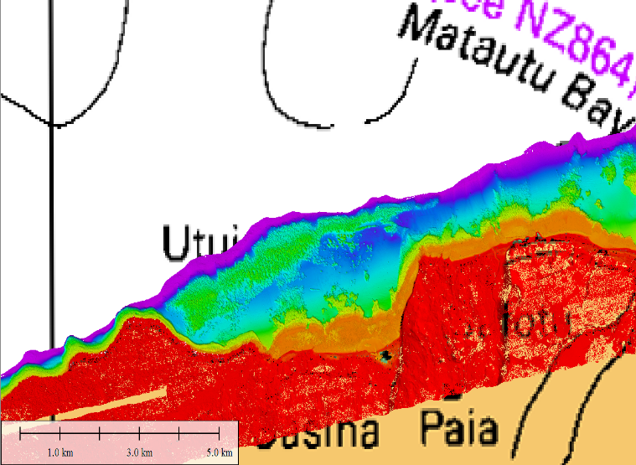
Samoan Survey – Coverage
Chart NZ 86 (Samoa)
Only chart for most of island
NOTE: Utuimo Point

Slide 28
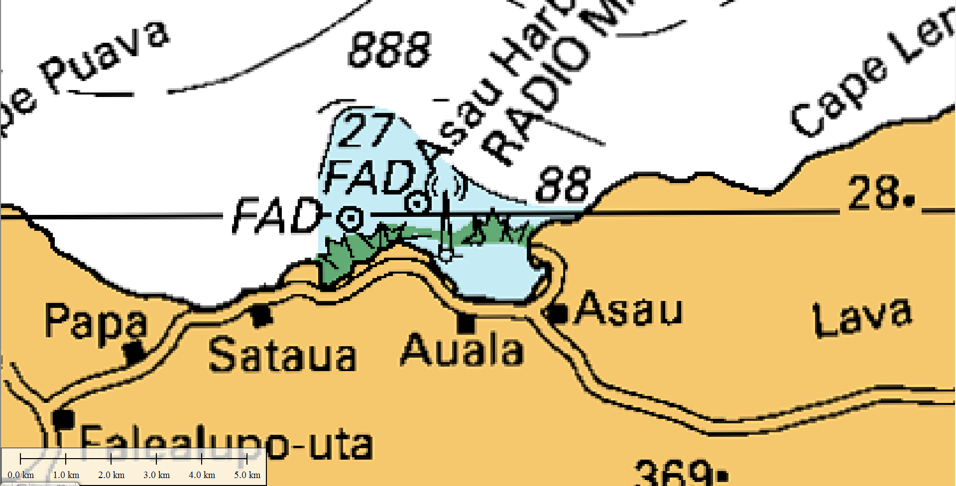
Samoan Survey – Coverage
Chart NZ 86 (Samoa)
Only chart for most of island
NOTE: Asau Harbour

Slide 29
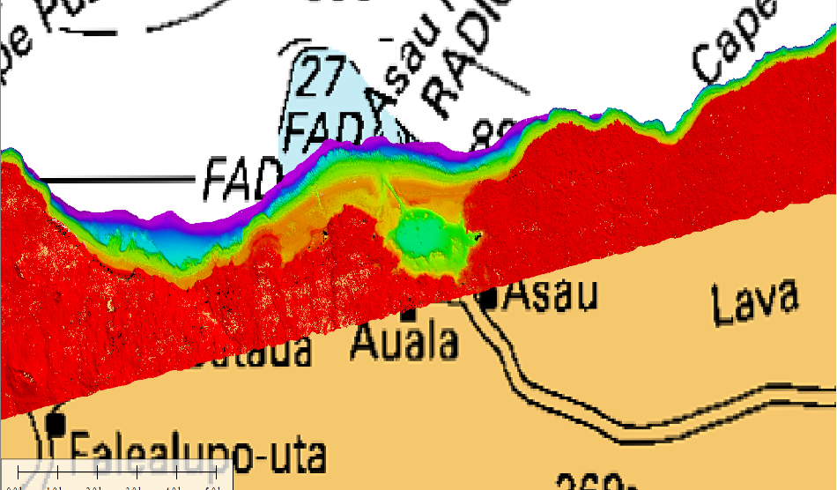
Samoan Survey – Coverage
Chart NZ 86 (Samoa)
Only chart for most of island
NOTE: Asau Harbour

Slide 30
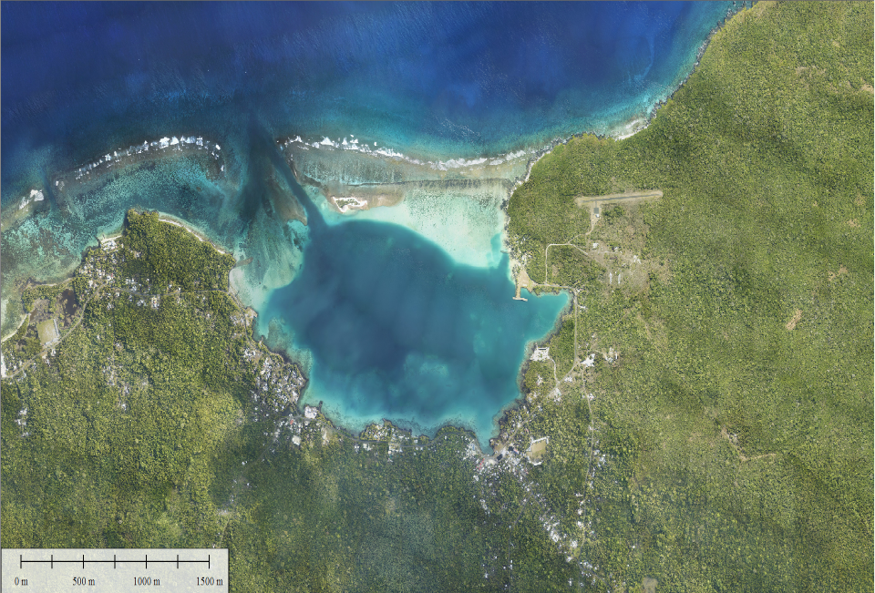
Samoan Survey – Coverage
Chart NZ 86 (Samoa)
Only chart for most of island
NOTE: Asau Harbour

Slide 31
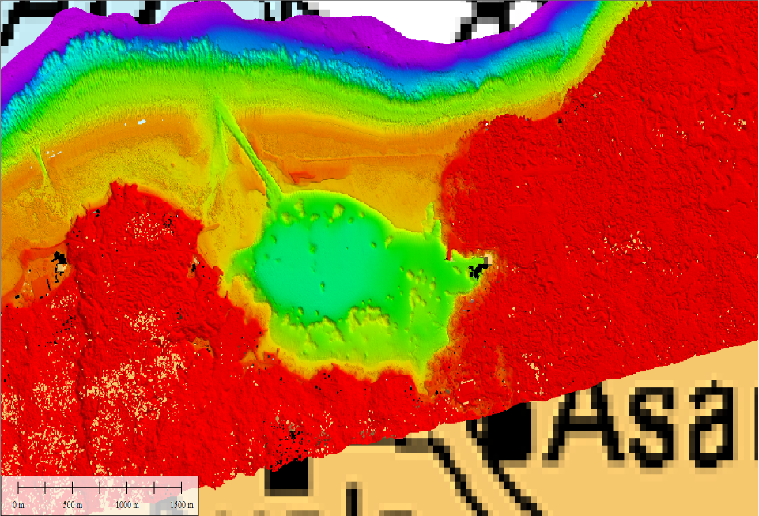
Samoan Survey – Coverage
Chart NZ 86 (Samoa)
Only chart for most of island
NOTE: Asau Harbour

Slide 32
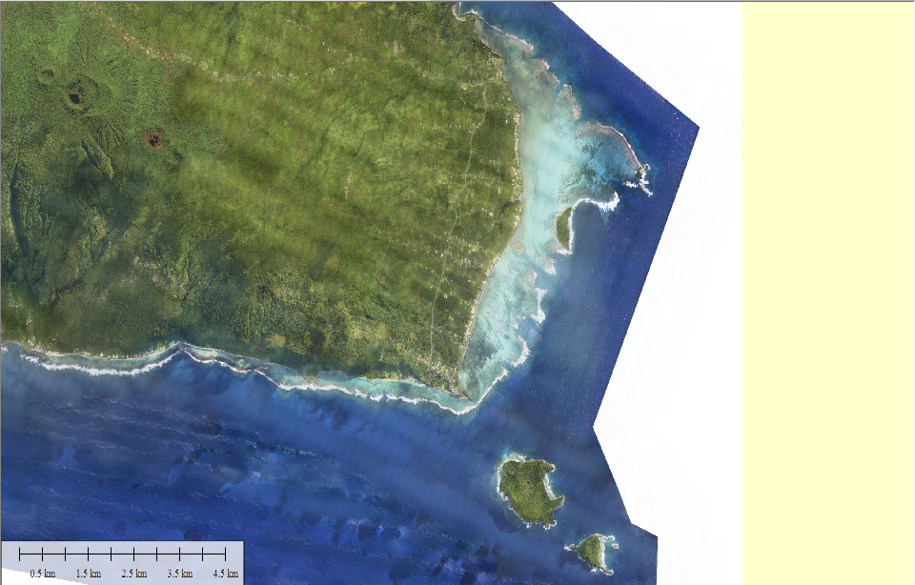
Samoan Survey – Coverage
South East Upolu Island, Samoa.

Slide 33
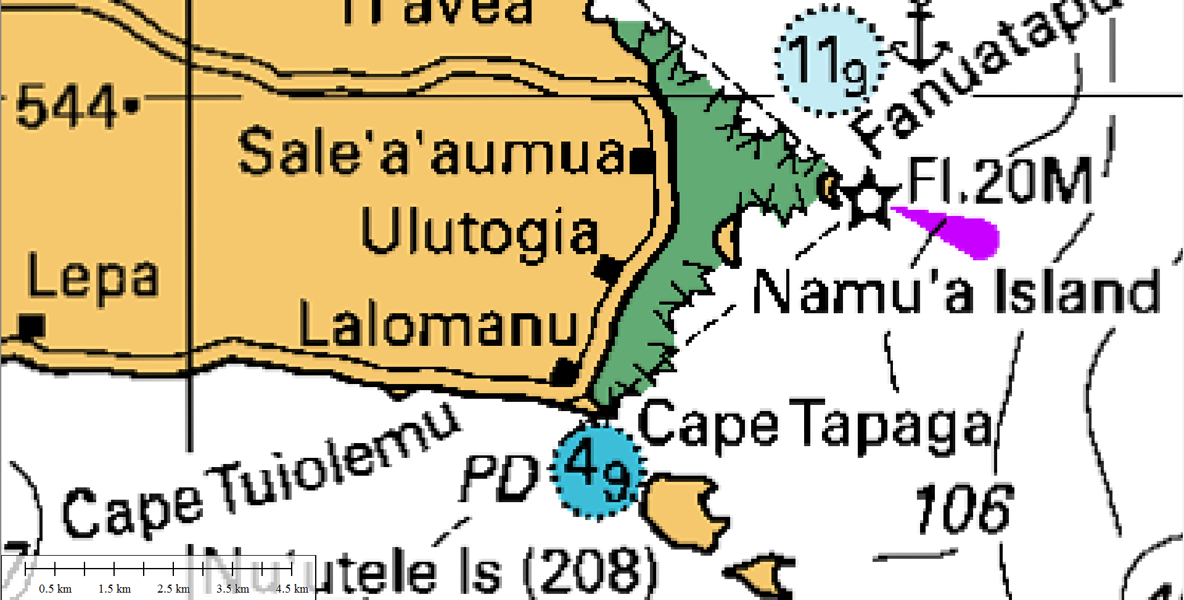
Samoan Survey – Coverage
South East Upolu Island, Samoa.
Chart NZ86

Slide 34
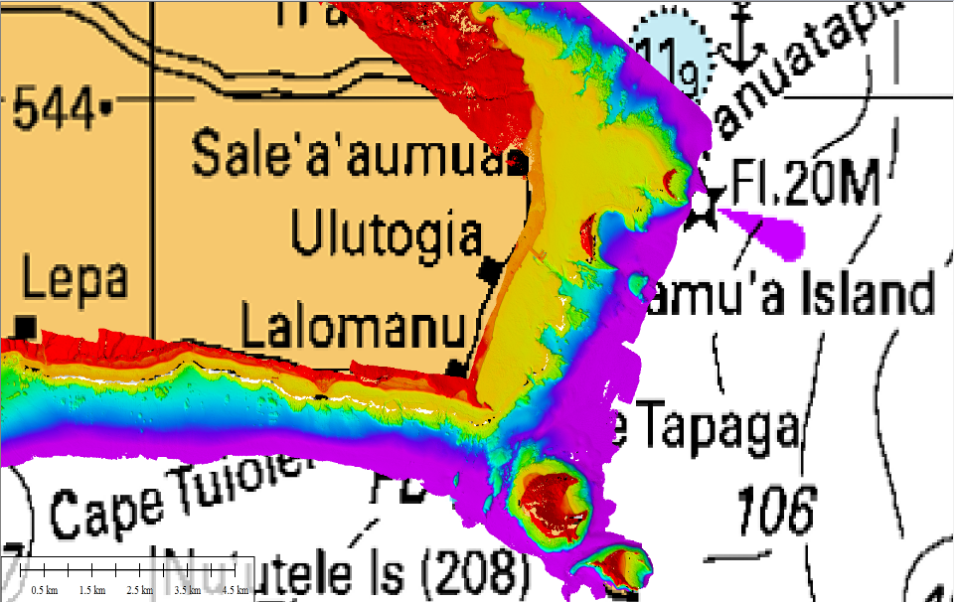
Samoan Survey – Coverage
South East Upolu Island, Samoa.
Chart NZ86

Slide 35
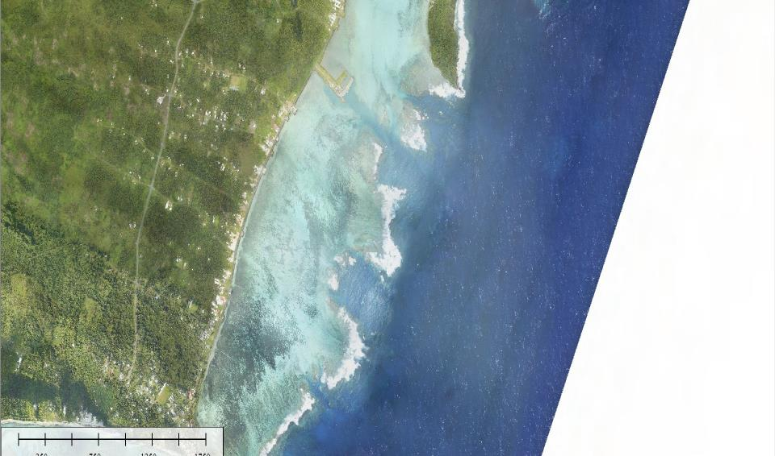
Samoan Survey – Coverage
South East Upolu Island, Samoa.
Chart NZ86

Slide 36
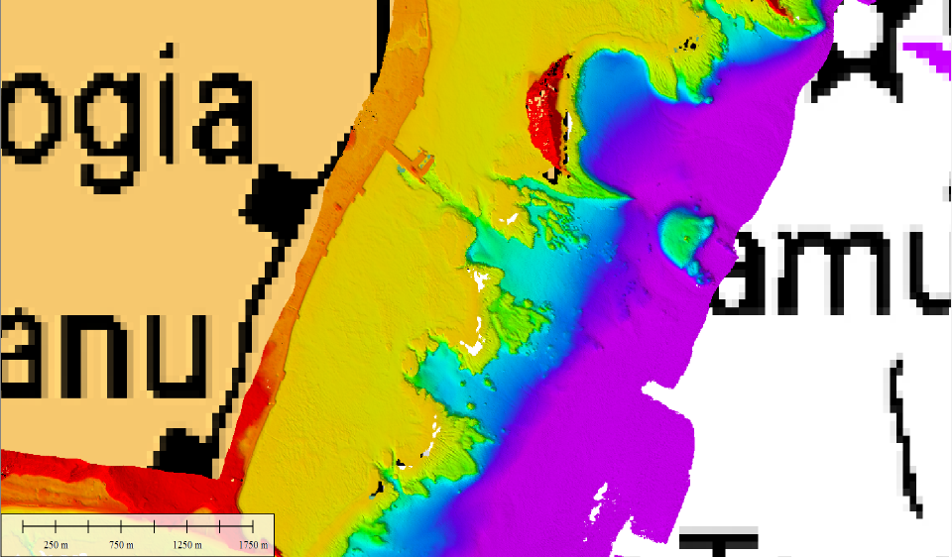
Samoan Survey – Coverage
South East Upolu Island, Samoa.
Chart NZ86

Slide 37
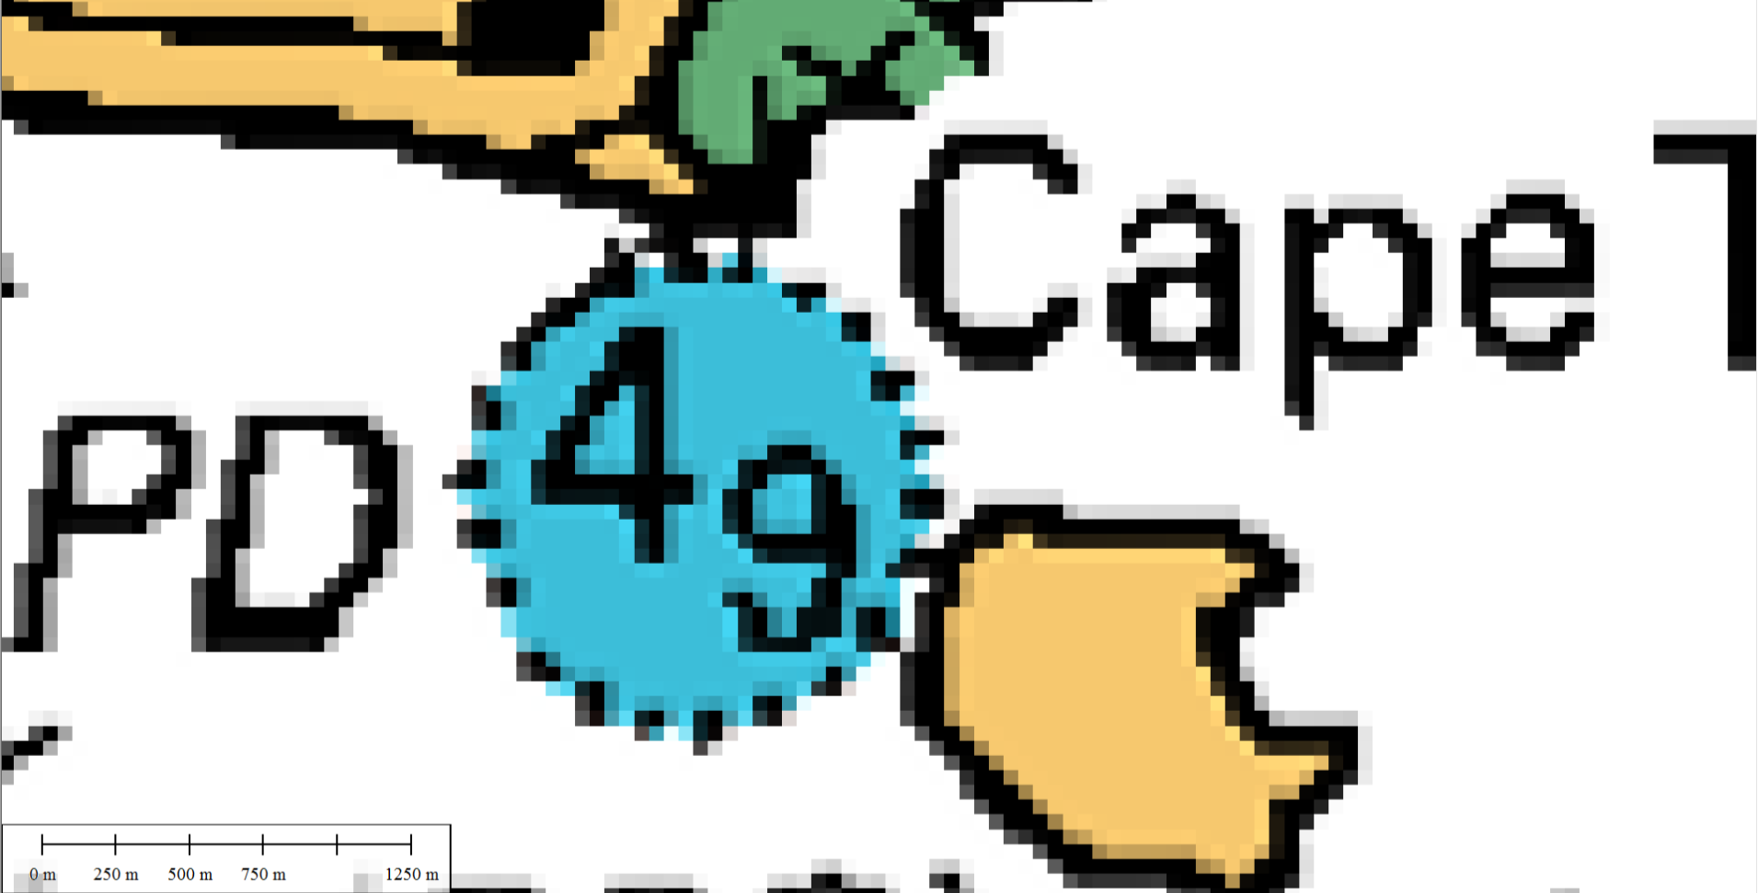
1. Samoa
South East Upolu Island, Samoa.
Chart NZ86

Slide 38
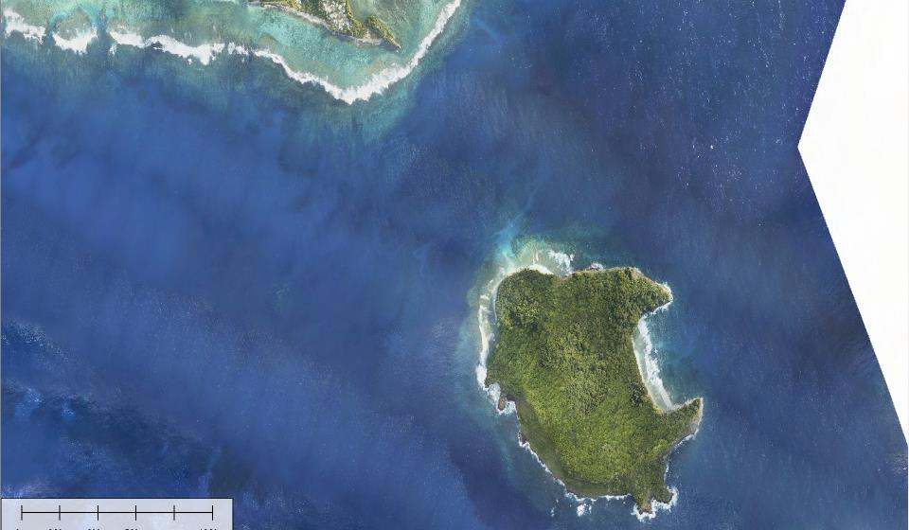
Samoan Survey – Coverage
South East Upolu Island, Samoa.
Chart NZ86

Slide 39
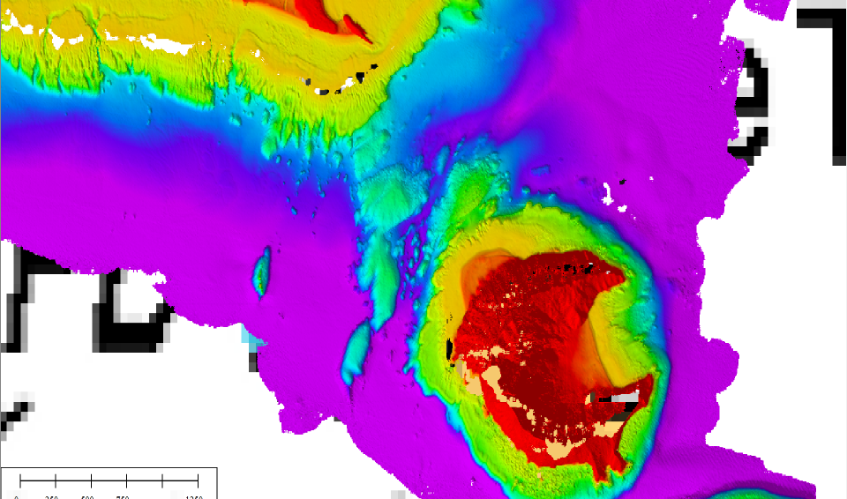
Samoan Survey – Coverage
South East Upolu Island, Samoa.
Chart NZ86

Slide 40
Thankyou
Questions?
Hugh Parker
Hydrographic Business Development Manager
Fugro LADS Corporation Pty. Ltd.
Email: h.parker@fugro.com

