Slide 1
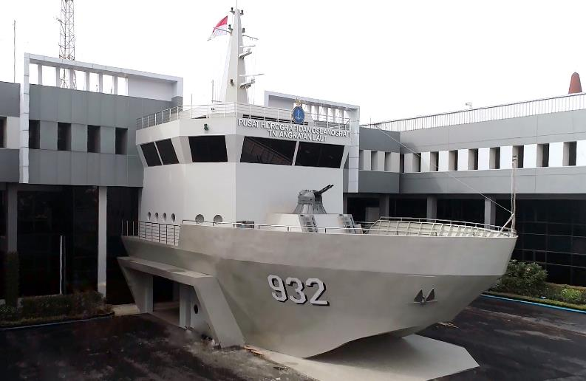
15th South West Pacific Hydrographic Commission Conference
THE INDONESIAN NAVY
HYDROGRAPHIC – OCEANOGRAPHIC CENTER
(PUSHIDROSAL)
1

Slide 2
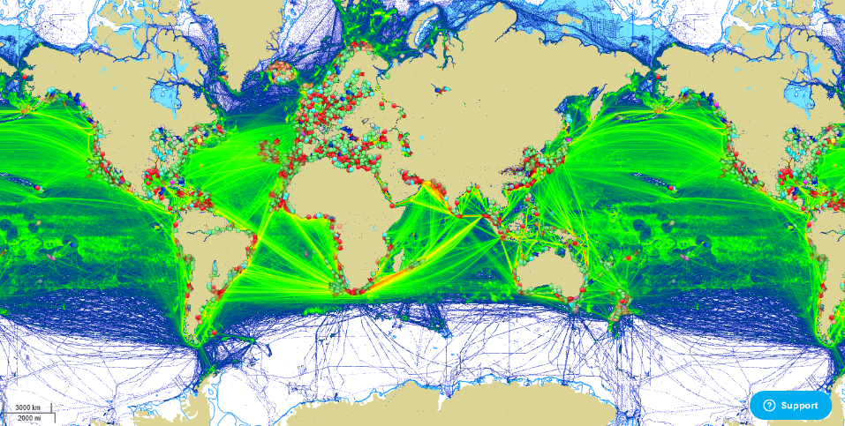
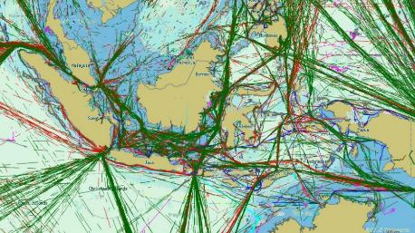
15TH SOUTH WEST PACIFIC HYDROGRAPHIC COMMISSION CONFERENCE
Source :www.marinetraffic.com
2

Slide 3
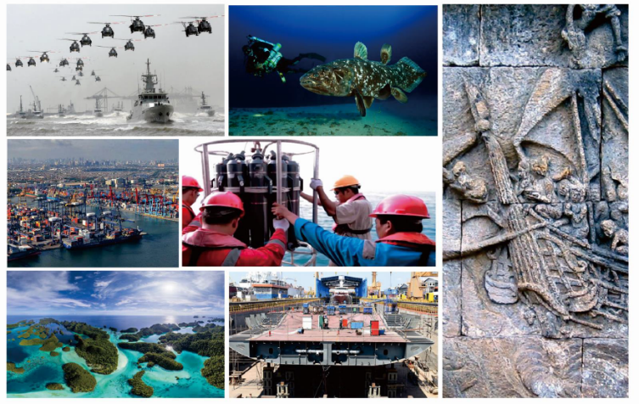
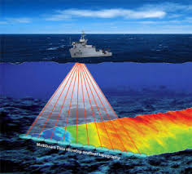
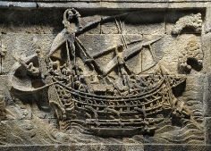
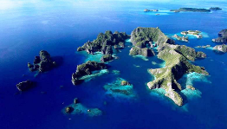
15TH SOUTH WEST PACIFIC HYDROGRAPHIC COMMISSION CONFERENCE
INDONESIAN MARITIME POLICY
GLOBAL MARITIME FULCRUM (GMF)
3

Slide 4
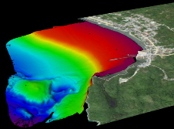
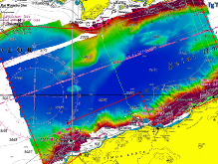
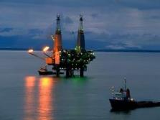
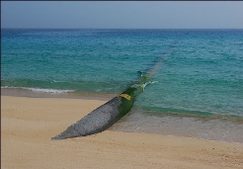
15TH SOUTH WEST PACIFIC HYDROGRAPHIC COMMISSION CONFERENCE
PRIMARY TASKS OF PUSHIDROSAL
(PRESIDENT REGULATION NO.10 / 2010 ON THE ORGANISATION OF INDONESIAN ARMED FORCES)
TO CONDUCT HYDROGRAPHY AND OCEANOGRAPHY ASSIGNMENT INCLUDING SURVEY, RESEARCH, NAUTICAL CHARTING AND NAUTICAL PUBLICATION, MARINE ENVIRONMENT AND SAFETY OF NAVIGATION FOR SUPPORT INDONESIAN ARMED FORCES AND PUBLIC SERVICE.
COURTESY OF KRI SPICA
COURTESY OF KRI RIGEL
4

Slide 5
15TH SOUTH WEST PACIFIC HYDROGRAPHIC COMMISSION CONFERENCE
PUSHIDROSAL
Pusat Hidrografi dan Oseanografi TNI Angkatan Laut (Pushidrosal) or The Indonesian Navy Hydrographic and Oceanographic Center is hydrographic and oceanographic organization under the Indonesian Navy Head Quarters.
MISSION
HYDROGRAPHY AND OCEANOGRAPHY CENTER (PUSHIDROSAL) or the Hydro-Oceanographic Office is an institution dealing with Hydrographic and Oceanographic affairs including survey and charting activities for the purpose of safety of navigation
The principle functions of the Hydrographic-Oceanographic Center ranges from surveys, researches, the publications of nautical charts, marine environment and safety of navigation, to support armed forces and public needs.
5

Slide 6
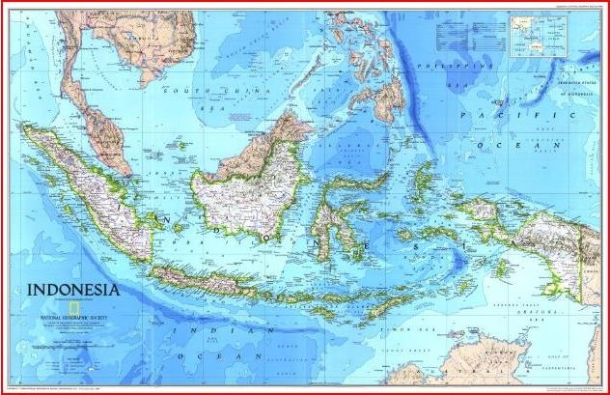
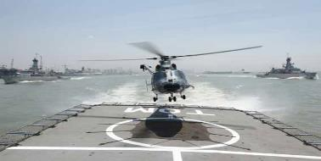
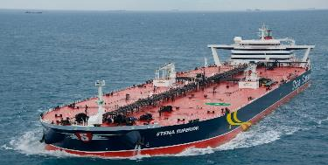
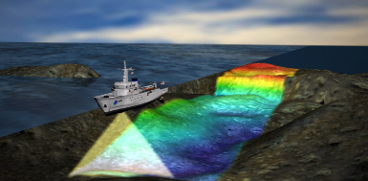
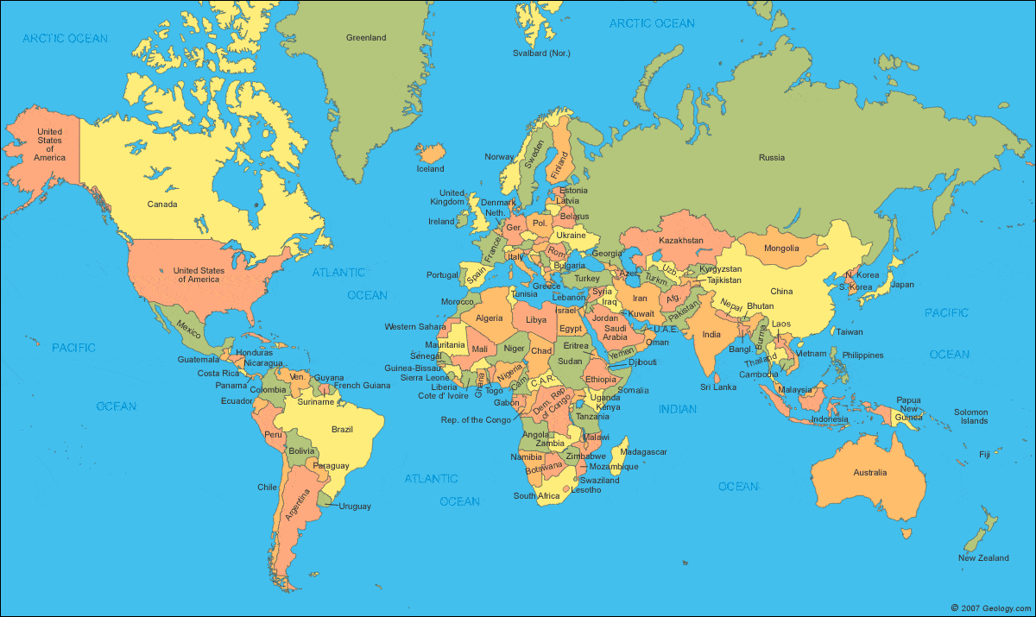
15TH SOUTH WEST PACIFIC HYDROGRAPHIC COMMISSION CONFERENCE
Role of Pushidrosal
MILITARY
PUBLIC SERVICES/ SAFETY OF NAVIGATION
MARINE ENVIRONMENT
INTERNATIONAL DIPLOMACY
6
6

Slide 7
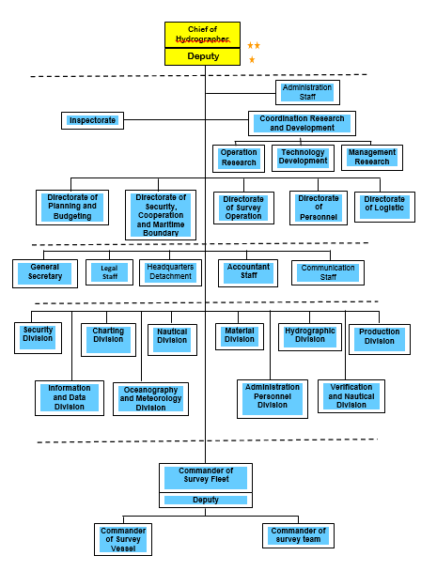
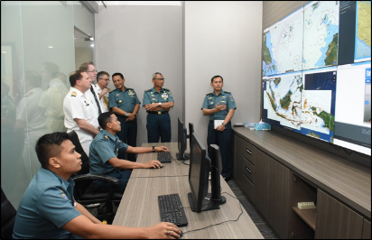
PUSHIDROSAL HAS 1.250 EMPLOYEES AND WILL INCREASE UNTIL 2.141 EMPLOYEES. THEY WERE CAME FROM VARIOUS BACKGROUND OF HYDRO-OCEANOGRAPHIC SCIENCE.
7

Slide 8
15TH SOUTH WEST PACIFIC HYDROGRAPHIC COMMISSION CONFERENCE
HUMAN RESOURCES
CENTER FOR HYDROGRAPHIC TRAINING
OFFICER COURSE (CAT B) : ACCREDITED BY IHO/FIG (24 WEEKS COURSE) – INTERNATIONAL COURSE
SEAMAN COURSE CAT ’C’ :
→ FOR SEAMAN/NON COMMISIONED OFFICER
(NATIONALLY ACCREDITED)
2. DEPARTMENT OF HYDROGRAPHIC ENGINEERING – NAVAL COLLEGE
BACHELOR DEGREE (NATIONALLY ACCREDITED) – 3 YEARS
NON-DEGREE : FOR SEAMAN/NCO - 3 YEARS
3. BANDUNG INSTITUTE OF TECHNOLOGY - Master Degree in Hydrographic Cat - A IHO
10

Slide 9
15TH SOUTH WEST PACIFIC HYDROGRAPHIC COMMISSION CONFERENCE
HYDROGRAPHIC SURVEYOR CAREER PLAN
Dean/Director:
Certificate of Program Completion
CHIEF OF HYDROGRAPHER:
CERTIFICATE OF FIELD PROFICIENCY
Cat B/Cat A
Professional
Association
International
Career
IHO Accredited
University/
Naval School
Continuing
Education
and
Professional
Development
Program
(CEPD)
Profession
Education
Obligatory
Experiences
Undergraduate/
Diploma
Oath of Profession,
Inauguration,
Registration
9

Slide 10
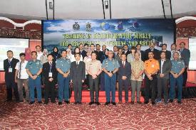
15TH SOUTH WEST PACIFIC HYDROGRAPHIC COMMISSION CONFERENCE
PARTICIPATING IN INTERNATIONAL COURSE
MCDA Training Course in UK
Oceanography Course in India
Hydrographic Course Cat – B Japan
Master of Science in USA
Long Hydrography Course in India
10th Course in Marine Cartography and Data Assessment (FIG-IHO-ICA-Cat B) in UK.
EAHC CB (Training/Workshop)
ENC Production;
Maritime Delimitation;
Seabed Classification;
Satellite Derived Bathymetry (SDB) and LIDAR;
Hydrographic Survey For Disaster Management and Relief;
Hydrographic Survey for Inundation Mapping;
Maritime Safety Information (MSI);
Hydrographic Training For Trainer (TFT);
Cat. B Marine Geospatial Information Programme;
Sea Bed Classification and Multi Beam Survey;
Digital Reference Tool for Cartographers
KRI PULAU ROTE-721
10
KRI PULAU ROMANG-723

Slide 11
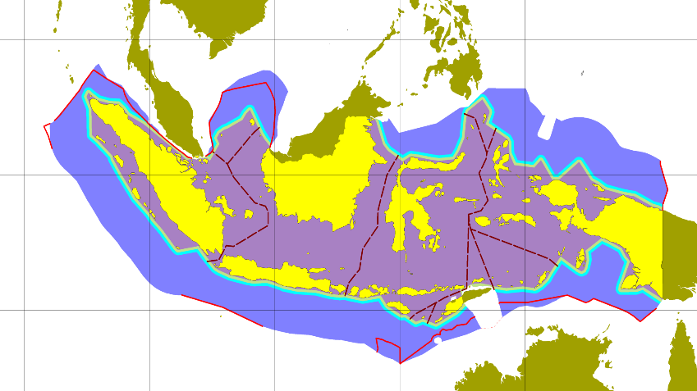
15TH SOUTH WEST PACIFIC HYDROGRAPHIC COMMISSION CONFERENCE
COVERED AREA OF RESPOSIBILITY
90° T
100° T
110° T
120° T
130° T
140° T
V I E T N A M
10°U
I N D I A
T H A I L A N D
L A U T C H I N A S E L A T A N
F I L I P I N A
P A L A U
S E L A T M A L A K A
M A L A Y S I A
L A U T S U L A W E S I
S A M U D E R A P A S I F I K
M A L A Y S I A
0°
K A L I M A N T A N
S U M A T E R A
ALKI I
SULAWESI
ALKI II
S A M U D E R A H I N D I A
L A U T J A W A
ALKI III
P N G
LEGENDA :
J A W A
L A U T A R U
R D T L
10°S
Archipelagic and internal water
Territorial water (12 Nm)
Continuous Zone(24 Nm)
ZEE (200 Nm)
Continental Shelf
Indonesian ASL
THE CHARTING RESPONSIBILITY COVERS : ± 5,8 MILLION KM² (± 1,7 MILLION NM²)
A U S T R A L I A
By: PUSHIDROSAL - 2011
11
Notes:
AS THE INDONESIAN GOVERNMENT AUTHORITATIVE HYDROGRAPHIC OFFICE, THE CHARTING RESPONSIBILITY COVERS THE ENTIRE WATERS, NOT ONLY INTERNAL WATERS AND TERRITORIAL WATER, BUT ALSO TO COVER OUR EEZ AND CONTINENTAL SHELF. WE HAVE TO CHART AROUND 5,8 MILLION KM SQUARE WITH 538 NAUTICAL CHART AND ENCS.

Slide 12
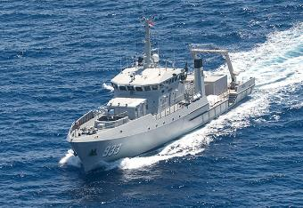
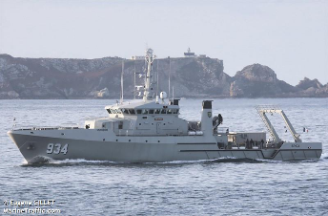
15TH SOUTH WEST PACIFIC HYDROGRAPHIC COMMISSION CONFERENCE
2 HYDROGRAPHIC SURVEY VESSELS 2015
(Total 9 Survey Vessel)
MULTIBEAM SHALOW & DEEP ( 6000 meter)
ROV (ECA HYTEC ROBOTIC) (1000 meter)
AUV (KONGSBERG HUGIN 1000)
CTD s.d 6000 meter
SUB BOTTOM PROFILE (7000 meter)
MAGNETOMETER (1000 meter)
CORING ( 2000 meter )
AQUACOM (for Divers)
ADCP DEEP SEA
MARINE METEOROLOGY VAISALA
PROCESSING 3D SEABED
12

Slide 13
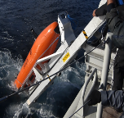
15th South West Pacific Hydrographic Commission Conference
RIGEL-CLASS
2 Radar Furuno FAR 2117
Seapath 330
For Heading
AWS
VAISALA
GPS Sea Star
ECDIS TRANSAS
INMARSAT
Gantry
5 Ton
Crane 50 Tm
METRALIUR
Manroy
12,7 mm
20 mm (Reutech)
Fixed boom
Workstation
SIS, MRU-5
Sbg Motion Sensor
USBL (Kons)
HIPAP 501
SBES & MBES
EA600 (D)(SB), EM302(D) & EM2040(S)
SSS
500m, ø 10,1mm
AUV HUGIN 1000
ADCP Teledyne
SVS + T
SBP SES 2000
deep36
Magneto
300m, ø 10,1mm
ROV
GRAVITY CORER
2000 m
CTD &
Bottle
Nansen
Grab Sampler
13

Slide 14
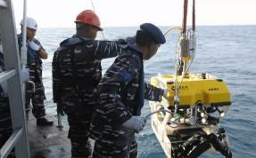
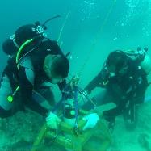
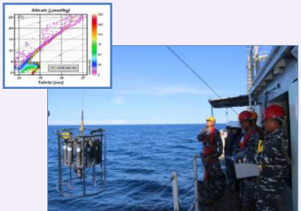
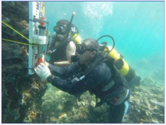
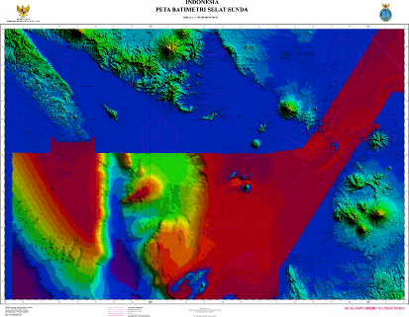
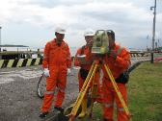
15TH SOUTH WEST PACIFIC HYDROGRAPHIC COMMISSION CONFERENCE
SURVEY ACTIVITIES
Conducting Hydrographic Oceanographic Survey
± 40 area annually (covering > 60.000 km²)
Update > 50 % of IDN water in 2017
Priority : (Channel; Ports; Archipelagic
Sea Lanes; Busiest water/Straits)
CATZOC C - D area
14

Slide 15
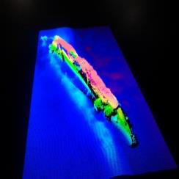
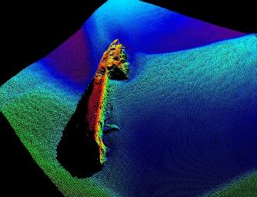
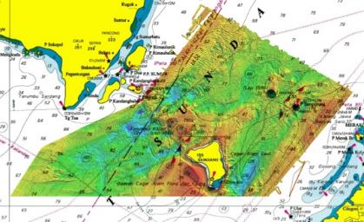
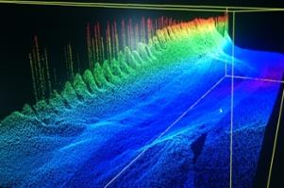
15TH SOUTH WEST PACIFIC HYDROGRAPHIC COMMISSION CONFERENCE
SOFTWARE DATA PROCESSING
CARIS GIS
CARIS HIPS/SIPS
CARIS BATHY DATA BASE
CARIS HOM
CARIS S57 COMPOSER
CARIS HYDROGRAPHIC PRODUCTION DATABASE (HPD)
SEVENCS ENC TOOLS
D’KART INSPECTOR
CARIS : COMPUTER AIDED RESOURCE INFORMATION SYTEM
15

Slide 16
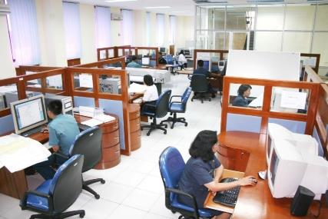
15TH SOUTH WEST PACIFIC HYDROGRAPHIC COMMISSION CONFERENCE
PAPER CHART AND ENC PRODUCTION
Software
Caris Hydrographic Production
Database
Caris S57 Composer
Caris Paper Chart Composer
Seven Cs ENC Tools
D’Kart Inspector
ECS Orca Master
ECDIS MARIS
Production
20 Cartographers on Paper Chart
150 Numbers of Paper Charts (Reprints and New Editions)
10 Cartographers on ENC
50 Cells annually (New Cells and New Editions)
16

Slide 17
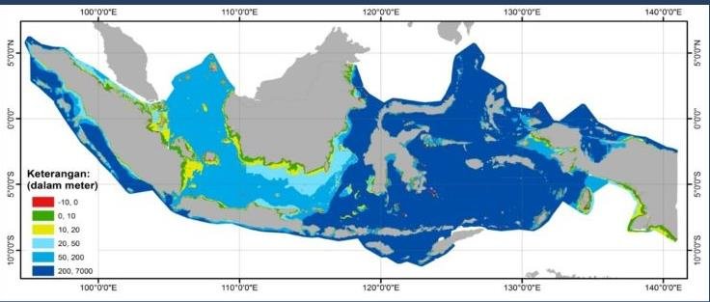
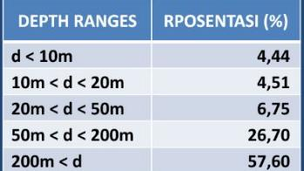
15TH SOUTH WEST PACIFIC HYDROGRAPHIC COMMISSION CONFERENCE
VARIOUS DEPTH IN INDONESIA WATER
17
Notes:
TO SUPPORT BOTH SHIPS AND SURVEY DETACHMENT UNITS, WE HAVE HYDROGRAPHIC, OCEANOGRAPHIC AND METEOROLOGY EQUIPMENTS

Slide 18
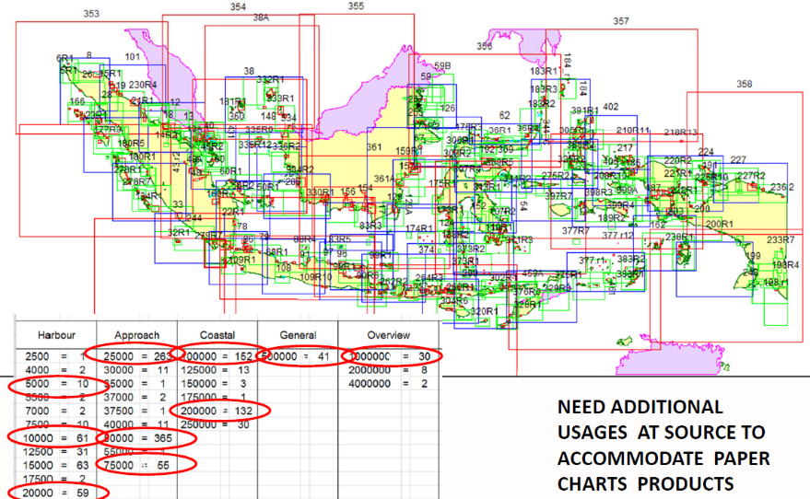
15TH SOUTH WEST PACIFIC HYDROGRAPHIC COMMISSION CONFERENCE
PAPERS CHART DEC 2017
538 PC
18
Notes:
UP TO NOW, PUSHIDROSAL HAD PRODUCTED 538 NUMBER OF PAPER CHRAST WITH VARIUS SCALES .

Slide 19
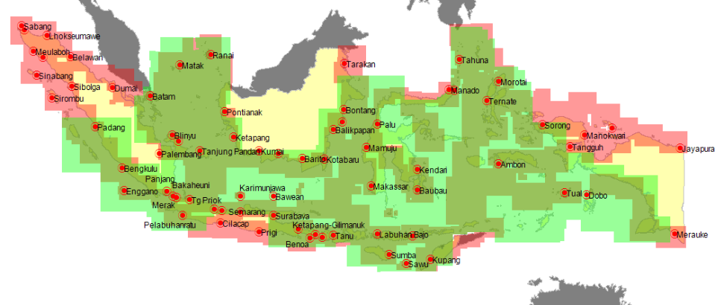
15TH SOUTH WEST PACIFIC HYDROGRAPHIC COMMISSION CONFERENCE
ENC COVERAGE 506 cells
GENERAL , COASTAL,
dan > 100 Major Ports
Band | Cells
Overview | 8
General | 45
Coastal | 172
Approach | 160
Harbour | 97
Berthing | 4
19

Slide 20
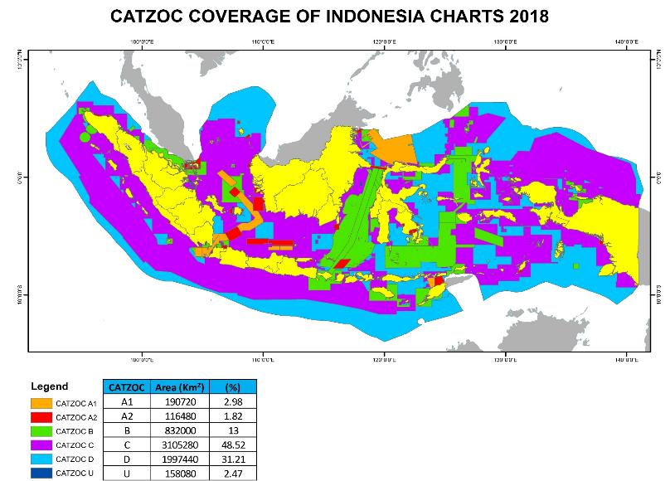
15TH SOUTH WEST PACIFIC HYDROGRAPHIC COMMISSION CONFERENCE
20
21-23 February 2018
NADI FIJI

Slide 21
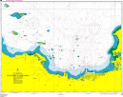
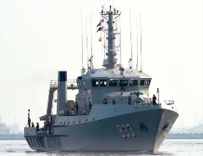
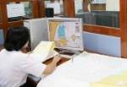
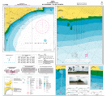
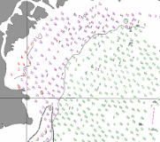
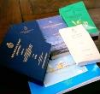
15TH SOUTH WEST PACIFIC HYDROGRAPHIC COMMISSION CONFERENCE
DATA PROCESSING
Papper
Chart
ENC
Military
Chart
DATABASE
Nautical Publication
DATA ENTRY
COLLECTION
CHARTING PROCESS
CHART PRODUCTION
21

Slide 22
15TH SOUTH WEST PACIFIC HYDROGRAPHIC COMMISSION CONFERENCE
INDONESIAN’S CHART DISTRIBUTOR :
UKHO
Primar – Norwegian Hydrographic Service
C – MAP Italia
JHA (MSS ENC) – Marine Electronic Highway
Conducting Joint Hydrographic Survey in Malacca Singapore Strait
22

Slide 23
15TH SOUTH WEST PACIFIC HYDROGRAPHIC COMMISSION CONFERENCE
of
Production
CHARTS
PUBLIC SERVICES
NAUTICAL CHARTS : 538 NUMBERS
ENC : 506 CELL
THEMATIC MAPS : 225 NUMBERS
BATHYMETRIC CHARTS : 33 NUMBERS
MAGHNETIC CHARTS : 29 NUMBERS
ECONOMIC EXCLUSIVE ZONE CHARTS : 17 NUMBERS
BASE POINTS CHARTS : 65 NUMBERS
GENERAL BATHYMETRIC CHART OF THE OCEAN (GEBCO) : 16 NUMBERS
NATIONAL MARINE ENVIROMENT MAPS : 44 NUMBERS
INDONESIAN COASTAL ENVIROMENT MAPS : COVERING 10 PROVINCES
23

Slide 24
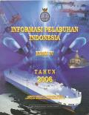
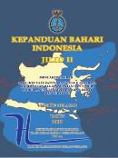
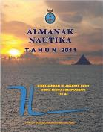
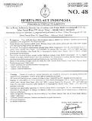
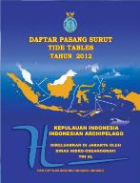
15TH SOUTH WEST PACIFIC HYDROGRAPHIC COMMISSION CONFERENCE
Nautical
PUBLICATION
NOTICES TO MARINERS:
NAUTICAL ALMANAC:
TIDE TABLES :
TIDAL STREAM TABLES :
SURFACE CURRENT CHART :
LIST OF LIGHTS :
PORT INFORMATION :
SAILING DIRECTIONS :
MARINE ENVIRONMENT INFORMATION:
MINE AREAS TABLES:
WRECK LIST :
RADIO NAVIGATIONAL WARNINGS:
INDONESIAN WATERS WEATHER CHARTS :
TRACK AND DISTANCE BOOK:
weekly
annual
annual
annual
every 5 years
annual
annual
annual
annual
annual
annual
annual
annual
annual
24

Slide 25
15TH SOUTH WEST PACIFIC HYDROGRAPHIC COMMISSION CONFERENCE
DEVELOPMENT INDONESIAN MARINE GEOSPATIAL INFORMATION CENTER (IMGIC) AS IMPLEMENTATION OF MSDI
I
M
G
I
C
P
O
R T A L
INDONESIAN ARMFORCES
INDONESIAN NAVY
GEOSPATIAL INTELEGENT
SAFETY OF NAVIGATION
MARINE ENVIRONMENT PROTECTION
INTEGRETED COASTAL ZONE MANAGEMENT
MARINE RESOURSES EXPLORATION AND EXPLOITATION
MARITIME BOUNDARY DELIMITATION
MARINE RESEARCH
PUBLIC SERVICES
25

Slide 26
15TH SOUTH WEST PACIFIC HYDROGRAPHIC COMMISSION CONFERENCE
INDONESIAN MARINE GEOSPATIAL INFORMATION CENTER (IMGIC)
http://hdc.dishidros.tnial.go.id
26

Slide 27
15TH SOUTH WEST PACIFIC HYDROGRAPHIC COMMISSION CONFERENCE
IMGIC CONTRIBUTION
PUSHIDROSAL
MILITARY PURPOSE
PUBLIC SERVICE
NSDI
BACK UP
HDC-MSDI
27

Slide 28
15TH SOUTH WEST PACIFIC HYDROGRAPHIC COMMISSION CONFERENCE
EAST ASIA HYDROGRAPHIC COMMISSION
1999 – 2000 Chairman of EAHC
EAHC TRAINING ACTIVITIES IN INDONESIA
Training in ENC Production – 2010
Training in Maritime Delimitation -2014
Training in Seabed Classification – 2015
Training in Hydrographic Survey For Disaster Management and Relief 2017
Pushidrosal also become member state of East Asia Hydrogphic Commission (EAHC) and an active as Republic of Indonesia delegation on the several international organization such as International Maritime Organization (IMO), Inter-Government Oceanographic Commission (IOC), United Nations Conference on Standardization of Geographical Names (UNCSGN) and United Nations Group of Experts on Geographical Names (UNGEGN).
28

Slide 29
15TH SOUTH WEST PACIFIC HYDROGRAPHIC COMMISSION CONFERENCE
NORTH INDIAN OCEAN HYDOGRAPHIC COMMISSION
(NIOHC)
PUSHIDROSAL ATTENDED THE 17TH NORTH INDIAN OCEAN HYDROGRAPHIC COMMISSION MEETING, CAIRO EGYPT, 17 – 20 JULY 2017.
APPROVAL FROM NIOHC MEMBERS AS FULL MEMBER OF NIOHC
29

Slide 30
15TH SOUTH WEST PACIFIC HYDROGRAPHIC COMMISSION CONFERENCE
REQUEST PARTICIPATE AT SWPHC AS A MEMBER
The geographic position of Indonesia, our maritime jurisdiction which span to the Australian Water in Arafuru Sea and Indian Ocean. The Indonesian territory stretches along nearly 6.100 Nm from West Java to Southern Papua (Merauke) And also span to Palau water in the Pacific Ocean.
Harmonizing ENC Product
Hydrography capacity building.
30

Slide 31
WORLD NAVAREA
3

Slide 32
PROPOSED FOR PERMANENT MEMBER OF SWPHC.
SHARING INFORMASI & TECH
REGIONAL ENC & MSDI (HARMONIZATION OF ENC)
EXCHANGE EXPERT
4

Slide 33
15TH SOUTH WEST PACIFIC HYDROGRAPHIC COMMISSION CONFERENCE
Thank YOU
Terimakasih
JL. PANTAI KUTA V/1 ANCOL TIMUR
JAKARTA UTARA 14430
Phone. (62) (21) 64714810,64714819 Fax : (62) (21) 64714809, 64714819
Website: www.dishidros.go.id
e-mail : infohid@pushidrosal.id

