Slide 1
IRCC10 INTRODUCTION
IRCC work is guided by the IHO Work Programme 3
“Inter-Regional Coordination and Support” and by the Council Key Priorities.
*IRCC10 was held in Goa, India, from 4 to 6 June 2019, hosted by the Indian National Hydrographic Office.
*The meeting was attended by the Chairs, or their representatives, of the 15 Regional Hydrographic Commissions (RHCs) and the IRCC subordinate bodies and 27 observers .
*Chaired by Dr Parry Oei (Singapore).

Slide 2
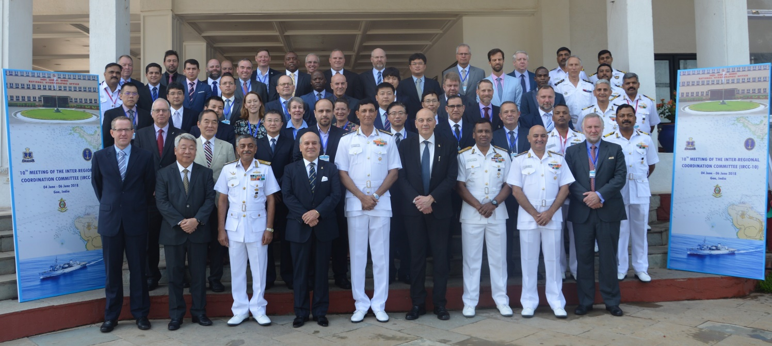
IRCC10 PARTICIPANTS:

Slide 3
IRCC10 OUTCOMES- General:
*IRCC10 reviewed the reports and activities of its subordinate bodies and the RHCs and considered the need for enhancing regional coordination and cooperation.
*IRCC10 also considered the outcomes of the 1st meeting of the IHO Council (C-1), acknowledged the accomplishments and challenges of the Capacity Building programme and IBSC activities, examined the developments on Crowd-Sourced Bathymetry (CSB) and ocean mapping activities and considered issues related to the Worldwide ENC Database (WEND).

Slide 4
IRCC10 OUTCOMES
*IRCC10 considered and agreed on the revision of IHO Resolution 2/1997 as amended (Establishment of Regional Hydrographic Commissions - RHC).

Slide 5
IRCC10 OUTCOMES - Capacity Building
*The meeting was informed of the achievements of the Capacity Building Programme and acknowledged the generous financial support from the Republic of Korea and from the Nippon Foundation of Japan, the in-kind support from Member States and industry stakeholders and the work of the RHC CB Coordinators and Project Leaders in these achievements.

Slide 6
IRCC10 OUTCOMES- WEND
*IRCC10 reviewed progress towards the full implementation of the WEND Principles and noted with concern that overlapping ENCs create confusion onboard ships and that the IHO community should strive to eliminate overlapping data.
*IRCC10 endorsed the proposal that the management of overlap cases should be addressed by RHCs.

Slide 7
IRCC10 OUTCOMES- CSB
*IRCC10 endorsed the final draft version of the B-12 Guideline (IHO Guideline on Crowd-sourced Bathymetry, Edition 1.0.0) prior to final approval by the Council and Member States.
*IRCC10 approved the proposed revisions to the CSBWG ToRs and RoPs and tasked the WG to continue its work under the proposed revised ToRs in order to safeguard the implementation phase and future work on Edition 2 of the Guidelines.

Slide 8
IRCC10 OUTCOMES- MSDI
*IRCC10 reviewed the progress on global Marine Spatial Data Infrastructure (MSDI) activities and considered the development in Marine Spatial Planning (MSP) implementation worldwide.
*IRCC10 established the IHO Project Team on the implementation of the UN-GGIM Shared Guiding Principles for Geospatial Information Management (PPT) and endorsed the ToRs and RoPs of the PPT.

Slide 9
IRCC10 - SWPHC REPORT
*Chair SWPHC presented report outlining:
Meeting held in Nadi , Fiji - Feb 18,
CB activities achieved/completed and planned,
Update on CME, PRNI activities,
Membership update: Vanuatu - full member, Indonesia - associate member
*IRCC10 noted the value and effectiveness of preceding SWPHC meetings with CB related workshops.
*IRCC10 noted SWPHC’s commitment in carrying forward hydrographic, nautical cartographic and capacity building activities in close alignment with IHO objectives and goals.

Slide 10
IRCC10 OUTCOMES- Key Priorities
*IRCC considered and agreed its key priorities for 2019:
Capacity Building Provision,
INT chart and ENC schemes,
Crowd Sourced Bathymetry,
Project Seabed 2030,
Marine Spatial Data Infrastructures.

Slide 11
IRCC10 OUTCOMES- Next Meeting
*11th meeting of the IRCC will take place in Genoa, Italy, from 3 to 5 June 2019, hosted by the Italian Hydrographic Institute
*The 12th meeting is planned to be held in Poland (in 2020).

