Slide 1
16th Meeting of the
South West Pacific
Hydrographic Commission
UK National Report
Submitted by the United Kingdom of Great Britain and Northern Ireland

Slide 2
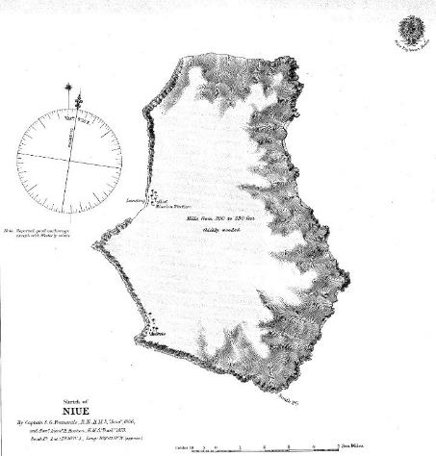
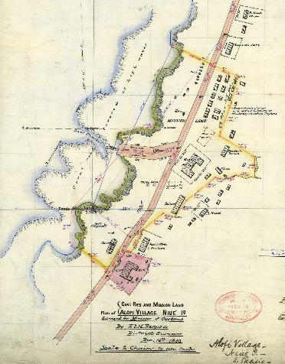
Niue and Alofi
Niue Island
1866-1873
Alofi Village
16th Dec 1903

Slide 3
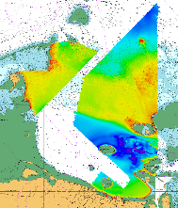
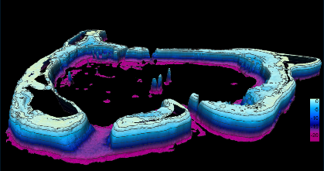
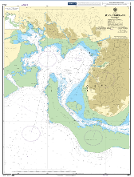
Main achievements during the year
Tonga – Survey of critical areas in approaches to Nuku’alofa
Tuvalu – Geodetic Survey and installation of tide gauges
Tuvalu – SDB survey of entire island chain
Fiji – Digitisation of 10 national charts into S-57 format data
World Hydrography Day - Trinity House London

Slide 4
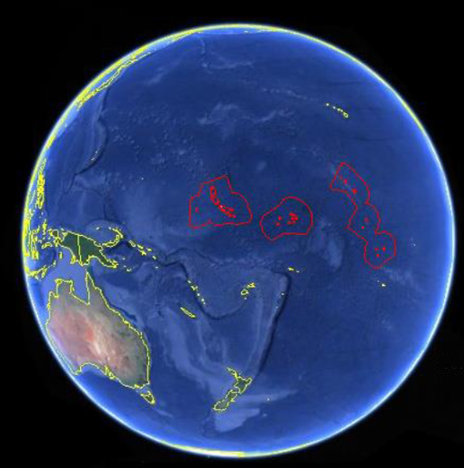
Main challenges and/or obstructions
Mobilisation of equipment
Logistics
Remote locations
Limited Face to Face opportunities
Utilising funding within time frames,
Limited availability of resource/trainers.
Notes:
Image shows Kiribati island chain
Survey work currently underway

Slide 5
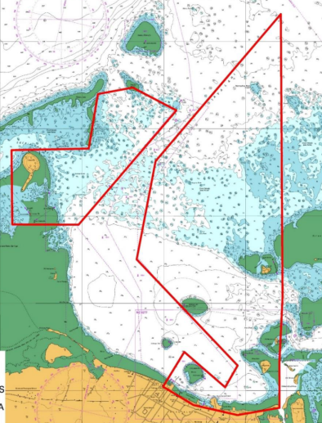
Progress on surveys, charting and MSI
Tonga
Multi Beam Echo Sounder Survey completed in approaches to Nuku’Alofa
Notes:
MBES Survey completed in approaches to Nuku’Alofa with CME Programme Funding
Images show intended capture area and actual capture area
Data passed to LINZ as PCA for Charting Action
Data handover workshop planned for early 2019

Slide 6
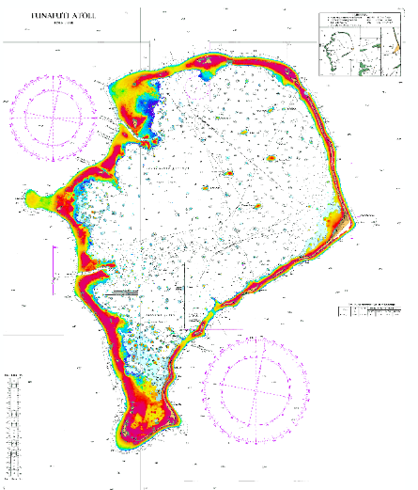
Progress on surveys, charting and MSI
Tuvalu
Satellite Derived Bathymetry Survey of entire island chain
Notes:
In partnership with SPC and Tuvalu government officials
Geodetic survey
Installation of tide Gauges in outer islands to establish vertical control
Production of special purpose EEZ/Fisheries chart

Slide 7
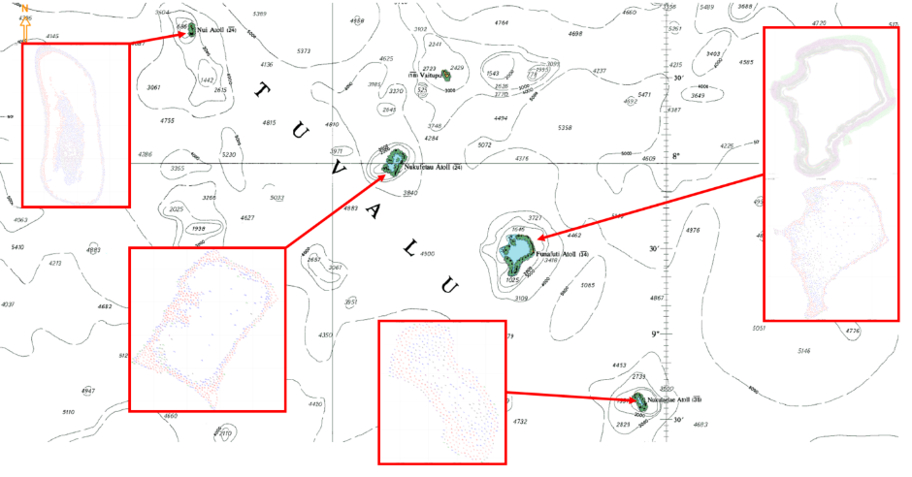
Progress on surveys, charting and MSI

Slide 8
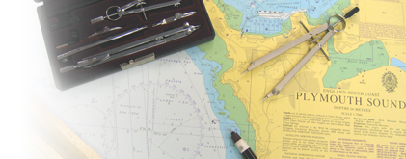
Progress on surveys, charting and MSI
Charting Activity
  19 New Editions of Australian charts
  12 New Editions of New Zealand charts
  8 New Editions in region, inc 6 INT charts
  Digitising of 10 Fiji large scale plan charts into S-57 data
MSI
  UK Continues to act as PCA for Fiji, Kiribati, Nauru, Tuvalu and Vanuatu
Notes:
The paper chart listing for the SWPHC region is in the main UK National Report which has been circulated to delegates prior to this presentation.
We have produced 39 SNCs in the region during the past year.
Some of this charting activity has resulted from the increased survey activity that we have been involved in in recent months.
Even though we are experiencing an ever accelerating shift to digital navigation, paper charts will continue to play an important role in navigation for years to come.
UKHO remains committed to the production of paper charts on a global basis in the future.
This raises the challenge for all of us with the future of the paper chart, which is the content of a later slide.

Slide 9
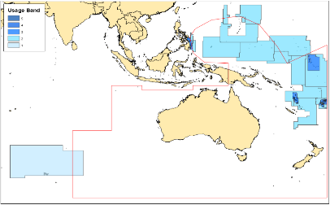
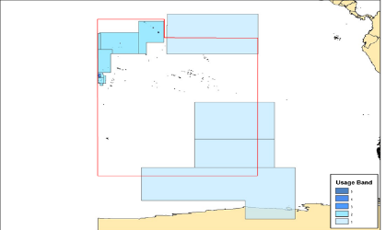
Progress on surveys, charting and MSI
ENC Activity
    5 Usage Band 1
    23 Usage Band 2
    24 Usage Band 3
    31 Usage Band 4
    24 Usage Band 5
    107
    New Editions
    5
    New Cells
    1 Usage Band 3
    2 Usage Band 4
    2 Usage Band 5
GB ENCs West of 180°
GB ENCs East of 180°
Notes:
Within the SWPHC region, the UKHO has published 107 ENC cells.
This represents an Increase of 3 cells over the last year as we endeavour to provide more suitable scale coverage post ECDIS mandation completed in July 2018.
Over the coming years, it is expected that GB coverage will reduce as more nations produce their own ENCs.
UKHO continues to support the development of ENC capability in the region through our bilateral relationships
Overview: 5
General: 23
Coastal: 24
Approach: 31
Harbour: 24
Berthing: 0
.

Slide 10
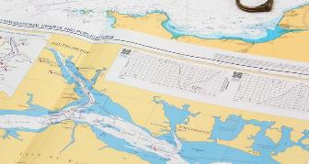
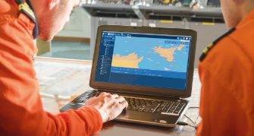
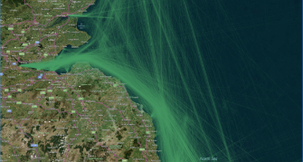
Progress on MSDI
Our MSDI Initiative
Creating a new information platform to support existing SOLAS products and services and wider “Blue Economy” transformation
Notes:
To enable our business, we aim to have a modern, cost-effective, automated data-processing platform which will be able to ingest, contain, maintain and deliver data efficiently
This will make it easier to control, discover, buy and use data
This data platform will support our existing world-leading portfolio of products and services
It will also enable our wider transformation as we prepare to meet demand from wider markets

Slide 11
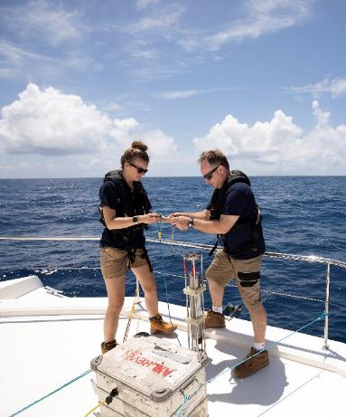
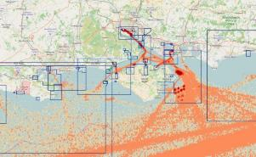
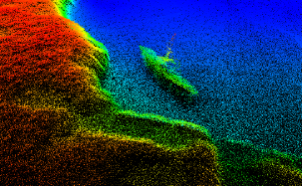
Progress on MSDI
Sources of MSDI-suitable data include:
Bathymetric surveying
Coastline, Tidal and Oceanographic data
Aids to Navigation and Geographical names
Seafloor type, Obstructions and Wrecks
Maritime information and regulations
At-Sea and Shoreline constructions
Practice and Exercise and/or Restricted areas
Notes:
The data we receive can range from large, fully-controlled multibeam surveys to simple hydrographic notes.
We receive survey data under hydrographic programmes including:
Civil Hydrography Programme (administered by the Maritime & Coastguard Agency)
Commonwealth Marine Economies Programme (of 17 Commonwealth nations across the Pacific and the Caribbean)
Overseas Territories Seabed Mapping Programme (of 14 British Overseas Territories)

Slide 12
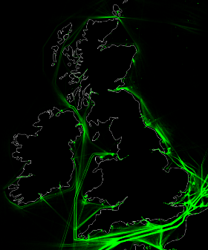
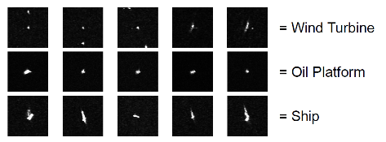
Progress on MSDI
Using big data technology to handle
complex data in new ways
We are adding ever-greater richness and value to the data solutions we provide
Using data in smarter and more efficient ways
Deriving meaningful information from large data sets
Predicting future behaviour from historical data sets
Creating new innovative products and services
Notes:
We are exploring big data technologies, such as the use of algorithms and machine learning, as well as exploiting advanced mathematics and statistics.
Understanding the movement of global shipping traffic – Example: utilising AIS data to extract ferry routes, low vs high tide routes, summer vs winter routes, time tables etc…
Using a ‘blob detection algorithms’ to detect offshore objects from satellite imagery – AI machine learning to identify offshore platforms, windfarms and vessels.
These techniques are enabling us to handle complex data in new ways and create innovative products from both new and existing data sets.

Slide 13
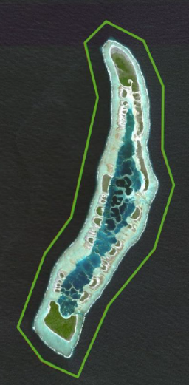
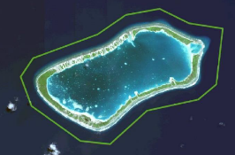
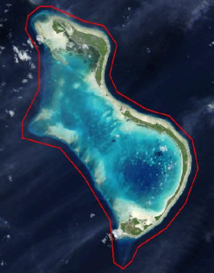
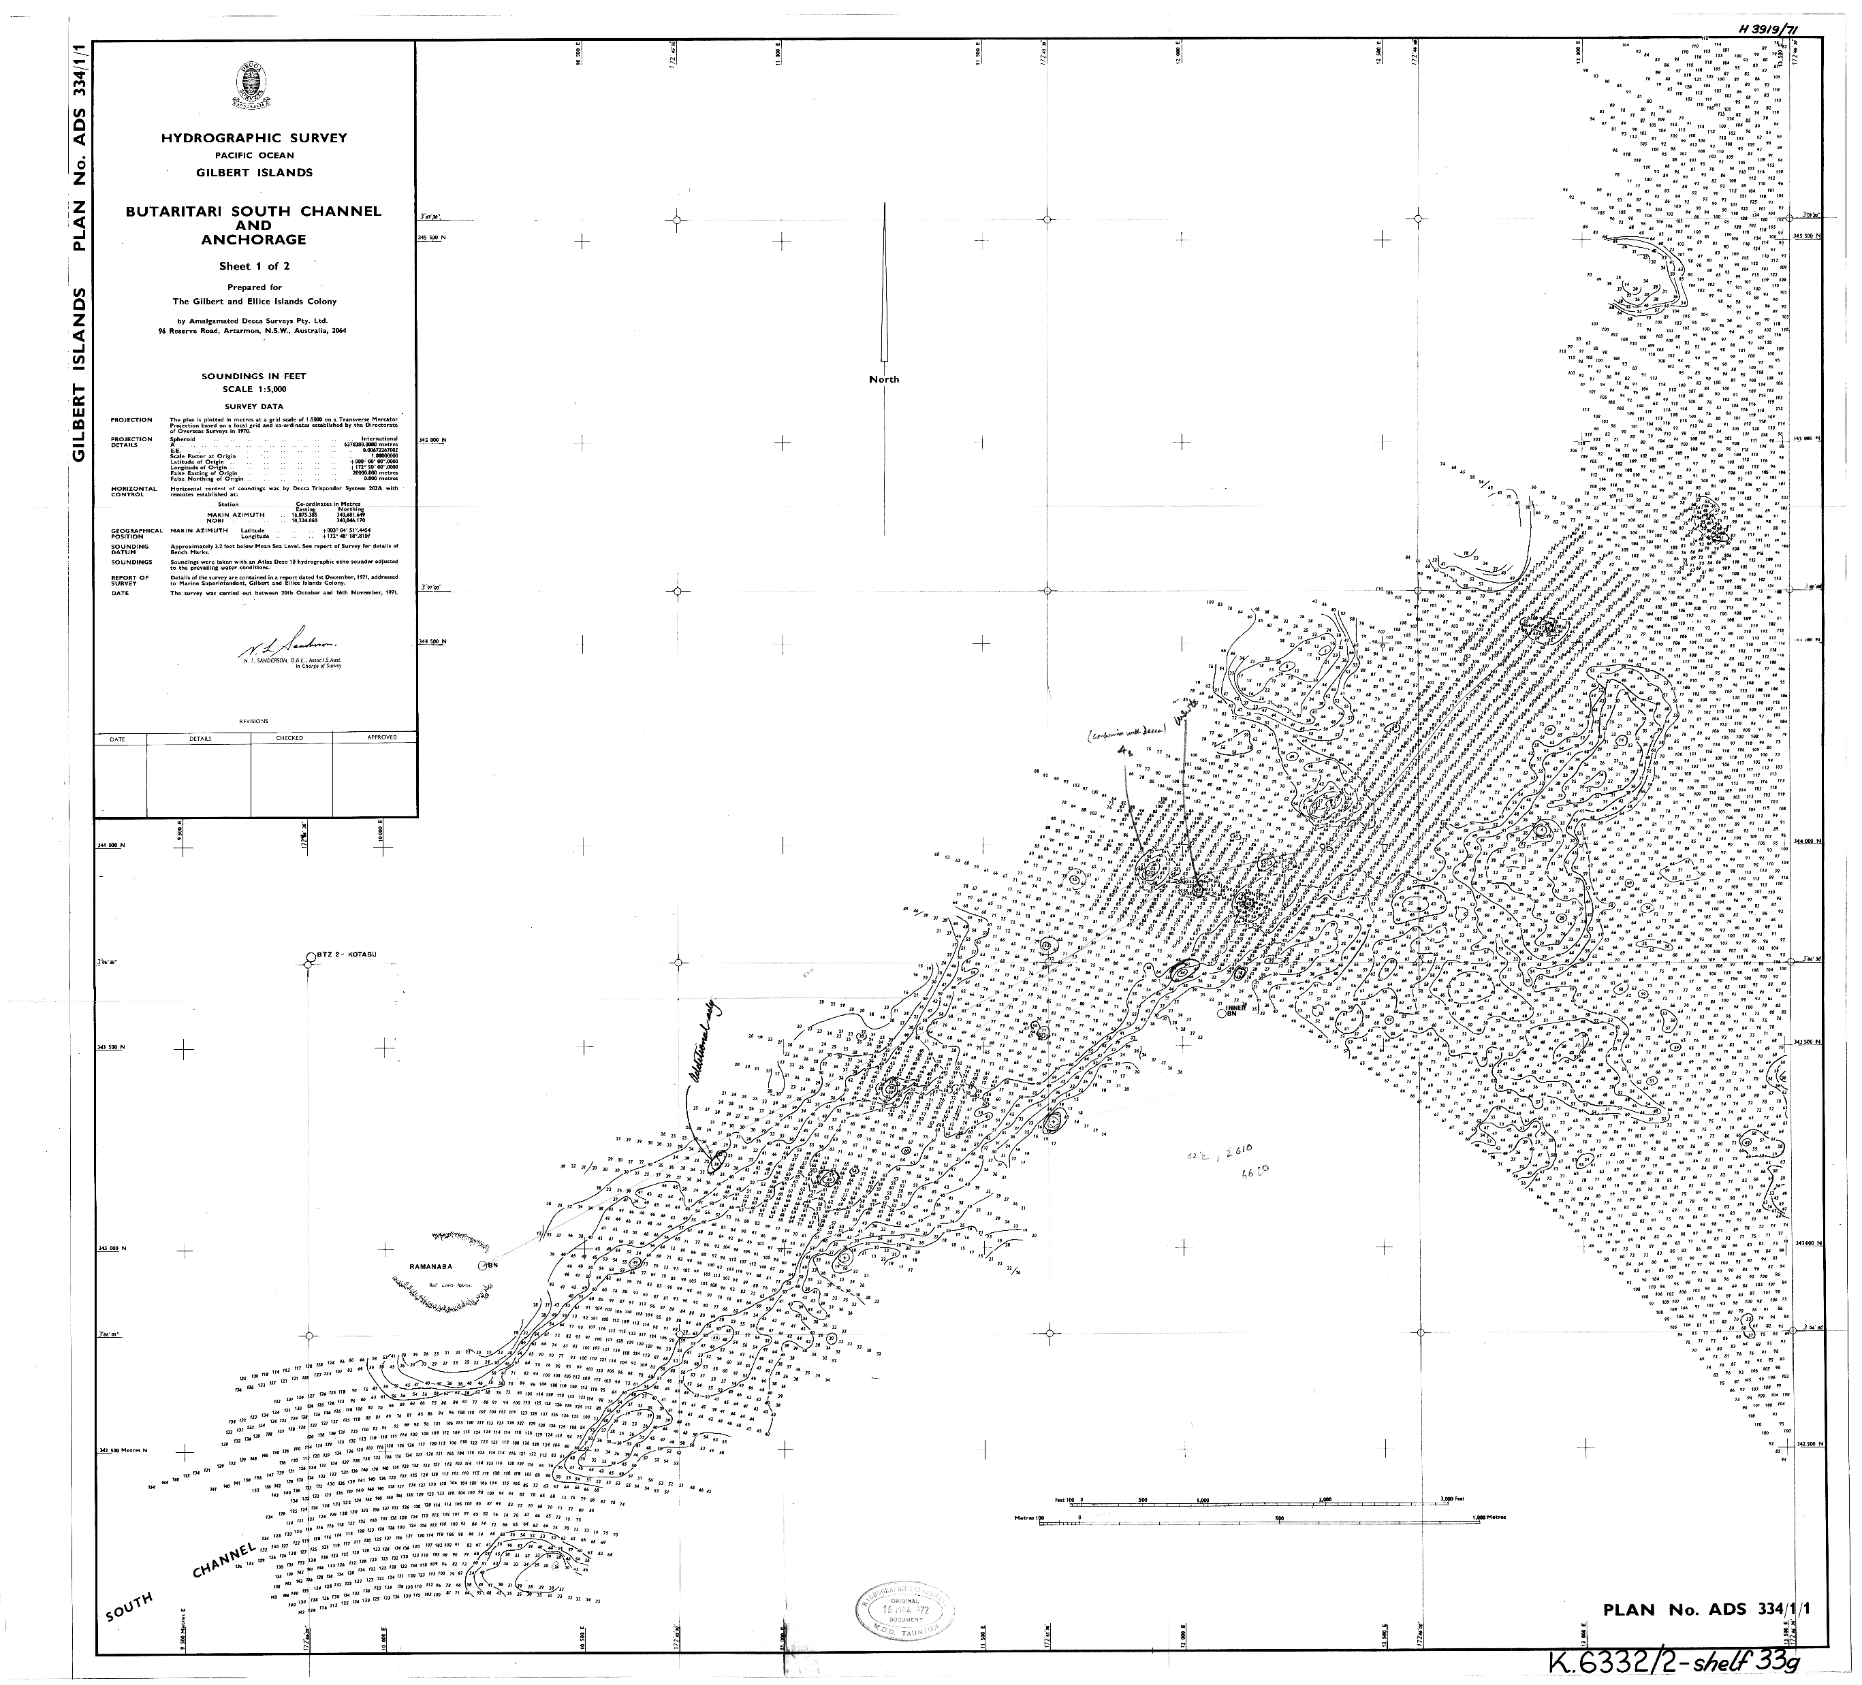
Plans that affect the region
Kiribati
SDB Survey of all 3 island chains
Currently underway, funded by the CME Programme
Notes:
Programme of work has been aligned with ADB and WB maritime infrastructure project to improve maritime connectivity and emergency/crisis response
Data will be used to assess current nautical charting and where necessary update any dangers/hazards identified
Data and Resulting Scoping Study produced by UKHO will act as a catalyst for the next stage of the programme allowing development of focused marine surveys in targeted areas.

Slide 14
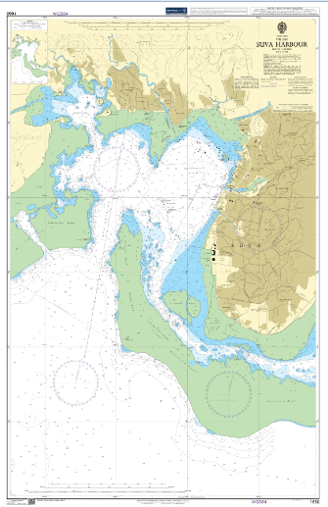
Plans that affect the region
Fiji
Training to be delivered by UKHO trainers in Feb 2019
2 Days of theory on key subject areas
10 Days of practical advice
Notes:
2 Days of theory on key subject areas
10 Days of practical advice and assistance during an ongoing MBES survey in the vicinity of Suva Harbour

Slide 15

Lessons learned to share
Communication and timings
Early engagement and planning.
Complexities in logistics
Communication limitations
Time zones
Notes:
Communications restraints. Email, band width, time zones.

Slide 16
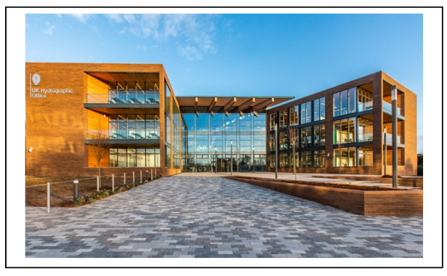
Success stories to share
Our new headquarters will enable our transformation
To meet the future needs of the business, we have constructed a new headquarters to:
Enable smarter ways of working through a modern, purpose-built working environment
Foster a flexible, open and collaborative culture
Help reduce our impact on the environment
Notes:
Our new headquarters has been built on our existing site on Admiralty Way, Taunton, providing a state-of-the-art and environmentally-friendly building.
The headquarters was purpose-built to provide a modern working environment for our teams, enabling us to be at the leading edge of geospatial information gathering.
The redevelopment was self-funded and was committed to achieving a footprint reduction for the Ministry of Defence.

Slide 17
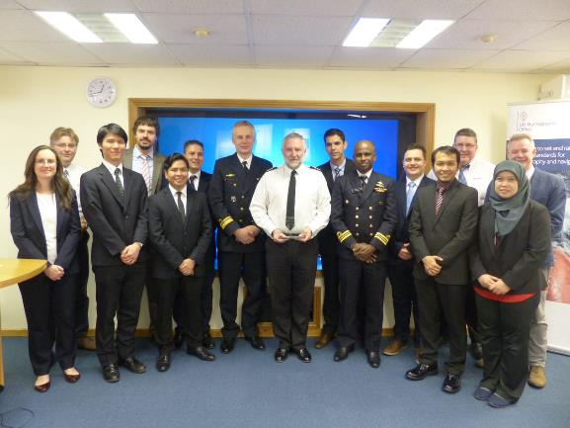
Success stories to share
Training: UKHO Bursary Course
        8 Jan 2018 – 20 Apr 2018
        10 Students
Nippon Foundation Course
        3 Sept 2018 – 14 Dec 2018
        10 Students
UKHO secondment to New Zealand
  Sharing experiences, challenges, working practices between hydrographic offices.
Notes:
The UKHO continues to support Capacity Building initiatives and completed the delivery of the 10th NIPPON Foundation funded CAT B course in Marine Cartography and Hydrographic data Processing (MCDA) in mid-December 2018.
The picture is of the 10 students from around the globe who completed the Nippon course in December 2018, from region:
Mr. Henry II Abad Coldes Philippines
Mr. Heru Kurniawan Indonesia
Ms. Hanisah Haji Timbang Brunei Darussalam
Not Pictured the 2018 Bursary course
Matthew Heaven Australia
Rilmar Ridjal Indonesia
Alison Cantrill New Zealand
Demand for places is high, the 2019 NIPPON Foundation course application prosess is currently open. Due to moving into our New Building there is no bursary course in 2019
Further details from the UKHO’s International Training & CB Manager.

Slide 18
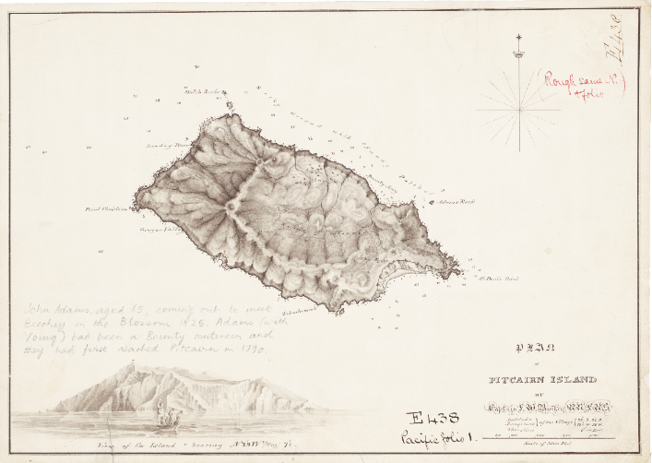
Thank You
Inscription reads:
‘John Adams, aged 65, coming out to meet Beechey in the Blossem 1825.
Adams (with Young) had been a Bounty Mutineer and they had first reached Pitcairn in 1790‘
Notes:
Chart of Pitcairn Island 1898
View inscriptions reads:
‘John Adams, aged 65, coming out to meet Beechey in the Blossem 1825.
Adams (with Young) had been a Bounty Mutineer and they had first reached Pitcairn in 1790‘

