Slide 1
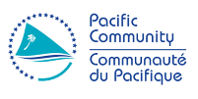
16th South West Pacific Hydrographic Commission Conference 13 -14 February 2019 Niue
Geoscience, Energy and Maritime Division (GEM)
Hydrographic related activities in 2018
Salesh Kumar, Hydrographic Surveyor
saleshk@spc.int
Francesca Pradelli, Acting Regional Safety Navigation Adviser
francescap@spc.int

Slide 2
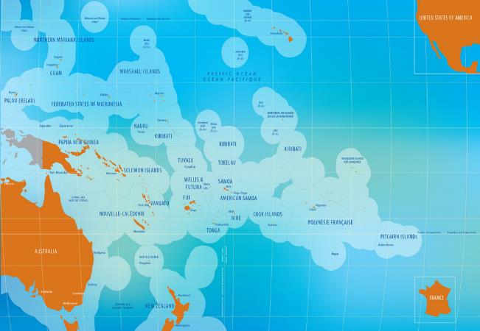
The Pacific Community (SPC) is the principal scientific and technical organisation in the Pacific region, proudly supporting development since 1947. We are an international development organisation owned and governed by our 26 country and territory members.
The Pacific Community (SPC)
26
Member Countries and Territories
600 staff
14 Sectors
USD 100 million
annual budget
www.spc.int

Slide 3
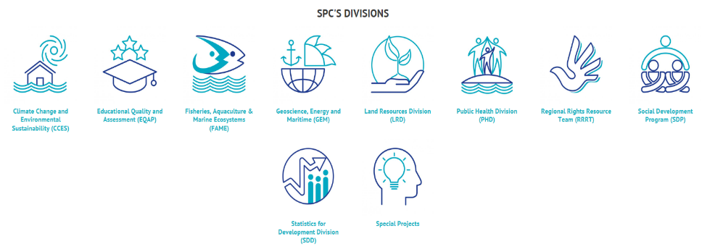
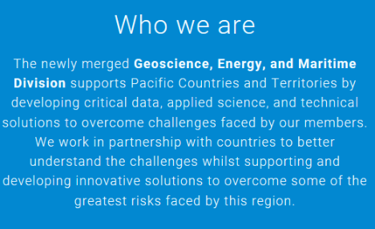
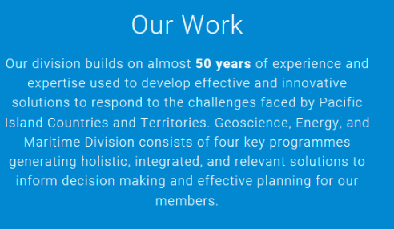

Slide 4
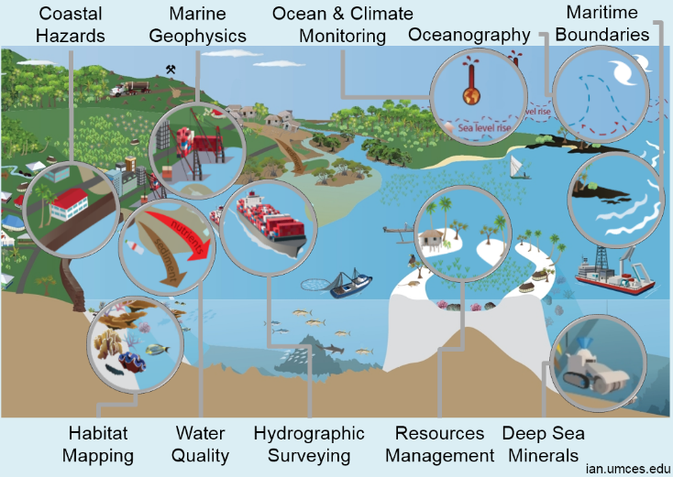
16th South West Pacific Hydrographic Commission Conference
Notes:
Lots of sectors and activities
Selected a few examples, starting with some work starting with Hydro section

Slide 5
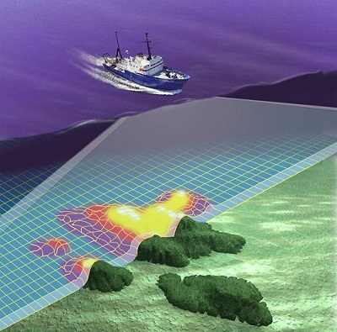
How can we map the seabed?
Multibeam Echosounder
Singlebeam Echosouders
Sidescan sonars
LiDAR Survey
Vessel
Expertise
Operational resources, etc.
Notes:
The risk model identifies shipping routes at risk, in relation to traffic type, size and volume, and considering a number of consequences and impact criteria.
One of the major contributors to the risk of shipping is inadequate and outdated charts.
Areas in red indicate significant risk levels and are therefore priorities for nautical chart improvements.
The port of Luganville is of high economic value to Vanuatu.
Although the area has been charted, closer examination of the underlying data shows that it mostly relies on 19th century data and no new information has been added to the chart since the surveys carried out during the 2nd world war.
No new data has been added to this chart in over 70 years and a lot relies on sketch surveys carried out more than 150 years ago
A chart such as this is an essential component of infrastructure and needs to be updated and modernised every 30 to 50 years.
This nautical chart is no longer fit for purpose
The risk assessment concludes that the chart needs to be upgraded to modern standards.
The chart can only be modernised through the provision of Hydrographic Services !
Who is responsible for providing Hydrographic Services ?
The answer to this can be found in the SOLAS Convention Chapter V / Regulation

Slide 6
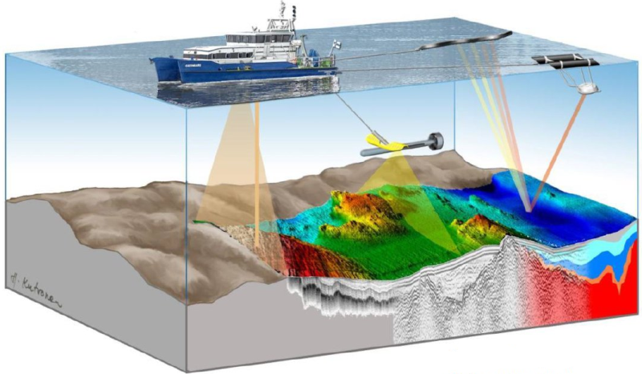
SPC has all the required toys (~USD 1M)
Singlebeam and Multibeam echosounders, precision GNSS, sidescan sonar, magnetometer, boomer seismic, UAV’s software, staff, etc.
Notes:
The risk model identifies shipping routes at risk, in relation to traffic type, size and volume, and considering a number of consequences and impact criteria.
One of the major contributors to the risk of shipping is inadequate and outdated charts.
Areas in red indicate significant risk levels and are therefore priorities for nautical chart improvements.
The port of Luganville is of high economic value to Vanuatu.
Although the area has been charted, closer examination of the underlying data shows that it mostly relies on 19th century data and no new information has been added to the chart since the surveys carried out during the 2nd world war.
No new data has been added to this chart in over 70 years and a lot relies on sketch surveys carried out more than 150 years ago
A chart such as this is an essential component of infrastructure and needs to be updated and modernised every 30 to 50 years.
This nautical chart is no longer fit for purpose
The risk assessment concludes that the chart needs to be upgraded to modern standards.
The chart can only be modernised through the provision of Hydrographic Services !
Who is responsible for providing Hydrographic Services ?
The answer to this can be found in the SOLAS Convention Chapter V / Regulation

Slide 7
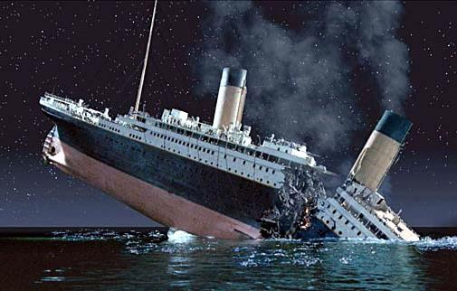
Governmental obligations under SOLAS
Under the Safety of Life at Sea (SOLAS) Convention,
Chapter V, Regulations 4 & 9
each State must ensure that :
Maritime Safety Information (MSI) is promulgated
Hydrographic surveys are carried out
Appropriate nautical charts and other nautical publications are available and up to date
The provision of Hydrographic Services and Navigational Warnings are an international obligations under Treaty Law
Notes:
Who is responsible to update charts? The coastal states of the Pacific are
As signatories to SOLAS they have to comply and provide Hydrographic Services and Navigational Warnings
This is not an optional service, but mandatory under Treaty Law
Most PICs are in danger of lapsing in their obligations under SOLAS
How can these services be delivered?
Following PIC have ratified the SOLAS convention (2 December 2013):
Cook Islands, Fjii, Kiribati, Marshall Islands, Niue, Palau, Papua New Guinea, Samoa, Solomon Islands, Tonga, Tuvlau, Vanuatu.
list of non-SOLAS states in the Pacific: Micronesia (FSM), Nauru, Timor-Leste

Slide 8
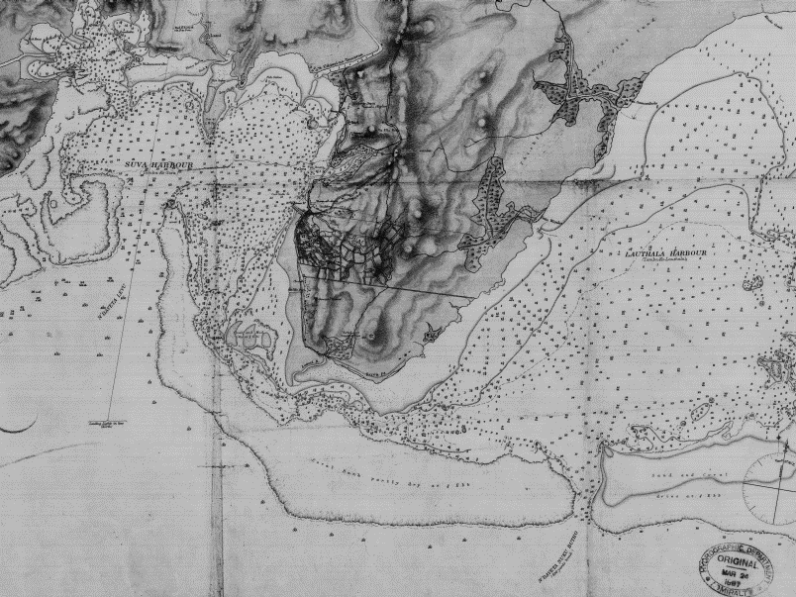
Suva 1887

Slide 9
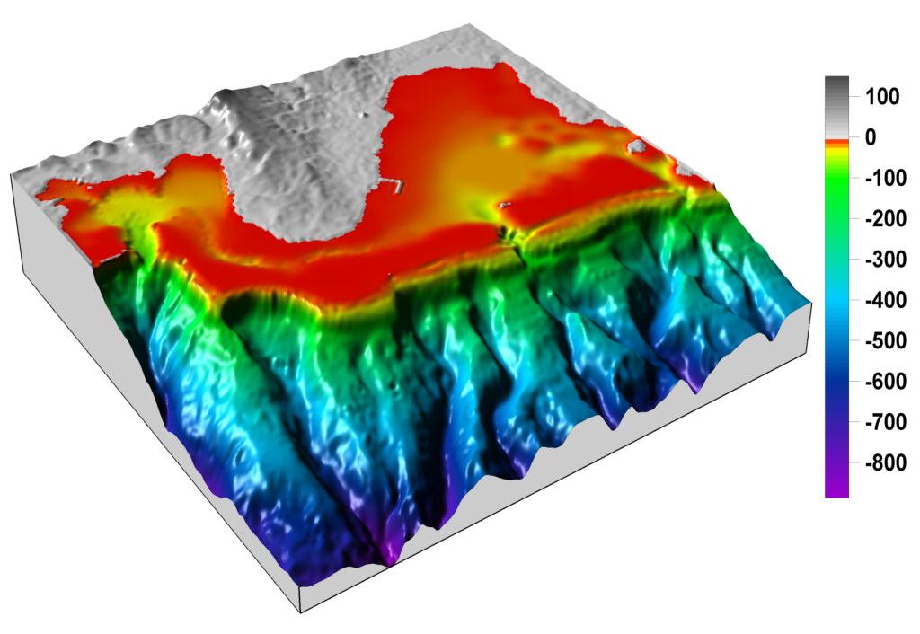
SUVA 2004
Suva 2007

Slide 10
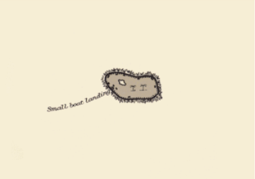
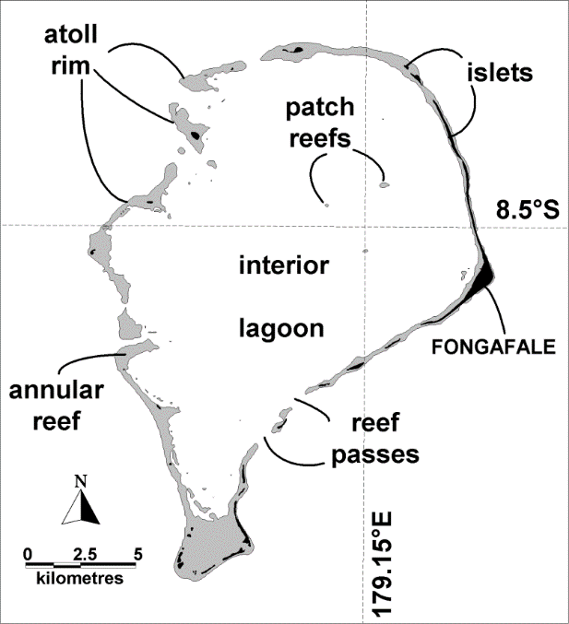
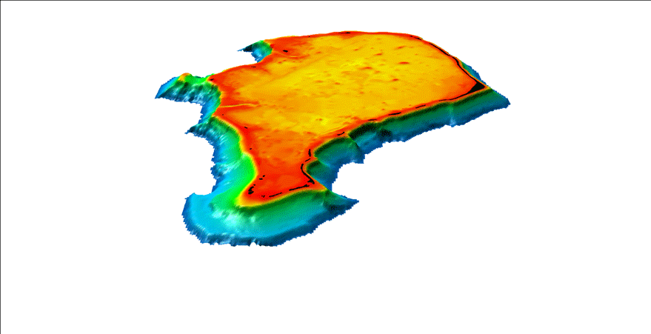
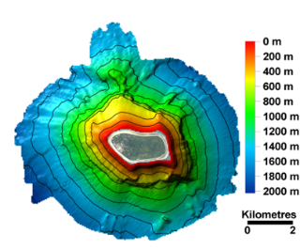
Niutao Island, Tuvalu, 1952 marine chart (based on 19th century data)
Funafuti, Tuvalu
SPC/SOPAC 2004 Multibeam Survey
and satellite imagery
Previously limited understanding
Collective wealth of information forms the basis for management tools

Slide 11
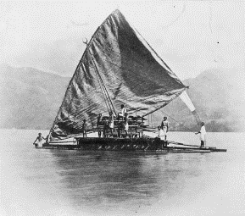
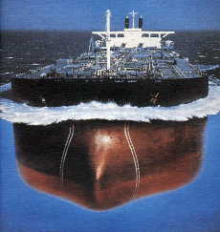
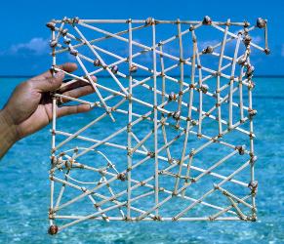
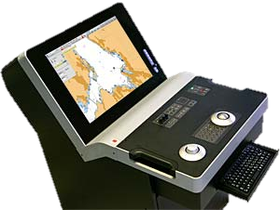
The changing face of shipping and charting
Traditional voyaging
Modern maritime transport
Digital navigation is now mandatory
Notes:
Our ancestors navigated across the ocean with great skill and an intimate knowledge of the winds, currents and waves. Master navigators on voyaging canoes used stick plots that showed the location of islands and swell patterns.
European sailors made the first nautical charts using lead lines and sextants. Many nautical charts in the Pacific still rely on data collected in the 19th century.
It was the sinking of the Titanic in 1912 that prompted the international community to introduce and adopt the first version of the SOLAS convention, which is the Convention for Safety of Life at Sea (SOLAS) with the main objective to specify minimum safety standard at sea.
Today, 12 Pacific Island countries are amongst 159 states that have ratified the SOLAS convention
The latest version of the SOLAS convention (Chapter V / Regulation 19) makes is mandatory that all newly built ships > 500 gt and existing ships >10,000 gt are required to carry Electronic Chart Display and Information Systems (ECDIS) systems.
These are the Mariner's obligations under SOLAS that come into force by 2018.
They already apply (July 2014) to the cruise ships operating in the Pacific.

Slide 12
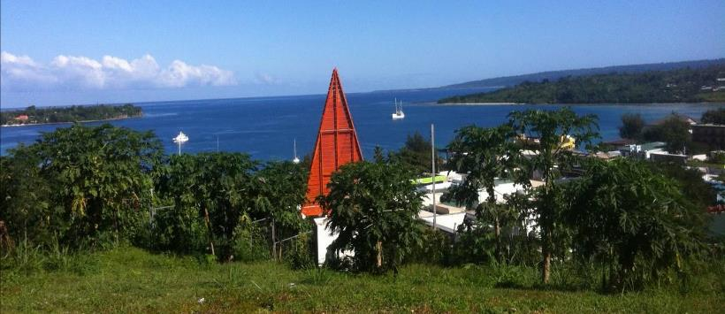
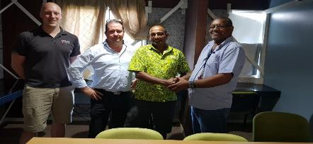
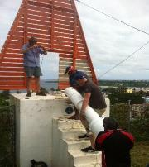
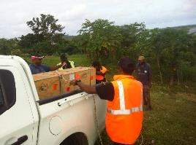
16th South West Pacific Hydrographic Commission Conference
Reinstatement of Port Entrance light, Efate - Vanuatu
Notes:
H- note sent,
work continuing with Vanuatu ports

Slide 13
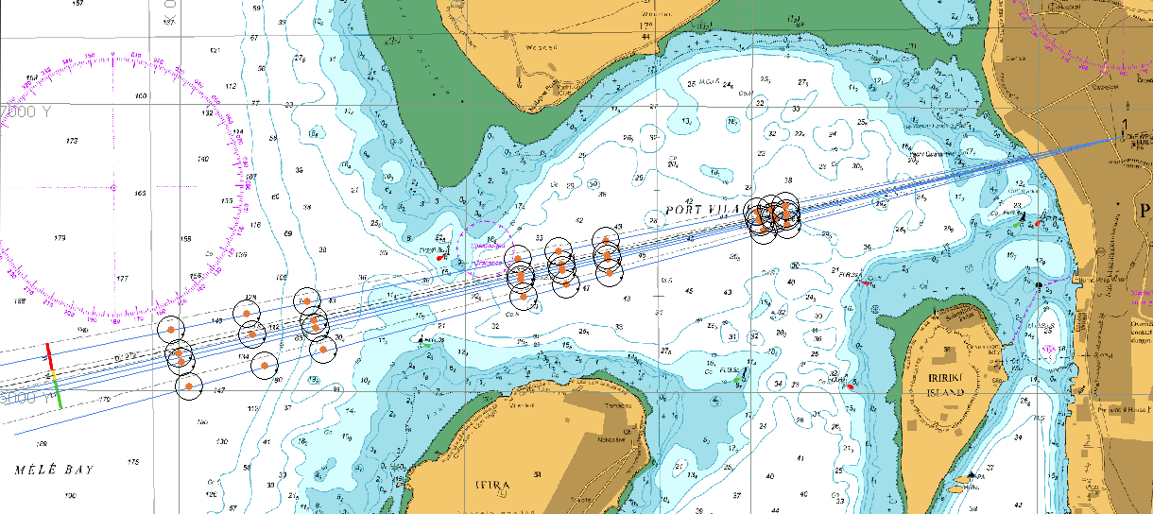
16th South West Pacific Hydrographic Commission Conference
Notes:
H- note sent,
work continuing with Vanuatu ports

Slide 14
Hydrography Unit – PRNI Project (video presentation)
The Pacific Regional Navigation Initiative (PRNI) is a project funded by the New Zealand Ministry of Foreign Affairs and Trade (MFAT) that focuses on navigation related aspects of maritime safety, in particular those necessary to support Pacific Island Countries fulfil their obligations relating to hydrography and nautical charting under UN Safety of Life at Sea (SOLAS). The Pacific Community (SPC) has been engaged by NZ MFAT to work with targeted countries to, amongst other objectives, support hydrographic capability building initiatives in conjunction with work being doing by international bodies and development partners
SPC target countries:
Tuvalu
Kiribati
Vanuatu

Slide 15
Output 1 – Data Discovery
Examination of SPC data holdings and subsequent analysis for suitability for charting
Provision of means of regular promulgation of updated list and associated access to PCA’s
Obtaining release agreements with PICTs for release of data held by SPC to PCA’s
Activities completed include:
Review of all SPC data holdings
Secured 8 out of 17 PIC’s data release agreement
PRNI data portal complete
Data release matrix (excel spreadsheet MEDIN Format) complete
Data for 4 countries released to PCA (LINZ)
Username and password provided for PCA (UKHO and LINZ) and PCA’s

Slide 16
16th South West Pacific Hydrographic Commission Conference
http://www.pacgeo.org/prni/

Slide 17
PRNI capacity building /MSI workshop for 2018
1st Phase of the PRNI project which ended in december 2018
Kiribati workshop September 2018
Vanuatu workshop October 2018
Resource Pack
Standard laptop
Handheld GPS
Software such as CARIS Easy view
Nautical charts
2nd phase of the project (June 2018 – June 2020) to be combined with PIDSS (MFAT funded project)

Slide 18
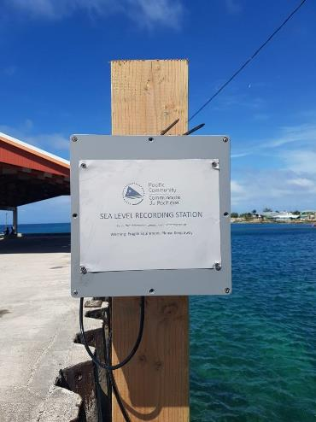
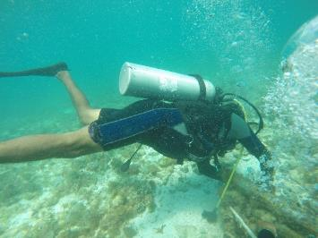
16th South West Pacific Hydrographic Commission Conference
Oceanography Unit
SPC’s Integrated Coastal Risk Management Project, which is part of the World Bank-funded Pacific Resilience Project Phase II.
Republic of Marshall Islands ( Majuro and Ebye)
Wave and current meter deployment
Tide gauge installation
UAV and LIDAR survey
Notes:
H- note sent,
work continuing with Vanuatu ports

Slide 19
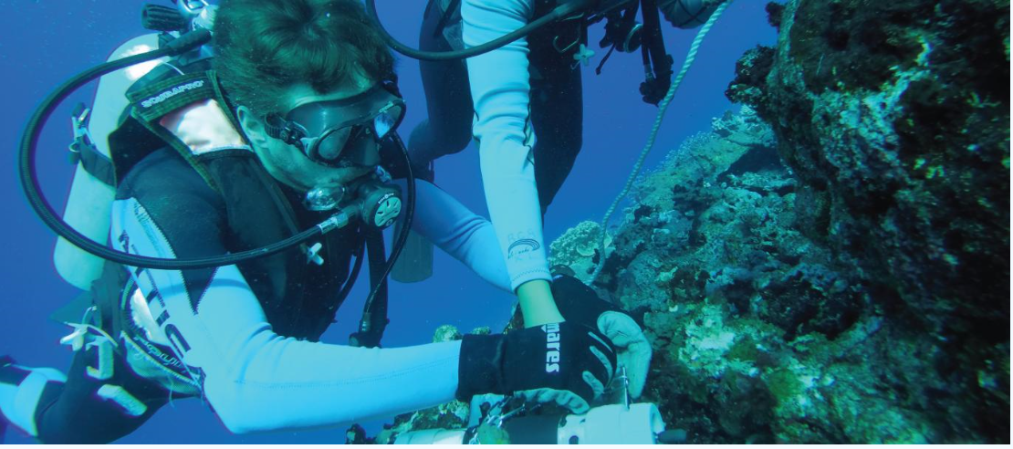
16th South West Pacific Hydrographic Commission Conference
Ocean and Tides Knowledge Unit
Contributions toward Technical Capacity and Ocean Literacy
Coordinator, Molly Powers-Tora
Notes:
H- note sent,
work continuing with Vanuatu ports

Slide 20
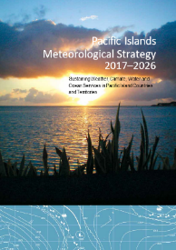
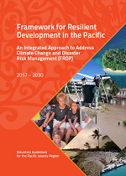
Why? The Regional Picture
Pacific Islands Meteorological Strategy
PKO 2: Improved marine weather services and establishment of ocean services
Framework for Resilient Development
Goal 1. Strengthened integrated adaptation and risk reduction to enhances resilience to climate change and disasters
Goal 3. Strengthened disaster preparedness, response and recovery
SPC Strategic Plan
Goal 1.1. Strengthen sustainable management of natural resources
PKO 4: Strengthened capacity to implement Multi-Hazard Early Warning Systems for tropical cyclones, coastal inundation and tsunamis
Goal 2.5. Improve multi-sectoral responses to climate change and disasters
Goal 1.3 Strengthen sustainable transport and energy security

Slide 21
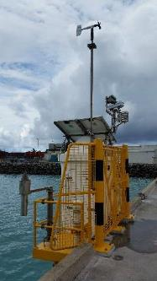
What do we do?
Transforming ocean data into products and applications for Pacific users
Building regional capacity in ocean science
Advocating for improved oceans data, services and cross-sectoral collaboration
Projects:
Pacific Sea Level Monitoring Project (PSLM) (1991-present)
Climate and Oceans Support Program in the Pacific (COSPPac) (2012-2021)
Australia Pacific Climate Change Action Programe

Slide 22
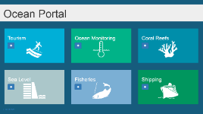
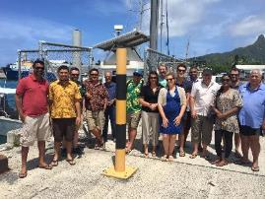
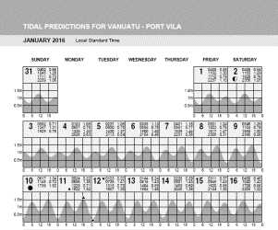
How do we do it?
Transforming ocean data into products and applications for Pacific users
Pacific Ocean Portal
Annual Tide Prediction Calendars
Factsheets, videos and information products
Building regional capacity in ocean science
Sub-regional and in-country trainings
Attachments and internships
Advocating for improved oceans data, services and cross-sectoral collaboration
Ocean capacity mapping and stakeholder engagement
Pacific Islands Marine and Ocean Services (PIMOS) Panel support

Slide 23
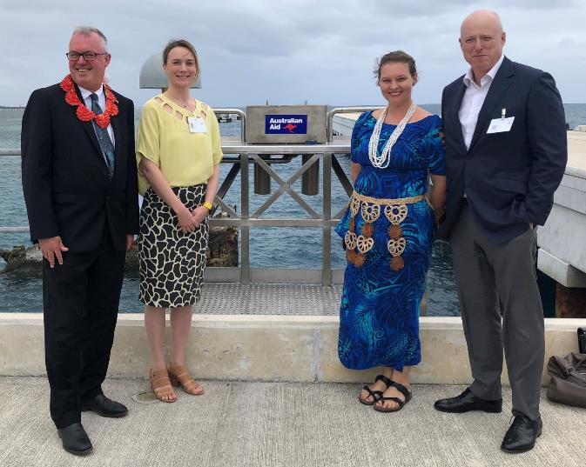
Recent Achievements
Ocean Monitoring and Observations
Upgraded Tide Gauge in Tonga (Mar 2018)

Slide 24
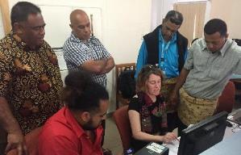
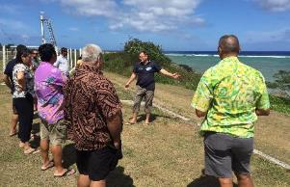
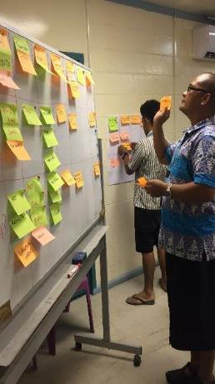
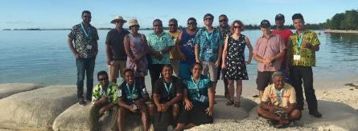
Recent Achievements
Ocean Data Analysis Training and Stakeholder Workshops

Slide 25
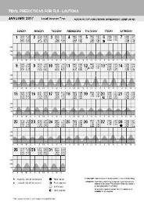
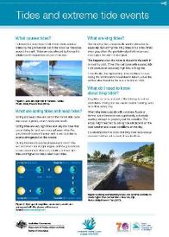
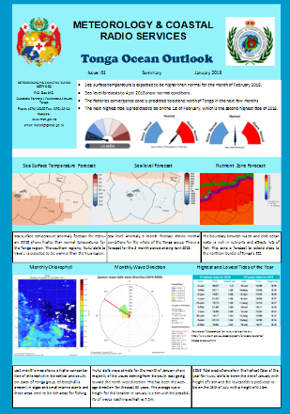
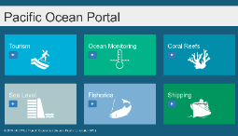
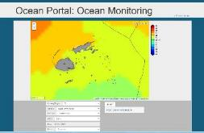
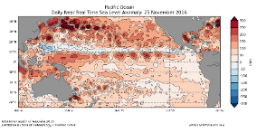
Recent Achievements
Ocean Data Analysis Products
Tide Calendars for 23 Pacific Locations
3 new tide prediction calendars last year for Kiritimati, Kanton (KI) and Vaitupu (TV)
Ocean Outlooks produced in Kiribati, Tuvalu and Tonga
The Pacific Ocean Portal oceanportal.spc.int

Slide 26
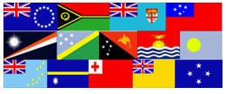
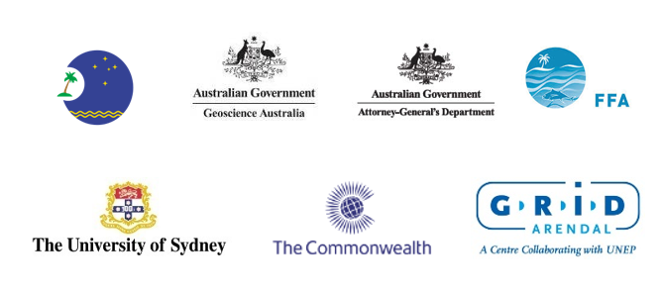
Pacific islands regional Maritime boundaries project
Notes:
The Pacific Islands Regional Maritime Boundaries Project defines the sovereignty for the fourteen (14) pacific island countries and its territories.
It is a successful collaboration between the consortium partners such as Pacific Islands Forum Secretariat, Forum Fisheries Agency, Geoscience Australia, Attorney General’s Office Australia, University of Sydney, Grid Arendal and the Commonwealth Secretariat.

Slide 27
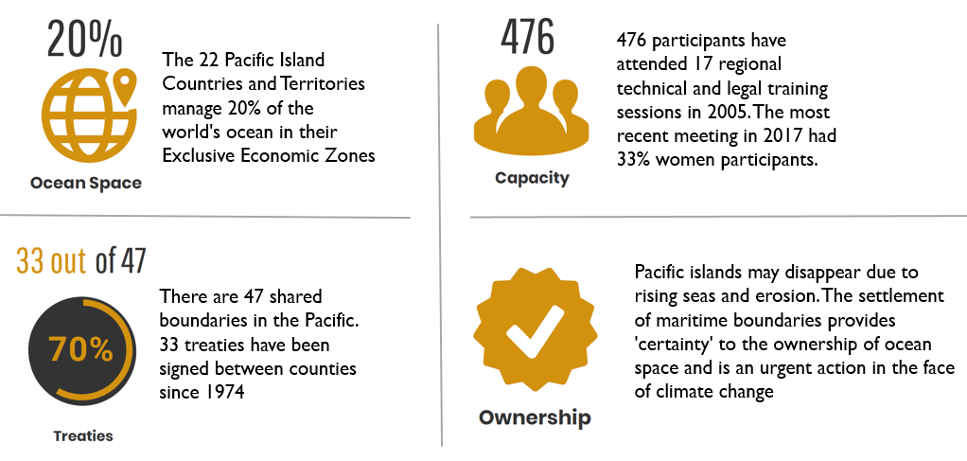
4 facts about the Regional Maritime Boundaries Project.
476 participants have attended 17 regional technical and legal training sessions in 2005. The most recent meeting in 2017 had 33% women participants.
The 22 Pacific Island Countries and Territories manage 20% of the world's ocean in their Exclusive Economic Zones
Pacific islands may disappear due to rising seas and erosion. The settlement of maritime boundaries provides 'certainty' to the ownership of ocean space and is an urgent action in the face of climate change
There are 47 shared boundaries in the Pacific. 33 treaties have been signed between counties since 1974
Notes:
There are 4 important facts about the Regional Maritime Boundaries Project:-
1. The 22 Pacific Island Countries and Territories manage 20% of the world's ocean in their Exclusive Economic Zones
2. 476 participants have attended 17 regional technical and legal training sessions in 2005. The most recent meeting in 2017 had 33% women participants.
3. There are 47 shared boundaries in the Pacific. 33 treaties have been signed between counties since 1974
4. Pacific islands may disappear due to rising seas and erosion. The settlement of maritime boundaries provides 'certainty' to the ownership of ocean space and is an urgent action in the face of climate change and Food Security

Slide 28
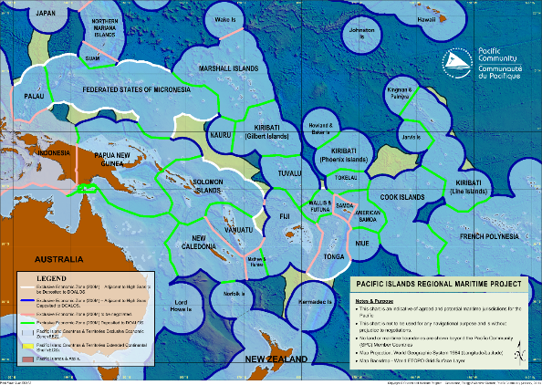
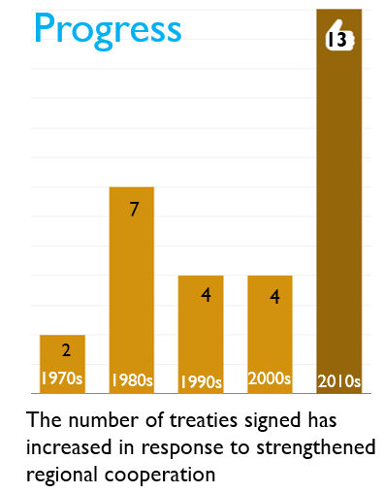
Current Maritime Boundary Status
Progress
13
7
4
4
2
1970s
1980s
1990s
2000s
2010s
The number of treaties signed has increased in response to strengthened regional cooperation
Notes:
The Regional Map coverage of the resolved maritime boundaries deposited to UNDOALOS are in green and the pending maritime boundaries are in red, this is the status to date.
During the decade of 2010, the number of treaties signed has increased in response to strengthened regional cooperation and these are some of the examples.

Slide 29
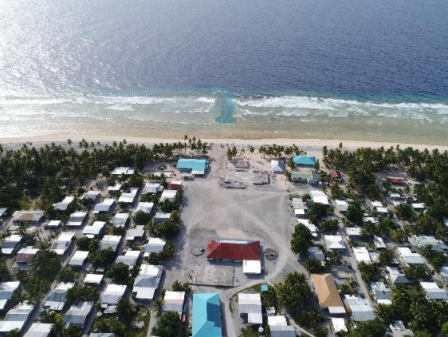
16th South West Pacific Hydrographic Commission Conference
Geodetic unit
Jens, Andrick, Marika & Veenil
Ocean Affairs
Notes:
H- note sent,
work continuing with Vanuatu ports

Slide 30
Role & Responsibilities - Geodetic Unit
Andrick Lal – Senior Geodetic Surveyor
Pacific Sea Level & Geodetic Monitoring Project
Geodetic Unit development and management;
Geodetic Survey Operations;
Regional Maritime Boundaries Project (RMBP);
Marika Kalouniviti – Geodetic Surveyor
Pacific Sea Level & Geodetic Monitoring Project (PSLGMP);
Survey and Data Acquisition, Capacity Building, Analysis and Reporting
Veenil Rattan – Geodetic Surveyor
Pacific Sea Level & Geodetic Monitoring Project (PSLGMP);
Survey and Data Acquisition, Capacity Building, Analysis and Reporting

Slide 31
Geodetic Unit - Activities
Survey Operations
Project implementation:-
Pacific Sea Level Monitoring Project (PSLMP) – 2001 to Current (13 project PICs)
Regional Maritime Boundaries Project (RMBP) – 2002 to Current (14 project PICs)
Survey Support:-
Hydrographic Surveys
Geophysical Surveys
Topographical Surveys
Water & Sanitation Surveys
Pacific Geospatial & Surveying Council Partnership Desk
Capacity Development, Assessment & Technical Advice
SPC/FJ/FIG/UNGGIM-AP/UNOOSA workshops
Fiji Institute of Surveyors Congress

Slide 32
Pacific Sea Level & Geodetic Monitoring Project (COSPPac)
Levelling Monitoring Surveys (18-month)
Reference Mark Monitoring Surveys
2019 – SB, KI, TO, NR, MH, FJ, TV FM
GNSS Station
Tide Gauge Station
Notes:
The major function of the Geodetic Unit is to implement the monitoring surveys from the GNSS Station to the Tide Gauge Station.

Slide 33
Surveys – Tuvalu Geodetic Project
Supported by TV Government, KFW (EU) and UKHO
Partnership with SPC – technology transfer & survey infrastructure
Phase I – 4; Field surveys on 9 islands (2016 – 2018);
GNSS surveys
RTK, Static and PP Kinematic
Tide Gauge Installation
Tide Observations
Cadastral survey
Establish local datum – link to nearby Survey BM on land occupy by GNSS
UAV Surveys
Photo control GNSS surveys

Slide 34
Pacific Geospatial & Surveying Council Cook Islands, Federated States Of Micronesia, Fiji, Kiribati, Marshall Islands, Nauru, Niue, Palau, Papua New Guinea, Samoa, Solomon Islands, Tonga, Tuvalu, Vanuatu
SPC Partnership desk
4th PGSC Meeting with
UNGGIM (Legal & Policy – Geospatial Workshop)
Nuku’alofa - Tonga
April 2018
Sustainable development in the Pacific enabled by world class geospatial information and surveying services http://gsd.spc.int/pgsc/
Notes:
The Pacific Community (SPC) shall provide secretariat and technical support for the Council through the Pacific Geospatial and Surveying Partnership Desk (PGSPD)
The objective of the PGSC will provide a regional network and forum for the geospatial information and survey authorities of Pacific Island Countries and Territories (PICTs) to address regional challenges, such as building the capacity of surveyors, improving and standardising geospatial information gathering and dissemination, maximising economic growth, alleviating poverty, improving natural resource management, disaster risk management and climate change adaptation. This will be achieved by coordinating, communicating, and collaborating activities, sharing resources and applications of location information through regional and global partnerships.

Slide 35
Pacific Geospatial & Surveying Council Cook Islands, Federated States Of Micronesia, Fiji, Kiribati, Marshall Islands, Nauru, Niue, Palau, Papua New Guinea, Samoa, Solomon Islands, Tonga, Tuvalu, Vanuatu
FIG/ Fiji/ SPC Partnership Desk
References Frame in Practice Seminar
Operational Aspects of GNSS CORS
Suva – Fiji
September 2018
The theme and objectives of this seminar was to provide perspectives and case studies on technical matters relating to the “Operational Aspects of GNSS CORS” infrastructure. Presenters also delivered content on the - “what, why and how” to build a sustainable and modernised geodetic reference frame and datum; challenges faced in the Pacific in relation to geospatial information management and data sharing; legal, policy, and codes of practice (including standards); and the issues pertaining to developing the capacity of surveyors in the discipline of geodetic surveying
Notes:
The Pacific Community (SPC) shall provide secretariat and technical support for the Council through the Pacific Geospatial and Surveying Partnership Desk (PGSPD)
The objective of the PGSC will provide a regional network and forum for the geospatial information and survey authorities of Pacific Island Countries and Territories (PICTs) to address regional challenges, such as building the capacity of surveyors, improving and standardising geospatial information gathering and dissemination, maximising economic growth, alleviating poverty, improving natural resource management, disaster risk management and climate change adaptation. This will be achieved by coordinating, communicating, and collaborating activities, sharing resources and applications of location information through regional and global partnerships.

Slide 36
Challenges
Lack of technical capacity in the region
Financial support of the Procurement and the Maintenance of the survey equipment and surveying software in SPC and for PICs.
Eliminate freight logistics.
Sustainable development of surveying capacity in the region.
Implementation of the PGSC Strategy; 10 year regional plan
Leadership and Visibility
Standards and Technology
Sustainability
Capacity Building
Articulate the emphasis of the development PGSC Strategy and its impact for the Socio & Economic growth regionally and internationally.
Attract women surveyors

Slide 37
Future of the Geodetic Unit
Provide the ongoing support and continue to play an active role for geodetic surveys in the Pacific Sea Level Monitoring Project in collaboration with GA.
Continue to build capacity in the region for surveying.
Provide the ongoing support within the GEM Division and SPC for surveying capacity.
Commencement of the Coastal Waters Project in PNG and Initiate the coastal waters project from PNG into the region.
Develop a regional database for the Spatial Information & Data which includes the historical survey information for PICs
Maintain the survey equipment and ensure that it is up to date.
Acquire latest Survey equipment as per technology

Slide 38
Future of the Geodetic Unit
Provide assistance and support and further engagement of PICTs for the development of the Geodetic Reference System.
Define the Horizontal and Vertical Reference for the PICTs
Provide assistance to establish CORS in the Pacific.
Advocacy of the CORS and its capabilities
Continue to support PGSC and its development.
Engagement of global geodetic organisations in the region through PGSC.
PGSC to be a member of FIG.
Continue to serve as a partnership desk for PGSC

Slide 39
Project goal: support economic development, shipping and trade in the Pacific Island countries and territories through safer maritime routes managed in accordance with international instruments and best practices
International Foundation for Aids to Navigation (IFAN)
Implementation
- Preparation Phase – 2016
- Phase I – 2016-2018, Phase II – 2018-2021
Target countries
- Cook Islands, Kiribati, FSM, RMI, Nauru, Niue, Palau,
Samoa, Solomon Islands, Tonga, Tuvalu and Vanuatu

Slide 40
Since 2018 SWPHC…..
2018
Tonga (March) | legal and economic assessment (Review progress IALA mission)
Tuvalu (March) | legal and economic assessment IALA Technical assessment - 24 recommendations
Samoa (March) | Technical, legal and economic assessment 22 recommendations
Tokelau (March) | Technical assessment 9 recommendations
Nauru (April) | Technical, legal and economic assessment 19 recommendations

Slide 41
June 2018: regional workshop in SPC Suva for targeted countries’ AtoN Managers
12 targeted countries’ AtoN Managers trained on IALA SIRA risk assessment tool
Implementation of Phase 1 activities 97% complete by July 2018

Slide 42
• Conduct risk assessments (as required by Regulation 13 of the SOLAS convention)
• Develop safety of navigation policy and legal framework
• Build capacity to develop and maintain aids to navigation
• Support and training for maritime safety
• Technical support for developing and maintaining eﬀective aids to navigation
• Maritime safety information
• Improve budgetary management
• Support regional coordination related to safety of navigation in the Pacific

Slide 43
Phase 2 – 2019 activities
FSM -1st visit (2nd quarter) | AtoN (SIRA) Risk assessment Pohnpei and Kosrae
Kiribati – 2nd visit | Follow up on AtoN risk assessment and AtoN budgeting
Vanuatu – 2nd visit | Follow up on AtoN risk assessment and AtoN budgeting
Solomon Islands - 2nd visit | Follow up on AtoN risk assessment and AtoN budgeting – completed
Niue (Feb) 1st visit | AtoN (SIRA) Risk assessment (Avatele and Namukulu)
Marshall Islands - 1st visit | AtoN (SIRA) Risk assessment
Palau - 1st visit (2nd quarter) | AtoN (SIRA) Risk assessment
Samoa 1st visit (3rd quarter) | AtoN (SIRA) Risk assessment
Phase 2 – 2018 activities
Solomon Islands (Sept) 1st visit | AtoN (SIRA) Risk assessment Honiara – completed
Kiribati (Sept) 1st visit | AtoN (SIRA) Risk assessment Betio – completed
Vanuatu (Oct) 1st visit | AtoN (SIRA) Risk assessment Port Vila – completed
Cook Islands (Oct) | AtoN (SIRA) Risk assessment Aitutaki – completed

Slide 44
Phase 2 – 2019 activities
AtoN Level 1 Manager Course (date TBC)
Kiribati – 3rd visit (4th quarter) | Follow up on AtoN risk assessment and AtoN budgeting
Vanuatu –3rd visit (4th quarter) | Follow up on AtoN risk assessment and AtoN budgeting
Solomon Islands 3rd visit (4th quarter) | Follow up on AtoN risk assessment and AtoN budgeting
Tokelau – 1st visit (TBC) | AtoN (SIRA) Risk assessment

Slide 45
VINAKA

