Slide 1
Expanding the Capabilities in the Region
David Crossman
14 Feb 2018
SWPHC16
Notes:
Hello
Introduce self and role
Make joke of presenting on IIC to long time clients
Intend that this not be a sales pitch but an indication of the capabilities that IIC brings and focus on areas most relevant to this audience
Complete with two capabilities that may be of particular relevance to nations in this room.

Slide 2
CONTENTS
Who is IIC
IIC Footprint
Available Capability
Focus: Marine Services and Training
NaAVIC

Slide 3
About IIC Technologies
Turnkey Surveying, Mapping, and Charting Solutions Company
Established in 1993
More than1500 employees
7 offices, 4 continents
Services over two dozen international government agencies
Six Divisions, focused on Geospatial Sciences
Terrestrial Services and Solutions
Innovation Centre
Geo Surveys
Geospatial Engineering
Marine Services and Solutions
Training & Capacity Building (IIC Academy)
Survey Data Processing
Hydrographic Database services
Validation and Maintenance
Hydrographic Surveys
Navigation Services
Education and Training
Notes:
2 min: read slide. Describe global deployment of hydrographic services

Slide 4
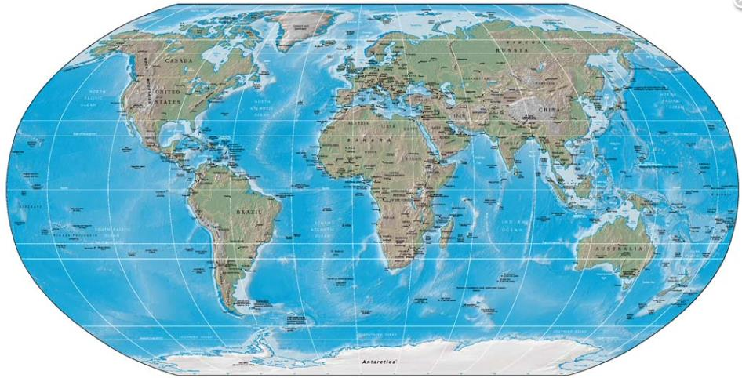
Where we are…
Notes:
IIC Offices in:
Hyderabad and Vyzag in India which includes the large processing and development centre, an R&D facility and the Academy
York in UK, that includes a classified facility for work for a number of the nations we support in the Geospatial space.
The UAE covering the Middle East
Vancouver in Canada
Riverdale in the USA
And now Australasia, covering NZ, Australia and the Pacific Islands, with footprints in AUS and NZ.
So who do we have in Australasia at present:
Ron Furness is based in Australia and I am based in NZ.
My background is 27 years in the RNZN
IHO/FIG Cat A Surveyor
As mentioned the other day I was the Hydrographer RNZN, and also Director Geospatial Intelligence NZ, both for 6 years.
During that period I also served as Chair on the NZ Region of the AHS, then Chair of the AHS and a member of the IFHS Board.
During that time I was passionate and active in promoting hydrography in the region and the conduct of surveys in the Pacific.
Intent is to grow the physical footprint in Aus and NZ over the coming years in order to provide presence and better support to the region and its users.

Slide 5
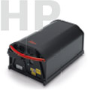
Geospatial Services

Slide 6
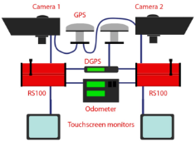
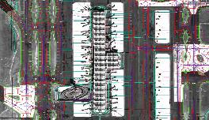
Geospatial Services
Aerial Photogrammetry
Aerial Data Acquisition
Aerial Triangulation
Planimetric (3D Feature) & Topographic (Contour) Mapping
Digital Orthophotography
Feature Extraction & Editing
LiDAR
DEM, DSM
Remote Sensing – Satellite Imagery Processing
Flythrough modeling
AM/FM – Utilities
Water, Waste water, Sewer, Electric, Gas, Ph
GIS Database & Application Development
Web GIS
Airport Mapping DB
Mobile Mapping
Heritage Mapping
Notes:
Geospatial Services include: ortho and satellite image processing, aerial photography and lidar surveys, airborne and geophysical surveys, specialty surveys

Slide 7
Geospatial Services
MGCP. Scope of work :
Processing of raw image
DEM and ortho photo generation
1:50k Feature extraction
IIC produced over Samoa, Tonga, Fiji and most recently Kiribati.
Data is in the public domain via Koordinates/Geoint Data Service (https://koordinates.com).
Similar work for other nations including in the classified domain.
Notes:
Give blurb, noting:
Much of the Pacific has been undertaken by GNZ
IIC produced over Samoa, Tonga, Fiji and most recently Kiribati.
and imagery may be freely available if licencing allows.
Imagery was extended to cover all offlying reef systems should be utilised as a free resource for Hydro work and navigations safety.
We also do similar work in the classified domain for a number of other Nations utilising secure facility in York UK

Slide 8
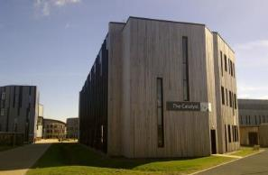
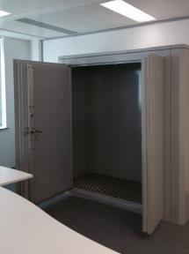
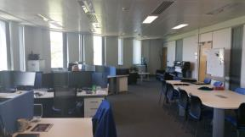
Geospatial Services
Security cleared facility, storage, people and IT, up to NATO Secret

Slide 9
Cadastral, Engineering & Geodesy

Slide 10
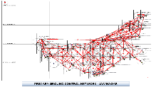
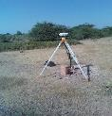
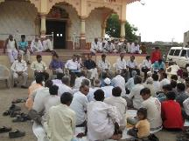
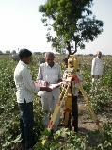
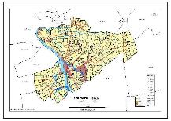
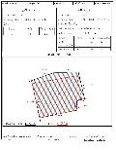
Cadastral, Engineering & Geodesy
Cadastral, Engineering & Geodetic Surveys:
Geoid modernization
Gravity observations
Orthometric levelling
Asset management surveys

Slide 11
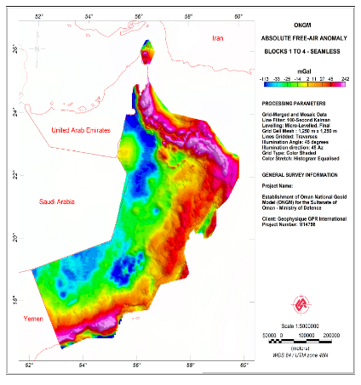
OMAN National Geoid Project
Cadastral, Engineering & Geodesy

Slide 12
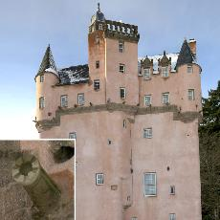
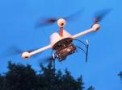
Cadastral, Engineering & Geodesy
Digital Documentation
Alhambra Palace, Spain - Gigapixel photography
UAV Photogrammetry
Craigievar Castle, Royal Commission for Ancient and Historic Monuments of Scotland - UAV photography, gigapixel and immersive imagery and 3D modelling.
3D Visualization
Bradford Cathedral we have created a virtual tour to digitally document many of the important features of the building for tourism and preservation management.
Notes:
Use of gigapixel and immersive imagery, UAV photography and 3D modelling, for historic places management, tourism and digital documentation.

Slide 13
Software Develop & System Integration

Slide 14
Software Develop & System Integration
Workflow Management and QMS
Existing Data
Migration
Geoscience Database
(Seismic, Mag, SBP, SSS)
New Scientific
Cruises
Oceanographic / Meteorological
Database
(SVP, ADCP, Currents, Tides)
Product
Database
Web Services
Government
Agencies
Source Registry
Database
Bathymetric Database
Other Sources
(Industry, NGO)
OtherDatabase
(Satellite Imagery, Photography, etc)
Web Mapping Services
- NSDI / MSDI
- OGC Compliance
- FTP
Data Cataloging Tools
- Meta Data Creation
- Domain Controller
- Data Verification & Quality
Archiving
System
System Backup and Recovery
Analysis, Visualization & Production Tools
Notes:
IIC Software can undertake data integration, system integration, software development and workflow management.

Slide 15
Marine Services

Slide 16
IIC Technologies - Marine
Data Value Chain
Data Acquisition
Survey Data Processing
Marine Products
Verification & Validation
Updating & Maintenance
Multibeam
Airborne Bathy Lidar
Sidescan
Subbottom Profiler
Satellite Imagery
Satillite Derived Bathymetry
Bathy Data Cleaning
Surface Modeling
Image processing
Deconfliction
ENCs / IENCs
Military Overlays
Paper Charts
Nautical Pub
Notice to Mariners
Spatial Accuracy
Feature Verification
Logical Consistency
3rd Party Checks
Vertical/Horizontal Consistency
Database maintenance
Data Assessment
Data critical updates
Data management
Data warehousing
Capacity Building
Notes:
What we do for those entities varies, but as we are able to undertake work across the full breadth of the Data value chain we can be flexible to meet the individual need.
For example:
- One nation utilizes a team of 50 personnel in Hyderabad to work directly on their HPD database, loading data, creating paper chart masters, collecting new data, and upgrading existing data.
- For other bodies we provide Third Party Support Services (3PS) such as additional Military Layer (AML) , compilation of new charts data from third party sources, creation and maintenance of leisure products, production and maintenance of stand-alone ENCs, Chart updates from imagery, horizontal accuracy assessments of data using imagery,

Slide 17
Marine Services
Some current clients (this list represents 30 separate projects)
Australian Hydrographic Service (AHS)
GeoInt New Zealand (GNZ)
Land Information New Zealand (LINZ)
UK Hydrographic Office (UKHO)
UK Ordinance Survey (UK OS)
UK Ministry of Defence (MOD)
Canadian Dept. of Defence (DND)
Canadian Hydrographic Service (CHS)
Natural Resources Canada (NRCAN)
Norwegian Hydrographic Office
NOAA
US Army Corps of Engineers (USACE)
Brazilian Navy Hydrographic Office
General Commission for Survey, Saudi Arabia (GCS)
Danish Geodata Agency
Indian Hydrographic Office
Indian Survey & Mapping Organization
Government of Chile (Latitude)
French Hydrographic Office / Navy
Panama Canal Authority
Notes:
Our 250+ marine specialists have worked with over 30 national mapping and charting agencies, complementing their skills and resources where and when most needed.

Slide 18
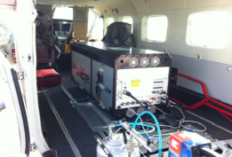
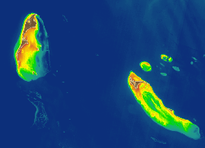
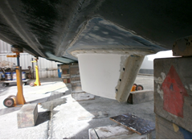
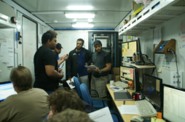
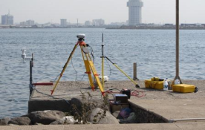
Marine Services
Multibeam, Sidescan,
Sub-bottom Profiling
Airborne Bath Lidar
Satellite Derived
Bathymetry
Geodetic & Tidal Control

Slide 19
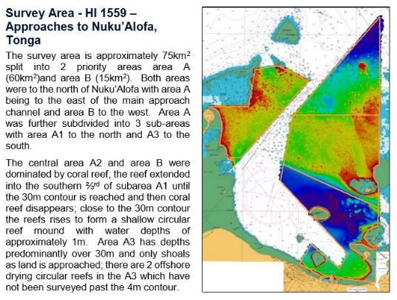
Marine Services
Notes:
Surveys such as this MBES survey of Tonga conducted last year for the UKHO. This was done using a team flown in from offshore.

Slide 20
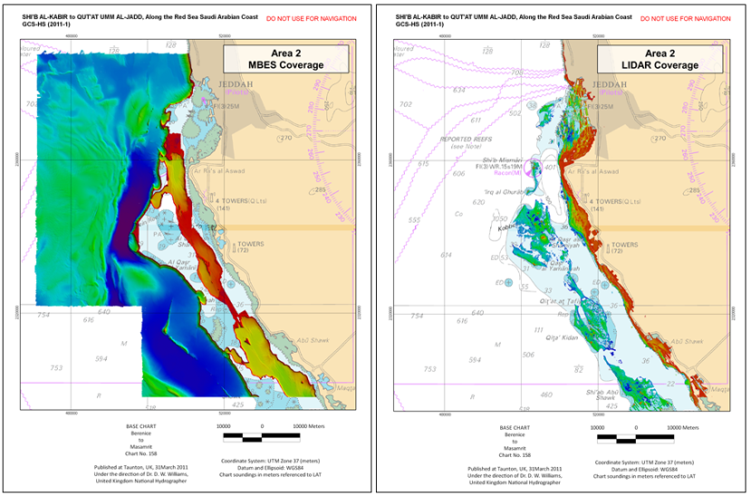
Marine Services
Notes:
- And mutli-disciplinary surveys combining data capture methods such as MBES, Bathy Lidar, SDB and LIDAR.

Slide 21
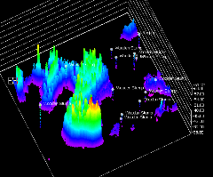
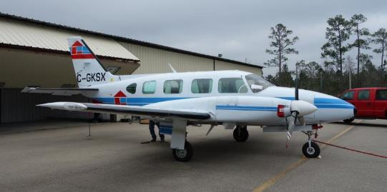
Marine Services
Panama Canal

Slide 22
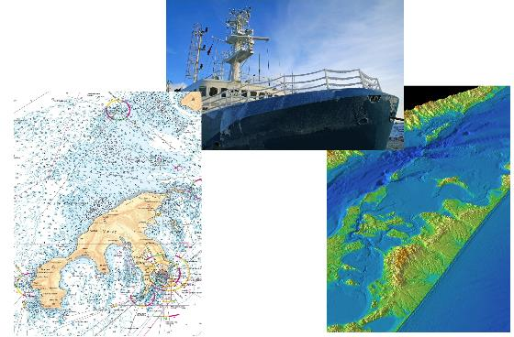
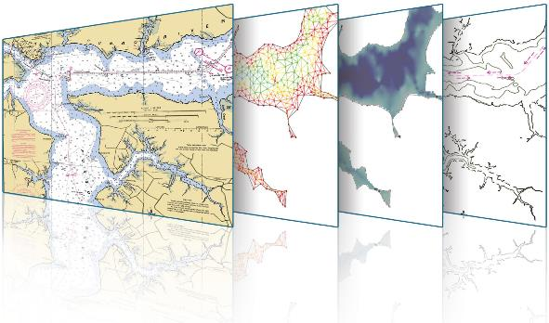
Marine Services
Charts and ENCs

Slide 23
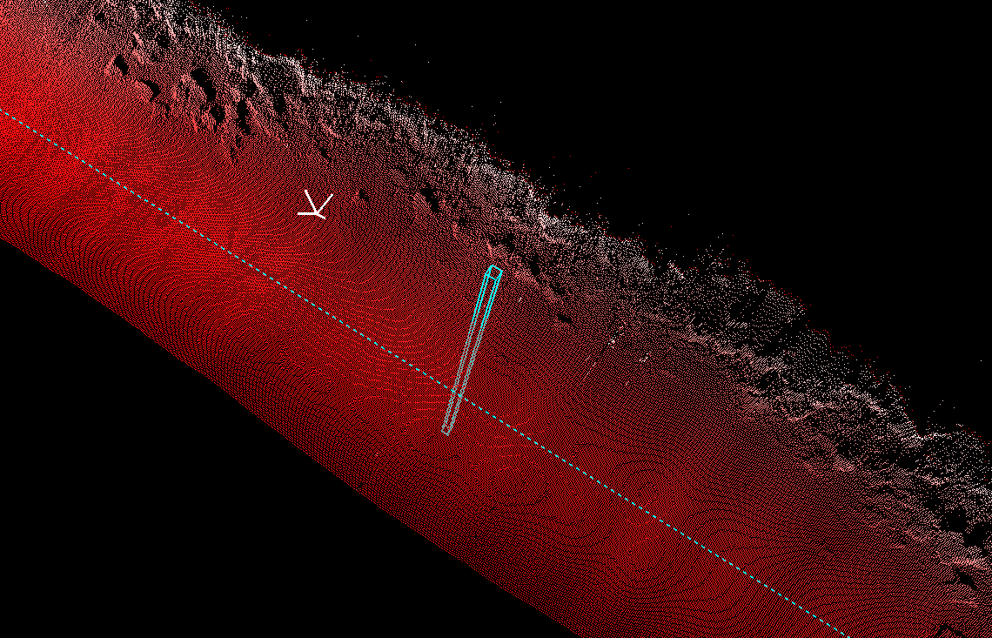
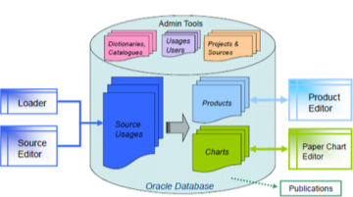
Marine Services
Data Management
Notes:
For some nations IIC directly and continuously updates their hydrographic databases using a variety of sources including surveys, dredging plans, permits, and notices to mariners.
IIC also maintains and stores a variety of support information such as a
A geospatial overlays for emergency management facilities, hazardous facilities, homeland security information and rapidly changing hydrographic information areas (specific areas that change daily or weekly)

Slide 24
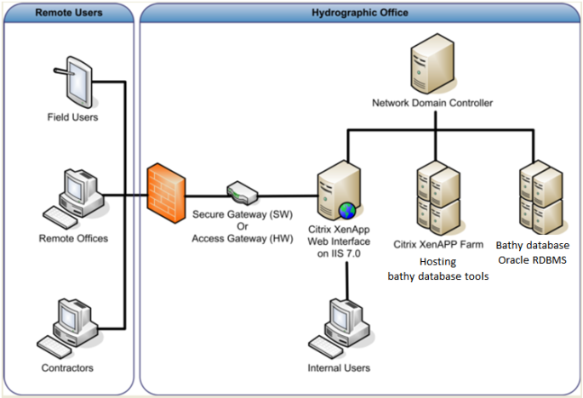
Marine Services
IIC Technologies
Remote National Charting Agency
Notes:
This direct maintenance of the database is possible by embedding teams into the organisation or remotely.
So there are many ways that we can support agencies with either their set to work, or ongoing activities.

Slide 25
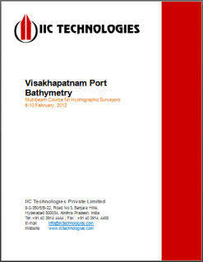
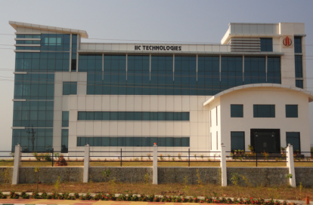
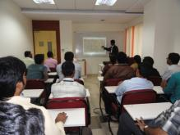
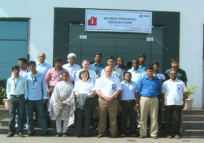
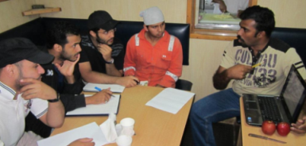
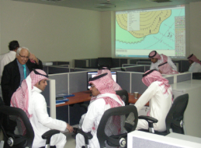
IIC Academy
Notes:
So at the start I mentioned I would talk to two specific areas of interest. The first is the IIC Academy.
-The academy is able to provide a broad range of training across the maritime services and geospatial discipline either at the Academy, at the client facility, via online learning or a combination of any of the above.
The key thing when working with a client is to determine what the need is and meet this in the most appropriate and flexible way possible.
IIC provide training to many organisations including the major Hydrographic Offices around the world, and are particularly keen to look for opportunities in this region to assist where we are able.

Slide 26
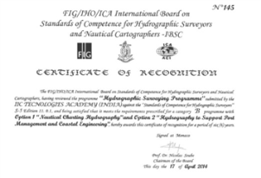
Surveying
Capacity Building with
Internationally Recognised Programmes
Oman
Saudi Arabia
UAE
Denmark
Brazil
Korea
New Zealand
US
Bhutan
India
International Maritime Organization
International Hydrographic Organization
Cartography
Notes:
Of particular note is that IIC are accredited to provide IHO Category B S8 (Nautical Cartography) and IHO Category B S5 (Hydrographic) Training.
The S8 Cat B can be delivered at our facilities (UK, US, India) or client facilities using a global delivery model.
- The IHO S5 Cat is currently delivered at our facilities. However the Global Delivery model is being presented for approval at IBSC next month, which will include the flexibility of distance learning for portions of the coursework.

Slide 27
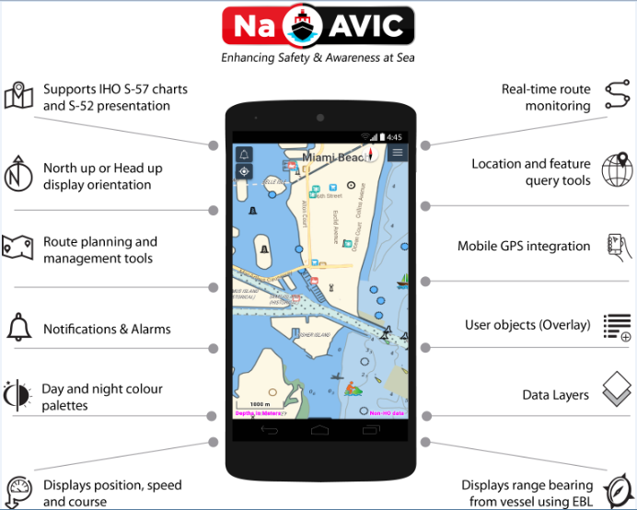
Solutions
Notes:
NaAVIC, is a free and downloadable mobile app produced by IIC that provides a new approach to an ECS where the electronic chart data does not physically exist within the onboard computer, but instead draws its data from the Cloud.
But what is it:
A free to use Electronic Charting System that can be used wherever data is made available.
This provides a cost effective safety and planning tool for small boat users, and recreational water users such as kyakers.
It automatically engages with numerous free-to-use land and maritime databases which can be selected as layers.
The tool provides real time positioning and updates, and allows, route planning.
Allows user defined editing and a built in emergency reporting function.
What do you need for it to work in your area of responsibility?
A Mobile phone and data access
Provision of the chart info. So for the US, NZ and a number of others this system can work easily as the data is freely available. However, for it to work in your nation you will need to determine if that data can be made available, if so, then you are good to go.
For some nations their may be a requirement to undertake a cost capture for the use of the chart info, in which case this can be facilitated as an ‘in-app’ purchase.
The data for NaAVIC goes beyond traditional ENC content and consists of an output from a database consolidating many different data products currently available in the marine domain.
NaAVIC has the following features:
- A “cloud native” approach where components are designed to be run in cloud environments (e.g. PODS).
- Because it I cloud based there is no need to build a distribution network.
- NaAVIC via the Nautilus Cloud engages the mariner with several IHO S-100 products, starting with S-101 (the next generation of electronic navigational chart data), S-102 (high resolution bathymetric surfaces), and progressing onto other S-100 based product specifications.
With, both free and paid access to data the system gives organisations the ability to switch between free and cost-recovery models as their demands dictate. It allows the substitution of multiple disparate systems which may be already in place, with a system at substantially lower costs for implementation and support.

Slide 28
Summary
NaAVIC, is a free and downloadable mobile app and it represents a new approach to an ECS where the electronic chart data does not physically exist within the onboard computer.
The data for this particular form of ECS goes well beyond the traditional ENC content and consists of an output from a database consolidating many different data products currently available in the marine domain.
NaAVIC attempts to thrust the sailing experience several steps further by enabling all members of expeditions to engage in the voyage and share that voyage to fellow “marine friends”.
Notes:
Bottom line is:
It’s a great tool
Its free
It will improve safety on the water by providing ECS tools to users who have not been able to afford it or it was impractical.
I encourage you to look to see if the data for your area can be made available.

Slide 29
Thank You
NEW PATHS. NEW APPROACHES
David Crossman
david.crossman@iictechnologies.com
www.iictechnologies.com

Slide 30
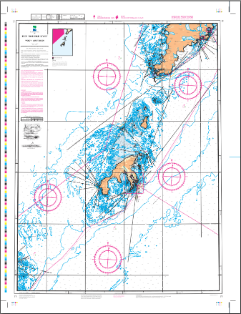
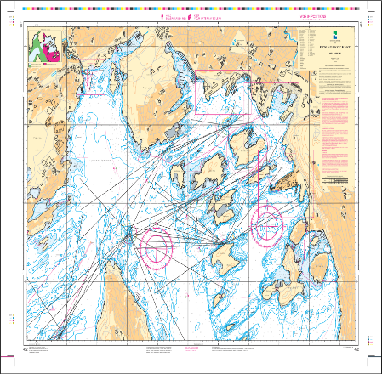
ICA Award winning NHS charts
Marine Services
Chart No. 71 Værøy – Lofoten
Chart No. 452 Den Norske Kyst (Oslo Havn)

