Slide 1
Briefing on the
work of GEBCO
www.gebco.net

Slide 2
What is GEBCO?
GEBCO aims to provide the most authoritative publicly-available bathymetry of the world's oceans.
It operates under the joint auspices of the International Hydrographic Organization (IHO) and the Intergovernmental Oceanographic Commission (IOC) of UNESCO

Slide 3
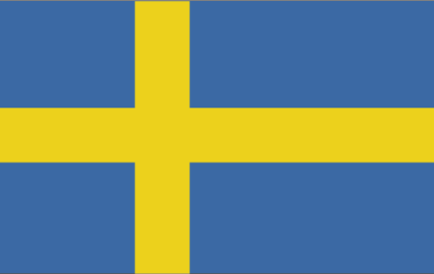
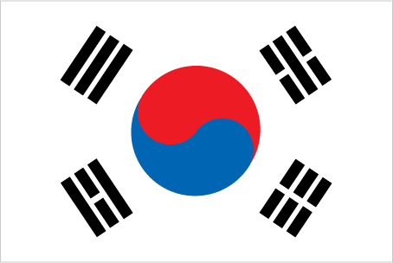
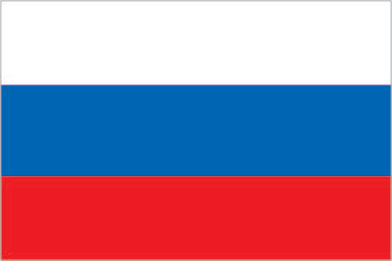
What is GEBCO?
GEBCO’s work is directed by a Guiding Committee and supported by sub-committees and ad hoc working groups:
Technical Sub-Committee for Ocean Mapping (TSCOM)
Sub-Committee for Undersea Feature Names (SCUFN)
Sub-Committee for Regional Undersea Mapping (SCRUM)
Outreach Working group
IHO-IOC GEBCO Cook Book Working group

Slide 4
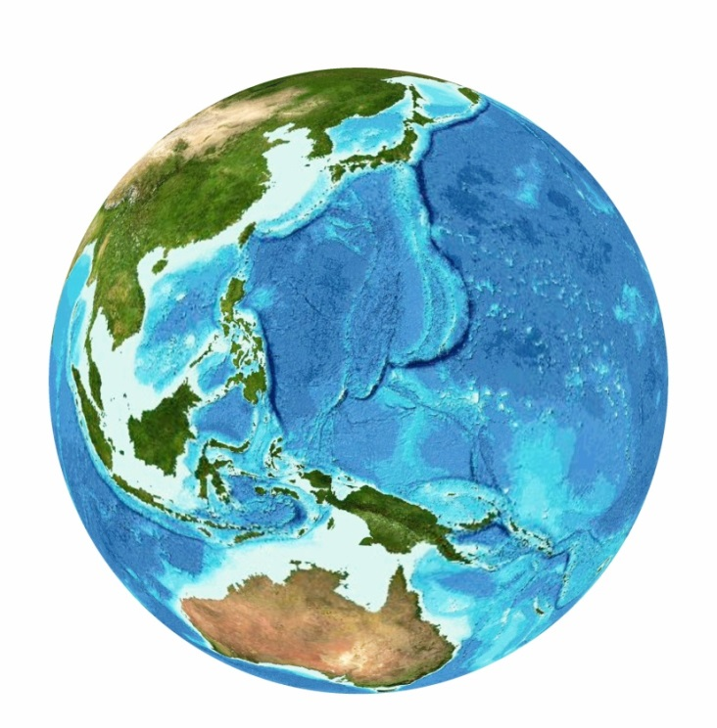
GEBCO Products
Global gridded bathymetric data
GEBCO 2014: 30 arc-second grid
GEBCO 2019 15 arc-second grid
Gazetteer of Undersea Feature Names
Digital Atlas
Grid viewing software
Printable maps
Web Map Service (WMS)
IHO-IOC GEBCO Cook Book
www.gebco.net/data_and_products/

Slide 5
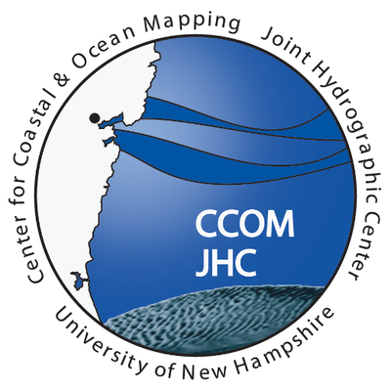
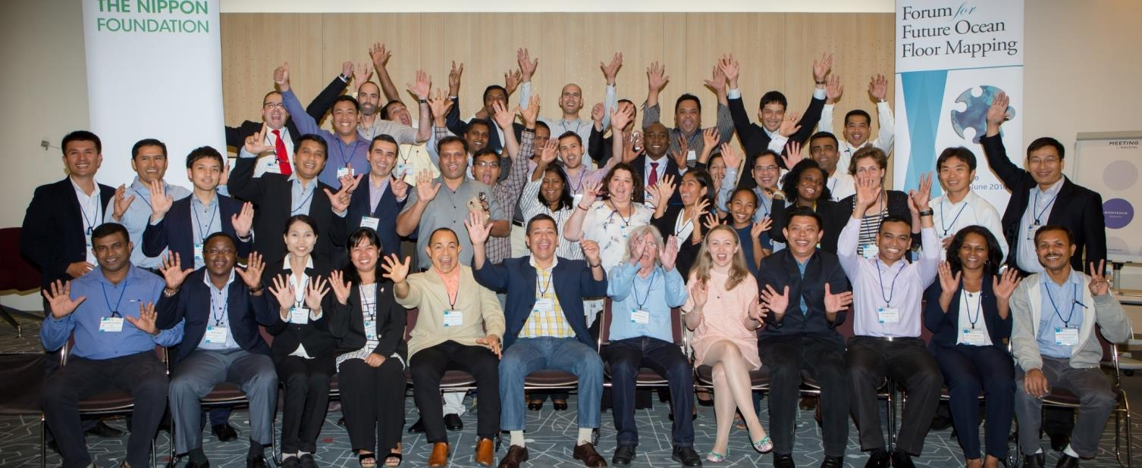
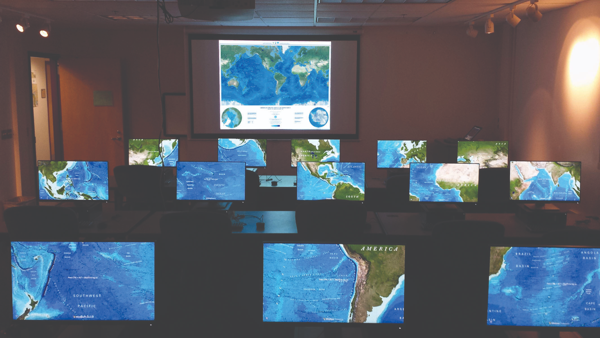
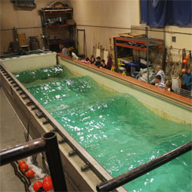
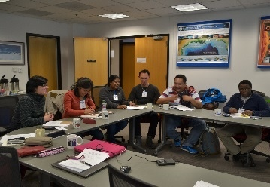
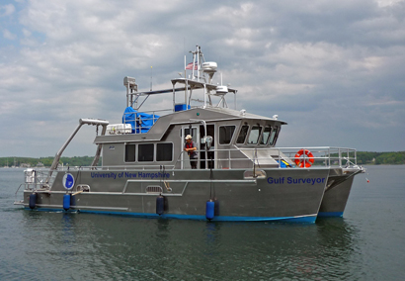
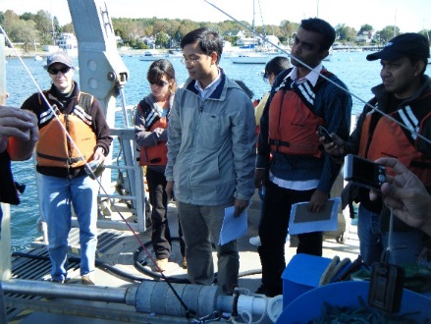
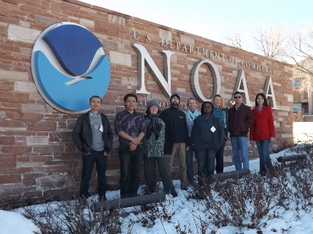
Capacity-building Initiative:
Postgraduate Certificate in Ocean Bathymetry
Funded by: The Nippon Foundation of Japan
Taught at: The Center for Coastal and Ocean Mapping / Joint Hydrographic Center; University of New Hampshire, USA
Training a new generation of scientists and hydrographers in ocean bathymetry
www.gebco.net/data_and_products/
Notes:
Applications for Year 16 of the Training Program due end-March 2019!

Slide 6
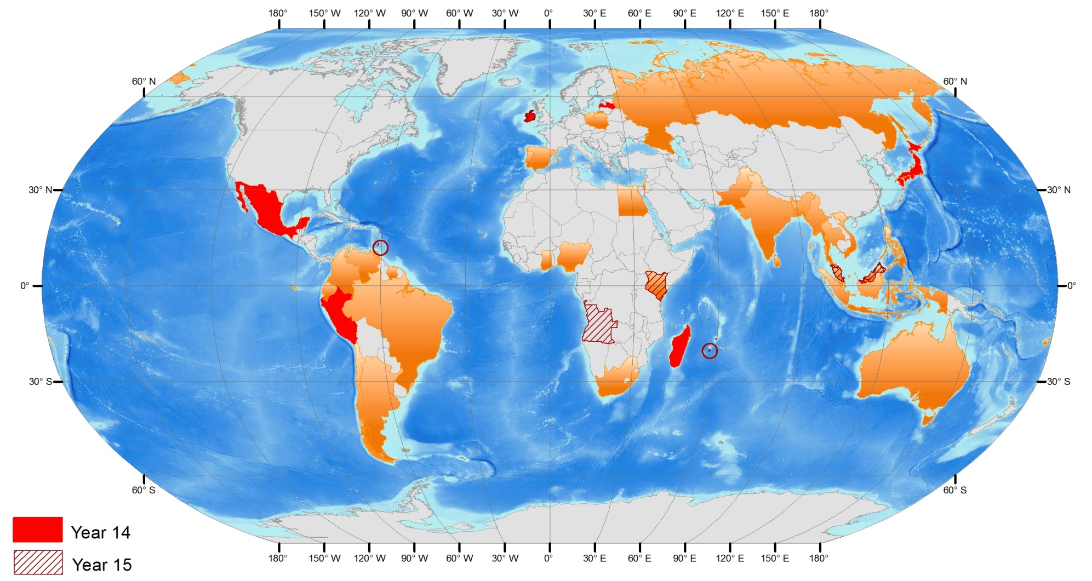
Capacity-building Initiative:
Nippon Foundation / GEBCO Alumni
90 Scholars from 40 coastal states over last 15 years!
Notes:
This ocean bathymetry course, now in its 13th year, having trained 78 scholars from 35 coastal states, provides these scholars with a a graduate certificate from UNH and a CAT A certification but, more importantly, fosters a passion for ocean-mapping. This course aims to provide the knowledge, skills and networks to allow this interest to be developed and built-upon.

Slide 7
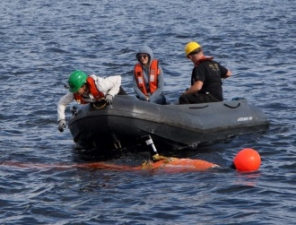
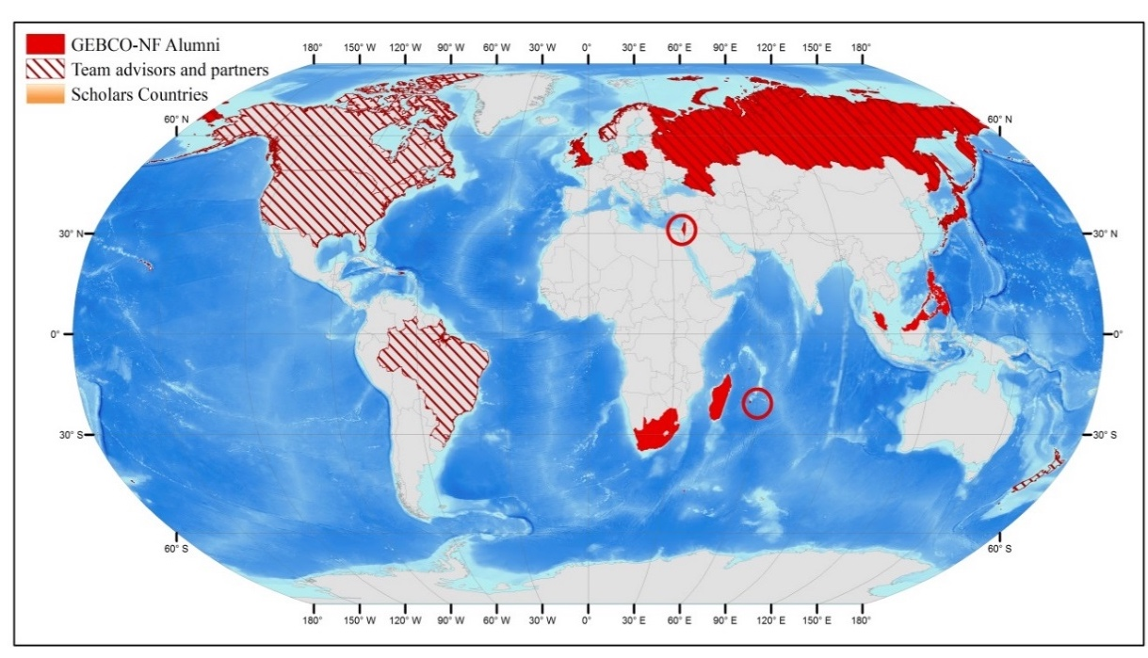
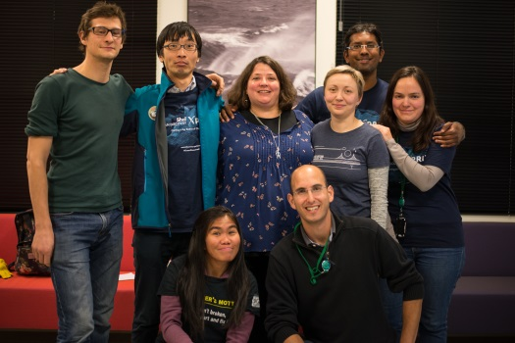
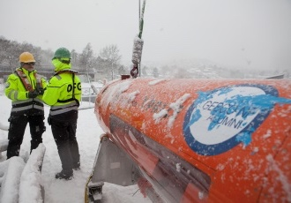
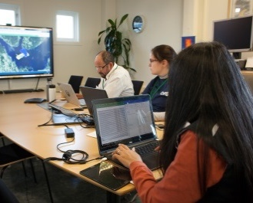
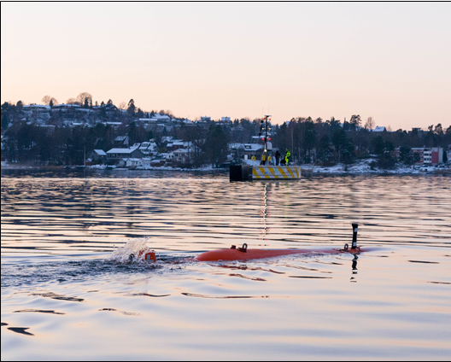
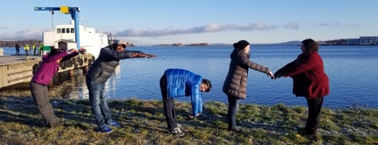
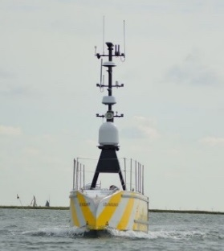
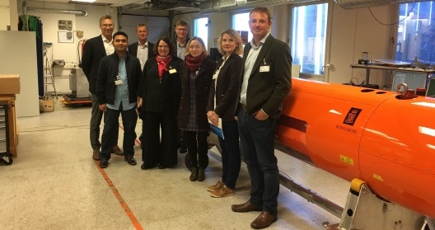
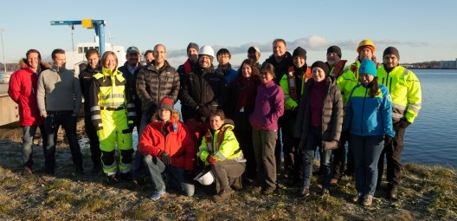
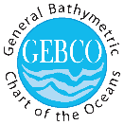
GEBCO-NF Alumni Team

Slide 8
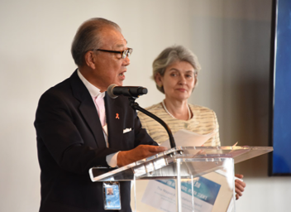
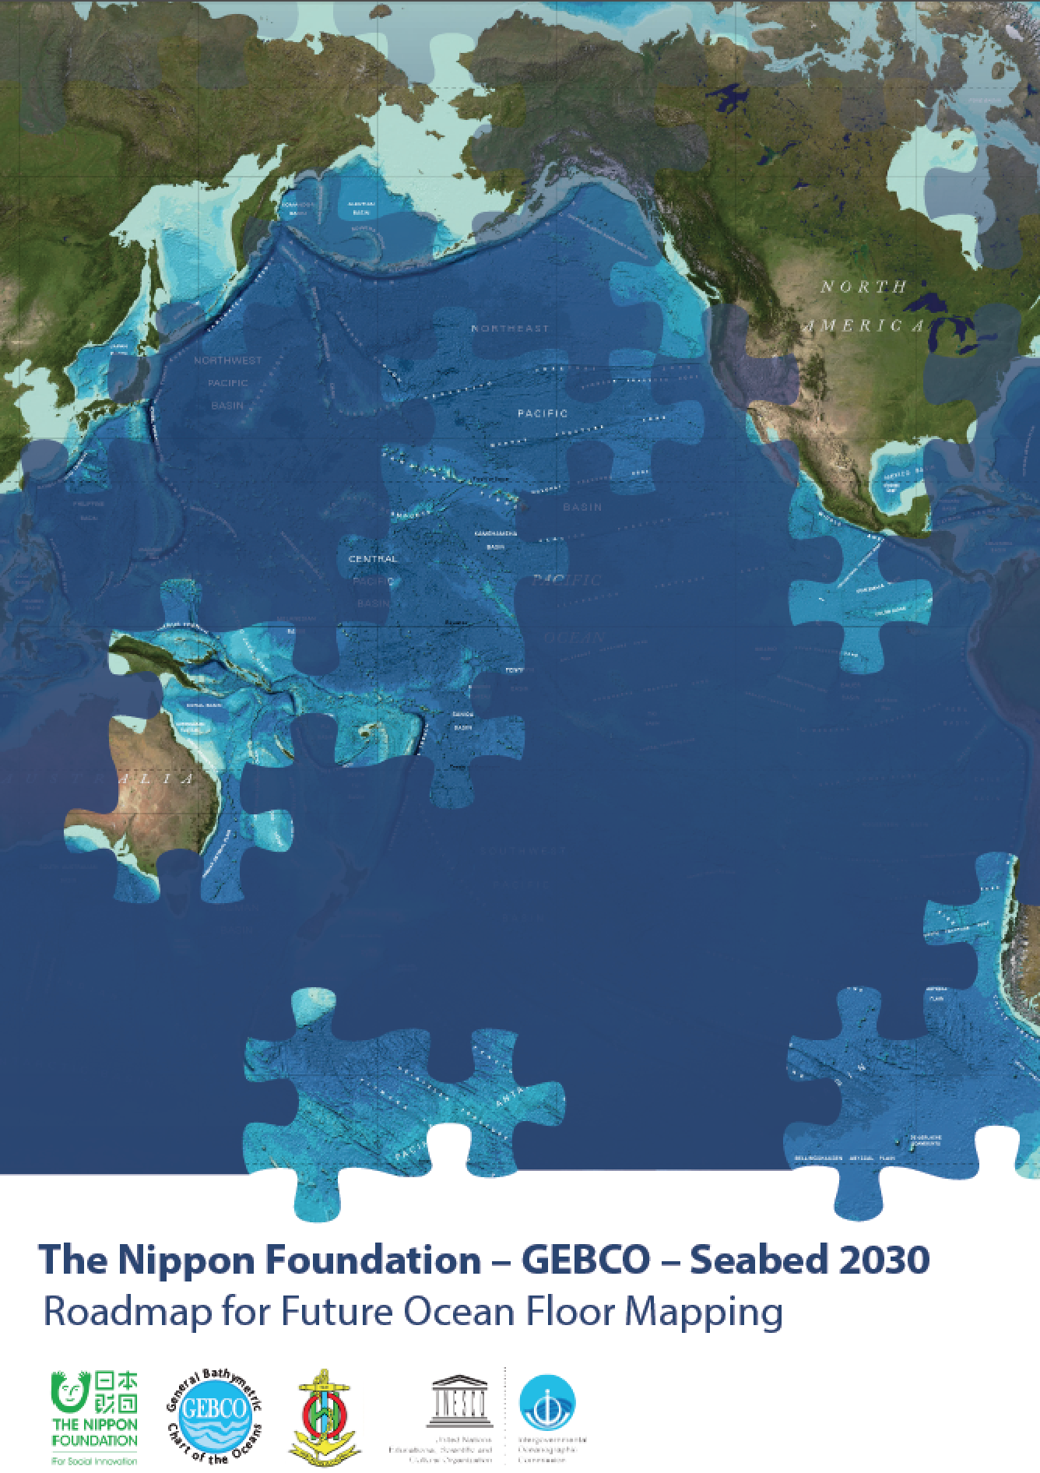
The Nippon Foundation – GEBCO Seabed 2030 Project
Vision Established through 2016 Forum for Future Ocean Floor Mapping
Project Announced at 2017 UN Ocean Conference

Slide 9
A collaborative project between the Nippon Foundation and GEBCO to inspire the complete mapping of the world’s ocean by 2030, and to compile all bathymetric data into the freely-available GEBCO Ocean Map.

Slide 10
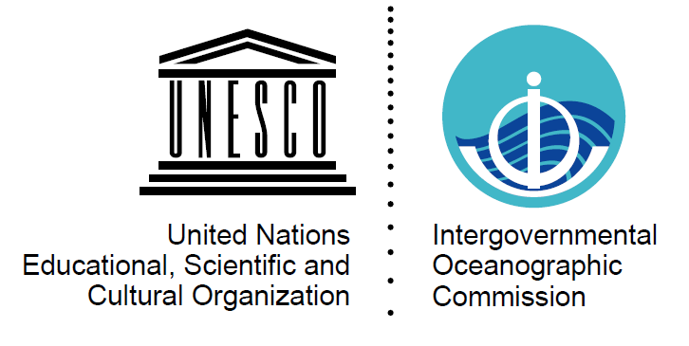
Seabed 2030
Seabed 2030 is a global initiative to cooperatively work towards creating a high resolution complete map of the world’s ocean floor by 2030.
-The Nippon Foundation is a private Japanese-based, non-profit grant-making organization with a mission based around philanthropic activities to pursue global maritime development and assistance for humanitarian work.
-The General Bathymetric Chart of the Oceans (GEBCO) organization operates under the joint auspices of the International Hydrographic Organization (IHO) and the Intergovernmental Oceanographic Commission (IOC) of UNESCO

Slide 11
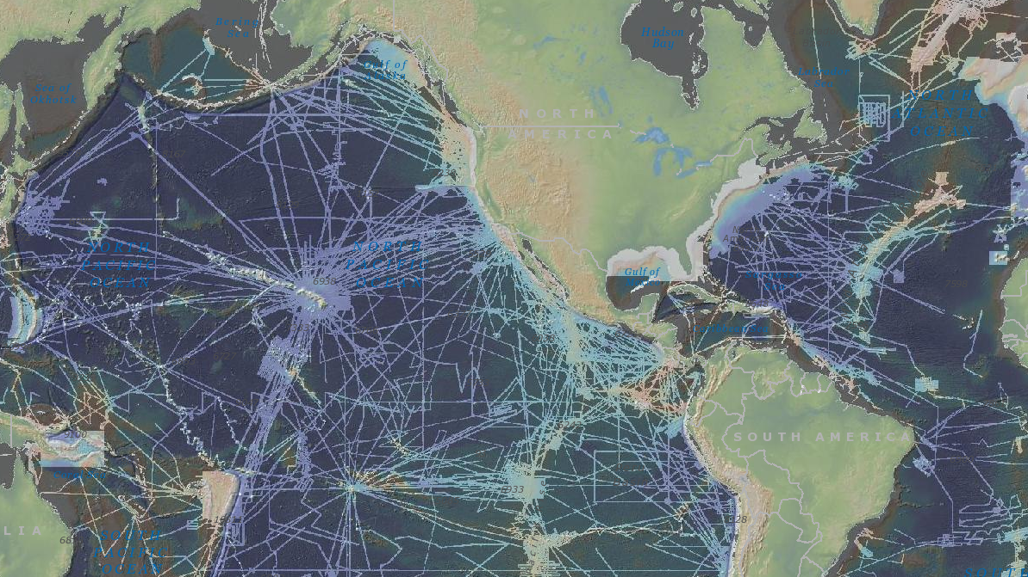
Empower the world to make policy decisions, use the ocean sustainably, and undertake scientific research that is informed by a detailed understanding of the global ocean floor.
Only a small portion of the ocean has been mapped with direct measurement.
~ 50% of the world’s coastal waters remain unsurveyed*
*IHO publication C-55, Status of Surveying and Charting Worldwide

Slide 12
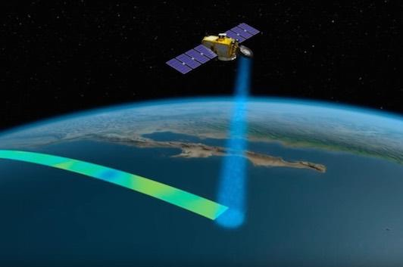
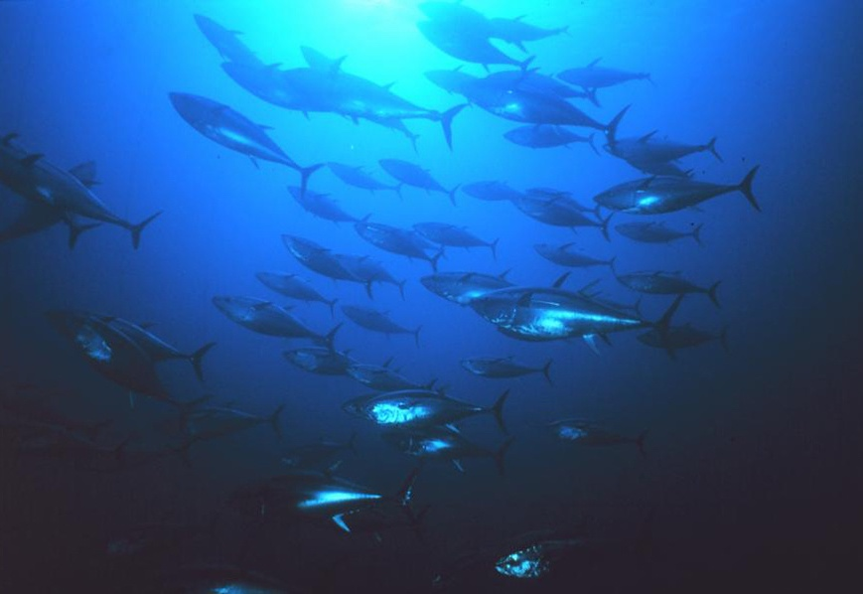
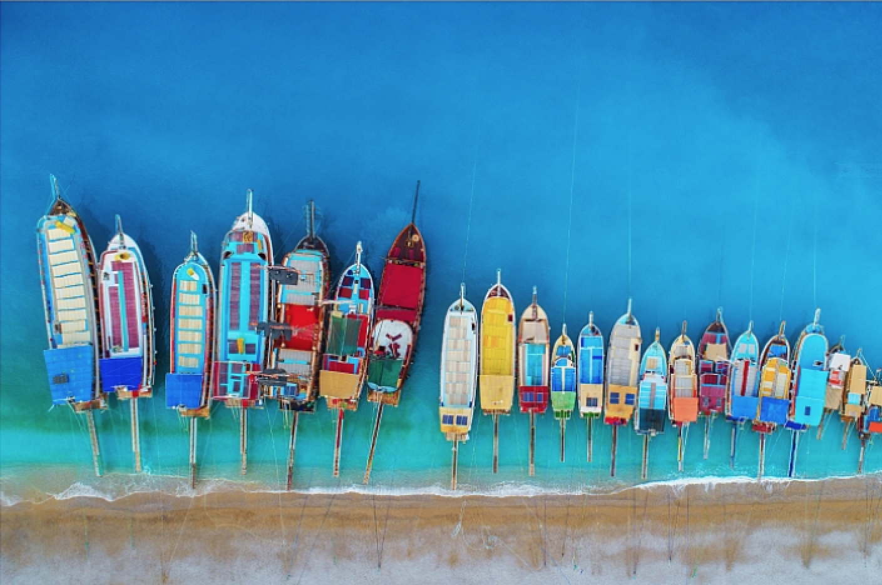
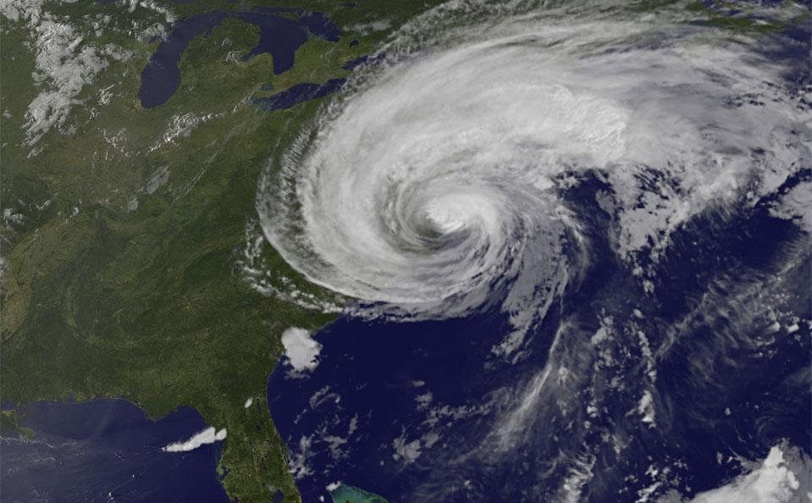
Why are Bathymetry Data Important?
Nautical charts
Oil and gas exploration
Safety and storm surge/tsunami inundation models
Ecosystem identification and management
Emergency response
Satellite verification models
Ocean Models
Coastal/Marine Spatial Planning
Coastal Hazard Assessment
Ocean Exploration
Coastal Change Analysis
Sea Level Rise Mitigation
New Energy Siting
Marine heritage

Slide 13
The UN Decade of Ocean Science for Sustainable Development (2021-2030)
SDG14 will not be achievable without a comprehensive map of the world ocean floor

Slide 14
Seabed 2030 Strategy
Partnership
Work with all stakeholders to form a global coalition dedicated to giving the world a complete GEBCO Ocean Map.
Sharing and acknowledging
Encourage and facilitate the sharing of bathymetric data, giving due acknowledgement to Partners and data contributors.
Invest in human capacity development
Invest in capacity development to increase skills and greater capacity in ocean mapping, and meet growing needs of big data analysis and visualization.
Leverage technology innovation
Work with technology partners to apply new mapping and data analysis techniques to support Seabed 2030’s mission.

Slide 15
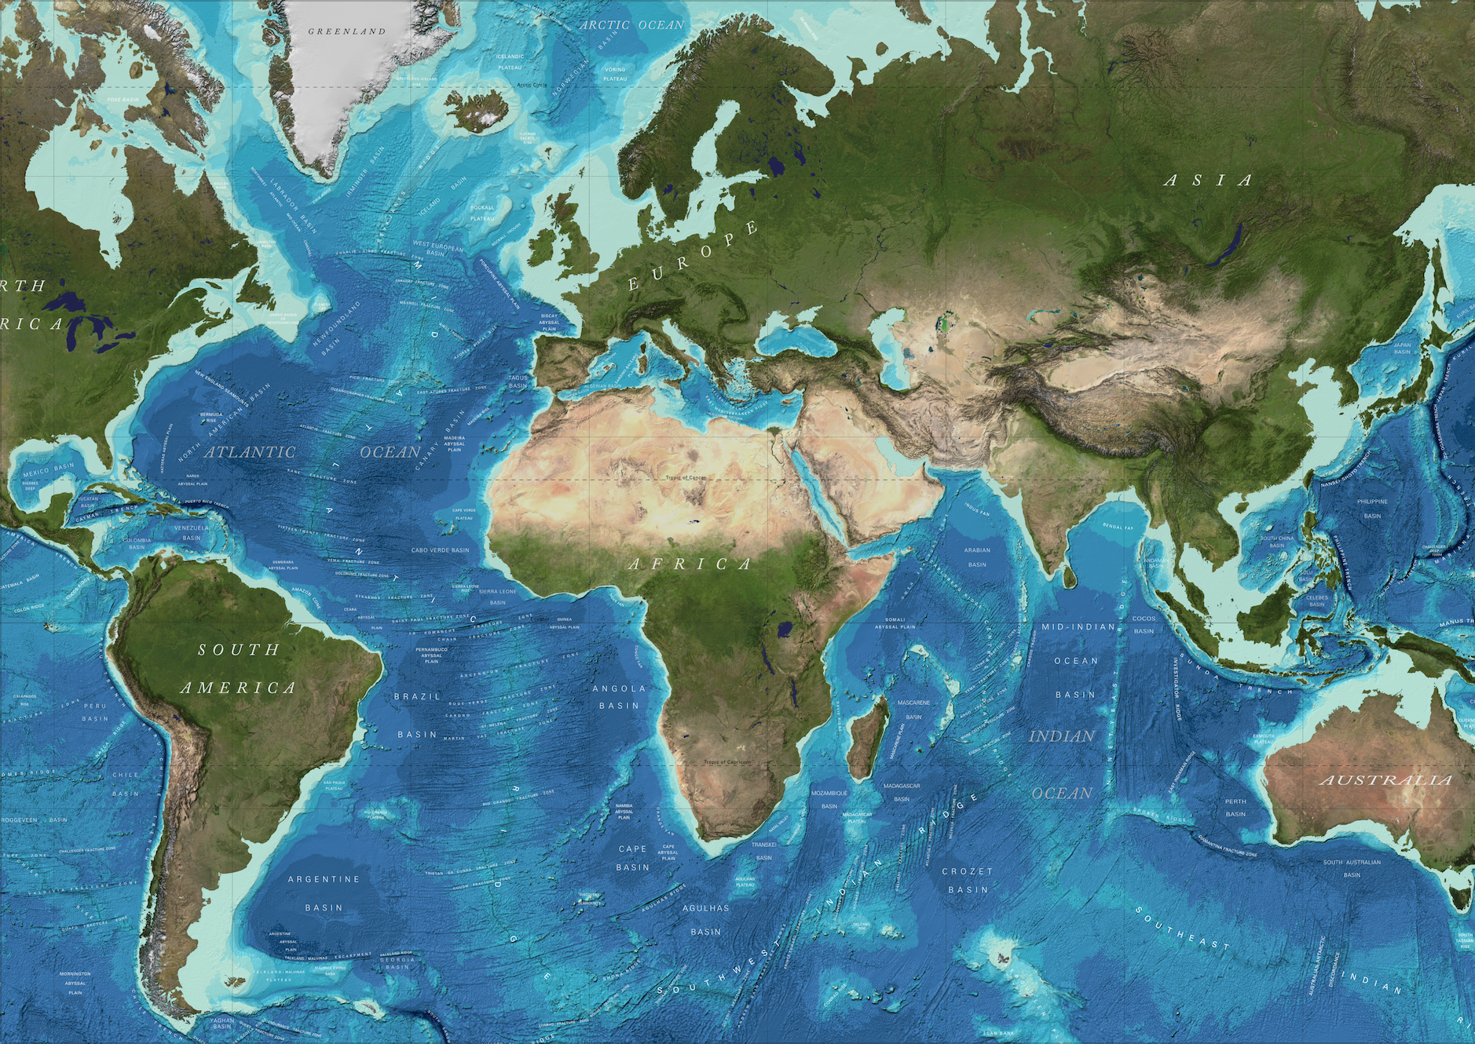
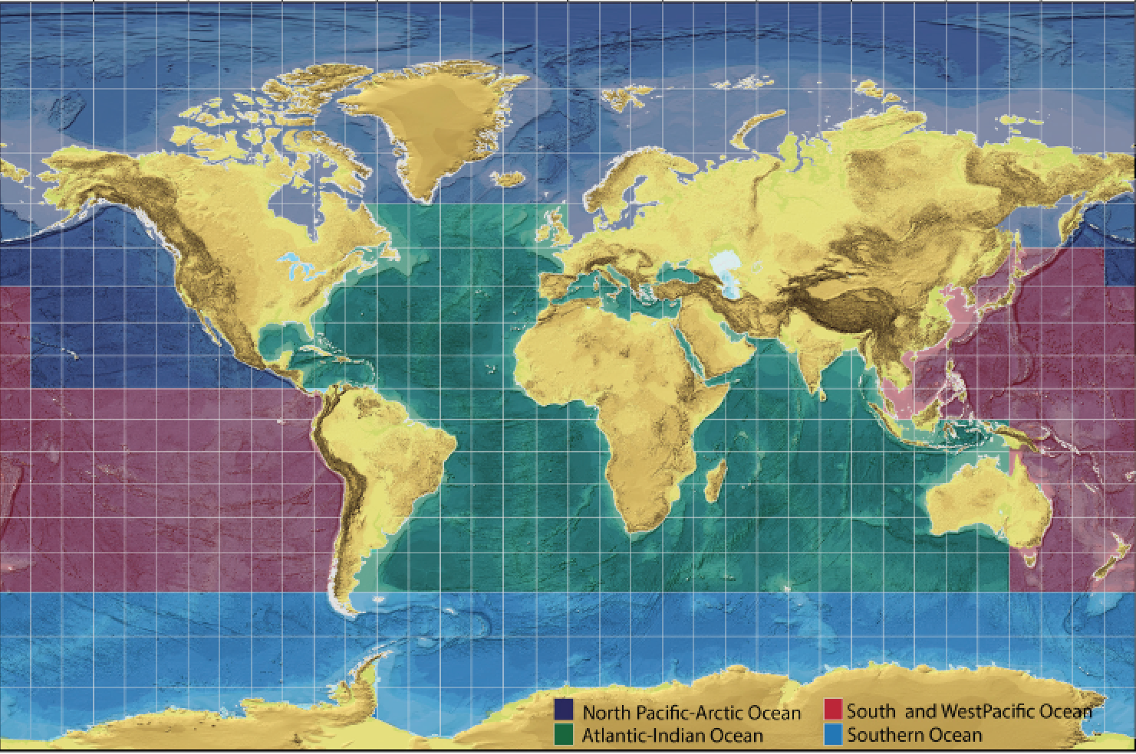
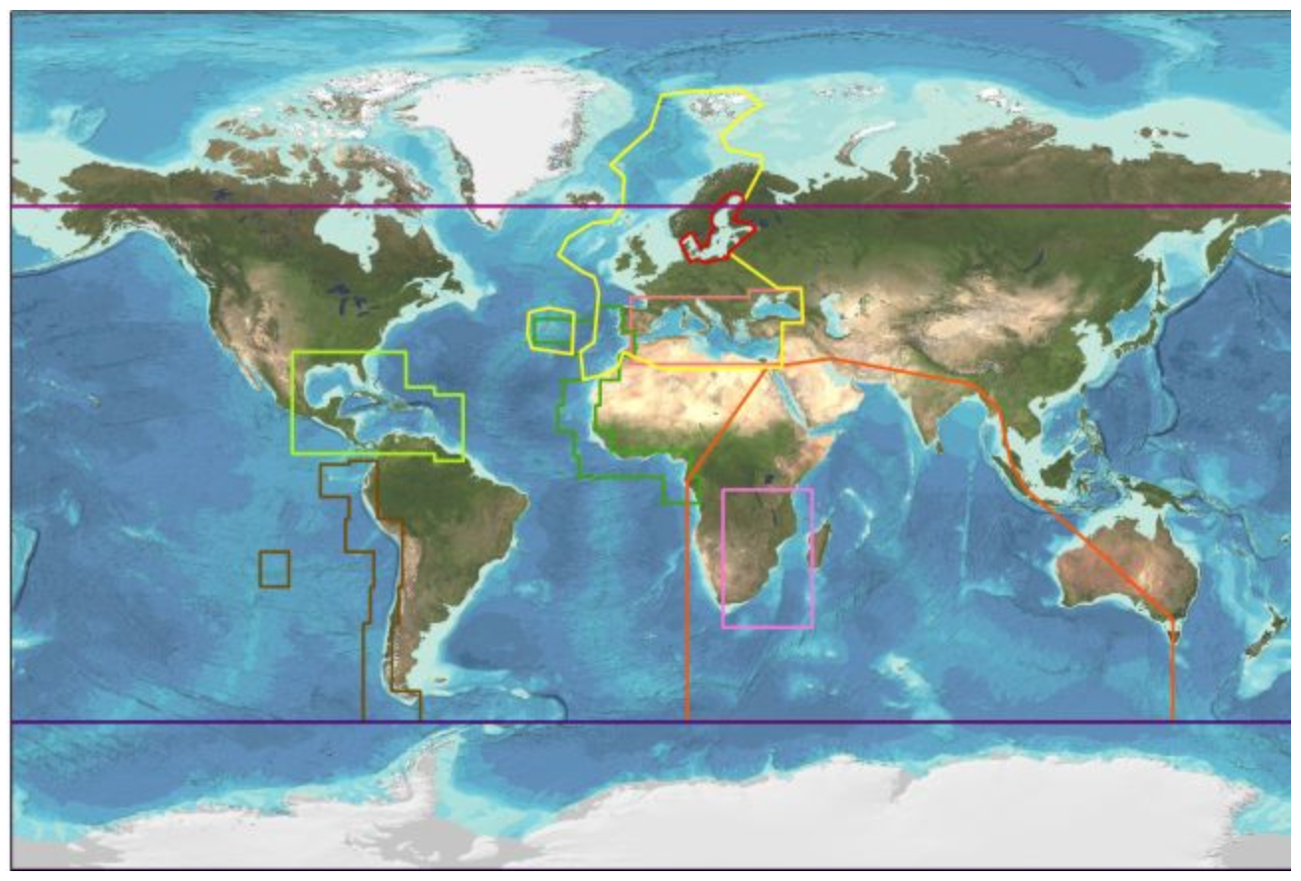
Seabed 2030 Regional Data Assembly
Global
Regional
National
Collaboration and cooperation at local, regional and global scales
Regional IBCs
Seabed 2030 Regional Compilations
GEBCO Global Products

Slide 16
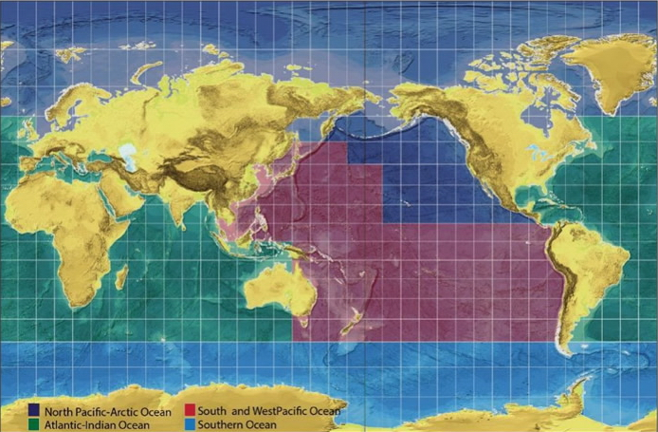
Seabed 2030: Data Centers
Coordinate with stakeholders
Build upon ongoing regional efforts including IBCs
Develop mechanisms for attribution
Assemble regional & global data products
SU
AWI
NOC
CCOM
LDEO
NIWA/GNS/LINZ

Slide 17
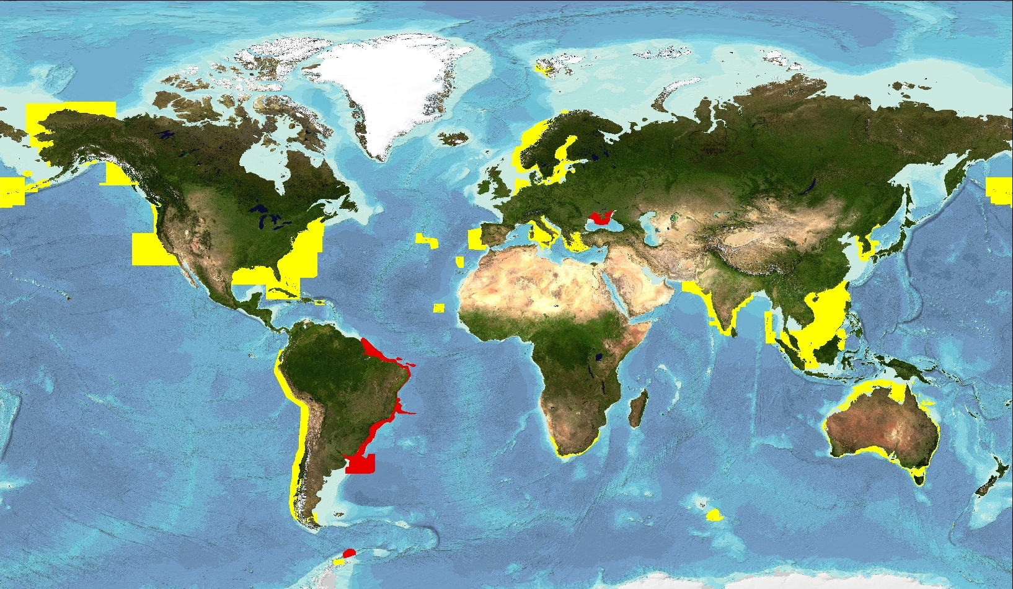
ENC Data Contributions to GEBCO
Usage bands 2 & 3 provided after IHO calls
2006 (yellow) and 2016 (red)

Slide 18
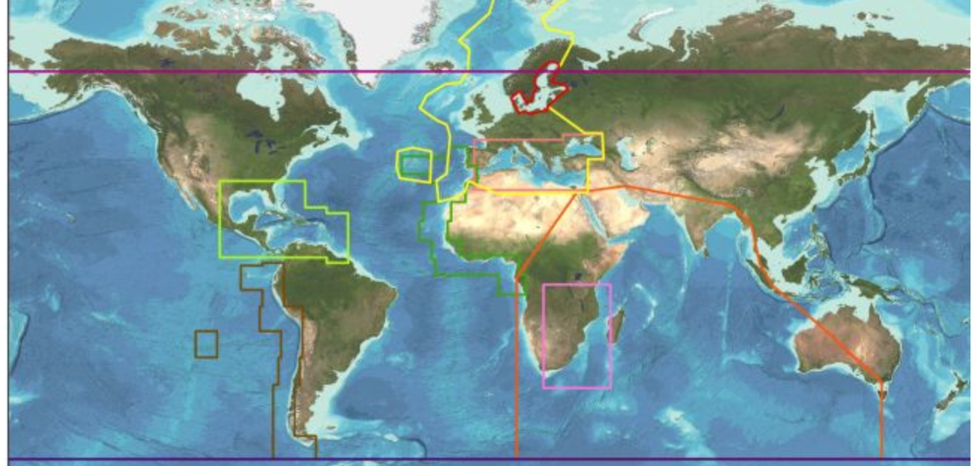
Coordinating with IBCs
Seabed 2030 Atlantic/Indian Oceans Data Center
IBC of the Caribbean Sea & Gulf of Mexico (IBCCA)
IBC of the Central Eastern Atlantic (IBCEA)
IBC of the Mediterranean (IBCM)
IBC of the Western Indian Ocean (IBCWIO)
Seabed 2030 South & West Pacific Data Center
IBC of the South Eastern Pacific (IBCSEP)
Seabed 2030 Arctic/North Pacific Data Center
IBC of the Arctic Ocean (IBCAO)
IBC of the Caribbean Sea & Gulf of Mexico (IBCCA)
Seabed 2030 Southern Ocean Data Center
IBC of the Southern Ocean (IBCSO)
Global
Regional
Regional

Slide 19
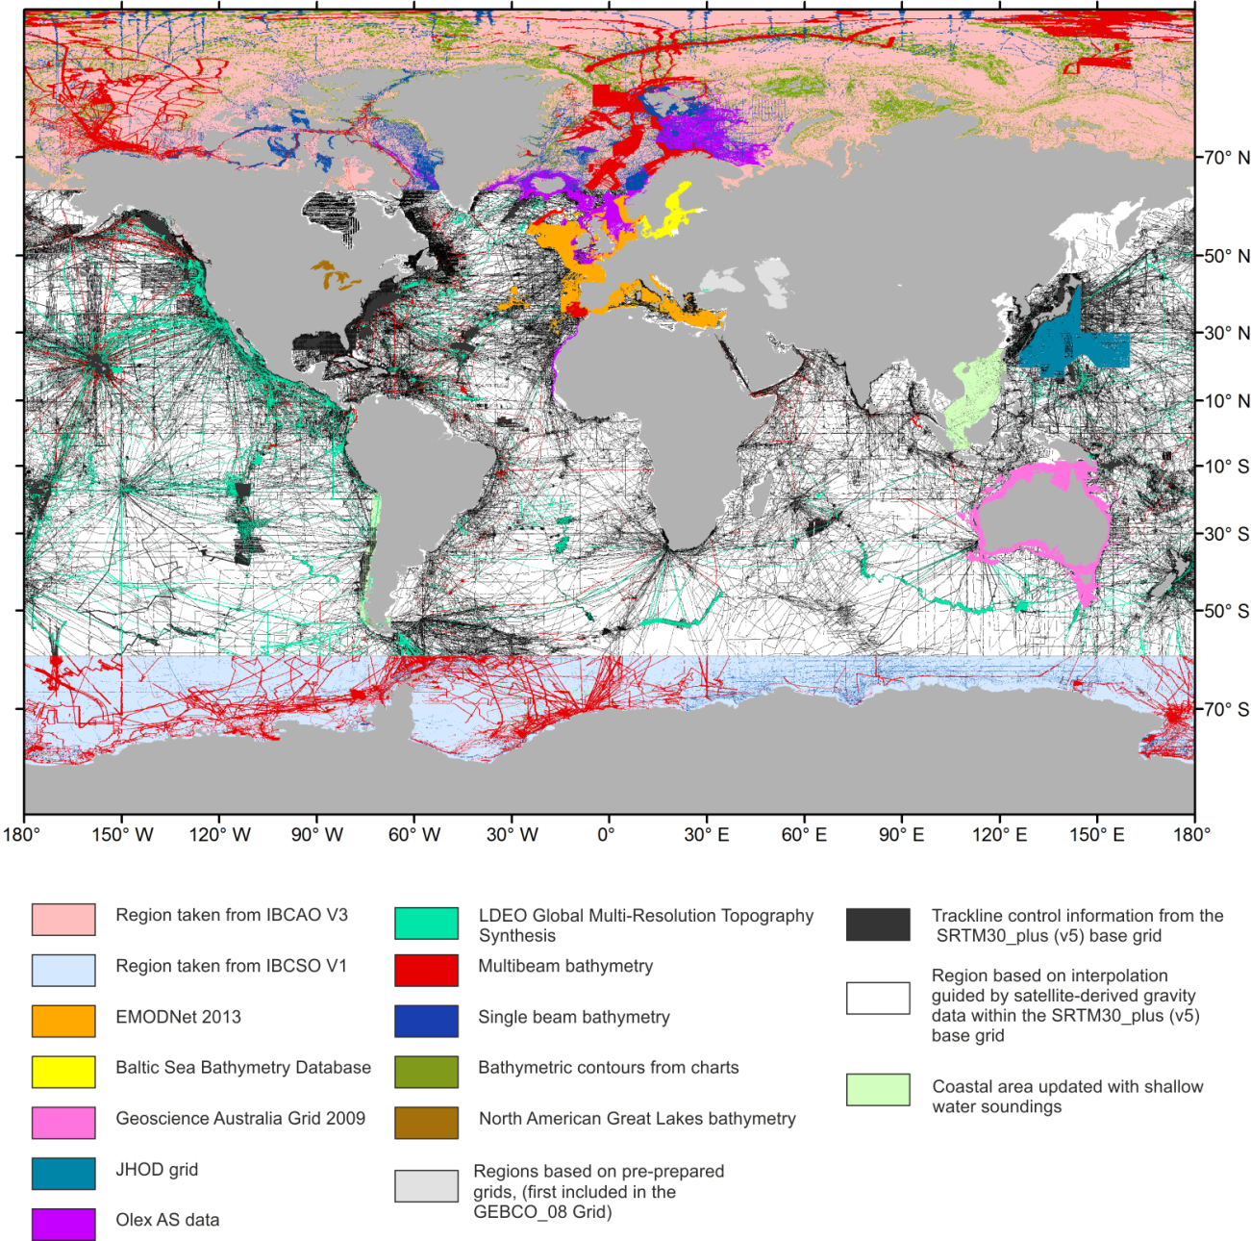
How much of the ocean is mapped?
X + Y + Z = 100%
known
X: Data in GEBCO products
Y: Data that exists but are not yet integrated
Public
Embargoed
Z: Data that must be acquired
unknown

Slide 20
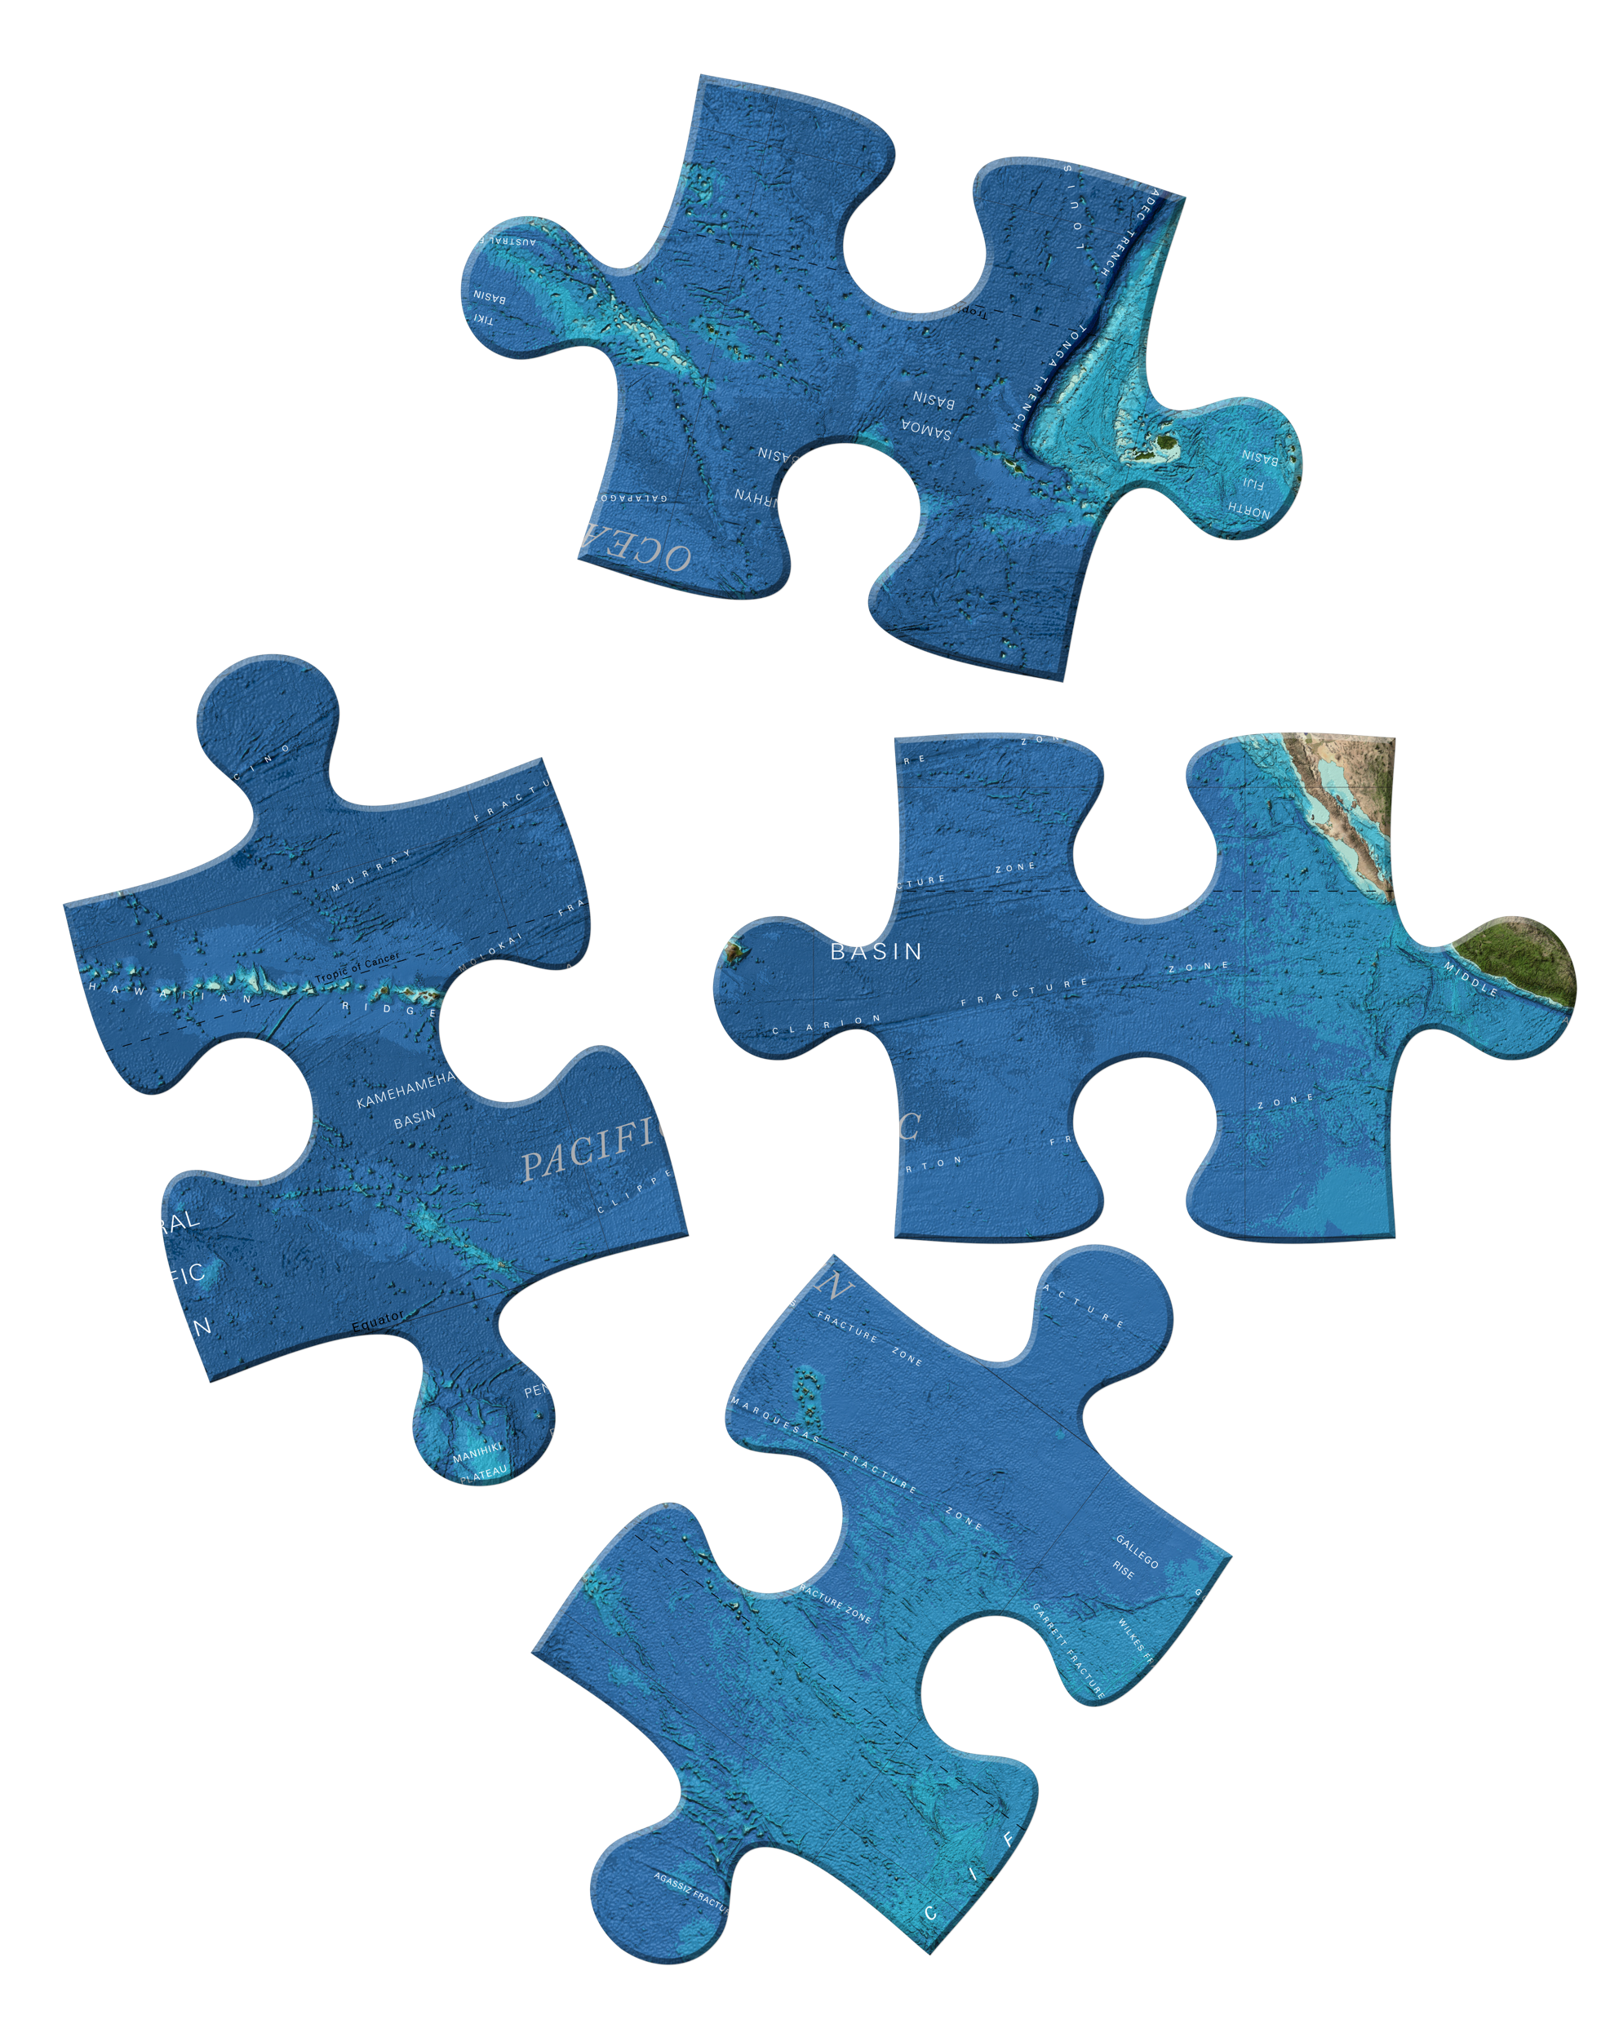
Completing the Map
Existing data not yet integrated
Gather information about existing data even if embargoed
Facilitate data sharing
New Data Acquisition
Identify gaps in coverage
Inform new acquisition
Technology innovation
Accelerate uptake of new technology
X + Y + Z = 100%

Slide 21
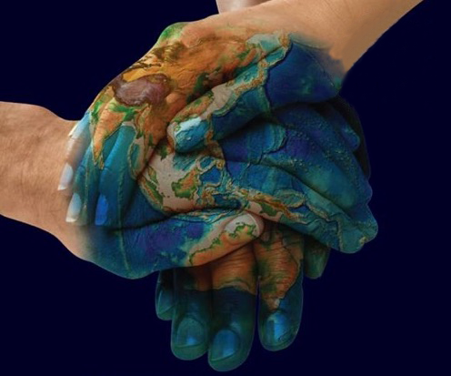
How to participate
Contribute information about existing data coverage
Contribute data
Gridded data products
Points from ENCs
Share information about future mapping plans
Engage with Data Centers
Support and promote GEBCO activities and products
seabed2030.org
@seabed2030

Slide 22
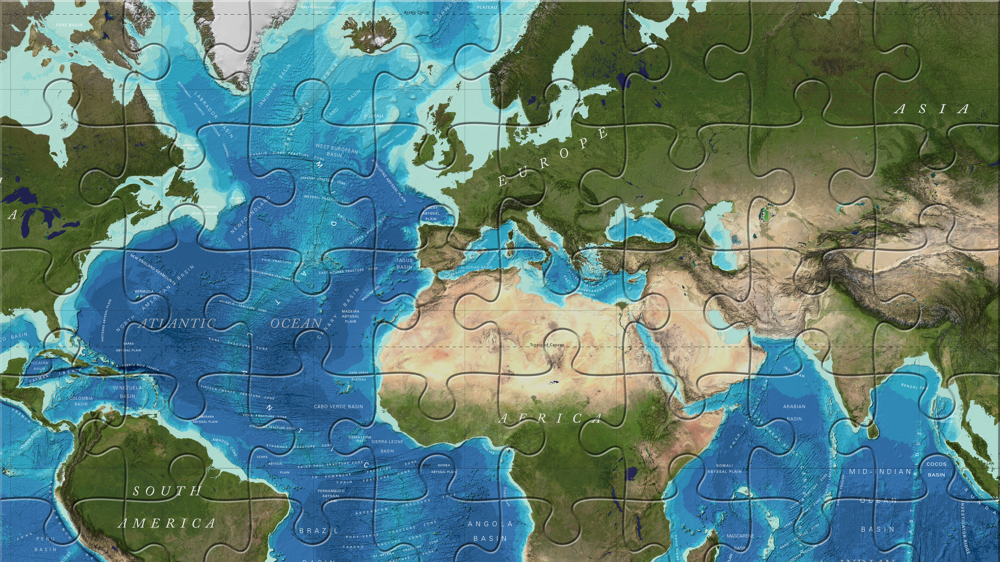
Thank you!
www.gebco.net

