Slide 1
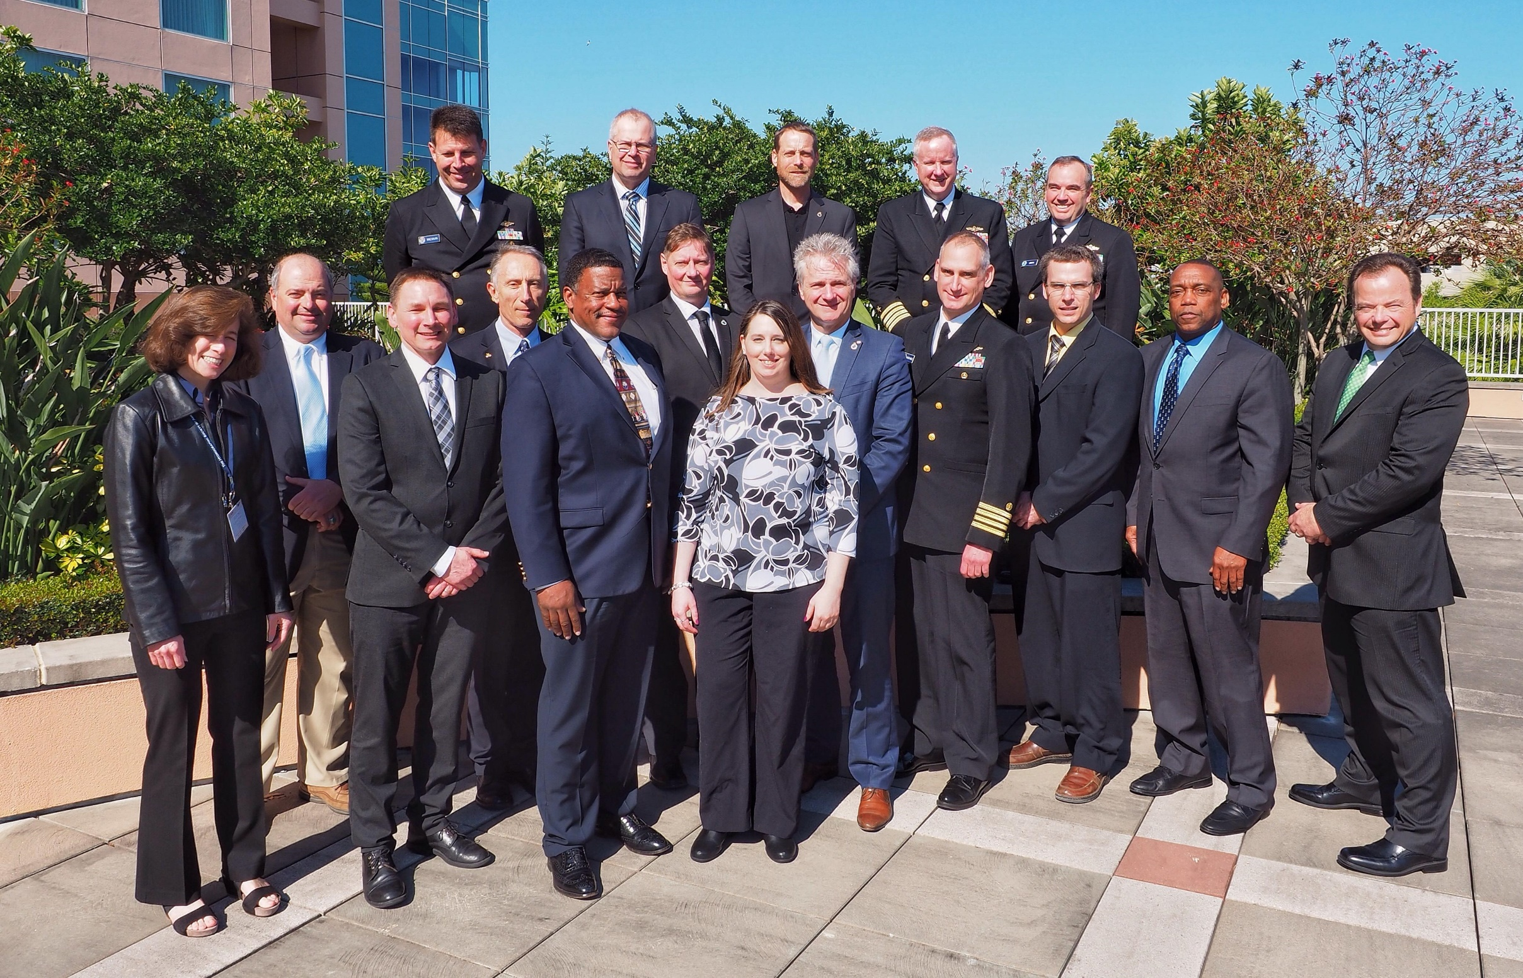
USCHC40
Galveston, Texas
April 2017
Not pictured:
John Lowell Jr., Rodney “Wade” Ladner,
Vanessa Self Miller, Rear Admiral Tim Gallaudet, Chris Thorne, Dave Price, Chris Hemmingway
Photo credit:
John Lowell
Top row (l-r): Capt Richard Brennan, Dave Prince, Doug Brunt, Capt Brian Connon, Rear Admiral Shepard Smith
Bottom row (l-r): Gretchen Imahori, Jonathan Justi, Marc LeBlanc , Bruno Frachon, Charles Baptist, Serge Gosselin, Christie Ence, Denis Hains, Capt. Edward J. Van De Ameele, Louis Maltais, Stan Harvey, Michael Swedberg

